Slide 1

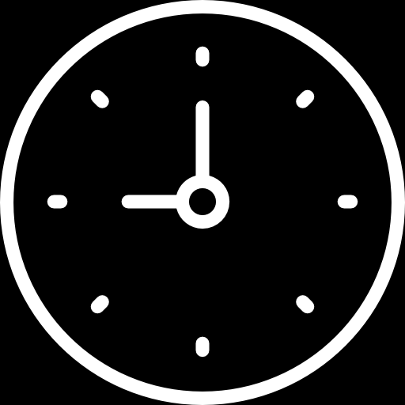
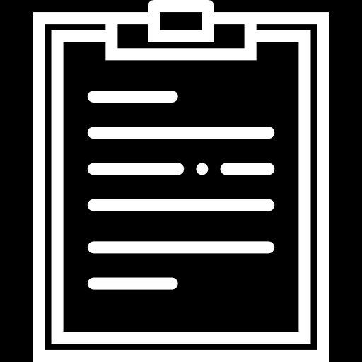
COLL
NELS
AMERICAS CUP
2018. RACE 2A
TIMER
EVENTS
95 Dec 120505
95 Dec 120510
95 Dec 120515
95 Dec 120520
95 Dec 120525
95 Dec 120530
95 Dec 120535
95 Dec 120540
95 Dec 120545
95 Dec 120550
95 Dec 120555
95 Dec 120600
95 Dec 120605
95 Dec 120610
95 Dec 120615
95 Dec 120620
95 Dec 120625
95 Dec 120630
95 Dec 120635
95 Dec 120640
95 Dec 120645
95 Dec 120650
95 Dec 120655
95 Dec 120700
95 Dec 120705
95 Dec 120710
95 Dec 120715
95 Dec 120720
95 Dec 120725
95 Dec 120730
95 Dec 120735
95 Dec 120740
95 Dec 120745
95 Dec 120750
95 Dec 120755
95 Dec 120800
95 Dec 120805
95 Dec 120810
95 Dec 120815
95 Dec 120820
95 Dec 120825
95 Dec 120830
95 Dec 120835
95 Dec 120840
95 Dec 120845
95 Dec 120850
95 Dec 120855
95 Dec 120900
95 Dec 120905
95 Dec 120910
95 Dec 120915
95 Dec 120920
95 Dec 120925
95 Dec 120930
95 Dec 120935
95 Dec 120940
95 Dec 120945
95 Dec 120950
95 Dec 120955
95 Dec 121000
95 Dec 121005
95 Dec 121010
???
120500.00 COMEX. Rule amendment Charlie 3???
120501.00 Intend patrolling to the South, to take advantage of dawn light???
120502.00 System Echo Trial 3 commencing???
120522.00 Invsetigating System Echo Power-up failure???
120612.00 System Echo working satisfactoritly???
120622.00 System Echo given 3 invalid hits. Adjusting Gain to -2Db???
120642.00 System Echo optimal level is 16.5 Db???
120953.00 Moving search area to North, Dawn advantage gone???
120954.00 Requset relaxation of amendment Charlie 13 from 120000 today;???
120957.00 SUSPECTED DETECTION OF RED???
121003.00 CONFIRMED. OBTAIN SOLUTION???
Notes:
Americas Cup 2018. Race 2a

