Slide 1
India’s Demographic Edge: A Race Against Time
CS752 Project Presentation
Causal Thinkers
23M0742 | Arijeet De
23M0793 | Ronak Upasham
23M0827 | Mohiboddin Shaikh

Slide 2
Philosophy
All who have meditated on the art of governing mankind have been convinced that the fate of empires depends on the education of youth.
Aristotle
Real swaraj will come not by the acquisition of authority by a few but by the acquisition of the capacity by all to resist authority when it is abused
Mahatma Gandhi
Educate and raise the masses, and thus alone a nation is possible.
Swami Vivekananda

Slide 3
Problem Statement
Demographic Opportunity & Risk: India has a large youth population that can drive economic growth if properly harnessed, but neglecting proper investment could lead to a demographic disaster.
Key Challenges:
Gaps in education quality and skill development.
Limited employment opportunities.
Inadequate infrastructure.
How can India effectively utilize its youth population and prevent it from becoming a liability in the next few decades?

Slide 4
Objective
To show if the corruption is not managed properly it can lead to economic collapse of india.
To show how India’s growing youth population can be transformed into a productive workforce.
To examine the role of government initiatives in education and infrastructure development.
To understand the impact of increased skill development on reducing unskilled labour.
To explore how a skilled workforce can attract more businesses and enhance entrepreneurship.
To assess how these factors can enhance government funds and long-term economic growth.

Slide 5
SFD Model
Logically Divided our model into 5 parts:
Population and Workforce Dynamics
Government Fiscal Dynamics
Education Infrastructure Dynamics
Economic Infrastructure Dynamics
Business & Employment Dynamics

Slide 6
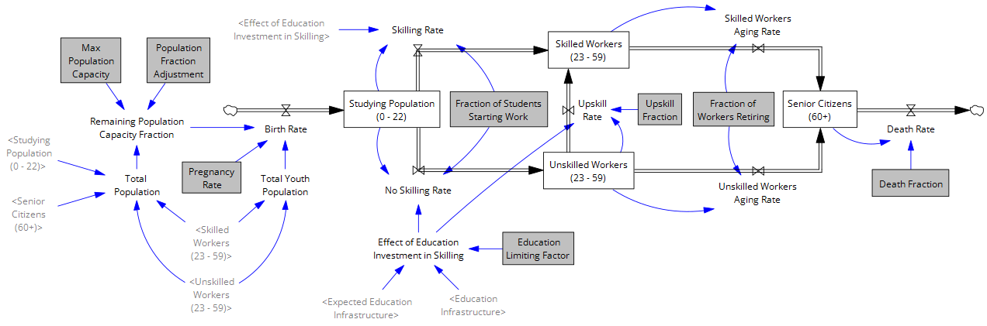
1. Population and Workforce Dynamics

Slide 7
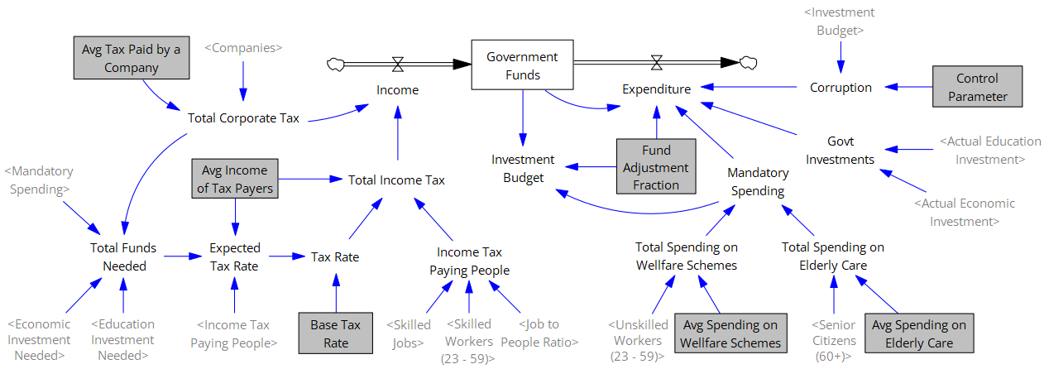
2. Government Fiscal Dynamics

Slide 8
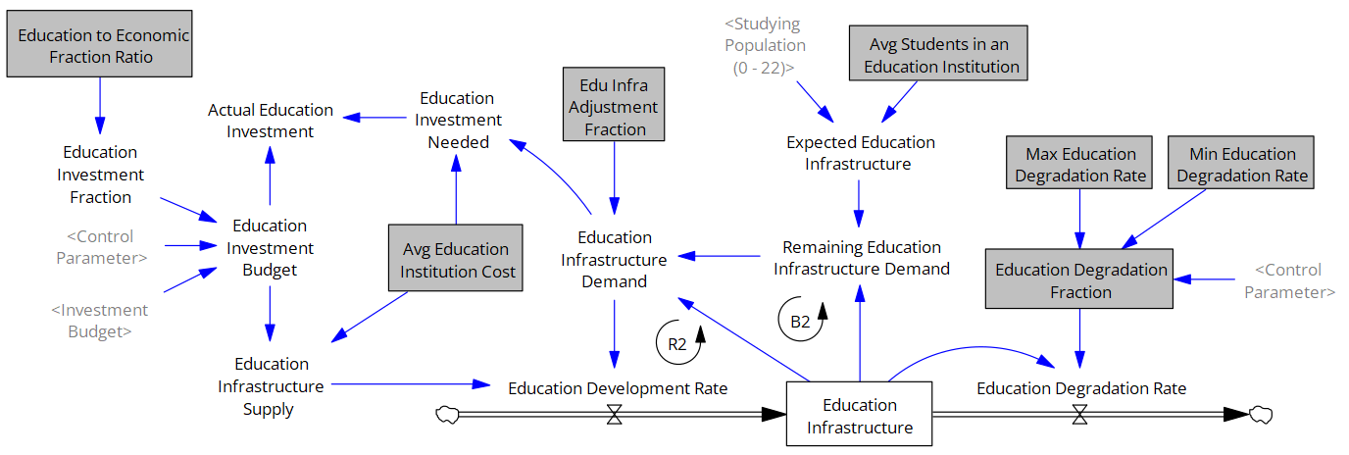
3. Education Infrastructure Dynamics
Demand: Decided by Studying Population
Supply: Decided by Education Investment Budget

Slide 9
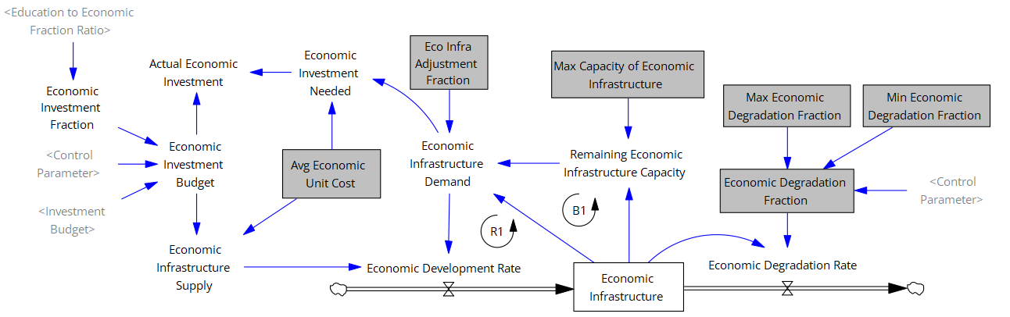
4. Economic Infrastructure Dynamics
Demand: Decided by Max Capacity
Supply: Decided by Economic Investment Budget

Slide 10
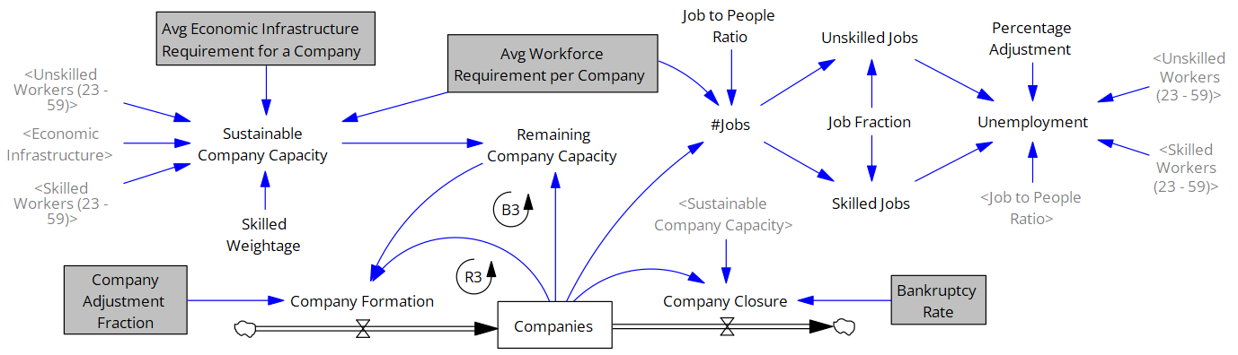
5. Business & Employment Dynamics
Sustainable Company Capacity > Companies: More Inflow, No Outflow
Sustainable Company Capacity < Companies: No Inflow, More Outflow
Notes:
Sustainable Company Capacity: How many Companies can India Accommodate

Slide 11
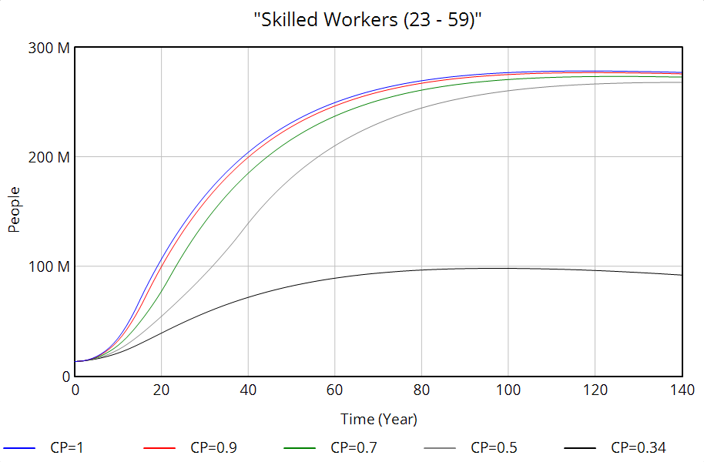
Results

Slide 12
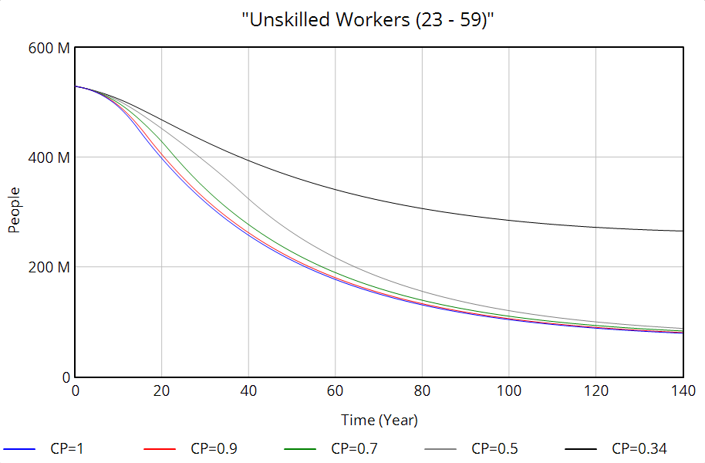
Results

Slide 13
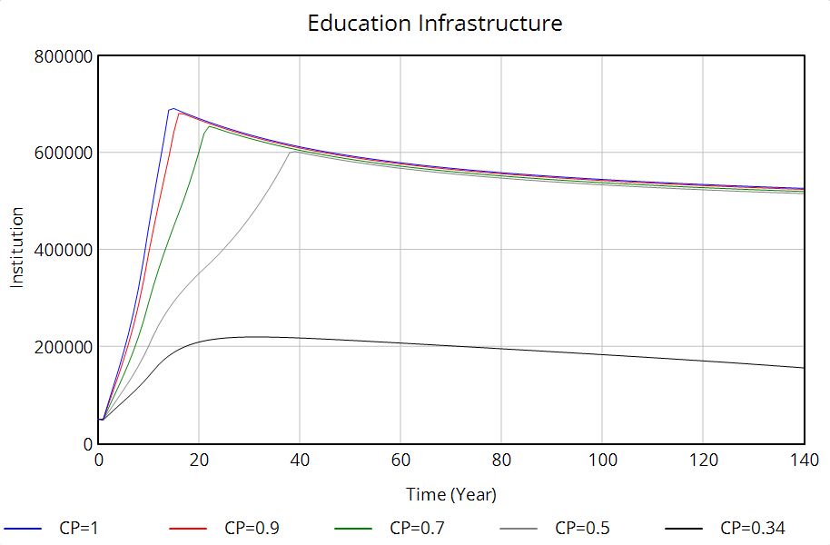
Results

Slide 14
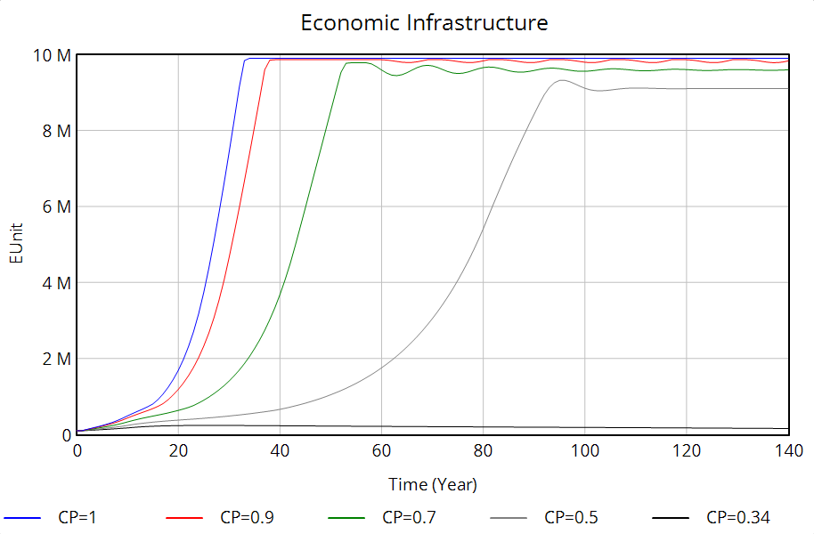
Results

Slide 15
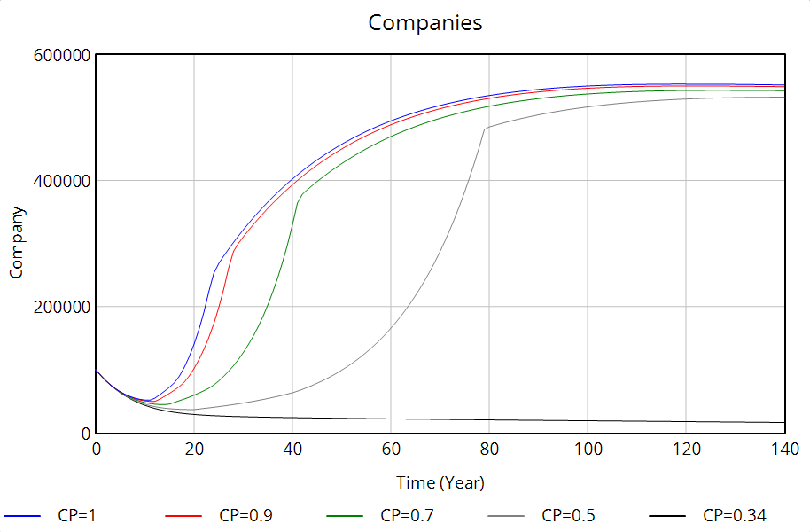
Results

Slide 16
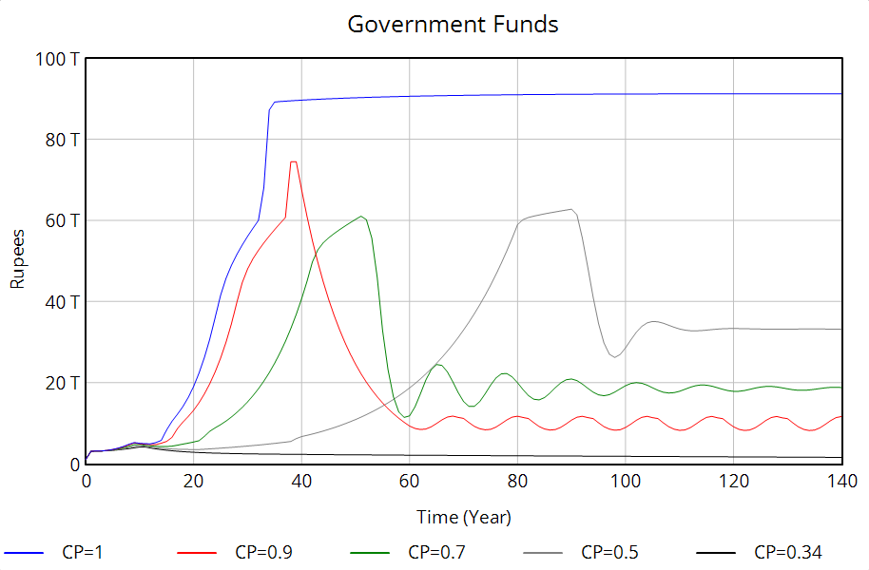
Results

Slide 17
Conclusion
Corruption causes delays in development projects, and it leads to more unemployment and social unrest.
Threshold of collapse (66%) , if corruption is 66% or more then there will be inevitable collapse.
If corruption happens then it will lead to less companies in the nation and less jobs.
Dependence on a limited skilled workforce increases economic vulnerability.
A skilled youth workforce is pivotal in transforming demographic potential into economic prosperity.
A proficient workforce attracts businesses and increases entrepreneurship, driving economic growth.
Strategic reforms targeting corruption and skill enhancement are essential to avert potential economic collapse.

Slide 18
References
[1] Singh, Paramjit, and Surinder Kumar. "Demographic dividend in the age of neoliberal capitalism: an analysis of employment and employability in India." The Indian Journal of Labour Economics 64.3 (2021): 595-619.
[2] Parida, Jajati Keshari, and S. Madheswaran. "Harnessing demographic dividend before it is lost forever in India." The Indian Journal of Labour Economics 66.1 (2023): 61-79.
[3] Oghenekohwo, Jonathan E., and Ekima A. Frank-Oputu. "Literacy education and sustainable development in developing societies." International Journal of Education and Literacy Studies 5.2 (2017): 126-131.
[4] Naik, Kasturi, and Anita Bobade. "Youth in India: Demographic Dividend or Demographic Disaster." 9th Annual Conference of the EuroMed Academy of Business. 2016.
[5] Hans, V., 2023. India's Demographic Dividend: Opportunities and Policies. India's Demographic Dividend: Opportunities and Policies (October 22, 2023).
[6] Jain, N. and Goli, S., 2022. Potential demographic dividend for India, 2001 to 2061: a macro-simulation projection using the spectrum model. SN Social Sciences, 2(9), p.171.
[7] Nejat, E.R.K., Çabuk, H.A. and Sanlı, A.T.E.Ş., Long-Run Growth and Physical Capital-Human Capital Concentration.
[8]https://www.indiatvnews.com/news/india/sonia-gandhi-demands-raising-minimum-wages-guaran teed-workdays-under-mgnrega-parliament-budget-session-2025-03-18-981118
[9]https://www.cnbctv18.com/business/finance/fy23-direct-tax-collection-interesting-facts-income-tax-data-19468376.htm#:~:text=This%20means%20the%20average%20income,%E2%82%B97.2 4%20lakh%20in%20FY23

Slide 19
Thank You

