Slide 1
Sys_perf_check : A tool to diagnose bottleneck component in the backend server
Api_perf_check : A tool to observe
performance change in APIs over time.
BPS presentation by
Jatin Lachhwani
(Guide : Prof. Bhaskaran Raman)

Slide 2
Contents
SPC (sys_perf_check): recap
SPC : validation & new feature
Case Study for APC (api_perf_check)
APC : Overview
APC Implementation
APC Demonstration
Conclusion & Future Work

Slide 3
SPC : Sys_Perf_check(recap)

Slide 4


SPC (sys_perf_check): recap
Modern Web Application
SPC detects
SLOW
Components
Client
Backend server

Slide 5
SPC (sys_perf_check): recap
Sys_perf_check
Client end module
server end module
Backend server

Slide 6
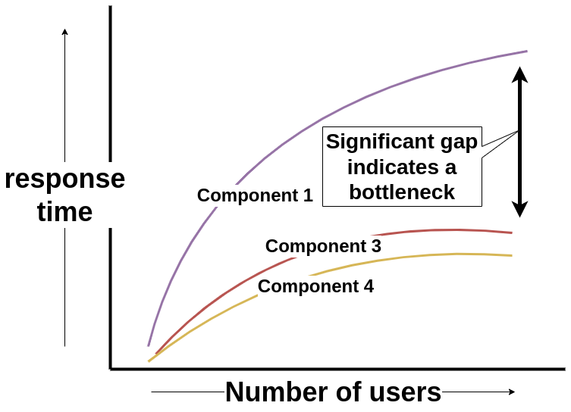



SPC (sys_perf_check): recap
Sys_perf_check
20
30
Perf
Test
40
Client end module
server end module
Backend server

Slide 7
SPC Validation and new feature

Slide 8
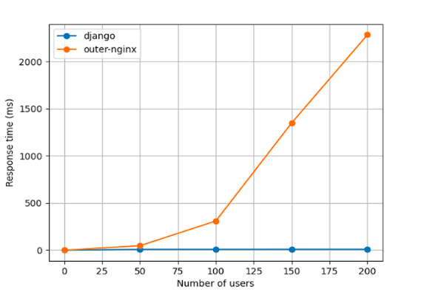



SPC : validation
SQRE Architecture
Used SPC on SQRE
Significant gap
Client
Backend server

Slide 9
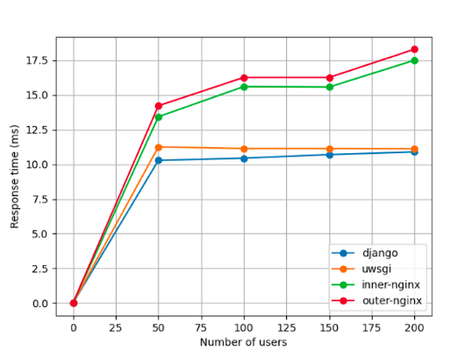

SPC : validation
SQRE new Architecture - uWSGI
Close in performance
Backend server

Slide 10
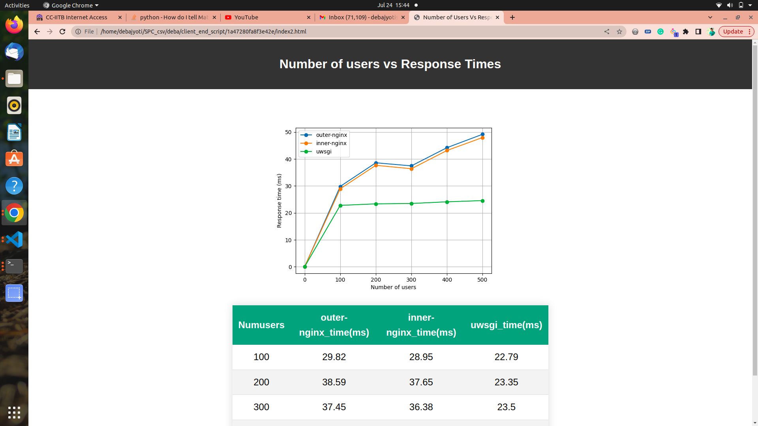

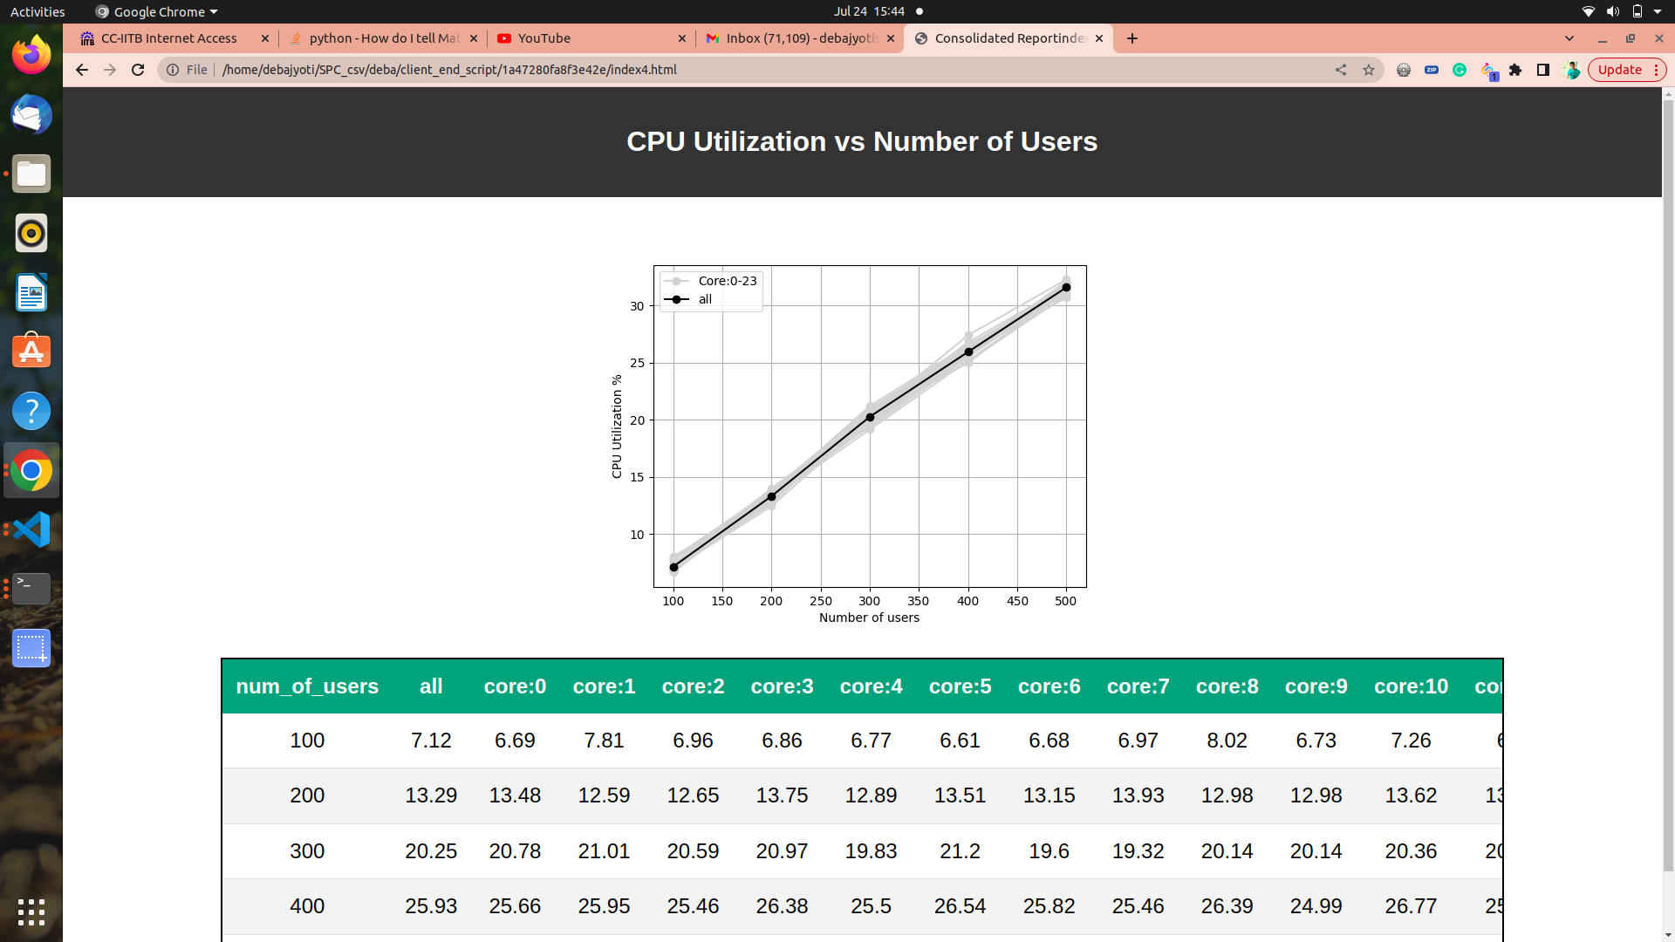

SPC : new feature
CPU utilization as metric
Better performing architecture
Poorly configured Architecture
All cores are not properly utilized
All cores are getting utilized
Response Time dropped significantly. From 700ms to 50 ms for 500 users
Response time is increasing sharply with rising load

Slide 11
SPC : new feature
Poor
vs
Proper

Slide 12
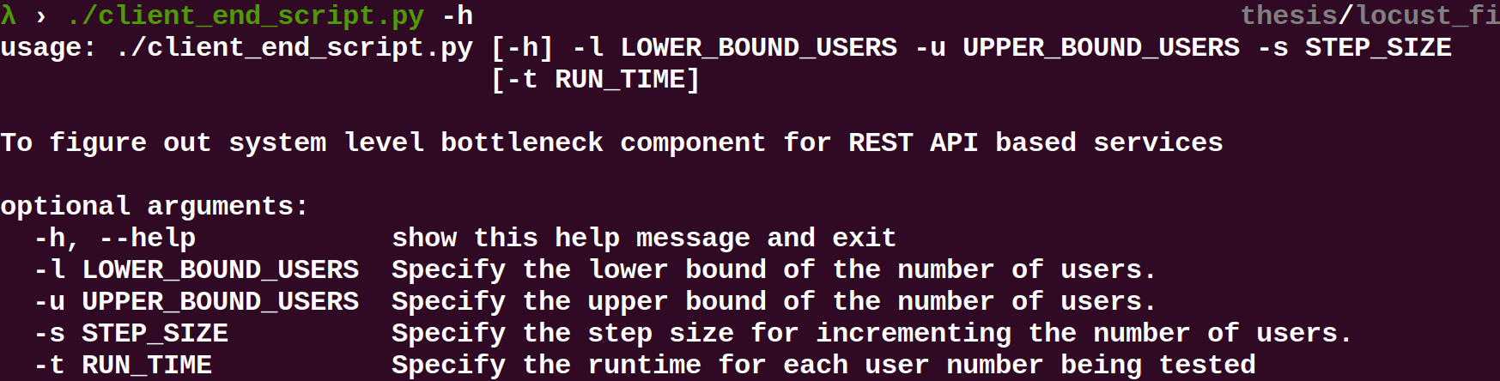
SPC : new feature
CPU utilization : Implementation
Client end script input

Slide 13
SPC : new feature
CPU utilization : Implementation
Client end module will
RUN_TIME : 60 secs
Send these to server end module before starting the performance test
USERS : 200
Configured ramp up time : 3 secs
CPU utilization measured using htop
Point in graph
Performance test duration : 60
Ramp up: 3

Slide 14
Case Study for APC (api_perf_check)

Slide 15




Case Study for APC (api_perf_check)
Software versions
Recent commit

Slide 16




Case Study for APC (api_perf_check)

Slide 17



Case Study for APC (api_perf_check)
Analyzed the commit
Software versions
Recent commit
Detecting performance issues at this stage will prevent
Performance failure in productions
Heavy ML library
APC comes for rescue

Slide 18
Case Study for APC (api_perf_check)
Problem Statement
To create a tool that is
able to detect performance issues with code changes in APIs
able to detect performance issues happening over time in APIs (e.g say due to database size change)

Slide 19
APC : Overview

Slide 20


APC : Overview
Requirements
APIs you want to monitor
Performance testing Scripts
Initial configuration json and setup scripts

Slide 21



APC : Overview
Requirements
SAFE (e.g.)
API
1. Login
2. Get Course List
3. Get Quiz List
4. Get Quiz Info
5. Quiz Download
6. Quiz Authenticate
7. Quiz Submit
APIs you want to monitor
Performance testing Scripts
Locust scripts
Initial configuration json and setup scripts

Slide 22
APC : Overview
APC steps
Initial setup scripts
Performance Test of APIs (being monitored)
Extracting Relevant Metrics (response time)
Comparing it to previous performance results (1,7,30)
Displaying APC Results

Slide 23
APC : Overview
APC steps
E.g SAFE
Initial setup scripts
Quiz Publish and Start quiz
Performance Test of APIs
Locust Performance Test
Extracting Relevant Metrics
APC
Comparing it to previous performance results (1,7,30)
Configured
Displaying APC Results
t-test

Slide 24
APC : Overview
APC Architecture
APC
Client end module
server end module
Backend server

Slide 25
APC Implementation

Slide 26
APC Implementation
Generate Testid
Testid
Date time at the time of test
Format : "%Y-%m-%d_%H-%M-%S"
e.g. "2023-12-18_11-13-13"
Useful in log extraction
Comparison to previous dates

Slide 27
APC Implementation
Initial script
Inspired from the idea of constructor in class (RAII)
User needs to create initial_script.py
Contains steps to be performed before performance test
e.g.
1. Login as instructor
2. Publish a particular quiz
3. Start the published quiz

Slide 28

APC Implementation
Performance test
Generate START log
API
1. Login
2. Get Course List
3. Get Quiz List
4. Get Quiz Info
5. Quiz Download
6. Quiz Authenticate
7. Quiz Submit
Performance Test of APIs
Generate END log

Slide 29

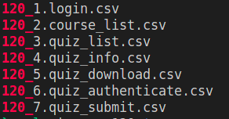
APC Implementation
Extracting Relevant metrics (resp time)
Transfer of logs from server end module to client end module
storing test id in database and extracting response time for all APIs
Storing all response times in csv file

Slide 30
APC Implementation
Comparing it to previous performance tests
Config: (1,7,30)
Compare results of current performance test with 1 ,7 and 30 entry before
Use t-test for comparing distributions
90
30 before
113
7 before
119
1 before
Say current test id : 120
120

Slide 31
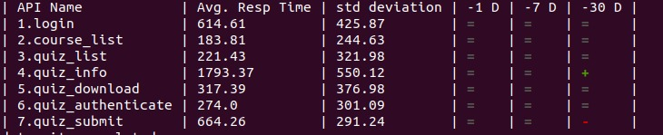
APC Implementation
Displaying APC Results
After performing t-test with previous performance tests
APC results are displayed on command line

Slide 32
APC Demonstration

Slide 33
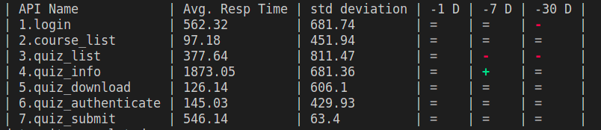
APC Demonstration
Detecting change in API performance
In quiz_list 100ms of delay was added and it was red at 7d and 30d

Slide 34
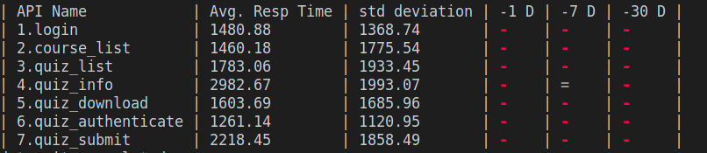
APC Demonstration
Detecting system performance change
Uwsgi process from 24 to 5 process

Slide 35
Conclusion & Future Work

Slide 36
Conclusion & Future Work
Conclusion
Sys_Perf_check was validated.
It is more useful now by adding CPU utilization as a metric
Api_perf_check monitors performs changes overtime
It can be used as a regular cron job or as a CI/CD integrated tool

Slide 37
Conclusion & Future Work
Future Work
To reduce number of false signals by api_perf_check (make it more reliable)
Add CPU utilization as a metric (use it for comparison as well)
Add more types of test (other than t-test) based on underlying distribution
Evaluate it in real CI/CD pipelines or as regular cron job

Slide 38
Conclusion & Future Work
References
https://en.wikipedia.org/wiki/Constructor_(object-oriented_programming)
https://nginx.org/en/docs/
https://docs.scipy.org/doc/scipy/reference/generated/scipy.stats.ttest_ind.html
https://locust.io/

Slide 39
The End

