Slide 1
SPC : A tool to diagnose bottleneck component in the backend server
BPS-2 presentation by
Jatin Lachhwani
(Guide : Prof. Bhaskaran Raman)

Slide 2
Contents
Introduction
SPC Overview
SPC Implementation
SPC Functionality Testing
Conclusion & Future Work

Slide 3
Introduction

Slide 4
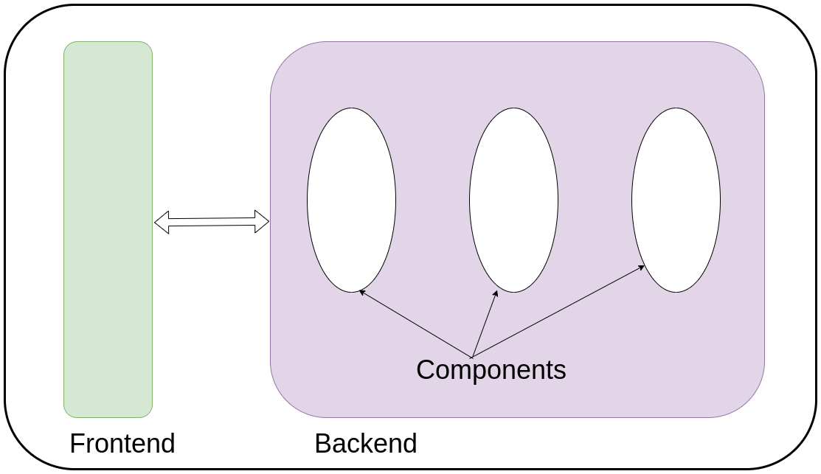
Introduction
Modern Web Applications
Composed of frontend and backend.
Backend is more complex
Multiple modular components

Slide 5
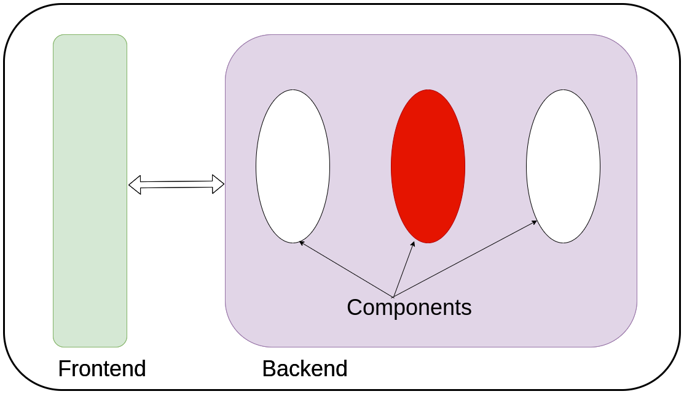
Introduction
Modern Web Applications
Composed of frontend and backend.
Backend is more complex
Multiple modular components
One component might be slow

Slide 6
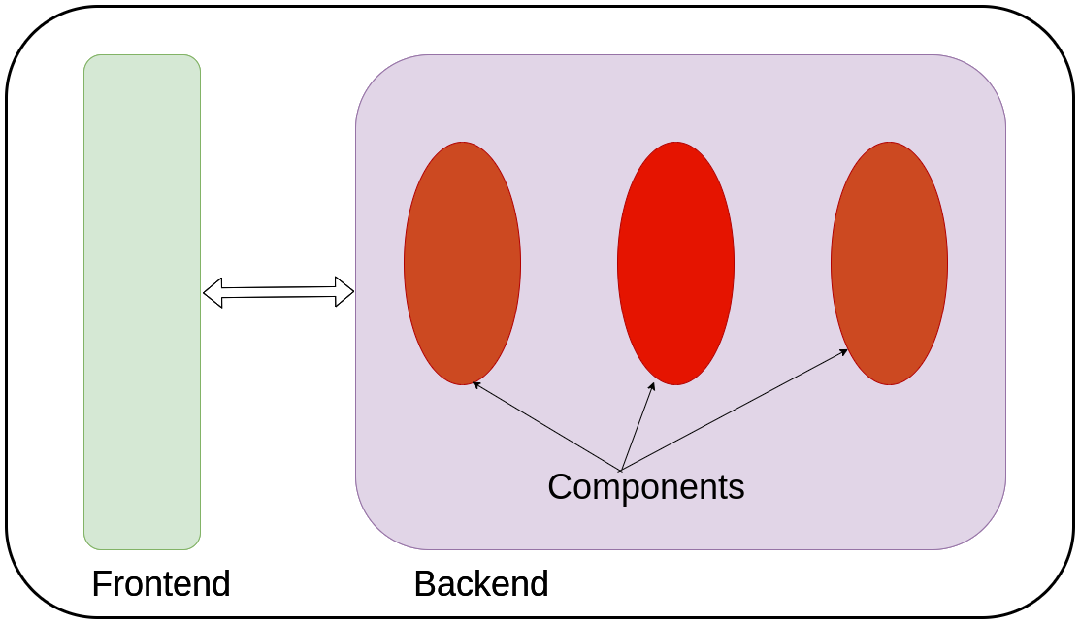
Introduction
Modern Web Applications
Composed of frontend and backend.
Backend is more complex
Multiple modular components
One component might be slow
Potential to slow down the entire system

Slide 7
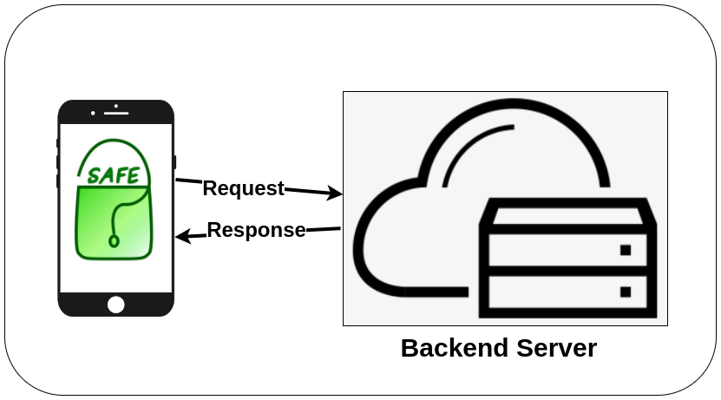
Introduction
Case Study | SAFE
SAFE - Smart Authenticated Fast Exams
Take quiz in classroom using their own smartphones.

Slide 8

Introduction
Case Study | SAFE | Core Functionality
SAFE - Smart Authenticated Fast Exams
Take quiz in classroom using their own smartphones.

Slide 9
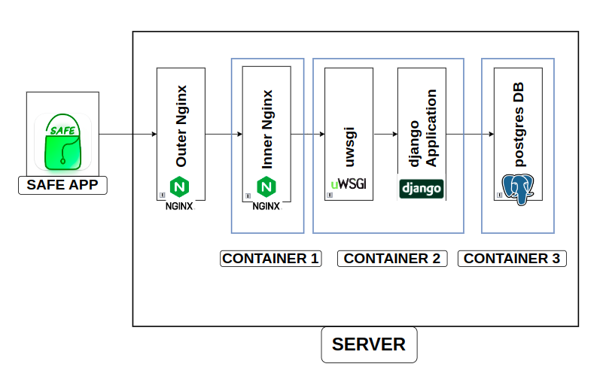
Introduction
Case Study | SAFE | Architecture
SAFE app
Outer nginx
Inner nginx
uWSGI
Django
Postgres

Slide 10


Introduction
Case Study | SAFE | Core Functionality
Steps : Taking a Quiz in SAFE
0. Instructor starts the quiz
4. Get Quiz Info
1. Login
5. Quiz Download
2. Get Course List
6. Quiz Authenticate
3. Get Quiz List
7. Quiz Submit

Slide 11
Introduction
Case Study | Previous Work
To identify bottleneck APIs among them.
0. Instructor starts the quiz
4. Get Quiz Info
1. Login
5. Quiz Download
2. Get Course List
6. Quiz Authenticate
3. Get Quiz List
7. Quiz Submit

Slide 12
Introduction
Case Study | Previous Work
Tried to find bottleneck APIs.
API | Avg. Resp. time(ms)
1. Login | 4279
2. Get Course List | 4378
3. Get Quiz List | 4278
4. Get Quiz Info | 9407
5. Quiz Download | 7766
6. Quiz Authenticate | 4278
7. Quiz Submit | 5704
Test Conditions
Num of users : 100
Spawn Rate : 10/s
Num Questions : 10

Slide 13
Introduction
Case Study | Previous Work
Tried to find bottleneck APIs.
API | Avg. Resp. time(ms)
1. Login | 4279
2. Get Course List | 4378
3. Get Quiz List | 4278
4. Get Quiz Info | 9407
5. Quiz Download | 7766
6. Quiz Authenticate | 4278
7. Quiz Submit | 5704
Too high
for these conditions
Test Conditions
Num of users : 100
Spawn Rate : 10/s
Num Questions : 10

Slide 14
Introduction
Case Study | Previous Work
Tried to find bottleneck APIs.
API | Avg. Resp. time(ms)
1. Login | 4279
2. Get Course List | 4378
3. Get Quiz List | 4278
4. Get Quiz Info | 9407
5. Quiz Download | 7766
6. Quiz Authenticate | 4278
7. Quiz Submit | 5704
Too high
for these conditions
Test Conditions
Num of users : 100
Spawn Rate : 10/s
Num Questions : 10
Possibility of a system level bottleneck

Slide 15
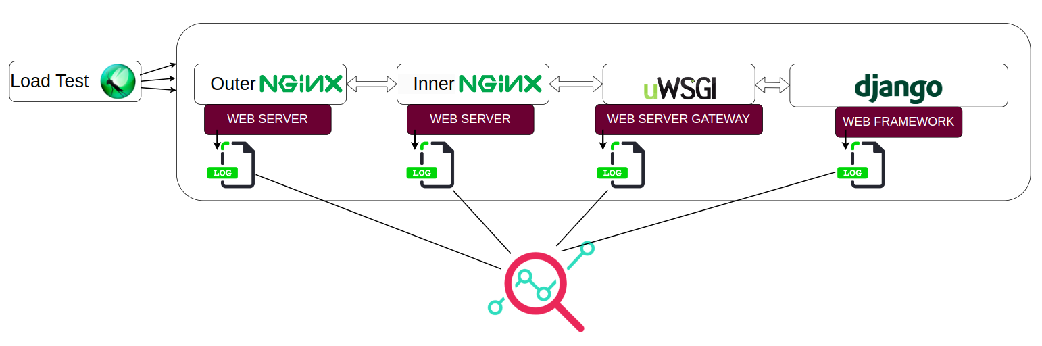
Introduction
Case Study | Previous Work
Analysed the logs of each component in SAFE

Slide 16
Introduction
Case Study | Previous Work
Analysed the logs of each component in SAFE
Bottleneck

Slide 17
Introduction
Case Study | Previous Work
After Properly configuring uWSGI (bottleneck component)
API | Avg. Resp. time(ms)
1. Login | 4279
2. Get Course List | 4378
3. Get Quiz List | 4278
4. Get Quiz Info | 9407
5. Quiz Download | 7766
6. Quiz Authenticate | 4278
7. Quiz Submit | 5704
Avg. Resp. time(ms) (uWSGI configured)
1968
438
519
306
325
405
783
Test Conditions
Num of users : 100
Spawn Rate : 10/s
Num Questions : 10

Slide 18
Introduction
Case Study | Previous Work Conclusion
System level bottleneck component(s)
are hard to detect
can stay unnoticed for too long
have a significant impact on overall performance

Slide 19
Introduction
Problem Statement
To create a tool that is
helps to detect System level bottleneck component(s).
independent of any application specific APIs
easy to use and configure
visual feedback for analysis of components.

Slide 20
Introduction
Problem Statement
To create a tool that is
able to detect System level bottleneck component(s).
independent of any application specific APIs
easy to use and configure
visual feedback for analysis of components.
This tool is named SPC : Sys_Perf_Check

Slide 21
SPC Overview

Slide 22
SPC Overview
Assumptions
Possible to customize the log format for all components in the backend stack.
Components are stacked linearly (like nginx-uwsgi-django)
URL of the request is visible at all components.
Mainly designed for backend web application stacks.

Slide 23
SPC Overview
SPC Design Brainstorm
How can we detect a bottleneck component like ill-configured uWSGI?
while ensuring
independent of any application specific APIs
SPC: easy to use and configure
visual feedback for analysis of components.

Slide 24
SPC Overview
SPC Design Brainstorm
1.Performance Test with varying load.
2.Extract logs from all components
3. Display relevant data as graphs for analysis
4. Use graphs to find bottleneck

Slide 25
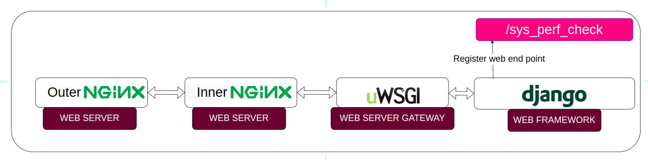
SPC Overview
SPC Design Brainstorm | Idea 1
Add a specific API endpoint at application code independent of other APIs.
Say : sys_perf_check

Slide 26
SPC Overview
SPC Design Brainstorm | Idea 1
Add a specific API endpoint at application code independent of other APIs.
Say : sys_perf_check
Why?

Slide 27
SPC Overview
SPC Design Brainstorm | Idea 1
Add a specific API endpoint at application code independent of other APIs.
Say : sys_perf_check
Why?
independent of any application specific APIs

Slide 28
SPC Overview
SPC Design Brainstorm | Idea 1
What will /sys_perf_check do?

Slide 29
SPC Overview
SPC Design Brainstorm | Idea 1
What will /sys_perf_check do?
It will execute for a bounded time then exit. (say 10ms)
10 ms

Slide 30
SPC Overview
SPC Design Brainstorm | Idea 1
What will /sys_perf_check do?
It will execute for a bounded time then exit. (say 10ms)
Why?
10 ms

Slide 31
SPC Overview
SPC Design Brainstorm | Idea 1
What will /sys_perf_check do?
It will execute for a bounded time then exit. (say 10ms)
Why?
We observed in our case study, django code would execute for roughly 5-40ms. (empirical). (Adjusted based upon the system under test.)
10 ms

Slide 32
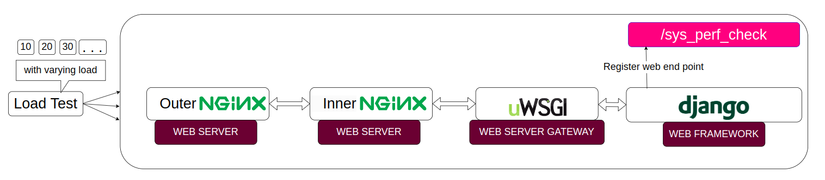
SPC Overview
SPC Design Brainstorm | Idea 1
Now we can do a load test with varying number of users.
We can analyze the component logs and find the bottleneck.
10 ms
10 ms

Slide 33
SPC Overview
SPC Design Brainstorm | Idea 2
Now we can do a load test with varying number of users.
We can analyze the component logs and find the bottleneck.
Wait. But there is a catch. How to identify the number of users for a request entry in a log?
10 ms
10 ms

Slide 34
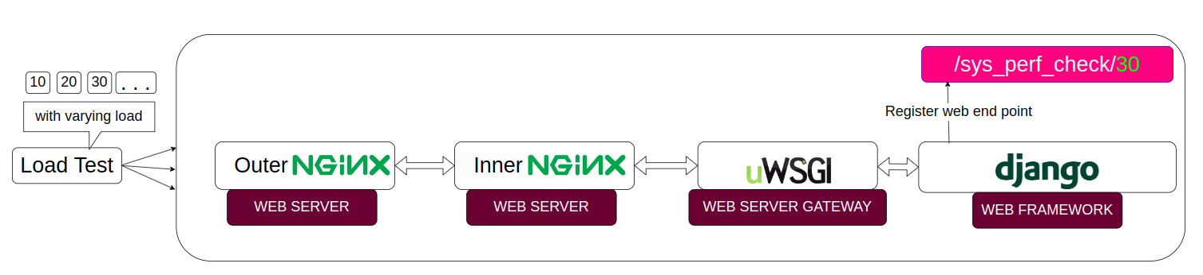
SPC Overview
SPC Design Brainstorm | Idea 2
Now we can do a load test with varying number of users.
We can analyze the component logs and find the bottleneck.
Wait. But there is a catch. How to identify the number of users for a request entry in a log? By appending number of users as a part of request.
10 ms

Slide 35
SPC Overview
SPC Design Brainstorm | Idea 3
Suppose we change something for a new test.(say endpoint time to 20 ms)
After the load test when we extract the logs. We might get logs from the previous test.
20 ms

Slide 36
SPC Overview
SPC Design Brainstorm | Idea 3
Suppose we change something for a new test.(say endpoint time to 20 ms)
After the load test when we extract the logs. We might get logs from the previous test. What now?
20 ms

Slide 37
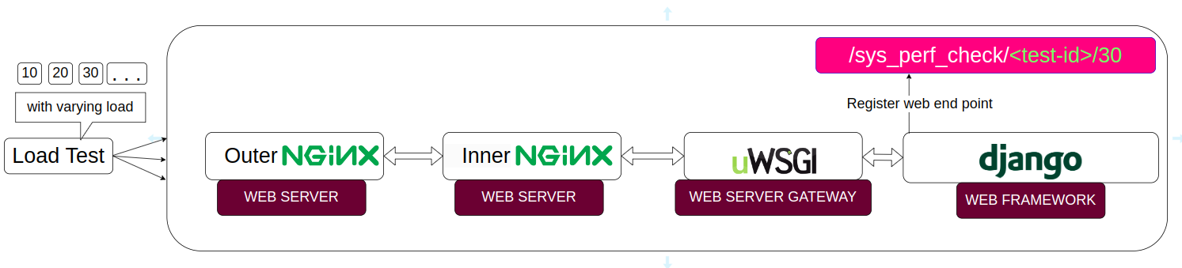
SPC Overview
SPC Design Brainstorm | Idea 3
Suppose we change something for a new test.(say endpoint time to 20 ms)
After the load test when we extract the logs. We might get logs from the previous test. What now?. We need a way to distinguish tests uniquely
We will add a unique test id in the request for each varying load test.
20 ms

Slide 38
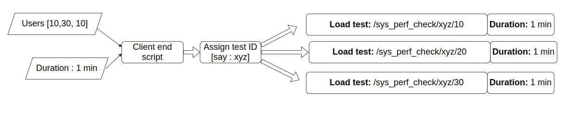
SPC Overview
SPC Design Brainstorm | Idea Aggregation
Register endpoint sys_perf_check
2. Script that generates load for varying number of users
3. Assigns Id to each instance of test.
These things will be done by a script : client end script

Slide 39
SPC Overview
SPC Design Brainstorm | Client end script
client end script
Why?

Slide 40
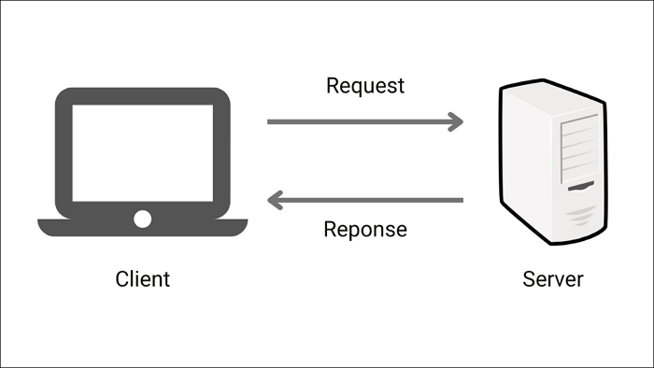
SPC Overview
SPC Design Brainstorm | Client end script
client end script
Why?
Generally load generation for testing happens on a separate machine.
To keep the server machine same for all tests.

Slide 41

SPC Overview
SPC Design Brainstorm | Idea 4
Once the client end script executes
We need something to
extract the logs
transfer them to client end script for analysis

Slide 42
SPC Overview
SPC Design Brainstorm | Idea 4
Once the client end script executes
We need something to
extract the logs
transfer them to client end script for analysis
Server end script

Slide 43
SPC Overview
SPC Design Brainstorm | Idea 4
Once the client end script executes
We need something to
extract the logs
transfer them to client end script for analysis
Server end script
SPC: easy to use and configure

Slide 44
SPC Overview
SPC Design Brainstorm | Idea 5
Once logs are received : Extract relevant data

Slide 45
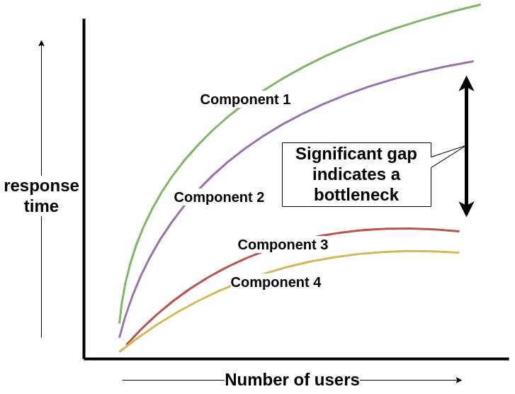
SPC Overview
SPC Design Brainstorm | Idea 5
Once logs are received : Extract relevant data
Display graphical results for analysis.
visual feedback for analysis of components.

Slide 46
SPC Overview
Test for SPC
Good test for SPC : It can detect the uWSGI bottleneck we detected in our previous work.
Bottleneck

Slide 47
SPC Implementation

Slide 48
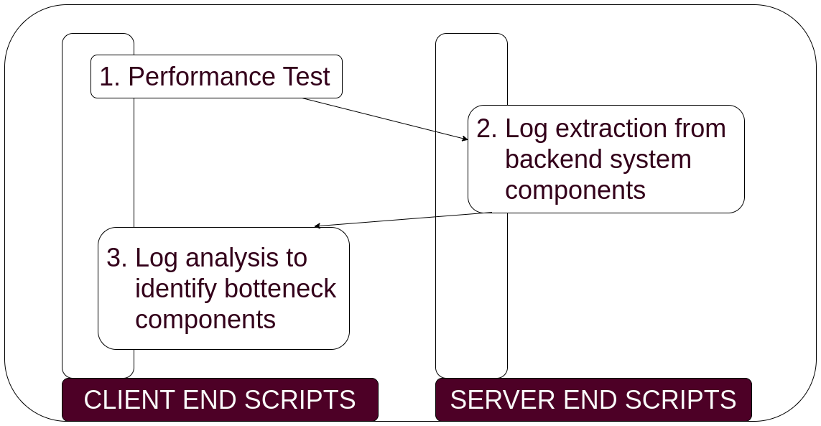
SPC Implementation
3 Phases

Slide 49
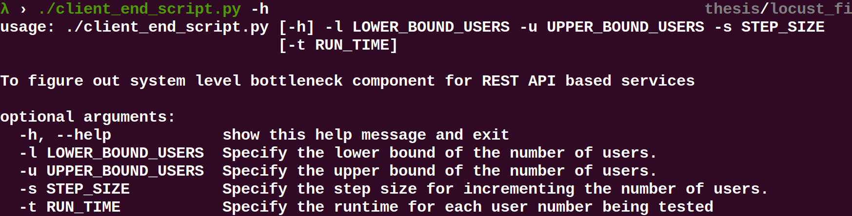
SPC Implementation
Phase 1 - Performance Test | Client End Script
Client end script input
Notes:
Phase 1 - Performance Test | Client End Script | 1. Client end script input

Slide 50
SPC Implementation
Phase 1 - Performance Test | Client End Script
Client end script input
-l 10 -u 40 -s 10 -t 40 | Run test for Users {10,20,30,40}, each for 40 secs.
Notes:
Phase 1 - Performance Test | Client End Script | 1. Client end script input

Slide 51
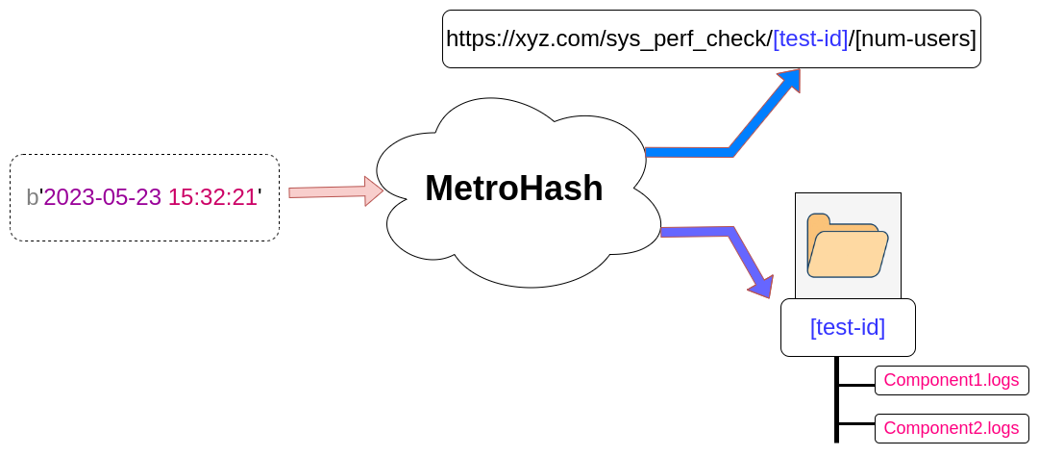
SPC Implementation
Phase 1 - Performance Test | Client End Script
2. Generating unique id for this instance of script.

Slide 52
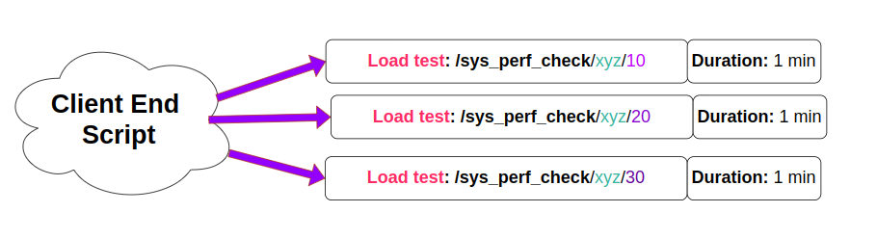
SPC Implementation
Phase 1 - Performance Test | Client End Script
3. Performance Test (uses locust)
say : l: 10, u:30, s:10, t:1 min | test-id : xyz

Slide 53
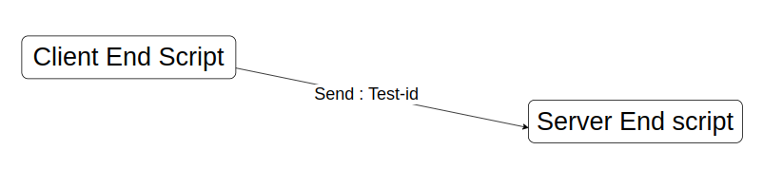
SPC Implementation
Transition Phase 1 to Phase 2
After Phase 1, client end script will send the test-id to server end script.

Slide 54
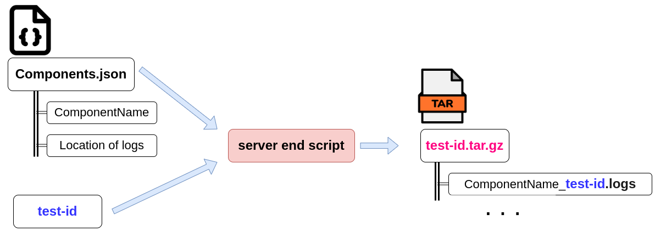
SPC Implementation
Phase 2 - Log Extraction | Server End Script
4. Log Extraction from Component logs.
It requires a components.json file to describe the location of component logs.

Slide 55
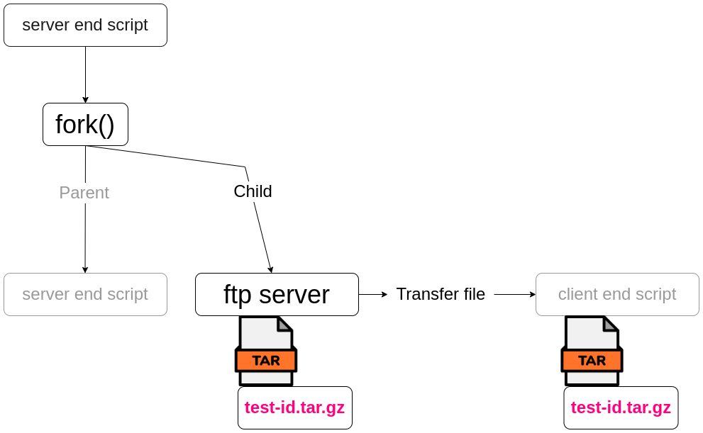
SPC Implementation
Phase 2 - Log Extraction | Server End Script
5. Creating an ftp server to transfer logs

Slide 56
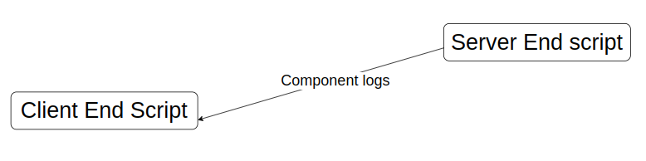
SPC Implementation
Transition Phase 2 to Phase 3
After Phase 2, Components logs are transferred to client end script.

Slide 57
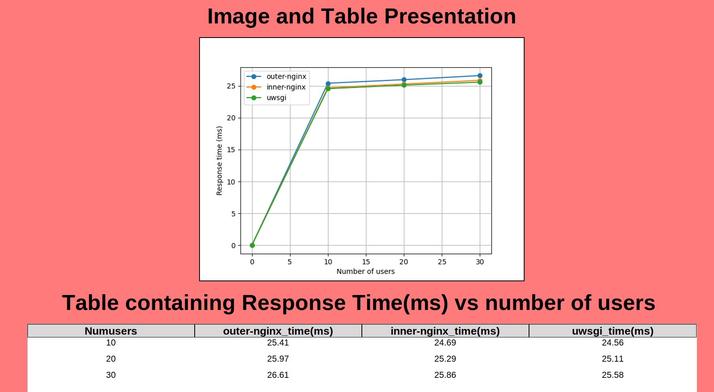
SPC Implementation
Phase 3 - Graph for analysis| Client End Script
6. Component logs are used to create graph for analysis.
This can be used to detect the bottleneck.

Slide 58
SPC Functionality Testing

Slide 59
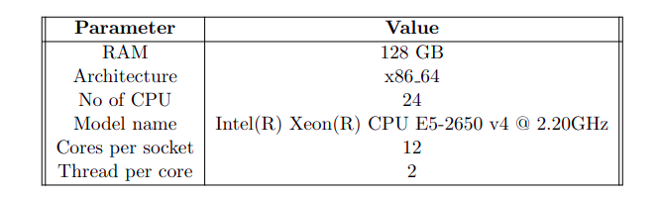
SPC Functionality Testing
Test Setup | Machine Specifications

Slide 60
SPC Functionality Testing
Test Setup | Machine Specifications

Slide 61
SPC Functionality Testing
Test Setup | Bottleneck from Previous Work
Configuration issue in uWSGI
Bottleneck

Slide 62

SPC Functionality Testing
Test Setup | uWSGI configurations
We tried four configurations for number of processes in uWSGI

Slide 63
SPC Functionality Testing
Test Setup | uWSGI configurations
5: lower than ideal config. | 24: equal to num of cores
48: ideal config. (documentation) | 64: higher than ideal config.
Test: $ ./client_end_script -l 50 -u 400 -s 50 -t 60

Slide 64
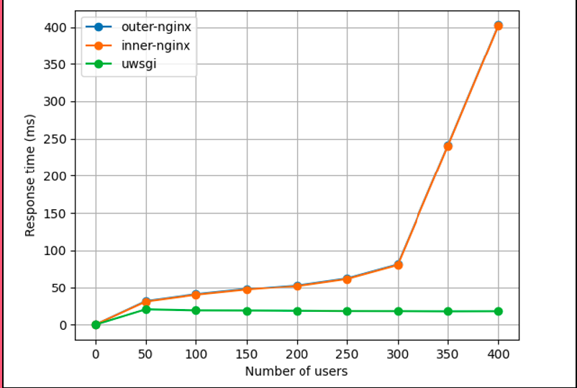
SPC Functionality Testing
Final Test | uWSGI Processes 5

Slide 65
SPC Functionality Testing
Final Test | uWSGI Processes 5
This wide gap indicates a bottleneck.

Slide 66
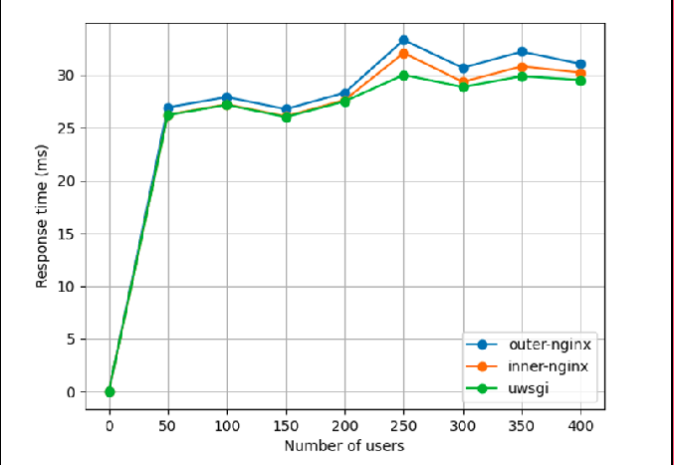
SPC Functionality Testing
Final Test | uWSGI Processes 24

Slide 67
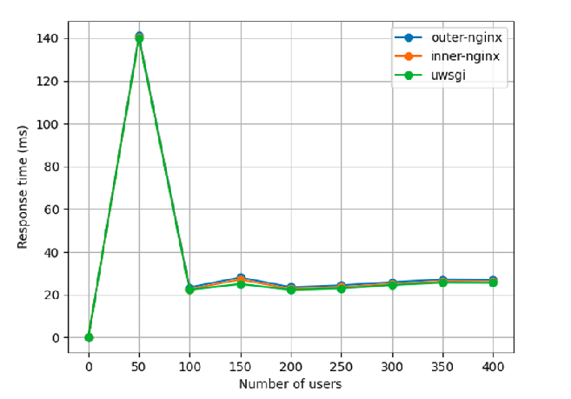
SPC Functionality Testing
Final Test | uWSGI Processes 48

Slide 68
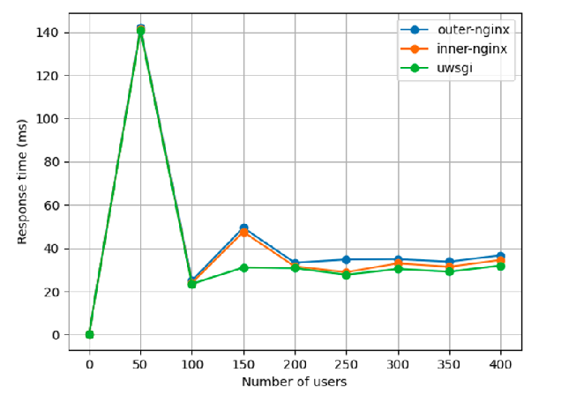
SPC Functionality Testing
Final Test | uWSGI Processes 64

Slide 69
SPC Functionality Testing
Final Test | Results
RESULTS | Worst Performance | Best Performance
Low load(50 users) | uWSGI Processes : 64 Response time : 141.7 ms | uWSGI Processes : 24 Response time : 26.9 ms
High load(400 users) | uWSGI Processes : 5 Response time :402 ms | uWSGI Processes : 48 Response time : 27 ms

Slide 70
Conclusion & Future Work

Slide 71
Conclusion & Future Work
Conclusion
SPC works and it helps in bottleneck detection
It satisfies the following conditions :
independent of any application specific APIs
easy to use and configure
visual feedback for analysis of components.

Slide 72
Conclusion & Future Work
Conclusion | Other use cases
To fine tune application performance
To check impact of certain API endpoints by modifying /sys_perf_check API

Slide 73
Conclusion & Future Work
Future Work
Figure out ways to extend SPC for more use cases.
Experimenting with different implementations of sys_perf_check Endpoint.
More user friendly naming for test-id names instead of metrohash
Extend it for more complex distributed systems as well.

Slide 74
The End

