Slide 1
Assignment 1:
Implementation of Backpropagation and Training a Palindrome Network
Arijeet De, 23M0742
Tirthesh Jain, 23M0758
Vivek Ramrao Pawar, 23M0769
20th Feb., 2024
Code Link

Slide 2
Problem Statement
Input: 10-bit String (of numbers)
Output: 1 if Palindrome, 0 otherwise

Slide 3
Architecture and hyperparameter details
Input Layer:
10 neurons, corresponding to the 10 bits in each binary string
One Hidden Layer:
2 neurons (Hyperparameter)
Activation Function: Sigmoid
Output Layer:
Single neuron, representing the probability of predicted class (palindrome or not).
Activation Function: Sigmoid

Slide 4
W1 [10,2]
b1 [2,1]
W2 [2,1]
b2 [1,1]
Output Layer [m,1]
Best Hyperparameters:
Learning Rate: 0.2
Momentum Rate: 0.09
No. of Epochs: 150000
No. of neurons in hidden layer: 2
Hidden Layer
Input [m,10]

Slide 5
Overall performance
Total Accuracy: 0.9974
Class 0 (Non-Palindrome) Accuracy: 0.9946
Class 1 (Palindrome) Accuracy: 1.0

Slide 6
Interpretability of middle layer
Hidden neurons:
H1 = X1’.X10 + X2’.X9 + ... + X5’.X6
H2 = X1.X10’ + X2.X9’ + … + X5.X6’
Output neuron
(H1+H2)’ (NOR operation)

Slide 7
Interpretability of middle layer
1. Hidden Layer Neurons Structure:
Two neurons in the hidden layer.
Edge weights from the ith and (n-i+1)th input neurons to a hidden layer neuron are approximately equal in magnitude but opposite in sign.
2. Palindrome Detection:
If input features at positions i and (n-i+1) are the same, the net input to the respective hidden layer neuron is zero.
Magnitude of edge weights from input features to both hidden layer neurons is nearly equal but with opposite signs.
Facilitates identification of non-palindromic numbers.

Slide 8
Interpretability of middle layer
3. Behavior with Palindromic Numbers:
Net contribution of input features to hidden layer neurons is zero for palindromic numbers.
Threshold value of hidden layer neurons is less than -1.
Activation at hidden layer neuron for palindromic numbers is always less than 0.25.
4. Behavior with Non-Palindromic Numbers:
Due to symmetric but complementary edge weight pattern, one hidden layer neuron receives positive contributions while the other receives negative.
Magnitude of contributions exceeds threshold, resulting in sigmoid activation values: one neuron > 0.5, the other close to zero.
5. Behavior of Output Layer Neuron based on Middle Layer Neurons:
Edge weight from hidden layer neurons to the output neuron is same in magnitude and sign (negative).
Threshold value at the output layer is positive, approximately half the magnitude of the edge weight from any one of the hidden layer neurons to the output layer neuron.

Slide 9
Interpretability of middle layer
6. Behavior of Output Layer Neuron in Case of Palindromic Number:
Net input in the case of palindrome is positive as the contribution of the hidden layer neurons is less than the threshold.
Results in a sigmoid value greater than 0.5 at the output neuron, interpreted as a positive class with a predicted value of 1.
7. Behavior of Output Layer Neuron in Case of Non-Palindromic Number:
Net input in the case of non-palindromic number is negative as the magnitude of the contribution of hidden layer neurons exceeds the threshold value but with a negative sign.
Results in a sigmoid activation value less than 0.5, interpreted as a negative class with a predicted value of 0.

Slide 10
Learnings
Effect of Momentum: Accelerating convergence, overcoming local minima
Hyperparameter Tuning: Optimizing learning rate, momentum, epochs, hidden layer size
Handling class imbalance: Oversampling palindrome examples
Effect of Learning Rate: Balance between convergence speed and stability
Use of activation function: Introducing non-linearity with sigmoid
Cross-validation: Robust evaluation technique for limited data

Slide 11
BP Implementation
W1, b1
A2: o/p of o/p layer after activation
Z2: o/p of o/p layer before activation
A1: o/p of hidden layer after activation
Z1: o/p of hidden layer before activation
W2: Weights b/w hidden & o/p layer
b2: Bias for o/p neuron
W1: Weights b/w i/p & hidden layer
b1: Bias for hidden neurons
W2, b2
Z2, A2
Z1, A1

Slide 12
BP Implementation
Gradient Descent
Loss
Update Weights and biases
W2_{new} = W2 - ղ*dW2
b2_{new} = b2 - ղ*db2
W1_{new} = W1 - ղ*dW1
b1_{new} = b1 - ղ*db1
dW2 is -ve
dW2 is +ve
W2

Slide 13
BP Implementation
Goal: Find
dW2, db2
dW1, db1

Slide 14
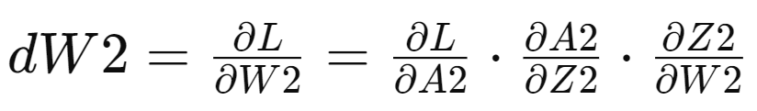
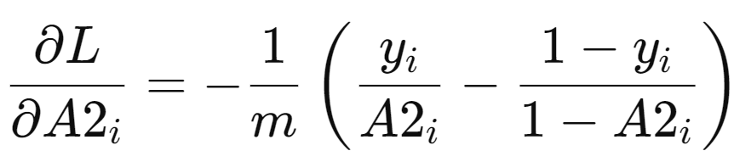
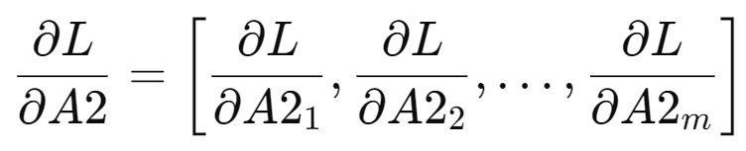
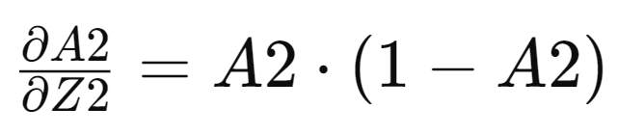
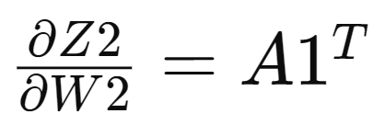
BP Implementation
L = lossFunc(y, A2)
A2 = sig(Z2)
Z2 = A1.W2^{T} + b2
A1 = sig(Z1)
Z2 = X.W1^{T} + b1

Slide 15
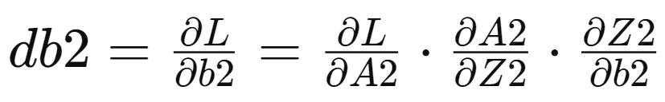
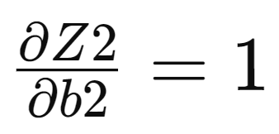
BP Implementation
L = lossFunc(y, A2)
A2 = sig(Z2)
Z2 = A1.W2^{T} + b2
A1 = sig(Z1)
Z2 = X.W1^{T} + b1

