Slide 1
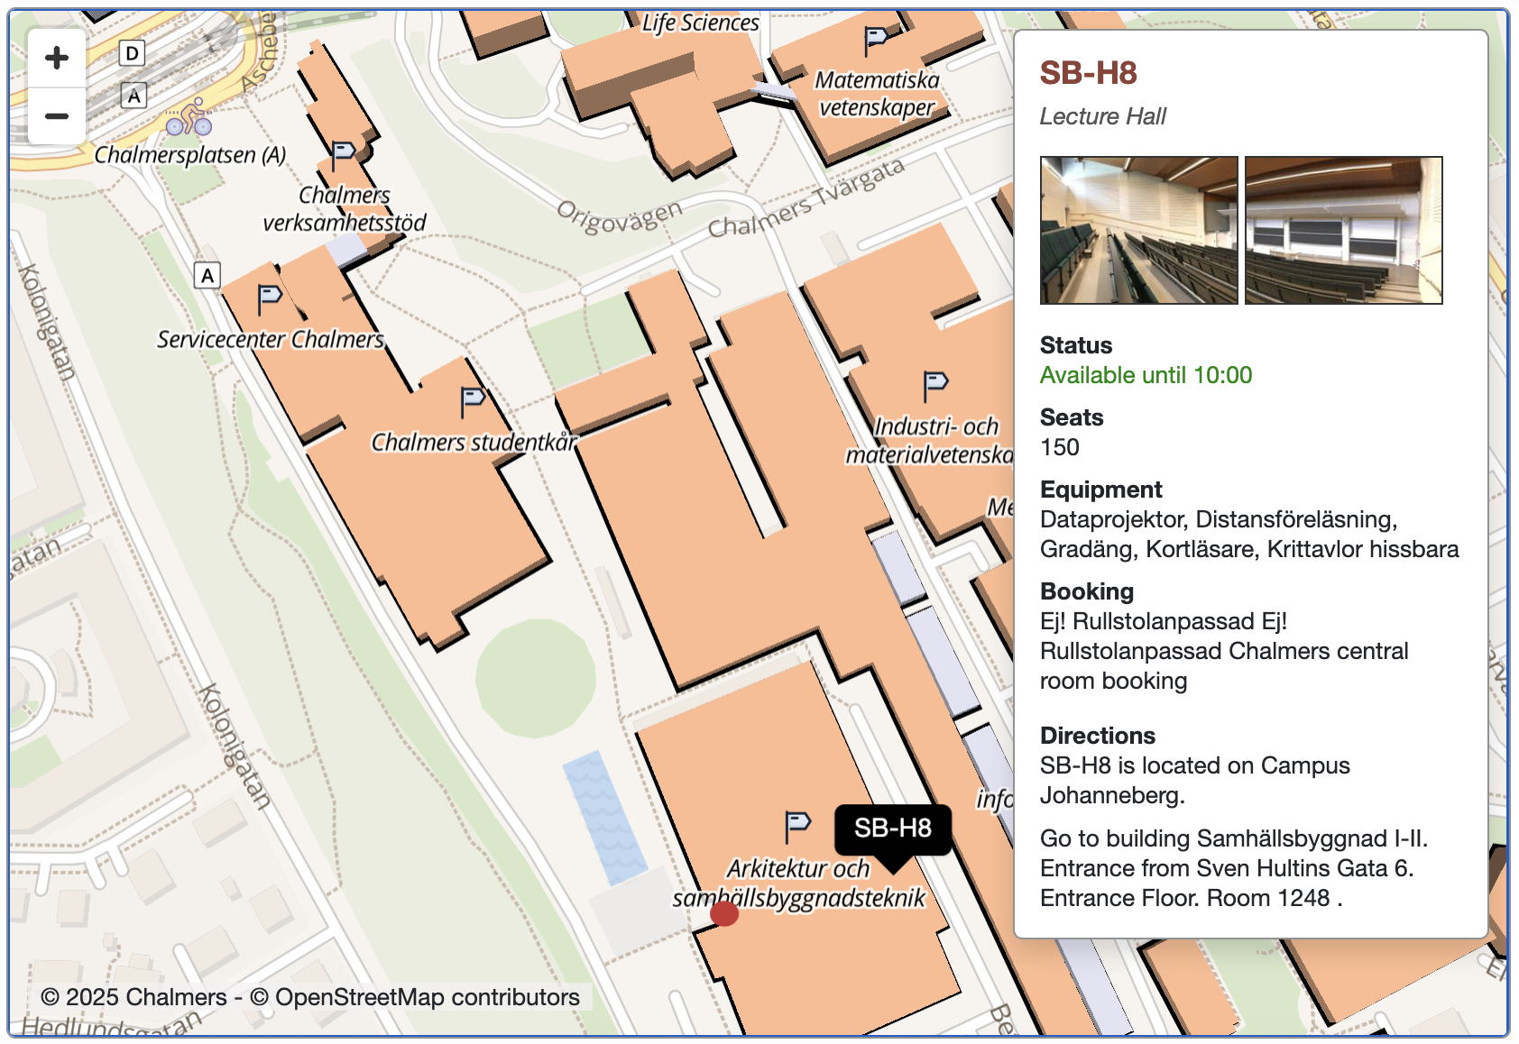
Chalmers – Bus/Tram stop

