Slide 1
Recurrent LSTM Network Design for Natural Language Processing
Student name: Debanjali Saha
Roll no.: 1810110059
Under supervision of:
Prof. Madan Gopal, Electrical Engineering

Slide 2
INTRODUCTION TO PROJECT
The task in this project is to perform Binary Sentiment Classification on a dataset of tweets using Recurrent Neural Network- LSTM which is usually used for Natural Language Processing.
This project specifically belongs to the domain of Sentiment Analysis in Social Data Analytics.
In Social Data Analytics, data-driven analysis of how people interact in social contexts is done, often with data obtained from social networking services. In this project, Twitter data has been used.
Sentiment Analysis is an approach to Natural Language Processing that identifies the emotional tone behind a body of text. It is currently an extremely popular way for organizations to determine and categorize opinions about a product, service, or idea and involves the use of data mining, machine learning and artificial intelligence to predict sentiments or subjective information in a text corpus.
APPLICATIONS: Identifying brand awareness, reputation and popularity at a specific moment or over time, Tracking consumer reception of new products or features, Conducting market research, Evaluating the success of a marketing campaign, Pinpointing the target audience or demographics, Collecting customer feedback from social media, websites or online forms, Categorizing customer service requests.

Slide 3
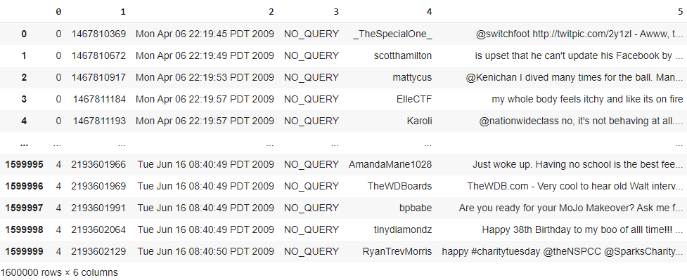
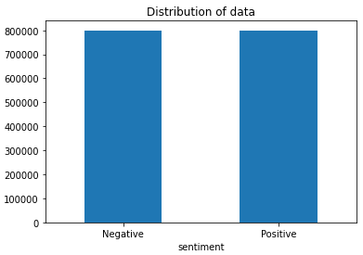
ABOUT THIS PROJECT
AIM: To test several deep-learning models and find the one which gives the best results on the chosen performance metric, which is accuracy and thereby minimise the loss.
DATASET: Twitter data is used for this project because it has a rich source of human-generated information on a large set of topics. Dataset used- “Sentiment140 dataset with 1.6 million tweets” (Student version by Stanford with emoticons removed). It contains 1,600,000 tweets extracted using the twitter api . The tweets have been annotated (0 = negative, 4 = positive). This dataset was chosen because it is: (1) Generic (2) Large (3) Perfectly balanced

Slide 4
Before Mid-term evaluation
STEP 1: DATA CLEANING AND PREPROCESSING
STEP 2: WORD EMBEDDING USING WORD2VEC
STEP 3: TRAINING AND EVALUATION OF A STACKED UNIDIRECTIONAL MODEL

Slide 5
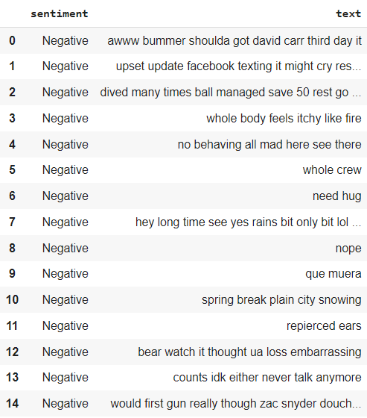
STEP 1: DATA CLEANING AND PREPROCESSING
Initial Steps:
Exploratory Data Analysis (Importing, Dealing with missing values, Removing redundant columns,Labelling classes)
Data Skewness Visualization
Steps in Data Cleaning and Preprocessing:
Removing URLs, hashtags, mentions and old style retweet ‘RT’
Split attached words
Lowercasing all words
Expand contracted words
Removing stop-words using nltk library
Removing all non-alphabetic characters
Train-Test split = 95% (1.52 million)-5%(80,000)
Tokenization
Zero padding (maximum length = 60)

Slide 6
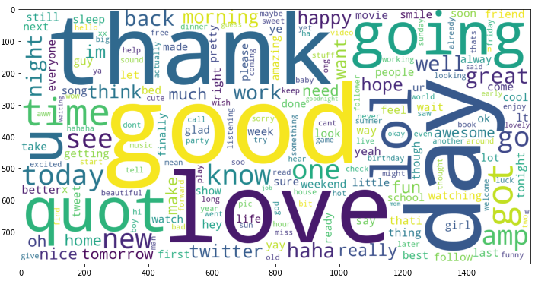
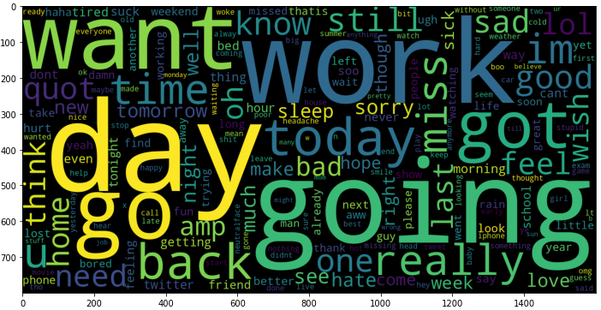
POSITIVE WORD CLOUD
NEGATIVE WORD CLOUD
After training word2vec model, we can choose prominent words from here to check similar words.
Why are these word clouds important?

Slide 7
STEP 2: WORD EMBEDDING USING WORD2VEC
Word embedding is one of the most popular representation of document vocabulary. It is capable of capturing context of a word in a document for similarity and relation with other words, etc. Word embeddings are vector representations of a particular word because computers can only take numbers as input.
Developed by Google and is one of the most popular technique to learn word embeddings using shallow neural network.
Library used for implementation : gensim
Chosen Embedding dimension or Vector Size for this task= 100. The number of dimensions (N) that the Word2Vec maps the words onto. Bigger size values require more training data, but can lead to better (more accurate) models. The argument is called vector_size or size in different versions of gensim while implementing in software. Generally, the exact number of embedding dimensions does not affect task performance. The number of dimensions can affect training time.
After training the word2vec model, the embedding matrix is created.

Slide 8
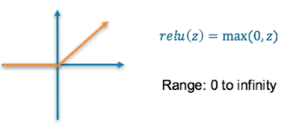
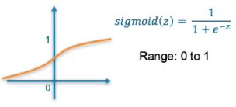
STEP 3: MODEL FOR MID-TERM
Model Architecture:
Embedding Layer with 0.2 dropout
Unidirectional LSTM Layer 1 with dropout 0.2
Unidirectional LSTM Layer 2 with dropout 0.2
Dense layer with 16 neurons and ReLu activation function (deals with Vanishing gradient problem)
Output dense layer (1 neuron) and Sigmoid activation function
Callbacks used:
Early Stopping (Validation accuracy, change by 1e-4, atleast 5 epochs)
Model Checkpoint (Save the best model - the epoch trained having minimum training loss and maximum training accuracy)
Loss='binary_crossentropy', Optimizer='adam', Metrics=['accuracy']
Batch size=1024, Number of epochs=35

Slide 9
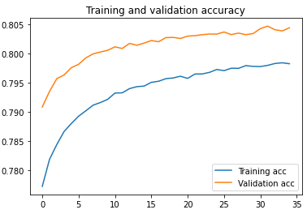
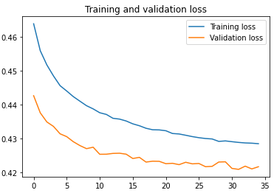
STEP 3: MODEL FOR MID-TERM (contd.)
Model Results:
After this, predictions are made on X_test and compared with y_test for testing accuracy:
Testing Accuracy= 80.375% (on 5% testing set)
DRAWBACKS:
Learning curves have not reached saturation even after about 10 hours of training.
Training and validation plots should ideally intersect at a point.
The number of epochs were decided as 35, solely by trial and capacity of kernel GPU on Kaggle because of which training was not automatically stopped by any of the callbacks.
Due to these, even though the model may give good testing results, it is inconclusive to infer anything from these plots.

Slide 10
After Mid-term evaluation
EXPERIMENTATION
LITERATURE REVIEW FOR SUGGESTED MODELS
TRAINING SEVERAL DIFFERENT MODELS
UNDERSTANDING WHY AND HOW THESE MODELS IMPROVE PERFORMANCE
RESULT ANALYSIS
EVALUATION OF PERFORMANCES AND THEIR COMPARISON
CONCLUDING WITH BEST MODEL

Slide 11
LITERATURE REVIEW FOR SUGGESTED MODELS
The paper “A Double Channel CNN-LSTM Model for Text Classification” by Liang et al. shows progressively how performance increases on this dataset from simple LSTM to a CNN-LSTM hybrid model which is a variant of RCNN proposed by Lai et al. in 2015.
In the paper called “Hybrid Deep Learning Models for Sentiment Analysis” by Dang et al., 4 hybrid models are proposed and experimented with on this Sentiment140 and other datasets. The 4 models differ in the position of the CNN and LSTM, the first two having the CNN layers before LSTM and the last two having the LSTM layers before the CNN layers. Since the latter gave better results, in the experimentation I chose to place the CNN layer after the LSTM layer.
The paper “Twitter data sentiment analysis” by Xing et al. demonstrate experimentally the improvement from a Normal LSTM (unidirectional) to a Bidirectional LSTM with change in training run-time per epoch.
Finally, the paper by Liu and Guo, “Bidirectional LSTM with attention mechanism and convolutional layer for text classification” proposes a model with Bidirectional LSTM + CNN + Attention layer after comparing several models in progression which I have also experimented with as my last model and found to have the best results for.

Slide 12
MODELS TRAINED AND RESULTS COMPARATIVE ANALYSIS
RESULTS TABLE
Model No. | Architecture | Testing Accuracy | Loss
Model 1 | Single unidirectional LSTM ( with sigmoid activation and 20% dropout) | 79.99% | 0.4278
Model 2 | Doubly stacked unidirectional LSTM | 80.36% | 0.4231
Model 3 | Unidirectional LSTM + CNN | 80.19% | 0.4260
Model 4 | Single Bidirectional LSTM | 80.35% | 0.4243
Model 5 | Doubly stacked bidirectional LSTM | 80.61% | 0.4209
Model 6 | Doubly stacked bidirectional LSTM + Attention | 80.70% | 0.4202
Model 7 | Bidirectional LSTM + CNN + Attention | 80.77% | 0.4105
It can be observed that stacking up of unidirectional LSTM layers gives improvement in performance from 79.99% to 80.36%. Similarly, stacking up of unidirectional LSTM layers also gives improvement in performance from 80.35% to 80.61%. A single bidirectional LSTM model gives nearly about the same performance as a doubly stacked unidirectional LSTM model. The addition of a CNN layer improves performance as claimed by Liang et al. in their paper. However, this improvement in performance is lesser than the one which is observed with staking. However, a single bidirectional LSTM layer gives results as good as a doubly stacked unidirectional LSTM layer.

Slide 13
WHY AND HOW IS PERFORMANCE GETTING IMPROVED?
In traditional RNNs, when the length of the input sequence is too long, the network may suffer from a vanishing gradient problem which will make it more difficult to learn information from a longer time context. The LSTM model solves this problem.
Combined CNN and LSTM give better performance by taking advantage of the two network architectures when performing sentiment analysis on data in different domains. CNNs are good at dealing with spatially related data while the RNNs are good at temporal signals. LSTM can remember forward information of the sequence, and CNN can catch and learn local information sufficiently. So, the combination makes use of the best of both networks.
When classifying sequential patterns, it might be the case that patterns lying ahead in the sequence influence the classification of the current pattern, bidirectional architectures can exploit this information. They can use both the ‘left’ and ‘right’ context at each position, if arranged horizontally. Unidirectional LSTM only preserves information of the past because the only inputs it has seen are from the past. Using bidirectional will run inputs in two ways, one from past to future and one from future to past and what differs this approach from unidirectional is that in the LSTM that runs backwards, we preserve information from the future and using the two hidden states combined.
The attention mechanism emerged as an improvement over the encoder decoder-based neural machine translation system in natural language processing (NLP). It is employed to give different focus to the information outputted from the hidden layers of BiLSTM. Attention mechanism can highlight the important information from the contextual information by setting different weights. In short, there are two RNNs/LSTMs. One we call the encoder – this reads the input sentence and tries to make sense of it, before summarizing it. It passes the summary (context vector) to the decoder which translates the input sentence by just seeing it.

Slide 14
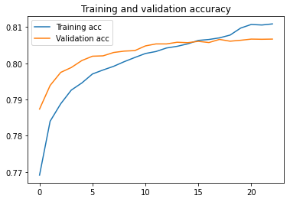
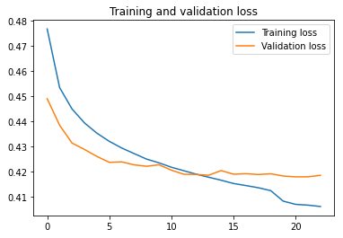
CONCLUSION
The best model is the Bidirectional LSTM+CNN+Attention mechanism model which gives highest performance with a testing accuracy of 80.77% (almost 81%) and the minimum loss of 0.4105 as compared to other models.
Combination of best features from all models leads us to best results.

Slide 15
REFERENCES
Liang et al.; A Double Channel CNN-LSTM Model for Text Classification; 2020 IEEE 22nd International Conference on High Performance Computing and Communications; IEEE 18th International Conference on Smart City; IEEE 6th International Conference on Data Science and Systems (HPCC/SmartCity/DSS)
Xing et al.; Twitter data sentiment analysis; Semantic Scholar 2020
Dang et al.; Hybrid Deep Learning Models for Sentiment Analysis; Hindawi Complexity Volume 2021, Article ID 9986920, 16 pages
Deng et al.; Sparse Self-Attention LSTM for Sentiment Lexicon Construction; IEEE/ACM TRANSACTIONS ON AUDIO, SPEECH, AND LANGUAGE PROCESSING, VOL. 27, NO. 11, NOVEMBER 2019
Liu and Guo; Bidirectional LSTM with attention mechanism and convolutional layer for text classification; Neurocomputing
Volume 337, 14 April 2019, Pages 325-338
Pal et al.; Sentiment Analysis in the Light of LSTM Recurrent Neural Networks; International Journal of Synthetic Emotions Volume 9, Issue 1, January-June 2018
Zhang et al.; Learning interaction dynamics with an interactive LSTM for conversational sentiment analysis; Elsevier, Neural Networks 133 (2021) 40-56
Dai et Prout; Unlock big data emotions: Weighted word embeddings for sentiment classification; 2016 IEEE International Conference on Big Data (Big Data)
Othman et al.; Improving Sentiment Analysis in Twitter Using Sentiment Specific Word Embeddings; The 10th IEEE International Conference on Intelligent Data Acquisition and Advanced Computing Systems: Technology and Applications 18-21 September, 2019, France, Metz
Edilson et al.; A Multi-view Ensemble for Twitter Sentiment Analysis; NILC-USP at SemEval-2017

