Slide 1
Advanced Visual Perception Few-Shot Detection
By Debsparsha Dasgupta Guide: Dr. D. Srikanth (DIAT) M. Swapna, Sc E (RCI)

Slide 2
problem statement
An application that detects multiple ground targets using 5 images per class. The algorithm will be integrated & tested in a simulation platform.
Traditional object detection models require large amounts of labelled training data per class. However, in many real-world applications, collecting extensive datasets is impractical due to:
Data scarcity (e.g., New or rare military equipment)
Labelling costs and time
Security or classification restrictions
This project addresses this challenge using Few-Shot Learning (FSL) — a method where the model learns to detect and recognise new classes from only a few labelled examples.
We aim to:
Efficiently detect unseen military targets with limited supervision
Achieve good generalisation using only 5 images per class
Maintain fast inference and high accuracy that works in real-world, low-data situations

Slide 3
Literature survey
Few-Shot Learning (FSL) aims to generalise to novel classes using only a few labelled examples.
Meta-learning approaches like Model-Agnostic Meta-Learning (MAML) [Finn et al., 2017] learn model parameters that can be quickly adapted to new classes via a small number of gradient steps, making them suitable for detection tasks where domain shifts occur.
Metric-based methods, such as Prototypical Networks [Snell et al., 2017], instead learn an embedding space where class prototypes are formed from support examples, and classification is performed by measuring distances to these prototypes.
Combining both enables rapid adaptation and robust similarity-based classification. This project adopts YOLO-NAS as a backbone, and leverages MAML with Prototypical Networks for rapid adaptation and robust classification in a 5-shot multi-target detection setting.
References
Finn, C. et al. “Model-Agnostic Meta-Learning for Fast Adaptation of Deep Networks.” ICML, 2017.
Snell, J. et al. “Prototypical Networks for Few-shot Learning.” NeurIPS, 2017.

Slide 4
General approach
Phase 1: Setup & Data Preparation
Use a pretrained YOLO-NAS backbone + FPN (detection head removed) for multi-scale feature extraction.
Prepare a dataset with 5 labelled images per class in YOLO format.
Configure YAML file with dataset paths and custom class names.
Phase 2: Prototype Computation & Fine-Tuning
For each class, compute class prototypes in the embedding space (via support images).
Apply MAML-based adaptation to fine-tune the last layers of the YOLO-NAS backbone for each few-shot task.
The fine-tuned model learns to generalize from only 5-shot samples per class.
Phase 3: Query Inference & Evaluation
Extract query image features and compare them with stored prototypes using Prototypical Networks (Euclidean or cosine distance).
Assign the query object to the nearest prototype and regress bounding boxes.
Evaluate performance with precision, recall, and mAP.
Visualise results with bounding boxes and class labels.

Slide 5
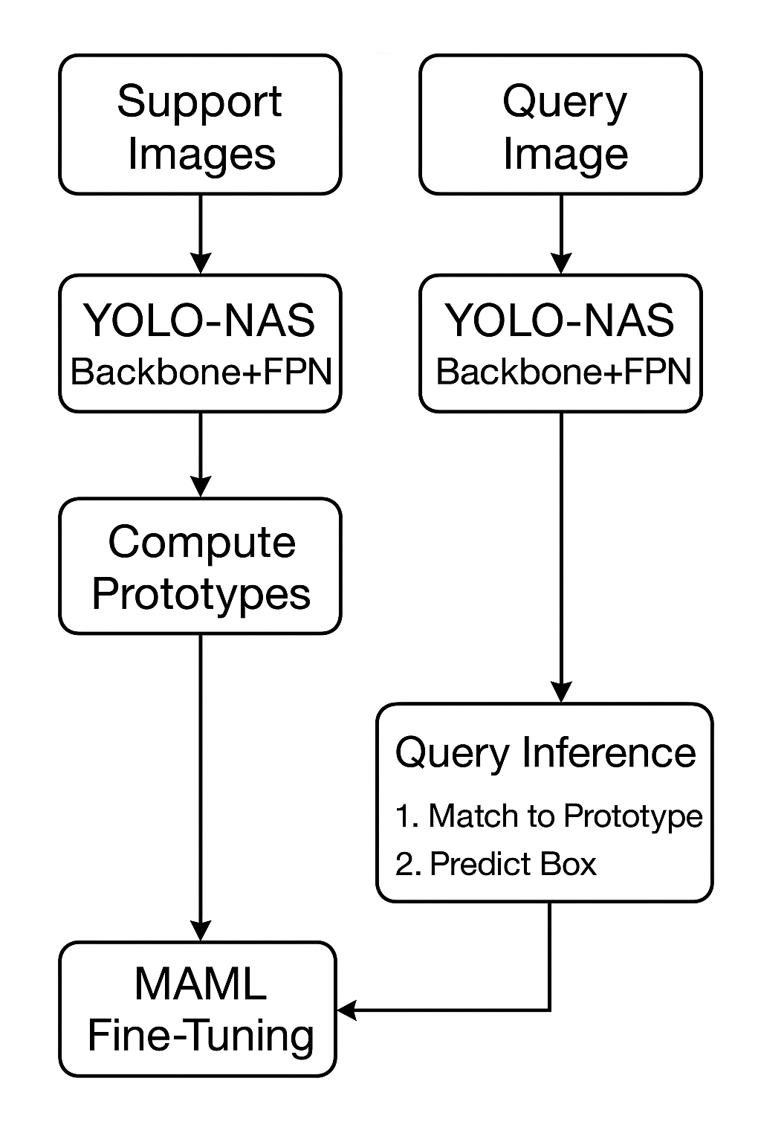
General approach
Phase 4: Optimisation & Deployment
Apply data augmentation to increase generalisation.
Explore active learning to semi-automate dataset expansion.
Optimise inference speed and robustness for real-world deployment.

Slide 6
progress
Literature Review: Studied MAML and Prototypical Networks
Data Preparation: DOTA Dataset converted to YOLO-NAS format with support/query split.
Model Training: Working on object detection model

Slide 7
THANK YOU

