Slide 1
Cassandra vs Hbase vs Mongo

Slide 2
 | Cassandra | Hbase | Mongo
Database Model | Wide column store | wide column store | Document store
DB Engine Ranking | 8th | 15th | 5th
Language | Java | Java | C++
Types | Yes | no | Yes

Slide 3
 | Cassandra | Hbase | Mongo
Secondary indexes | yes(restricted) | No | Yes
Partitioning | Sharding | Sharding | Sharding
Replication | Selectable | Selectable | Master-Slave
Consistency | Eventual —>Immediate | Immediate | Eventual —> Immediate

Slide 4
 | Cassandra | Hbase | Mongo
Foreign Key | no | No | No
Transaction | no | No | No
Concurrency | Yes | Yes | Yes
In-memory | no | no | Yes
Access control | Access rights for users can be defined per object | Access Control Lists (ACL) | Access rights for users and roles

Slide 5
NoSQL- BASE not ACID
Basically Available
Soft State
Eventually Consistence

Slide 6
Selecting NoSQL DB
Compromising Features of RDBMS
Consistency
Data Model

Slide 7
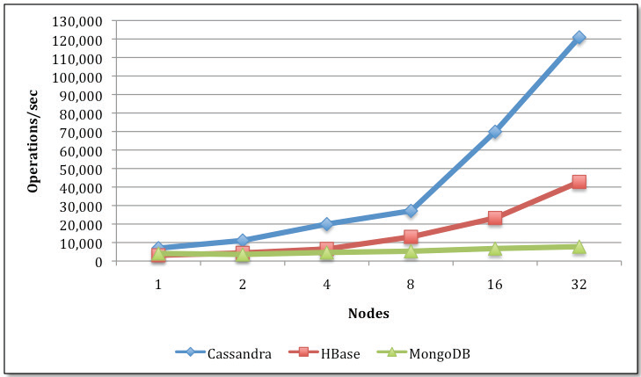
Load process

Slide 8
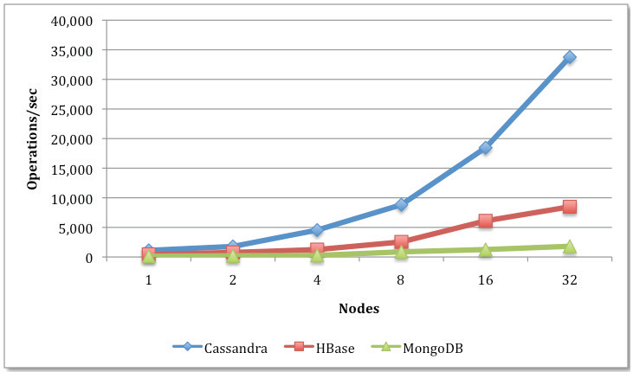
Mix read/write

Slide 9
Mix read/scan

Slide 10
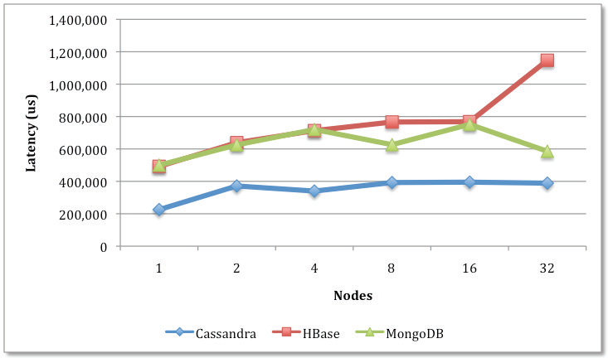
Read Latency

Slide 11
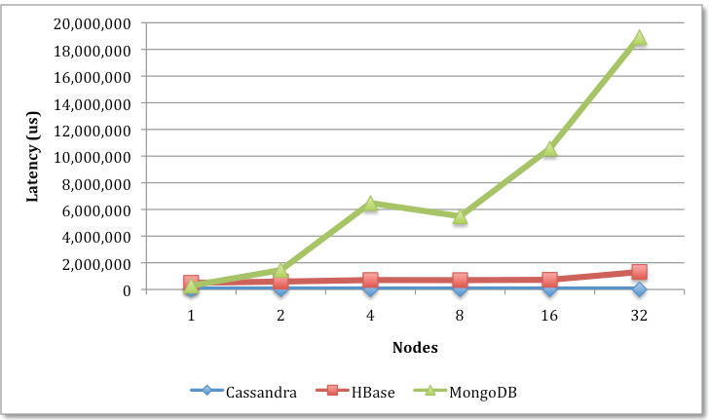
Write Latency

