Slide 1

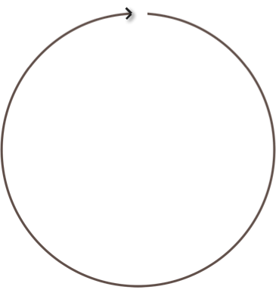

What is a cluster?
A peer to peer set of nodes
Node – one Cassandra instance
Rack – a logical set of nodes
Data Center – a logical set of racks
Cluster – the full set of nodes which map to a single complete token ring
Cassandra Cluster
Data Center - West
Data Center - East
+ 263
- 263
Node 1
NNooddee51
Rack 1
Rack 1
Token Range
(Murmur3)
Node 4
Node2
NNooddee84
NNooddee62
Rack 2
Rack 2
Node 3
NNoodede7 3

Slide 2
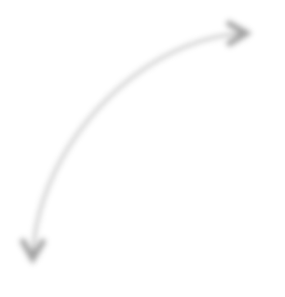
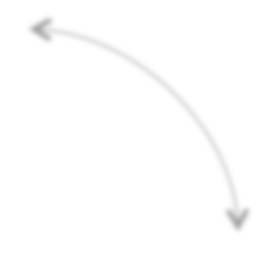
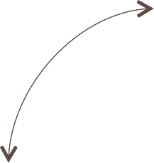



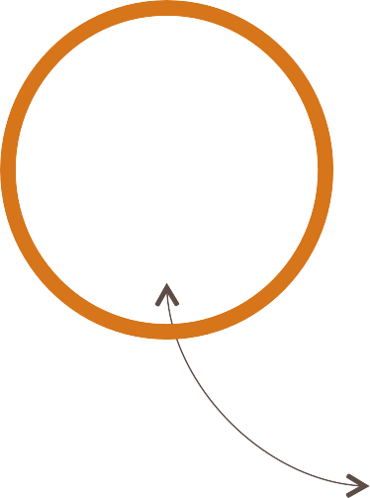
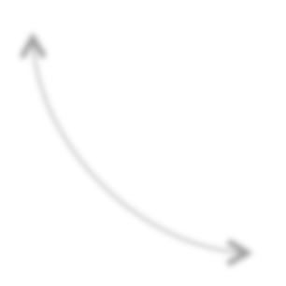

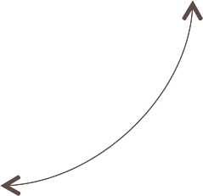
What is a cluster?
Nodes join a cluster based on the configuration of their own conf/cassandra.yaml file
Key settings include
Seed
Node 1
127.0.0.1
cluster_name – shared name to logically distinguish a set of nodes
seeds – IP addresses of initial nodes for a new node to contact and discover the cluster topology (best practice to use the same two per data center)
listen_address – IP address through which this particular node communicates
43 NNooddee Cluster "MusicMoz"
Node 4
Node 2
127.0.0.2
127.0.0.4
Node 3
127.0.0.3

Slide 3
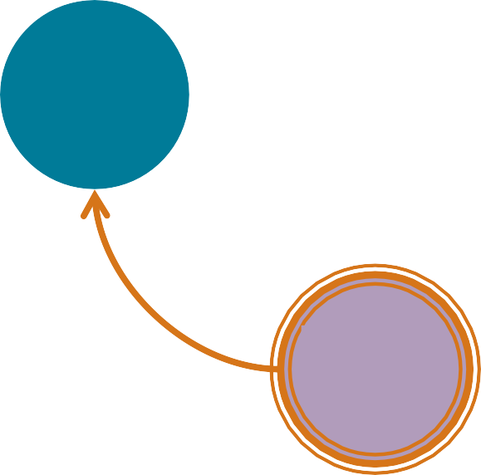

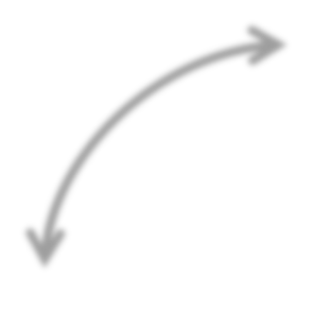


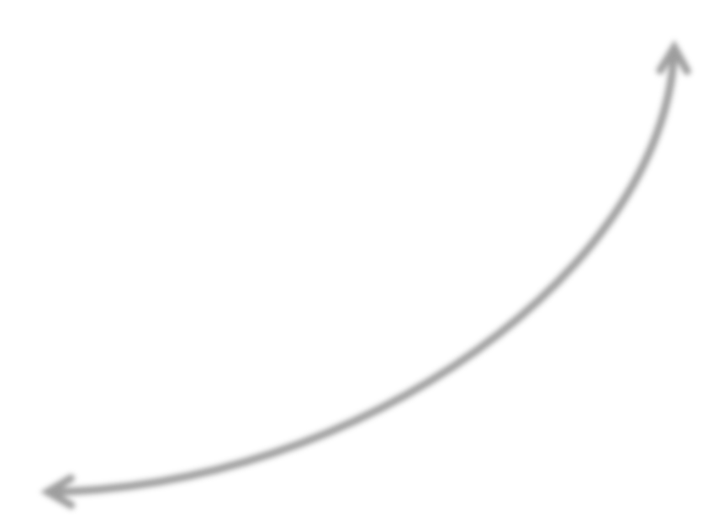
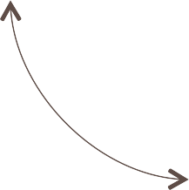
What is a coordinator?
The node chosen by the client to receive a particular read or write request to its cluster
Node 1
Any node can coordinate any request
Each client request may be coordinated by a different node
No single point of failure
Node 4
RF=3
Node 2
CL=QUORUM
This principle is fundamental to Cassandra's architecture
Node 3
Client

Slide 4

How are client requests coordinated?
The Cassandra driver chooses the node to which each read or write request is sent
Node 1
Client library providing APIs to manage client read/write requests
Default policy is TokenAware DCAWARE
DataStax maintains open source drivers for Java, C#, Python, Node.js, Ruby, C/C++ (beta)
Cassandra Community maintains drivers for PHP, Perl, Go, Clojure, Haskell, R, Scala
Node 4
Node 2
Client development is taught in the Apache Cassandra: Building Scalable Applications course
Node 3
Client
Driver

Slide 5




How are client requests coordinated?
The coordinator manages the Replication Factor (RF)
Node 1
Replication factor (RF) – onto how many nodes should a write be copied?
Possible values range from 1 to the total of planned nodes for the cluster
RF is set for an entire keyspace, or for each data center, if multiple
Node 4
RF=3
Node 2
Every write to every node is individually time-stamped
Node 3
Replication factor is discussed further ahead
Client
Driver

Slide 6



How are clients requests coordinated?
The coordinator also applies the Consistency Level (CL)
Consistency level (CL) – how many nodes must acknowledge a read or write request
CL may vary for each request
On success, coordinator notifies client
Node 1
Possible consistency levels include
Node 4
RF=3
Node 2
ANY
ONE
QUORUM ( RF / 2 ) + 1
ALL
CL=QUORUM
Node 3
Consistency Level is discussed further ahead
Client
Driver

Slide 7



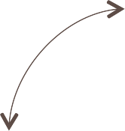
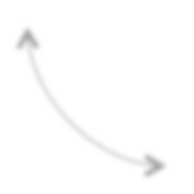

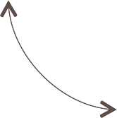
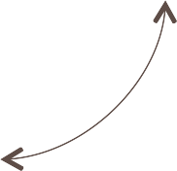
What is consistent hashing?
Data is stored on nodes in partitions, each identified by a unique token
+ 263
- 263
Partition – a storage location on a node (analogous to a "table row")
Token – integer value generated by a hashing algorithm, identifying a partition's location within a cluster
Node 1
Node 4
Node 2
The 2⁶⁴ value token range for a cluster is used as a single ring
Node 3
So, any partition in a cluster is
locatable from one consistent set of hash values, regardless of its node
Specific token range varies by choice of partitioner
Partitioner options discussed ahead
Slide 9

Slide 8




What is the partitioner?
A system on each node which hashes tokens from designated values in rows being added
+ 263
- 263
Hash function – converts a variable
length value to a corresponding fixed length value
"@DataStax" 97203
NNooddee11
P
Node 4
Node 2
Hash Function
P
P
-2245462676723223822
Node 3
P
7723358927203680754
Slide 10

Slide 9
What is the partitioner?
Imagine a 0 to 100 token range (instead of -2⁶³ to +2⁶³)
100
0
Each node is assigned a token, just like each of its partitions
Node tokens are the highest value in the segment owned by that node
0
Node 1
76-0
1-25
P
75
25
This segment is the primary token range of replicas owned by this node
Node 4
Node 2
P
P
50
51-75
Node 3
26-50
Nodes also store replicas keyed to tokens outside this range ("secondary range")
P

Slide 10




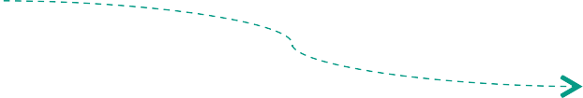


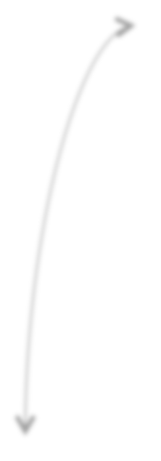
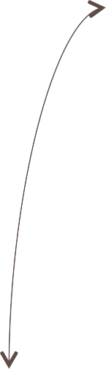
How does a partitioner work?
A node's partitioner hashes a token from the partition key value of a write request
100
0
First replica written to node that owns the primary range for this token
NNooddee11
Partitioner
Token 91
'Orange:Oscar'
The primary key of a table determines its partition key values
CREATE TABLE Users (
firstname text, lastname text, level text,
PRIMARY KEY ((lastname, firstname))
);
N_{N}o_{o}d_{d}e_{e}4₄
Node 2
Node 3
INSERT INTO Users (firstname, lastname, level)
VALUES ('Oscar', 'Orange', 42);
Driver
Client

Slide 11
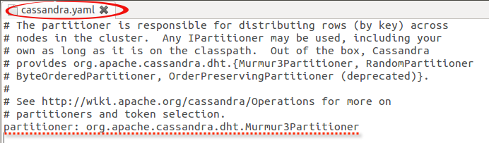
What partitioners does Cassandra offer?
Cassandra offers three partitioners
Murmur3Partitioner (default) – uniform distribution based on Murmur3 hash
RandomPartitioner – uniform distribution based on MD5 hash
ByteOrderedPartitioner (legacy only) – lexical distribution based on key bytes
Murmur3Partitioner is the default and best practice
The partitioner is configured in the cassandra.yaml file
Must be the same across all nodes in the cluster

Slide 12
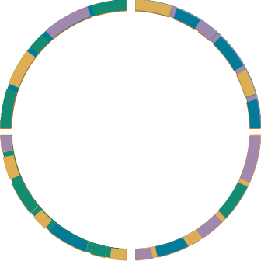
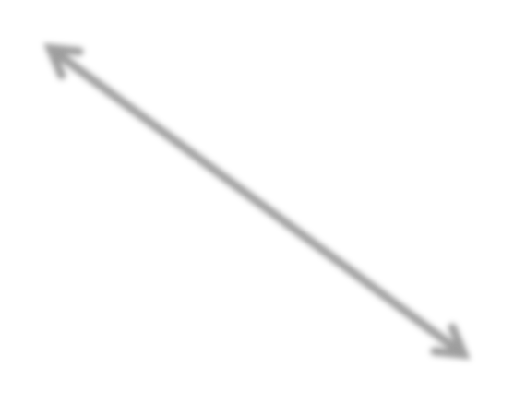





What are virtual nodes?
Multiple smaller primary range segments
– virtual nodes – can be owned by each machine, instead of one larger range
virtual nodes behave like a regular node
available in Cassandra 1.2+
default is 256 per machine
not available on nodes combining Cassandra with Solr or Hadoop
Node 1
Node 4
Node 2
How are virtual nodes helpful?
token ranges are distributed, so machines bootstrap faster
impact of virtual node failure is spread across entire cluster
token range assignment automated
Node 3

Slide 13
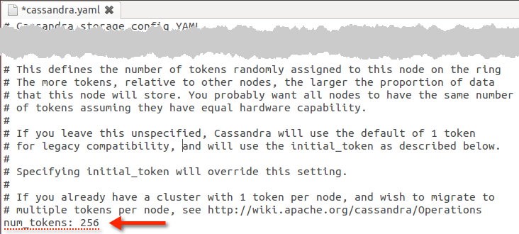
What are virtual nodes?
Virtual nodes are enabled in cassandra.yaml
partitions, regular nodes, and virtual nodes are each identified by a token
regular or virtual node tokens are the highest value in one segment of the total token range for a cluster, which is the primary range of that node

Slide 14
Learning Objectives
Understand how requests are coordinated
Understand replication
Understand and tune consistency
Introduce anti-entropy operations
Understand how nodes communicate
Understand the System keyspace

Slide 15
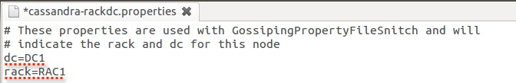
How are nodes organized as racks and data centers?
A cluster of nodes can be logically grouped as racks and data centers
Node – the virtual or physical host of a single Cassandra instance
Rack – a logical grouping of physically related nodes
Data Center – a logical grouping of a set of racks
Enables geographically aware read and write request routing
Cluster topology is communicated by the Snitch and Gossip (discussed ahead)
Each node belongs to one rack in one data center
A default Cassandra node belongs to rack1 in datacenter1
The identity of each node's rack and data center may be configured in a property file

Slide 16
How does the keyspace impact replication?
Replication factor is configured when a keyspace is created
SimpleStrategy (learning use only) – one factor for entire cluster
assigned as "replication_factor"
CREATE KEYSPACE simple-demo
WITH REPLICATION =
{'class':'SimpleStrategy', 'replication_factor':2}
NetworkTopologyStrategy – separate factor for each data center in cluster
assigned by data center id (as also used in cassandra-rackdc.properties)
CREATE KEYSPACE simple-demo
WITH REPLICATION =
{'class':'NetworkTopologyStrategy', 'dc-east':2, 'dc-west':3}

Slide 17
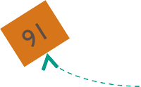



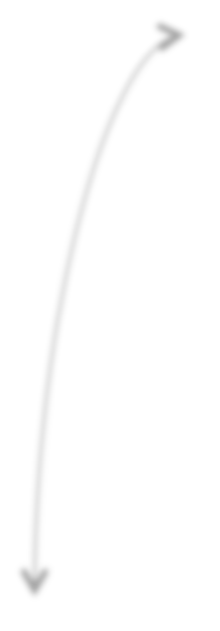

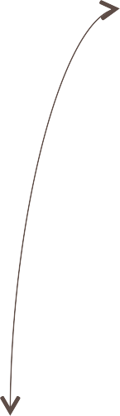
How does a coordinator forward write requests?
The target table's keyspace
determines
Replication factor – how many replicas to make of each partition
Replication strategy – on which node should each replica be placed
76-0
NNooddee11
1-25
All partitions are "replicas", there are no "originals"
91
N_{N}o_{o}d_{d}e_{e}4₄
RF=3
SimpleStrategy
NNooddee 22
First replica – placed on the node owning its token's primary range
Closest node – replicas placed in same rack and data center, if possible
(Subsequent) replicas (if RF > 1) – placed in "secondary range" of other nodes, per the replication strategy
91
51-75
N_{N}o_{o}d_{d}e_{e}3₃
26-50
Client
Driver

Slide 18
How is data replicated among nodes?
SimpleStrategy – create replicas on nodes subsequent to the primary range node
CREATE KEYSPACE demo WITH REPLICATION =
{'class':'SimpleStrategy', 'replication_factor':3}
Single Data Center
Primary Range for Token 91
76-0
NNooddee11
1-25
91
N_{N}o_{o}d_{d}e_{e}4₄
NNooddee 22
replication factor of 3 is a recommended minimum
91
51-75
N_{N}o_{o}d_{d}e_{e}3₃
26-50
Client
Driver

Slide 19
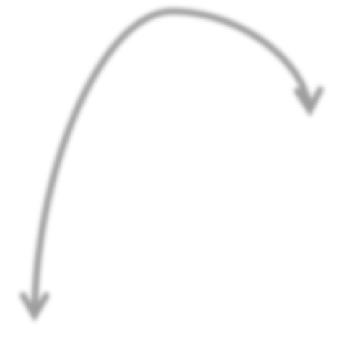
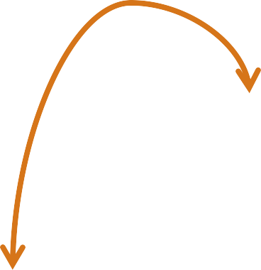
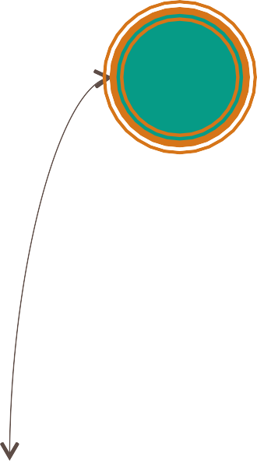










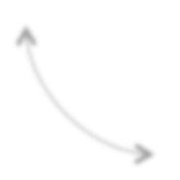


How is data replicated between data centers?
NetworkTopologyStrategy – distribute replicas across racks and data centers
CREATE KEYSPACE demo WITH REPLICATION =
{'class':'NetworkTopologyStrategy', 'dc-east':2, 'dc-west’:3}
Data Center - East
Primary Range for Token 91
89-100
1-13
NNooddee11
76-88
14-25
Data Center - West
Rack 1
91
Node 1
N_{N}o_{o}d_{d}e_{e}4₄
NNooddee 22
Rack 1
Rack 2
91
64-75
91
26-38
Node 4
N_{N}o_{o}d_{de}e ₂2
Remote Coordinator
N_{N}o_{o}d_{d}e_{e}3₃
Rack 2
51-63
39-50
91
Node 3
Client
Driver

Slide 20
What is a hinted handoff?
A recovery mechanism for writes targeting offline nodes
Coordinator can store a hinted handoff if target node for a write
is known to be down, or
fails to acknowledge
76-0
NNooddee11
1-25
91
N_{N}o_{o}d_{d}e_{e}4₄
NNooddee 22
91
Coordinator stores the hint in its system.hints table
The write is replayed when the target node comes online
N_{NX}o_{o}d_{d}e_{e}3₃
51-75
26-50
Client
Driver

Slide 21
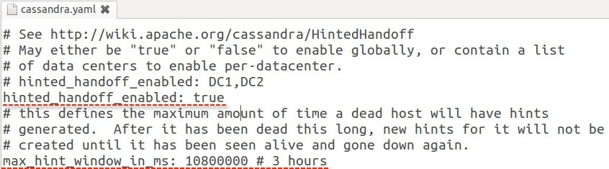
What is a hinted handoff?
The hinted handoff is comprised of
the target node location which is down
the partition which requires a replay
the data to be written
Configurations in the cassandra.yaml file include
hinted_handoff_enabled (default: true) – HH enabled per DC or disabled
max_hint_window_in_ms (default: 3 hours) – after this consecutive outage period hints are no longer generated until target node comes back online
nodes offline longer are made consistent using repair or other operations

