Slide 1
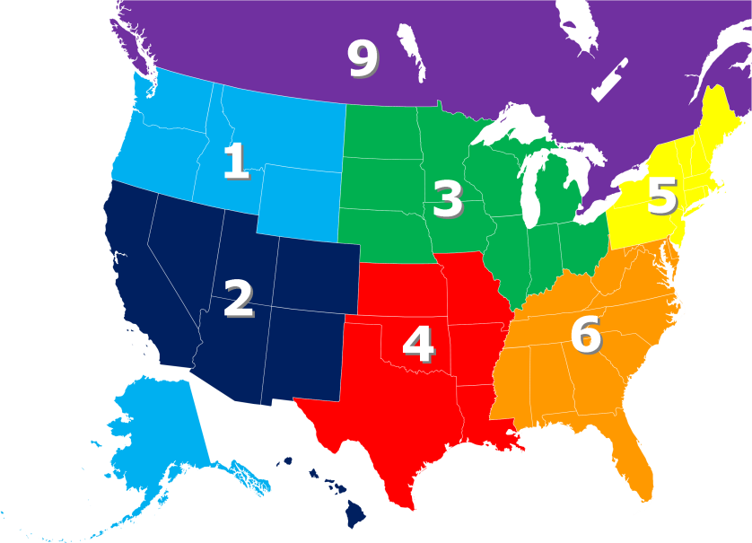
Exercise: Sensors Data
Multiple sensor networks are deployed over non-overlapping regions
Every sensor network is identified by a unique name
A sensor belongs to exactly one network
A sensor has its own characteristics
A sensor records measurements(temperature,humidity,pressure etc.) every second.

Slide 2
Conceptual Data Model

Slide 3
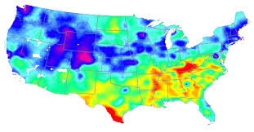


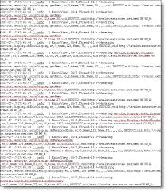
Application WorkFlow
Q2
Q1
Q3
Q4
Q1:- Find info about all networks, order by name(ASC).
Q2: Find average hourly temperature within a date range for a network’s sensors, order by date(DESC) and hour(DESC)
Q3: Find info about all sensors in a network
Q4: Find raw measurements by a sensor on a given date, order by timestamp(DESC).

Slide 4
Logical Data Model

Slide 5
Physical Data Model

