Slide 1











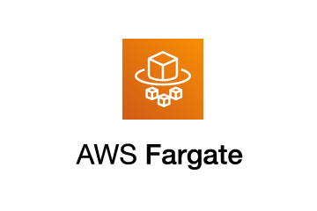




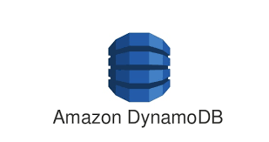




Customer Datacenter
Customer VPC – Data Plane
Public Subnet
Private Subnet
Job/Server Edge Site
NAT Gateway
Bastion Host
Register Data Source
Profiling
Lineage
Extraction
Data
Quality
Data
Matching
Catalog
Metadata
Custom
Integration

Slide 2





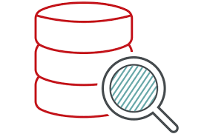

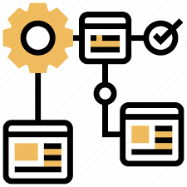




Data
Intelligence
Cloud
Data Governance
Data Catalog
Data Privacy
Metadata
Extraction
Metadata
Extraction
Data
Classification
Lineage
Extraction
Custom Data
landscape
RDBMS
BI
Data lakes
Native Cloud Sources
Vaults

