Slide 1
Most significant Object Detection using Unsupervised Learning (real time data)
Capturing image from video
Detecting corner points
Creating image patch around corners
Clustered similar/ nearest features to k classes
Feature space obtained for all features
Feature extraction of all corners using HOG
Determined the most significant class(object)
Localized the object

Slide 2
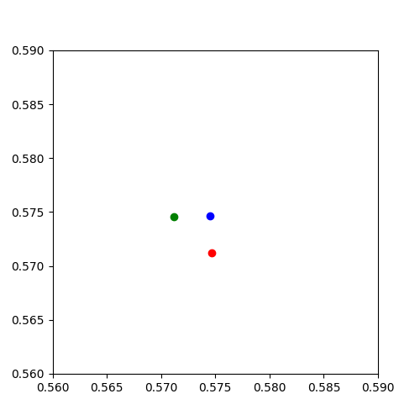
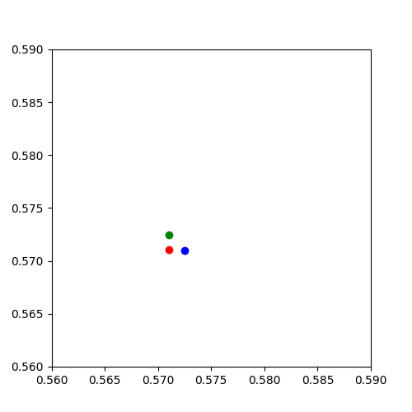
K means Clustering
Classified an image into 3 objects
Before K means
After K means
Classified sample image (28 corners) into 3 object

Slide 3
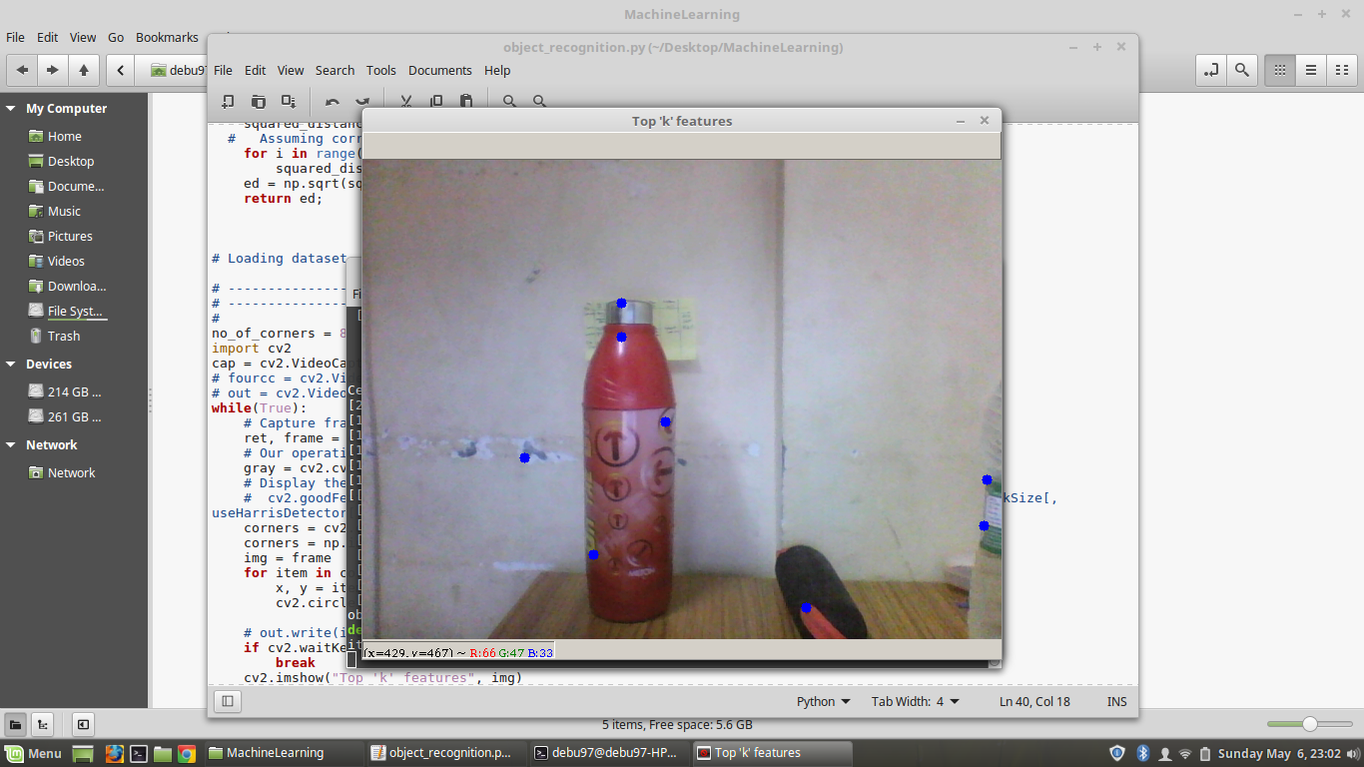
Test Results
Captured this image using front cam .

Slide 4
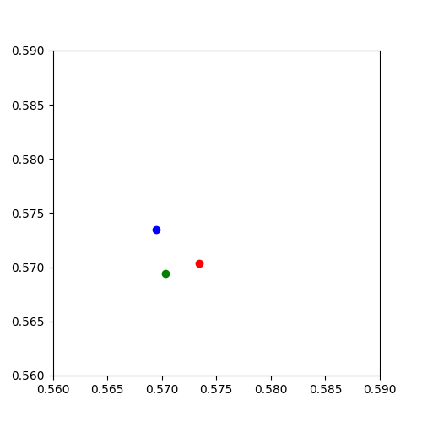
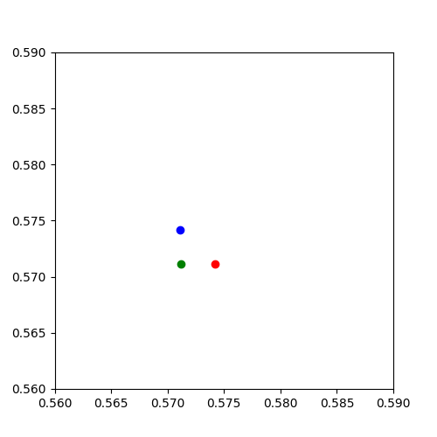
Bottle results
Before K means
After K means
Before K means

Slide 5
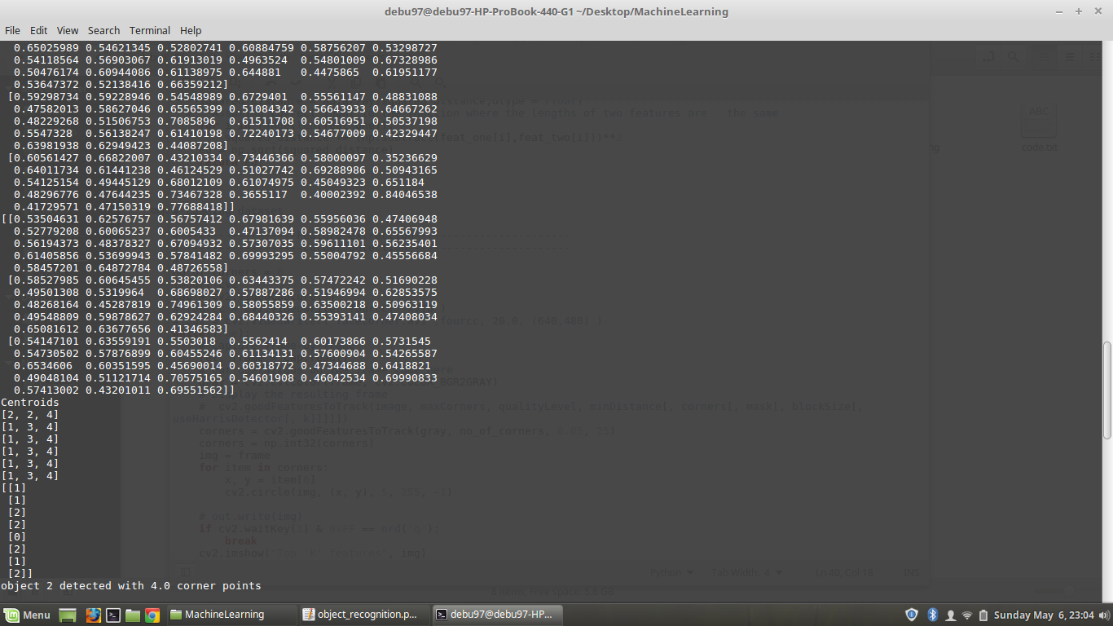

Slide 6
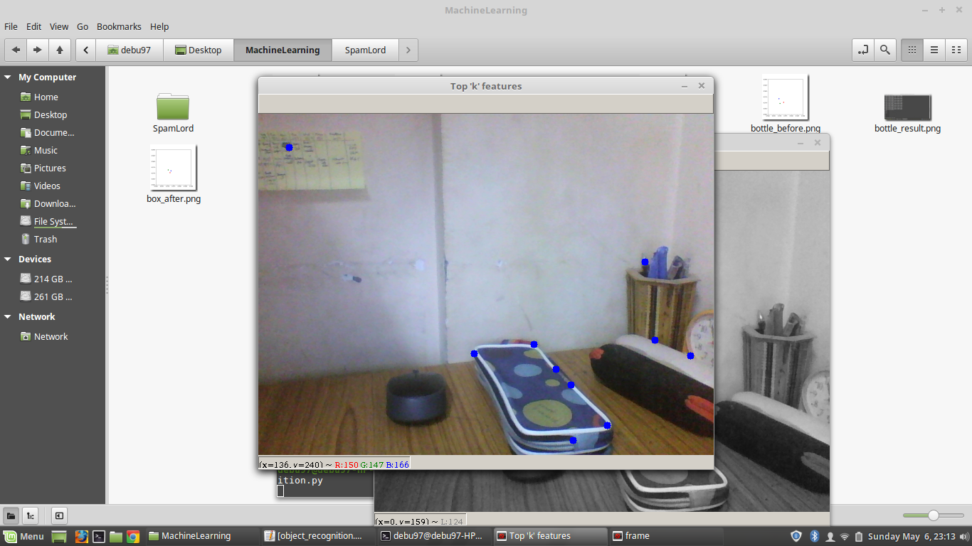
Test results for Box

Slide 7
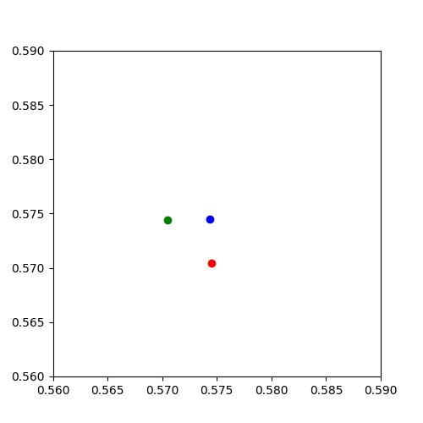
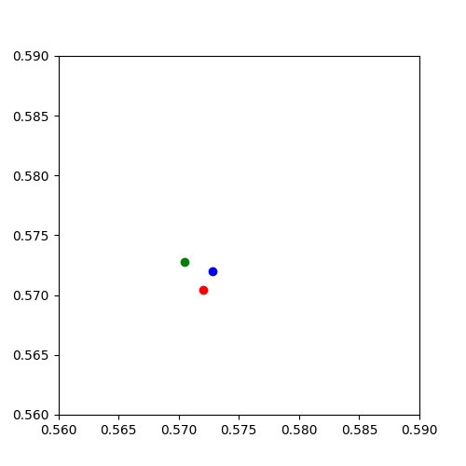
Box results
Before K means
After K means

Slide 8
