Slide 1
Transform and Conquer

Slide 2
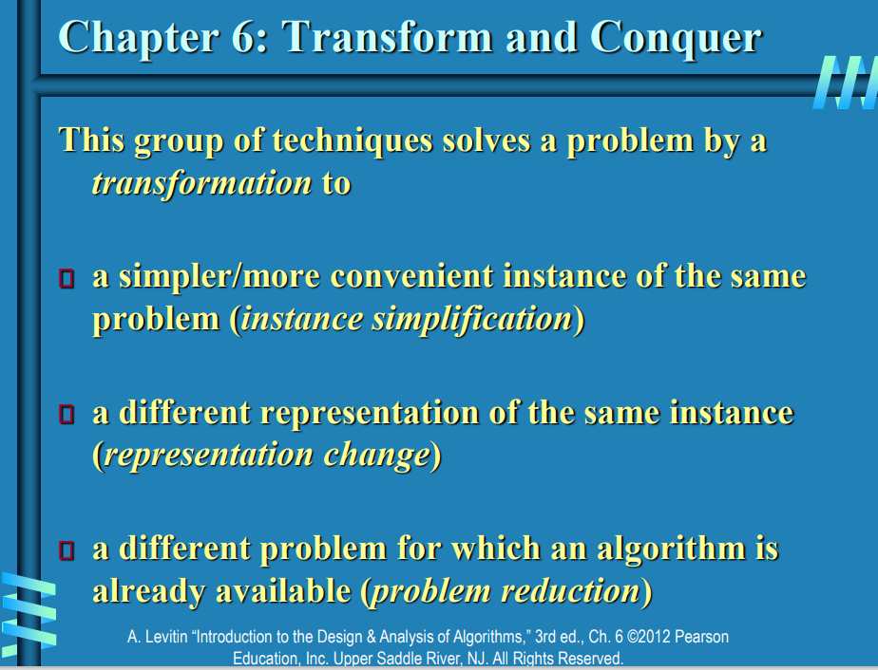

Slide 3
Objectives
To learn and appreciate the following concepts:
Presorting
Balanced Search Trees
Heaps and Heapsort
Problem Reduction

Slide 4
Session outcome
At the end of session the student will be able to understand:
What is presorting
Understanding balanced search trees
Importance of heaps and heapsort
Problem reduction

Slide 5
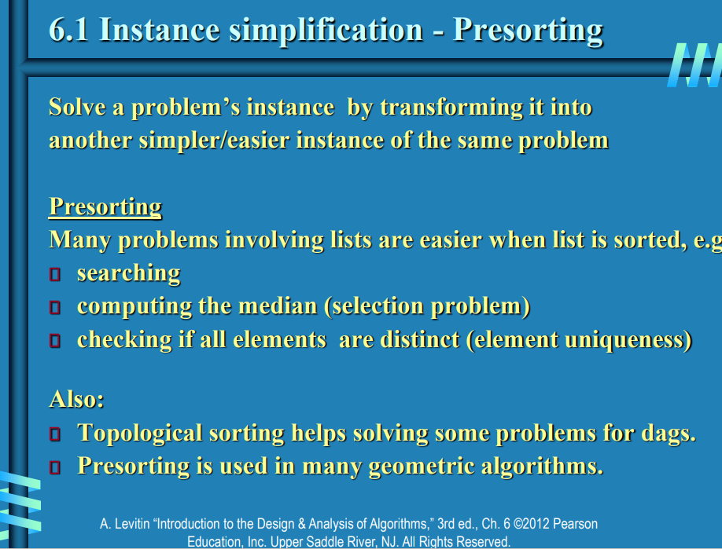

Slide 6
Presorting
EXAMPLE 1: Checking element uniqueness in an array
The brute-force algorithm compared pairs of the array’s elements until either two equal elements were found or no more pairs were left.
Its worst-case efficiency was in (n^2).
we can sort the array first and then check only its consecutive elements: if the array has equal elements, a pair of them must be next to each other, and vice versa.

Slide 7
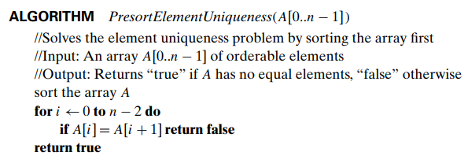
Presorting
The algorithm for presort Element Uniqueness is:
The running time of this algorithm is the sum of the time spent on sorting and the time spent on checking consecutive elements. Since the former requires at least n log n comparisons and the latter needs no more than n − 1 comparisons, it is the sorting part that will determine the overall efficiency of the algorithm. So, if we use a quadratic sorting algorithm here, the entire algorithm will not be more efficient than the brute-force one. But if we use a good sorting algorithm, such as mergesort, with worst-case efficiency in (n log n), the worst-case efficiency of the entire presorting-based algorithm will be also in (n log n):
T (n) = Tsort(n) + Tscan(n) ∈ (n log n) + (n) = (n log n).

Slide 8
Presorting
EXAMPLE 2: Computing a mode A mode is a value that occurs most often in a given list of numbers.
For example, for 5, 1, 5, 7, 6, 5, 7, the mode is 5. (If several different values occur most often, any of them can be considered a mode.)
The brute-force approach to computing a mode would scan the list and compute the frequencies of all its distinct values, then find the value with the largest frequency.

Slide 9

Presorting
we can store the values already encountered, along with their frequencies, in a separate list. On each iteration, the ith element of the original list is compared with the values already encountered by traversing this auxiliary list. If a matching value is found, its frequency is incremented; otherwise, the current element is added to the list of distinct values seen so far with a frequency of 1. It is not difficult to see that the worst-case input for this algorithm is a list with no equal elements. For such a list, its ith element is compared with i − 1 elements of the auxiliary list of distinct values seen so far before being added to the list with a frequency of 1. As a result, the worst-case number of comparisons made by this algorithm in creating the frequency list is:
The additional n − 1 comparisons needed to find the largest frequency in the auxiliary list do not change the quadratic worst-case efficiency class of the algorithm.

Slide 10
Presorting
EXAMPLE 3: Searching problem Consider the problem of searching for a given value v in a given array of n sortable items.
The brute-force solution here is sequential search, which needs n comparisons in the worst case.
If the array is sorted first, we can then apply binary search, which requires only log n + 1 comparisons in the worst case. Assuming the most efficient n log n sort, the total running time of such a searching algorithm in the worst case will be:
which is inferior to sequential search. The same will also be true for the average case efficiency. Of course, if we are to search in the same list more than once, the time spent on sorting might well be justified.

Slide 11
Presorting - TRY
1. Consider the problem of finding the distance between the two closest numbers in an array of n numbers. (The distance between two numbers x and y is computed as |x − y|.)
a. Design a presorting-based algorithm for solving this problem and determine its efficiency class.
b. Compare the efficiency of this algorithm with that of the brute-force algorithm.

Slide 12
Representation Change
A different representation of the same instance

Slide 13
Introduction to Binary Search Trees
Definition: A Binary Search Tree (BST) is a node-based data structure where each node has up to two children, and the left child is less than the parent node, while the right child is greater.
Importance: Efficient for search, insertion, and deletion operations.

Slide 14
Structure of a BST
Node Structure: Each node contains a value, a reference to the left child, and a reference to the right child.
Example:
8
/ \
3 10
/ \ \
1 6 14
/ \ /
4 7 13

Slide 15
Properties of BST
Ordering Property: Left subtree values < node value < right subtree values.
No Duplicates: Typically, BSTs do not contain duplicate values.

Slide 16
Searching in a BST
Algorithm:
1. Start at the root.
2. Compare the target value with the current node's value.
3. Move left if the target is smaller, or right if it's larger.
4. Repeat until the value is found or the subtree is empty.
Example: Searching for 7 in the example BST.

Slide 17
Insertion in a BST
Algorithm:
1. Start at the root.
2. Compare the value to be inserted with the current node's value.
3. Move left if the value is smaller, or right if it's larger.
4. Insert the new node at the position where the search would end.
Example: Inserting 5 into the example BST.
8
/ \
3 10
/ \ \
1 6 14
/ \ /
4 7 13
\
5

Slide 18
Deletion in a BST
Algorithm:
Case 1: Node with No Children (Leaf Node)
Example: Deleting node 1 from the BST.
8
/ \
3 10
/ \ \
1 6 14
/ \ /
4 7 13
Explanation: Node 1 is a leaf node. Simply remove it.

Slide 19
Deletion in a BST
Case 2: Node with One Child
Example: Deleting node 14 from the BST.
8
/ \
3 10
/ \ \
1 6 13
/ \
4 7
Explanation: Node 14 has one child (13). Remove node 14 and link 13 directly to 10.
8
/ \
3 10
/ \ \
1 6 14
/ \ /
4 7 13

Slide 20
Deletion in a BST
Case 3: Node with Two Children
Example: Deleting node 3 from the BST.
8
/ \
4 10
/ \ \
1 6 14
/ \ /
3 7 13
Explanation: Node 3 has two children (1 and 6). Find the in-order successor (4), swap values, and delete the successor.
8
/ \
3 10
/ \ \
1 6 14
/ \ /
4 7 13

Slide 21
Applications of BST
Usage: Databases, search engines, and memory management.
Advantages: Efficient search, insertion, and deletion operations.

Slide 22
Balanced Search Trees
AVL tree
A red-black tree
If an insertion or deletion of a new node creates a tree with a violated balance requirement, the tree is restructured by one of a family of special transformations called rotations that restore the balance required.
B-trees.
2-3 trees, 2-3-4 tree

Slide 23
Balanced binary tree
The disadvantage of a binary search tree is that its height can be as large as N-1
This means that the time needed to perform insertion and deletion and many other operations can be O(N) in the worst case
We want a tree with small height
A binary tree with N node has height at least Θ(log N)
Thus, our goal is to keep the height of a binary search tree O(log N)
Such trees are called balanced binary search trees. Examples are AVL tree, red-black tree.

Slide 24
AVL-Trees (Adelson-Velskii and Landis-Trees)

Slide 25
AVL tree
AVL trees were invented in 1962 by two Russian scientists, G. M. Adelson-Velsky and E. M. Landis [Ade62], after whom this data structure is named.
Height of a node
The height of a leaf is 0. The height of an empty tree is -1.
The height of an internal node is the maximum height of its children plus 1

Slide 26
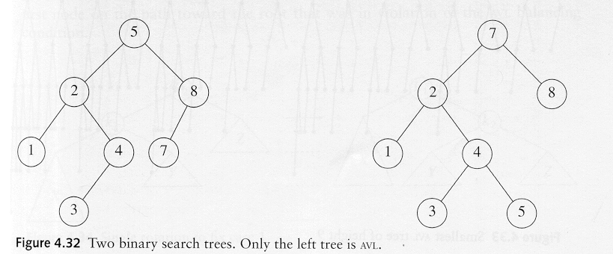
AVL tree
An AVL tree is a binary search tree in which
for every node in the tree, the height of the left and right subtrees differ by at most 1.
AVL property violated here

Slide 27
AVL tree
Let x be the root of an AVL tree of height h
Let S(h) denote the minimum number of nodes in an AVL tree of height h.
S(h)=S(h-1)+S(h-2)+1
Many operations (searching, insertion, deletion) on an AVL tree will take O(log N) time.

Slide 28
Rotations
When the tree structure changes (e.g., insertion or deletion), we need to transform the tree to restore the AVL tree property.
This is done using single rotations or double rotations.
e.g. Single Rotation
y
x
x
y
C
A
C
B
B
A
Before Rotation
After Rotation

Slide 29
Rotations
Since an insertion/deletion involves adding/deleting a single node, this can only increase/decrease the height of some subtree by 1
Thus, if the AVL tree property is violated at a node x, it means that the heights of left(x) and right(x) differ by exactly 2.
Rotations will be applied to x to restore the AVL tree property.

Slide 30
Insertion
First, insert the new key as a new leaf just as in ordinary binary search tree
Then trace the path from the new leaf towards the root. For each node x encountered, check if heights of left(x) and right(x) differ by at most 1.
If yes, proceed to parent(x). If not, restructure by doing either a single rotation or a double rotation
For insertion, once we perform a rotation at a node x, we don’t need to perform any rotation at any ancestor of x.

Slide 31
Insertion
Let x be the node at which left(x) and right(x) differ by more than 1
A violation may occur in four cases:
1. An insertion into the left subtree of the left child of x
2. An insertion into the right subtree of the left child of x
3. An insertion into the left subtree of the right child of x.
4. An insertion into the right subtree of the right child of x.

Slide 32
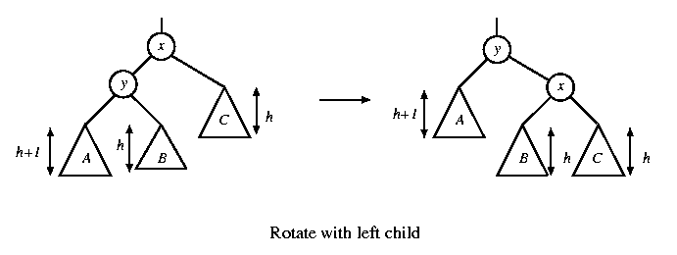
Single rotation
The new key is inserted in the subtree A.
The AVL-property is violated at x
height of left(x) is h+2
height of right(x) is h.

Slide 33
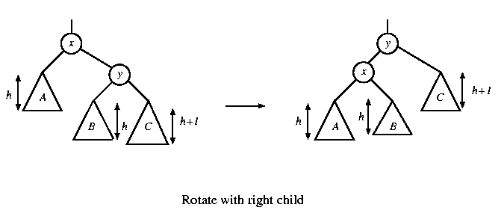
Single rotation
The new key is inserted in the subtree C.
The AVL-property is violated at x.
Single rotation takes O(1) time.
Insertion takes O(log N) time.

Slide 34
x
AVL Tree
5
5
y
8
C
3
3
8
1
4
B
1
4
A
0.8
Insert 0.8
3
5
1
After rotation
4
8
0.8

Slide 35
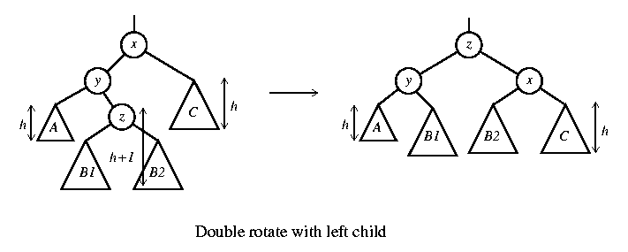
Double rotation
The new key is inserted in the subtree B1 or B2.
The AVL-property is violated at x.
x-y-z forms a zig-zag shape
also called left-right rotate

Slide 36
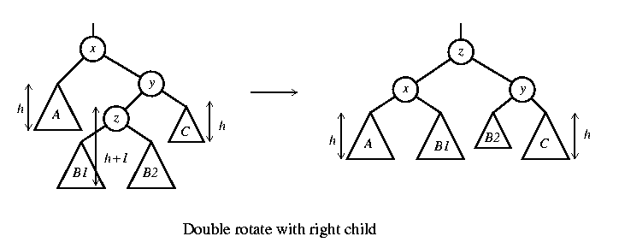
Double rotation
The new key is inserted in the subtree B1 or B2.
The AVL-property is violated at x.
also called right-left rotate

Slide 37
x
5
AVL Tree
5
C
y
8
3
3
8
A
1
4
z
1
4
B
3.5
Insert 3.5
4
5
3
3.5
8
After Rotation
1

Slide 38
An Extended Example
Insert 3,2,1,4,5,6,7, 16,15,14
Single rotation
3
2
3
3
2
1
Fig 1
2
3
Fig 4
Fig 2
2
1
2
Single rotation
Fig 3
1
1
3
3
Fig 5
Fig 6
4
4
5

Slide 39
2
2
Single rotation
1
4
1
4
3
5
3
5
Fig 8
Fig 7
6
4
4
Single rotation
2
5
2
5
1
3
6
1
3
6
4
Fig 9
Fig 10
7
2
6
1
3
7
5
Fig 11

Slide 40
4
2
6
1
3
7
5
16
Fig 12
4
Double rotation
4
2
6
2
6
1
3
7
1
3
15
5
16
5
16
Fig 13
7
15
Fig 14

Slide 41
4
4
Double rotation
2
6
2
7
15
1
3
15
1
3
5
6
16
7
5
14
16
Fig 15
14
Fig 16

Slide 42
AVL Tree : Deletion
Algorithm:
Case 1: Node with No Children (Leaf Node)
Example: Deleting node 1 .
8
/ \
3 10
/ \ / \
1 6 9 14
/ \ /
4 7 13
Explanation: Node 1 is a leaf node. Simply remove it. Check for AVL tree property violations
8
/ \
6 10
/ \ / \
3 7 9 14
\ /
4 13
Single Rotation

Slide 43
AVL Tree : Deletion
Case 2: Node with One Child
Example: Deleting node 14
8
/ \
3 10
/ \ / \
1 6 9 13
/ \
4 7
Explanation: Node 14 has one child (13). Remove node 14 and link 13 directly to 10. Check for AVL tree property violations
8
/ \
3 10
/ \ / \
1 6 9 14
/ \ /
4 7 13

Slide 44
AVL Tree : Deletion
8
/ \
3 10
/ \ / \
1 6 9 14
/ \ /
4 7 13
Case 3: Node with Two Children
Example: Deleting node 3 .
8
/ \
4 10
/ \ / \
1 6 9 14
\ /
7 13
Explanation: Node 3 has two children (1 and 6). Find the in-order successor (4), swap values, and delete the successor.. Check for AVL tree property violations

Slide 45
Create Avl tree with following keys
30, 40, 25, 20, 5, 50, 45, 48, 60, 70, 65, 80, 90, 100, 10, 2
After construction delete the keys 60, 50, 45, 30

Slide 46
For Visualization:
https://www.cs.usfca.edu/~galles/visualization/AVLtree.html

Slide 47
Definition of a B-tree
A B-tree of order m is an m-way tree (i.e., a tree where each node may have up to m children) in which:
1. the number of keys in each non-leaf node is one less than the number of its children.
2. all leaves are on the same level
3. all non-leaf nodes except the root have at least ⎡m / 2⎤ children
4. the root is either a leaf node, or it has from two to m children
5. a leaf node contains no more than m – 1 keys

Slide 48
An example B-Tree
26
A B-tree of order 5 containing 26 items
6
12
42
51
62
1
2
4
7
8
13
15
18
25
27
29
45
46
48
53
55
60
64
70
90
Note that all the leaves are at the same level

Slide 49
Analysis of B-Trees
The maximum number of items in a B-tree of order m and height h:
root m – 1
level 1 m(m – 1)
level 2 m²(m – 1)
. . .
level h m^{h}(m – 1)
So, the total number of items is (1 + m + m² + m³ + … + m^{h})(m – 1) = [(m^{h+1} – 1)/ (m – 1)] (m – 1) = m^{h+1} – 1
When m = 5 and h = 2 this gives 5³ – 1 = 124

Slide 50
Comparing Trees
Binary trees
Can become unbalanced and lose their good time complexity (big O)
AVL trees are strict binary trees that overcome the balance problem
Multi-way trees
B-Trees can be m-way, they can have any (odd) number of children
One B-Tree, the 2-3 (or 3-way) B-Tree, approximates a permanently balanced binary tree, exchanging the AVL tree’s balancing operations for insertion and (more complex) deletion operations

Slide 51
2-3 Trees (BTree of order 3)

Slide 52
Insertion
Given 50
30 70,90
10,20 40 60 80 100
Insertions
are always
at a leaf
Insert 39
50
30 70,90
10,20 39,40 60 80 100

Slide 53
Insert 38
50
30 70,90
10,20 38,39,40 60 80 100
illegal
50
30,39 70,90
10,20 38 40 60 80 100

Slide 54
Insert 37
50
30,39 70,90
10,20 37,38 40 60 80 100
When the height
grows it does so
from the top.

Slide 55
Insert 36
50
30,39 70,90
10,20 36,37,38 40 60 80 100
illegal
50
30,37,39
10,20 36 38 40
37,50
30 39
10,20 36 38 40
illegal

Slide 56
Insert 35, 34, 33
37,50
30
10,20 35,36
37,50
30
10,20 34,35,36
37,50
30,35
10,20 34 36
illegal
h
ALL leaves are at the same level

Slide 57
37,50
30,35 39 70,90
10,20 33,34 36 38 40 60 80 100
h

Slide 58
Deletion
Given
50
30 70,90
10,20 40 60 80 100
Delete 50
60
30 70,90
10,20 40 80 100
60
30 90
10,20 40 70,80 100

Slide 59
Delete 100
60
30 90
10,20 40 70,80
60
30 80
10,20 40 70 90

Slide 60
Delete 60
70
30 80
10,20 40 90
70
30
10,20 40 80,90
N
30 70
10,20 40 80,90
30,70
10,20 40 80,90

Slide 61
Delete 70
30,80
10,20 40 90
Delete 80
30,90
10,20 40
30
10,20 40,90

Slide 62
Given
50
30 70,90
10,20 40 60 80 100
Delete 70
You always begin deletion from a leaf so swap with inorder successor.
50
30 80,90
10,20 40 60 70 100
50
80,90
60 100
illegal

Slide 63
50
90
60,80 100
50
30 90
10,20 40 60,80 100

Slide 64
Delete 100
50
90
60,80
This leaf can spare a value
50
30 80
10,20 40 60 90
50
80
60 90

Slide 65
Delete 80
50
30 90
10,20 40 60 80
50
30 90
10,20 40 60
50
30
10,20 40 60,90
Can‘t spare a value
30,50
10,20 40 60,90

Slide 66
https://www.cs.usfca.edu/~galles/visualization/BTree.html

Slide 67
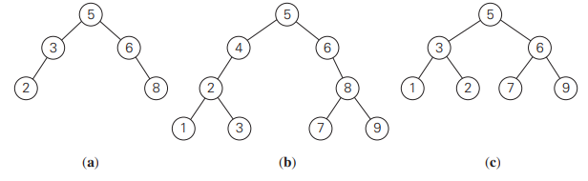
Balanced Search Trees - TRY
1. Which of the following binary trees are AVL trees?
2.a. For n = 1, 2, 3, 4, and 5, draw all the binary trees with n nodes that satisfy the balance requirement of AVL tree.
b. Draw a binary tree of height 4 that can be an AVL tree and has the smallest number of nodes among all such trees.
3. a. Construct a 2-3 tree for the list C, O, M, P, U, T, I, N, G. Use the alphabetical order of the letters and insert them successively starting with the empty tree.
b. Assuming that the probabilities of searching for each of the keys (i.e., the letters) are the same, find the largest number and the average number of key comparisons for successful searches in this tree.

Slide 68
Heap and Heap Sort : Refer another ppt

Slide 69


Problem Reduction
If you need to solve a problem, reduce it to another problem that you know how to solve .
Notes:
It suggests that when faced with a complex problem that you don't know how to solve directly, you can break it down into smaller, more manageable problems that you do know how to solve. By doing so, you can tackle each component of the problem separately, making it easier to understand and address.

Slide 70
Problem Reduction
Examples:
Computing the least common multiple
Counting paths in a graph
Reduction of maximization problems: Maximization and minimization problem.
Reduction in graph problems.

Slide 71
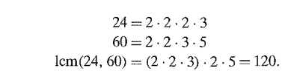
Computing the Least Common Multiple
Recall that the least common multiple of two positive integers m and n, denoted lcm(m, n ), is defined as the smallest integer that is divisible by both m and n.
lcm(24, 60) = 120, and lcm(11, 5) =55.
Notes:
To find the least common multiple (LCM), we take all the prime factors present in both numbers, including duplicates, and also include any prime factors that are unique to either number. Then, we multiply them together.

Slide 72

Calculate the least common multiple (LCM) of two numbers using the formula:

Slide 73
Example:
First, we need to find the greatest common divisor (GCD) of m and n. We can use Euclid's algorithm for this. LCM(24,60)?
The GCD of 24 and 60 is 12.
Now, plug the values into the formula for LCM:
LCM(24,60)=(24×60)/12 = 120

Slide 74
Counting paths in a graph
Problem: Counting paths between two vertices in a graph.
It is not difficult to prove by mathematical induction that the number of different paths of length k > 0 from the ith vertex to the jth vertex of a graph (undirected or directed) equals the (i, j)th element of A^k where A is the adjacency matrix of the graph.
Thus, the problem of counting a graph's paths can be solved with an algorithm for computing an appropriate power of its adjacency matrix.

Slide 75

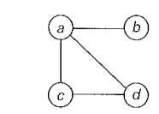
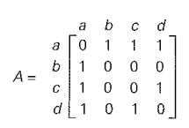
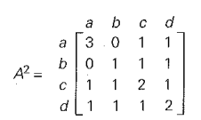
Counting paths in a graph
Its adjacency matrix A and its square A^2 indicate the number of paths of length 1 and 2, respectively, between the corresponding vertices of the graph.
In particular, there are three paths of length 2 that start and end at vertex a: a - b- a, a - c- a, and a - d -a, but only one path of length 2 from a to c: a - d -c.

Slide 76
Reduction to Graph Problems
Using State space graph.
States: Nodes or vertices in the graph represent individual states or configurations of a system. Each state captures relevant information about the problem being modeled.
Transitions: Directed edges or arcs between states represent possible transitions or actions that can be taken to move from one state to another. These transitions typically correspond to allowable moves, decisions, or events in the problem domain.
Initial State: One of the states in the graph is designated as the initial state, representing the starting point of the system or problem.
Goal State(s): One or more states in the graph are designated as goal states, representing the desired outcomes or solutions of the problem.

