Slide 1
Advanced Parallel Programming with MPI
Slides are available at
http://www.mcs.anl.gov/~balaji/2013-06-16-isc-mpi.pptx
Pavan Balaji
Argonne National Laboratory
Email: balaji@mcs.anl.gov
Web: http://www.mcs.anl.gov/~balaji
Torsten Hoefler
ETH, Zurich
Email: htor@inf.ethz.ch
Web: http://htor.inf.ethz.ch/
Martin Schulz
Lawrence Livermore National Laboratory
Email: schulz6@llnl.gov

Slide 2
What this tutorial will cover
Some advanced topics in MPI
Not a complete set of MPI features
Will not include all details of each feature
Idea is to give you a feel of the features so you can start using them in your applications
Hybrid Programming with Threads and Shared Memory
MPI-2 and MPI-3
One-sided Communication (Remote Memory Access)
MPI-2 and MPI-3
Nonblocking Collective Communication
MPI-3
Topology-aware Communication
MPI-1 and MPI-2.2
Tools, MPI_T, and Info
MPI-1, MPI-2.2 and MPI-3

Slide 3
What is MPI?
MPI: Message Passing Interface
The MPI Forum organized in 1992 with broad participation by:
Vendors: IBM, Intel, TMC, SGI, Convex, Meiko
Portability library writers: PVM, p4
Users: application scientists and library writers
MPI-1 finished in 18 months
Incorporates the best ideas in a “standard” way
Each function takes fixed arguments
Each function has fixed semantics
Standardizes what the MPI implementation provides and what the application can and cannot expect
Each system can implement it differently as long as the semantics match
MPI is not…
a language or compiler specification
a specific implementation or product

Slide 4
Following MPI Standards
MPI-2 was released in 2000
Several additional features including MPI + threads, MPI-I/O, remote memory access functionality and many others
MPI-2.1 (2008) and MPI-2.2 (2009) were recently released with some corrections to the standard and small features
MPI-3 (2012) added several new features to MPI
The Standard itself:
at http://www.mpi-forum.org
All MPI official releases, in both postscript and HTML
Other information on Web:
at http://www.mcs.anl.gov/mpi
pointers to lots of material including tutorials, a FAQ, other MPI pages

Slide 5
Important considerations while using MPI
All parallelism is explicit: the programmer is responsible for correctly identifying parallelism and implementing parallel algorithms using MPI constructs

Slide 6
Parallel Sort using MPI Send/Recv
Rank 0
8
23
19
67
45
35
1
24
13
30
3
5
Rank 0
O(N log N)
Rank 1
8
19
23
35
45
67
1
3
5
13
24
30
Rank 0
8
19
23
35
45
67
1
3
5
13
24
30
Rank 0
1
3
5
8
13
19
23
24
30
35
45
67

Slide 7
Parallel Sort using MPI Send/Recv (contd.)
#include <mpi.h>
#include <stdio.h>
int main(int argc, char ** argv)
{
int rank;
int a[1000], b[500];
MPI_Init(&argc, &argv);
MPI_Comm_rank(MPI_COMM_WORLD, &rank);
if (rank == 0) {
MPI_Send(&a[500], 500, MPI_INT, 1, 0, MPI_COMM_WORLD);
sort(a, 500);
MPI_Recv(b, 500, MPI_INT, 1, 0, MPI_COMM_WORLD, &status);
/* Serial: Merge array b and sorted part of array a */
}
else if (rank == 1) {
MPI_Recv(b, 500, MPI_INT, 0, 0, MPI_COMM_WORLD, &status);
sort(b, 500);
MPI_Send(b, 500, MPI_INT, 0, 0, MPI_COMM_WORLD);
}
MPI_Finalize(); return 0;
}

Slide 8
A Non-Blocking communication example
P0
Blocking Communication
P1
P0
Non-blocking Communication
P1

Slide 9
A Non-Blocking communication example
int main(int argc, char ** argv)
{
[...snip...]
if (rank == 0) {
for (i=0; i< 100; i++) {
/* Compute each data element and send it out */
data[i] = compute(i);
MPI_Isend(&data[i], 1, MPI_INT, 1, 0, MPI_COMM_WORLD,
&request[i]);
}
MPI_Waitall(100, request, MPI_STATUSES_IGNORE)
}
else {
for (i = 0; i < 100; i++)
MPI_Recv(&data[i], 1, MPI_INT, 0, 0, MPI_COMM_WORLD,
MPI_STATUS_IGNORE);
}
[...snip...]
}

Slide 10
MPI Collective Routines
Many Routines: MPI_ALLGATHER, MPI_ALLGATHERV, MPI_ALLREDUCE, MPI_ALLTOALL, MPI_ALLTOALLV, MPI_BCAST, MPI_GATHER, MPI_GATHERV, MPI_REDUCE, MPI_REDUCESCATTER, MPI_SCAN, MPI_SCATTER, MPI_SCATTERV
“All” versions deliver results to all participating processes
“V” versions (stands for vector) allow the hunks to have different sizes
MPI_ALLREDUCE, MPI_REDUCE, MPI_REDUCESCATTER, and MPI_SCAN take both built-in and user-defined combiner functions

Slide 11
MPI Built-in Collective Computation Operations
MPI_MAX
MPI_MIN
MPI_PROD
MPI_SUM
MPI_LAND
MPI_LOR
MPI_LXOR
MPI_BAND
MPI_BOR
MPI_BXOR
MPI_MAXLOC
MPI_MINLOC
Maximum
Minimum
Product
Sum
Logical and
Logical or
Logical exclusive or
Bitwise and
Bitwise or
Bitwise exclusive or
Maximum and location
Minimum and location

Slide 12
Introduction to Datatypes in MPI
Datatypes allow to (de)serialize arbitrary data layouts into a message stream
Networks provide serial channels
Same for block devices and I/O
Several constructors allow arbitrary layouts
Recursive specification possible
Declarative specification of data-layout
“what” and not “how”, leaves optimization to implementation (many unexplored possibilities!)
Choosing the right constructors is not always simple

Slide 13
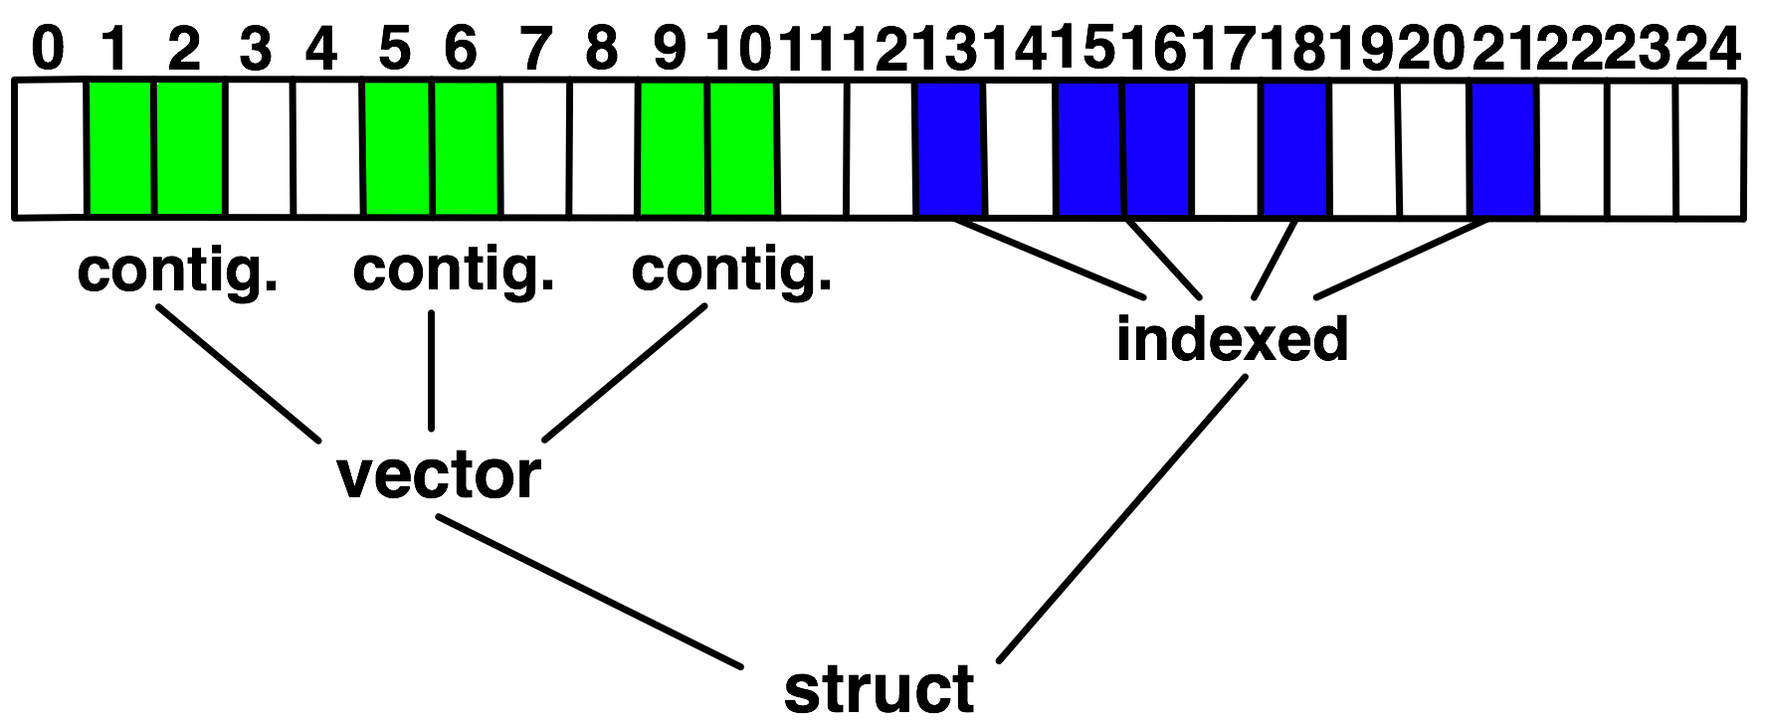
Derived Datatype Example
Explain Lower Bound, Size, Extent

Slide 14
Advanced Topics: Hybrid Programming with Threads and Shared Memory

Slide 15
MPI and Threads
MPI describes parallelism between processes (with separate address spaces)
Thread parallelism provides a shared-memory model within a process
OpenMP and Pthreads are common models
OpenMP provides convenient features for loop-level parallelism. Threads are created and managed by the compiler, based on user directives.
Pthreads provide more complex and dynamic approaches. Threads are created and managed explicitly by the user.

Slide 16
Programming for Multicore
Almost all chips are multicore these days
Today’s clusters often comprise multiple CPUs per node sharing memory, and the nodes themselves are connected by a network
Common options for programming such clusters
All MPI
MPI between processes both within a node and across nodes
MPI internally uses shared memory to communicate within a node
MPI + OpenMP
Use OpenMP within a node and MPI across nodes
MPI + Pthreads
Use Pthreads within a node and MPI across nodes
The latter two approaches are known as “hybrid programming”

Slide 17
MPI’s Four Levels of Thread Safety
MPI defines four levels of thread safety -- these are commitments the application makes to the MPI
MPI_THREAD_SINGLE: only one thread exists in the application
MPI_THREAD_FUNNELED: multithreaded, but only the main thread makes MPI calls (the one that called MPI_Init_thread)
MPI_THREAD_SERIALIZED: multithreaded, but only one thread at a time makes MPI calls
MPI_THREAD_MULTIPLE: multithreaded and any thread can make MPI calls at any time (with some restrictions to avoid races – see next slide)
MPI defines an alternative to MPI_Init
MPI_Init_thread(requested, provided)
Application indicates what level it needs; MPI implementation returns the level it supports
Notes:
PAVAN: work in that the thread levels are ordered!

Slide 18
MPI+OpenMP
MPI_THREAD_SINGLE
There is no OpenMP multithreading in the program.
MPI_THREAD_FUNNELED
All of the MPI calls are made by the master thread. i.e. all MPI calls are
Outside OpenMP parallel regions, or
Inside OpenMP master regions, or
Guarded by call to MPI_Is_thread_main MPI call.
(same thread that called MPI_Init_thread)
MPI_THREAD_SERIALIZED
#pragma omp parallel
…
#pragma omp critical
{
…MPI calls allowed here…
}
MPI_THREAD_MULTIPLE
Any thread may make an MPI call at any time

Slide 19
Specification of MPI_THREAD_MULTIPLE
When multiple threads make MPI calls concurrently, the outcome will be as if the calls executed sequentially in some (any) order
Blocking MPI calls will block only the calling thread and will not prevent other threads from running or executing MPI functions
It is the user's responsibility to prevent races when threads in the same application post conflicting MPI calls
e.g., accessing an info object from one thread and freeing it from another thread
User must ensure that collective operations on the same communicator, window, or file handle are correctly ordered among threads
e.g., cannot call a broadcast on one thread and a reduce on another thread on the same communicator
Notes:
19

Slide 20
Threads and MPI
An implementation is not required to support levels higher than MPI_THREAD_SINGLE; that is, an implementation is not required to be thread safe
A fully thread-safe implementation will support MPI_THREAD_MULTIPLE
A program that calls MPI_Init (instead of MPI_Init_thread) should assume that only MPI_THREAD_SINGLE is supported
A threaded MPI program that does not call MPI_Init_thread is an incorrect program (common user error we see)
Notes:
20

Slide 21
An Incorrect Program
Process 0
MPI_Bcast(comm)
MPI_Barrier(comm)
Process 1
MPI_Bcast(comm)
MPI_Barrier(comm)
Thread 1
Thread 2
Here the user must use some kind of synchronization to ensure that either thread 1 or thread 2 gets scheduled first on both processes
Otherwise a broadcast may get matched with a barrier on the same communicator, which is not allowed in MPI

Slide 22
A Correct Example
Process 0
MPI_Recv(src=1)
MPI_Send(dst=1)
Process 1
MPI_Recv(src=0)
MPI_Send(dst=0)
Thread 1
Thread 2
An implementation must ensure that the above example never deadlocks for any ordering of thread execution
That means the implementation cannot simply acquire a thread lock and block within an MPI function. It must release the lock to allow other threads to make progress.

Slide 23
The Current Situation
All MPI implementations support MPI_THREAD_SINGLE (duh).
They probably support MPI_THREAD_FUNNELED even if they don’t admit it.
Does require thread-safe malloc
Probably OK in OpenMP programs
Many (but not all) implementations support THREAD_MULTIPLE
Hard to implement efficiently though (lock granularity issue)
“Easy” OpenMP programs (loops parallelized with OpenMP, communication in between loops) only need FUNNELED
So don’t need “thread-safe” MPI for many hybrid programs
But watch out for Amdahl’s Law!

Slide 24
Performance with MPI_THREAD_MULTIPLE
Thread safety does not come for free
The implementation must protect certain data structures or parts of code with mutexes or critical sections
To measure the performance impact, we ran tests to measure communication performance when using multiple threads versus multiple processes
Details in our Parallel Computing (journal) paper (2009)

Slide 25
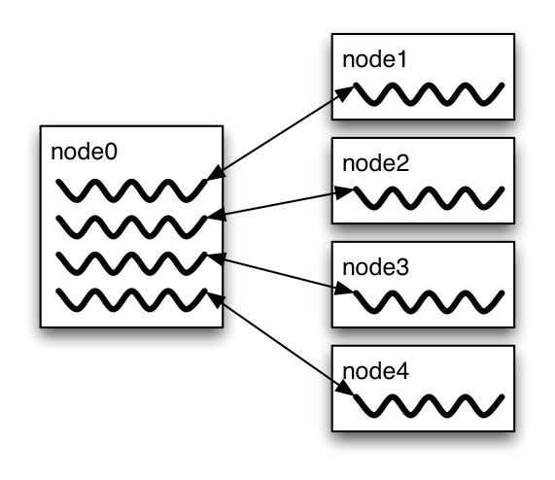
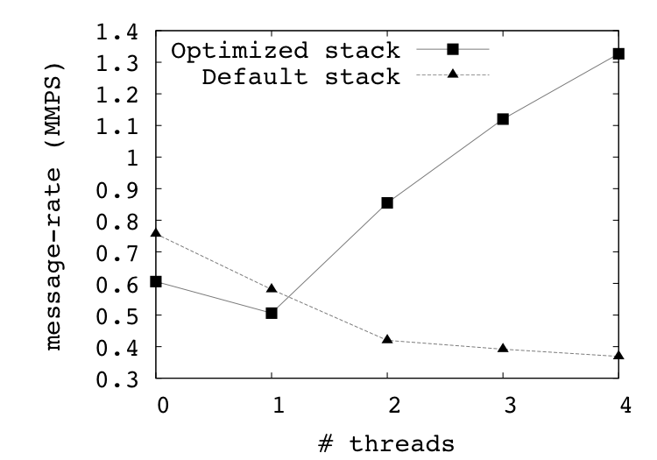
Message Rate Results on BG/P
Message Rate Benchmark

Slide 26
Why is it hard to optimize MPI_THREAD_MULTIPLE
MPI internally maintains several resources
Because of MPI semantics, it is required that all threads have access to some of the data structures
E.g., thread 1 can post an Irecv, and thread 2 can wait for its completion – thus the request queue has to be shared between both threads
Since multiple threads are accessing this shared queue, it needs to be locked – adds a lot of overhead
In MPI-3.1 (next version of the standard), we plan to add additional features to allow the user to provide hints (e.g., requests posted to this communicator are not shared with other threads)

Slide 27
Thread Programming is Hard
“The Problem with Threads,” IEEE Computer
Prof. Ed Lee, UC Berkeley
http://ptolemy.eecs.berkeley.edu/publications/papers/06/problemwithThreads/
“Why Threads are a Bad Idea (for most purposes)”
John Ousterhout
http://home.pacbell.net/ouster/threads.pdf
“Night of the Living Threads” http://weblogs.mozillazine.org/roc/archives/2005/12/night_of_the_living_threads.html
Too hard to know whether code is correct
Too hard to debug
I would rather debug an MPI program than a threads program
27

Slide 28
Ptolemy and Threads
Ptolemy is a framework for modeling, simulation, and design of concurrent, real-time, embedded systems
Developed at UC Berkeley (PI: Ed Lee)
It is a rigorously tested, widely used piece of software
Ptolemy II was first released in 2000
Yet, on April 26, 2004, four years after it was first released, the code deadlocked!
The bug was lurking for 4 years of widespread use and testing!
A faster machine or something that changed the timing caught the bug

Slide 29
An Example I encountered recently
We received a bug report about a very simple multithreaded MPI program that hangs
Run with 2 processes
Each process has 2 threads
Both threads communicate with threads on the other process as shown in the next slide
I spent several hours trying to debug MPICH2 before discovering that the bug is actually in the user’s program ☹

Slide 30
2 Proceses, 2 Threads, Each Thread Executes this Code
for (j = 0; j < 2; j++) {
if (rank == 1) {
for (i = 0; i < 3; i++)
MPI_Send(NULL, 0, MPI_CHAR, 0, 0, MPI_COMM_WORLD);
for (i = 0; i < 3; i++)
MPI_Recv(NULL, 0, MPI_CHAR, 0, 0, MPI_COMM_WORLD, &stat);
}
else { /* rank == 0 */
for (i = 0; i < 3; i++)
MPI_Recv(NULL, 0, MPI_CHAR, 1, 0, MPI_COMM_WORLD, &stat);
for (i = 0; i < 3; i++)
MPI_Send(NULL, 0, MPI_CHAR, 1, 0, MPI_COMM_WORLD);
}
}

Slide 31
What Happened
Rank 0
3 recvs
3 sends
3 recvs
3 sends
3 recvs
3 sends
3 recvs
3 sends
Rank 1
3 sends
3 recvs
3 sends
3 recvs
3 sends
3 recvs
3 sends
3 recvs
Thread 1
Thread 2
All 4 threads stuck in receives because the sends from one iteration got matched with receives from the next iteration
Solution: Use iteration number as tag in the messages

Slide 32
Hybrid Programming with Shared Memory
MPI-3 allows different processes to allocate shared memory through MPI
MPI_Win_allocate_shared
Uses many of the concepts of one-sided communication
Applications can do hybrid programming using MPI or load/store accesses on the shared memory window
Other MPI functions can be used to synchronize access to shared memory regions
Much simpler to program than threads

Slide 33
Advanced Topics: Nonblocking Collectives

Slide 34
Nonblocking Collective Communication
Nonblocking communication
Deadlock avoidance
Overlapping communication/computation
Collective communication
Collection of pre-defined optimized routines
Nonblocking collective communication
Combines both techniques (more than the sum of the parts ☺)
System noise/imbalance resiliency
Semantic advantages
Examples

Slide 35
Nonblocking Communication
Semantics are simple:
Function returns no matter what
No progress guarantee!
E.g., MPI_Isend(<send-args>, MPI_Request *req);
Nonblocking tests:
Test, Testany, Testall, Testsome
Blocking wait:
Wait, Waitany, Waitall, Waitsome

Slide 36
Nonblocking Communication
Blocking vs. nonblocking communication
Mostly equivalent, nonblocking has constant request management overhead
Nonblocking may have other non-trivial overheads
Request queue length
Linear impact on performance
E.g., BG/P: 100ns/request
Tune unexpected queue length!

Slide 37
Collective Communication
Three types:
Synchronization (Barrier)
Data Movement (Scatter, Gather, Alltoall, Allgather)
Reductions (Reduce, Allreduce, (Ex)Scan, Reduce_scatter)
Common semantics:
no tags (communicators can serve as such)
Not necessarily synchronizing (only barrier and all*)
Overview of functions and performance models

Slide 38
Nonblocking Collective Communication
Nonblocking variants of all collectives
MPI_Ibcast(<bcast args>, MPI_Request *req);
Semantics:
Function returns no matter what
No guaranteed progress (quality of implementation)
Usual completion calls (wait, test) + mixing
Out-of order completion
Restrictions:
No tags, in-order matching
Send and vector buffers may not be touched during operation
MPI_Cancel not supported
No matching with blocking collectives
Hoefler et al.: Implementation and Performance Analysis of Non-Blocking Collective Operations for MPI

Slide 39
Nonblocking Collective Communication
Semantic advantages:
Enable asynchronous progression (and manual)
Software pipelinling
Decouple data transfer and synchronization
Noise resiliency!
Allow overlapping communicators
See also neighborhood collectives
Multiple outstanding operations at any time
Enables pipelining window
Hoefler et al.: Implementation and Performance Analysis of Non-Blocking Collective Operations for MPI

Slide 40
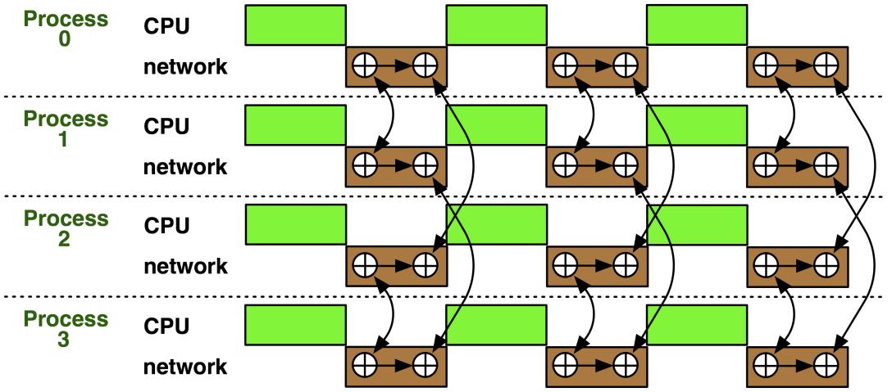
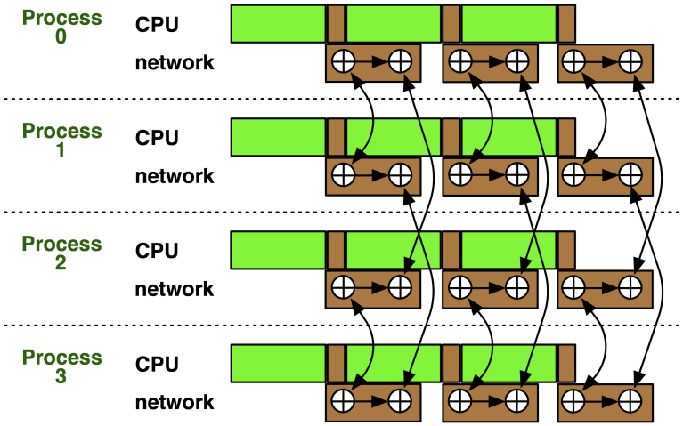
Nonblocking Collectives Overlap
Software pipelining
More complex parameters
Progression issues
Not scale-invariant
Hoefler: Leveraging Non-blocking Collective Communication in High-performance Applications

Slide 41
A Non-Blocking Barrier?
What can that be good for? Well, quite a bit!
Semantics:
MPI_Ibarrier() – calling process entered the barrier, no synchronization happens
Synchronization may happen asynchronously
MPI_Test/Wait() – synchronization happens if necessary
Uses:
Overlap barrier latency (small benefit)
Use the split semantics! Processes notify non-collectively but synchronize collectively!

Slide 42

A Semantics Example: DSDE
Dynamic Sparse Data Exchange
Dynamic: comm. pattern varies across iterations
Sparse: number of neighbors is limited ( )
Data exchange: only senders know neighbors
Hoefler et al.:Scalable Communication Protocols for Dynamic Sparse Data Exchange

Slide 43
Dynamic Sparse Data Exchange (DSDE)
Main Problem: metadata
Determine who wants to send how much data to me (I must post receive and reserve memory)
OR:
Use MPI semantics:
Unknown sender
MPI_ANY_SOURCE
Unknown message size
MPI_PROBE
Reduces problem to counting the number of neighbors
Allow faster implementation!
T. Hoefler et al.:Scalable Communication Protocols for Dynamic Sparse Data Exchange

Slide 44

Using Alltoall (PEX)
Bases on Personalized Exchange ( )
Processes exchange metadata (sizes) about neighborhoods with all-to-all
Processes post receives afterwards
Most intuitive but least performance and scalability!
T. Hoefler et al.:Scalable Communication Protocols for Dynamic Sparse Data Exchange

Slide 45
Reduce_scatter (PCX)
Bases on Personalized Census ( )
Processes exchange metadata (counts) about neighborhoods with reduce_scatter
Receivers checks with wildcard MPI_IPROBE and receives messages
Better than PEX but non-deterministic!
T. Hoefler et al.:Scalable Communication Protocols for Dynamic Sparse Data Exchange

Slide 46

MPI_Ibarrier (NBX)
Complexity - census (barrier): ( )
Combines metadata with actual transmission
Point-to-point synchronization
Continue receiving until barrier completes
Processes start coll. synch. (barrier) when p2p phase ended
barrier = distributed marker!
Better than PEX, PCX, RSX!
T. Hoefler et al.:Scalable Communication Protocols for Dynamic Sparse Data Exchange

Slide 47
Parallel Breadth First Search
On a clustered Erdős-Rényi graph, weak scaling
6.75 million edges per node (filled 1 GiB)
HW barrier support is significant at large scale!
BlueGene/P – with HW barrier!
Myrinet 2000 with LibNBC
T. Hoefler et al.:Scalable Communication Protocols for Dynamic Sparse Data Exchange
Notes:
PEX – All_to_all
PCS – Reduce_scatter
NBX – ISSEND / IBARRIER

Slide 48
A Complex Example: FFT
for(int x=0; x<n/p; ++x) 1d_fft(/* x-th stencil */);
// pack data for alltoall
MPI_Alltoall(&in, n/p*n/p, cplx_t, &out, n/p*n/p, cplx_t, comm);
// unpack data from alltoall and transpose
for(int y=0; y<n/p; ++y) 1d_fft(/* y-th stencil */);
// pack data for alltoall
MPI_Alltoall(&in, n/p*n/p, cplx_t, &out, n/p*n/p, cplx_t, comm);
// unpack data from alltoall and transpose
Hoefler: Leveraging Non-blocking Collective Communication in High-performance Applications

Slide 49
FFT Software Pipelining
MPI_Request req[nb];
for(int b=0; b<nb; ++b) { // loop over blocks
for(int x=b*n/p/nb; x<(b+1)n/p/nb; ++x) 1d_fft(/* x-th stencil*/);
// pack b-th block of data for alltoall
MPI_Ialltoall(&in, n/p*n/p/bs, cplx_t, &out, n/p*n/p, cplx_t, comm, &req[b]);
}
MPI_Waitall(nb, req, MPI_STATUSES_IGNORE);
// modified unpack data from alltoall and transpose
for(int y=0; y<n/p; ++y) 1d_fft(/* y-th stencil */);
// pack data for alltoall
MPI_Alltoall(&in, n/p*n/p, cplx_t, &out, n/p*n/p, cplx_t, comm);
// unpack data from alltoall and transpose
Hoefler: Leveraging Non-blocking Collective Communication in High-performance Applications

Slide 50
A Complex Example: FFT
Main parameter: nb vs. n → blocksize
Strike balance between k-1st alltoall and k^{th} FFT stencil block
Costs per iteration:
Alltoall (bandwidth) costs: T_{a2a} ≈ n²/p/nb * β
FFT costs: T_{fft} ≈ n/p/nb * T_{1DFFT}(n)
Adjust blocksize parameters to actual machine
Either with model or simple sweep
Hoefler: Leveraging Non-blocking Collective Communication in High-performance Applications
Notes:
Use blocks and compute/transmit in a more pipelined way

Slide 51
Nonblocking And Collective Summary
Nonblocking comm does two things:
Overlap and relax synchronization
Collective comm does one thing
Specialized pre-optimized routines
Performance portability
Hopefully transparent performance
They can be composed
E.g., software pipelining

Slide 52
Advanced Topics: One-sided Communication

Slide 53
One-sided Communication
The basic idea of one-sided communication models is to decouple data movement with process synchronization
Should be able move data without requiring that the remote process synchronize
Each process exposes a part of its memory to other processes
Other processes can directly read from or write to this memory
Process 0
Process 1
Process 2
Process 3
Public Memory Region
Private Memory Region
Public Memory Region
Private Memory Region
Public Memory Region
Private Memory Region
Public Memory Region
Global Address Space
Private Memory Region
Private Memory Region
Private Memory Region
Private Memory Region
Private Memory Region

Slide 54
Two-sided Communication Example
Memory
Processor
Processor
Memory
Memory
Segment
Memory
Segment
Memory
Segment
Memory
Segment
Memory
Segment
Send
Recv
Send
Recv
MPI implementation
MPI implementation

Slide 55
One-sided Communication Example
Memory
Processor
Processor
Memory
Memory
Segment
Memory
Segment
Memory
Segment
Memory
Segment
Send
Recv
Send
Recv
MPI implementation
MPI implementation

Slide 56
Comparing One-sided and Two-sided Programming
Process 0
Process 1
SEND(data)
DELAY
Even the sending process is delayed
RECV(data)
Process 0
Process 1
PUT(data)
DELAY
Delay in process 1 does not affect process 0
GET(data)

Slide 57
What we need to know in MPI RMA
How to create remote accessible memory?
Reading, Writing and Updating remote memory
Data Synchronization
Memory Model

Slide 58
Creating Public Memory
Any memory created by a process is, by default, only locally accessible
X = malloc(100);
Once the memory is created, the user has to make an explicit MPI call to declare a memory region as remotely accessible
MPI terminology for remotely accessible memory is a “window”
A group of processes collectively create a “window”
Once a memory region is declared as remotely accessible, all processes in the window can read/write data to this memory without explicitly synchronizing with the target process

Slide 59
Window creation models
Four models exist
MPI_WIN_CREATE
You already have an allocated buffer that you would like to make remotely accessible
MPI_WIN_ALLOCATE
You want to create a buffer and directly make it remotely accessible
MPI_WIN_CREATE_DYNAMIC
You don’t have a buffer yet, but will have one in the future
MPI_WIN_ALLOCATE_SHARED
You want multiple processes on the same node share a buffer
We will not cover this model today

Slide 60
MPI_WIN_CREATE
int MPI_Win_create(void *base, MPI_Aint size, int disp_unit, MPI_Info info, MPI_Comm comm, MPI_Win *win)
Expose a region of memory in an RMA window
Only data exposed in a window can be accessed with RMA ops.
Arguments:
base - pointer to local data to expose
size - size of local data in bytes (nonnegative integer)
disp_unit - local unit size for displacements, in bytes (positive integer)
info - info argument (handle)
comm - communicator (handle)

Slide 61
Example with MPI_WIN_CREATE
int main(int argc, char ** argv)
{
int *a; MPI_Win win;
MPI_Init(&argc, &argv);
/* create private memory */
a = (void *) malloc(1000 * sizeof(int));
/* use private memory like you normally would */
a[0] = 1; a[1] = 2;
/* collectively declare memory as remotely accessible */
MPI_Win_create(a, 1000*sizeof(int), sizeof(int),
MPI_INFO_NULL, MPI_COMM_WORLD, &win);
/* Array ‘a’ is now accessibly by all processes in
* MPI_COMM_WORLD */
MPI_Win_free(&win);
free(a);
MPI_Finalize(); return 0;
}

Slide 62
MPI_WIN_ALLOCATE
int MPI_Win_allocate(MPI_Aint size, int disp_unit, MPI_Info info, MPI_Comm comm, void *baseptr, MPI_Win *win)
Create a remotely accessible memory region in an RMA window
Only data exposed in a window can be accessed with RMA ops.
Arguments:
size - size of local data in bytes (nonnegative integer)
disp_unit - local unit size for displacements, in bytes (positive integer)
info - info argument (handle)
comm - communicator (handle)
base - pointer to exposed local data

Slide 63
Example with MPI_WIN_ALLOCATE
int main(int argc, char ** argv)
{
int *a; MPI_Win win;
MPI_Init(&argc, &argv);
/* collectively create remotely accessible memory in the
window */
MPI_Win_allocate(1000, sizeof(int), MPI_INFO_NULL,
MPI_COMM_WORLD, &a, &win);
/* Array ‘a’ is now accessible from all processes in
* MPI_COMM_WORLD */
MPI_Win_free(&win);
MPI_Finalize(); return 0;
}

Slide 64
MPI_WIN_CREATE_DYNAMIC
int MPI_Win_create_dynamic(…, MPI_Comm comm, MPI_Win *win)
Create an RMA window, to which data can later be attached
Only data exposed in a window can be accessed with RMA ops
Application can dynamically attach memory to this window
Application can access data on this window only after a memory region has been attached

Slide 65
Example with MPI_WIN_CREATE_DYNAMIC
int main(int argc, char ** argv)
{
int *a; MPI_Win win;
MPI_Init(&argc, &argv);
MPI_Win_create_dynamic(MPI_INFO_NULL, MPI_COMM_WORLD, &win);
/* create private memory */
a = (void *) malloc(1000 * sizeof(int));
/* use private memory like you normally would */
a[0] = 1; a[1] = 2;
/* locally declare memory as remotely accessible */
MPI_Win_attach(win, a, 1000);
/* Array ‘a’ is now accessible from all processes in
MPI_COMM_WORLD*/
/* undeclare public memory */
MPI_Win_detach(win, a);
MPI_Win_free(&win);
MPI_Finalize(); return 0;
}

Slide 66
Data movement
MPI provides ability to read, write and atomically modify data in remotely accessible memory regions
MPI_GET
MPI_PUT
MPI_ACCUMULATE
MPI_GET_ACCUMULATE
MPI_COMPARE_AND_SWAP
MPI_FETCH_AND_OP

Slide 67
Data movement: Get
MPI_Get(
origin_addr, origin_count, origin_datatype,
target_rank,
target_disp, target_count, target_datatype,
win)
Move data to origin, from target
Separate data description triples for origin and target
Target Process
RMA
Window
Local
Buffer
Origin Process

Slide 68
Data movement: Put
MPI_Put(
origin_addr, origin_count, origin_datatype,
target_rank,
target_disp, target_count, target_datatype,
win)
Move data from origin, to target
Same arguments as MPI_Get
Target Process
RMA
Window
Local
Buffer
Origin Process

Slide 69
Data aggregation: Accumulate
Like MPI_Put, but applies an MPI_Op instead
Predefined ops only, no user-defined!
Result ends up at target buffer
Different data layouts between target/origin OK, basic type elements must match
Put-like behavior with MPI_REPLACE (implements f(a,b)=b)
Atomic PUT
Target Process
+=
RMA
Window
Local
Buffer
Origin Process

Slide 70
Data aggregation: Get Accumulate
Like MPI_Get, but applies an MPI_Op instead
Predefined ops only, no user-defined!
Result at target buffer; original data comes to the source
Different data layouts between target/origin OK, basic type elements must match
Get-like behavior with MPI_NO_OP
Atomic GET
Target Process
+=
RMA
Window
Local
Buffer
Origin Process

Slide 71
Ordering of Operations in MPI RMA
For Put/Get operations, ordering does not matter
If you do two PUTs to the same location, the result can be garbage
Two accumulate operations to the same location are valid
If you want “atomic PUTs”, you can do accumulates with MPI_REPLACE
All accumulate operations are ordered by default
User can tell the MPI implementation that (s)he does not require ordering as optimization hints
You can ask for “read-after-write” ordering, “write-after-write” ordering, or “read-after-read” ordering

Slide 72
Additional Atomic Operations
Compare-and-swap
Compare the target value with an input value; if they are the same, replace the target with some other value
Useful for linked list creations – if next pointer is NULL, do something
Fetch-and-Op
Special case of Get_accumulate for predefined datatypes – faster for the hardware to implement

Slide 73
RMA Synchronization Models
RMA data visibility
When is a process allowed to read/write from remotely accessible memory?
How do I know when data written by process X is available for process Y to read?
RMA synchronization models provide these capabilities
MPI RMA model allows data to be accessed only within an “epoch”
Three types of epochs possible:
Fence (active target)
Post-start-complete-wait (active target)
Lock/Unlock (passive target)
Data visibility is managed using RMA synchronization primitives
MPI_WIN_FLUSH, MPI_WIN_FLUSH_ALL
Epochs also perform synchronization

Slide 74
Fence Synchronization
Target
Origin
MPI_Win_fence(assert, win)
Collective synchronization model -- assume it synchronizes like a barrier
Starts and ends access & exposure epochs (usually)
Everyone does an MPI_WIN_FENCE to open an epoch
Everyone issues PUT/GET operations to read/write data
Everyone does an MPI_WIN_FENCE to close the epoch
Fence
Fence
Get
Fence
Fence

Slide 75
PSCW Synchronization
Target: Exposure epoch
Opened with MPI_Win_post
Closed by MPI_Win_wait
Origin: Access epoch
Opened by MPI_Win_start
Closed by MPI_Win_compete
All may block, to enforce P-S/C-W ordering
Processes can be both origins and targets
Like FENCE, but the target may allow a smaller group of processes to access its data
Target
Origin
Post
Start
Get
Complete
Wait

Slide 76
Lock/Unlock Synchronization
Active Target Mode
Passive Target Mode
Post
Lock
Start
Get
Get
Complete
Unlock
Wait
Passive mode: One-sided, asynchronous communication
Target does not participate in communication operation
Shared memory like model

Slide 77
Passive Target Synchronization
int MPI_Win_lock(int lock_type, int rank, int assert, MPI_Win win)
int MPI_Win_unlock(int rank, MPI_Win win)
Begin/end passive mode epoch
Doesn’t function like a mutex, name can be confusing
Communication operations within epoch are all nonblocking
Lock type
SHARED: Other processes using shared can access concurrently
EXCLUSIVE: No other processes can access concurrently

Slide 78
When should I use passive mode?
RMA performance advantages from low protocol overheads
Two-sided: Matching, queueing, buffering, unexpected receives, etc…
Direct support from high-speed interconnects (e.g. InfiniBand)
Passive mode: asynchronous one-sided communication
Data characteristics:
Big data analysis requiring memory aggregation
Asynchronous data exchange
Data-dependent access pattern
Computation characteristics:
Adaptive methods (e.g. AMR, MADNESS)
Asynchronous dynamic load balancing
Common structure: shared arrays

Slide 79
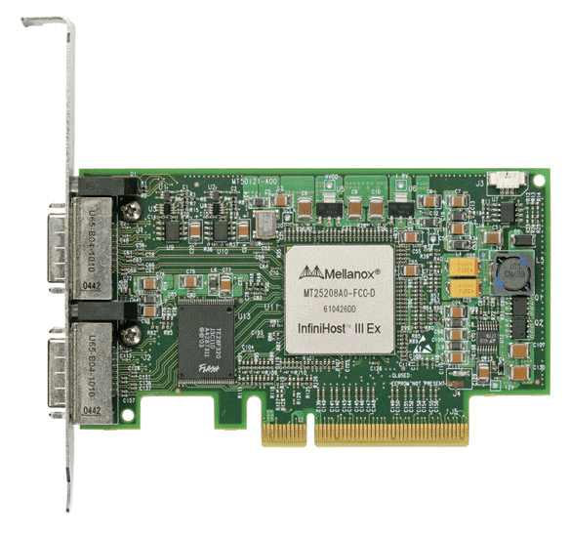
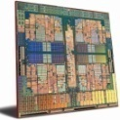
MPI RMA Memory Model
Window: Expose memory for RMA
Logical public and private copies
Portable data consistency model
Accesses must occur within an epoch
Active and Passive synchronization modes
Active: target participates
Passive: target does not participate
Rank 0
Rank 1
Begin Epoch
Put(X)
Get(Y)
Public
Copy
End Epoch
Completion
Unified
Copy
Private
Copy
Notes:
TODO: add epoch label, eliminate lock/unlock?

Slide 80
MPI RMA Memory Model (separate windows)
Same source
Same epoch
Diff. Sources
Public
Copy
X
X
Private
Copy
load
store
store
Compatible with non-coherent memory systems

Slide 81
MPI RMA Memory Model (unified windows)
Same source
Same epoch
Diff. Sources
Unified
Copy
load
store
store

Slide 82
MPI RMA Operation Compatibility (Separate)
 | Load | Store | Get | Put | Acc
Load | OVL+NOVL | OVL+NOVL | OVL+NOVL | X | X
Store | OVL+NOVL | OVL+NOVL | NOVL | X | X
Get | OVL+NOVL | NOVL | OVL+NOVL | NOVL | NOVL
Put | X | X | NOVL | NOVL | NOVL
Acc | X | X | NOVL | NOVL | OVL+NOVL
This matrix shows the compatibility of MPI-RMA operations when two or more processes access a window at the same target concurrently.
OVL – Overlapping operations permitted
NOVL – Nonoverlapping operations permitted
X – Combining these operations is OK, but data might be garbage

Slide 83
MPI RMA Operation Compatibility (Unified)
 | Load | Store | Get | Put | Acc
Load | OVL+NOVL | OVL+NOVL | OVL+NOVL | NOVL | NOVL
Store | OVL+NOVL | OVL+NOVL | NOVL | NOVL | NOVL
Get | OVL+NOVL | NOVL | OVL+NOVL | NOVL | NOVL
Put | NOVL | NOVL | NOVL | NOVL | NOVL
Acc | NOVL | NOVL | NOVL | NOVL | OVL+NOVL
This matrix shows the compatibility of MPI-RMA operations when two or more processes access a window at the same target concurrently.
OVL – Overlapping operations permitted
NOVL – Nonoverlapping operations permitted

Slide 84
Advanced Topics: Network Locality and Topology Mapping

Slide 85
Topology Mapping and Neighborhood Collectives
Topology mapping basics
Allocation mapping vs. rank reordering
Ad-hoc solutions vs. portability
MPI topologies
Cartesian
Distributed graph
Collectives on topologies – neighborhood collectives
Use-cases

Slide 86
Topology Mapping Basics
First type: Allocation mapping
Up-front specification of communication pattern
Batch system picks good set of nodes for given topology
Properties:
Not widely supported by current batch systems
Either predefined allocation (BG/P), random allocation, or “global bandwidth maximization”
Also problematic to specify communication pattern upfront, not always possible (or static)

Slide 87
Topology Mapping Basics
Rank reordering
Change numbering in a given allocation to reduce congestion or dilation
Sometimes automatic (early IBM SP machines)
Properties
Always possible, but effect may be limited (e.g., in a bad allocation)
Portable way: MPI process topologies
Network topology is not exposed
Manual data shuffling after remapping step

Slide 88
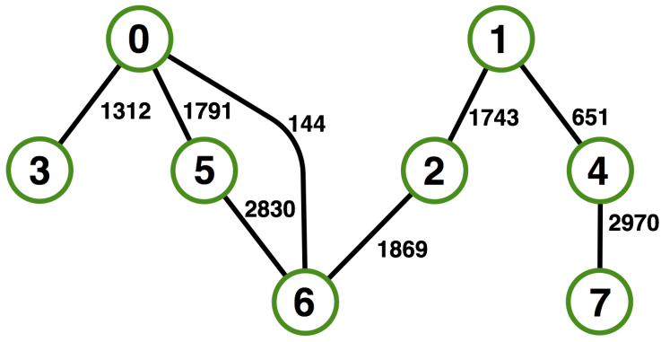

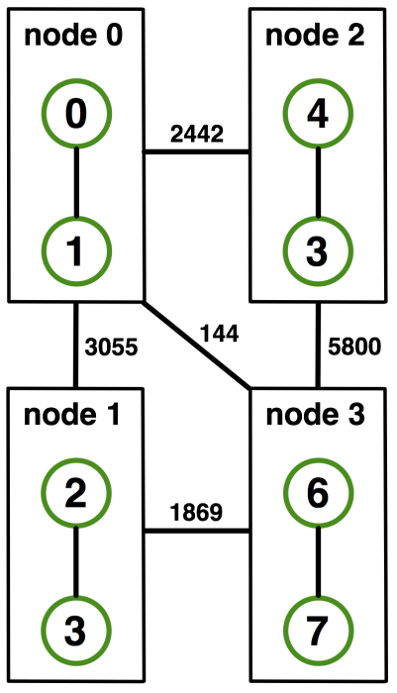
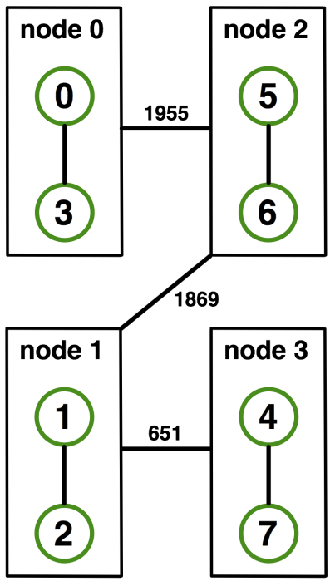
On-Node Reordering
Naïve Mapping
Optimized Mapping
Topomap
Gottschling et al.: Productive Parallel Linear Algebra Programming with Unstructured Topology Adaption

Slide 89
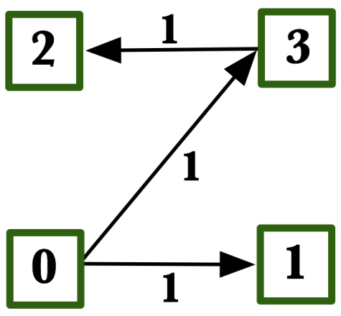
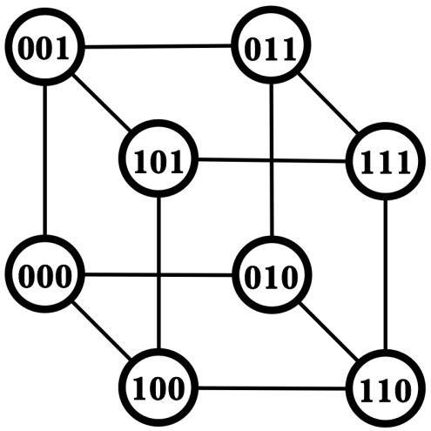
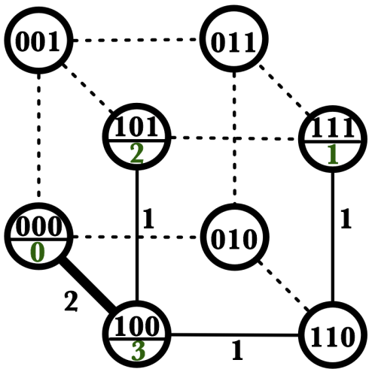
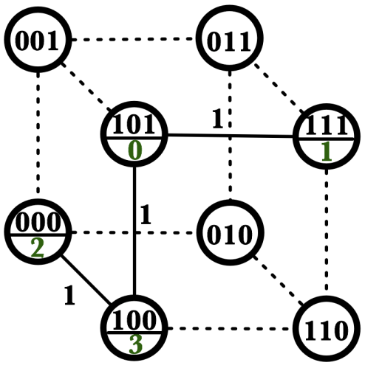
Off-Node (Network) Reordering
Application Topology
Network Topology
Naïve Mapping
Optimal Mapping
Topomap

Slide 90
MPI Topology Intro
Convenience functions (in MPI-1)
Create a graph and query it, nothing else
Useful especially for Cartesian topologies
Query neighbors in n-dimensional space
Graph topology: each rank specifies full graph ☹
Scalable Graph topology (MPI-2.2)
Graph topology: each rank specifies its neighbors or an arbitrary subset of the graph
Neighborhood collectives (MPI-3.0)
Adding communication functions defined on graph topologies (neighborhood of distance one)

Slide 91
MPI_Cart_create
MPI_Cart_create(MPI_Comm comm_old, int ndims, const int *dims, const int *periods, int reorder, MPI_Comm *comm_cart)
Specify ndims-dimensional topology
Optionally periodic in each dimension (Torus)
Some processes may return MPI_COMM_NULL
Product sum of dims must be <= P
Reorder argument allows for topology mapping
Each calling process may have a new rank in the created communicator
Data has to be remapped manually

Slide 92
MPI_Cart_create Example
Creates logical 3-d Torus of size 5x5x5
But we’re starting MPI processes with a one-dimensional argument (-p X)
User has to determine size of each dimension
Often as “square” as possible, MPI can help!
int dims[3] = {5,5,5};
int periods[3] = {1,1,1};
MPI_Comm topocomm;
MPI_Cart_create(comm, 3, dims, periods, 0, &topocomm);

Slide 93
MPI_Dims_create
Create dims array for Cart_create with nnodes and ndims
Dimensions are as close as possible (well, in theory)
Non-zero entries in dims will not be changed
nnodes must be multiple of all non-zeroes
MPI_Dims_create(int nnodes, int ndims, int *dims)

Slide 94
MPI_Dims_create Example
Makes life a little bit easier
Some problems may be better with a non-square layout though
int p;
MPI_Comm_size(MPI_COMM_WORLD, &p);
MPI_Dims_create(p, 3, dims);
int periods[3] = {1,1,1};
MPI_Comm topocomm;
MPI_Cart_create(comm, 3, dims, periods, 0, &topocomm);

Slide 95
Cartesian Query Functions
Library support and convenience!
MPI_Cartdim_get()
Gets dimensions of a Cartesian communicator
MPI_Cart_get()
Gets size of dimensions
MPI_Cart_rank()
Translate coordinates to rank
MPI_Cart_coords()
Translate rank to coordinates

Slide 96
Cartesian Communication Helpers
MPI_Cart_shift(MPI_Comm comm, int direction, int disp,
int *rank_source, int *rank_dest)
Shift in one dimension
Dimensions are numbered from 0 to ndims-1
Displacement indicates neighbor distance (-1, 1, …)
May return MPI_PROC_NULL
Very convenient, all you need for nearest neighbor communication
No “over the edge” though

Slide 97
MPI_Graph_create
Don’t use!!!!!
nnodes is the total number of nodes
index i stores the total number of neighbors for the first i nodes (sum)
Acts as offset into edges array
edges stores the edge list for all processes
Edge list for process j starts at index[j] in edges
Process j has index[j+1]-index[j] edges
MPI_Graph_create(MPI_Comm comm_old, int nnodes, const int *index, const int *edges, int reorder, MPI_Comm *comm_graph)

Slide 98

MPI_Graph_create
Don’t use!!!!!
nnodes is the total number of nodes
index i stores the total number of neighbors for the first i nodes (sum)
Acts as offset into edges array
edges stores the edge list for all processes
Edge list for process j starts at index[j] in edges
Process j has index[j+1]-index[j] edges
MPI_Graph_create(MPI_Comm comm_old, int nnodes, const int *index, const int *edges, int reorder, MPI_Comm *comm_graph)
Notes:
- Taschi: sieht seltsam aus

Slide 99
Distributed graph constructor
MPI_Graph_create is discouraged
Not scalable
Not deprecated yet but hopefully soon
New distributed interface:
Scalable, allows distributed graph specification
Either local neighbors or any edge in the graph
Specify edge weights
Meaning undefined but optimization opportunity for vendors!
Info arguments
Communicate assertions of semantics to the MPI library
E.g., semantics of edge weights
Hoefler et al.: The Scalable Process Topology Interface of MPI 2.2

Slide 100
MPI_Dist_graph_create_adjacent
MPI_Dist_graph_create_adjacent(MPI_Comm comm_old, int indegree, const int sources[], const int sourceweights[], int outdegree, const int destinations[], const int destweights[], MPI_Info info,int reorder, MPI_Comm *comm_dist_graph)
indegree, sources, ~weights – source proc. Spec.
outdegree, destinations, ~weights – dest. proc. spec.
info, reorder, comm_dist_graph – as usual
directed graph
Each edge is specified twice, once as out-edge (at the source) and once as in-edge (at the dest)
Hoefler et al.: The Scalable Process Topology Interface of MPI 2.2

Slide 101
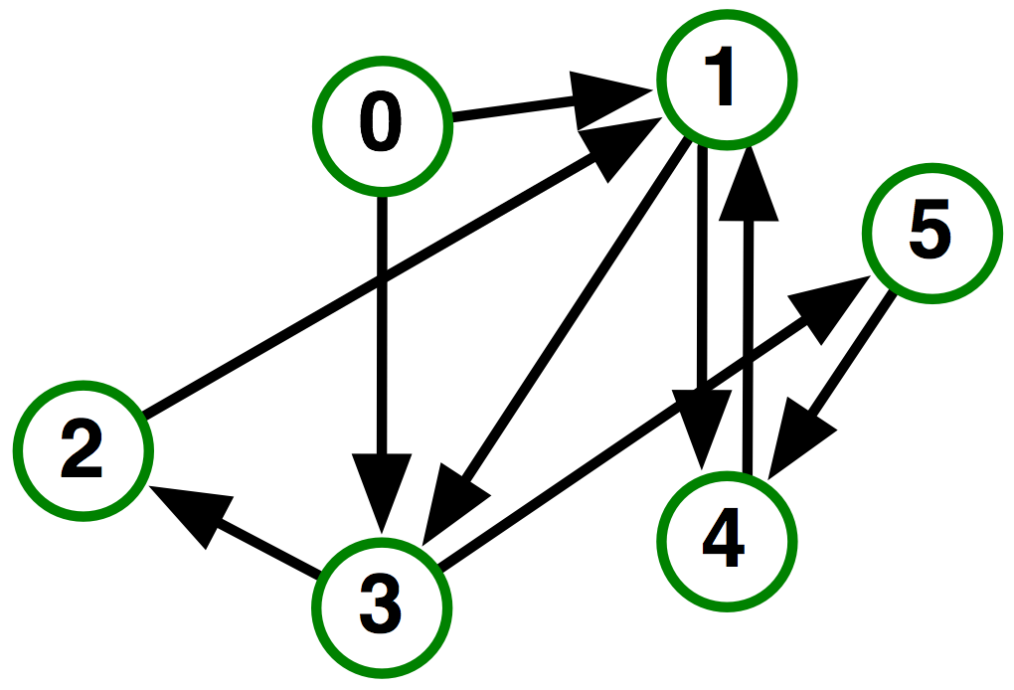
MPI_Dist_graph_create_adjacent
Process 0:
Indegree: 0
Outdegree: 2
Dests: {3,1}
Process 1:
Indegree: 3
Outdegree: 2
Sources: {4,0,2}
Dests: {3,4}
…
Hoefler et al.: The Scalable Process Topology Interface of MPI 2.2

Slide 102
MPI_Dist_graph_create
MPI_Dist_graph_create(MPI_Comm comm_old, int n, const int sources[], const int degrees[], const int destinations[], const
int weights[], MPI_Info info, int reorder, MPI_Comm *comm_dist_graph)
n – number of source nodes
sources – n source nodes
degrees – number of edges for each source
destinations, weights – dest. processor specification
info, reorder – as usual
More flexible and convenient
Requires global communication
Slightly more expensive than adjacent specification

Slide 103
MPI_Dist_graph_create
Process 0:
N: 2
Sources: {0,1}
Degrees: {2,1}
Dests: {3,1,4}
Process 1:
N: 2
Sources: {2,3}
Degrees: {1,1}
Dests: {1,2}
…
Hoefler et al.: The Scalable Process Topology Interface of MPI 2.2

Slide 104
Distributed Graph Neighbor Queries
MPI_Dist_graph_neighbors_count()
Query the number of neighbors of calling process
Returns indegree and outdegree!
Also info if weighted
MPI_Dist_graph_neighbors()
Query the neighbor list of calling process
Optionally return weights
MPI_Dist_graph_neighbors_count(MPI_Comm comm, int *indegree,int *outdegree, int *weighted)
MPI_Dist_graph_neighbors(MPI_Comm comm, int maxindegree, int sources[], int sourceweights[], int maxoutdegree, int destinations[],int destweights[])
Hoefler et al.: The Scalable Process Topology Interface of MPI 2.2

Slide 105
Further Graph Queries
Status is either:
MPI_GRAPH (ugs)
MPI_CART
MPI_DIST_GRAPH
MPI_UNDEFINED (no topology)
Enables to write libraries on top of MPI topologies!
MPI_Topo_test(MPI_Comm comm, int *status)

Slide 106
Neighborhood Collectives
Topologies implement no communication!
Just helper functions
Collective communications only cover some patterns
E.g., no stencil pattern
Several requests for “build your own collective” functionality in MPI
Neighborhood collectives are a simplified version
Cf. Datatypes for communication patterns!

Slide 107
Cartesian Neighborhood Collectives
Communicate with direct neighbors in Cartesian topology
Corresponds to cart_shift with disp=1
Collective (all processes in comm must call it, including processes without neighbors)
Buffers are laid out as neighbor sequence:
Defined by order of dimensions, first negative, then positive
2*ndims sources and destinations
Processes at borders (MPI_PROC_NULL) leave holes in buffers (will not be updated or communicated)!
T. Hoefler and J. L. Traeff: Sparse Collective Operations for MPI

Slide 108
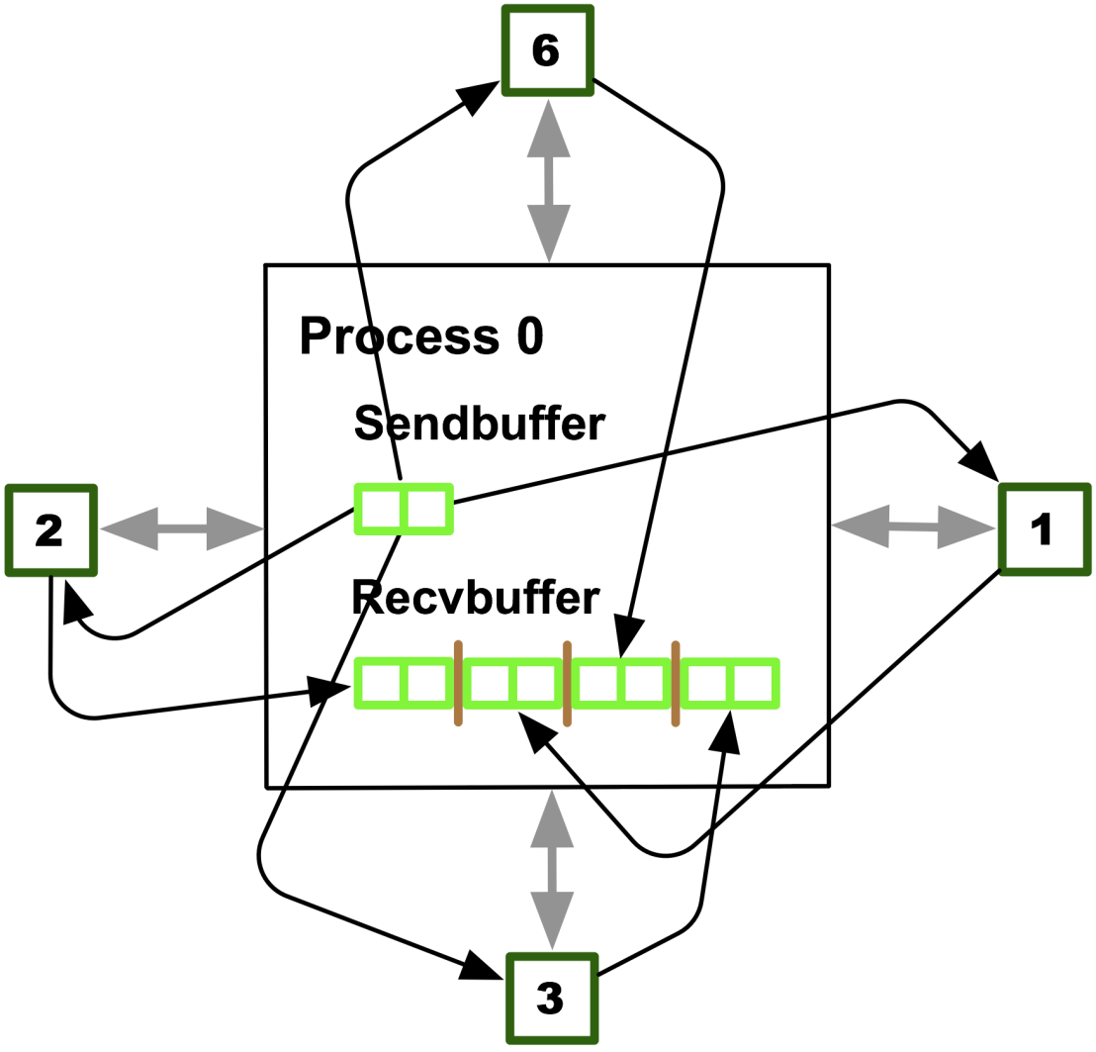
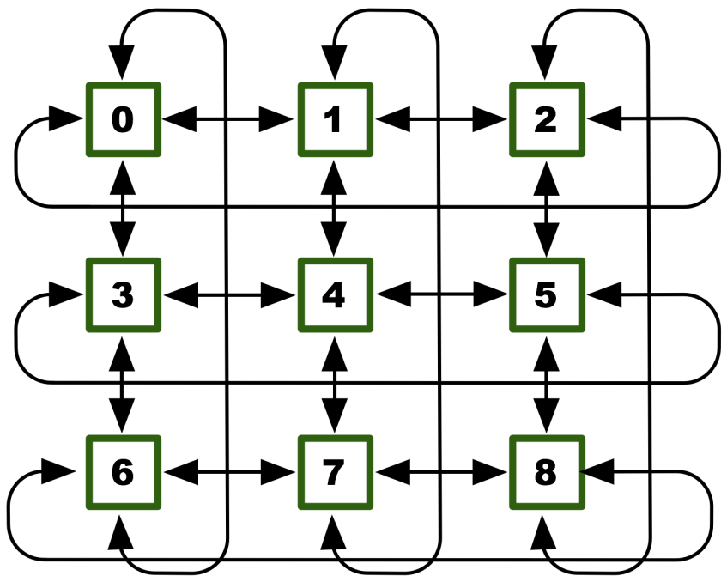
Cartesian Neighborhood Collectives
Buffer ordering example:
T. Hoefler and J. L. Traeff: Sparse Collective Operations for MPI

Slide 109
Graph Neighborhood Collectives
Collective Communication along arbitrary neighborhoods
Order is determined by order of neighbors as returned by (dist_)graph_neighbors.
Distributed graph is directed, may have different numbers of send/recv neighbors
Can express dense collective operations ☺
Any persistent communication pattern!
T. Hoefler and J. L. Traeff: Sparse Collective Operations for MPI

Slide 110
MPI_Neighbor_allgather
Sends the same message to all neighbors
Receives indegree distinct messages
Similar to MPI_Gather
The all prefix expresses that each process is a “root” of his neighborhood
Vector and w versions for full flexibility
MPI_Neighbor_allgather(const void* sendbuf, int sendcount, MPI_Datatype sendtype, void* recvbuf, int recvcount, MPI_Datatype recvtype, MPI_Comm comm)

Slide 111
MPI_Neighbor_alltoall
Sends outdegree distinct messages
Received indegree distinct messages
Similar to MPI_Alltoall
Neighborhood specifies full communication relationship
Vector and w versions for full flexibility
MPI_Neighbor_alltoall(const void* sendbuf, int sendcount, MPI_Datatype sendtype, void* recvbuf, int recvcount, MPI_Datatype recvtype, MPI_Comm comm)

Slide 112
Nonblocking Neighborhood Collectives
MPI_Ineighbor_allgather(…, MPI_Request *req); MPI_Ineighbor_alltoall(…, MPI_Request *req);
Very similar to nonblocking collectives
Collective invocation
Matching in-order (no tags)
No wild tricks with neighborhoods! In order matching per communicator!

Slide 113
Why is Neighborhood Reduce Missing?
MPI_Ineighbor_allreducev(…);
Was originally proposed (see original paper)
High optimization opportunities
Interesting tradeoffs!
Research topic
Not standardized due to missing use-cases
My team is working on an implementation
Offering the obvious interface
T. Hoefler and J. L. Traeff: Sparse Collective Operations for MPI

Slide 114
Topology Summary
Topology functions allow to specify application communication patterns/topology
Convenience functions (e.g., Cartesian)
Storing neighborhood relations (Graph)
Enables topology mapping (reorder=1)
Not widely implemented yet
May requires manual data re-distribution (according to new rank order)
MPI does not expose information about the network topology (would be very complex)

Slide 115
Neighborhood Collectives Summary
Neighborhood collectives add communication functions to process topologies
Collective optimization potential!
Allgather
One item to all neighbors
Alltoall
Personalized item to each neighbor
High optimization potential (similar to collective operations)
Interface encourages use of topology mapping!

Slide 116
Section Summary
Process topologies enable:
High-abstraction to specify communication pattern
Has to be relatively static (temporal locality)
Creation is expensive (collective)
Offers basic communication functions
Library can optimize:
Communication schedule for neighborhood colls
Topology mapping
Notes:
- Figure: summary

Slide 117
The MPI Info Object
Basic Concept and Usage
Creation and Handling
Optimization Usage
Changes in MPI 3.0

Slide 118
The Info Object (Chapter 9)
Question:
How to provide hints and specifications?
How to enable implementation specific hints?
How to keep this extensible with significant changes to MPI?
Key concept:
Opaque object that carries additional information
Information can be added and arbitrarily named
MPI functions that can make use of additional information takes such an object as argument
Information can be added as needed without a new prototype
Introduced in MPI 2.0
Additional routines and functionality added with 3.0

Slide 119
Basic Concepts
MPI_Info is an opaque object
Stores arbitrary number of key / value pairs
Keys and values are arbitrary strings
MPI predefines a set of keys for particular functions
Users can add arbitrary keys
MPI implementations can use arbitrary routines
Interface routines
Object creation and freeing
Add and delete key value pairs
Query values based on keys
Iteration over MPI Objects

Slide 120
A First Example
MPI_Win_create
Discussed earlier
Used to create a memory window for RMA
int MPI_Win_create(void *base, MPI_Aint size, int disp_unit, MPI_Info info, MPI_Comm comm, MPI_Win *win)
Predefined key for MPI_Info: no_locks
If set to “true” user asserts that no locks will be used
No 3 party communication
Simpler synchronization
Can lead to performance improvements
Other keys are possible/used in other implementations

Slide 121
A First Example (cont.)
int my_create_nolock_window(void *base, MPI_Aint size, MPI_Win *win)
{
int err;
MPI_Info info;
err=MPI_Info_create(&info);
if (err!=MPI_SUCCESS) return err;
err=MPI_Info_set(info, “no_locks”, “true”);
if (err!=MPI_SUCCESS) return err;
err=MPI_Win_create(base,size,0,info,MPI_COMM_WORLD,win);
if (err!=MPI_SUCCESS) return err;
err=MPI_Info_free(&info);
return err;
}

Slide 122
General Usage of MPI_Info
MPI Info objects store arbitrary key/value pairs
Users allocate/free objects
Users can
Option for implementation predefined Info objects
Some keys are user assertions
User guarantees certain properties
MPI can operate incorrectly if assertion is violated
Some keys are hints
Implementation will always execute correctly
Key/Values can influence performance
Users can use keys to store application information

Slide 123
MPI_Info API
Set of routines that operate on Info objects
Creation/Freeing
Set/Delete values
Query values
Iterate over all values
Predefined keys
Defined for particular functions
Used for assertions or hints (as specified in the standard)

Slide 124
MPI Info Object Creation/Destruction
MPI_INFO_NULL
Constant that can be used as default Info object
int MPI_Info_create(MPI_Info *info)
Creates an empty MPI Info object
On return, no key/value pair is defined
User is responsible for memory management
int MPI_Info_free(MPI_Info *info)
Deletes MPI Info objects and frees resources
Sets argument to MPI_INFO_NULL

Slide 125
Setting and Deleting Key/Value Pairs
int MPI_Info_set(MPI_Info info, char *key, char *value)
Add the specified key/value pair to the Info object
If key does not exist, yet
Adds the key/value pair
If key does already exist
Value is replaced with new value
In C, strings need to be NULL terminated
In Fortran, leading and trailing spaces are removed
MPI_MAX_INFO_KEY/VAL show maximal string lengths
Returns MPI_ERR_INFO_KEY/VALUE if string is too long

Slide 126
Querying Values for Specific Keys
int MPI_Info_get(MPI_Info info, char *key, int valuelen, char *value, int *flag)
Check whether key exists in the specified Info object
If no:
Flag set to false
Value argument not changed
If yes:
Flag set to true
Value returns through value argument
Valuelen specifies length/size of the value buffer as it is passed into the routine by the user
Value will be truncated if there is not enough space

Slide 127
Additional Key/Value Routines
int MPI_Info_get_valuelen(MPI_Info info, char *key, int *valuelen,int *flag)
Returns lengths of the value for a key
Flag indicates whether key is present or not
Can be used to correctly size buffers for MPI_Info_get
int MPI_Info_delete(MPI_Info info, char *key)
Delete a key from an Info object
If key is not present, returns MPI_ERR_INFO_NOKEY

Slide 128
Example (without error handling)
int delete_key(MPI_Info info, char *key)
{
char *val;
int len,flag;
MPI_Info_get_valuelen(info,key,&len,&flag);
if (!flag) return MPI_SUCCESS;
val=(chat*) malloc(len);
MPI_Info_get(info,key,len,val,&flag);
printf(“Old value was: %s\n”,val);
free(val);
MPI_Info_delete(info,key);
return err;
}

Slide 129
Exploring an MPI Info object
int MPI_Info_get_nkeys(MPI_Info info, int *nkeys)
Queries the number of keys available in the object
Keys are numbered from 0 to nkeys-1
int MPI_Info_get_nthkey(MPI_Info info, int n, char *key)
Return the name of the n^{th} key
Can then be used as input to MPI_Info_get

Slide 130
Exploring an MPI Info object (cont.)
int print_all_keys(MPI_Info info)
{
char key[MPI_MAX_INFO_KEY];
int num_keys, i, err;
err=MPI_Info_get_nkeys(info,&num_keys);
i=0;
while ((err==MPI_SUCCESS) && (i<num_keys))
{
err=MPI_Info_get_nthkey(info,i,key);
if (err==MPI_SUCCESS)
printf(“Key %i is %s\n”,i,key);
i++;
}
return err;
}

Slide 131
MPI_Info Replication
Explicit replication:
int MPI_Info_dup(MPI_Info info, MPI_Info *newinfo)
Duplicates entire info object
Includes all already existing keys
Maintains ordering

Slide 132
All Routines with Info Objects
MPI_Comm_accept
MPI_Comm_connect
MPI_Comm_spawn
MPI_Comm_spawn_ multiple
MPI_Lookup_name
MPI_Open_port
MPI_Publish_name
MPI_Unpublish_name
MPI_Info_c2f
MPI_Info_f2c
MPI_Win_create
MPI_File_open
MPI_File_delete
MPI_File_set_info
MPI_File_get_info
MPI_File_set_view
MPI_Dist_graph_create
MPI_Dist_graph_create_ adjecent
MPI_Alloc_mem

Slide 133
Info and MPI I/O
Routines that take info arguments:
MPI_File_open, MPI_File_delete, MPI_File_set_view
Implementation specific optional hints
Example: access patterns
Given on a per file basis
The MPI standard does not provide any predefined keys
Explicit access to the info object of a file
MPI_File_set_info, MPI_File_get_info
“Rules”
Implementations are not required to support any hints
Each defined hint has to have a predefined default value
If info only specifies some hints, the remaining are not affected

Slide 134
Info and RMA Memory Allocation
int MPI_Alloc_mem(MPI_Aint size, MPI_Info info, void *baseptr)
Allocate a memory region for RMA
Info objected intended to help specify where memory is located
NUMA issues
Device/Pinned/Regular memory
Hint is optional
MPI doesn’t define particular keys

Slide 135
Info and Graph Communicators
MPI_Dist_graph_create / MPI_Dist_graph_create_adjecent
Create a new communicator with graph information
Specifies the virtual topology
Input graph with weighted edges
Allows implementations to optimize layout
Both routines take an info object
Intended to allow optimizations on interpretation of the weights
Adjust the optimization function
No keys predefined in the MPI standard
MPI is free to ignore any or all hints / info keys
Routines are collective
User must ensure the same keys are passed on every rank

Slide 136
MPI Info & Communicators
Two new parts:
Clarification of what info objects mean for communicators
New routines to work with info objects that are associated with a communicator
Clarification: What happens on communicator creation?
MPI_Comm_dup also duplicates info objects
[Also duplicates topology information]

Slide 137
New MPI_Info_comm Routines
Creation of a new communicator with a new MPI info object
int MPI_Comm_dup_info(MPI_Comm comm, MPI_Info info, MPI_Comm *newcomm)
Setting and reading info for communicators
int MPI_Comm_set_info(MPI_Comm comm, MPI_Info info)
int MPI_Comm_get_info(MPI_Comm comm, MPI_Info *info_used)

Slide 138
MPI Info & Windows
Windows support MPI Info objects
But users can not read or later set them
New routines, similar to communcators
int MPI_Win_set_info(MPI_Win win, MPI_Info info)
int MPI_Win_get_info(MPI_Win win, MPI_Info *info_used)
Warning: hints that work in window creation may no longer be applicable later on

Slide 139
Predefined Environment Info Object
MPI_INFO_GET_ENV
Describes the basic execution environment
Gives the MPI application to query how it is executed
Values are parameters given to mpiexec NOT actual parameters that were determined at runtime
Object has to be present in any MPI
Not all keys have to defined
Can also be empty
Access through usual MPI_Info routines

Slide 140
Keys for the Environment Info Object
Key | Meaning
command | Name of the program being executed
argv | Command line arguments (space separated)
maxprocs | Maximum number of processes to start (of this binary)
soft | Allowed values for number of processes
host | Hostname
arch | Identifying name for the architecture
wdir | Working directory from which the MPI process is run
file | Optional, additional file with extra information
thread_level | Requested thead level (if specified by mpiexec)

Slide 141
Example: Environment Info Object
mpiexec -n 5 -arch sun ocean : -n 10 -arch rs6000 atmos
Requests 5 nodes on a SUN system to run ocean
Requests 10 nodes on an IBM system to run atmos
Environment object in rank 0-4
(command, ocean), (maxprocs, 5), (arch, sun)
Environment object in rank 5-14
(command, atmos), (maxprocs, 10), (arch, rs600)

Slide 142
Language bindings
Removal of C++ Bindings
Support for Fortran 2008

Slide 143
C++ Bindings
C++ were deprecated in MPI 2.0
Long discussion the in MPI forum about their future
Consensus: Current state not acceptable
Inconsistent in the document
Option 1: removal
Option 2: un-deprecate
Ticket for option 1 has passed first vote
Likely to be accepted at the July meeting
No counter ticket for option 2 on the table
Alternative suggestion
Boost MPI

Slide 144
Fortran Support
MPI 3.0 added support for Fortran 2008
Three sets of concurrent Fortran interfaces
“Old style” Fortran 77 (MPI-1)
Usable with “INCLUDE ‘mpif.h’”
Strongly discouraged, but provided for legacy applications
Fortran 90 interface (MPI-2)
Useable with “USE mpi”
Includes compile time checks, but inconsistent with Fortran standard
Fortran 2008 interface (MPI-3)
Usable with “USE mpi_f08”
Compile time checks and unique MPI handle types
Consistent with Fortran standard with TR 29113
Recommended option for new Fortran applications

Slide 145
Fortran Support (cont.)
MPIs supporting Fortran must provide either or both
USE mpi_f08
USE mpi -AND- INCLUDE mpif.h
Must be compatible and useable within one application
Fortran 2008 interface can support subarrays
Compile time constant MPI_SUBARRAYS_SUPPORTED
When enabled, works on all choice (message) buffers
Resolved issue for asynchronous communication
Required work with Fortran committee to define ASYNCHRONOUS
Requires TR 29113 to be implemented by the compiler
Compile time constant MPI_ASYNC_PROTECTS_NONBLOCKING
Error return (ierror) declared as optional

Slide 146
THE MPI PROFILING interface
Concept
Sample Use
Implications due to Fortran 2008

Slide 147
The MPI Profiling Interface
Part of the original MPI standard
Standardized mechanism for tools to “profile” all MPI calls
Intercept and redirect any call (without OS tricks)
Usage
Initially intended for profiling tools
Intercept all calls
Record information before continuing original call
Create application execution profile
Can be generalized to any kind of wrapper
Greatly simplifies tool implementation
Role model for integration of tool capabilities !

Slide 148
The Principle of the PMPI Interface
Name shifting interface
Tools provide library that overrides MPI function names
Typically implemented as weak symbols in MPI library
Second set of MPI calls starting with “P”
Mandatory for almost all MPI functions
Can be called by the tool to invoke initial functionality
Call MPI_Send
MPI_Send
{ …
PMPI_Send()
}
MPI_Send
PMPI_Send

Slide 149
Example of an PMPI tool: mpiP
Open source MPI profiling library
Developed at LLNL, maintained by LLNL & ORNL
Available from sourceforge
Works with any MPI library
Easy-to-use and portable design
Implemented solely based on PMPI
Intercepts and profiles all calls
Script to generate all wrappers for a particular MPI implementation
Workflow
No additional tool daemons or support infrastructure
Single text file as output
Optional: GUI viewer

Slide 150
Running with mpiP
mpiP implemented in form of a library
Redefines all MPI calls
Uses standard development chain
Run option 1: Relink
Specify libmpi.a/.so on the link line
Portable solution, but requires object files
Run option 2: library preload
Set preload variable (e.g., LD_PRELOAD) to mpiP
Transparent, but only on supported systems
In both cases:
mpiP replaces all calls from the application to MPI
mpiP forwards calls to appropriate PMPI calls

Slide 151
Running with mpiP 101 / Running
bash-3.2$ srun –n4 smg2000
mpiP:
mpiP:
mpiP: mpiP V3.1.2 (Build Dec 16 2008/17:31:26)
mpiP: Direct questions and errors to mpip-help@lists.sourceforge.net
mpiP:
Running with these driver parameters:
(nx, ny, nz) = (60, 60, 60)
(Px, Py, Pz) = (4, 1, 1)
(bx, by, bz) = (1, 1, 1)
(cx, cy, cz) = (1.000000, 1.000000, 1.000000)
(n_pre, n_post) = (1, 1)
dim = 3
solver ID = 0
=============================================
Struct Interface:
=============================================
Struct Interface:
wall clock time = 0.075800 seconds
cpu clock time = 0.080000 seconds
Header
=============================================
Setup phase times:
=============================================
SMG Setup:
wall clock time = 1.473074 seconds
cpu clock time = 1.470000 seconds
=============================================
Solve phase times:
=============================================
SMG Solve:
wall clock time = 8.176930 seconds
cpu clock time = 8.180000 seconds
Iterations = 7
Final Relative Residual Norm = 1.459319e-07
mpiP:
mpiP: Storing mpiP output in [./smg2000-p.4.11612.1.mpiP].
mpiP:
bash-3.2$
Output File

Slide 152
mpiP / Output – Metadata
@ mpiP
@ Command : ./smg2000-p -n 60 60 60
@ Version : 3.1.2
@ MPIP Build date : Dec 16 2008, 17:31:26
@ Start time : 2009 09 19 20:38:50
@ Stop time : 2009 09 19 20:39:00
@ Timer Used : gettimeofday
@ MPIP env var : [null]
@ Collector Rank : 0
@ Collector PID : 11612
@ Final Output Dir : .
@ Report generation : Collective
@ MPI Task Assignment : 0 hera27
@ MPI Task Assignment : 1 hera27
@ MPI Task Assignment : 2 hera31
@ MPI Task Assignment : 3 hera31

Slide 153
mpiP / Output – Overview
------------------------------------------------------------
@--- MPI Time (seconds) ------------------------------------
------------------------------------------------------------
Task AppTime MPITime MPI%
0 9.78 1.97 20.12
1 9.8 1.95 19.93
2 9.8 1.87 19.12
3 9.77 2.15 21.99
* 39.1 7.94 20.29
-----------------------------------------------------------

Slide 154
mpiP / Output –Function Timing
--------------------------------------------------------------
@--- Aggregate Time (top twenty, descending, milliseconds) ---
--------------------------------------------------------------
Call Site Time App% MPI% COV
Waitall 10 4.4e+03 11.24 55.40 0.32
Isend 3 1.69e+03 4.31 21.24 0.34
Irecv 23 980 2.50 12.34 0.36
Waitall 12 137 0.35 1.72 0.71
Type_commit 17 103 0.26 1.29 0.36
Type_free 9 99.4 0.25 1.25 0.36
Waitall 6 81.7 0.21 1.03 0.70
Type_free 15 79.3 0.20 1.00 0.36
Type_free 1 67.9 0.17 0.85 0.35
Type_free 20 63.8 0.16 0.80 0.35
Isend 21 57 0.15 0.72 0.20
Isend 7 48.6 0.12 0.61 0.37
Type_free 8 29.3 0.07 0.37 0.37
Irecv 19 27.8 0.07 0.35 0.32
Irecv 14 25.8 0.07 0.32 0.34
...

Slide 155
MPI_Pcontrol
Communication between application and tool
No-Op call that has to be provided by any MPI
Can be intercepted by tools
No effect when run without tool
MPI_Pcontrol(int level, …)
Suggested usage in MPI
Level=0: turn profiling off
Level=1: turn profiling on
Level=2: dump profile
Can be used for other purposes:
Mark iteration boundaries
Configure tool with application parameters

Slide 156
PMPI / Discussion
Portable mechanism to enable tool integration
First full scale approach in a widely used programming model
Used by most/all MPI tools
Enables quick tool integration
Usage has grown way beyond profiling
MPI correctness tools monitor correct usage of MPI API
Fault tolerance protocols can intercept and record messages
Drawback
Only a single tool possible at a time
Limits tool modularity
Can be overcome, but requires system tricks
P^{n}MPI tool (LLNL, available on github)

Slide 157
Fortran 2008 & The PMPI Interface
PMPI relies on the tool knowing MPI symbol names
Needed to define wrappers and replace calls
In MPI-1 and MPI-2, each routine had names for C and Fortran
Can be automatically derived based on MPI names and compiler/linker conventions for Fortran
Fortran 2008 adds additional routines & semantics
Routines with descriptors for subarrays (instead void*)
Support for BIND(C) in the compiler
Optional ierror arguments
Tools need to generate the appropriate routines
Constants to detect which routines exist
Support grouped by functionality

Slide 158
MPI Tool information interface
Motivation, Concepts, and Capabilities
Control Variables
Performance Variables
Usage Examples

Slide 159
The MPI Tool Information Interface
Short name: the MPI_T interface
Provide introspection into the MPI layer
Export internal performance information
Enable standardized access for tools
Allow for implementation specific information
Included in MPI 3.0 as part of a new tools chapter
Replaces the existing MPI profiling interface chapter
PMPI included as a new subchapter (unchanged)
API is a set of routines with the prefix MPI_T
Mostly encapsulated in the new chapter
Same general restrictions/requirements as any MPI routine
Some special conditions regarding startup/termination

Slide 160
MPI_T Goals
Provide access to MPI internal information
Configuration and control information
Performance information
Debugging information
Standardized access to this information
Build on top of the success of the PMPI interface
Integrate MPIT into the MPI standard
MPI_T is an MPI implementation agnostic specification
No particular implementation model assumed
Ability to provide no/varying amount of information
Support for production vs. debug versions of MPI

Slide 161
General Approach
Basic concept: a set of named variables
Set of variables and naming left to the MPI implementation
MPI_T provides query functions to detect variables
Semantics provided as clear text
Routines to read and write values of these variable
Split into performance and control variables
Performance: internal performance data
“Software counters for MPI”
Control: Configuration information / environment variables
Performance Variables
Number of packets sent
Time spent blocking
Memory allocated
Control Variables
Parameters like Eager Limit
Startup control
Buffer sizes and management

Slide 162
MPI_T Query Approach
Which variables exist can differ between …
… MPI implementations
… compilations of the MPI library (debug vs. production version)
… executions of the same application/MPI library
Libraries can decide not to provide any variables
Example: Performance Variables:
User Requesting a Performance Variable from MPIT
Setup
Measurement
Query All
Variables
Return Var. Information
Start Counter
Stop Counter
Counter Value
Measured Interval
MPI Implementation with MPIT

Slide 163
A Warning for Application Users
MPI_T is intended for tool development
Access to internal, potentially implementation specific information
Existence of variables is not guaranteed
Consistent naming across MPI implementations is not guaranteed
Only C bindings (no Fortran)
Equivalent to PAPI: Access to hardware counters in CPUs
Warning for application developers
Don’t rely on a particular variable
If using it: make its use optional
Typical usage scenarios
Document environment (list all configuration variables)
Set configurations on particular platforms (check for platform!)

Slide 164
MPI_T Query Process
Same process for control and performance variables
Variables are indexed 0 to N-1 (per class)
Value represented by datatype and count (similar to messages)
Each variable has a name (mandatory) and description (optional)
Each variable has metadata & attributes to describe its properties
Workflow
Query number of variables N
Loop through all variables 0 to N-1 to find a variable
Query the name of the i^{th} variable and compare
Once found, bind a variable to an MPI object to get a handle
Use handle to access the variable (read, write, …)
Additional concept of sessions for performance variables

Slide 165
Querying Control Variables
int MPI_T_cvar_get_num(*num)
Returns the number of control variables available (in total)
int MPI_T_cvar_get_info(index, name, namelen, verbosity, datatype, enumtype, desc, desclen, bind, scope)
Provides additional information / meta data about a variable
Variable specified by “index”
Return mandatory name and optional description
Report variable’s verbosity and scope
Returns datatype used for this variable
Information on which object this variable needs to be bound

Slide 166
Changes to Variables
Variables can be loaded on-demand by implementations
Modular MPI implementations
Lazy initialization
Consequence: number of variables can change
Tools can check this by periodically querying number of variables
Number of existing variables is not allowed to change
New variables can only be appended
Information of existing variables can not change
Variables can also be disabled/unloaded
Number of variables is NOT reduced
Variables become inaccessible / defunct
Accessing them will return errors

Slide 167
A Word on MPI_T Errors
Each MPI_T routine returns MPI_SUCCESS or an specific MPI_T error code
Specified in the MPI_T chapter of the MPI 3.0 standard
Clearly indicate why an MPI_T call failed
MPI_T errors are not fatal to MPI
Should not affect general MPI calls
Errors do not invoke MPI error handlers
Applications can continue
Correct execution is not guaranteed in case of user error
Wrong parameter can cause problems in the implementation
E.g., segmentation faults if improper handles are used
User’s responsibility

Slide 168
MPI_T_cvar_get_info
MPI_T_cvar_get_info(
int index, /* index of variable to query */
char *name,
int *name_len, /* unique name of variable */
int *verbosity, /* verbosity level of variable */
MPI_Datatype *dt, /* MPI datatype representing variable */
MPI_T_enum *enumtype, /* opt. descriptor for enumerations */
char *desc,
int *desc_len, /* optional description */
int *bind, /* MPI object to be bound */
int *scope /* additional attributes */
)

Slide 169
MPI_T_cvar_get_info
MPI_T_cvar_get_info(
int index, /* index of variable to query */
char *name,
int *name_len, /* unique name of variable */
int *verbosity, /* verbosity level of variable */
MPI_Datatype *dt, /* MPI datatype representing variable */
MPI_T_enum *enumtype, /* opt. descriptor for enumerations */
char *desc,
int *desc_len, /* optional description */
int *bind, /* MPI object to be bound */
int *scope /* additional attributes */
)

Slide 170
Returning Strings in MPI_T
Different / safer method to return strings
User passes buffer and its length
MPI returns the string up to the specified length
If string is longer than buffer:
String is truncated
MPI returns the untruncated length of the string as length argument
Can then be used for a second call with larger buffer
If user passes 0 as length:
No string is returned
MPI only returns length of string
If user passes NULL as length:
No string or length is returned

Slide 171
MPI_T_cvar_get_info
MPI_T_cvar_get_info(
int index, /* index of variable to query */
char *name,
int *name_len, /* unique name of variable */
int *verbosity, /* verbosity level of variable */
MPI_Datatype *dt, /* MPI datatype representing variable */
MPI_T_enum *enumtype, /* opt. descriptor for enumerations */
char *desc,
int *desc_len, /* optional description */
int *bind, /* MPI object to be bound */
int *scope /* additional attributes */
)

Slide 172
Variable Verbosity
The number of variables can be large for particular MPI implementations
Can be hard for users to sift through
Some variables can be very specialized and not useful for basic performance analysis
Need for subsetting
Each variable is assigned to one of nine verbosity levels
Returned by the MPIT_*_GET_INFO calls
Three groups of levels based on target audience
User, Tuner, MPI Implementor
Three sublevels
Basic, Detailed, Verbose

Slide 173
Verbosity Constants
MPIT Verbosity Constants | Level Descriptions
MPI_T_VERBOSITY_USER_BASIC | Basic information of interest for end users
MPI_T_VERBOSITY_USER_DETAIL | Detailed information –” –
MPI_T_VERBOSITY_USER_ALL | All information –” –
MPI_T_VERBOSITY_TUNER_BASIC | Basic information required for tuning
MPI_T_VERBOSITY_TUNER_DETAIL | Detailed information –” –
MPI_T_VERBOSITY_TUNER_ALL | All information –” –
MPI_T_VERBOSITY_MPIDEV_BASIC | Basic information for MPI developers
MPI_T_VERBOSITY_MPIDEV_DETAIL | Detailed information –” –
MPI_T_VERBOSITY_MPIDEV_ALL | All information
Constants are integer values and ordered
Lowest value: MPIT_VERBOSITY_USER_BASIC
Highest value: MPIT_VERBOSITY_MPIDEV_VERBOSE

Slide 174
MPI_T_cvar_get_info
MPI_T_cvar_get_info(
int index, /* index of variable to query */
char *name,
int *name_len, /* unique name of variable */
int *verbosity, /* verbosity level of variable */
MPI_Datatype *dt, /* MPI datatype representing variable */
MPI_T_enum *enumtype, /* opt. descriptor for enumerations */
char *desc,
int *desc_len, /* optional description */
int *bind, /* MPI object to be bound */
int *scope /* additional attributes */
)

Slide 175
Types in MPI_T
Use of datatypes is restricted in MPI_T
Only a subset of basic data types allowed/possible
Reason: enable use before MPI_Init
Type of variables defined by MPI_T
Returned by query functions
Tools/Users have to adjust storage based on returned types
Additional enumeration type
Similar to C-like “enum” type
Descriptor returned separately
Used for describe variables with finite number of states
Ability to query state names and descriptions
More on type system later

Slide 176
MPI_T_cvar_get_info
MPI_T_cvar_get_info(
int index, /* index of variable to query */
char *name,
int *name_len, /* unique name of variable */
int *verbosity, /* verbosity level of variable */
MPI_Datatype *dt, /* MPI datatype representing variable */
MPI_T_enum *enumtype, /* opt. descriptor for enumerations */
char *desc,
int *desc_len, /* optional description */
int *bind, /* MPI object to be bound */
int *scope /* additional attributes */
)

Slide 177
Scope of Control Variables
MPI_T provides mechanisms to write control variables
Ability to influence control settings
Opportunities for (auto) tuning
Changes to settings can be limited
Some configurations cannot be changed
Some configurations are fixed after a certain point, e.g., MPI_Init
Some configurations not to be applied globally
Scope returned by query
Set of integer constants
Indicates read-only variables
Shows restrictions on global settings
Write restrictions returned on write attempts

Slide 178
Scope Constants
MPI_T Scope Constants | Descriptions
MPI_T_SCOPE_READONLY | Read only
MPI_T_SCOPE_LOCAL | May be writeable, local operation
MPI_T_SCOPE_GROUP | Value must be consistent in a group
MPI_T_SCOPE_GROUP_EQ | Value must be equal in a group
MPI_T_SCOPE_ALL | Value must be consistent across all ranks
MPI_T_SCOPE_ALL_EQ | Value must be equal across all ranks
Additional information supposed to be returned by description text for the variable
Group across which values must be consistent/equal
Meaning of consistent

Slide 179
Example: List All Control Variables (1)
#include <stdio.h>
#include <stdlibh.h>
#include <mpi.h>
int main(int argc, char **argv)
{
int i, err, num, namelen, bind, verbose, scope;
int threadsupport;
char name[100];
MPI_Datatype datatype;
err=MPI_T_init_thread(MPI_THREAD_SINGLE,&threadsupport);
if (err!=MPI_SUCCESS)
return err;
err=MPI_T_cvar_get_num(&num);
if (err!=MPI_SUCCESS)
return err;

Slide 180
Example: List All Control Variables (2)
for (i=0; i<num; i++)
{
namelen=100;
err=MPI_T_cvar_get_info(i, name, &namelen, &verbose, &datatype,
MPI_T_ENUM_NULL, NULL, NULL, &bind, &scope);
if (err!=MPI_SUCCESS)
return err;
printf("Var %i: %s\n", i, name); /* could add meta data to output */
}
err=MPI_T_finalize();
if (err!=MPI_SUCCESS)
return 1;
else
return 0;
return 0;
}

Slide 181
MPI_T_cvar_get_info
MPI_T_cvar_get_info(
int index, /* index of variable to query */
char *name,
int *name_len, /* unique name of variable */
int *verbosity, /* verbosity level of variable */
MPI_Datatype *dt, /* MPI datatype representing variable */
MPI_T_enum *enumtype, /* opt. descriptor for enumerations */
char *desc,
int *desc_len, /* optional description */
int *bind, /* MPI object to be bound */
int *scope /* additional attributes */
)

Slide 182
Concept of Binding to MPI Objects
Some variables have limited scope and only refer to state of individual MPI objects, e.g.,
Message traffic on a given communicator
Remote accesses to a specific RMA window
I/O buffer settings for a particular MPI file
Approach: bind variables to MPI objects
Variable represent a general concept/template across all objects
Binding creates a specific instance
Object type returned by MPI_T_cvar_get_info calls
Otherwise: would need separate variable for each object
Semantics do not allow a reuse of variable indices
Unlimited growth of MPI_T variable space

Slide 183
Supported MPI Object Types
MPIT Constant | Corresponding MPI Object
MPI_T_BIND_NO_OBJECT | N/A – global
MPI_T_BIND_MPI_COMM | MPI communicators
MPI_T_BIND_MPI_DATATYPE | MPI datatypes
MPI_T_BIND_MPI_ERRHANDLER | MPI error handlers
MPI_T_BIND_MPI_FILE | MPI file handles
MPI_T_BIND_MPI_GROUP | MPI groups
MPI_T_BIND_MPI_OP | MPI reduction operators
MPI_T_BIND_MPI_REQUEST | MPI request objects
MPI_T_BIND_MPI_WIN | MPI one-sided communication window
MPI_T_BIND_MPI_MESSAGE | MPI message object
MPI_T_BIND_MPI_INFO | MPI info object

Slide 184
Acquiring Handles
int MPI_T_cvar_handle_alloc(index, void *object, MPI_T_cvar_handle *handle, int *count)
Request a handle for the variable specified by “index”
Bind to object specified by “object”
Pointer to object handle cast to void*
Caller is responsible that the right object type is used
Returns handle
Returns count
Number of elements in the variable
Type returned by MPI_T_cvar_get_info
int MPI_T_cvar_handle_free(handle)
Free handle and release resources
Set handle to MPIT_CVAR_HANDLE_NULL

Slide 185
Using Control Variables
MPI_T_cvar_read(handle, void *buf)
Reads the variable instance referred to by handle
Buffer buf treated similar to MPI message buffers
Datatype provided by corresponding MPI_T_cvar_get_info call
Count provided by corresponding MPI_T_cvar_handle_alloc call
MPI_T_cvar_write(handle, void *buf)
Writes data to the variable instance referred to by handle
Buffer buf treated similar to MPI message buffers
Datatype and count provided as for MPI_T_cvar_read
If write is not possible, MPI_T will return an error
Separate error code if writes are no longer possible for entire runtime
User must provide consistency when indicated by scope

Slide 186
Example: Get Value of a Cvar
int getValue_int_comm(int index, MPI_Comm comm, int *val)
{
int err,count;
MPI_T_cvar_handle handle;
/* This is example assumes that the variable index */
/* can be bound to a communicator */
err=MPI_T_cvar_handle_alloc(index,&comm,&handle,&count);
if (err!=MPI_SUCCESS)
return err;
/* The following assumes that the variable is represented by a single integer */
err=MPI_T_cvar_read(handle,val);
if (err!=MPI_SUCCESS)
return err;
err=MPI_T_cvar_handle_free(&handle);
return err;
}

Slide 187
Performance Variables
Enable access to internal performance information
Think of as “software counters”
Examples
Number of messages sent
Number cycles waited
Total memory allocated
Typical usage scenarios
Calipers within a PMPI tool
Used within signal handler for a sampling tool
Usage similar to control variables
Calls are prefixed with MPI_T_pvar_...
Similar calls to query the number of variables and their metadata
Same concept of handle allocation and binding

Slide 188
Additional Concepts
Performance variables are grouped into classes
Provides basic semantic information about the variable’s behavior
Specifies types used for this variable and starting values
Variables are accessed within “sessions”
Isolate multiple uses of MPI_T
Users create/free sessions
All access are relative to one session
Variables can be started and stopped
Enable and disable recording of state
Intended for easier implementation of calipers / reduced overhead
Optional, since it may not be supportable for every variable

Slide 189
Overview of Variable Classes
Variable Class | Types | Initial
MPIT_PERFVAR_CLASS_STATE Current state of the library or object | Enum | n/a
MPIT_PERFVAR_CLASS_RESOURCE_LEVEL Absolute usage of a resource | all types | n/a
MPIT_PERFVAR_CLASS_RESOURCE_PERCENTAGE Percentage usage of a resource | float types | n/a
MPIT_PERFVAR_CLASS_RESOURCE_HIGHWATERMARK High water mark of resource usage | all types | current usage
MPIT_PERFVAR_CLASS_RESOURCE_LOWWATERMARK Low water mark of resource usage | all types | current usage
MPIT_PERFVAR_CLASS_EVENT_COUNTER Counts the number of times an event occurs | integer types | 0
MPIT_PERFVAR_CLASS_EVENT_AGGREGATE Aggregates parameters passed to events | all types | 0
MPIT_PERFVAR_CLASS_EVENT_TIMER Aggregate time spent executing an event | float types | 0

Slide 190
Querying Performance Variables
int MPI_T_pvar_get_num(*num)
Returns the number of performance variables available (in total)
int MPI_T_Perfvar_get_info(index, name, namelen, verbosity, varclass, datatype, count, desc, desclen, bind, attr)
Provides additional information / metadata about a variable
Variable specified by “index”
Return mandatory name and optional description
Return class of the variable
Report variable’s verbosity and attributes (more on that later)
Variable specification through datatype/count pair
Information to which object this variable needs to be bound

Slide 191
MPI_T_pvar_get_info
MPI_T_pvar_get_info(
int index, /* index of variable to query */
char *name,
int *name_len, /* unique name of variable */
int *verbosity, /* verbosity level of variable */
int *varclass, /* class of the performance variable */
MPI_Datatype *dt, /*MPIT datatype representing variable*/
int *enumtype, /* number of datatype elements */
char *desc,
int *desc_len, /* optional description */
int *bind, /* MPI object to be bound */
int *readonly, /* is the variable read only */
int *continuous, /* can the variable be started/stopped or not */
int *atomic /* does this variable support atomic read/reset */
)

Slide 192
The Concept of Sessions
Multiple libraries and/or tools may use MPI_T
Avoid collisions and isolate state
Separate performance calipers
Concept of MPI_T performance sessions
Each “user” of MPIT allocates its own session
All calls to manipulate a variable instance reference this session]
MPI_T_pvar_session_create (MPI_T_pvar_session *session)
Start a new session and returns session identifier
MPI_T_pvar_session_free (MPI_T_pvar_session *session)
Free a session and release resources

Slide 193
Performance Variable Handles
Need to acquire a handle before using a variable
Includes the binding process
Handles are on a per session basis
Returns count of elements for variable
Datatype returned by MPI_T_pvar_get_info
int MPI_T_pvar_handle_allocate (MPI_T_pvar_session session, int index, void *object, MPI_T_pvar_handle *handle, int *count)
int MPI_T_pvar_handle_free (MPI_T_pvar_session session, MPI_T_pvar_handle handle)

Slide 194
Starting/Stopping Pvars
Variables can be active (started) or disabled (stopped)
Typical semantics used in other counter libraries
Easier to implement calipers
Potential optimizations (don’t require updates of stopped variables)
All variables are stopped initially (if possible)
MPI_T_pvar_start(session, handle)
MPI_T_pvar_stop(session, handle)
Start/Stop variable identified by handle
Effect limited to the specified session
Handle can be MPI_T_PVAR_ALL_HANDLES to start/stop all valid handles in the specified session

Slide 195
Reading/Writing Pvars
MPI_T_pvar_read(session, handle, void *buf)
MPI_T_pvar_write(session, handle, void *buf)
Read/write variable specified by handle
Effects limited to specified session
Buffer buf treated similar to MPI message buffers
Datatype and count provided by get_info and handle_allocate calls
MPI_T_pvar_reset(session, handle)
Set value of variable to its starting value
MPI_T_PVAR_ALL_HANDLES allowed as argument
MPI_T_pvar_readreset(session, handle, void *buf)
Combination of read & reset on same (single) variable
Must have the atomic parameter set in MPI_T_pvar_get_info

Slide 196
Example: Performance Variables
Tool to detect receive operations that are called on long unexpected message queues
Implementable as PMPI tool
Note: PMPI also valid for all MPI_T calls
Setup, variable detection and handle allocation in MPI_Init wrapper
Query unexpected message queue at MPI_Recv
#include <stdio.h>
#include <stdlib.h>
#include <assert.h>
#include <mpi.h> /* Adds MPI_T definitions as well */
#define THRESHOLD 5
/* Global variables for tool */
static MPI_T_pvar_session session;
static MPI_T_pvar_handle handle;

Slide 197
Step 1: Initialization
int MPI_Init(int *argc, char ***argv)
{
int err, num, i, index, namelen, verb, varclass, bind, threadsup;
int readonly, continuous, atomic, count;
char name[17];
MPI_Comm comm;
MPI_Datatype datatype;
MPI_T_enum enumtype;
/* Run MPI Initialization */
err=PMPI_Init(argc,argv);
if (err!=MPI_SUCCESS)
return err;
/* Run MPI_T Initialization */
err=PMPI_T_init_thread(MPI_THREAD_SINGLE,&threadsup);
if (err!=MPI_SUCCESS)
return err;

Slide 198
Step 2: Find MPI_T Variable
/* get number of variables */
err=PMPI_T_pvar_get_num(&num);
if (err!=MPI_SUCCESS)
return err;
/* iterate until variable is found */
index=-1;
while ((i<num) && (index<0) && (err==MPI_SUCCESS))
{
namelen=17;
err=PMPI_T_pvar_get_info(i, name, &namelen, &verb, &varclass, &datatype, &enumtype, NULL, NULL, &bind,
&readonly, &continuous, &atomic);
if (strcmp(name,”MPIT_UMQ_LENGTH”)==0)
index=i;
i++;
}
if (err!=MPIT_SUCCESS) return err;

Slide 199
Step 3: Prepare MPI_T Variable
/* we assume that the class indicated a resource level, the datatype */
/* is an integer, and the object to bind to is a communicator */
/* Create a session */
err=PMPI_T_pvar_session_create(&session);
if (err!=MPI_SUCCESS) return err;
/* Get a handle and bind to MPI_COMM_WORLD */
comm=MPI_COMM_WORLD;
err=PMPIT_Perfvar_handle_allocate(session, index, &comm, &handle);
if (err!=MPIT_SUCCESS) return err;
/* Start variable */
err=PMPIT_Perfvar_start(session, handle);
if (err!=MPIT_SUCCESS) return err;
return MPI_SUCCESS;
}

Slide 200
Step 4: Query Variable at MPI_Recv
int MPI_Recv(void *buf, int count, MPI_Datatype dt, int source, int tag, MPI_Comm comm, MPI_Status *status)
{
int value, err;
if (comm==MPI_COMM_WORLD)
{
err=PMPI_T_pvar_read(session, handle, &value);
if ((err==MPIT_SUCCESS) && (value>THRESHOLD))
{
/* gather and print call stack */
}
}
return PMPI_Recv(buf, count, dt, source, tga, comm, status);
}

Slide 201
Step 5: Cleanup During Finalization
int MPI_Finalize()
{
int err;
err=PMPI_T_handle_free(&session, &handle);
err=PMPI_T_session_free(&session);
err=PMPI_T_finalize();
return PMPI_Finalize();
}

Slide 202
Using MPI_T for Sampling
Alternate usage
Query performance variables as part of a sampling tool
Example state of MPI library
Basis: variable that shows whether MPI is working/idle/blocked
Periodic interruptions lead to statistical performance profiles
Advantage: uniform overhead
User define granularity
Calls to MPI_T from a signal handler
MPI implementations are encourage to be make calls to MPI_T signal safe
Only for actual read routines
Initialization/Setup/Handle/Session should be handled elsewhere
No guarantees / should be documented

Slide 203
Summary / Basic Functionality 1/2
Query interface to ask for provided variables
Variables numbered from 0 to N-1
Routine to ask for N
Routine to ask for metadata for each variable
Handle allocation and free
Enable access to a particular variable
Binds an MPI_T variable to an MPI object
Binding of variables
Enables the restriction of a variable to a particular object
Instantiates the concrete variable in the context of the object
One variable can be bound to multiple objects

Slide 204
Summary / Basic Functionality 2/2
Performance Variables
Control Variables
Allocate Session
Allocate Handle
Reset/Write Variable
Start Variable
Stop Variable
Read/Readreset Variable
Free Handle
Free Session
Allocate Handle
Read/Write Variable
Scoping to define to which ranks a configuration change must be applied to
Free Handle

Slide 205
MPI_T Initialization
MPI_T initialization is separate from MPI initialization
Analyze MPI_Init and MPI_Finalize calls
Change configuration settings before MPI_Init
Enable multiple, independent initializations
MPI_T_Init
MPI_T_Finalize
MPI_T_Init
MPI_T_Finalize
MPI_Init
MPI_Finalize
MPI_T_Init
MPI_T_Finalize
Library using MPIT
PMPI Tool using MPIT
PMPI Tool using MPIT
MPI Execution

Slide 206
Initialization / Finalization Calls
int MPI_T_init_thread(int required, int *provided)
Initialize the use of MPI_T
Can be called at any time
Before MPI_Init, after MPI_T_init_thread, after MPI_T_finalize
Arguments follow MPI_Init_thread call
int MPI_T_finalize()
Finalize the use of MPI_T
Cannot be called more often than MPI_T_init_thread up to this point
MPI_T no longer initialized after as many calls to MPI_T_finalize as to MPI_T_init_thread
Correct MPI programs must call MPI_T_init_thread and MPI_T_finalize the same number of times
Exception: abort by MPI_Abort

Slide 207
MPI_T Datatype System
MPI_T has separate initialization/finalization
Cannot rely on MPI’s comlete datatype systems (may not be available, yet)
Yet, should be integrated with MPI type system
Use a subset of MPI datatypes
Subset of basic datatypes
No complex datatypes
No constructed datatypes
MPI has to make (only) these available before MPI_Init
MPI Datatypes in MPI_T
MPI_INT
MPI_UNSIGNED
MPI_UNSIGNED_LONG
MPI_UNSIGNED_LONG_LONG
MPI_COUNT
MPI_CHAR
MPI_DOUBLE

Slide 208
MPI_T Enumerations
Idea: represent collection of items
Comparable to C-style enum types
Each item with a distinct name that can be queried
Represented by integer variables
Examples
Finite number of states (e.g., MPI state as Computing, Blocked, Communicating)
Finite number of configuration options (e.g., communication protocols)
Routines to query more information
Additional reference to enumerations returned by _get_info calls
Query name of the type itself (and number of items)
Query name for each item for a particular type

Slide 209
MPI_T Enumeration Functions
MPI_T_enum_get_info(MPI_T_enum enumtype, int num, char *name, int name_len)
Query more information about an enumeration type
num = number of items in the enumeration type
name = string showing the name of the type (mandatory)
Names must be unique among all enumeration types
MPI_T_enum_get_item(MPI_T_enum datatype, int item, char *name, int name_len)
Query name if a particular item is an enumeration item
Item identified by datatype/item pair
Names must be unique among all items in this datatype

Slide 210
Example: Enumerations
#include <stdio.h>
#include <stdlibh.h>
#include <mpi.h>
int main(int argc, char **argv)
{
int i, j, err, num, enum, namelen, bind, verbose, scope;
int threadsupport;
char name[100];
MPI_Datatype datatype;
MPI_T_Enum enumtype;
err=MPI_T_init_thread(MPI_THREAD_SINGLE,&threadsupport);
if (err!=MPI_SUCCESS)
return err;
err=MPI_T_cvar_get_num(&num);
if (err!=MPI_SUCCESS)
return err;

Slide 211
Example: List All Control Variables (2)
for (i=0; i<num; i++)
{
namelen=100;
err=MPI_T_cvar_get_info(i, name, &namelen, &verbose, &datatype,
&enumtype, NULL, NULL, &bind, &scope);
if (err!=MPI_SUCCESS) return err;
if (enumtype!=MPI_T_ENUM_NULL)
{
err=MPI_T_enum_get_info(enumtype,&enum,NULL,NULL);
if (err!=MPI_SUCCESS) return err;
printf("Var %s has the following %i values\n", name,enum);
for (j=0; j<enum; j++)
{
namelen=100;
err=MPI_T_enum_get_item(enumtype, j, name, &namelen);
if (err==MPI_SUCCESS) printf(”\t%s\n”,name);
}
}
err=MPI_T_finalize(); return (err!=MPI_SUCCESS) }

Slide 212
MPI_T Categories
Goal: provide some semantic/grouping information to tools
Tools know/can know little about individual variables
Categories provide an hierarchical grouping of variables
Categories can contain variables and other categories
Example: group all communication related variables
Categories organized similarly to variables
Indexed from 0 to N-1 with potentially growing N
MPI_T implementations can add categories, but not remove them
Routines to query metadata and contents of categories
Categories can not by cyclic or contain themselves

Slide 213
Conceptual Idea of Categories
List of Categories
C1
C2
C3
C4
Category C4
C2
C3
Category C3
Category C1
CV1
CV2
PV1
PV2
Category C2
CV3
PV3
CV1
METADATA
CV2
METADATA
CV3
METADATA
PV1
METADATA
PV2
METADATA
PV3
METADATA

Slide 214
Examples: Categories
List of Categories
C1
C2
C3
C4
C4: Memory
C2
C3
C3: ShMem.
C1: Comm.
CV1
CV2
PV1
PV2
C2: LocMem
CV3
PV3
CV1
Protocol
CV2
Eager lim.
CV3
#Buffers
PV1
#Sent
PV2
#Recv
PV3
#malloc()

Slide 215
Getting Information on Categories
MPI_T_category_get_num(int *num)
Returns the number of categories (in total)
MPI_T_category_get_info(
int index, /* category to be queried */
char *name,
int *name_len, /* mandatory name of category */
char *desc,
int * desc_len, /* optional description */
int *num_controlvars, /* number of controlvars in category */
int *num_perfvars, /* number of perfvars in category */
int *num_categories /* number of categories in category */
)

Slide 216
Reading MPI_T Categories
Routines to query contents of a category
MPI_T_Category_get_cvars (int cat_index, int len, int indices[])
MPI_T_Category_get_pvars (int cat_index, int len, int indices[])
MPI_T_Category_get_categories (int cat_index, int len, int indices[])
All routines return an array of indices that lists all variables or categories (respectively)
Caller is responsible to pass a sufficiently long array
The required length is returned by _get_info call
If array is too small, a truncated list is returned

Slide 217
Changes in Categories
Adding/removing variables can change categories
New categories can appear
Membership in categories can change
Mechanism to detect when this has happened
Avoid frequent re-scanning of category details
Enable caching of category information
int MPI_T_category_changed(int *stamp)
Provides virtual time stamp
Time stamp is guaranteed to increase on every change
Should not be used for anything else

Slide 218
Summary
MPI Tool Information Interface provides a view into MPI
Configuration information through control variables
Performance counters through performance variables
Offered in addition to the MPI Profiling Interface
Basic concept: query interface
MPI decides which variables to offer
Users must query for available variables
Additional information can be queried as meta data
Variables need to be bound to MPI objects
Done during the handle creation process
Can be tailored to items like communicators or files
Session isolation for performance variables

Slide 219
Process Acquisition Interface
Overview of MPIR
Usage Instructions
Tool Examples

Slide 220
1st vs. 3rd Party Tools for MPI
Tools using the MPI Profiling or MPI_T interface
Part of the same address space as the application
Based on intercepting MPI calls or using the API themselves
Typically initialized by intercepting MPI_Init
Often loaded as additional shared library
1st party tools
Tools loaded independently from the application
Can be launched during the application’s runtime
Implemented as separate processes
Communication through the OS’s debug interface
Separate initialization
3rd party tools

Slide 221
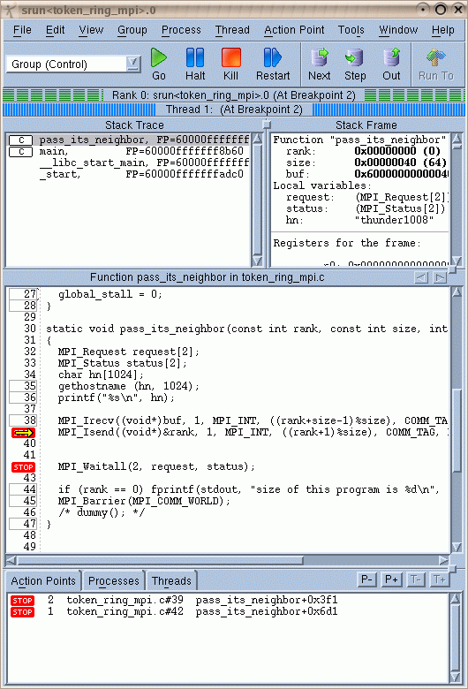
Debuggers: Typical 3rd Party Tools
Independent Execution
Fault isolation
External program control
Startup Options
Launch
Attach
Communication through OS’s debug interface
Start/stop process
Breakpoints
Read/write memory
Example: Totalview

Slide 222
Requirements for 3rd Party MPI Tools
Where to find all MPI processes?
Manual specification painful/impossible
Need a mechanism to identify host name/PID pairs
Process Acquisition
Typical process
Point debugger to this mechanism
Gather all host/PID information
Launch daemons on all hosts
Daemons use PID information to attach all MPI processes
Central debugger instances controls MPI processes through daemons

Slide 223
The MPIR Interface
Process Acquisition Interface for MPI
Not part of the MPI standard
Introduced by Cownie and Gropp, “A Standard Interface for Debugger Access to Message Queue Information in MPI”, EuroPVM/MPI 1999
Documented in an official MPI side document “The MPIR Process Acquisition Interface, Version 1.0”
Established as the de-facto standard
Implemented by all major MPI versions
Two components
Handshake protocol to gain control over MPI processes
Support for both launch and attach case
Access to a process table listing all MPI processes in a job
Assumes access through the debugger interface

Slide 224
The Basic Process
Launch case
Tool is launched first and then launches MPI job
Tool gains control right after startup and indicates its presence
MPI job detects tool presence and enables debug information
MPI job calls a well known routine / breakpoint
Attach case
Tool attached to “well-lknown” process and stops process
Tool indicates its presence and continues process
MPI job detects tool presence and enables debug information
MPI job calls a well known routine that can be used as a breakpoint
One “well-known” process implements MPIR
Either rank 0 or available on all ranks redundantly
Other option: MPIR implemented by resource manager

Slide 225
Handshake Protocol
Coordination performed through pre-defined symbols
Tool needs access to process’s symbol table
Translate symbol names into addresses
Handshake through shared variables
Written either by tool or by MPI library
Tool reads/writes variable through debug interface
Basic steps
Tool indicates its presence
Tool waits for acknowledgement from MPI
MPI detects tool presence
MPI fills out data structure containing the required information
MPI signals tools that information is present

Slide 226
The MPI Process Table
MPIR_proctable_size
Number of MPI processes created
MPIR_proctable
Variable containing a pointer to an array
One entry for each process
Contains host name and PIDs
Size of entry defined by MPIR_PROCDESC structure
Can/Should be queried through the symbol table

Slide 227
The Complete Picture MPIR

Slide 228
Status
MPIR is the de-facto standard
Available on basically all platforms
BUT: no official standardization
Slight variations and extensions have evolved
Documented in the MPIR side document
Limitations
MPI process table is a static, monolithic data structure
Can’t support dynamic processes
Not scalable to very large number of processes
Support for fault tolerance unclear
Plans for MPIR-2 in upcoming MPI versions

Slide 229
Minor MPI 3.0 enhancements
Cleanup
Query Minor Version
Matched Probe/Receive
New Communicator Creation Routines
New type creation routine
Support for Large Counts

Slide 230
Various Cleanup Items
Consistent use of [ ] in input and output arrays
Use of “const” in C bindings
Enables reading of buffers during asynchronous operations
Fixed and clarifications
MPI_Cart_map and MPI_Graph_map are local calls
Usage of MPI_Cart_map with num_dims=0
Fixes in text for routines returning strings
Fixes in examples
String limits for naming functions
MPI_TYPE_SET_NAME and MPI_TYPE_GET_NAME
MPI_WIN_SET_NAME and MPI_WIN_GET_NAME
New type routine: MPI_Type_create_hindexed_block

Slide 231
Version Queries
Applications can query the MPI Version
Call: MPI_Get_version(int *version, int *subversion)
Returns major/minor version of the implemented MPI standard
Drawback:
Does not provide any details about which MPI is used
Implementor
Version
Compilation options
Variant / Available options
Not helpful for bug reports/problem identification
New routine in MPI 3.0 to query implementation specific Version of the MPI library

Slide 232
Query Minor/Implementation Version
MPI_Get_library_version(char *version, int *len)
Returns a string in arbitrary format
Interface similar to MPI_get_processor_name
User must allocate buffer of at least size MPI_MAX_LIBRARY_VERSION_STRING and pass as “version”
MPI returns real length in “len”
Format of the version depends on the MPI implementation
Typically some kind of build string
Should return a different string for any change in behavior
Typical usage
Verbose mode of applications return version for documentation
Input for bug reports
Comparisons to ensure the presence of a specific library

Slide 233
Matched Probe/Receive
Probe/Receive function pairs cannot be used on a thread safe manner in MPI-2
Other thread can intercept the message that has been probed
Limits the ability to build some programming models on top of MPI
Need to provide state that couples receive with probe and helps identify dynamic matches
Some kind of tagging similar to requests
Decision to use new type: MPI_MESSAGE

Slide 234
Probes / Detailed
Added message argument to new probe calls
MPI_IMPROBE(source, tag, comm, flag, message, status)
MPI_MPROBE(source, tag, comm, message, status)
If successful, “keep” message and store in argument
Added new receive function that can reference a message argument
int MPI_Mrecv(void* buf, int count, MPI_Datatype datatype, MPI_Message *message, MPI_Status *status)
Int MPI_IMRECV(buf, count, datatype, message, request)
Receive only the previously probed message

Slide 235
New Communicator Creation Calls
MPI offers a series of calls to create communicators
Typically derived from another communicators
Collective, blocking routines
Example: MPI_Comm_split(comm,color,key,*newcomm)
Limitations and how to overcome them
Routines are blocking
New, non blocking creation routine
Routines are collective over parent communicator
Need to main collective behavior, but we can limit it to new members
New routines to build up communicators from local groups
No ability to create communicators for machine properties
MPI can not provide machine optimized communicators
Have to query them separately and use as key/color pairs

Slide 236
Nonblocking Communicator Duplication
Currently all communicator creations are blocking
Can’t overlap computation and communicator creation
Strict synchronization between all processes
int MPI_Comm_idup(MPI_Comm comm, MPI_Comm *newcomm, MPI_Request *request)
Similar to MPI_Split
Creates a request that can be waited on
Newcomm becomes active once requests completes

Slide 237
Noncollective Communicator Creation
Currently all ranks within the parent communicator have to participate in the creation of a new communicator
Restrictive and includes ranks that are not relevant
Non-scalable approach
int MPI_Group_comm_create(MPI_Comm in, MPI_Group grp, int tag, MPI_Comm *out)
Create communicator from group
Group operations are local
Call collective over all ranks of the MPI process that are members of the group

Slide 238
Machine specific communicators
Right now, all information for a new communicator must come from the applications
Typical pattern
Query system information (e.g., processes that share node)
Use information in MPI_Comm_split
MPI runtime may know data better
Idea: new communicator creation routine
Similar to MPI_Comm_split
Instead of key/value use a predefined split-type to drive partitioning
Besides that MPI_Comm_split rules apply
MPI_Info object allows this to be flexible and enables future extensions

Slide 239
New Comm_split variant
int MPI_Comm_split_type(MPI_Comm comm, int split_type, int key, MPI_Info info, MPI_Comm *newcomm)
Collective operation
Split-type specifies how to partition communicator
So far only one type defined in MPI 3.0
MPI_COMM_TYPE_SHARED to create a communicator for each domain that can share memory
Can be extended either by individual implementations/systems or in the next version of the standard
Key sorts ranks within each new commnicator
Options for future split-types
Communicators for capturing I/O nodes
Capture on-node NUMA domains

Slide 240
Large Counts
MPI-2 only supports integer as the “count” arguments
Typically 32bit, can’t be more on most platforms
Limits the size of messages
More importantly: Limits the file size in MPI I/O
Straightforward solution
Change “int” definition
Problem: destroys backwards compatibility
Alternate solution
Support the creation of new/large datatypes
Use datatypes combined with small counts
Maintains backward compatibility, but requires new functions to deal with larger count/size information

Slide 241
Changes For Large Counts
New types to safely capture more than 32bit
C: MPI_Count / Fortran: MPI_COUNT_KIND
MPI Datatype MPI_COUNT for message transfers
Creation routines need not to be modified
Create larger datatypes by combining small ones
Just internal count will be higher more than 32bit
Problem: users can query the size of types
Routines return an integer, which is limited to 32bit
Solution: new query routines
Existing routines return warning if count is too high
MPI_ UNDEFINED
User can then use the new set of routines to query these

Slide 242
New Type Query Routines
int MPI_Type_size_x (MPI_Datatype datatype, MPI_Count *size)
int MPI_Type_get_extent_x (MPI_Datatype datatype, MPI_Count *lb, MPI_Count *extent)
int MPI_Type_get_true_extent_x (MPI_Datatype datatype, MPI_Count *true_lb, MPI_Count *true_extent)
int MPI_Get_elements_x (MPI_Status *status, MPI_Datatype datatype, MPI_Count *count)

Slide 243
CONST Attribute in C Bindings
Most C bindings did not use “const” attributes for arrays
Even, though, array contents never changed
Prevented optimizations
MPI 3 adds “const” attribute where appropriate
Example:
Send buffer for asynchronous MPI communication
int MPI_Isend(const void* buf, int count, MPI_Datatype datatype, int dest, int tag, MPI_Comm comm, MPI_Request *request)
Consequences
Read access to MPI buffer now possible between MPI_Isend and MPI_Wait/MPI_Test calls
Now “officially” allows multiple sends from same buffer

Slide 244
Additional Items likely for MPI 3.0
Minor items
Clean up language for MPI_Init and MPI_Finalize
Updated and corrected examples
Deprecated functions moved to separate chapter
Removal of C++ bindings

Slide 245
Summary
MPI 3 will provide several new large additions
Nonblocking collectives
Neighborhood collectives
Updated RMA functionality
MPI Tool Information Interface
Many small additions and corrections
Cleanup items, incl. removal of deprecated functionality
Additions of missing functionality for MPI_Info objects
New variants for communicator creation
Nonblocking, Noncollective, Architecture-specific
Large counts for large file support
Updated examples

Slide 246
What’s next Towards MPI 3.1/4.0
Planned/Proposed Extensions

Slide 247
Fault Tolerance
Current model for MPI
If on process dies, all other processes die as well
Typical support for fault tolerance
Global checkpointing
On fault: restart entire MPI applications
Goal: enable continued operation of MPI application if individual nodes fail
Need: Ability to reason about state
Need: Ability to continue issue MPI calls not affected by error
High priority item for the MPI forum
Stabilization proposal is on the table
Many discussions, but was seen as not quite ready for MPI-3

Slide 248
Proposal
Target: node-level fail/stop errors
New option that failures don’t have to be fatal
Ability to deal with missing nodes
Communicators can be in error states
Can no longer be used for communication
Have to be globally acknowledged
By all remaining members through a new call
Before that: calls using the communicator will return error
After global acknowledgement
A new communicator with holes can be created
The old one can be deleted/revoked

Slide 249
Complications (1)
Collective operations
Failures can cause inconsistent return states
May already be done on certain nodes before failure
E.g., broadcast with failure not at root
Solution: Communicator set to error state on some nodes that are affected by the fault (at first)
Must wait for implicit propagation
Must eventually occur
At that time: communication will return error
Trigger global acknowledgement protocol
Application must roll back appropriately

Slide 250
Complications (2)
Wildcard receives
Failures can cause missing communication that we don’t know of ahead of time
Can cause wrong matches/deadlocks
Solution: temporarily suspend wildcards
Set non-resolved requests with wildcards to pending
Disallow new wildcard receives
Enable only after global resolution protocol
Application specific
User has to potentially restart communication

Slide 251
Beyond Stabilization
Current proposal allows to continue in case of hard node failure
Communicators will have holes
Reduced resources
Open issue / topic of debate
How to recover from a fault?
How to regain resources?
How about other error types?
Messaging/Link errors?
Transient errors?

Slide 252
Support for Hybrid Programming
How to support co-existence with other models?
MPI and UPC / MPI and OpenMP / MPI and CUDA
What is needed to make this work?
Issues
Thread support / interaction
Interference of MPI and application threads
Operation in LWK environments with limited thread support
Multiple ranks/MPI processes per OS process
How to keep state separate?
How to maintain existing MPI abstractions?
Exploitation of on node resources
Support for shared memory windows is a first step
What else can and should be done?

Slide 253
What’s next Towards MPI 3.1/4.0
Ideas for possible proposals

Slide 254
Piggybacking
Transparently attach data to messages
Uniquely associated with a specific message
Piggyback data added/removed without influencing application
Typically used for small amounts of data
Msg.
MPI_Send
Msg.
MPI_Send
Msg.
PB
PMPI_Send
PB
PMPI_Recv
PB
Msg.
PB
MPI_Recv
Msg.
MPI_Recv
Msg.

Slide 255
Use Cases
Fault Tolerance Protocols
Transparent propagation of checkpoint interval IDs
Message logging
Performance Analysis
Overhead propagation/detection
Critical path analysis
Late sender instrumentation
Debugging
MPI correctness tools
General
Transparent state propagation in libraries
Message matching

Slide 256
Piggybacking / Issues
Can be implemented on top of MPI, but
Most variants have correctness issues
All variants have performance issues
If implemented within MPI
Chance for optimization / low overhead
E.g., attach to header of any message
Question:
How to implement this without changing the standard too much?
How to maintain backwards compatibility?
How to enable clean PMPI wrapping?

Slide 257
Piggybacking / Alternatives
Duplicating all Send/Recv calls
Semantically clean version
But: large impact on standard
Two versions
Single piggyback of small data
Vector send/recv
Datatype templates
Optimization potential?
Attach to/Overload existing parameter
Semantically not clean
Attach to communicator through global setting
Thread safety?

Slide 258
Plans for MPIR-2
MPIR has two major drawbacks
Not scalable (single large table)
No support for dynamic process management
Not much used now
But: as impact on fault tolerance
Need extensions to support tools at exascale
Dynamical and distributed
Proposal from …
Exact plans to be discussed
Will likely again be a side document like MPIR-1

Slide 259
Summary
Major proposals for the next version of MPI
Fault tolerance
Asynchronous I/O
Enhanced support for hybrid programming models
Piggybacking
MPIR-2
There will be again many small additions and corrections
Timeline: open

Slide 260
Conclusions

Slide 261
Concluding Remarks
Parallelism is critical today, given that that is the only way to achieve performance improvement with the modern hardware
MPI is an industry standard model for parallel programming
A large number of implementations of MPI exist (both commercial and public domain)
Virtually every system in the world supports MPI
Gives user explicit control on data management
Widely used by many many scientific applications with great success
Your application can be next!

Slide 262
Web Pointers
MPI standard : http://www.mpi-forum.org/docs/docs.html
MPI Forum : http://www.mpi-forum.org/
MPI implementations:
MPICH : http://www.mpich.org
MVAPICH (MPICH on InfiniBand) : http://mvapich.cse.ohio-state.edu/
Intel MPI (MPICH derivative): http://software.intel.com/en-us/intel-mpi-library/
Microsoft MPI (MPICH derivative)
Open MPI : http://www.open-mpi.org/
IBM MPI, Cray MPI, HP MPI, TH MPI, …
Several MPI tutorials can be found on the web

