Slide 1
Operating System

Slide 2
Instructor information
University of Engineering and Technology
Faculty of Technology
Department of Information Systems
Name: Assoc. Prof. Nguyen Tri Thanh
Email: ntthanh@vnu.edu.vn

Slide 3
Materials
Textbook
  Abraham Silberschatz, Peter Baer Galvin, Greg Gagne, Operating System Concepts, 7th edition, John Wiley & Sons, Inc., 2005.

Slide 4
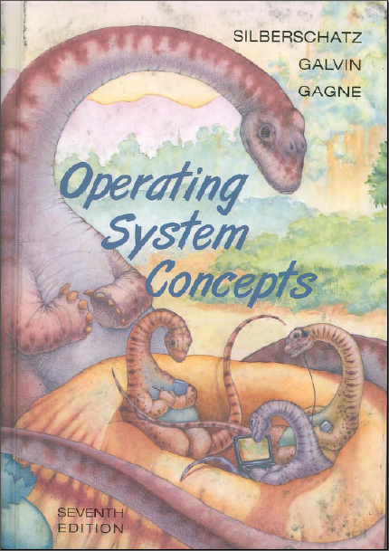
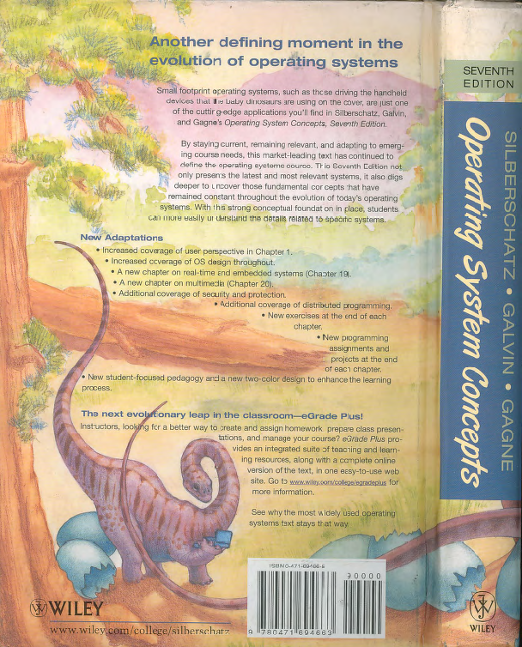
Materials

Slide 5
Materials
References
William Stallings, Operating Systems: Internals and Design Principles 5th edition, Prentice-Hall, 2005.
Andrew S. Tanenbaum, Modern Operating Systems, 2nd edition, Prentice-Hall, 2001.
Andrew S. Tanenbaum, Albert S Woodhull, Operating Systems: Design and Implementation, 3rd edition, Prentice-Hall. 2006.
Hà Quang Thụy, Nguyên lý hệ điều hành, NXB KHKT, 2002.

Slide 6
Materials cont’d
Delivery
Lecture will be presented in ENGLISH
Via course website http://courses.uet.vnu.edu.vn
ID Nguyên lý hệ điều hành (INT2206 5)

Slide 7
Course evaluation
Exam at every chapter
Midterm 30%~40%
Final exam 60%~70%
Students who are absent 3 or more classes will fail

Slide 8
Slide structure
Main content of the chapter
What you have to achieve
Chapter content (with lots of quizzes)
Shelf-study is required a lot

Slide 9
Anything not clear?
Any questions?

