Slide 1
Object oriented analysis and design
Module 6: Others UML Diagrams

Slide 2
Objectives
Demonstrate how to read and interpret a:
  State machine diagram
  Component diagram
  Deployment diagram
Notes:
Essentials of Visual Modeling w/ UML 2.0 - Instructor Notes
Introduce the objectives for this module.

Slide 3
Where Are We?
State machine diagrams
Component diagrams
Deployment diagrams
Notes:
Essentials of Visual Modeling w/ UML 2.0 - Instructor Notes
The goal for this section is to introduce, not teach everything about state machines.

Slide 4
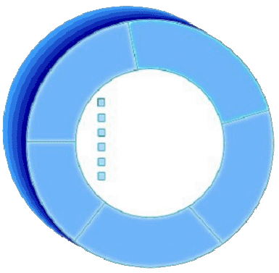
Review: An Object Has State
State is a condition or situation during the life of an object, which satisfies some condition, performs some activity, or waits for some event.
The state of an object normally changes over time.
Name: J Clark
Employee ID: 567138
HireDate: 07/25/1991
Status: Tenured
Discipline: Finance
MaxLoad: 3
Name: J Clark
Employee ID: 567138
Date Hired: July 25, 1991
Status: Tenured
Discipline: Finance
Maximum Course Load: 3 classes
Professor Clark
Notes:
Essentials of Visual Modeling w/ UML 2.0 - Instructor Notes
The state of an object is one of the possible conditions that an object may exist in, and it normally changes over time.
The state of an object is usually implemented by a set of properties called attributes, along with the values of the properties and the links the object may have with other objects.
State is not defined by a “state” attribute or set of attributes. Instead, state is defined by the total of an object’s attributes and links. For example, if Professor Clark’s status changed from Tenured to Retired, the state of the Professor Clark object would change.
Review the definition of state. The state of an object is primarily defined through its attributes.
In the next couple of slides, show the students that we will use the values of the Status attribute as a state in a state machine. The example of becoming a professor in the next slide is meant to explain how the state of an object changes over time.

Slide 5
Example: Professor
There are a sequence of events before an instructor becomes a University professor.
  Assistant professor (achieves tenure by producing a number of quality publications)
  Tenure/Associate professor
  Professor (based on seniority)
Notes:
Essentials of Visual Modeling w/ UML 2.0 - Instructor Notes
The example of someone becoming a college professor serves us well in explaining how a state machine works. When you are hired for a teaching position at the university, you begin as an assistant professor. Based on your successful publication of numerous quality papers, you receive tenure and the title of assistant professor. There is not an automatic time line for becoming an associate professor, it is based on producing and publishing quality papers. However after you have tenure, seniority makes you available for the next available professorship.
Before an instructor becomes a University professor, they are first an assistant and then an associate professor. Each of these states or steps must satisfy some condition.

Slide 6
What Are State Machine Diagrams?
A state machine diagram models dynamic behavior.
It specifies the sequence of states in which an object can exist:
  The events and conditions that cause the object to reach those states
  The actions that take place when those states are reached
Assistant
Professor
Tenured
Notes:
Essentials of Visual Modeling w/ UML 2.0 - Instructor Notes
A state machine diagram is typically used to model the discrete stages of an object’s lifetime. They show the sequences of state that an object goes through, the events that cause a transition from one state to another, and the actions that result from the state change. State machine diagrams are closely related to activity diagrams.
Each state represents a named condition during the life of an object in which it satisfies some condition or waits for some event. A state machine diagram typically contains one start and multiple end states. Transitions connect the various states on the diagram. Like activity diagrams, decisions, and synchronizations may also appear on state machine diagrams.
State machines are used to model the dynamic behavior of a model element, and more specifically, the event-driven aspects of the system's behavior. State machines are specifically used to define state-dependent behavior, or behavior that varies depending on which state the model element is in. Model elements whose behavior does not vary with the state, do not require state machines to describe their behavior. These elements are typically passive classes whose primary responsibility is to manage data.
Introduce the concept of state machines.
A state machine diagram shows a state machine, emphasizing the flow of control from state to state.
Using the previous example, J. Clarke was an associate professor before she achieved tenure and became a full Professor.
Another type of state machine that has been formalized in UML 2 is the Protocol State Machine. This is used to express usage protocols by defining rules on the invocation of operations or exchange of messages that a behavioral state machine or procedure may perform. This course does not cover these diagrams.

Slide 7
Special States
The initial state is the state entered when an object is created.
  An initial state is mandatory.
  Only one initial state is permitted.
  The initial state is represented as a solid circle.
A final state indicates the end of life for an object.
  A final state is optional.
  A final state is indicated by a bull’s eye.
  More than one final state may exist.
Applied
Notes:
Essentials of Visual Modeling w/ UML 2.0 - Instructor Notes
Explain the need for start and final states.
There is exactly one initial (start) state and 0..* final (end) states.
To emphasize why an initial state is mandatory, ask the students to think about how they would read a diagram without an initial state.
Note: Refer to the statement that “Only one initial state is permitted.” This is not always true. When you have nested states, there can be an initial state within each nested state AND the one outside of them.
The initial state indicates the default starting place for the state machine or sub-state. An initial state is represented as a filled black circle.
The final state indicates the completion of the execution of the state machine or the enclosing state. A final state is represented as a filled black circle surrounded by an unfilled circle.
Initial and final states are actually pseudo-states. Neither may have the usual parts of a normal state, except for a name.

Slide 8
What Are Events?
An event is the specification of a significant occurrence that has a location in time and space.
  An event is an occurrence of a stimulus that can trigger a state transition.
  Example:
    Successful publication of numerous papers
Event
Assistant
Professor
Tenured
Notes:
Essentials of Visual Modeling w/ UML 2.0 - Instructor Notes
In the context of the state machine, an event can be defined as an occurrence of a stimulus that can trigger a state transition. Events may include signals, calls, the passing of time, or a change in state.
A signal or call may have parameters whose values are available to the transition, including expressions for the guard conditions and action.
It is also possible to have a triggerless transition, represented by a transition with no event trigger. These transitions, also called completion transitions, are triggered implicitly when their source state has completed its action. They are implicitly triggered on the completion of any internal ‘do activity’ in the state.
Explain events on a state machine.

Slide 9
What Are Transitions?
A transition is a change from an originating state to a successor state as a result of some stimulus.
  The successor state could possibly be the originating state.
A transition may take place in response to an event.
Transitions can be labeled with event names.
Assistant
Professor
Tenured
maxPapers
Transition
Event Name
Notes:
Essentials of Visual Modeling w/ UML 2.0 - Instructor Notes
A Transition can be defined as:
A relationship between two states indicating that an object in the first state performs certain actions and enters a second state when a specified event occurs and specified conditions are satisfied. On such a change of state, the transition is said to “fire.” Until the transition fires, the object is said to be in the “source” state. After it fires, it is said to be in the “target” state.
You can show one or more state transitions from a state as long as each transition is unique. Transitions originating from a state can not have the same event unless there are conditions on the event.
The icon for a state transition is a line with an arrowhead pointing toward the destination state.
Label each state transition with the name of at least one event that causes the state transition. You do not have to use unique labels for state transitions because the same event can cause a transition to many different states but it is recommended that they have unique labels.
Explain transitions on a state machine.
Transitions are not bi-directional. If transitions need to run both ways between two states, you can draw two different transitions going in opposite directions.

Slide 10
Example: State Machine
Hired
accepted
Assistant
Professor
Applied
H
maxPapers
rejected
Tenured
seniority
retired
Professor
H
takeSabbatical
return
Hiatus
Notes:
Essentials of Visual Modeling w/ UML 2.0 - Instructor Notes
Provide a sample state machine for the students to read. Briefly explain the advanced concepts of the state machine that are not covered in detail in this course.
The Hired state is a composite state which means that it contains additional behavior inside the state.
The H within a circle is known as a history pseudo state or a return to history. When the accepted transition reaches history of the Hired state, since we have never been here before we go to the initial pseudo state.
The takeSabbatical transition is a group transition which means that any state inside of Hired can trigger this transition. When the return transition reaches history of the Hired state, we return to the state we were in last, i.e., if we were in the Tenured state when we took a Hiatus, we will return to the Tenured state upon reaching history.

Slide 11
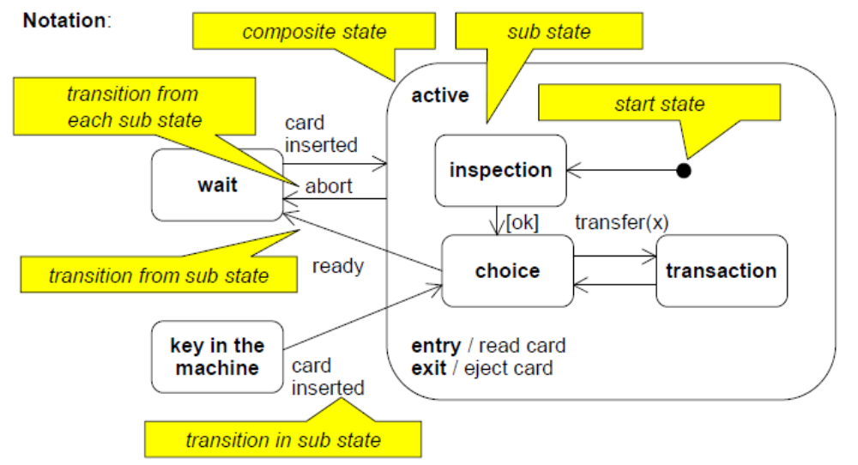
Composite States

Slide 12
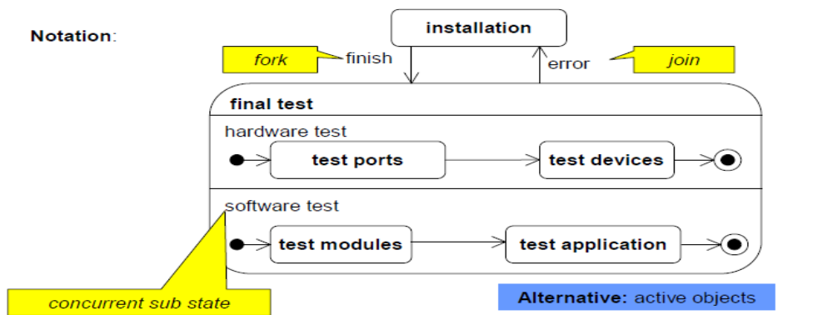
Concurrent Sub States
In a state several sequences of sub states described by own state machines can be performed concurrently.

Slide 13
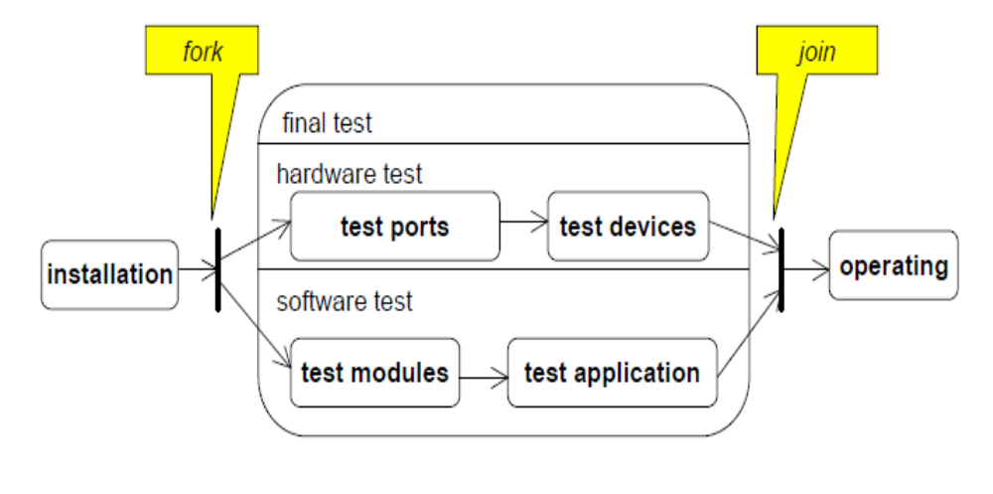
Concurrent Sub States: Alternative

Slide 14
Where Are We?
State machine diagrams
Component diagrams
Deployment diagrams
Notes:
Essentials of Visual Modeling w/ UML 2.0 - Instructor Notes

Slide 15
What Is a Component Diagram?
A diagram that shows the organizations and dependencies among components
<<component>>
<<component>>
ComponentA
ComponentB
<<component>>
<<component>>
ComponentC
ComponentD
Notes:
Essentials of Visual Modeling w/ UML 2.0 - Instructor Notes
Component diagrams commonly contain:
Components
Interfaces
Realization, implementation and usage dependencies
Classes
Artifacts
Ports
You use component diagrams to model a static view of a system. There is no significant distinction between a component diagram and a general class diagram. Both are examples of structure diagrams which depict elements in a specification that are irrespective of time.
Interfaces and ports are not covered in any detail in this course. Interfaces allow you to encapsulate, or hide, the implementation of a supplier. Ports are a structural notation used for interfaces.
Introduce the students to the concept of a component diagram.
Interfaces and ports are covered in detail in DEV475 Mastering Object-Oriented Analysis and Design with UML 2.0.

Slide 16
What Is a Component?
A modular part of a system that hides its implementation behind a set of external interfaces.
  Part of a logical or physical system
It conforms to and provides the physical realization of a set of interfaces.
It specifies the physical dependency to interfaces it requires.
<<component>>
<<component>>
Component Name
ComponentName
Provided Interface
Name
Required Interface
Name
Notes:
Essentials of Visual Modeling w/ UML 2.0 - Instructor Notes
Graphically, a component is shown as a rectangle with the keyword «component». Optionally, in the right hand corner, a component icon can be displayed. This icon is a small rectangle with two smaller rectangles protruding from its left hand side. The name of the component (as a type) is placed inside the outer rectangle.
A component is a modular part of a system that encapsulates its contents and whose manifestation is replaceable within its environment. A component defines its behavior in terms of provided and required interfaces.
A component represents a modular piece of a logical or physical system. Components satisfying the same interfaces may be freely substituted.
Introduce the students to the concept of a component.
Explain to the students that the component notation is backwards compatible to UML 1.x.
In UML 1.x, components were focused on the physical view. UML 2.0 has redirected this focus toward a more logical concept of a tightly encapsulated element so that they can be used in conceptual models.
The distinction between a structured class and a component is somewhat vague and more a matter of intent than firm
semantics.
Structured classes are covered in DEV475 Mastering Object-Oriented Analysis and Design with UML 2.0.

Slide 17
Where Are We?
State machine diagrams
Component diagrams
Deployment diagrams
Notes:
Essentials of Visual Modeling w/ UML 2.0 - Instructor Notes

Slide 18
What Is a Deployment Diagram?
The deployment diagram shows:
  Configuration of processing nodes at run-time
  Communication links between these nodes
  Deployed artifacts that reside on them
Notes:
Essentials of Visual Modeling w/ UML 2.0 - Instructor Notes
The purpose of the deployment diagram is to capture the configuration of processing elements, and the connections between processing elements in the system.
The deployment diagram consists of one or more:
Nodes (processing elements with at least one processor and memory)
Connectors between nodes and/or devices
The deployment diagram also maps processes on to these processing elements, allowing the distribution of behavior across nodes to be represented.
Introduce deployment diagrams to the students. Remember, this is new to them.

Slide 19
What Is a Node?
Represents a run-time computational resource
  Generally has at least memory and often processing capability.
Types:
  Device
    Physical computational resource with processing capability.
    May be nested
  Execution Environment
    Represent particular execution platforms
<<device>>
Device Name
<<device>>
Sub Device
Name
<<exe env>>
EE Name
Notes:
Essentials of Visual Modeling w/ UML 2.0 - Instructor Notes
The essential elements of a deployment diagram are nodes and their connectors. A node is a run-time physical object that represents a computational resource, generally having at least memory and often processing capability as well.
Execution Environment and device are types of node but the UML2 distinction between them is rather vague.
Devices may have artifacts deployed for execution software that controls the functionality of the device itself (physical computational resource with processing capability). Typical examples include <<print server>>, <<application server>>, <<client workstation>>, <<mobile device>>, <<embedded device>>, <<processor>>, etc. Devices may be complex and contain other devices.
Execution Environments represent particular execution platforms, such as an operating system (<<Win2K>>, <<VxWorks>>, etc.), a workstation engine (<<workstation engine>>), a database management system <<DB2>>), etc.
Explain a node on a deployment diagram.

Slide 20
What Is a Connector?
A connector represents a:
  Communication mechanism
    Physical medium
    Software protocol
<<client workstation>>
Kiosk
<<100-T Ethernet>>
<<application server>>
Server
Connector
<<RS-232>>
<<client workstation>>
Console
Notes:
Essentials of Visual Modeling w/ UML 2.0 - Instructor Notes
Connectors can be drawn between nodes. These connectors represent communication mechanisms and can be described by physical mediums (for example, Ethernet, fiber optic cable) or software protocol (for example, TCP/IP, RS-232). A stereotype may be used to specify the type of connector.
Explain a connector on a deployment diagram.

Slide 21
Example: Deployment Diagram
<<client workstation>>
PC
<<Campus LAN>>
0..2000
1
<<application server>>
Registration Server
1
<<Campus LAN>>
<<Campus LAN>>
1
1
1
<<legacy RDBMS>>
Course Catalog
<<legacy>>
Billing
System
Notes:
Essentials of Visual Modeling w/ UML 2.0 - Instructor Notes
Deployment diagrams show the configuration of run-time processing nodes. A deployment diagram may be at the class or instance level.
Deployment diagrams allow you to capture the topology of the system nodes. This allows you to visually see potential bottlenecks.
A deployment diagram contains nodes connected by associations. The associations indicate a communication path between the nodes.
The above diagram illustrates the deployment view for the Course Registration System.
There are PC client workstations on the campus network.
The main business processing hardware is the Registration Server. It talks to the two machines that host the legacy systems. All nodes are on the campus network.
Provide an example of a deployment diagram for the student to read.

Slide 22
Example: Deployment Diagram with Processes
<<client workstation>>
PC
StudentApplication
0..2000
<<Campus LAN>>
1
<<application server>>
Registration Server
1
CourseCatalogSystemAccess
CourseRegistrationProcess
BillingSstemAccess
1
<<Campus LAN>>
<<Campus LAN>>
1
1
<<legacy RDBMS>>
Course Catalog
<<legacy>>
Billing
System
Notes:
Essentials of Visual Modeling w/ UML 2.0 - Instructor Notes
The above diagram illustrates a refined deployment view for the Course Registration System.
There are PC client workstations on the campus network. Each running a StudentApplication process.
The main business processing hardware is the Registration Server running the CourseCatlogSystemAccess, CourseRegistrationProcess, and BillingSystemAccess processes. The Registration Server talks to the two machines that host the legacy systems. All nodes are on the campus network.
Provide an example of a deployment diagram for the student to read.

Slide 23
Tools for creating UML diagrams
Violet (free)
  http://horstmann.com/violet/
Rational Rose
  http://www.rational.com/
Visual Paradigm UML Suite (trial)
  http://www.visual-paradigm.com/
Notes:
Essentials of Visual Modeling w/ UML 2.0 - Instructor Notes
A. The state of an object is one of the possible conditions that an object may exist in, and it normally changes over time. The state of an object is usually implemented by a set of properties called attributes, along with the values of the properties.
B. State machine diagrams model the dynamic behavior of individual objects. They show the sequences of states that an object goes through, the events that cause a transition from one state to another, and the actions that result from a state change.
C. A diagram that shows the organization of and dependencies among a set of components.
D. The purpose of a deployment diagram is to capture the configuration of processing elements, and the connections between processing elements in the system.

Slide 24

Review
Define state. How do you determine the classes with significant state?
What is a state machine diagram? Describe the different parts of the diagram.
What is a component diagram?
What is the purpose of a deployment diagram?
Notes:
Essentials of Visual Modeling w/ UML 2.0 - Instructor Notes
A. The state of an object is one of the possible conditions that an object may exist in, and it normally changes over time. The state of an object is usually implemented by a set of properties called attributes, along with the values of the properties.
B. State machine diagrams model the dynamic behavior of individual objects. They show the sequences of states that an object goes through, the events that cause a transition from one state to another, and the actions that result from a state change.
C. A diagram that shows the organization of and dependencies among a set of components.
D. The purpose of a deployment diagram is to capture the configuration of processing elements, and the connections between processing elements in the system.

