Slide 1
Object oriented analysis and design
Module 3: Use-Case and Activities Diagrams

Slide 2
Objectives
Demonstrate how to read and interpret:
  A use-case diagram
  An activity diagram

Slide 3
Where Are We?
Use-case diagrams
Activity diagrams

Slide 4
What Is an Actor?
Actors represent roles a user of the system can play.
They can represent a human, a machine, or another system.
They can actively interchange information with the system.
They can be a giver of information.
They can be a passive recipient of information.
Actors are not part of the system.
  Actors are EXTERNAL.
Actor

Slide 5
What Is a Use Case?
Defines a set of use-case instances, where each instance is a sequence of actions a system performs that yields an observable result of value to a particular actor.
  A use case models a dialogue between one or more actors and the system
  A use case describes the actions the system takes to deliver something of value to the actor
Use Case

Slide 6
Use Cases and Actors
A use case models a dialog between actors and the system.
A use case is initiated by an actor to invoke a certain functionality in the system.
Use Case
Association
Actor

Slide 7
How Would You Read This Diagram?
View Report Card
Course Catalog
Maintain Professor
Information
Register for Courses
Student
Login
Maintain Student
Information
Registrar
Select Courses to
Teach
Close Registration
Professor
Submit Grades
Billing System

Slide 8
Where Are We?
Use-case diagrams
Activity diagrams

Slide 9
What Is an Activity Diagram?
An activity diagram in the use-case model can be used to capture the activities and actions performed in a use case.
It is essentially a flow chart, showing flow of control from one activity or action to another.

Slide 10
What Is an Activity?
A specification of behavior expressed as a flow of execution via sequencing of subordinate units.
  Subordinate units include nested activities and ultimately individual actions.
May contain boolean expression constraints when the activity is invoked or exited

Slide 11
Example: Activity Diagram
Decision
Concurrent Threads
Select Course
[ delete course ]
Delete Course
[ add course ]
Synchronization
Bar (Fork)
Guard
Condition
Check
Check
Schedule
Pre-requisites
Synchronization
Bar (Join)
[ checks completed ]
[ checks failed ]
Assign to
Resolve
Transition
Course
Conflicts
Update
Schedule

Slide 12
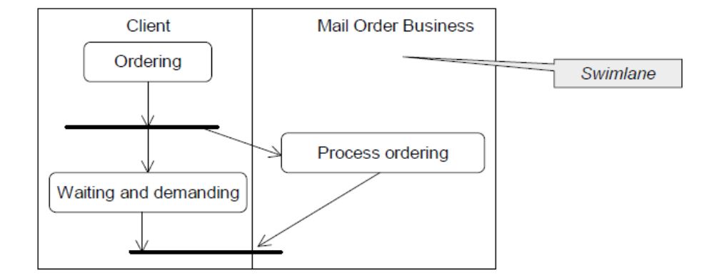
Swimlanes
A swimlane shows the actions and activities being executed by a unit, an object or a class, mostly concurrent to other actions/activities.

