Slide 1
Introduction To Rational Rose

Slide 2
What is Rational Rose?
ROSE = Rational Object Oriented Software Engineering
Rational Rose is a set of visual modeling tools for development of object oriented software
Rose uses the UML to provide graphical methods for non-programmers wanting to model business processes as well as programmers modeling application logic

Slide 3
HOWTO
Create New Class, Sequence, or Use Case Diagram –Right click in browser over “Use Case View” or “Logical View” and select New Diagram
Delete – Deleting modeling items is very odd in Rational Rose
  Diagram – Right Click on Diagram name and select delete
  Class from Diagram – <DEL> Key
  Class or Message from Model - <CNTRL-D>

Slide 4
HOWTO (2)
Modify properties of Objects
  Double Click on Object in Class Diagram View
  Right Click “New Attribute” to add
  Right Click and modify properties in “Browser”
Attach a File, URL, or note to something to describe it better
  Double click on Object to open it
  Tab to Files
  Right click to “Insert File”
  Add File

Slide 5
More Information
Getting the program:
  http://www-01.ibm.com/software/rational/
Online Tutorials for Rational Rose - http://www.rational.com/products/rose/gstart/online.jtmpl
Rose Whitepapers http://www.rational.com/products/rose/prodinfo/whitepapers/index.jtmpl
Rose Architect E-Magazine http://www.rosearchitect.com/mag/index.shtml

Slide 6
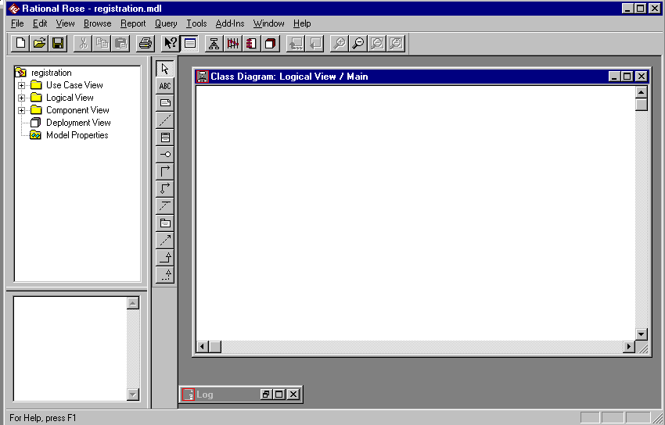

Rational Rose
Standard
Toolbar
Browser
Documentation
Window
Status
Bar
Diagram Toolbar
Diagram Window

Slide 7
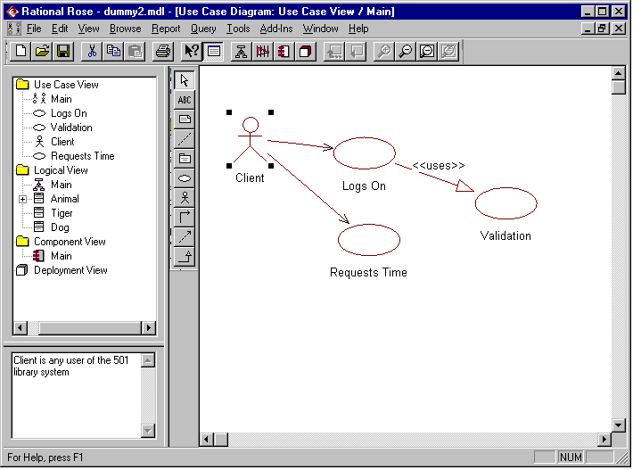

Slide 8
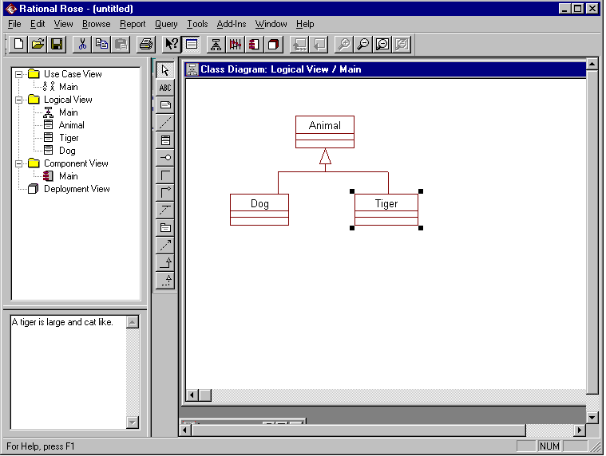

Slide 9
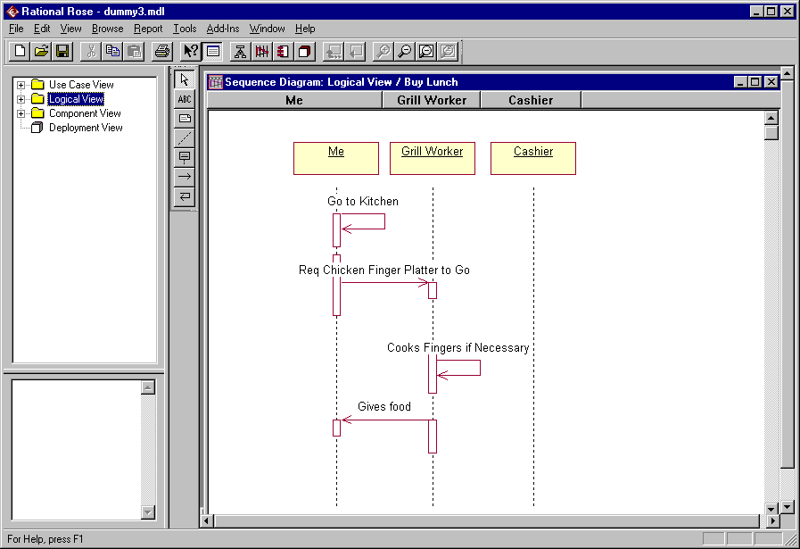

Slide 10
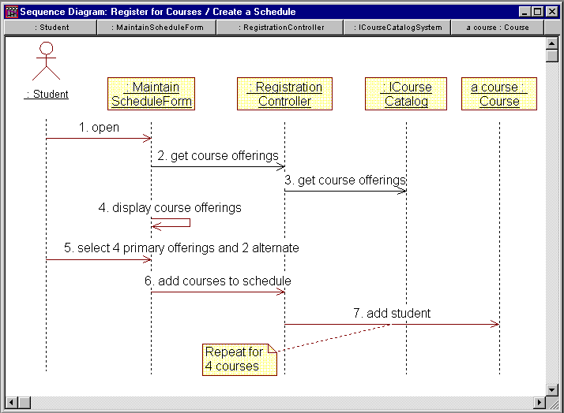
Sequence Diagram

Slide 11
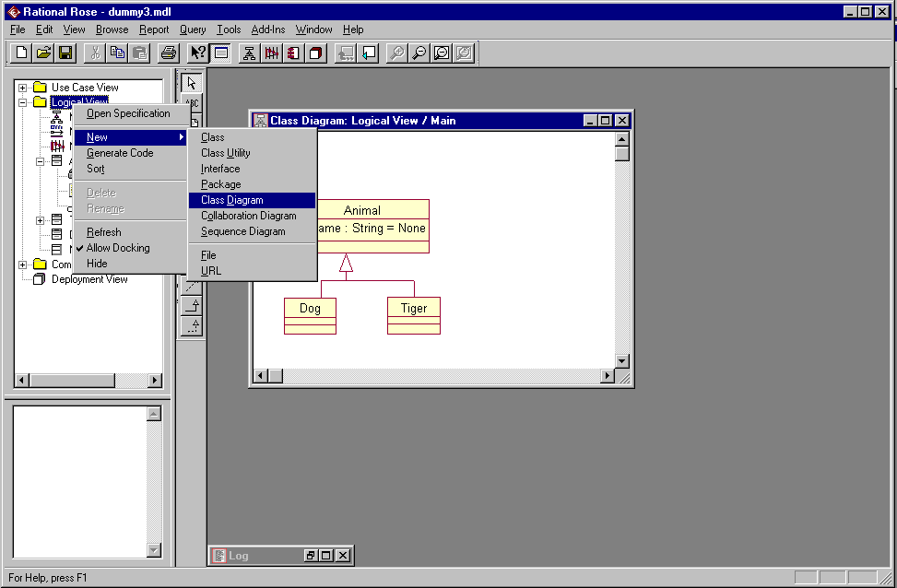

Slide 12
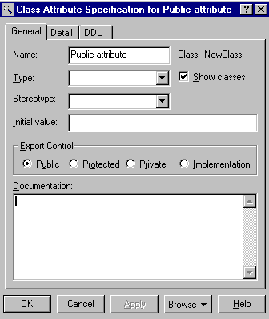
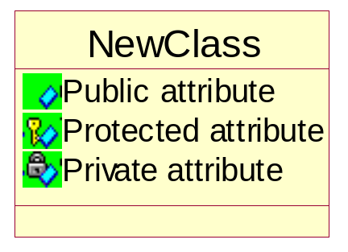
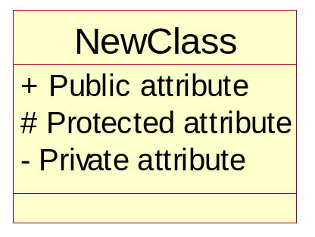
Attribute Visibility Options

Slide 13
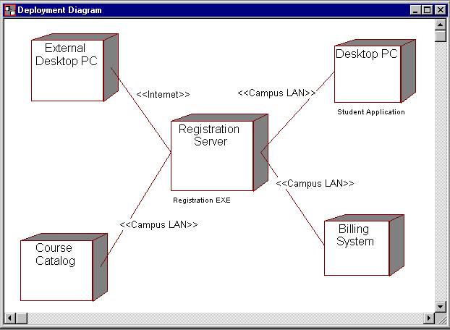
Deployment Diagram

