Slide 1
Object oriented analysis and design
Module 6: Best practices of Software Engineering

Slide 2
Objectives: Best Practices
Identify symptoms of software development problems
Explain the Best Practices
Present the Rational Unified Process (RUP) within the context of the Best Practices.

Slide 3
Symptoms of Software Development Problems
User or business needs not met
Requirements not addressed
Modules not integrating
Difficulties with maintenance
Late discovery of flaws
Poor quality of end-user experience
Poor performance under load
No coordinated team effort
Build-and-release issues

Slide 4
Trace Symptoms to Root Causes
Symptoms
Root Causes
Best Practices
Insufficient requirements
Ambiguous communications
Brittle architectures
Overwhelming complexity
Undetected inconsistencies
Poor testing
Subjective assessment
Waterfall development
Uncontrolled change
Insufficient automation
Modules do not fit
Ambiguous communications
Undetected inconsistencies
Needs not met
Requirements churn
Modules don’t fit
Hard to maintain
Late discovery
Poor quality
Poor performance
Colliding developers
Build-and-release
Develop Iteratively
Manage Requirements
Use Component Architectures
Model Visually (UML)
Continuously Verify Quality
Manage Change

Slide 5
Best Practices Reinforce Each Other
Best Practices
Develop Iteratively
Manage Requirements
Use Component Architectures
Model Visually (UML)
Continuously Verify Quality
Manage Change
Ensures users are involved
as requirements evolve
Validates architectural
decisions early on
Addresses complexity of
design/implementation incrementally
Measures quality early and often
Evolves baselines incrementally

Slide 6

Develop Iteratively
Iterative development produces an executable
3. Requirements
4. Analysis & Design
2. Planning
1. Initial
Planning
5. Implementation
Management
Environment
(on-going)
6. Test
8. Evaluation
7. Deployment
Each iteration results in an executable release

Slide 7
Managing Requirements
Ensures that you
  solve the right problem
  build the right system
by taking a systematic approach to
  eliciting
  organizing
  documenting
  managing
the changing requirements of a software application.

Slide 8
Use Component Architectures
Software architecture needs to be:
Component-based | Resilient
Reuse or customize components Select from commercially available components Evolve existing software incrementally | Meets current and future requirements Improves extensibility Enables reuse Encapsulates system dependencies

Slide 9
Purpose of a Component-Based Architecture
Basis for reuse
  Component reuse
  Architecture reuse
Basis for project management
  Planning
  Staffing
  Delivery
Intellectual control
  Manage complexity
  Maintain integrity
Application-
specific
Business-
specific
Middleware
System-
software

Slide 10
Model Visually (UML)
Captures structure and behavior
Shows how system elements fit together
Keeps design and implementation consistent
Hides or exposes details as appropriate
Promotes unambiguous communication
  The UML provides one language for all practitioners.

Slide 11
Visual Modeling with the Unified Modeling Language
Static Diagrams
Class
Diagrams
Use-Case
Diagrams
Sequence
Diagrams
Object
Diagrams
Communication
Diagrams
Component
Diagrams
Models
State Machine
Diagrams
Deployment
Diagrams
Activity
Diagrams

Slide 12
Continuously Verify Quality
Software problems are
100 to 1000 times more costly
to find and repair after deployment
Cost to Repair Software
Cost of Lost Opportunities
Cost of Lost Customers
Cost
Inception
Elaboration
Construction
Transition

Slide 13
Testing Dimensions of Quality
Usability
Test application from the perspective of convenience to the end user.
Functionality
Reliability
Test the accurate workings of each usage scenario.
Supportability
Performance
Test the ability to maintain and support the application under production use.
Test the online response under average and peak loading.

Slide 14
Manage Change
To avoid confusion, have:
  Secure workspaces for each developer
  Automated integration/build management
  Parallel development
Workspace
Management
Process
Integration
Parallel
Development
Build
Management

Slide 15
Manage Change (continued)
Unified Change Management (UCM) involves:
  Management across the lifecycle
    System
    Project management
  Activity-based management
    Tasks
    Defects
    Enhancements
  Progress tracking
    Charts
    Reports

Slide 16

Rational Unified Process Implements Best Practices
Best Practices
Process Made Practical
Develop Iteratively
Manage Requirements
Use Component Architectures
Model Visually (UML)
Continuously Verify Quality
Manage Change

Slide 17
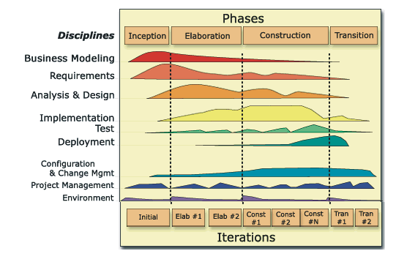
Achieving Best Practices
Iterative approach
Guidance for activities and artifacts
Process focus on architecture
Use cases that drive design and implementation
Models that abstract the system

Slide 18
A Team-Based Definition of Process
A process defines Who is doing What, When, and How, in order to reach a certain goal.
New or changed
requirements
Software Engineering
Process
New or changed
system

Slide 19
Process Structure - Lifecycle Phases
The Rational Unified Process has four phases:
  Inception – Define the scope of the project
  Elaboration – Plan the project; specify features and baseline architecture
  Construction – Build the product
  Transition – Transition the product into the end-user community
Inception
Elaboration
Construction
Transition
Time

Slide 20



Bringing It All Together: The Iterative Approach
In an iteration, you walk through all disciplines.
Disciplines group activities logically.

Slide 21
Summary
Best Practices guide software engineering by addressing root causes.
Best Practices reinforce each other.
Process guides a team on who does what, when, and how.
The Rational Unified Process is a means of achieving Best Practices.

