Slide 1




FUTSA
A WEB BASED FUTSAL BOOKING SYSTEM

Slide 2

Team Members
Saroj Aryal [19180079]
Chiranjibi Ranabhat [19180056]
Suraj Gautam [19180089]
Amrit Adhikari [19180047]

Slide 3
Introduction
Futsa is technical way of managing the futsal booking process. It is developed to assist everyone who loves to play futsal and are futsal owners.
Notes:
Big data is a fast emerging topic among both industry and academia, it is featured by 3Vs: Volume, Variety and Velocity. Volume is size of data. Variety is different type of data industry generating i.e. structured, semi-structured and unstructured. Velocity is the speed data is generating. The main challenge for big data is that how to extract required information within given time limit.
Therefore, several big data processing tools emerge, like Hadoop[1] and Storm. Hadoop is mostly used for off-line data processing, whereas Storm is adequate for on-line stream process. Nowadays,more data-intensive applications and technologies require online massive data processing instead of traditional store then-process system with minimum latency.

Slide 4
Problem Statement
Waste of time to reserve futsal with conventional method.
Difficulty in finding the futsals near your location.
Conflict may arise when multiple teams arrive at the same time.
Record of booking in log book.

Slide 5
Objectives
To find nearby and easily accessible futsals.
To eradicate complicated phone based booking processes.
To enable the users to book the playing schedule.

Slide 6
Features
User can access or view all futsals registered in the system.
User can book any futsal at available time. (Login Required)
User can search the futsals nearest to your location.
User can compare and select cheap and feasible futsals.
Owner account can view and manage the booking.

Slide 7
Methodology

Slide 8

Technology Used
React Js ( Frontend )
Tailwind Css ( Css Prefixer )
Node Js ( Backend Language )
MongoDB ( Database System )
Flutter ( For mobile app)

Slide 9
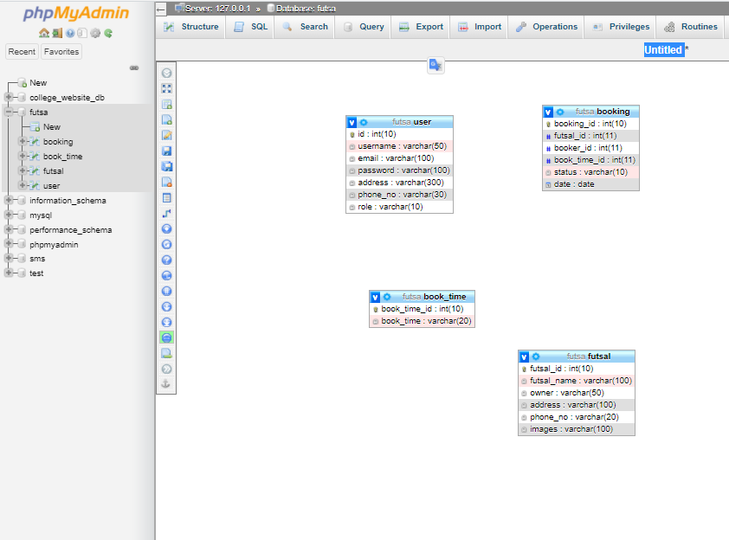
Class Diagram

Slide 10
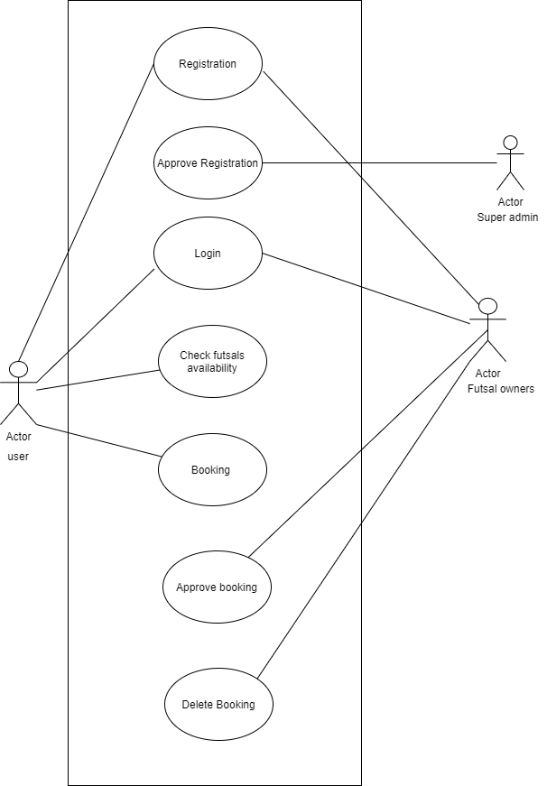
Use Case Diagram

Slide 11
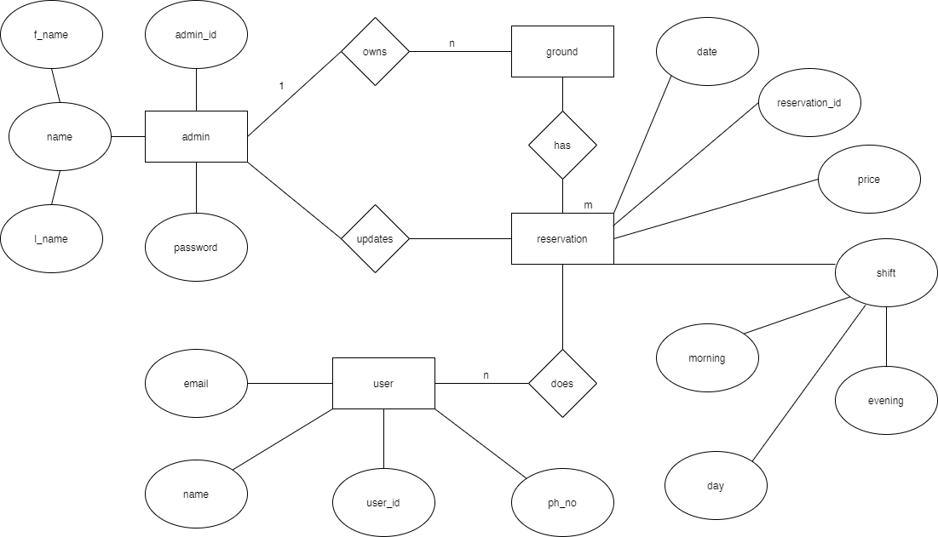
E-R Diagram

Slide 12
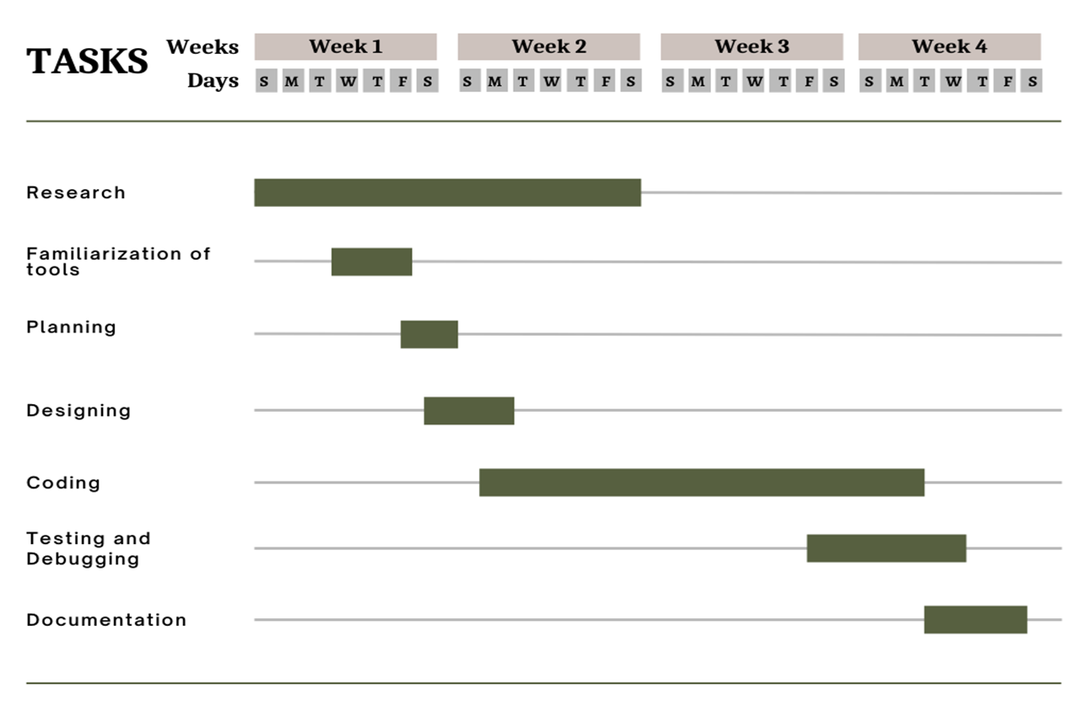
Gantt Chart

Slide 13
Expected Outcomes
FUTSA is an ambitious project focused on technical way of managing the futsal booking process.
Easiest and reliable method to book futsal.
Good means for futsal owners to display their futsals on web.
Users can easily find a suitable futsal as per their need and time availability.
Notes:
we evaluate our operator scale out approach with respect to time, load and threshold value
The test cases in our experiments are randomly generated. The followings are the details:
Parameters B, W, and D are randomly generated such that they are uniformly distributed within interval of [1, 10], [30, 60], and [40, 50], respectively. [B, W] The best case execution time and the worst case execution time of task i. D The relative deadline of
The execution time of an operator is assumed to be evenly distributed between interval of [B, W] i.e. f_{i}(t) = 1 ÷ (W_{i} - B_{i}).
G, L were assumed to be linear functions, i.e. G(t)= -ag*(t - D) in the range of [0, D] and L(t) = al*t. The gradient for G(t) and L(t), i.e.ag and al were randomly chosen from the interval of [4, 10] and [1, 5], respectively.
G(t) The profit TUF, which represents the profit accrued when a task is completed at time t. We assume G(t) is a non-increasing unimodal function before its deadline, i.e. G(t’i)>=G(t’j) if if t’i<=t’j and G(t) = 0 if t >=D;
L_{i}(T) :The penalty TUF, which represents the penalty, suffered when a task is discarded or aborted or exceeded deadline at time t. We assume L_{i}(T) is a non-decreasing unimodal function before its deadline, i.e. L_{i}(T’i) <=L_{i}(T’j) if t’i<=t’j , and a task is immediately discarded once it missed its deadline;
Operator execution Task release times intervals follow the exponential distribution with 𝜆 = 5.
The utility threshold 𝛿 is set 13075.579. This is average value of four operators. For each operator we run our experiment 60 times and then take average of generated value. There are four average values, each for one operator. Finally we again take average value of these four operator average value and we get 13075.579.
P_{i}(t): Size of stream tuples are generated randomly in the range of [128,1024] KB.
c_{i}(t): Cpu utilization is generated randomly in the range of [0, 1] for task i.
m_{i}(t): Memory utilization is also generated randomly in the range of [0, 1] for task i.
Each experiment was run 60 times and we report averaged measurements for more accuracy.

Slide 14
Future Work
Tournament Organization And Management.
Recruitment, Transparency, Availability Of Skilled Players.
Live Feed And Stream of Tournaments and Important Matches.
Nepali language interface.
Event booking systems.
Mobile Application for IOS.

Slide 15
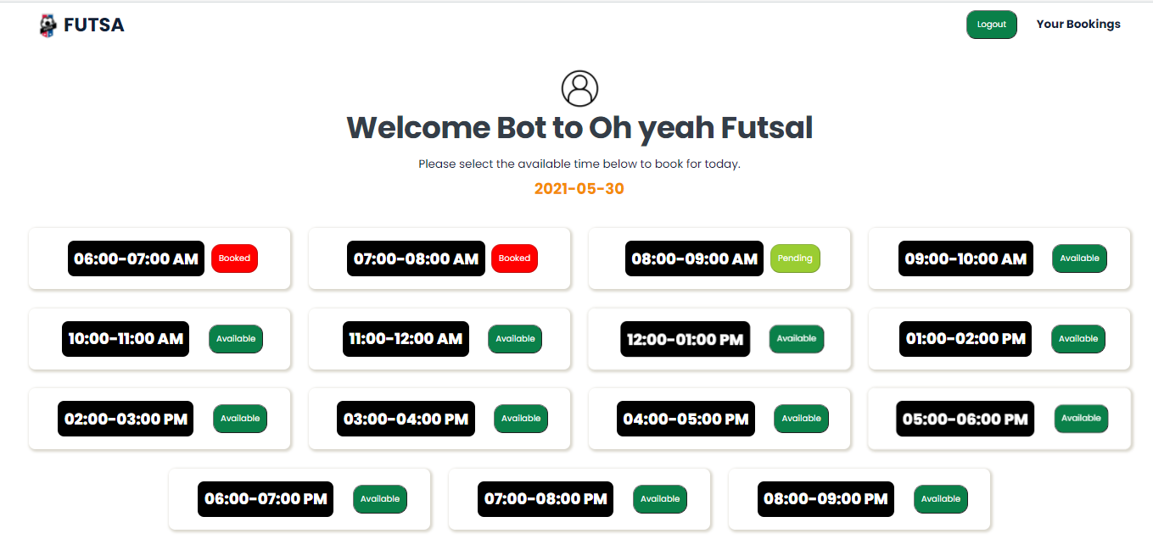
User interface - Book Futsal ( User )

Slide 16
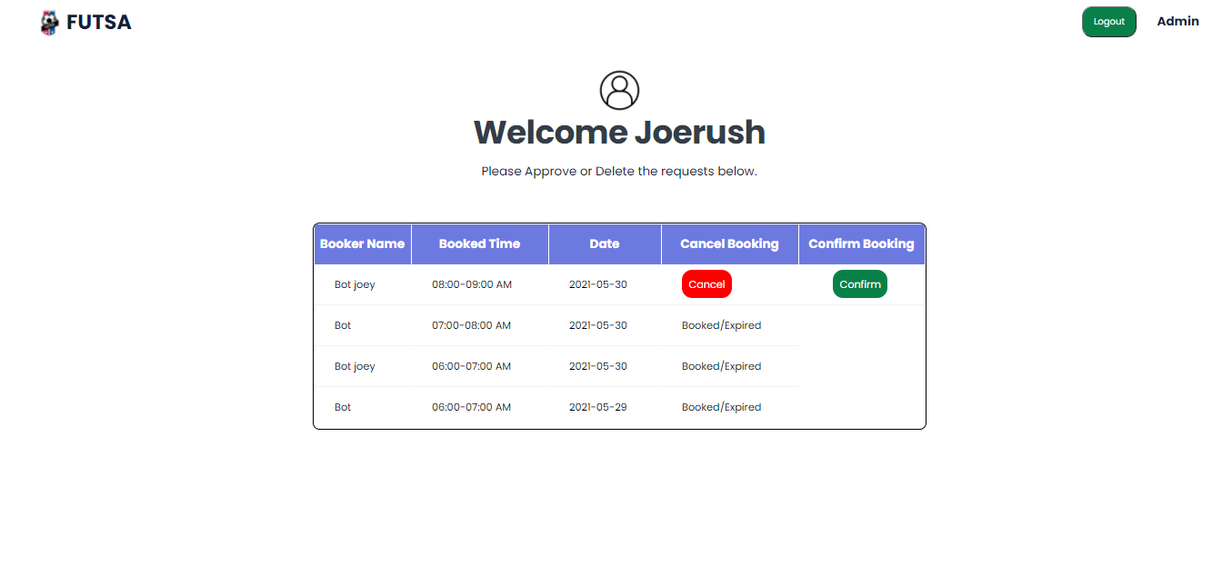
User interface - Futsal Owners Dashboard

Slide 17
Any Questions ?

Slide 18
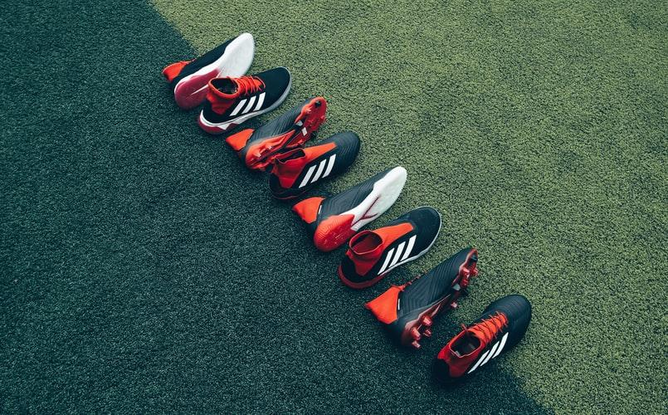

Thank You !!!

