Slide 1
Developing for Node.js in Visual Studio
@debug_mode
Dhananjay Kumar
Developing for Node.js

Slide 2
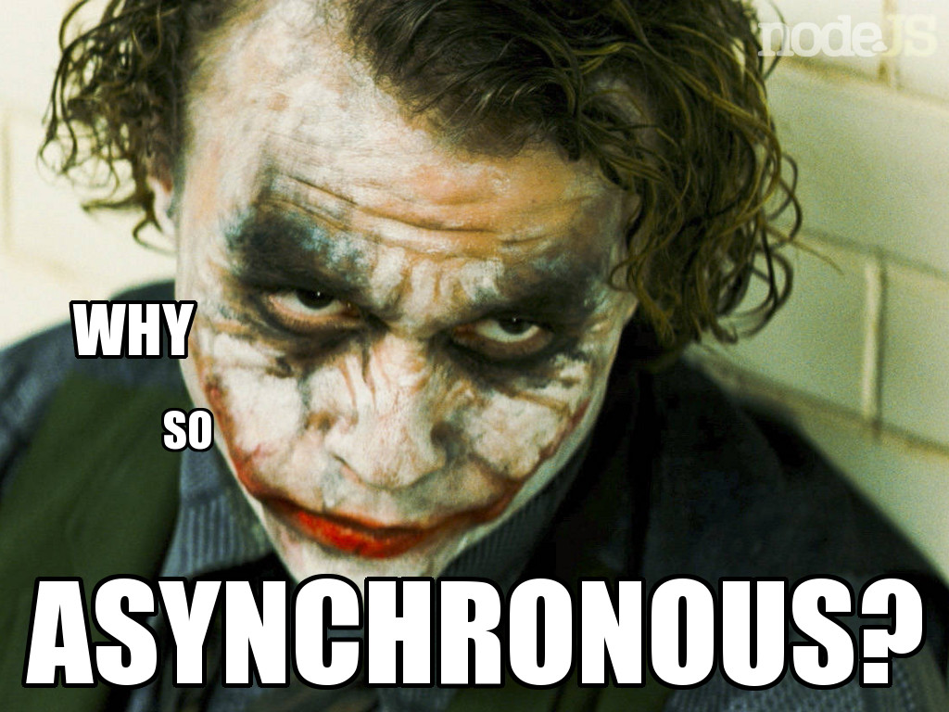
Agenda
What is this buzz Node
Create first HTTP Server : Demo
How Node works ?
Understanding EventLoop and Callback
Create Echo Server : Demo
Create app to upload large file asynchronously : Demo
Create routers using Crossroads : Demo
Create REST API using Express and Visual Studio : Demo

Slide 3
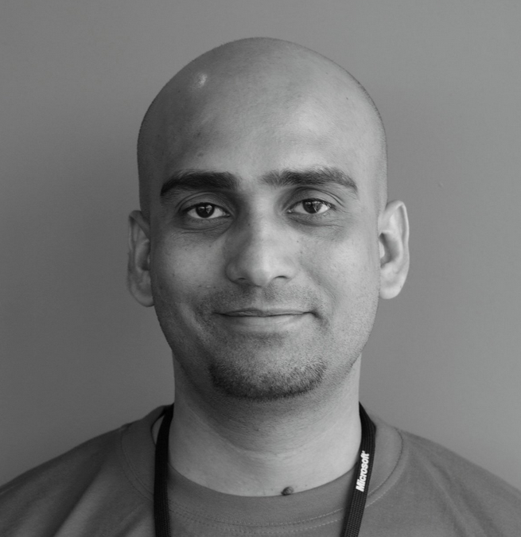
Your Presenter
Dhananjay Kumar
Evangelist , Telerik
Microsoft MVP
Mentror C-Sharpcorner
@debug_mode
http://debugmode.net
http://telerikhelper.net
Dhananjay.kumar@telerik.com

Slide 4
What is Node.js ?
Asynchronous Event Driven Server Side JavaScript
Runs on Google JS V8 Engine
Non-blocking I/O and File API
Highly Scalable
Single Threaded
Node Apps are created using JavaScript
Faster in performance

Slide 5
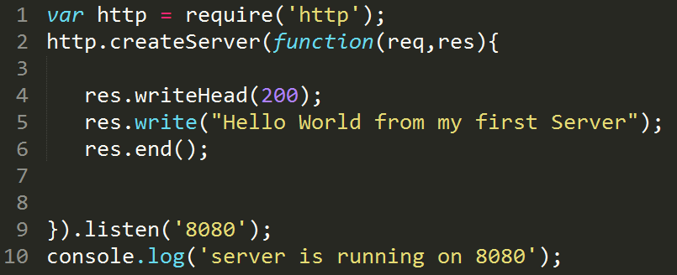
Demo : Create first web Server

Slide 6
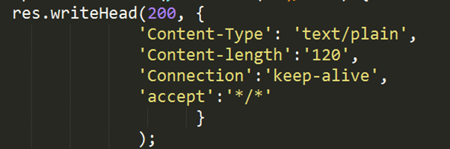
Let us understand code line by line
Line 1
Loading http module
It is required to work with HTTP request and response
It is required to create HTTP Server
Line 4
Writing response header
It takes a JSON object as optional second parameter
second parameter contains informations like
Content Length
Content Type
Connection
Accept Type
Line 2
Create server using createServer() function
It takes a callback as parameter . It takes HTTP request and response as paramtere
Callback got two input parameter .
Both input parameters are readable and writeable stream

Slide 7
Let us understand code line by line
Line 9
createServer() method is finished with chained http.Server.listen() method
It specifies port number on which request will be listen
Optional host name
Line 5-6
Writing data in response
Data can be written in form of string or buffer
ServerResponse.end indicates the communication has been finished
Line 10
Printing a message

Slide 8
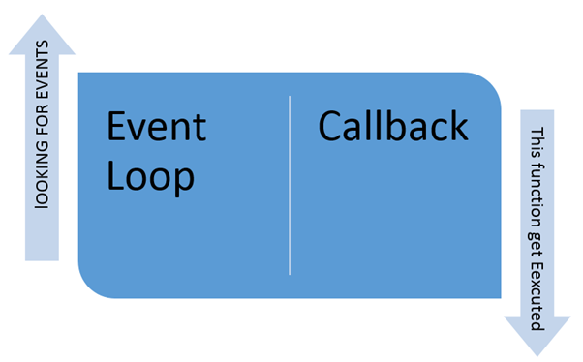
How Node works ?
It works on single thread
It handles all request asynchronously on same thread
It does not create new thread for each request which is very unlikely like other web servers
It does not wait to complete a request
Keep poling for event in EventLoop
When gets event process asynchronously and assign a CallBack
CallBack get executed once event execution is complete

Slide 9
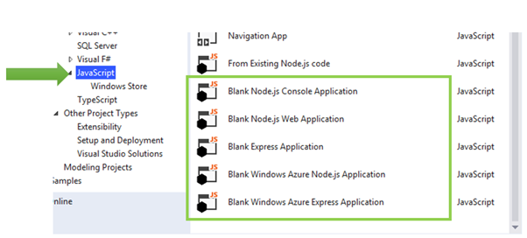
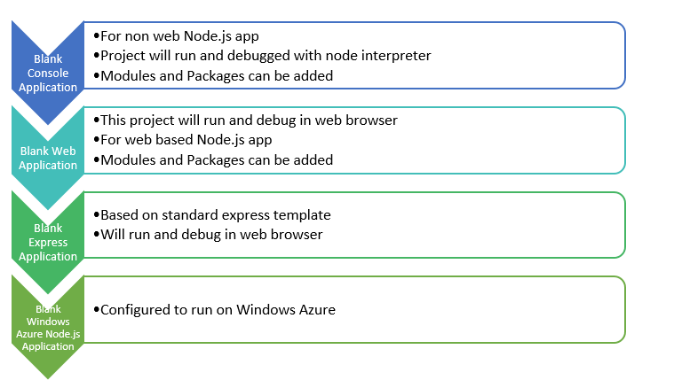
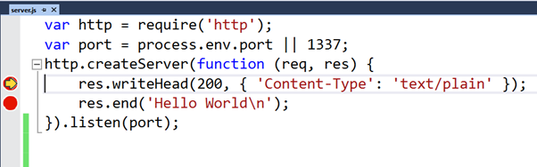
Visual Studio and Node
Manage NPM Modules
Notes:
https://nodejstools.codeplex.com/releases/view/114437 : download from here

Slide 10
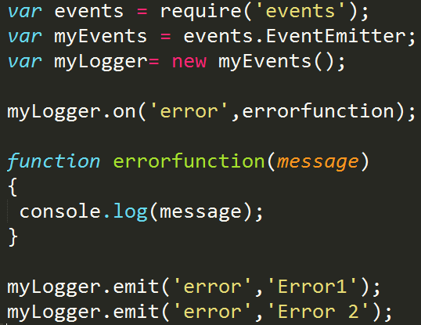
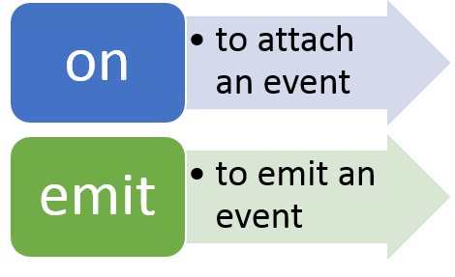
Events in Node
Each objects in Node emit an asynchronous event.
event is handled by an object EventEmitter.
EventEmitter is underneath every object.
Notes:
https://nodejstools.codeplex.com/releases/view/114437 : download from here

Slide 11
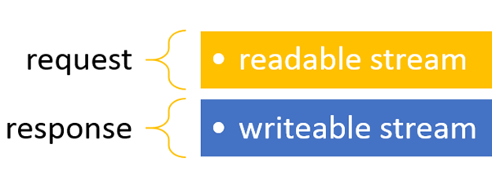
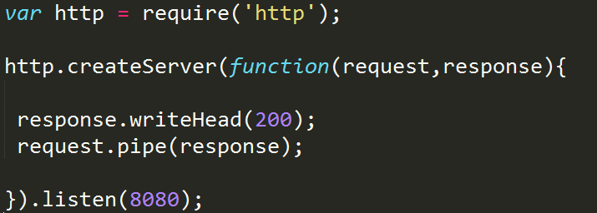
Streams in Node
Demo on echo server
Demo on uploading file asynchronously

Slide 12
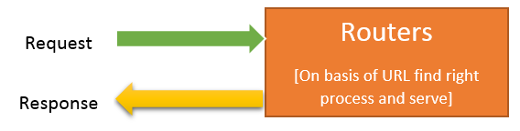
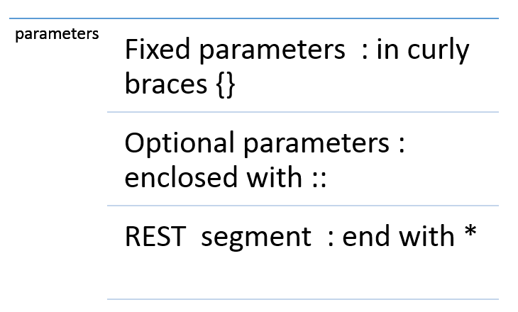
Routers in Node
Modules to create Routers
Express
Director
Bouncy
Backbone
Crossroads
Demo add routes using Crossroads

Slide 13
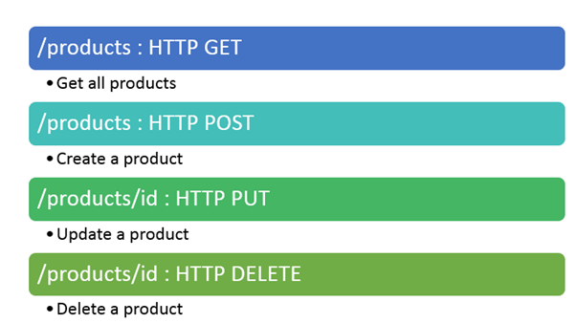
Demo : REST API on Node.js
Export data from a Module
Add routes in Express
Map routes to function
Test in fiddler
Use Visual Studio Template

Slide 14
Thanks & Questions?
@debug_mode

