Slide 1

FLOATING TRASH DETECTION
Team No: 1
Project Advisor: B Saranya Devi
Sl. No. | Reg. No. | Name Of The Student
1 | BL.EN.U4CSE23009 | EASWER A
2 | BL.EN.U4CSE23024 | KIRAN KISHORE
3 | BL.EN.U4CSE23057 | VARUN S

Slide 2
INTRODUCTION
Water pollution, specifically floating debris, poses a severe threat to aquatic ecosystems.
Manual cleanup is inefficient; automated systems utilizing Computer Vision are required.
Project Scope:
Implementing and comparing 7 distinct models (YOLO variants, RT-DETR, UNET, DBSCAN) to identify "tiny" objects (32 X 32 pixels) in challenging water environments.

Slide 3
PROBLEM STATEMENT
Core Issue: Detecting "Tiny" Objects.
Objects often occupy less than 0.5% of the image.
Feature Loss: Tiny objects disappear in deep network layers due to down-sampling.
Background Interference: Water ripples, reflections, and variable lighting mimic debris features.
Imbalanced Loss: Standard detection metrics (IoU) penalize small object errors more harshly than large ones.

Slide 4
Literature Survey
SL. NO. | AUTHORS | PAPER | INFERENCE
1 2 3 4 | Li, K. et al. (Base Paper) Zhang, L., et al. Lin, F., et al. Yi, Z., et al. | Feature augmentation and scale penalty for tiny floating detection 2023 (Springer) Real-time detection of river surface floating object based on improved RefineDet 2021 (IEEE Access) Improved YOLO based detection algorithm for floating debris in waterway 2021 (Entropy) Detection and localization for lake floating objects based on CA-Faster R-CNN 2022 (Multimedia Tools) | Proposed enhanced YOLOv4 with Feature Augmentation Module (FAM) and Scale Penalty to preserve tiny object features. Result: 94.6% mAP on Flow-RI dataset. Improved RefineDet to handle the poor robustness of traditional algorithms against changing water backgrounds and illumination. Addressed the speed limitations of image processing by proposing an optimized YOLOv5s for real-time monitoring of waterways. Proposed a "Context-Aware" network combined with Faster R-CNN to solve the issue where bounding boxes fail to accurately localize amorphous floating trash.

Slide 5
Literature Survey
SL.NO. | AUTHORS | PAPER | INFERENCE
5 6 7 8 | Cheng, Y., et al. Kisantal, M., et al. Liu, W., et al. Lin, T-Y., et al. | Robust small object detection... through fusion of camera and mm-wave radar 2021 (ICCV) Augmentation for small object detection 2019 (arXiv) SSD: Single Shot MultiBox Detector 2016 (ECCV) Feature Pyramid Networks for Object Detection 2017 (CVPR) | Proposed fusing RGB images with millimeter-wave radar point clouds to overcome visual limitations like illumination and distortion. Addressed the lack of training samples for tiny objects by "Copy-Pasting" small objects multiple times into images to increase gradient contribution. Introduced multi-scale detection using low-level feature maps for small objects and high-level maps for large objects. Proposed Top-Down and Lateral connections (FPN) to build high-level semantic feature maps at all scales, crucial for small object visibility

Slide 6
RESEARCH GAPS AND CHALLENGES
Gap 1: The "Small Object" Dilemma: Most state-of-the-art models (SOTA) optimize for medium/large objects (COCO metrics). Tiny objects (<32px) are often treated as noise.
Gap 2: Real-time Constraint: Heavy models (like Transformers) are accurate but too slow for a moving boat. Lightweight models (YOLO Nano) lose accuracy.
Gap 3: Environmental Noise: Sun glint, ripples, and reflections on water are often misclassified as debris (False Positives).
Feature Disappearance: Most standard backbones (ResNet, DarkNet) downsample images by 32x32 object becomes 1x1 pixel, effectively vanishing.
Conflicting Information: Fusing high-level (semantic) and low-level (spatial) features often creates noise, obscuring tiny targets¹⁵.
IoU Metric Bias: A 1-pixel shift in a prediction box for a tiny object causes a massive drop in IoU compared to the same shift for a large object.

Slide 7
DESIGN
YOLOv11-P2 (The Tiny Specialist)
Design Flow: Input (1024x1024) -> Backbone (C1, C2 (P2)) -> Neck (High-Res Feature Fusion) -> Head (Detect at P2 level) -> Output
Modules:
P2 Layer Utilization: Extracts features at 4x downsampling (instead of standard 8x/32x) to keep small objects visible.
High-Res Input: Processing at 1024px to maximize pixel density for tiny debris.
2. YOLOv5 & YOLOv8 (The Baselines)
Design Flow: Input (640x640) -> CSPDarknet Backbone -> PANet Neck (Feature Pyramid) -> Decoupled Head (v8) / Coupled Head (v5) -> Output
Modules:
C2f Module (v8): Richer gradient flow for feature extraction.
Anchor-Free Head (v8): Directly predicts object center, reducing the complexity of anchor box matching for small irregular trash boundaries.
Pixel Classification: Classifies every single pixel as "Water" or "Trash".

Slide 8
DESIGN
3. RT-DETR (Real-Time Transformer)
Design Flow: Input -> CNN Backbone -> Hybrid Encoder (Attention) -> Transformer Decoder -> Prediction Heads -> Output
Modules:
Self-Attention: Mechanisms that look at the entire image at once, helping distinguish debris from global water patterns (ripples).
IoU-aware Query Selection: Selects object queries based on quality, improving accuracy on difficult targets.
4. UNET (Semantic Segmentation)
Design Flow: Input -> Encoder (Downsampling) -> Bottleneck -> Decoder (Upsampling + Skip Connections) -> Pixel-wise Mask
Modules:
Skip Connections: Concatenates encoder features with decoder features to recover precise spatial details of
5. DBSCAN (Unsupervised Clustering)
Design Flow: Input Image -> Preprocessing (HSV/Gray) -> Feature Extraction (Edges/Blobs) -> Density Clustering (DBSCAN) -> Bounding Box Gen -> Output
Modules:
Density Reachability: Groups pixels that are close together (trash) and marks sparse areas (water) as noise.
No Training: Detects anomalies purely based on pixel density without a dataset.

Slide 9
MODULES
MODEL | CORE MODULES | FUNCTION
YOLOv11 P2 | C3k2 Block | Faster feature extraction with adaptive kernel sizes.
 | C2PSA | Spatial Attention module to focus on object regions.
 | P2 Head | Critical: Detection at 4x downsampling (vs 8x standard).
RT-DETR | AIFI | Intra-scale feature interaction (Attention based).
 | CCFM | Cross-scale feature fusion (CNN based).
YOLOv5/v8 | C2f / CSP | Cross-Stage Partial networks for gradient flow.
UNET | Skip Connections | Copy high-res features from encoder to decoder to fix boundaries.

Slide 10
IMPLEMENTATION DETAILS
Model | Epochs Trained | Precision (P) | Recall (R) | mAP @ 50 | mAP @ 50-95 | Inference
YOLOv8 | 100 | 0.941 | 0.932 | 96.0% | 0.601 | Best Overall. Highest strict accuracy (50-95).
YOLOv5 | 100 | 0.944 | 0.946 | 97.1% | 0.538 | Best Detection Rate. Highest mAP@50.
YOLOv11-P2 | 50 | 0.918 | 0.918 | 95.6% | 0.570 | Excellent for Tiny Objects. High performance despite fewer epochs.
RT-DETR | 50 | 0.944 | 0.949 | 94.0% | 0.549 | Competitive with base paper, comparable to v11.
YOLOv11s | 50 | 0.927 | 0.925 | 94.4% | 0.540 | Lower performance than P2/v8 on this specific task.
Base Paper | N/A | N/A | N/A | 94.6% | N/A | Benchmark (YOLOv4 + FAM).

Slide 11
IMPLEMENTATION DETAILS
Metric | Value | Interpretation
Best Val IoU (Trash) | 0.8166 | The model achieved 81.7% overlap between predicted and actual trash pixels. This is a high score for irregular floating debris.
Training Loss | 0.0127 | Indicates the model converged well without overfitting (Validation IoU remained stable).
Epochs | 50 | Best model saved at Epoch 39.
UNET
Metric | Value | Interpretation
Silhouette Score | 0.8105 | Measures how similar an object is to its own cluster compared to other clusters. A score of 0.81 (max 1.0) indicates excellent separation - the trash objects are distinct and dense.
Noise Ratio | 0.49% | Only 0.49% of radar points were classified as noise, meaning the sensor data was very clean and the algorithm effectively utilized almost all data points.
Total Objects | 6,280 | Total potential floating objects detected across 2,227 frames.
DBSCAN

Slide 12
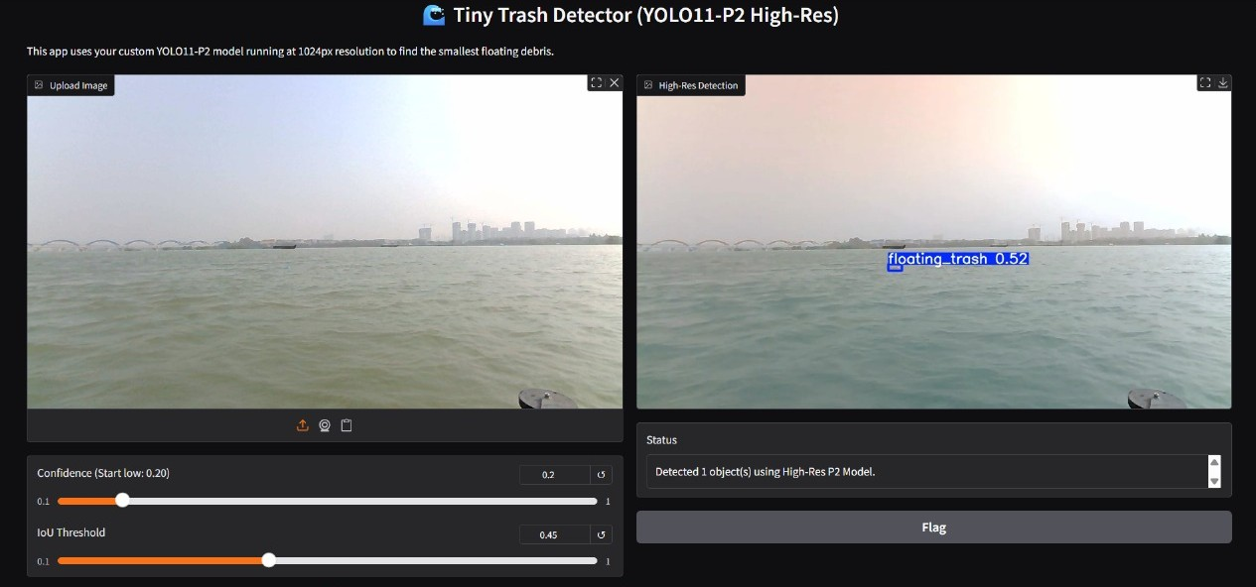
UI (Dataset)

Slide 13
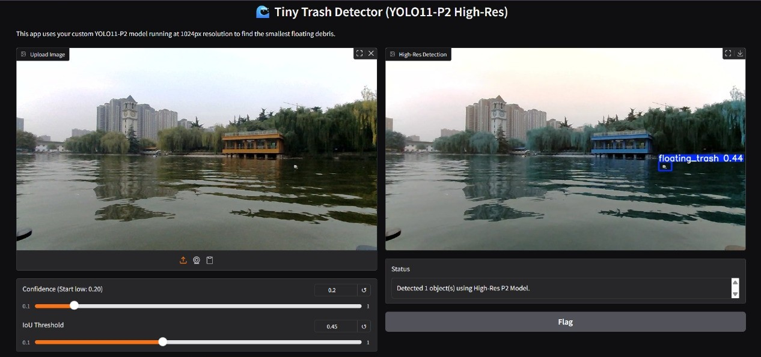
UI (Random image)

Slide 14
References
[Base Paper] K. Li, Y. Wang, W. Li, S. Shen, S. Duan, and L. Wang, "Feature augmentation and scale penalty for tiny floating detection," International Journal of Machine Learning and Cybernetics, vol. 15, pp. 853–862, Sep. 2023. [Online]. Available: https://doi.org/10.1007/s13042-023-01943-1
L. Zhang, Y. Wei, H. Wang, Y. Shao, and J. Shen, "Real-Time Detection of River Surface Floating Object Based on Improved RefineDet," IEEE Access, vol. 9, pp. 81147–81160, 2021. [Online]. Available: https://ieeexplore.ieee.org/document/9447209
F. Lin, T. Hou, Q. Jin, and A. You, "Improved YOLO Based Detection Algorithm for Floating Debris in Waterway," Entropy, vol. 23, no. 9, p. 1111, Sep. 2021. [Online]. Available: https://www.mdpi.com/1099-4300/23/9/1111
Z. Yi, D. Yao, G. Li, J. Ai, and W. Xie, "Detection and localization for lake floating objects based on CA-Faster R-CNN," Multimedia Tools and Applications, vol. 81, no. 12, pp. 17263–17281, 2022. [Online]. Available: https://link.springer.com/article/10.1007/s11042-022-12404-3
Y. Cheng, H. Xu, and Y. Liu, "Robust Small Object Detection on the Water Surface Through Fusion of Camera and Millimeter Wave Radar," in Proceedings of the IEEE/CVF International Conference on Computer Vision (ICCV), Montreal, QC, Canada, 2021, pp. 15263–15272. [Online]. Available: https://ieeexplore.ieee.org/document/9607684
M. Kisantal, Z. Wojna, J. Murawski, J. Naruniec, and K. Cho, "Augmentation for small object detection," arXiv preprint arXiv:1902.07296, 2019. [Online]. Available: https://arxiv.org/abs/1902.07296
W. Liu et al., "SSD: Single Shot MultiBox Detector," in Computer Vision – ECCV 2016, Amsterdam, The Netherlands, 2016, pp. 21–37. [Online]. Available: https://link.springer.com/chapter/10.1007/978-3-319-46448-0_2
T.-Y. Lin, P. Dollár, R. Girshick, K. He, B. Hariharan, and S. Belongie, "Feature Pyramid Networks for Object Detection," in Proceedings of the IEEE Conference on Computer Vision and Pattern Recognition (CVPR), Honolulu, HI, USA, 2017, pp. 2117–2125. [Online]. Available: https://ieeexplore.ieee.org/document/8099589
J. Leng, Y. Ren, W. Jiang, X. Sun, and Y. Wang, "Realize your surroundings: Exploiting context information for small object detection," Neurocomputing, vol. 433, pp. 287–299, 2021. [Online]. Available: https://doi.org/10.1016/j.neucom.2020.12.093
Y. Bai, Y. Zhang, M. Ding, and B. Ghanem, "SOD-MTGAN: Small Object Detection via Multi-Task Generative Adversarial Network," in Proceedings of the European Conference on Computer Vision (ECCV), Munich, Germany, 2018, pp. 206–221. [Online]. Available: https://openaccess.thecvf.com/content_ECCV_2018/html/Yancheng_Bai_SOD-MTGAN_Small_Object_ECCV_2018_paper.html

Slide 15
THANK YOU

