Slide 1
Project Management and theming
Project management for software
HTML and CSS

Slide 2
Recap – Class 1
We installed a LAMP stack using Vagrant
  L – Linux
  A – Apache
  M – MySQL
  P – PHP
Installed Git, set up on github
Installed better text editors
Notes:
open-source Web development platform, also called a Web stack, that uses Linux as the operating system, Apache as the Web server, MySQL as the RDBMS and PHP as the object-oriented scripting language.
LAMP has become a de facto development standard. Today, the products that make up the LAMP stack are included by default in nearly all Linux distributions, and together they make a powerful web application platform.
Linux operating system. Stuff executes on it
Apache - Within the standard Apache HTTPD project, these include modules for caching data, providing different authentication and security environments, and supporting a wide range of management functionality, such as Web site traffic. Although complex at first, Apache can be easily installed and configured and then largely forgotten about. It is safe, secure, and self-managing, and it needs little attention to keep it running.

Slide 3
Agile Manifesto
Individuals and interactions over Processes and tools
Working software over Comprehensive documentation
Customer collaboration over Contract negotiation
Responding to change over Following a plan
That is, while there is value in the items on the right, we value the items on the left more
Notes:
Agile principles[edit]
The Agile Manifesto is based on twelve principles:[8]
Customer satisfaction by rapid delivery of useful software
Welcome changing requirements, even late in development
Working software is delivered frequently (weeks rather than months)
Close, daily cooperation between business people and developers
Projects are built around motivated individuals, who should be trusted
Face-to-face conversation is the best form of communication (co-location)
Working software is the principal measure of progress
Sustainable development, able to maintain a constant pace
Continuous attention to technical excellence and good design
Simplicity—the art of maximizing the amount of work not done—is essential
Self-organizing teams
Regular adaptation to changing circumstances
One of the differences between agile and waterfall is that testing of the software is conducted at different stages during the software development life-cycle. In the Waterfall model, there is always a separate testing phase near the completion of an implementation phase.

Slide 4
Flavors of Agile
Scrum
  Sprint items, defined roles. Scrum master enforces processes.
XP
  Smaller springs, frequent checkpoints, pair programming, code review. Frequent cross testing, higher quality of code.
Kanban
  One item at a time, incremental development, no set roles for team members
Notes:
-- Scrum team should have the three main roles – Product Owner, Scrum Master and a cross-functional Development Team. The product owner assumes maximum responsibility with the success of the product, ROI and the sprint deliverables. The Scrum master however, is the main arbitrator for Scrum and ensures that continuous integration and best practices are adhered to.
Lets not forget the most popular aspect of Scrum – the standup daily Scrum meetings. Ladies and Gentlemen, these meetings are not just to stare at and compare each other’s footwear. ☺ Its a quick, succinct standup meeting meant to address what each person in the team did yesterday, what they plan to do today and what roadblocks they face to achieve their goals. It’s a great recap of what everyone in the team is trying to achieve.
Apart from the daily scrums, there are other periodic meetings for sprint planning, sprint demo and addressing backlogs and caveats. When done right (which many companies don’t), this can be extremely effective for lean software development. - See more at: http://www.acquia.com/blog/agile-software-development-cracking-code#sthash.g13SNwpc.dpuf
-- CP: XP is a programming methodology primarily meant to improve the quality of code that teams deliver. Along with smaller sprints, XP encourages frequent checkpoints in the form of pair programming and code review. There is frequent cross testing and validation of code quality and best practices. - See more at: http://www.acquia.com/blog/agile-software-development-cracking-code#sthash.g13SNwpc.dpuf
-- Kanban: The underlying concept of incremental development resonates with Kanban just as it does with Scrum, but it is quite different from typical scrum management. Kanban does not impose a set of roles for team members. In fact, one of the principles of Kanban is to get started with what we have now and change how we function. The basic idea is to not overwhelm the developers with a set of sprint action items like we do in Scrum. With Kanban, the team creates a framework around the workflow of the development process allowing developers to pull out and work on a single action item at a time. - See more at: http://www.acquia.com/blog/agile-software-development-cracking-code#sthash.g13SNwpc.dpuf
See more at http://www.acquia.com/blog/agile-software-development-cracking-code

Slide 5
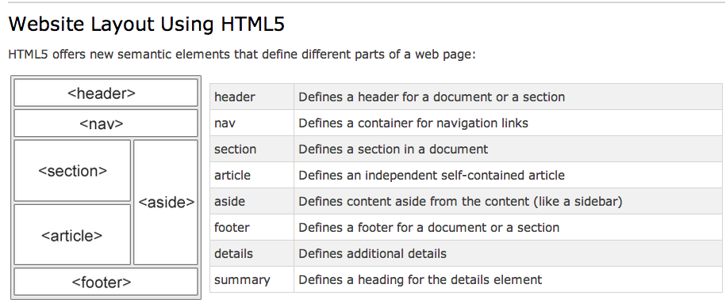
Common HTML tags
div, span
ul, ol, li
h1, h2, h3..
html
body, p
id=“unique”, class=“attribute”
table, tr, td, thead, tbody
Notes:
The foundation. A house with no paint, no wiring.

Slide 6
CSS
display: block | inline-block | inline | table-cell | none | initial;
position: absolute|fixed|relative|initial|inherit;
float: none|left|right|initial|inherit;
Padding: length in px, pt, em;
Margin: auto | length in px, pt, em;
List-style: (disc|circle|none) (inside|outside) (none|url|initial|inherit);
Width: auto|px|em|%;
Height: auto|px|em|%;
Border: px (solid|dotted) color;
Z-index: number;
<head>
<style>
body { background-color:lightgrey; }
h1 { color:blue; }
p { color:green; }
</style>
</head>
Notes:
Paint, carpets, furniture, etc

Slide 7
Responsive design
em (or %) before px
media queries
  e.g.
  @media all and (min-width: 800px) and (max-width: 1024px) {...}
Mobile first
Notes:
Mobile first is simpler, and then the other stuff doesn’t need to load then be hidden. So, faster

Slide 8
Creating a layout
http://learnlayout.com/display.html
http://webdesignerwall.com/tutorials/css-responsive-navigation-menu
http://w3schools.com
We will add to this list together

Slide 9
Drupal theming
Zen theme
“Zen is a powerful, yet simple, HTML5 starting theme with a responsive, mobile-first grid design.”
https://www.drupal.org/project/zen

