Slide 1
Progress Update
Transformers for Antimicrobial Resistance Prediction

Slide 2
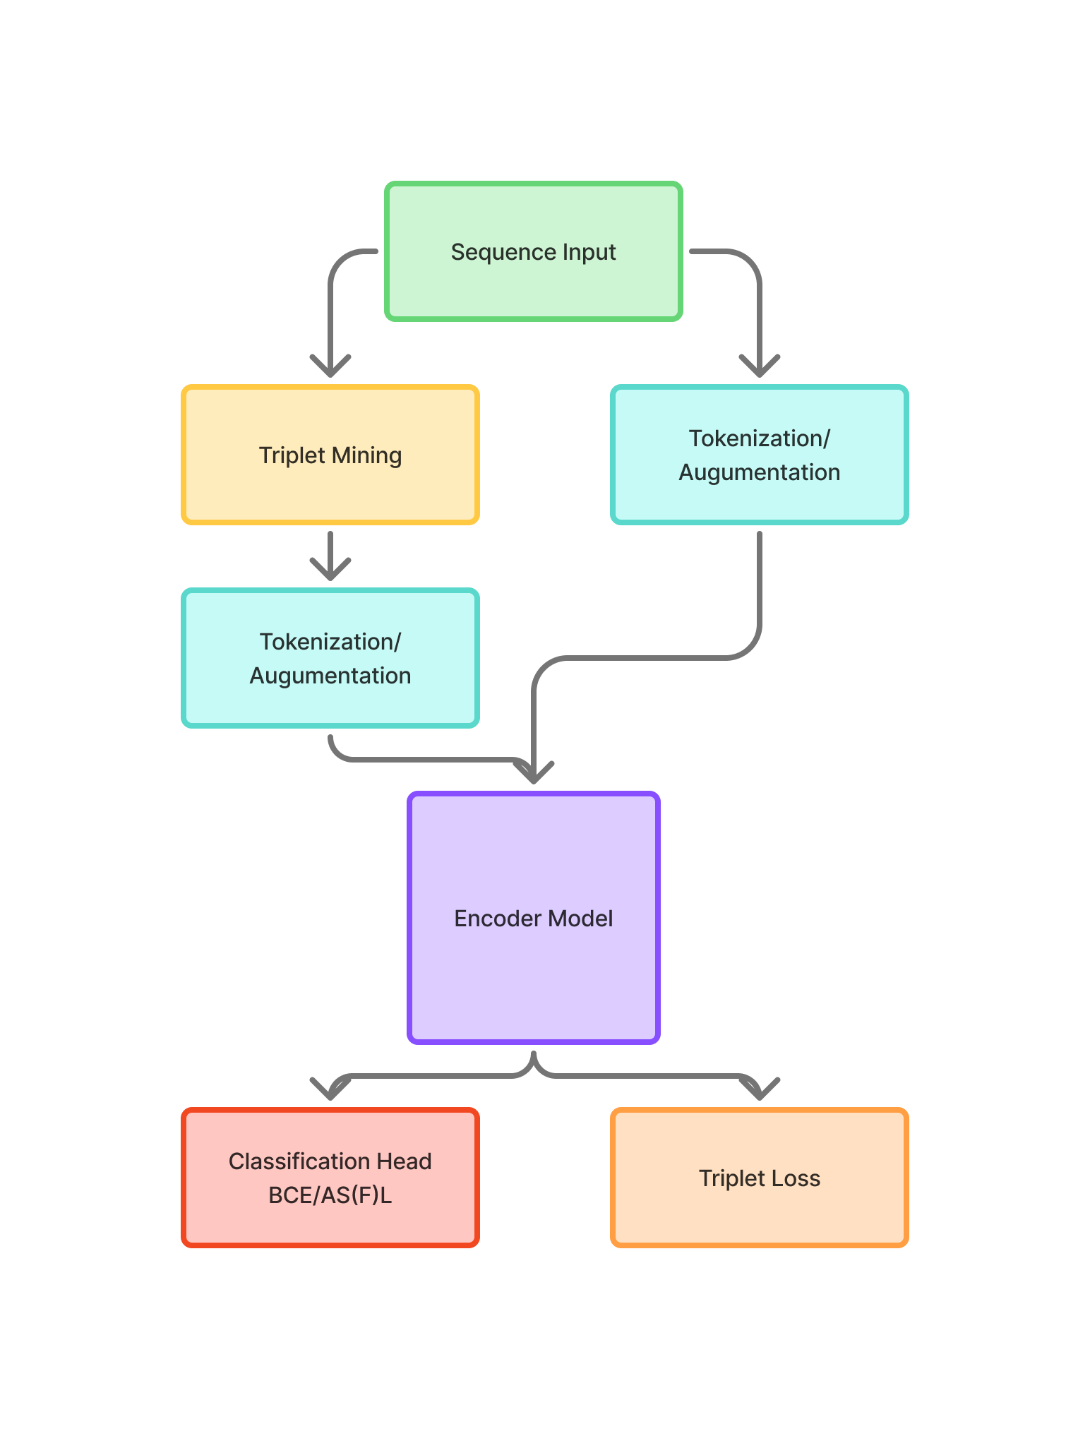
Current Progress
Investigating fine tuning through metric learning (triplet loss) vs. direct classification.
Compare encoder backbones:
LSTM (lightweight, custom-trained)
DNABERT-2 (pretrained transformer)
Nucleotide Transformer (large-scale pretrained model).

Slide 3
Datasets
Two reference database:
CARD
NCBI Pathogen Reference Database
Preprocessing into Multi-label classification (binary per class)
Augmentations for generalization:
Random mutation (Does not respect GC ratio)
Indels (Respecting GC ratio)
Reverse complement. (50% of samples, adjustable)

Slide 4
DNABERT-2
512 Max sequence length
Learned Positional Embeddings
12 Transformer layers

Slide 5
Encoder models used in the project
DNABERT-2 Pretrained on k-mer representations.
Strong generalization, but heavy GPU demand.
Nucleotide Transformer
Pretrained on large-scale genomic data. State of the art in recent literature.
Project priority:
LSTM (baseline, efficient) > DNABERT-2 (mid-tier pretrained) > Nucleotide Transformer (future work, heavy infra).

Slide 6
Triplet Learning (Metric Learning) (AMR Gene Family)
Anchor, positive, negative sampling.
Positive = label overlap ≥ threshold.
Negative = no label overlap.
TripletMetricModel → shared encoder.
Goal: Learn discriminative embeddings before classification.

Slide 7
Classification (Multilabel) (Antibiotics)
Architecture:
Encoder backbone → pooled representation.
Linear classifier → logits for each label.
Loss: Asymmetric Focal Loss (class-weighted).
Handles severe class imbalance.
Training with AdamW + ReduceLROnPlateau.

Slide 8
Results
LSTM
With Metric Learning and without, results looks almost the same, so increase number of epochs, different metric to calculate pairwise distance is needed.
Stronger Mining methods is needed as positive samples might be weakly related.

Slide 9
Next Steps
Sync latest codebase changes (shared encoder across tasks).
Benchmark DNABERT-2 and Nucleotide Transformer thoroughly.
Add hard negative mining for triplet training.
Add more data from RefSeq Pathogen.
Analysis of attention weights for interpretability.

Slide 10
References
DNABERT-2: https://arxiv.org/abs/2403.19687
Nucleotide Transformer: https://www.nature.com/articles/s41587-023-01663-6
Asymmetric Focal Loss: https://arxiv.org/abs/2009.14119

