Slide 1
Progress Update
Transformers for Antimicrobial Resistance Prediction

Slide 2
Objective
Develop an embedding-based AMR detection framework using transformer-derived representations and compare non-parametric (KNN) and deep classifiers.

Slide 3
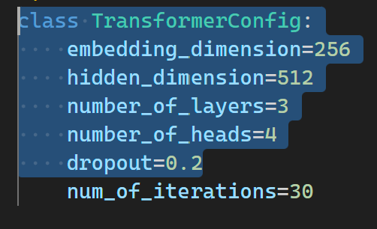
Pipeline
Pretrained Transformer Encoder for sequence embeddings (finetuned with offline triplet learning and classification model).
Embedding-based Classification using:
K-Nearest Neighbors (KNN) as a search-based classifier.
Linear classifier (nn.Linear) as a deep supervised head.
26k protein/gene sequences for pretraining.
~6k labeled samples for AMR category classification (multiclass).
Binary split: AMR vs Non-AMR for downstream benchmarking.

Slide 4
Pretraining
Metric | Value
Masked-token accuracy | 0.1175
Top-5 accuracy | 0.1710
Validation loss | 11.6851
The model learned some sequence context but did not reach semantic convergence.
Despite this, the encoder provided non-trivial token embeddings—enough to bootstrap the next stage (triplet learning) effectively.
Small corpus (≈ 26 k sequences) for full-sized transformer pretraining.
Low statistical coverage for 4096 tokens vs 26k samples
Critical for Triplet learning accuracy.

Slide 5
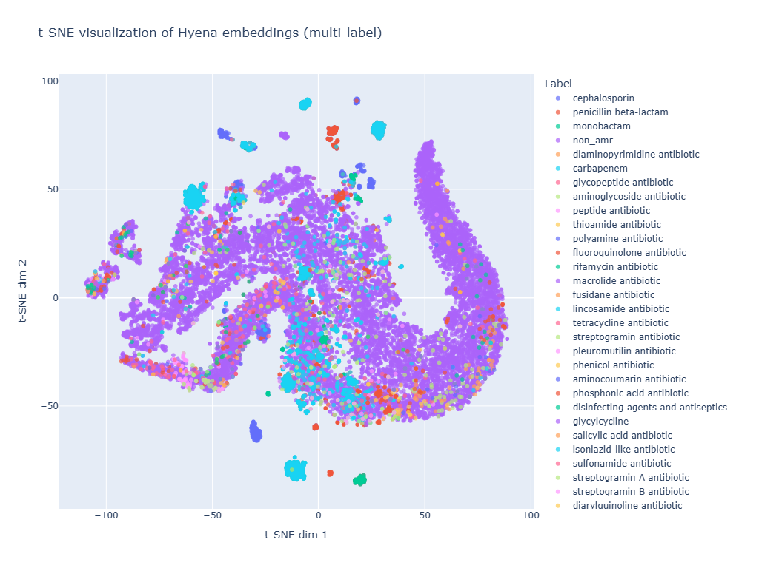
Offline Triplet Learning
Brought significant improvement in representation clustering.
t-SNE / UMAP visualizations showed clear separation between AMR and non-AMR embeddings.
Result:
AMR clusters emerged naturally in latent space → indicates strong semantic encoding.

Slide 6
Evaluation of KNN (Multiclass)
Train set: Perfect accuracy (KNN memorizes data).
Test set: Reasonable generalization for dominant β-lactam classes (carbapenem, cephalosporin, penicillin, monobactam).
Smaller or rare antibiotic classes (n < 10) → zero recall (due to severe imbalance).
Metric | Train | Test
Precision | 1.00 | 0.88
Recall | 1.00 | 0.87
F1-Score | 1.00 | 0.87

Slide 7
Evaluation of KNN (Binary)
AMR vs Non-AMR: Excellent separation.
Indicates embeddings carry strong discriminative signal.
Metric | Train | Test
Accuracy | 1.00 | 0.91
Precision (AMR) | 1.00 | 0.90
Recall (AMR) | 1.00 | 0.91
Weighted F1 | 1.00 | 0.90

Slide 8
Classifier: Linear Head (nn.Linear)
Used Asymmetric Focal Loss to counter heavy class imbalance.
Applied threshold optimization: Best global threshold = 0.05 (F1=0.6028).
Strong overfitting to dominant classes (e.g., β-lactams, non-AMR).
Embeddings linearly separable only for major classes → minor classes too sparse for stable gradients.
Deep classifier underperforms KNN in low-sample / highly imbalanced regimes.
Metric | Score
F1 | 0.55
Precision | 0.87
Recall | 0.48

Slide 9
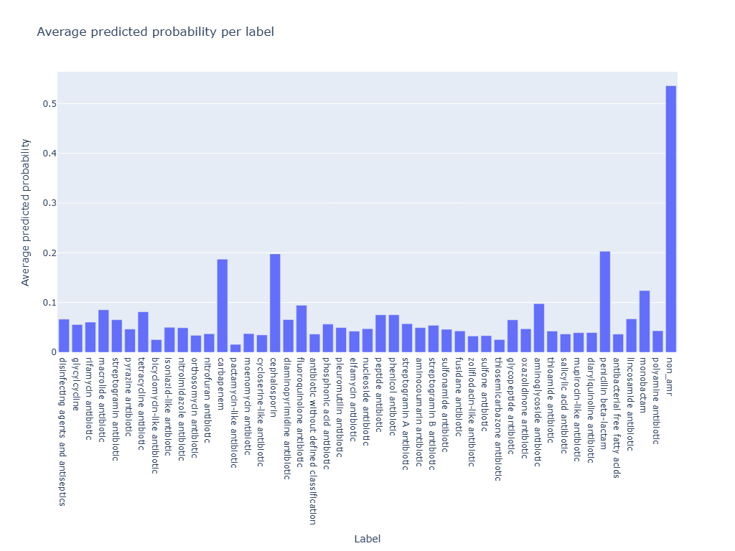
Class imbalance statistics
Positive label ratio: 0.026 → only ~2.6% positive samples.
Many antibiotic subclasses have <10 samples.
KNN robust under imbalance (non-parametric memory).
Linear head struggles (few positives → unstable loss landscape).

Slide 10
Comparative Benchmarks (Contextual)
Model | Species | Type | Metric | Score
This work (KNN + Embedding) | Multi-species | AMR | Accuracy | 0.88 (0.91 bin)
S. aureus Gene ML | Single species | XGBoost | AUCROC | 0.99
A. baumannii | Genome-wide mutation scoring | XGBoost | Balanced Acc | 0.858
RGI (CARD) | Rule-based |  | Precision | 0.99
RGI (CARD) |  |  | Recall | 0.85
PLM_ARG | Transformer embeddings |  | Test Acc | 0.838
Notes:
Embedding + KNN approach performs competitively with top AMR tools, despite being model-agnostic and lightweight.

Slide 11
Next Steps
Next week:
Apply class reweighting / oversampling for rare antibiotic categories.
Explore few-shot fine-tuning with synthetic augmentations.
Long Term:
Incremental KNN index using FAISS (ANN) for scalable retrieval.
Integrate into AMR prediction pipeline alongside ResFinder / AMRFinderPlus for validation (Embed-Search-Align)
Expand dataset diversity across species and AMR gene families.

Slide 12
Code and Reports
https://github.com/debugst1ck/TARP

