Slide 1

ABINITIO VECTORS
Created and Presented by
Avishek Gupta Roy

Slide 2
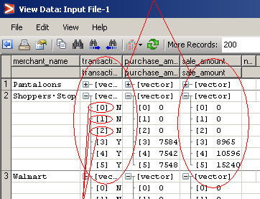
What is a vector in Abinitio?
Vector is a multi dimensional view of a of multiple fields having identical data type and in most cases holding similar kind of data. In short it is view to represent denormalized data grouped under the same field identified by an index.
Vector
Index
Index: Index is a pointer value pointing to a specific position of a vector. The value of index starts from 0 and can extend up to any integer value incremented by 1.

Slide 3
DML and data types
A Typical Vector DML
record
string("|") merchant_name;
string("|")[6] transaction_flag;
decimal("|")[6] purchase_amount;
decimal("|")[6] sale_amount;
string("\n") newline;
End;
Note:
The value inside [ ] describes the vector length and is placed immediately after the data type. The length of the vector can also be a variable value based on the value of an column. In the below example the length of the vectors for the amount fields shall depend of the value contained in the field length_of_amount_vector:
record
string("|") merchant_name;
decimal("|") length_of_amount_vector;
decimal("|")[length_of_amount_vector] purchase_amount;
decimal("|")[length_of_amount_vector] sale_amount;
string("\n") newline;
End;

Slide 4
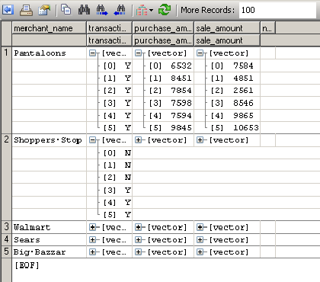
Understanding Data
A Typical Raw data from a File:
Pantaloons|Y|Y|Y|Y|Y|Y|6532|8451|7854|7598|7594|9845|7584|4851|2561|8546|9865|10653|
Shoppers Stop|N|N|N|Y|Y|Y|0|0|0|7584|7542|7548|0|0|0|8965|10596|15240|
A Vector Representation of this data:
record
string("|") merchant_name;
string("|")[6] transaction_flag;
decimal("|")[6] purchase_amount;
decimal("|")[6] sale_amount;
string("\n") newline;
End;

Slide 5
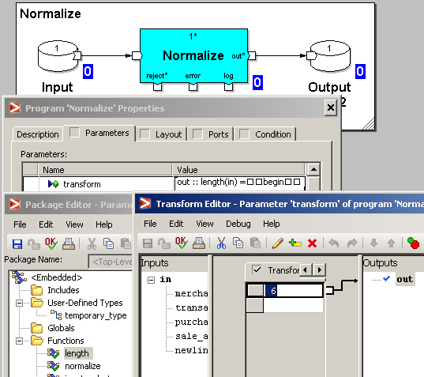
Normalizing a Vector
Normalizing Record with fixed vector length:
//Source DML Target DML
record record
string("|") merchant_name; string("|") merchant_name;
string("|")[6] transaction_flag; string("|") transaction_flag;
decimal("|")[6] purchase_amount; decimal("|") purchase_amount;
decimal("|")[6] sale_amount; decimal("|") sale_amount;
string("\n") newline; string("\n") newline;
end; end;

Slide 6
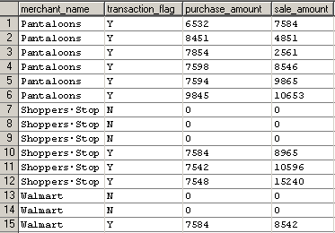
Transformation for Normalize:
out :: length(in) =
begin
out :: 6;
end;
out :: normalize(in, index) =
begin
out.merchant_name :: in.merchant_name; Normalized Data
out.transaction_flag :: in.transaction_flag[index];
out.purchase_amount :: in.purchase_amount[index];
out.sale_amount :: in.sale_amount[index];
out.newline :: in.newline;
end;
Explanation : In the above transform index is parameter which is equal to the vector position. Here the length of the vector is 6, so for any record the value of index would start from 0 and increment up to 5, there by creating 6 records and assigning the 1st of the vector to the 1st record, 2nd value to the 2nd record and so on. Finally we would get 6 records from 1 single record for each merchant.

Slide 7
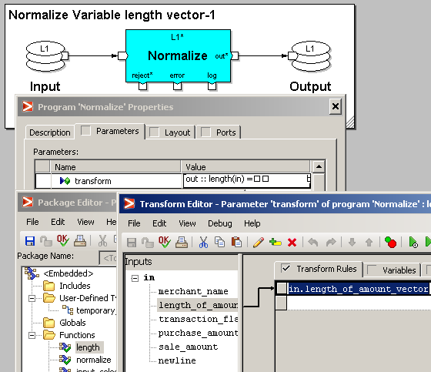
Normalizing Record with fixed vector length:
// Source DML Target DML
record record
string("|") merchant_name; string("|") merchant_name;
decimal("|") length_of_amount_vector; string("|") transaction_flag;
string("|")[length_of_amount_vector] transaction_flag; decimal("|") purchase_amount;
decimal("|")[length_of_amount_vector] purchase_amount; decimal("|") sale_amount;
decimal("|")[length_of_amount_vector] sale_amount; string("\n") newline;
string("\n") newline; end;
end;

Slide 8
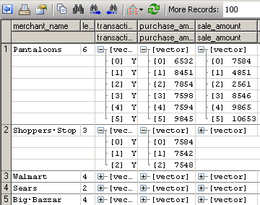
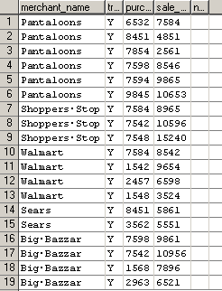
Transformation for Normalize:
out :: length(in) = Source Data:
begin
out::in.length_of_amount_vector;
end;
out :: normalize(in, index) =
begin
out.merchant_name :: in.merchant_name;
out.transaction_flag :: in.transaction_flag[index];
out.purchase_amount :: in.purchase_amount[index];
out.sale_amount :: in.sale_amount[index];
out.newline :: in.newline; Normalized Data:
End;
Explanation: In this part all of the transformation would
remain the same except the way length (number of records
each record shall be split into) is populated. Here length is populated
with a straight pull from the field length_of_amount_vector.

Slide 9
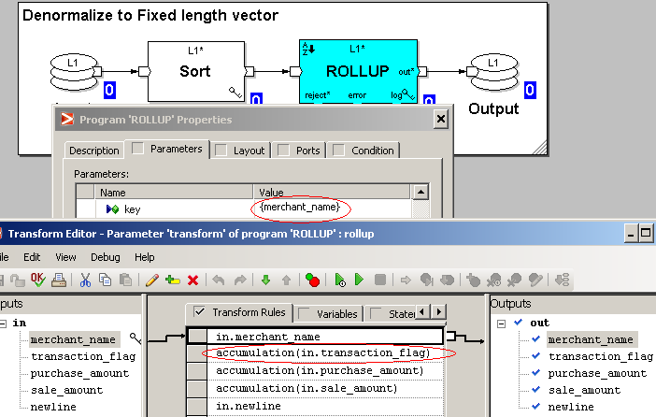
Denormalizing to a Vector
Denormalizing to a fixed length Vector:
//Source DML Target DML
record record
string("|") merchant_name; string("|") merchant_name;
string("|") transaction_flag; string("|")[6] transaction_flag;
decimal("|") purchase_amount; decimal("|")[6] purchase_amount;
decimal("|") sale_amount; decimal("|")[6] sale_amount;
string("\n") newline; string("\n") newline;
end; end;

Slide 10
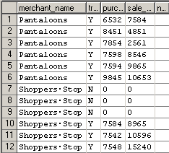
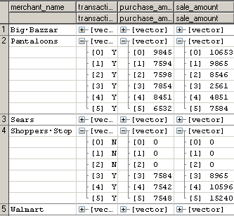
Transformation for denormalize using Rollup:
out::rollup(in)= Source Data:
begin
out.merchant_name :: in.merchant_name;
out.transaction_flag :: accumulation(in.transaction_flag);
out.purchase_amount :: accumulation(in.purchase_amount);
out.sale_amount :: accumulation(in.sale_amount);
out.newline :: in.newline;
End;
Target Data:
Explanation: When using rollup to denormalize the mandatory
requirement is to have the data sorted before rollup. The key field
for the rollup is/are the common field / fields in the record (In this
example Merchant Name). For creating the vectors (denormalizing
the data) the vector fields should is defined with the proper length
in the output DML. Each vector field (field to be denormalized)
should then be transformed with the accumulation function to
get the desired.
Note: While denormalizing to a fixed length vector the source data
should not contain record count exceeding the vector length when
a group by operation is performed on the key columns.

Slide 11
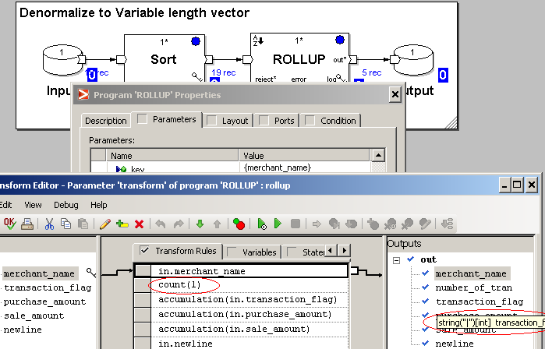
Denormalizing to a variable length Vector:
// SOURCE DML TARGET DML
record record
string("|") merchant_name; string("|") merchant_name;
string("|") transaction_flag; decimal("|") number_of_tran;
decimal("|") purchase_amount; string("|")[int] transaction_flag;
decimal("|") sale_amount; decimal("|")[int] purchase_amount;
string("\n") newline; decimal("|")[int] sale_amount;
end; string("\n") newline;
end;

Slide 12
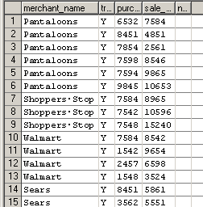
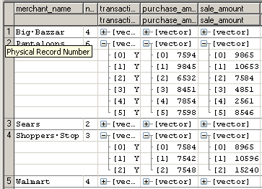
Transformation to denormalize to Variable vector using Rollup:
out::rollup(in)= Source Data:
begin
out.merchant_name :: in.merchant_name;
out.number_of_tran :: count(1);
out.transaction_flag :: accumulation(in.transaction_flag);
out.purchase_amount :: accumulation(in.purchase_amount);
out.sale_amount :: accumulation(in.sale_amount);
out.newline :: in.newline;
end;
Target Data:
Explanation: Here the length of the vector is a variable, so we need to
store the length of the vector (which is a group by count on the key).
The rest of the transformation would be the same as while creating a
fixed length vector.
Note: One very important thing to notice here is the vector definition of
the output dml :
string("|")[int] transaction_flag;
Here in the vector length definition we define the length with no fixed
Number or column name but instead a data type int.

Slide 13
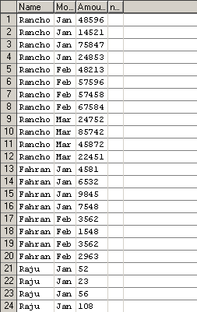
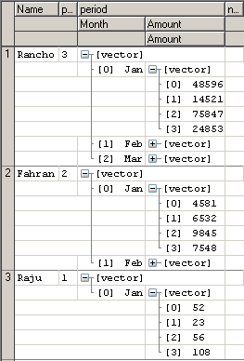
Normalizing a Vector with in a Vector
//SOURCE DML TARGET DML
record record
string ("|") Name; string ("|") Name;
decimal ("|") period_tran_count; string ("|") Month;
record string ("|") Amount = NULL;
string ("|") Month; string ("\n") newline;
string ("|") [4] Amount; end;
end [period_tran_count] period;
string ("\n") newline;
end

Slide 14
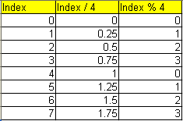
Normalize transform for Vector within a vector:
out :: length(in) =
begin
out :: in.period_tran_count * 4;
end;
out :: normalize(in, index) =
begin
out.Name :: in.Name;
out.Month :: in.period[index/4].Month;
out.Amount :: in.period[index/4].Amount[index%4];
out.newline :: in.newline;
end;
Explanation: For this example where we have vector with in a vector the total number of records after normalize would be the product of the lengths of both the vectors. Let us take an example with the source data for Farahan. Farahan spends money during two months, January and February. Based on the source dml, he and all others can make 4 transactions each month (fixed length vector). So the total number of records on normalization would be 4 * 2 = 8.
Now for the data population part using index: For Farhan the value for index would range from 0 – 7 (8 records). The value if Index / 4 and index % 4 is given for all the value of index in range (0 – 7).
In this case case it is it is essential to remember that index is an integer value. So 0.25, 0.5, 0.75 would all translate to 0 in this case. There by evaluating the 1st four values in this case to 0 and the rest 4 (1, 1.25, 1.5 and 1.75) to 1.
In this way the fields evaluate the values for index and and populates each value of index in proper position.

Slide 15
Vector Functions
Here are some Vector functions:
Allocate function:
This function with synonymous with allocate_with_defaults() in the current versions. It allocates specific values to both vector and non vector elements. This function is supplied with no arguments. It comes handy when initializing a vector with a specific operation.
Usage: out.a = allocate();
Example: let (decimal “|”) [3] field_1 = allocate();
The result is [vector 0,0,0]
vector_sum function:
This function is used to add all the values inside a vector. Basically it generates the summation of all the elements in a vector.
Usage: out.a = vector_sum (vector_field);
vector_product function:
This function returns the product of all the values in a vector. Usage: out.b = vector_product(vector_field);
vector_difference function:
This function returns the elements of the first vector which are not present in the second vector based on a key field . Below is an example:
Usage: vector_difference (vector_1, vector_2, {key_field});
let (string “|”) [3] vector_1 = [vector “a”, “b”, “c”, “d”];
let (string “|”) [2] vector_2 = [vector “c”, “d”];
vector_difference (vector_1, vector_2) = [vector “a”, “b”]

Slide 16
Accessing individual elements in a vector
In a vector individual elements can be handles by using a for loop expression to perform various operations. Below is an example to calculate the max value within the vector elements for a set of vector records.
We can write this code as a statement in the xfr for normalize or reformat.
Code:
begin
max_length_of_inner_vector = in.period[0].amount_tran_count;
for (i , i < in.period_tran_count )
if (max_length_of_inner_vector < in.period[i].amount_tran_count)
max_length_of_inner_vector = in.period[i].amount_tran_count;
end;

Slide 17
Some Points to remember
A vector length is specified by [ ] after the data definition for a field.
The vector examples used in this presentation are all delimited vectors. Apart from delimited vectors. There can also be fixed column size vectors.
Vectors are a very good way of storing data as it eliminates redundancy. But it should be remembered that they are not very good performers when transforming data. For performing large transforms it is advised to either normalize the data first or read the data in non vector denormal form.
Apart from the type of vectors mentioned in the sheet, there is also a kind of vector by the name of delimited vector whose length is defined by delimiter characters in the data. This is not a very common practice in the real scenarios and hence are seldom used.

Slide 18
THANK YOU

