Slide 1
Saint-Petersburg
Okhrimenko Anastasia

Slide 2
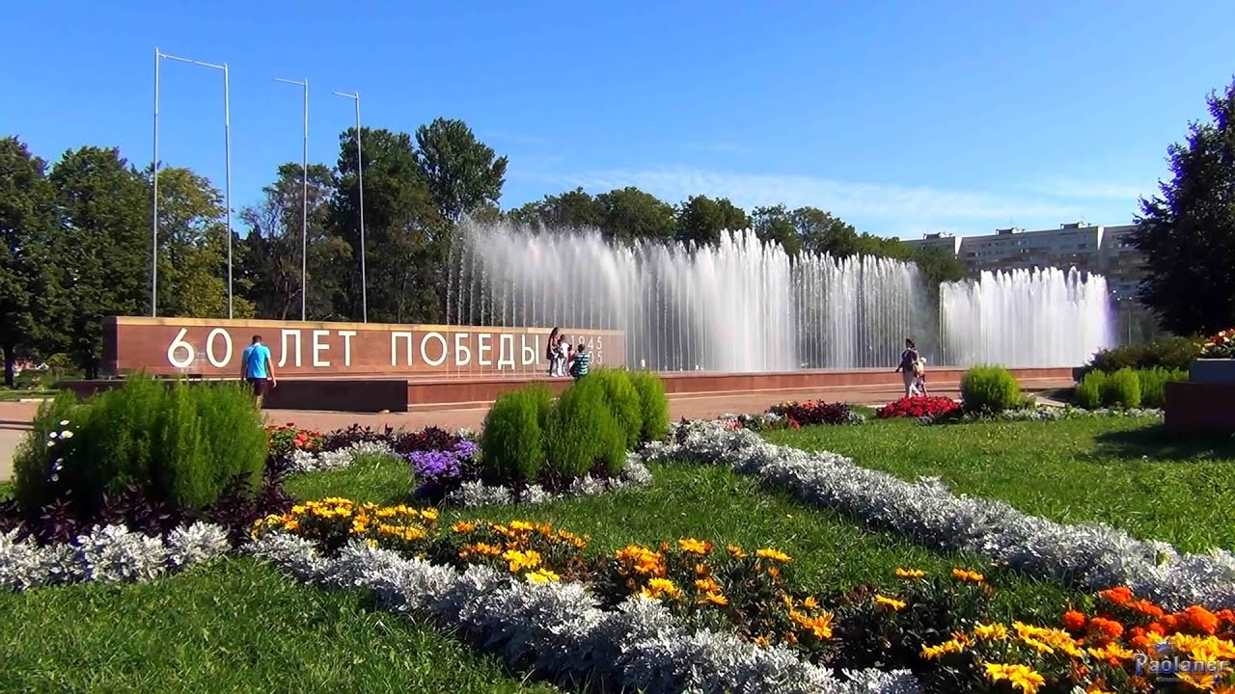
Yuzhno-Primorskiy Park

Slide 3
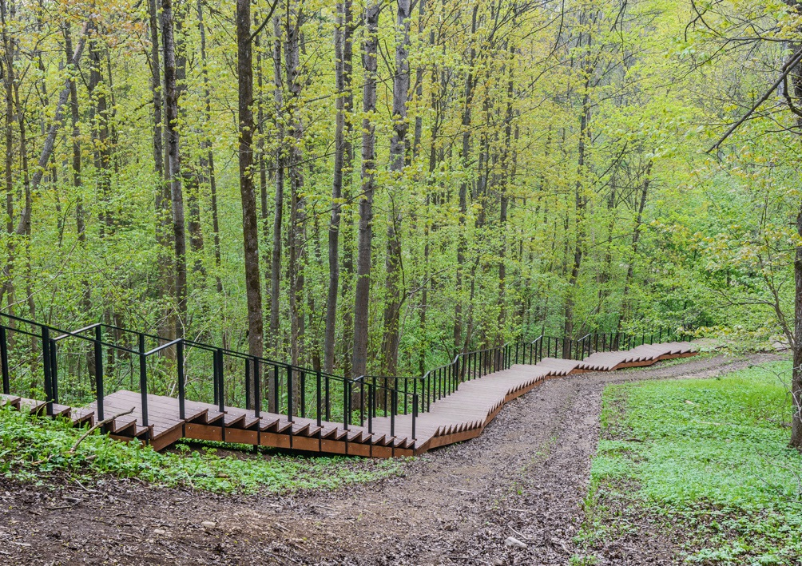
Duderhof Heights

Slide 4
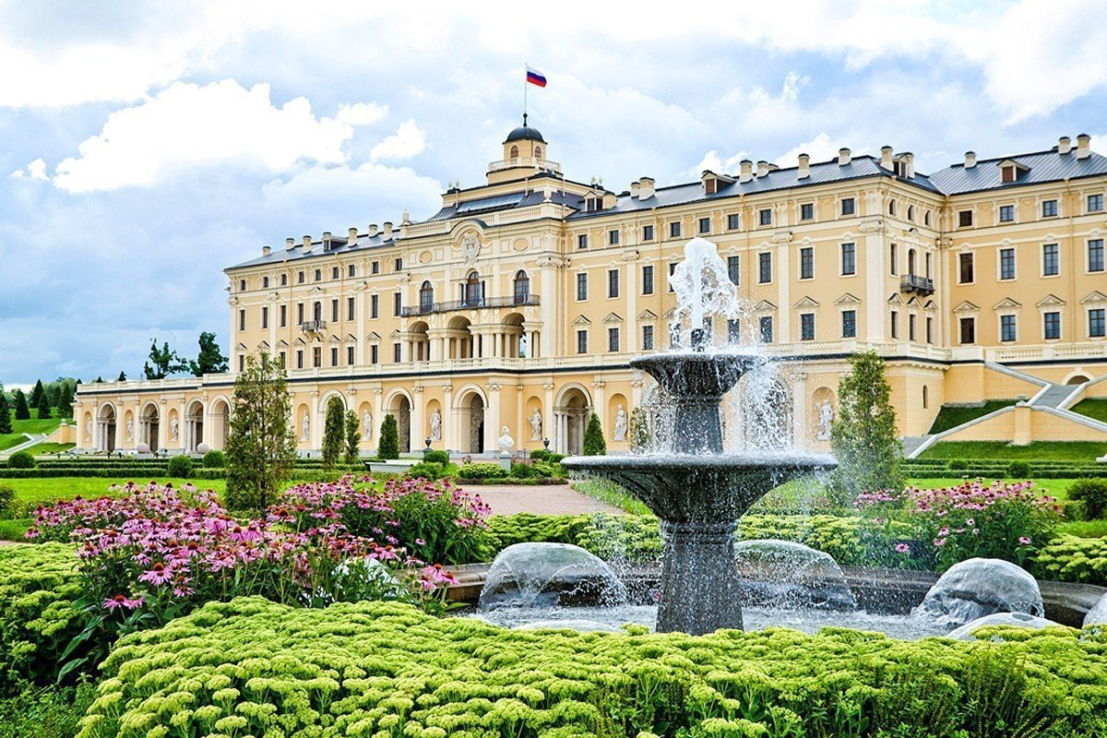
Konstantinovsky Park

