Slide 1
Decant
If you can’t decant it, distill it.
JSFOO ‘16
cherry@zyx.in
&
santhosh.raju@gmail.com

Slide 2
Episodic Memory #1
memory
  autobiographical events
  times, places, associated emotions
  Contextual - who, what, when, where, why
  can be explicitly stated.

Slide 3
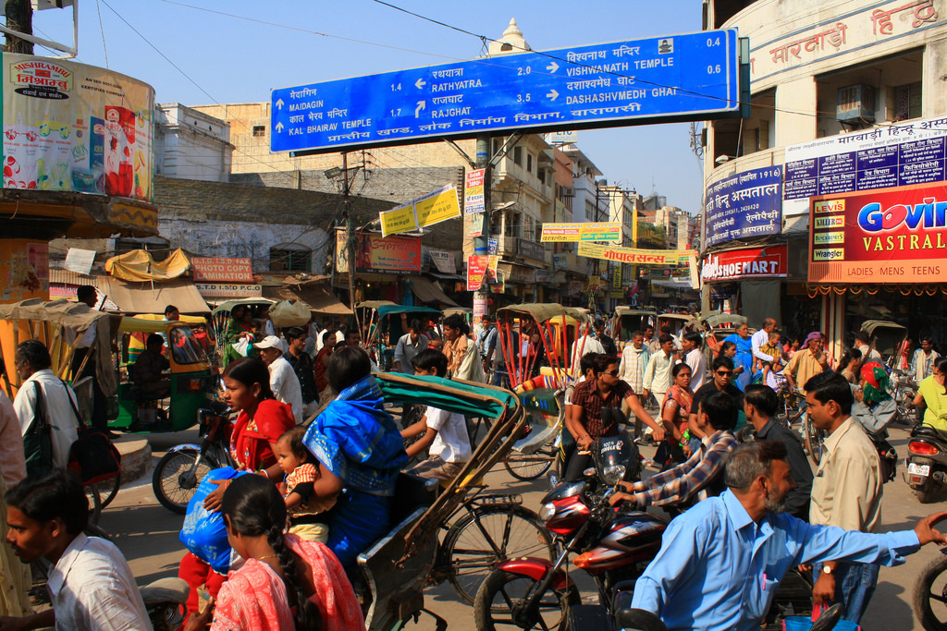
Episodic Memory #2
Pic credit: https://flic.kr/p/7yKkfJ

Slide 4
Episodic Memory #3
Walking down this street – what would you remember ?
  Landmarks ?
  Events ? (ate jilebi, met my friend, knocked a bike down...)
  People ? (was with friends ? Met the CEO of Hasgeek ?)
What would you NOT remember ?
  Date ?
  Names of all the shops ?
  Number plates of all the cars ?

Slide 5
Episodic Memory #4
The de-cerebrated cat
I want to talk about how watching a flow of information without begin involved in it actively makes it harder to remember details.
https://www.youtube.com/watch?v=wPiLLplofYw

Slide 6
Your mobile phone #1
I want to talk about the data streams in mobile phones.
These streams are like walking through huge distances along streets.

Slide 7
Your mobile phone #2
Screenshot of busy notifications

Slide 8
Your mobile phone #3
How do you reduce the cognitive load of crazy amounts of data ?
Notifications are redundant now – they are mostly ignored.
How do you use the machine itself to fix this problem ?
How do you help a user to navigate through their episodic memory of this huge data stream ?

Slide 9
Decant
It’s a process of narrowing down to the important things.
The exact mechanism is application specific.
Talk about the example case of SMS spam
Talk about the simple case of narrowing down via rules, because the SMSs are simply structured.

Slide 10
Distill
What next ? “Road map”?
Write your own plugins.
UI improvements.
“Framework”
Start coding!

Slide 11

Questions ?

