Slide 1
Decant
If you can’t decant, distil it.
JSFOO ‘16
cherry@zyx.in
&
santhosh.raju@gmail.com

Slide 2







Episodic Memory #1
What is episodic memory?
  autobiographical events
  times, places, associated emotions
  contextual - who, what, when, where, why
  can be explicitly stated.

Slide 3
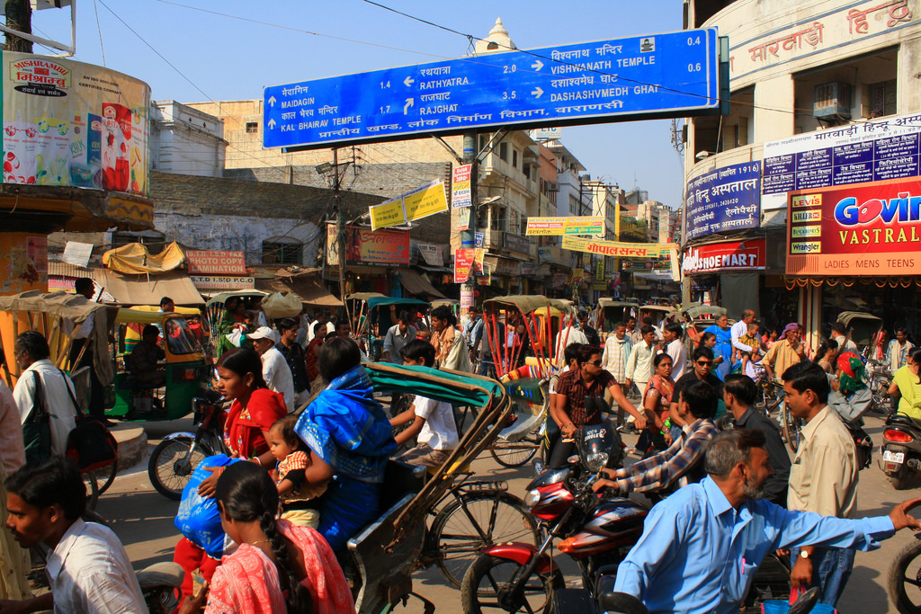
Episodic Memory #2
Let’s say you were strolling down this street.
Pic credit (CC by 2.0) : https://flic.kr/p/7yKkfJ

Slide 4
Episodic Memory #3
What would you remember?
  Landmarks?
  Events? (ate jilebi, met my friend, knocked a bike down...)
  People? (was with friends? Met the CEO of HasGeek?)
What would you NOT remember?
  Date?
  Names of all the shops?
  Number plates of all the cars?
  Number of times you’ve been there?

Slide 5
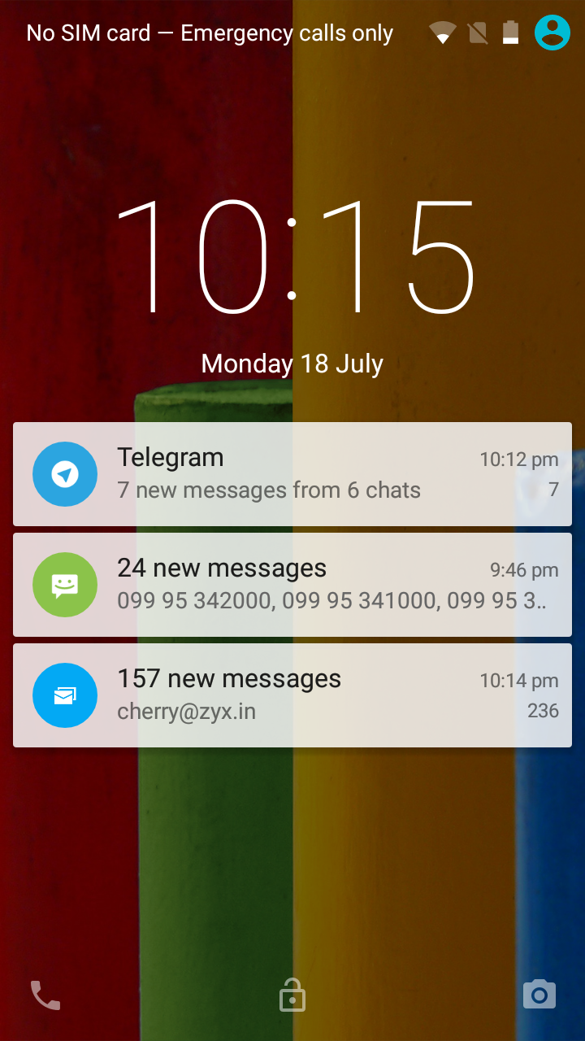
Your mobile phone #1
The high street of your modern mobile phone is CROWDED
Cognitive load is higher:
  Compressed timeline
  Need to keep mental state
  Multi-media, not just visuals – eg: reading headlines.
  Interactive – needs a response – sometimes deferred.

Slide 6
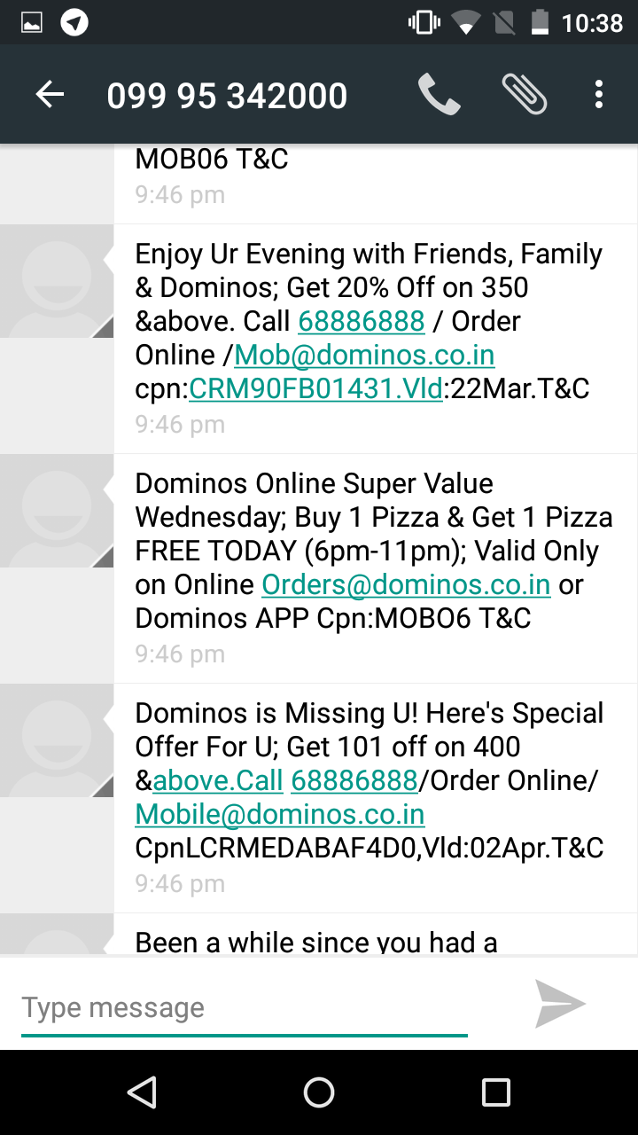
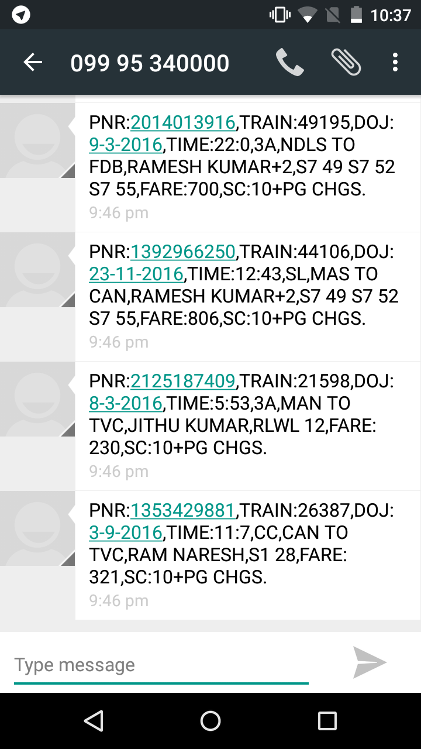
Your mobile phone #2
DATA TORRENT – COGNITIVE OVERLOAD!

Slide 7

Your mobile phone #3
As a programmer,
How do you help reduce the cognitive load from crazy amounts of (often machine generated) data?
Notifications are redundant now – they are mostly ignored.
But then that stream of data is never ending – and sometimes a notification is personal and CRITICAL!
How do you help a user to navigate through their episodic memory of this huge torrent of data?
How do you devise the machine, that’s partly the problem, to fix it?
We came up with

Slide 8
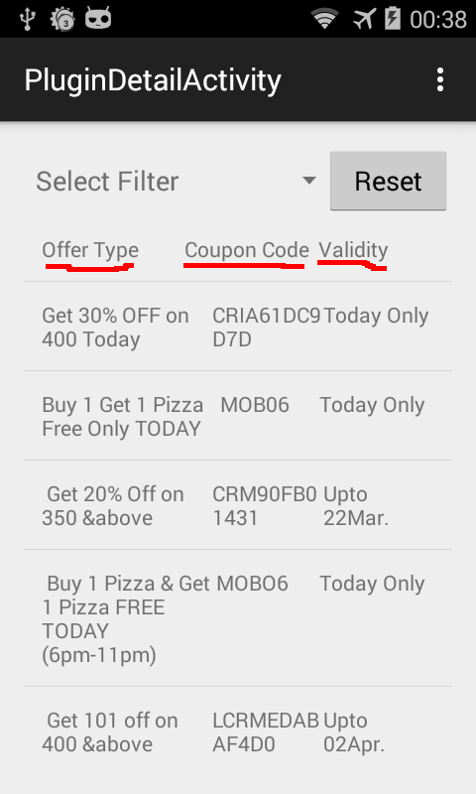
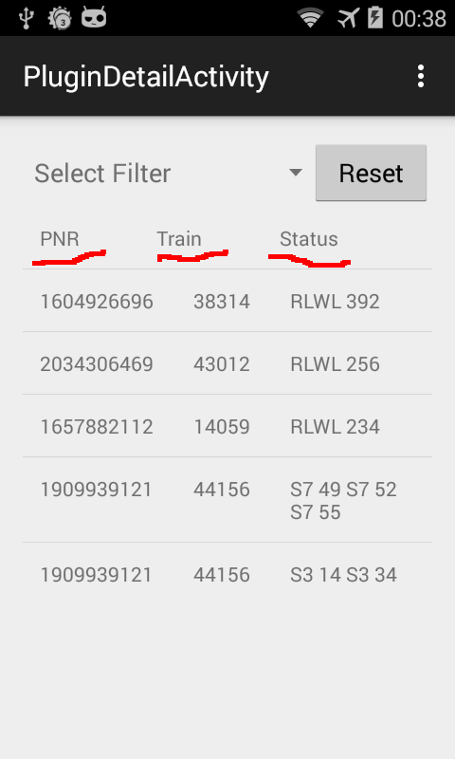
Decant #1
“DECANT” YOUR DATA INTO LABELS

Slide 9
Your mobile phone #4
Problem
  I remember this vague thing/picture/phrase
  I want to find/forward it NOW!
  Every application is unique.
  Applications won’t talk to each other.
Case study: SMS
  SMS-es are structured in simple ways via fixed rules
  Structured information is easier to navigate/narrow down to
See: https://www.github.com/decant/decant
Solutions:
  Crowdsource! Decant is a guiderope to do this.
  Break the rules!
  The notification system is your hack!

Slide 10
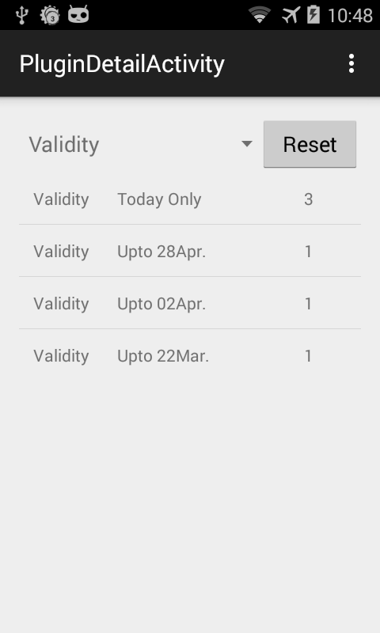
Decant #2
Look further in your labelled pot of Decant
Using the Filter, for eg: you can narrow down your search
Example – Validity of pizza offers
Know which offer expires when without the need to keep a mental state on each of them.
Never miss a Pizza Offer!! :-)

Slide 11
Anatomy of a Plugin
Holy Foo, it’s in javascript!
function name() {
// Name of the plugin.
}
function description() {
// A brief description of what it does.
}
function filter(title) {
// The condition to check to see if a
// notification needs to be processed.
}
function extractor(message) {
// Extract Useful information from the
// Notification and pass it back.
}
function filterKeys() {
// Keys that can be used for filtering the
// extracted results.
}
function settings() {
// Settings like whart sort of columns will be
// displayed or not etc
}

Slide 12

Episodic Memory #4
What if you wanted to find that shop on commercial street with the cuddly toy you noticed when snacking on your favourite dehi puri chaat while trying hard not to drop your arm full of shopping ?
Pic src: CC by 2.0 : https://flic.kr/p/6QbceF

Slide 13
Distil it
What next - road map?
Write your own plugins.
UI improvements.
Framework.
Start coding!

Slide 14
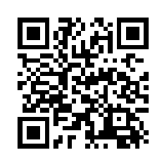
Questions ?
Hackathon! https://github.com/decant/decant/issues/2

