Slide 1
Data quality verification tools
Verifier overview, Image Feed design, example application
erhtjhtyhy
Barbara Frosik
In collaboration with beamline 32-ID scientists
Francesco De Carlo
Doga Gursoy
et al
Principal Software Engineer
Scientific Software Engineering & Data Management
Advanced Photon Source
Argonne National Laboratory
March 20, 2017

Slide 2
Thank you
Francesco De Carlo, Doga Gursoy, Rafael Vescovi, Vincent De Andrade; Jun-Sung Park, John Hammomds, Nicholas Schwarz, Arthur Glowacki, Mark Rivers, Tim Madden, Sinisa Veseli, Tekin Bicer
Thank you for great ideas, help, support, consultations.

Slide 3
Use cases

Slide 4
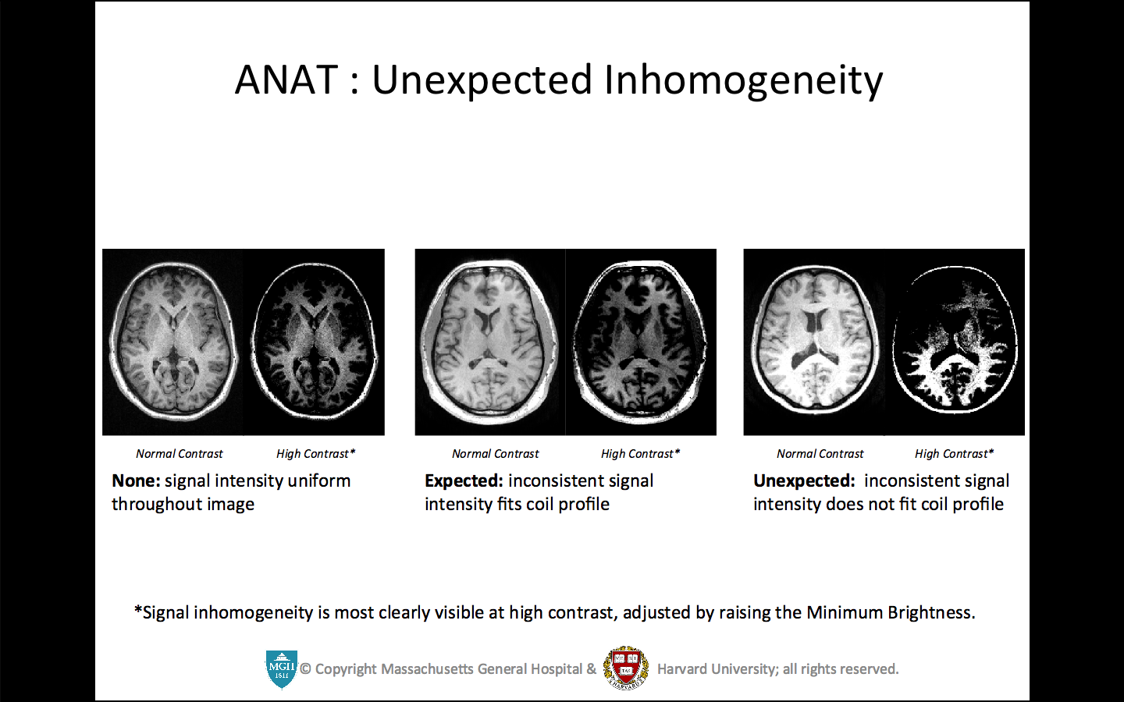
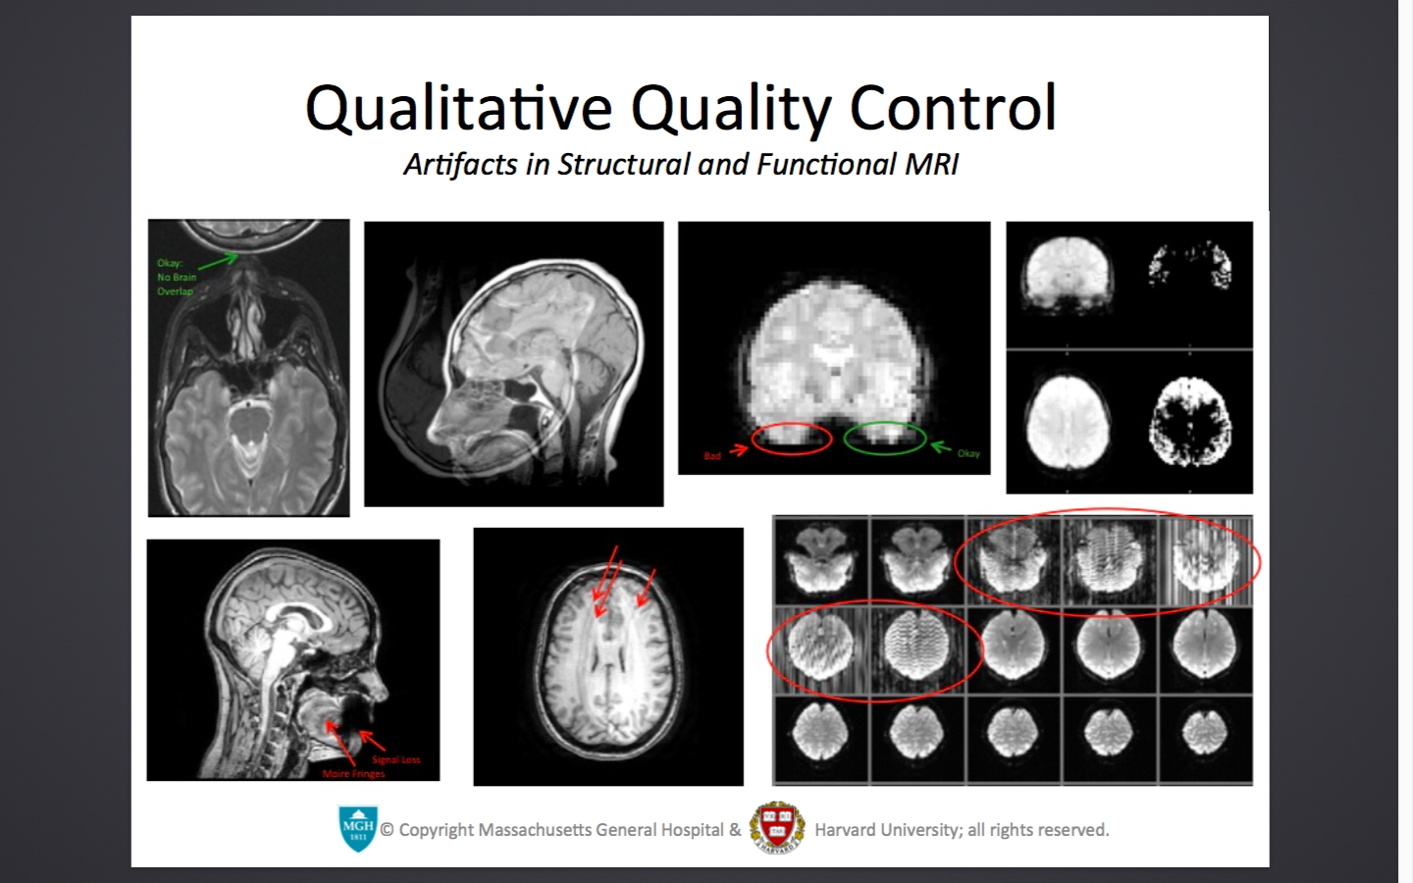
Future data processing architecture
http://cbs.fas.harvard.edu/usr/mcmains/CBS_MRI_Quality_Control_Workshop.pdf

Slide 5
verification
32-ID Tomography, Transmission x-ray microscopy, Radiography, Phase contrast imaging
Verifying PVs before start of experiment
Verifying collected hdf data file structure
Verifying collected hdf data
Frame mean value within limits
Frame standard deviation within limits
Frame mean value and mean of means does not exceed delta

Slide 6
Blocked projections
32-ID Tomography, Transmission x-ray microscopy, Radiography, Phase contrast imaging
For some samples certain projections are blocked, and the characteristic of the corresponding data frames is the same as ‘data dark’.
By applying characteristic (limits) for ‘data’, the blocked frames can be found in a data file and reported. The indexes of blocked frames are used by reconstruction scripts.

Slide 7
Detect saturation
1-ID High-energy x-ray diffraction
The intensity of single points may exceed a limit (saturate)
If there are many of such points, the experiment may be said unsuccessful
The verifier can detect this condition in a data set
With a new detector it may be possible to monitor the data in a real time, so the experiment can be stopped on bad quality

Slide 8
Future data processing architecture
converter
analyzer
feed
verifier
converter
analyzer

Slide 9
Verifiers

Slide 10
verifiers
PV – verifies settings of process variables; can be run before experiment, as well as periodically during experiment
Quality results verifiers
Data verifier – verifies quality of experiment data in a file (hdf, ge, tiff)
Monitor – monitors directory for experiment data files, and runs data verifier on discovery
Structure – used for hdf type files. Verifies that the tags are in sync with gathered data.
Real-time – verifies quality of experiment data while experiment is collecting data

Slide 11
Verifier architecture
aggregate
Aggr res
handler
results
frames
frames
real-time
Experiment
data
Channel
Access
Data verifier
Image feed
hdf, ge, tiff

Slide 12
Monitoring file system
Experiment
data1
Data verifier1
hdf, ge, tiff
Data verifier2
Experiment
data2
hdf, ge, tiff
Monitor
observe
monitored
folder

Slide 13
Live feed usage
app
aggregate
aggregated res
handler
results
frames
real-time
frames
Channel
Access
Image feed

Slide 14
Quality checks
Functions targeted to validate specific experiment data
The checks are configured
Easy to add quality check function to the framework
Check on each frame (ex: mean value expected in certain bounds)
Check on the collected so far frames (ex: number of saturation points exceeded limit)
The same function can be used to assess experiment data taken by different detector by using different limits

Slide 15
Configuration example
'pv_file' = /home/beams/USR32IDC/.dquality/32id_nano/schemas/pvs.json
'limits' = /home/beams/USR32IDC/.dquality/32id_nano/schemas/limits.json
'quality_checks' = /home/beams/USR32IDC/.dquality/32id_nano/schemas/quality_checks.json
'time_zone' = America/Chicago
'extensions' = .hd5, .HD5, .hdf5, .HDF5, .h5, .H5
#real-time verifier
'feedback_type' = console
'detector' = BBF1
'detector_basic' = cam1
'detector_image' = image1
'no_frames' = 20

Slide 16
Pv.json
{"S:SRcurrentAI" : {
"greater_than" : 60.0,
"less_than" : 102.0 },
"ID32ds:Energy.VAL" : {
"greater_than": 5.0,
"less_than" : 30.0},
"ID32us:Gap.VAL" : {
"greater_or_equal" : 3.0,
"less_or_equal" : 50.0},
"32ida:BraggEAO.VAL" : {
"greater_or_equal" : 5.0,
"less_or_equal" : 25.0 } }

Slide 17
Limits.json
{ "data" : {
"mean" : {
"low_limit" : 400,
"high_limit" : 600 },
"stat_mean" : {
"low_limit" : -150,
"high_limit" : 150 },
"std" : {
"low_limit" : 150,
"high_limit" : 200 } } }

Slide 18
Quality_checks.json
{ “data” :
{ "QUALITYCHECK_MEAN" : ["STAT_MEAN"], "QUALITYCHECK_STD" : []},
“data_white” :
{ "QUALITYCHECK_MEAN" : [], "QUALITYCHECK_STD" : []},
“data_dark” :
{ "QUALITYCHECK_MEAN" : [] }
}

Slide 19
Verification results
The results are provided in a text file. It lists the result for each frame, and for each check method.
The output of verification is a list of frame indexes that did not pass the quality checks. The list can be used as an input to subsequent calculations.
The real-time verifier provides immediate feedback. Currently the user can choose console and log file. There are plans to add live feedback on the experiment status web page.

Slide 20
How to use it
Under Documentation Examples tab there are code snippets for each verifier.
The examples are run with the assumption that a configuration file exists in a folder defined by “instrument”
The github contains another suite of examples in a check.py and check_rt.py files
dquality.pv.verify(conf)
dquality.monitor.verify(conf, folder, int(num_files))
dquality.data.verify(conf, fname)
dquality.hdf.verify(conf, fname)
dquality.realtime.real_time.verify(conf, report_file, sequence)

Slide 21
Live Image feed

Slide 22
Live Image feed
Uses Channel Access plugin
Uses pyepics
It provides a high level python API to retrieve image data at the time it is recorded
User needs to write defined methods in an adapter.py file and define Area Detector prefixes in a configuration file

Slide 23
adapter
Acts as a link between feed and consuming application
Has three methods that need to be implemented:
start_process: it parses arguments, and starts the consuming process. Passes in the queue on which the frames are received.
parse_config: reads configuration and sets required variables. Since the configuration is specific for the application, it is handled in the adapter.
pack_data: encapsulates the frame into object defined by a consuming application.

Slide 24
design
Epics
The Epics can be replaced by other software, ex. Tim Madden’s server
Frames, PVs
Dequeue
Frames
Area Detector
Feed
Consuming Application
Q
Enqueue
Frames

Slide 25
Adapter for real-time verifier
https://github.com/bfrosik/data-quality/blob/master/dquality/realtime/adapter.py

Slide 26
links
https://github.com/bfrosik/data-quality
http://data-quality.readthedocs.org/
http://cbs.fas.harvard.edu/usr/mcmains/CBS_MRI_Quality_Control_Workshop.pdf
bfrosik@anl.gov
Contact Barbara Frosik or Nicholas Schwarz for assistance in employing verifier on your beamline

Slide 27
Questions?
Thank you for your attention

