Slide 1
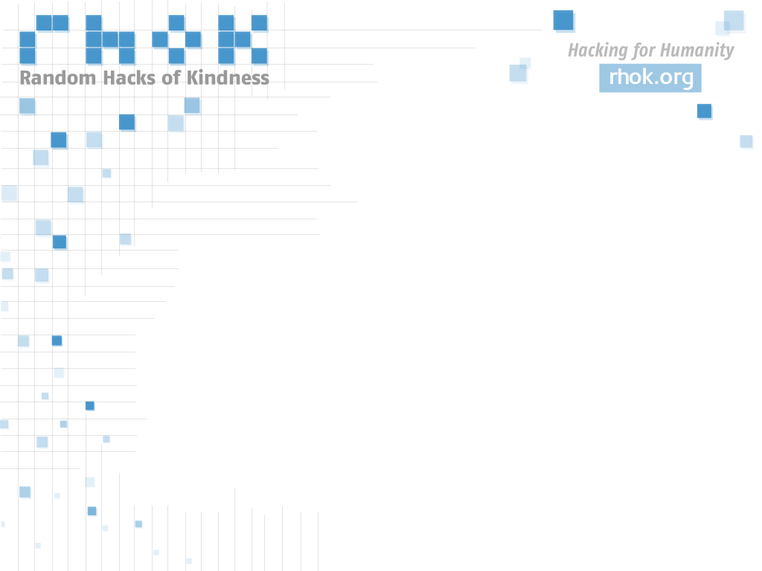
HACKING FOR HUMANITY:
INCREASING PARTICIPATION IN
HUMANITARIAN FREE/OPEN SOURCE
SOFTWARE DEVELOPMENT THROUGH
“RANDOM HACKS OF KINDNESS”
GLOBAL HACKATHONS

Slide 2
A.A.S. Business '08
Certificate Program in Organizational Change & Leadership '08
B.S. Applied Arts Sciences '08
  Concentrations: Business, Writing Studies, Organizational Change & Leadership, Political Science
M.S. Professional Studies '13
  Concentrations: Communications & Media Technology and Public Policy

Slide 3
1 - Course Concentrations | 7 - Steps Taken
2 - Contexts & Trends | 8 - Results
3 - Problem | 9 - Next Steps
4 - Project | 10 - Lessons Learned
5 - Objectives | 11 - Attribution
6 - Timeline | 12 - Resources

Slide 4

Course Concentrations
Communications
Electronic Communications & Society
Crafting the Message
Digital Design
Public Policy
Special Topics: Community Economic Development
Public Administration & Management
Science/Technology Policy Seminar
Free/Open Source Software (unofficial)
Special Topics: Security Technology
Seminar in Interactive Games & Media
Humanitarian Free/Open Source Software Development

Slide 5
Problem
Thousands of volunteers who answer the call to service each year, though motivated, do not possess the requisite technical skills to build their own solutions.
Aid organizations must prioritize their budgets to meet physical needs first. Technology solutions are often prohibitively expensive, and problematic to fund due to intellectual property issues.
Technical professionals are in high demand, and are often drawn to high technology regions with high-salary, private sector jobs (not volunteer work) to repay the high-cost of education.
Even with the efforts of Humanitarian hackers doing weekend or side projects, there are still many, many more problems than problem solvers.

Slide 6
Why?
“In this room, we have two cutting edge 21st century movements coming together. The first is the participatory development movement, where developers work with people in need to improve their lives. Because people have a sense of ownership, what is created is more sustainable, appropriate, and effective.
The second movement is the Free/Open Source Software movement, in which programmers around the world work together to create tools that are available to anyone. This is software that people can use to raise their standards of living, and those of their communities.
Both movements have a common denominator; empower people at the grassroots level to build their own solutions.”
Ban Ki-Moon, Secretary General, United Nations
2nd Annual Random Hacks of Kindness Keynote Address
http://www.unglobalpulse.org/blog/un-secretary-general-appeals-global-open-source-community

Slide 7
Project Objectives
Run Successful Hackathon
Solve Real-World Problems
Tell the Story
(Report & Slides)
Show the Results
(Source Code Visualization)
Publish and Distribute
(Github.com, RhoK.org, Opensource.com,
foss.rit.edu)
Rinse and Repeat
(Start all over again next year)

Slide 8
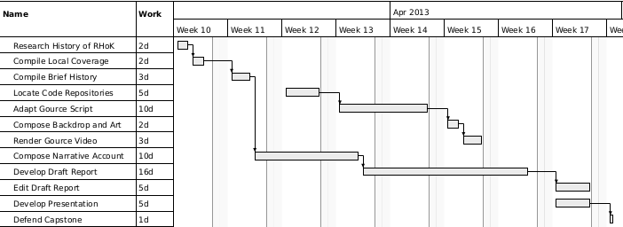
Timeline

Slide 9
Steps Taken Before
Get the Idea
Apply for License
Book the Venue
Create the Flyer
Create the Event Listing
Attend the CapitolCamp
Conference
Draft the Press Release
Confirm the Keynotes
Release Press Release
Secure the Swag
Conduct the Radio
Interview
Handle the Keynotes
Run The Event
Meet the Press
Serve the Meals
MC the Presentations
Catch my breathe

Slide 10
Steps Taken After
Research RHoK Organization
Compile Press Coverage
Review Literature
Locate Code Repositories
Adapt Multi-Gource Scripts
Adapt RHoK-Media Artwork
Produce Report
Produce Presentation
Defend Capstone

Slide 11
Project Results

Slide 12
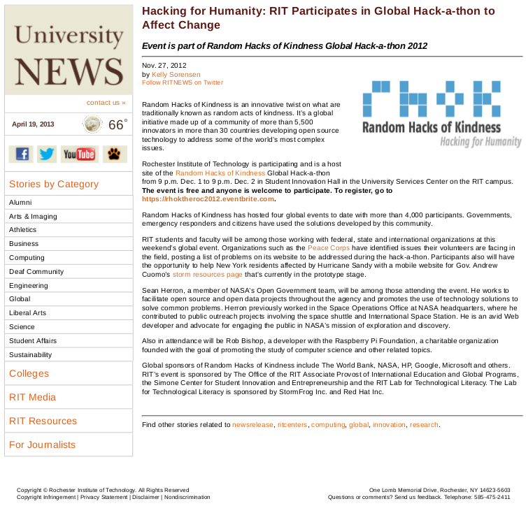
RIT Press Release

Slide 13
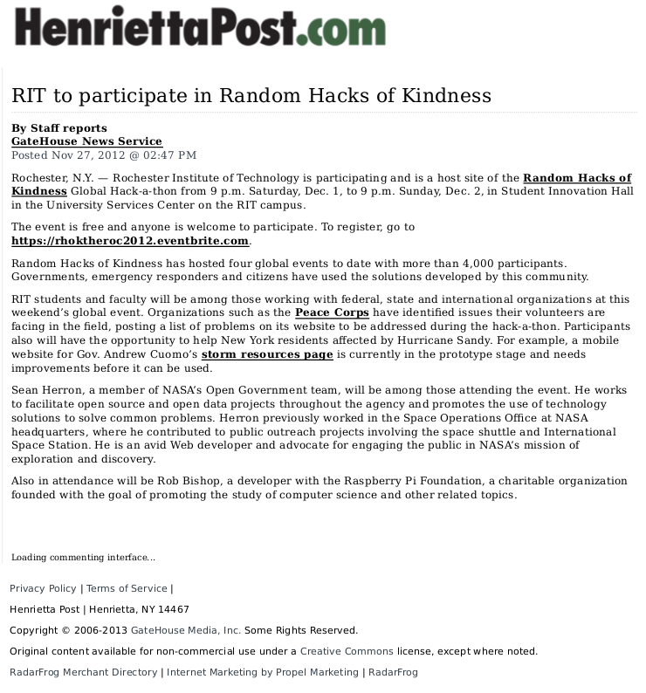
Local Press

Slide 14

WXXI 1370AM Radio: Interview with Bob Smith
http://foss.rit.edu/media/WXXI-AM%201370%20(am-hi)%20-%20.wav

Slide 15
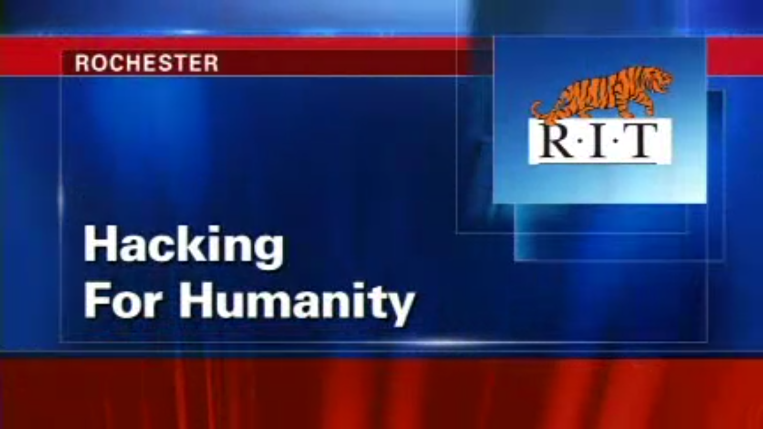
YNN News Clip
http://foss.rit.edu/media/YNN_RHoK.mp4

Slide 16
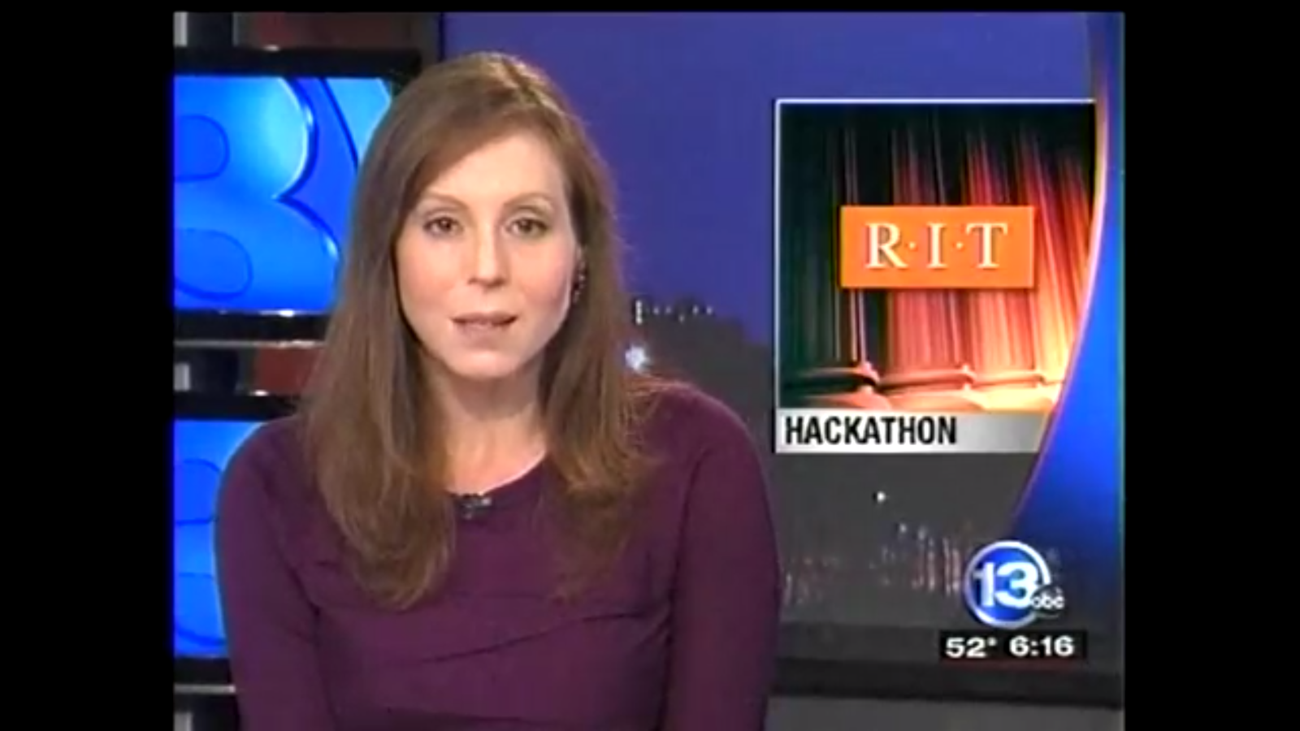
13WHAM News Clip
http://foss.rit.edu/media/13WHAM_RHoK.mp4

Slide 17
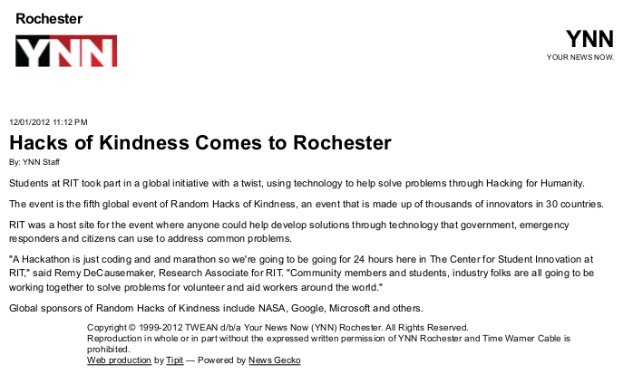
YNN Online Article

Slide 18
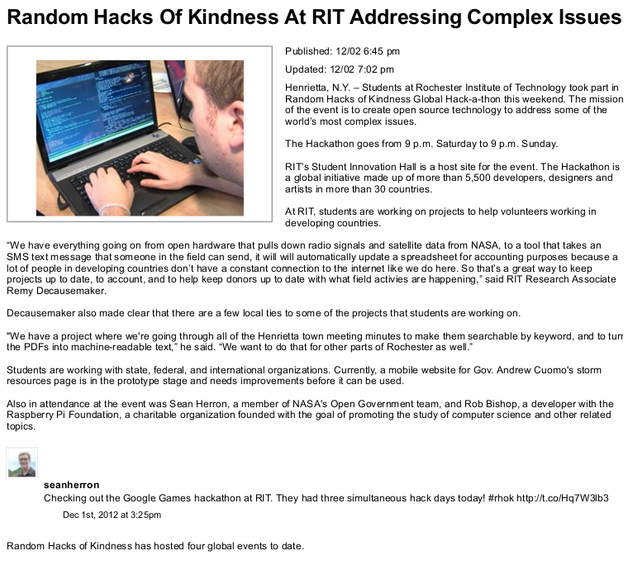
13WHAM Online Article

Slide 19
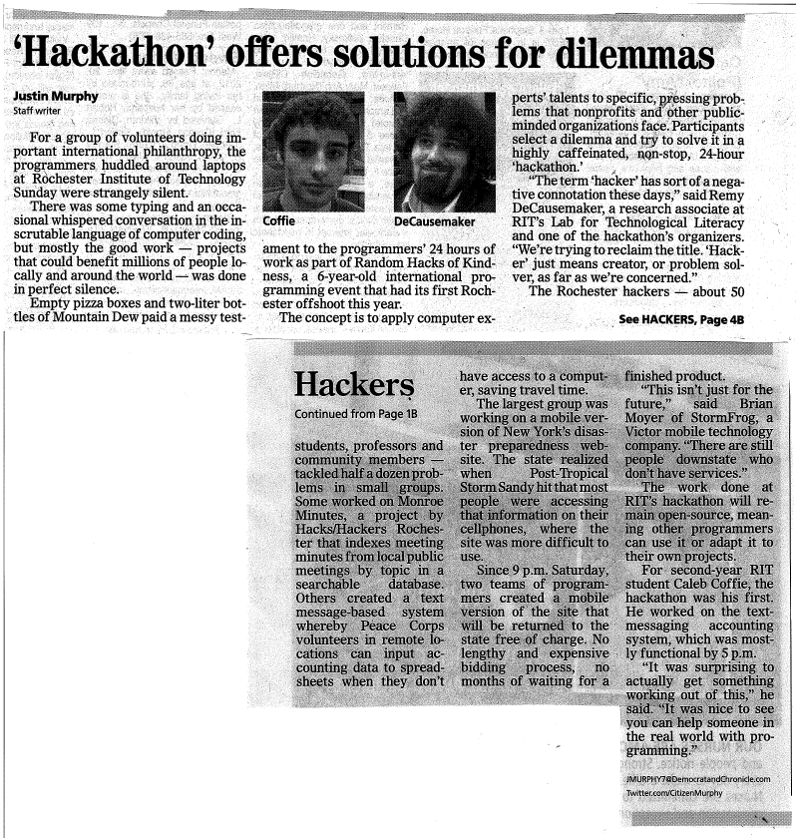
Democrat & Chronicle

Slide 20
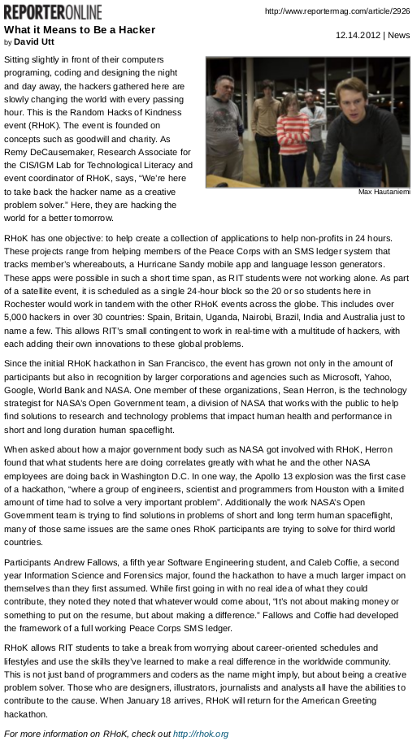
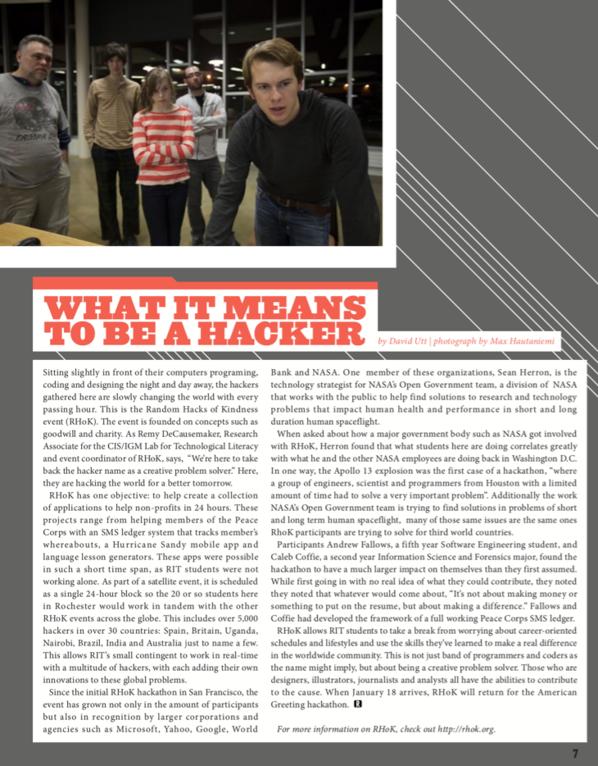
RIT Reporter

Slide 21
Outcomes

Slide 22
RadioBird
A project using a commodity radio antenna hooked up to a Raspberry Pi that creates a Software defined radio. Can be used to tap into a number of frequencies, including transmissions from NASA Satellites
Source Code: https://github.com/skykooler/radiobird

Slide 23
Outages
A live map of power outages in the North Eastern US, based on data feeds from National Grid and other Power Companies.
Source Code:
https://github.com/gregjurman/outages

Slide 24
Peacestagram
A webapp that shows a gallery of all the instatgram photos of PeaceCorps volunteers around the world, by searching for pictures tagged with terms like “PeaceCorps,” or the names of Host Countries.
Source Code:
https://github.com/seanherron/peacestagram

Slide 25
Monroe Minutes
Tools to scrape websites within Monroe County and pull meeting minutes and other important documents from various village, town, city, and county websites, and convert them to machine-readable text. These are then indexed using a histogram method with keyword rejection via a black list of common words to exclude from results.
Source Code:
https://github.com/thequbit/monroeminutes

Slide 26
RHoK-Media
A repository of art and design assets such as wallpapers, badges, and PowerPoint templates, based on the Random Hacks of Kindness logos and color palette.
Source Code:
https://github.com/JennX/RHoK-Media

Slide 27
PNC Notify
A project to notify expecting mothers with health prenatal care information during their pregnancy over SMS.
Source Code (Deleted): https://github.com/adamhayes/pnc_notify

Slide 28
SMS-to-Spreadsheet
Web application to allow users to send SMS messages to a designated phone number, and the contents of the message will be parsed and used to update a spreadsheet.
Source Code:
https://github.com/kaldrenon/sms_to_spreadsheet

Slide 29
Hurricane Sandy Relief
A mobile storm resources site to accompany http://governor.ny.gov/storm-resources that will;
1) aggregate all of the disparate data into one comprehensive data source, and
2) provide a mobile view of the information from the Governor's website, using Drupal as the underlying content management system
Source Code:
https://github.com/stormfrog/hurricane-sandy-relief

Slide 30
Random Hacks of Kindness: Four years of Hacking for Humanity
Multi-Gource Source Code Visualization

Slide 31
Next Steps

Slide 32
For the Capstone Report
Publish on Github.com
Publish as a guide/resource/narrative on RhoK.org
Publish a Feature-Length Article for Opensource.com?
Publish as part of a collection of Essays? Maybe chapter of a book?

Slide 33
For the Multi-Gource Visualization
Release rendered video on Youtube.com
Link to video on RhoK.org
Release log generation/colorization scripts on Github.com

Slide 34
For The Projects
Each repository is publicly available and ready for contributors. If accepted, We'll be running RHoK 2013 again in December.
One project in particular, SMS-To-Spreadsheet, is part of an ongoing effort--between our lab, and the PeaceCorps Special Assistant to the Director of Innovation--to test and possibly deploy in the field with active PeaceCorps Volunteers (PCVs)

Slide 35
What I'd Like to See Happen?
The story being told--on the sites mentioned prior, and elsewhere.
An increase in number of participants in our local event next year.
An increase in awareness of, and activity within existing projects (more press, more contributors, etc...)
An increase in awareness and publicity of RHoK Organization world-wide.
An increase in new projects (both technical and non-technical) built at future events.

Slide 36
After the MS degree?
Continue “Being the Change” I want to see in the world at the new RIT MAGIC Center—http://magic.rit.edu
Continue to research and develop HFOSS projects
Begin teaching HFOSS (and other) courses at RIT (16 students already registered)
Help RIT build the first Minor in Humanitarian Free/Open Source software development in the USA

Slide 37
Lessons Learned

Slide 38
What Went Right?
The Hackathon itself
  50ish attendees creating or improving 8 projects
The Gource Visualization
  It sure is pretty
The Press--Definitely the Press
  2 Television News Casts
  1 Radio Interview
  7 write-ups, both online and print

Slide 39
What you would do differently?
Connect with Other Sites
  Work together with other cities
  Video Conferencing/Broadcasting
Draw a more diverse crowd
  More creative/design folks
  More non-student attendees
  More Female attendees
  More local companies

Slide 40
Advice to future
Capstone students?
Do something you truly enjoy
Pick something that is already part of your professional life
Do something 'bigger' than just a paper; have a cause, make a difference!
Talk to and work with as many people as you can before/during/after to help you prepare, promote, and celebrate your Capstone!

Slide 41
THANK YOU
To the hackers who contributed to:
Gource and MultiGource
https://code.google.com/p/gource/people/list
https://github.com/Frencil/MultiGource
LibreOffice Writer and Impress
https://www.libreoffice.org/aboutus/credits/

Slide 42
THANK YOU
To Dr. Sam McQuade, who challenged me to be the best student I could be and gave me the opportunity to do so.
To Abby Berner, now Abby Cantwell, is the reason why I was able to make it through my first degree, and without which a second would not have been possible.
To the RIT Center for Multidisciplinary Studies, who's support and guidance has provided me with the opportunity to make my life's work, and my academic experience one and the same.

Slide 43
Obligatory Shoutout to my Boss (also Capstone Mentor)
To Professor Stephen Jacobs for always treating me as a colleague, and for his whole hearted support of my research and professional development.

Slide 44
Red Hat & Fedora
To the members of the Fedora Team, Opensource.com, and Red Hat, who have had our lab's back since Day zero.
In particular, Tom Callaway, Luke Macken, Ralph Bean, Ruth Suehle, Leslie Hawthorn, Dave Malcolm, Tohsio Kuratomi, and Mo Duffy.

Slide 45
Our .Gov Friends
Jim Bell, Ken Zalewski, Dean Hill, Graylin Kim, Dan Pozzi, and the NYSenate.gov development team (both past and present)
The office of ITS-OFT and the volunteers who organize CapitolCampNY, and work with many agencies and branches to bring the Open Source Way to the Great State of New York.
Special thanks to Ginger Gericitano for going above and beyond her duty to be involved with RHoK Rochester.

Slide 46
The FOSSBox
To the FOSSBox and its hackers.
Nathaniel Case, Justin Lewis, Ryan Brown, Sam Lucidi, Ross Dellinger, Chris Lockfort, Andres Ruiz, Matt Soucy, Luis Rosario, Duy Nguyen, Jenn Kotler, David Gay, Greg Jurman, Tim Duffy, David Silverman, Kevin Hockey, JT Mengel, Fran Rogers, and
Anyone else in the commit logs at http://github.com/FOSSRIT

Slide 47
The RHoKStars
Thea Aldritch, and the other members of the Random Hacks of Kindness organizing team.
The RhoK Global Sponsors.
Sean Herron, for being a speaker, and for getting the NASA Space Apps Challenge on my radar. We look forward to many more events like this at RIT.
Rob Bishop and the Raspberry Pi Foundation, for supporting Open Hardware on a global scale, and for bringing that presence to our local event.
The RhoK Rochester volunteers and attendees. No amount of planning or sponsorship will do much to help without all of your hard work.

Slide 48
StormFrog
Brian Moyer, Karthik Balasubramanian, and StormFrog's ace crew of developers and designers who pulled an extra 9-5 shift, then an extra 5-9 shift, on a weekend, to help us help others.

Slide 49
The Professors
Prof. Cameron
Prof. Cooper
Prof. Foltz
Prof. Worrell
Prof. Johnson
Prof. Sutton
Prof. Schull
Prof. Lundgren
Prof. Sherrill
Prof. Shein
Prof. Fornieri
Prof. Housel

Slide 50
The Admins and Staff
Clare Lagiewski
Jill Bray
Brenda Schlageter
Ann Dilal
Kim Shearer
Jenn Hinton

Slide 51
My Partner
And finally, Marie Nordin, for her patience and support through my entire Graduate School experience.
Particularly the patience.
And the love.
...But mostly the patience.

Slide 52
References
Chopra, Aneesh. Hacking For Humanity (2010). (Reviewed online 2/1/2013 at http://www.whitehouse.gov/blog/2010/06/03/hacking-humanity).
DeCausemaker, J. R. Should Government Endorse, Promote, or Develop Free/Open Source Software Policy? (2013). Rochester Institute of Technology: Unpublished.
DeCausemaker, J. R. (2011, October 11) "Open Data, Open Government, and The Open Source Way." (Reviewed online 04/02/2013 at http://tedxtalks.ted.com/video/TEDxBuffalo-2011-Remy-DeCausema).
DeCausemaker, J. R. Source Code: Living Artifacts of Developer Communication (2013). Rochester Institute of Technology: Unpublished.
Fontana, Richard, Kuhn, Bradley, M., Moglen, Eben, Norwood, Matthew, Ravicher, Danial, B., Sandler, Karen, Vasile, James, Williamson, Aaron. (2008). A Legal Issues Primer for Open Source and Free Software Projects. Software Freedom Law Center: Manhattan.
Ki-Moon, Ban. Random Hacks of Kindness Keynote Address (2010). (Reviewed online 2/1/2013 at http://www.unglobalpulse.org/blog/un-secretary-general-appeals-global-open-source-community).

Slide 53
References
Lerner, Josh, and Tirole, Jean. (2000). The Simple Economics of Open Source. National Bureau of Economic Research : Washington D.C.
Office of the CIO, Executive Office of the Governor (2012). Resources | Governor Andrew M. Cuomo. (Reviewed online 02/18/2012 at http://www.governor.ny.gov/resources/storm/)
Office of Management and Budget, Executive Office of the President (2012). Digital Government: Building a 21st Century Platform to Better Serve the American People. (Reviewed online 2/1/2013 at http://www.whitehouse.gov/sites/default/files/omb/egov/digital-government/digital-government.html).
Opensource.com (2009). Open Source Way - Open Source Principles. (Reviewed online 04/02/13 at http://opensource.com/open-source-way).
Random Hacks of Kindness (2013). About | Random Hacks of Kindness. (Reviewed online 2/1/2013 at http://www.rhok.org/about).
Skytland, Nick. Change The World (2012). (Reviewed online 2/1/2013 at http://open.nasa.gov/blog/2012/12/01/changetheworld/).
United States PeaceCorps. PeaceCorps Innovation Challenge (2011). (Reviewed online 10/20/2012 at http://innovationchallenge.peacecorps.gov/learn/).
Weber, Steven. (2004). The Success of Open Source. Massachusetts: Harvard University Press.

