Slide 1

Fedora <3 BrickHack
Remy DeCausemaker
Fedora Community Lead & Council
https://github.com/decause/decks/
Licensed CC-BY-SA 4.0 - https://creativecommons.org/licenses/by-sa/4.0/

Slide 2
/whois

Slide 3
/whois
Remy DeCausemaker
  Fedora Community Action & Impact Lead, Red Hat OSAS Team
  Hackademic & EDU Objective Lead, Fedora Council
  @remy_d | github.com/decause | decause@redhat.com
  308C A504 0B47 1503 C9D9 E670 E633 A79B 0BB0 F6D9

Slide 4
/whatis

Slide 5
The Fedora Project is...
A partnership of Free Software community members from around the globe who build software and communities to produce a Linux distribution called "Fedora."
The Project's mission is to lead the advancement of Free and Open Source software and content as a collaborative community.

Slide 6
Fedora has many subprojects:
Ambassadors
Community Operations
Design
Documentation
EPEL
Infrastructure
Internationalization
Localization
Marketing
Magazine
Package Maintainers
Quality Assurance
Websites

Slide 7
BrickHack:
Best in FOSS

Slide 8
Da Rulez
#1) Repository must be publicly hosted on a Code Forge
#2) All Code and Content must be released under Open Source Initiative Compatible Free/Open Licenses
#3) At Least ONE (1) member of your team must be physically at BrickHacks event

Slide 9

Publicly Hosted
Repository must be publicly hosted on a Code Forge
  https://GitHub.com
Fedora Specific Repos:
  https://pagure.io

Slide 10

FOSS Licensed
Code and Content must be released under OSI compatible Free/Open Source Licenses:
  http://opensource.org/licenses/category
License Resources:
  https://tldrlegal.com
  https://creativecommons.org/licenses
  http://www.gnu.org/licenses/license-list.en.html

Slide 11
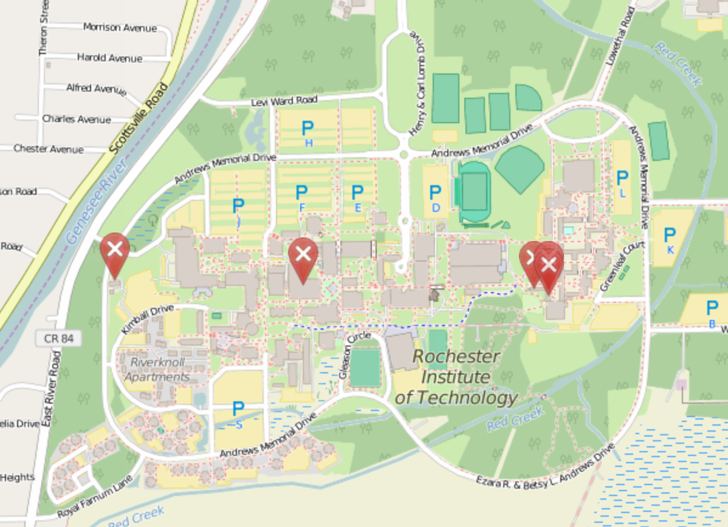
Physically Present
At least one member of your team must be here at BrickHack physically:

Slide 12
Prizes & Press
Hard Copy of The Open Organization by Jim Whithurst, CEO of Red Hat
Featured Article on Fedora Community Blog including interviews with your team syndicated to Fedora Magazine and OpenSource.com and Red Hat Community Blog.
Opensource.com Apparel
Some Open Hardware (TBD)

Slide 13
Thank you BrickHack organizers, sponsors, volunteers, and attendees!
Questions?
#fedora-commops on Freenode
decause@redhat.com
commops@fedoraproject.org
@Remy_D
Licensed CC-BY-SA 4.0 - https://creativecommons.org/licenses/by-sa/4.0/

