Slide 1
Fedora Project
Stats && Metrics && Tools
Remy DeCausemaker
decause@redhat.com
Fedora Community Impact & Action Lead
@remy_d | @fedobot

Slide 2

Fedora Project Profile: Status
  Overall, Fedora is executing well and is a mature community that has a large following of users and fair number of external contributors.
  We have room to improve when it comes to interacting with the community external to Red Hat and providing resources for community projects.
  We also need to improve our ability to act on initiatives / ideas coming from the community rather than being driven by our own teams.

Slide 3

Fedora Project Profile: Goals
Functional upstream for Red Hat Enterprise Linux (RHEL)
Have a strong community that helps improve Fedora, and generate goodwill for RHT
Help build a strong hiring pool for Red Hat
Give early feedback for features going into RHEL
Identify computing trends and generate ideas that RHT alone may not catch

Slide 4
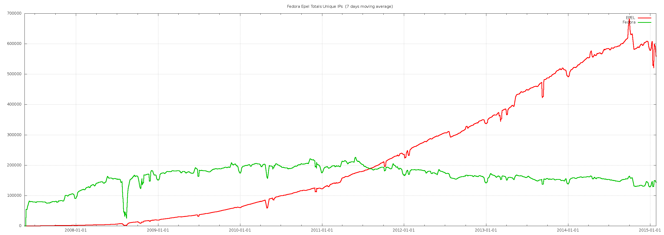
Fedora EPEL Unique IP's (7 Day Moving Average)

Slide 5
Fedora EPEL Unique IP's (7 Day Moving Average)
Yum Broken in 2008

Slide 6
Fedora EPEL Unique IP's (7 Day Moving Average)
EPEL Continues to grow in Popularity
Yum Broken in 2008

Slide 7
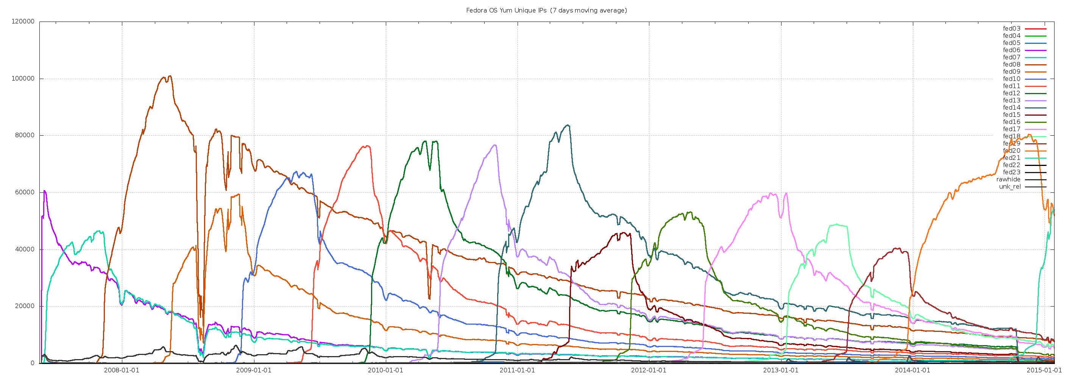
Fedora OS Yum Unique IP's (7 Day Moving Average)

Slide 8

Yum Repo Stats by Release
Graph Shows repo connections per IP address per day
Generally:
  1/3 of users update quickly to new releases
  1/3 update slowly up until EOL
  1/3 are long tail (never updated)

Slide 9
Fedora 21: ISO Downloads by Edition
(All < 2% each)
Extremely rough numbers with considerable guesswork and not yet enough data

Slide 10
Bodhi: Shipping Bits to Users

Slide 11
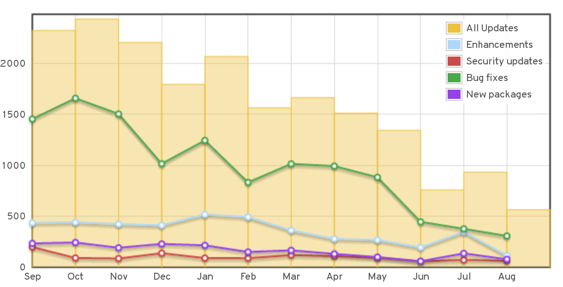
Bodhi Stats: F20 Updates

Slide 12
Bodhi Stats (F20)
Metric | Value | % Change | % of Total Updates
Updates | 15012 | 8%
Packages Updated | 6952 | 6%
Stable Updates | 13207 | 9%
Testing Updates | 250 | 9%
Pending Updates | 35 | -10%
Obsolete Updates | 1520 | 15%
Bugfix Updates | 8397 | 6% | 56%
Enhancement Updates | 3605 | 18% | 24%
Security Updates | 1114 | 16% | 7%
Newpackage Updates | 1896 | 6% | 13%
Bugs Resolved | 12315 | 14%
Critical-path Updates | 1603 | 44%
Approved Critical-path Updates | 1560 | 43%
Unapproved Critical-path Updates | 0 | 0%
Updates Received Feedback | 5455 | 34% | 36%
+0 Comments | 1259 | 42%
+1 Comments | 11579 | 48%
-1 Comments | 678 | 29%
Unique Authenticated Karma Submitters | 1195 | 15%
Anonymous Users Submitting Karma | 304 | 50% | 2%
Updates Stable Reached Karma Threshold | 2396 | 37% | 18%
Updates Reached Minimum Time in Testing Threshold | 11200 | 2% | 85%
Testing→Stable without Karma | 8259 | -4% | 64%
Testing→Stable with Negative Karma | 33 | -11% | 0%
Critical-path Updates pushed without Karma | 57 | -61%

Slide 13

Bodhi: F20 Take-aways
1195 unique users that submitted feedback, or did testing. That is a *huge* number, and it went up 15%! That is a 15% growth in active testers. FAS accounts is a weaker metric for "active contributors" whereas Bodhi users is much higher signal.
50% increase in Anonymous Users providing karma on Bodhi updates. This is a *huge* increase in the number of people participating in the project. Coming up with an onboarding strategy for these users will be a subject of future research for the CommOps team.
Updates that went from Testing->Stable without anyone providing karma is still slightly down from the previous release.
2/3rds of all packages remained the same through F20, which was the last non-editions release of Fedora.

Slide 14
Bodhi Stats: F20 Updates

Slide 15
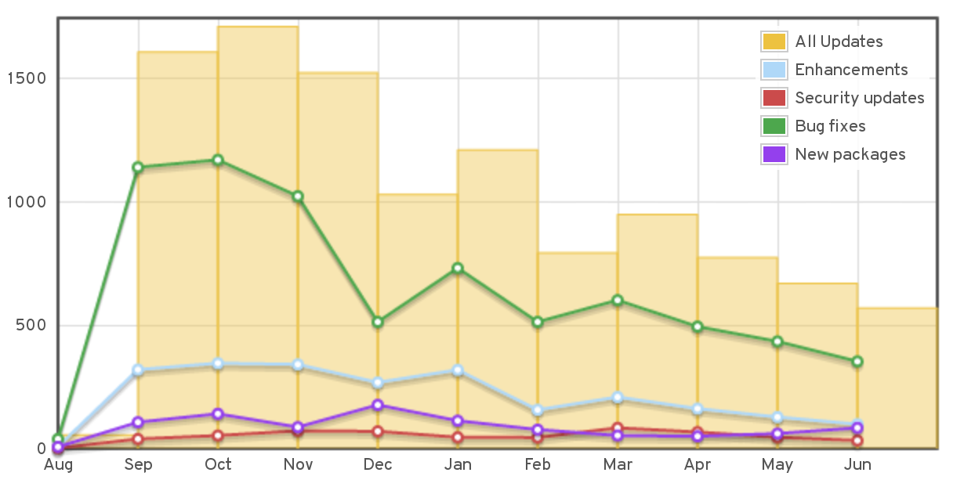
Bodhi Stats: F21 Updates

Slide 16
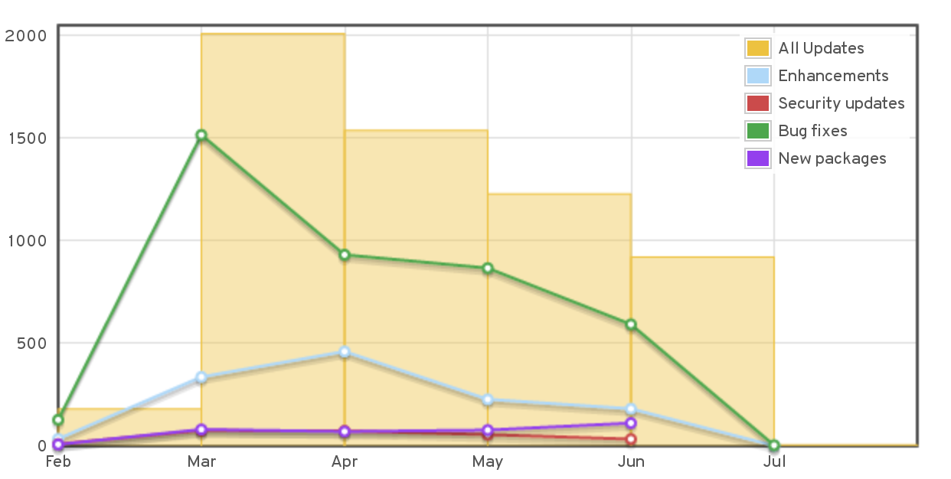
Bodhi Stats: F22 Updates

Slide 17

Bodhi Metrics: Future
Autogenerated Metrics and graphs (as seen in table slides previously)
Bodhi 1.0 only keeps track of Karma generally on an update, whereas Bodhi 2.0 Release will include more fine-grained information:
  Karma +1 – “This doesn't break my system”
  Karma -1 – “This doesn't fix Bug #1337
  Karma +0 – “Didn't test for Bug #31337

Slide 18
Fedmsg: Real-time Metrics

Slide 19
Fedmsg: Real-time Metrics
Real-time messaging bus capturing most types of contributor activity in Fedora
Running since late 2012
  35 Message Topics (and counting)
  29 Million messages Total (and counting)
Datagrepper provides access to fedmsgs, metrics, graphs
  Statscache, which will provide computed and cached statistics is currently under development by nyazdani, new RHT Intern this summer

Slide 20
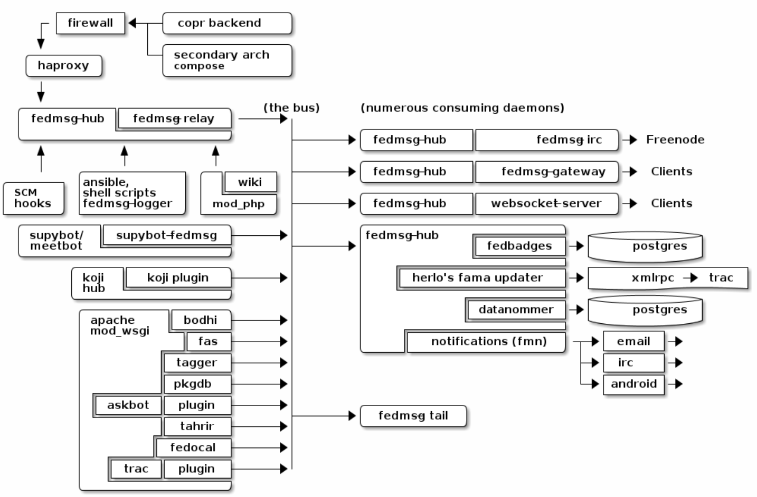
Fedmsg: Network Topology

Slide 21
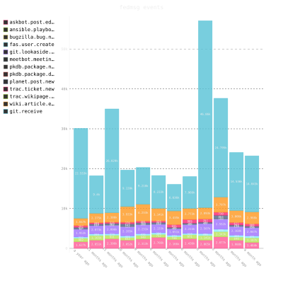
Fedmsg Stats
June 2014-2015
New FAS Accounts | 5096
Blog Posts to Fedora Planet | 4858
New Trac Tickets | 6480
New Package Tarballs | 25971
IRC Meetings | 1190
Ask.fp.o Q&A's | 26385
Total Fedmsgs | 2,329,251

Slide 22
Fedora Tagger: low-barrier contributions

Slide 23
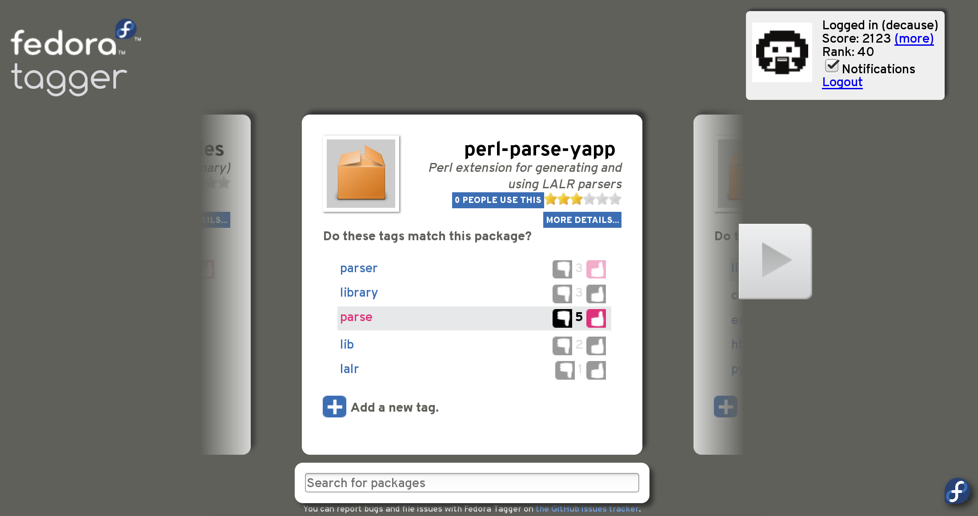
Fedora Tagger Stats
Total Packages | 15772
Total Unique Tags | 10842
Packages Without Tags | 632
Packages With Tags | 15140
Average Tags / Package | 3.885
Tags / Package (that have at least one tag) | 4.048
Average Votes / Tag | 16.153
Average Votes / Package | 11.104
Most Votes / Tag | 92
Fedor Tagger is an app that “Gamifies” tagging packages with metadata. Low-barrier to entry way to contribute, with an effective webapp at:
http://apps.fedoraproject.org/tagger

Slide 24
Fedobot

Slide 25
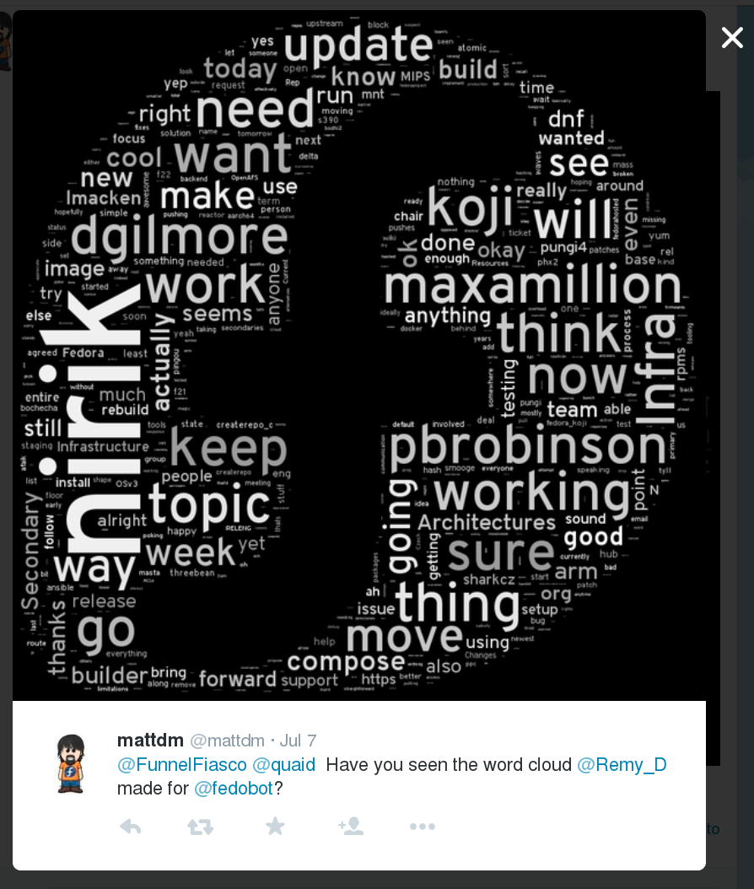
Fedobot: Tweepy + word_cloud
http://twitter.com/fedobot
http://github.com/decause/wordcloudbot

Slide 26
Fedora Hubs

Slide 27
Hubs: Fedora's Online Soul
Problem
  The Fedora web presence is very static—all the action is on mailing lists, IRC, and aging wikis.
Solution
  The vision is to have a modern, web-based Fedora activity center which feels like the positive, connected energy of Flock or FUDCon, available to all of us at any time.

Slide 28
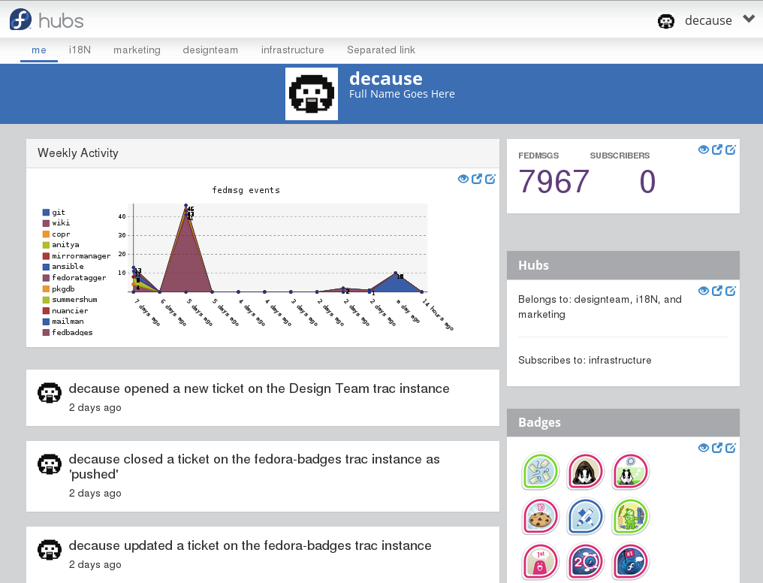
Fedora Hubs: Alpha

Slide 29
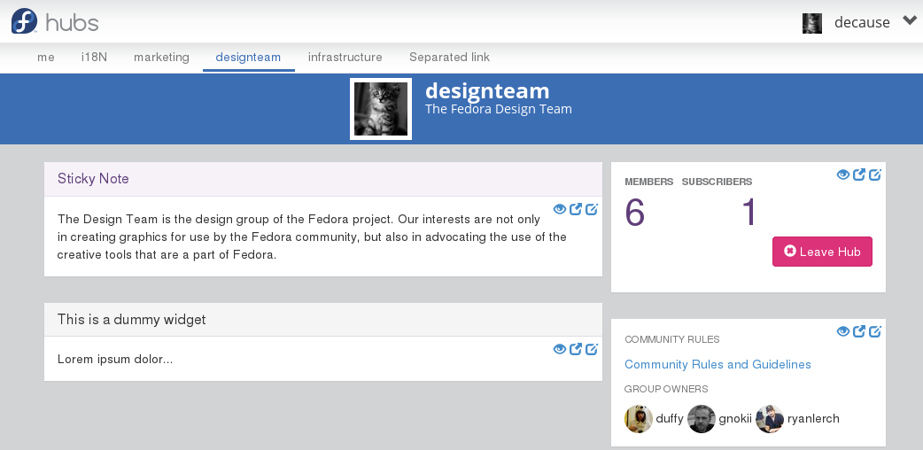
Fedora Hubs: Alpha

Slide 30
Fedora Council: 10,000 Foot View

Slide 31
Fedora Council Objectives
Fedora Editions, Phase 2
Summary: Take the initial Server/Workstation/Cloud split from Fedora 21 from an experiment into solid production. Increase autonomy from FESCo and improve targeted outreach.
Objective Lead: Stephen Gallagher
Timeframe: F22 and F23 releases, ending shortly after Flock 2015.
University Involvement Initiative
Summary: Increase Fedora's exposure in university environments, particularly engineering universities.
Objective Lead: Remy DeCausemaker
Timeframe: 2015-2016 academic year
Fedora Modularization (Requirements Phase)
Summary: Requirements-gathering from stakeholders for "Rings" aspect of Fedora.next
Objective Lead: Langdon White
Timeframe: F23 release - Flock; will be updated with subsequent phase

Slide 32
Q&A

Slide 33
Fedora Project
OSAS Community Briefing
All Company Call
July 1, 2015
Remy DeCausemaker
decause@redhat.com
Fedora Community Impact & Action Lead

