Slide 1

One Laptop Per Child
Who Are Children?
(4th Graders: 8-10 years of age)

Slide 2
Understanding Children
4th Graders are typically 8-10 years of age.
When developing for children, you have to make sure your application not only keeps their attention & is fun to play, but meets their level of understanding in a particular content area.
If you develop a math application that is below or above the 4th grade level, then it is not meeting this courses goals.
Education is based in a long history of research
and we will explore key theories & concepts to gain perspective and a fundamental understanding.

Slide 3
Piaget’s Stages of Cognitive Development
Piaget was a developmental biologist who devoted his life to closely observing and recording the intellectual abilities of infants, children, and adolescents.
Some resources, such as the work of Piaget, will help us understand the cognitive abilities of a 8-10 year olds & to develop applications for them.
Our focus is on the development stage of the “Period of Concrete Operations” (7-11 years old)

Slide 4
Piaget’s Stages of Cognitive Development
“Period of Concrete Operations” - Characteristic Behavior:
“Evidence for organized, logical thought. There is the ability to perform multiple classification tasks, order objects in a logical sequence, and comprehend the principle of conservation. Thinking becomes less transductive and less egocentric. The child is capable of concrete problem-solving.”
“Some reversibility now possible (quantities moved can be restored such as in arithmetic: 3+4 = 7 and 7-4 = 3, etc.)”
“Class logic-finding bases to sort unlike objects into logical groups where previously it was on superficial perceived attribute such as color. Categorical labels such as "number" or animal" now available.”
http://www.childdevelopmentinfo.com/development/piaget.shtml

Slide 5
Constructivist Learning Theory
“Constructivism is basically a theory - based on observation and scientific study -
about how people learn. It says that people construct their own understanding
and knowledge of the world, through experiencing things and reflecting on those
experiences. When we encounter something new, we have to reconcile it with
our previous ideas and experience, maybe changing what we believe, or maybe
discarding the new information as irrelevant. In any case, we are active creators
of our own knowledge. To do this, we must ask questions, explore, and assess
what we know.”
http://www.thirteen.org/edonline/concept2class/constructivism/index.html
“The teacher's role should be that of facilitator. Students are encouraged to
discover principles for themselves, whilst in active dialogue with the pedagogue.
The teacher's task is to mediate information (called scaffolding) to be learned into
an appropriate format applicable to the learner's level of understanding. The
teacher organises the curriculum in such a manner so as to enable the student
to continually build upon previously acquired knowledge. Good methods of
structuring knowledge should result in learners simplifying, generating new
hypotheses, and increasing the manipulation of information.
http://hagar.up.ac.za/catts/learner/smarks/constructivist-Gagne.htm#_Toc416343064

Slide 6
Bloom’s Taxonomy
Demonstration of Learning through the math applications could be
measured by Bloom’s Six levels identified below:
Bloom (in Huitt, 1996) developed a classification of levels of intellectual
behaviour important in learning. The main idea of Bloom's taxonomy is
that the knowledge that learners are required to know can be arranged
in a hierarchy from less to more complex. Bloom identified six levels of
learning demonstrated by:
o knowledge recall
o comprehension
o application of knowledge
o analysis of data
o synthesis of data
o evaluation of ideas or actions

Slide 7
Howard Gardner: Multiple Intelligences &
Education
“Howard Gardner's work around multiple intelligences has had a
profound impact on thinking and practice in education - especially
in the United States.”
Gardner’s views challenge Piaget’s work, offering a different view on
cognitive development:
“…that there exists a multitude of intelligences, quite independent of
each other; that each intelligence has its own strengths and
constraints; that the mind is far from unencumbered at birth...”
http://www.infed.org/thinkers/gardner.htm

Slide 8
Howard Gardner: Multiple Intelligences &
Education
Linguistic intelligence involves sensitivity to spoken and written
language, the ability to learn languages,and the capacity to use
language to accomplish certain goals. This intelligence includes the
ability to effectively use language to express oneself rhetorically or
poetically; and language as a means to remember information.
Writers, poets, lawyers and speakers are among those that Howard
Gardner sees as having high linguistic intelligence.
Logical-mathematical intelligence consists of the capacity to analyze
problems logically, carry out mathematical operations, and investigate
issues scientifically. In Howard Gardner's words, it entails the ability to
detect patterns, reason deductively and think logically. This intelligence
is most often associated with scientific and mathematical thinking.

Slide 9
Howard Gardner: Multiple Intelligences &
Education
Musical intelligence involves skill in the performance, composition,
and appreciation of musical patterns. It encompasses the capacity to
recognize and compose musical pitches, tones, and rhythms.
According to Howard Gardner musical intelligence runs in an almost
structural parallel to linguistic intelligence.
Bodily-kinesthetic intelligence entails the potential of using one's
whole body or parts of the body to solve problems. It is the ability to
use mental abilities to coordinate bodily movements. Howard Gardner
sees mental and physical activity as related.
Spatial intelligence involves the potential to recognize and use the
patterns of wide space and more confined areas.

Slide 10
Howard Gardner: Multiple Intelligences &
Education
Interpersonal intelligence is concerned with the capacity to understand
the intentions, motivations and desires of other people. It allows people
to work effectively with others. Educators, salespeople, religious and
political leaders and counsellors all need a well-developed
interpersonal intelligence.
Intrapersonal intelligence entails the capacity to understand oneself,
to appreciate one's feelings, fears and motivations. In Howard
Gardner's view it involves having an effective working model of
ourselves, and to be able to use such information to regulate our lives.
http://www.infed.org/thinkers/gardner.htm

Slide 11
Developing for Children
Knowing and using some of these theories will help in understanding youth, education, & development of quality applications.
Remember to reference standards & other resources online:
Reference New York State’s website: http://www.emsc.nysed.gov/nysatl/standards.html

Slide 12
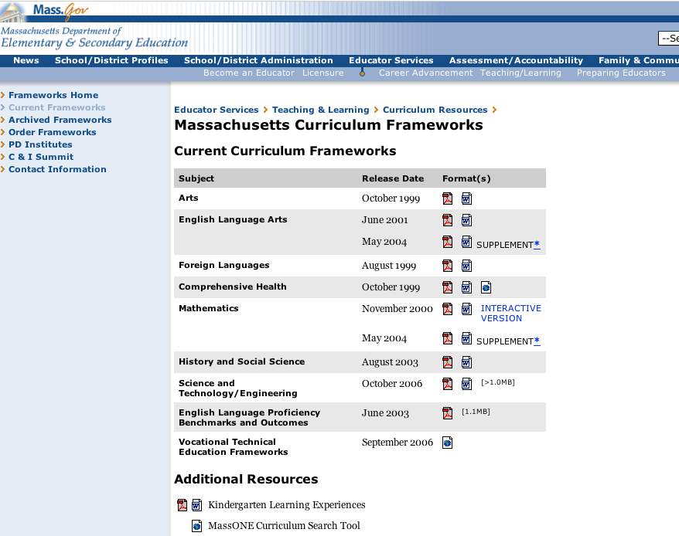
Developing to 4th Grade
Math Standards
http://www.doe.mass.edu/frameworks/current.html

Slide 13
Field Testing on 4th Graders
Prototypes, completed applications, or even key concepts should be tested in the field to ensure you are on the right track.
Comprehensive knowledge of research cannot supplement or replace the value of actual time with your target users.
Observe youth & their interaction with the XO’s and current applications.

Slide 14
Field Testing on 4th Graders
Take notes on 4th grader behavior & interests.
Ask questions & construct and/or implement surveys to collect actual user data.
Investigate current Math curriculum & tasks with both students and teachers, to find out what works & where gaps may exist.

Slide 15
Analyze Student Results
Analyze results of surveys and/or application testing.
Compare results with other RIT teams/classmates.
Compare results with existing research and data in online resources.
Share findings and next steps with online community.

Slide 16
Revise Application in Response to Field Tests
Use results & online community feedback to revise current projects/applications.

Slide 17
Re-test Revisions of Applications

Slide 18
Resources
http://www.pbs.org/teachers/classroom/3-5/math/ =
PBS resources for teachers for Math curriculum & lessons
http://www.search-institute.org/=
Search Institute’s home page for youth asset research
http://www.nifl.gov/childhood/childhood.html =
National Institue for Literacy, child overview page
http://hagar.up.ac.za/catts/learner/ameyer/constructivismandtechnology.htm
= Constructivism & Technology in Education

Slide 19
Resources
http://hagar.up.ac.za/catts/learner/smarks/constructivist-Gagne.htm#_Toc416343064
= Gagne's instructional design
http://www.infed.org/ideas/index.htm =
Online resources for education & learning
http://www.emsc.nysed.gov/nysatl/standards.html =
New York State Academy for Teaching & Learning
http://www.doe.mass.edu/frameworks/current.html =
Massachusetts Department for Education

Slide 20


Slide 21
PowerPoint created by:
Stephen Jacobs
Director, Lab for Technological Literacy
Associate Professor
Game Design & Development
GCCIS Department of Information Technology
Eric M. Grace
Adjunct Faculty Member
GCCIS Department of Information Technology
Rochester Institute of Technology

