Slide 1

One Laptop Per Child A
Who Are Children?
(4th Graders: 8-10 years of age)

Slide 2
Pedagogy—Instructional Theory
Didactic/Lecture method (described by Aristotle)—the teacher is considered to be the possessor of knowledge, which he or she then imparts to students through lecture and instruction.
Socratic/Dialectic method—instructor engages students in a common search for meaning and understanding.

Slide 3

Didactic Instruction
Was widely used in the primary school setting from the inception of formal public education in Europe in the Renaissance, through the 19th Century and mid 20th Century. Because this approach is not student-focused, it requires traditional hierarchical discipline to function smoothly

Slide 4

Didactic Classroom 1
Teacher is the “giver of knowledge”
Didactic method (Greek: didáskein, to teach; lore of teaching) is a teaching method that follows a consistent scientific approach or educational style to engage the student’s mind. (Wiki)

Slide 5

Didactic Classroom 2
On the surface, students are passive receivers of knowledge
Students participate only to ask questions,
BUT in order to be effective, students must be alert and engaged to follow the path the teacher is leading them on.
Students who are not engaged are left out/behind.

Slide 6

Socratic/Dialectic Method
Although the “teacher” may have more knowledge of a subject than students, the teacher leads students through questioning and response towards understanding or a specific learning outcome.
This method takes its name and derives from the Greek philosopher Socrates.

Slide 7
Which approach to use?
Socratic method has the benefit of teaching students how to think and to develop their own analytic process—creates independent minds and thinkers.
Dialectic method has the benefit of being able to impart large volumes of “concrete” or text-based knowledge, that is knowledge that is not necessarily dependent on analytic process or abstraction to be useful (language vocabulary, arithmetic, etc.).

Slide 8

Mixing it up
Most teachers use their knowledge of instructional methods and theory to “Mix it up.”
A blend of instructional approaches will bring benefit to the maximum number of students. Many students, particularly younger students, but more frequently older students, have little patience or practice sitting still, and cannot tolerate traditional, didactic teaching.

Slide 9
Instructional Tuning
Even teachers with years of experience find the need to fine tune, revise, or completely revamp lesson plans that had formerly worked to satisfaction.

Slide 10
Lesson Plans
A basic lesson plan has three elements
1. Objectives
2. Methods
3. Evaluation

Slide 11
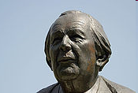
Jean Piaget
1896-1980
Was first major theorist on child development and learning theory
Largely responsible for shifting focus in classroom from needs of teacher to needs of students.

Slide 12
Piaget’s Developmental Learning Stages
Preoperational stage: from ages 2 to 7 (magical thinking predominates. Acquisition of motor skills). Egocentrism begins strongly and then weakens. Children cannot conserve or use logical thinking.
Concrete operational stage: from ages 7 to 12 (children begin to think logically but are very concrete in their thinking). Children can now conceive and think logically but only with practical aids. They are no longer egocentric.
Formal operational stage: from age 12 onwards (development of abstract reasoning). Children develop abstract thought and can easily conserve and think logically in their mind.

Slide 13
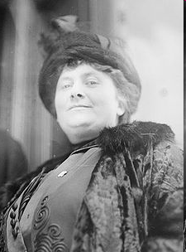
Maria Montessori
1870-1952
One of the first women to obtain degrees in either engineering or medicine.
Became involved in the mental health of children when doing a medical rotation in a sanitarium.
Developed a child-centered pedagogy

Slide 14
Montessori’s Innovations 1
instruction of children in 3-year age groups, corresponding to sensitive periods of development (example: Birth-3, 3-6, 6-9, 9-12, 12-15 year olds with an Erdkinder (German for "Land Children") program for early teens)
children as competent beings, encouraged to make maximal decisions
observation of the child in the prepared environment as the basis for ongoing curriculum development (presentation of subsequent exercises for skill development and information accumulation)

Slide 15
Montessori’s Innovations 2
small, child-sized furniture and creation of a small, child-sized environment (microcosm) in which each can be competent to produce overall a self-running small children's world
creation of a scale of sensitive periods of development, which provides a focus for class work that is appropriate and uniquely stimulating and motivating to the child (including sensitive periods for language development, sensorial experimentation and refinement, and various levels of social interaction)

Slide 16
Montessori’s Innovations 3
the importance of the "absorbent mind," the limitless motivation of the young child to achieve competence over his or her environment and to perfect his or her skills and understandings as they occur within each sensitive period. The phenomenon is characterized by the young child's capacity for repetition of activities within sensitive period categories (Example: exhaustive babbling as language practice leading to language competence).
self-correcting "auto-didactic" materials (some based on work of Jean Marc Gaspard Itard and Edouard Seguin)
-- Source Wikipedia
The Montessori Method online book

Slide 17
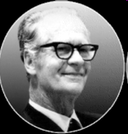
Behaviorism (B.F. Skinner)
focuses on modifying behavior by making changes to the subject’s environment
1. Classical Conditioning –stimulus-response
2. Operant Conditioning—the use of consequence to modify behavior
Behaviorism has found expression in modern education in movements like OBE.

Slide 18
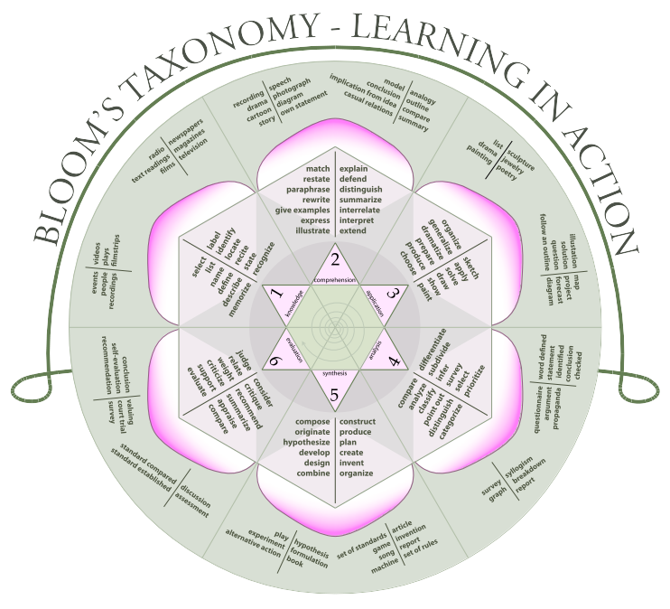
Bloom’s Taxonomy
https://upload.wikimedia.org/wikipedia/commons/2/24/Blooms_rose.svg

Slide 19
Bloom’s Taxonomy
Remembering
Comprehending
Applying
Analyzing
Synthesizing (Create)
Evaluating

Slide 20
William Spady
Outcome Based Education (OBE)—is a student centered approach that emphasizes testable results. Strongly influenced the Bush era “No Child Left Behind Program.”

Slide 21
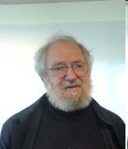
Constructionism
Seymour Papert (MIT), 1928-2016
People learn by making mental models of the world around them
This process is best facilitated by “hands-on” experiences
Also called “tactile learning”

Slide 22
Not to be confused with…
CONSTRUCTIVISM—a philosophicalb theory of knowledge (epistemology) that says that people derive knowledge from their experience. But you can see how people would be confused.

Slide 23
Logo (Papert, Feurzeig, Solomon; 1967)
Media Lab: Lifelong Kindergarten
Scratch
Sugar

Slide 24
Discovery Learning 1
“Discovery Learning is a method of inquiry-based instruction and is considered a constructivist based approach to education. It is supported by the work of learning theorists and psychologists Jean Piaget, Jerome Bruner, and Seymour Papert. Although this form of instruction has great popularity, there is some debate in the literature concerning its efficacy (Mayer, 2004).”

Slide 25

Discovery Learning 2
This teaching method attempts to engage students actively in the learning process by uniting various disciplines in pursuit of knowledge on a single topic.
A class studying squirrels might look at squirrel food chain biology, write poems, study famous squirrels of history (?), learn about exponents linking to squirrel reproduction curves, etc.
Locally there are a number of schools which use this approach to good effect including--
Genesee Community Charter School
School-58 World of Inquiry

Slide 26
OLPC in the Classroom
This is what we are looking at:
How is Sugar being used to enhance learning?
Are these and other technological approaches effective? Why or why not?
Is technology in the classroom useful or a distraction?
Is your application useful or a potential distraction?

