Slide 1


BOSH Fundamentals

Slide 2
Agenda
BOSH Overview
BOSH Architecture
BOSH Deployments and Releases
BOSH HA and Platform Updates

Slide 3
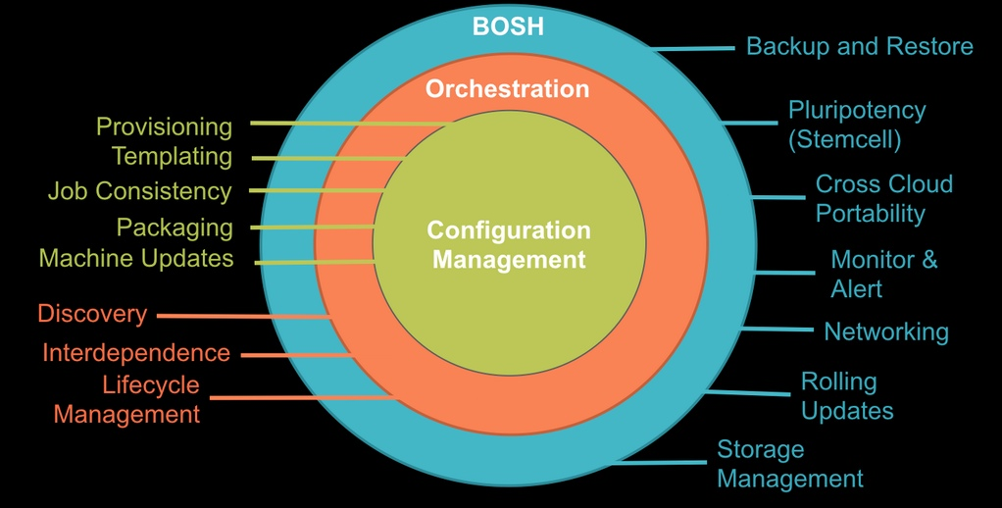
“ BOSH is an open-source tool chain for release engineering, deployment and lifecycle management of large-scale distributed services ”

Slide 4
Why BOSH?
Provision services, not machines
Enables continuous delivery
Cloud-agnostic view of Platform Ops
Holistic Toolchain for “rule them all"
Eliminate bespoke automation on top of config management

Slide 5

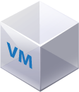
BOSH (Outer Shell) Logical View
DB
Blob Store
Deploys and manages large scale distributed systems. BOSH provides the means to go from deployment (i.e., Chef/Puppet) to VM creation and management (i.e., cloud CPI). It includes interfaces for vSphere, vCloud, AWS and OpenStack. Additional CPI can be written for alternative IaaS providers.
Key Elements:
CLI
Director
Blobstore
Workers
CLI
Director
Worker
NATS
Health Monitor
CPI
Message Bus
Health Monitor
IaaS CPI
Agents
Inner shell
Agents
Outer shell

Slide 6
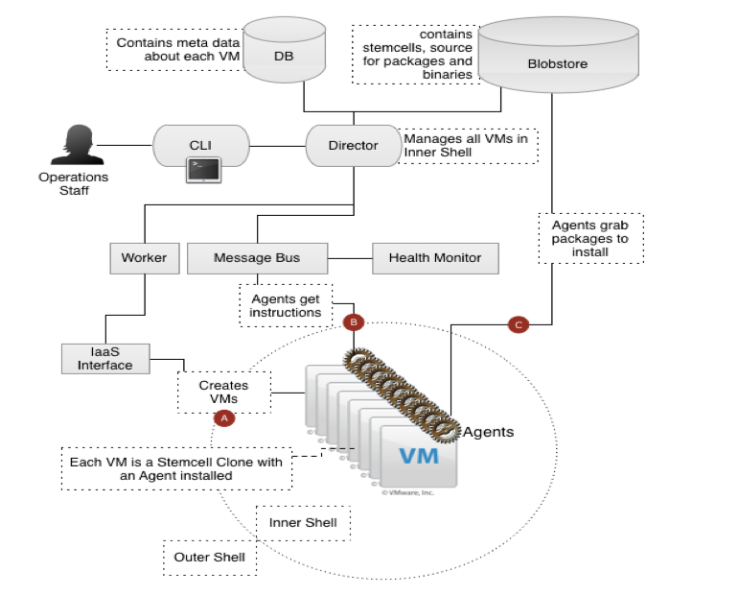
The BOSH Architecture
Very similar to CF architecture itself
Director as analogy to Cloud Controller
Different CPIs exist per IaaS implementation
Workers responsible for executing tasks as dictated by Director

Slide 7




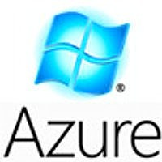

BOSH: Cloud Provider Interface
Stemcell
create_stemcell(image, cloud_properties)
delete_stemcell(stemcell_id)
VM
create_vm(agent_id, stemcell_id, resource_pool,
networks, disk_locality, env)
delete_vm(vm_id)
reboot_vm(vm_id)
configure_networks(vm_id, networks)
Disk
create_disk(size, vm_locality)
delete_disk(disk_id)
attach_disk(vm_id, disk_id)
detach_disk(vm_id, disk_id)
IaaS Neutral
...ETC

Slide 8

3 Components of a BOSH Deployment
Manifest
Stemcell
Release
Agent

Slide 9
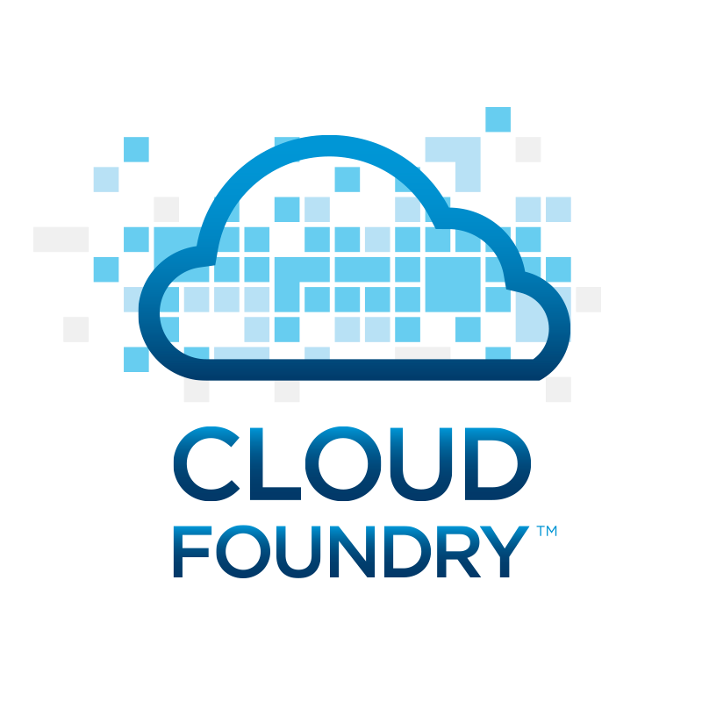


BOSH deployment
DB
BOSH
Upload Stemcell
BOSH CLI
BOSH Director
Blobstore
NATS
Health
Monitor

Slide 10
BOSH deployment
DB
BOSH
Upload Release
BOSH CLI
BOSH Director
Blobstore
NATS
Health
Monitor

Slide 11
BOSH deployment
DB
BOSH
Set Manifest
BOSH CLI
BOSH Director
Blobstore
NATS
Health
Monitor

Slide 12

BOSH deployment
IaaS
DB
BOSH
Deploy
BOSH CLI
BOSH Director
Worker VMs
Blobstore
NATS
Target VM
Target VM
Health
Monitor
Target VM
BOSH agent

Slide 13
3 Components of a BOSH Deployment
Manifest
Deployment Descriptor
Stemcell
Release
Agent
VM / Container template + Agent

Slide 14

… so what exactly is a BOSH release?
Release

Slide 15

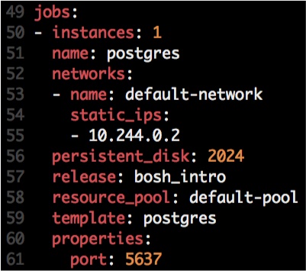



Anatomy of BOSH releases
Release
Job
Stemcell
Monit script
OS Process
OS Process
Instantiated in runtime based on
OS Process
Agent
Monit
Monit
Monit
Manifest
Depends
src
Scripts:
Example of Jobs:
DEA (CF)
CloudController (CF)
Service Broker (MySQL & Rabbit)
Locator (possible GemFire release)
Packaging
Templates & Packages
Depends
Pre-Packaging
Depends
Blobs
Depends
http://docs.cloudfoundry.org/bosh/create-release.html

Slide 16

Job Creation
Deployment
Stemcell
VM / Container
Job
VM / Container
BOSH Director
Ping
Agent
OS Process
Agent
Monit
NATS
Agent
Ping
Job
Health Monitor
OS Process
Compiled Packages
Monit

Slide 17

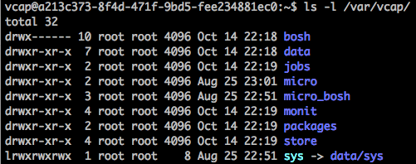
Logs
Deployment
Stemcell
Job
VM / Container
BOSH Director
Agent
Ping
OS Process
NATS
Monit
Agent
Log: /var/vcap/monit/monit.log
Health Monitor
Logs: /var/vcap/sys/logs/<job>
Logs: /var/vcap/sys/logs/hm9000*.log
Compiled Packages

Slide 18

BOSH AND HIGH AVAILABILITY
Notes:
(bold moves)
2015 – This is..
The year where we see a level of adoption of our products and services that propels us to becoming an ipo-worthy company
This is..the year where our great vision becomes a reality in production environments at the most important companies and organizations in the world.
This is the year that we show and teach our customers and partners the power and opportunity that building great software brings.

Slide 19

4 Layers of Built-in High Availability
Application Instance
Platform Processes
Platform VMs
Availability Zones

Slide 20
4 Layers of Built-in High Availability
Application Instance
Platform Processes
Platform VMs
Availability Zones

Slide 21
Application Instance HA
Pivotal Cloud Foundry
Elastic Runtime
Desired State
Blobstore
Cloud Controller
Service
credentials
DB
creds
Cloud Controller Bridge
Router
Access App
BBS
Converger & Auctioneer
Cell
Cell
Cell
creds
creds
Actual State

Slide 22
4 Layers of Built-in High Availability
Application Instance
Platform Processes
Platform VMs
Availability Zones

Slide 23
Platform Process HA
BBS
AGENT
Health Monitor
Restart!
Responses:
CELL
pager
AGENT
Message Bus
email
monitoring
…
Cloud Controller
AGENT
BOSH
IaaS
Notes:
The processes running on the virtual machines (i.e. the health manager) are started with monit, a nice little utility that keeps an eye on processes and will respond when one dies. If a process dies then, monit will do two things: first, it will try to restart the process and second, whether the restart is successful or not, it will tell the BOSH agent about the failure. Recall that the Bosh agent is there to communicate with Operations Manager and in this case it will relay this failure information to the Operations Manager Health Monitor (not to be confused with the Health Manager of the elastic runtime that was discussed above) – we’ll abbreviate it OMHM. The OMHM will take this alert and pass it through a list of responders that can be configured to do things like send emails, page administrators and display alerts in operations dashboards. There’s a good chance that monit will already have recovered the process, but we also want there to be an opportunity for a human to respond.

Slide 24
4 Layers of Built-in High Availability
Application Instance
Platform Processes
Platform VMs
Availability Zones

Slide 25
Platform VM HA
BBS
Desired State
Actual State
AGENT
Health Monitor
BOSH Director
Responses:
CELL
pager
AGENT
Message Bus
email
monitoring
resurector
Cloud Controller
…
AGENT
BOSH
IaaS
Notes:
Of course, the BOSH agent on a VM can only communicate back to the Operations Manager if the VM is there, so let’s talk about what happens when a VM disappears. First thing to understand is that by “disappear” I mean that the BOSH agent is not functional; the VM could be there, but Ops Manager no longer knows what it is up to so for all intents and purposes it’s “gone”. How does Ops Manager know? One of the things that a BOSH agent is responsible for is sending out heartbeat messages and by default it does so every 60 seconds. The OMHM is constantly listening for those heartbeats and when it finds that one is missing it will itself produce and alert and pass that through the list of responders. Just as described above, this could result in emails, pages and operations dashboard alerts, but in this case there is one more responder that kicks in – the “resurector”. The resurector will communicate with the IaaS over which PCF is running and will ask that the failed VM be replaced. Of course it will be replaced with a VM running the appropriate part of the elastic runtime – i.e. a health manager or DEA, etc. That’s right, Operations Manager will restart failed cluster components.

Slide 26
Platform VM HA
BBS
Desired State
Actual State
AGENT
Health Monitor
BOSH Director
Responses:
CELL
pager
AGENT
Message Bus
email
monitoring
resurector
Cloud Controller
…
AGENT
BOSH
IaaS
Notes:
Of course, the BOSH agent on a VM can only communicate back to the Operations Manager if the VM is there, so let’s talk about what happens when a VM disappears. First thing to understand is that by “disappear” I mean that the BOSH agent is not functional; the VM could be there, but Ops Manager no longer knows what it is up to so for all intents and purposes it’s “gone”. How does Ops Manager know? One of the things that a BOSH agent is responsible for is sending out heartbeat messages and by default it does so every 60 seconds. The OMHM is constantly listening for those heartbeats and when it finds that one is missing it will itself produce and alert and pass that through the list of responders. Just as described above, this could result in emails, pages and operations dashboard alerts, but in this case there is one more responder that kicks in – the “resurector”. The resurector will communicate with the IaaS over which PCF is running and will ask that the failed VM be replaced. Of course it will be replaced with a VM running the appropriate part of the elastic runtime – i.e. a health manager or DEA, etc. That’s right, Operations Manager will restart failed cluster components.

Slide 27
Platform VM HA
CPI
BBS
Desired State
Actual State
AGENT
Health Monitor
BOSH Director
Responses:
CELL
pager
AGENT
Message Bus
email
monitoring
resurector
Cloud Controller
…
AGENT
BOSH
IaaS
Notes:
Of course, the BOSH agent on a VM can only communicate back to the Operations Manager if the VM is there, so let’s talk about what happens when a VM disappears. First thing to understand is that by “disappear” I mean that the BOSH agent is not functional; the VM could be there, but Ops Manager no longer knows what it is up to so for all intents and purposes it’s “gone”. How does Ops Manager know? One of the things that a BOSH agent is responsible for is sending out heartbeat messages and by default it does so every 60 seconds. The OMHM is constantly listening for those heartbeats and when it finds that one is missing it will itself produce and alert and pass that through the list of responders. Just as described above, this could result in emails, pages and operations dashboard alerts, but in this case there is one more responder that kicks in – the “resurector”. The resurector will communicate with the IaaS over which PCF is running and will ask that the failed VM be replaced. Of course it will be replaced with a VM running the appropriate part of the elastic runtime – i.e. a health manager or DEA, etc. That’s right, Operations Manager will restart failed cluster components.

Slide 28
4 Layers of built-in High Availability
Application Instance
Platform Processes
Platform VMs
Availability Zones

Slide 29
Availability Zones
Zone 1
Zone 2
System components and Application instances are evenly distributed over two availability zones.
Cell
Cell
Cell
Cell
Loosing an AZ keeps instances running and available.
Router
Cell
Cell
Runtime

Slide 30
How Pivotal CF enables four layers of HA
PCF
PCF
PCF
Zone 1
Zone 2
A
B
C
A
B
C
A
B
C
A
B
C
A
B
C
A
B
C
A
B
C
Process
VM1
VM2
VM3
B
B
B
B
3. Resurrector restarts failed VMs
VM1
VM2
B
A
B
C
A
B
C
A
B
C
A
B
C
OS,
Mware
OS,
Mware
OS,
Mware
B
B
B
B
If an app fails, PCF reboots app in a new container.
If a process fails, PCF restarts the process
If an OS or network failure occurs PCF kills the VM and reboots the host in a new Virtual machine.
If a datacenter rack fails, PCF ensures applications stay running in multiple availability zones
App Fail
Process Fail
VM Fail
Rack Fail

Slide 31
BOSH-BASED PLATFORM UPDATES
Notes:
(bold moves)
2015 – This is..
The year where we see a level of adoption of our products and services that propels us to becoming an ipo-worthy company
This is..the year where our great vision becomes a reality in production environments at the most important companies and organizations in the world.
This is the year that we show and teach our customers and partners the power and opportunity that building great software brings.

Slide 32

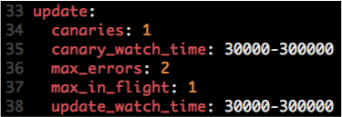
Canary Deployments
Manifest

Slide 33
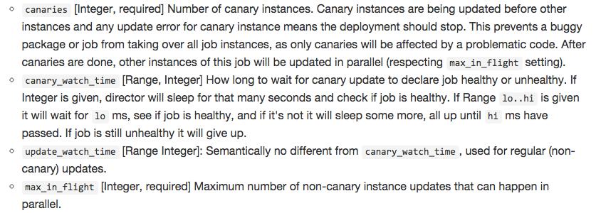
How Do Canary Deployments Work?

Slide 34
How Do Canary Deployments Work?
No downtime, atomic rolling update

Slide 35



How Do Canary Deployments Work?
Example:
# of Canaries: 2
Max in Flight: 2
Canaries
v1.0
v1.1

Slide 36

How Do Canary Deployments Work?
Example:
# of Canaries: 2
Max in Flight: 2
Once failed, Canary VMs are kept for troubleshooting purposes.
v1.1
v1.2

Slide 37
BOSH – Purpose-built for “Day 2 Operations”
Consistent, Reliable, Scalable, Secure
Provision
Deploy and Configure
Checks against “desired state to return consistency
No ad hoc automation burden
Manage services, not servers
4 layers of Self Healing
Current
State
Desired
State
Re-mediate
Monitor and Detect

Slide 38
Open.
Agile.
Cloud-Ready.

