Slide 1


Pivotal Cloud Foundry Basics and Architecture

Slide 2
Agenda
Pivotal Cloud Foundry
PCF Basics
PCF Architecture
Notes:
We’re introducing BOSH in the PCF Basics and Architecture 301 because BOSH is the tool that deploys PCF. It deploys PCF Elastic Runtime and PCF Services.

Slide 3

PCF BASICS

Slide 4
Pivotal Cloud Foundry Architecture
Platform Runtime (Elastic Runtime)
Services
Routing
Container Scheduling
Service Discovery
Configuration
Database
Application Framework
Big Data
12 Factor Apps
Microservices
RESTful Services
Circuit Breakers
Object Storage
Mobile
Spring Boot
Ruby on Rails
Node.js
.NET
Build CI
Logging & Metrics
Messaging
User Provided
Operations
Zero Downtime Deployments
Failover & Recovery
Scaling
Security Patching
Platform
Upgrades
Notes:
PCF is made of 3 major components – Operations (Ops Manager), Platform Runtime (Elastic Runtime) and Services. All, mostly deployed, by BOSH
Now we’ll briefly talks about the components

Slide 5
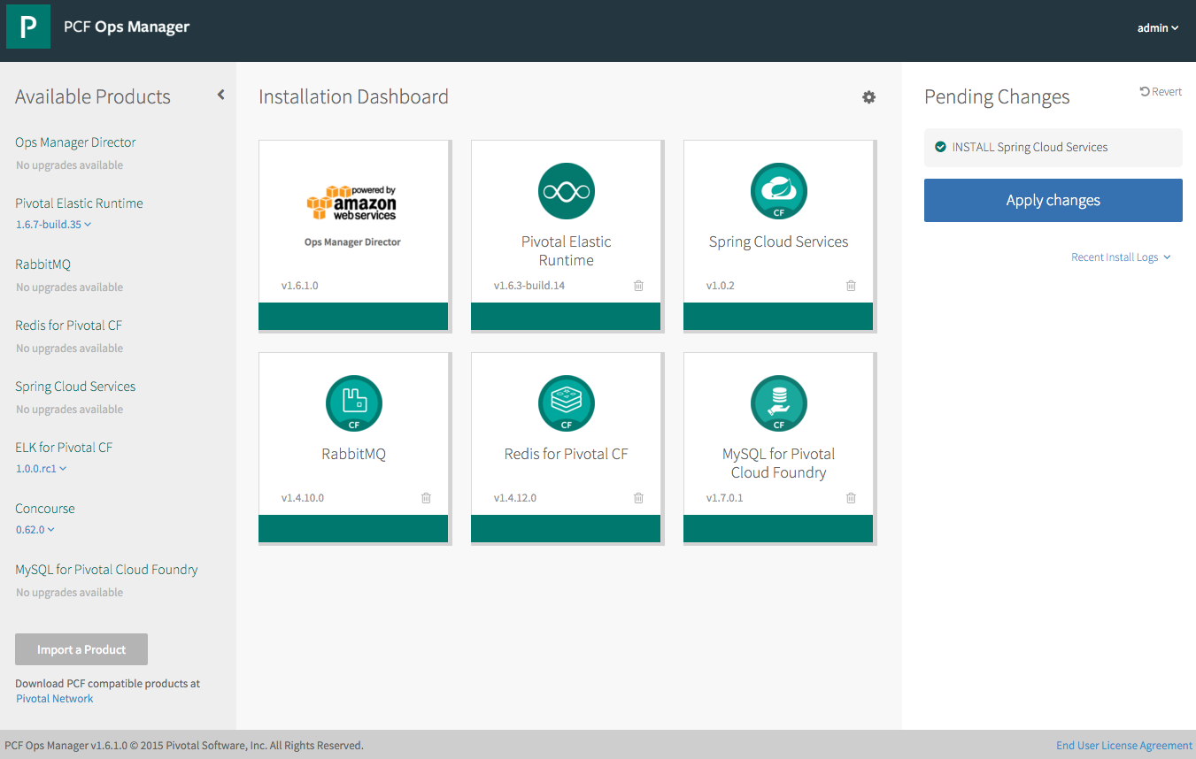
Operations - Pivotal Ops Manager
Click to Install the Platform
Built-in High Availability
Install and Manage Services
Handle Live upgrades and updates
Click to scale the platform
Built-in Platform monitoring
Notes:
http://docs.pivotal.io/pivotalcf/customizing/index.html
This picture allows us to walk thru Ops Manager. Left hand size you see some products that are not installed, you even see a new version of Elastic Rutnime (upgrades) and the Pending Changes (INSTALL Spring Cloud Services). You can talk about important products and the recent logs.
We have the Ops Director for AWS (but we support others). This is the very first tile you install and established the communication with the IaaS. Then you probably start with the Elastic Runtime, now you have a platform – basic platform services including the container runtime (DIEGO). Then you install additional services. All managed by bosh and done in a consistent manager.

Slide 6
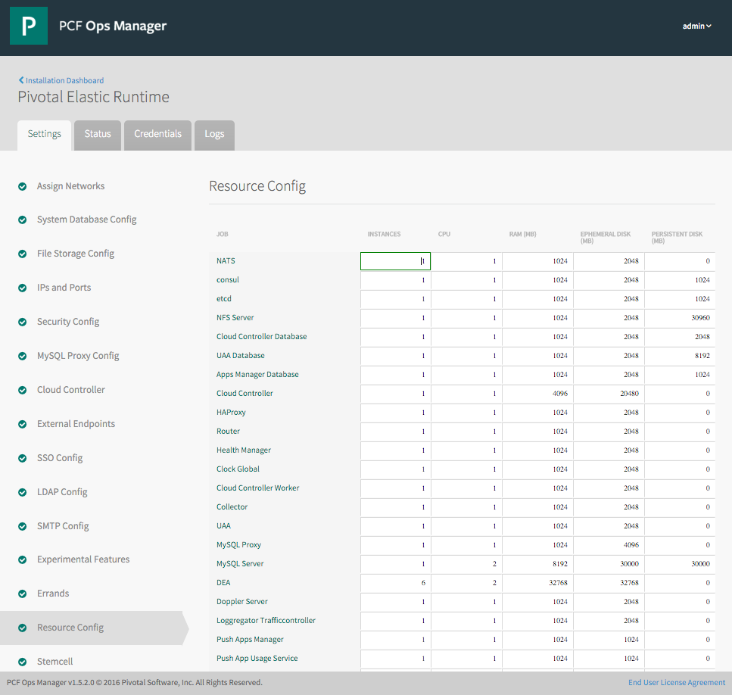
Elastic Runtime Tile
Web form allowing an operator to scale components both
vertically (CPU, RAM, Disk) and
horizontally (number of instances).
This results in updating the deployment manifest followed by a “bosh deploy.”
Notes:
http://docs.pivotal.io/pivotalcf/customizing/index.html
We can explain quiet a bit on the ERS image. We can highlight the wizard like functionality by showing the settings steps on the left and the monitoring capabilities on the status and logs tabs. We can also talk about credential management for the components of ERS. The setting step selected is the resource config which we can talk about scaling components and HA deployments.

Slide 7






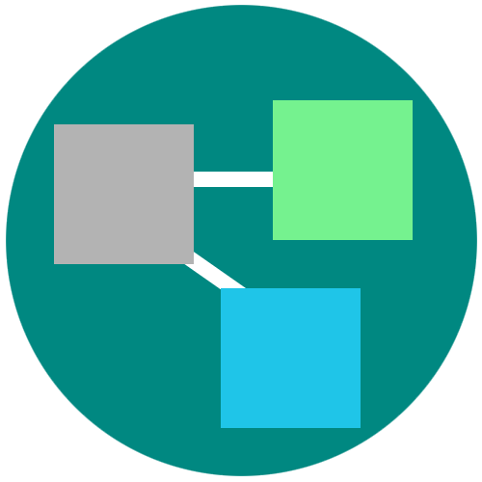
Platform Runtime – Application Centric
Roles and Policy
Log aggregation
Security and Isolation
APM
Scaling
APPLICATION
Blue green deployment
Health management
Notes:
Its no longer about running an app on a single VM and relying on Vm centric scaling to manage demand.
PCF provides an abstraction layer that allow you to scale out with application containers as the unit (not the VMs). So…You will no longer need to know which VM or where your app container is running because PCF surfaces visibility at the app layer and not though infrastructure constructs like VMs. We call this an application “dial tone”
This along with a high degree of automation with no additional wiring needed is what radically simplify application operations
You can do really rapid blue-green deployment, A/B testing, health management needed for the resiliency and fast updates of your apps. It has built in features that wrap full lifecycle management like APM, log aggregation. Policy enforcement and role based access to resources are all integrated and can be set.
Everything that you need for an enterprise grade distributed app container management system is right there.

Slide 8
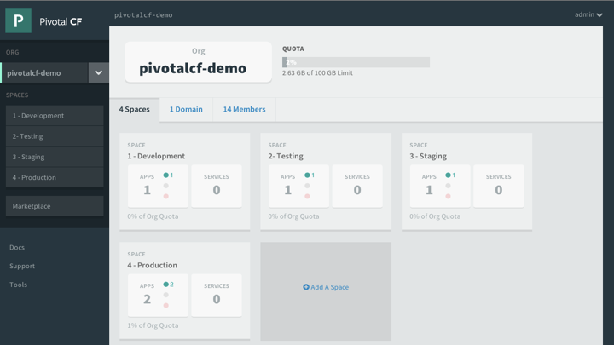
Platform Runtime - Apps Manager
Manage Organizations, users, applications and Spaces
Monitor applications logs, services and routes
Access Service Marketplace, create services and bind to applications
Notes:
http://docs.pivotal.io/pivotalcf/console/index.html
This picture allows us to walk thru the basics of Apps Manager. PCF Elastic Runtime self-service UI. ERS is a multi-tenant platform that can be logically divided into Organization and further into spaces. Quotas ensure resources are managed and Spaces further divides organization to manage and control access to application and services.

Slide 9
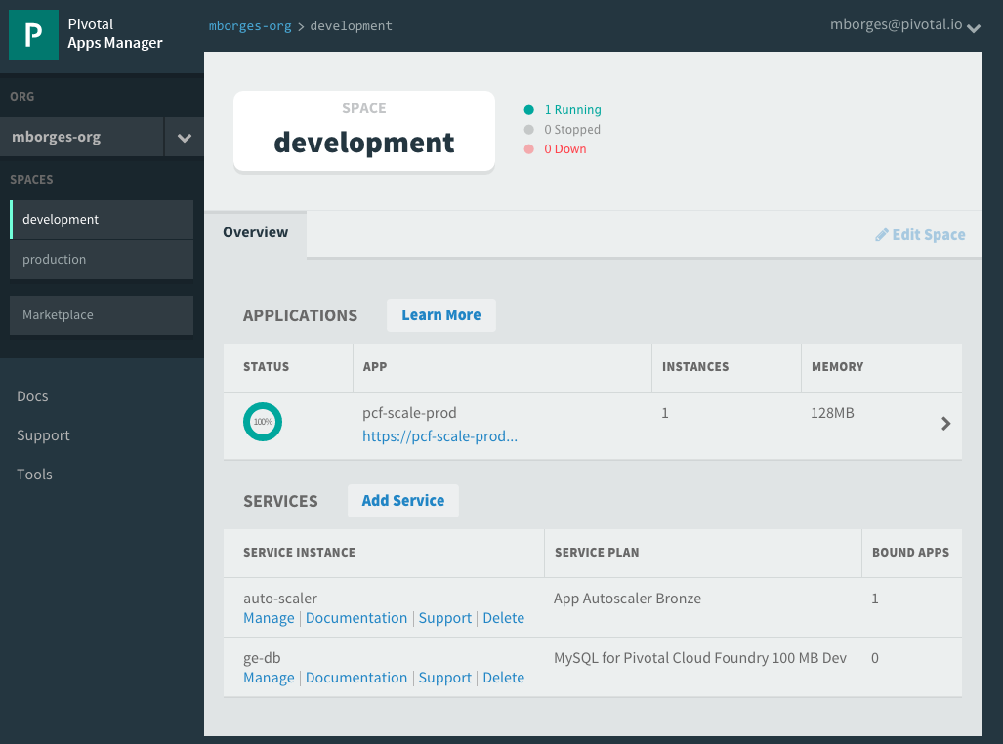
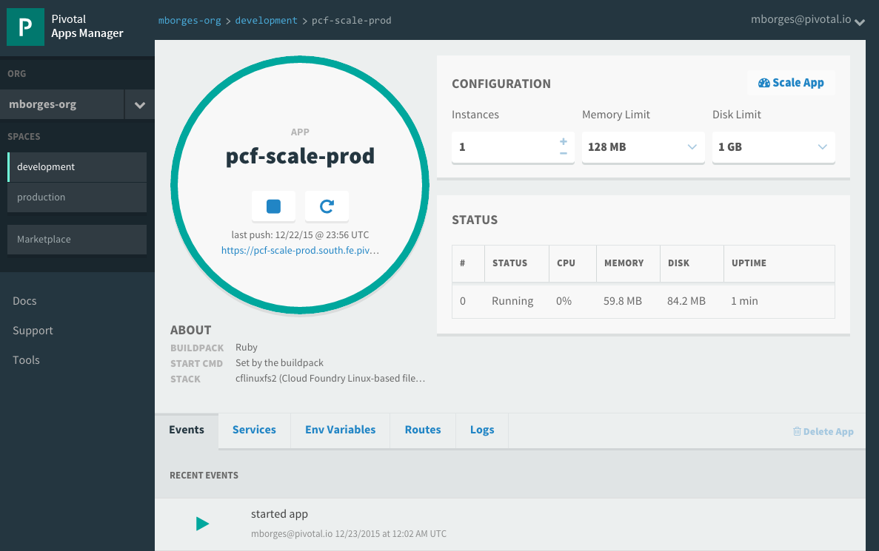
Pivotal Apps Mgr. – App View
Drill into a space to see all application and services instances
Then drill into an application to see configuration, status, event, logging, routes, environment variables and service instances bound to the application
Notes:
http://docs.pivotal.io/pivotalcf/console/index.html
This picture allows us to show the space view that provides quick overview of all applications and services target to it. Further application detail can be obtain by drilling into specific application. Notice that services can be managed via the quick manage link. The number of bounds apps is also showed.

Slide 10
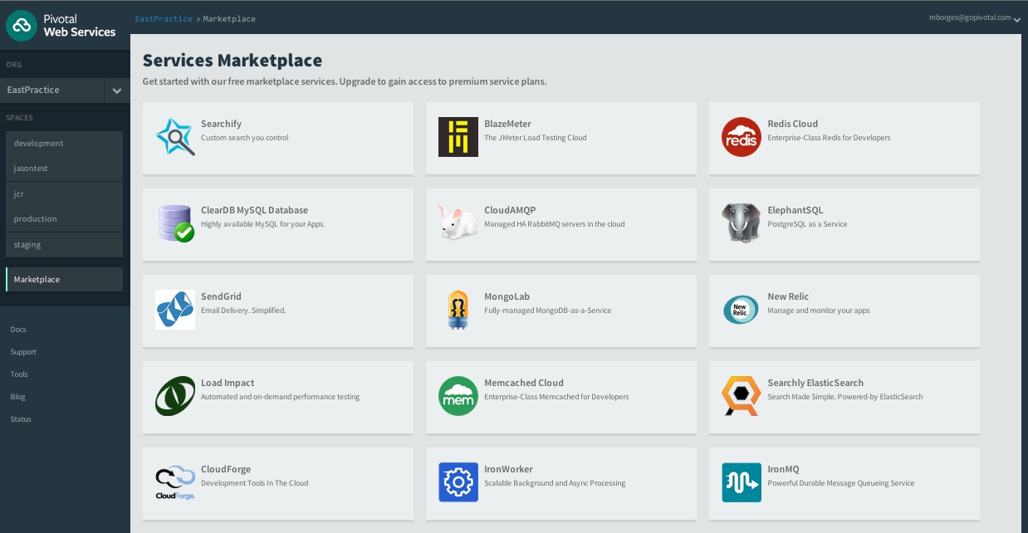
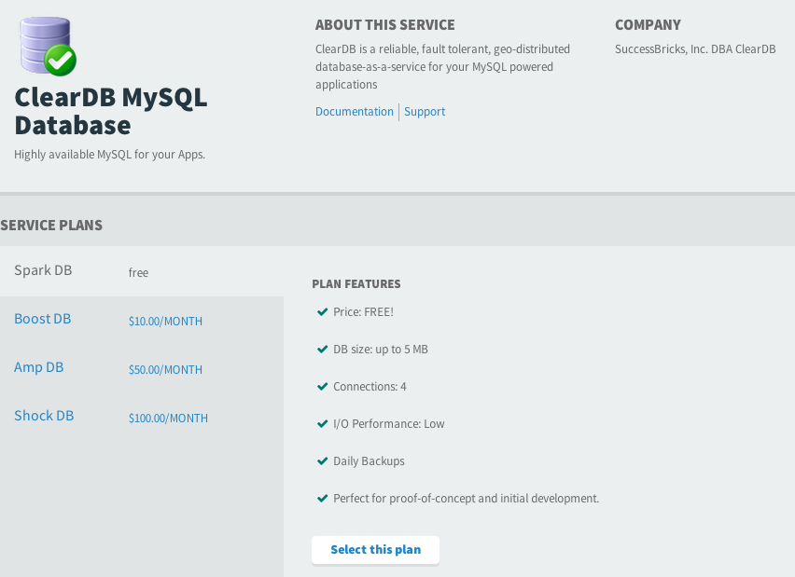
Services Marketplace
Service is an external application dependency or components such as:
Database or Message Queue
Quickly access platform services via marketplace
Create services instances based on service plans
Bind Services to Applications
Notes:
https://docs.pivotal.io/pivotalcf/devguide/services/
TDB – Change the image to be consistent to the Ops Manager Image – maybe use the pivotal documentation
*** This is part of Apps Manager ***
The marketplace is a ERS concept. Typically Ops Manager Services tiles register their service brokers (keep it simple since services were not introduced yet) with the marketplace. The service broker publishes a catalog of service plans that can be consumed by applications deployed in ERS via Apps Manager.

Slide 11
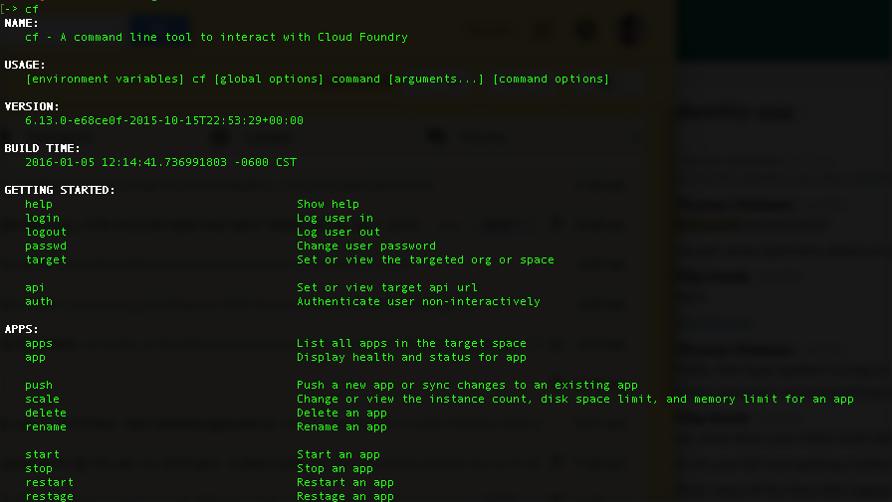
CLI – Command Line Interface
Command line utility providing easy access to the Pivotal CF commands.
Scriptable
Fully documented (cf –help)
Notes:
http://docs.pivotal.io/pivotalcf/console/index.html

Slide 12
PCF ARCHITECTURE
Notes:
(bold moves)
2015 – This is..
The year where we see a level of adoption of our products and services that propels us to becoming an ipo-worthy company
This is..the year where our great vision becomes a reality in production environments at the most important companies and organizations in the world.
This is the year that we show and teach our customers and partners the power and opportunity that building great software brings.

Slide 13
Elastic Runtime Architecture
Turnkey, Fully automated Cloud Native Platform
Scalable runtime environment, extensible to modern framework and languages
Instant scalable with updates and upgrades with no downtime
Deploy, scale and manage applications with services
Pivotal CF Elastic Runtime
Dynamic Router
ROUTING
OAuth 2.0 Server (UAA)
Login Server
AUTHENTICATION
Cloud Controller
etcd
Auctioneer
APP LIFECYCLE
Brain / BBS
MESSAGING
Service Brokers
CELL
Blob Store
APP STORAGE
& EXECUTION
Garden
Build Packs
Sys Log
Collector
App Log
METRICS & LOGGING
Pivotal CF Ops Manager / BOSH
Notes:
TDB: Sort out the box component to be represented at a high-level. For example, should we brake down the Diego Brain and Cell?
[Cornelia Notes] This should be used as a transition to say “the elastic runtime deployed a cluster of VMs – each of the green boxes is one, usually deployed in duplicates – and BOSH/Pivotal CF OpsManager is what we will talk about now…
*** Original bullets points ***
Turnkey, fully automated Platform-as-a-Service
Scalable runtime environment, extensible to most modern frameworks and languages running on Linux
Instant expansion or upgrade with no downtime
Deploy, scale and manage applications with bindable services using simplified semantics and APIs

Slide 14

Deploying an Application
Blobstore
Service
credentials
Upload app bits and metadata
DB
push app
+ app MD
Cloud Controller
Service Broker Node(s)
Create and bind services
Stage application
Deploy application
Manage application health
Router
Container Management - DIEGO
Cell
DEA
Brain
DEA
DEA
+
=
Notes:
We keep the cf push workflow simple and don’t get into the details of DIEGO. We only keep the BRAIN and Cell.
Cloud Foundry PaaS – Pushing an Application with Diego
App deployment: what has changed?
1- Domain specific (notion of apps) -> Abstractions (notions of LRPs and Tasks). App staging is a Task. App start is launching a LRP.
2- Platform specific (linux) -> Supporting multi platform (Windows & Linux) enabling running also .NET apps, thanks to our new Container implementation: Garden
What’s more, there is a 3rd workflow supported: Docker on Linux
3- New Auction-based workload scheduler: Cloud Controller no longer in charge of deciding where AIs are spun up. Auctioneer manages the process running an auction, making it more optimized.
With Diego in place, more loosely-coupled components take part in the process, stripping down the Cloud Controller from too many previous responsibilities, making it easier to maintain and evolve the entire architecture.
The Cloud Controller handles the routing of client requests internally through the Cloud Controller Bridge. It also manages the Blobstore to store packages and droplets and the DB to store App Metadata and Service credentials. Blobstore could be internal or external, depending on the setup.
A service gateway provides an interface for services (native or external).
More in the next slide about the Cloud Controller Bridge (CC-Bridge), the Bulletin Board System (BBS) and the Auctioneer in the next slide
Apps run in a CELL, part of the new Cloud Foundry Runtime, called Diego
Routers manage application traffic.
Diego handles all health management for apps (now LRPs), through a series of single-purpose components: Nsync (part of the CC-Bridge), BBS (part of Diego DB) and the Converger (part of the Diego Brain)
Apps are accessed directly through the router while web and CLI clients (e.g., vmc, STS) access Cloud Controller via RESTful services.

Slide 15
Creating and binding services
Service
credentials
DB
CLI
create service (HTTP)
Cloud Controller
create service (HTTP)
Service
Broker
reserve resources
Data
Service
Router
bind service (HTTP)
bind service (HTTP)
obtain connection data
Platform
Runtime
Notes:
In the previous slide we bundle many actions into one animated slide. Here we have the opportunity to briefly talked about services.
Note: We’re talking about creating and biding service but there was no formal introduction of services prior to this slide. We did talk on the service marketplace, so let’s keep it brief.

Slide 16
Staging an Application
Blobstore
DB
Cloud Controller
Cell
System
Buildpacks
Detect
Compile
Upload
Router
Yes
No
+
=
Platform Runtime
Notes:
The purpse is to simple explain our staging process and introduce buildpacks. We’re not getting into the details of DIEGO.
https://github.com/cloudfoundry-incubator/diego-design-notes#app-lifecycles

Slide 17
Platform Runtime – Application Frameworks
Container image
application layer
PCF buildpacks provide full support and maintenance for 3 of the 4 layers of the container stack
Devs can focus on just the app code
PCF creates the container image for you
runtime layer*
Dev Supported
PCF Supported
OS image
App container
Ops Supported
linux host & kernel
* Devs may bring a custom buildpack
Notes:
Introduction to buildpacks
Here we can compare and contrast with other container solutions like docker. We can bring up the advantages on the fact the container is built on the fly and that the buildpack provides consistency in building, updating and patching container images. Sometimes infrastructure people get’s concerned about the fact we bring our own OS images (stemcells) in regards to their “special” security and other needs. We need to find a subtle way to explain these “special” needs are often part of the problem. We should defer any detail security discussion as it can get hairy.

Slide 18
Pivotal Cloud Foundry Architecture
Platform Runtime
Services
Routing
Container Scheduling
Service Discovery
Configuration
Database
Application Framework
Big Data
12 Factor Apps
Microservices
RESTful Services
Circuit Breakers
Object Storage
Mobile
Spring Boot
Ruby on Rails
Node.js
.NET
Build CI
Logging & Metrics
Messaging
User Provided
Operations
Zero Downtime Deployments
Failover & Recovery
Scaling
Security Patching
Platform
Upgrades
Notes:
Before diving into BOSH we introduce the major components of the platform. Then we explain the platform infrastructure automation capabilities in the context of our structured (or opinioned) platform. The following BOSH sections would explained in more detail.
PCF is made of 3 major components – Operations (Ops Manager), Platform Runtime (Elastic Runtime) and Services. All, mostly deployed, by BOSH
Now we’ll briefly talks about the components

Slide 19
Open.
Agile.
Cloud-Ready.

