Slide 1


Slide 2

Cash & Carry

Slide 3
Group Members Introduction
Name: Uroosa Ajaz
VU ID : BC160403077

Slide 4

INTRODUCTION OF PROJECT
Online shopping is a trend nowadays. Everyone is busy enough to take time from their busy routine to go physically and do shopping. So, here we are developing a website through which customer can order anything from home, from edible items to non-edible item, shoes to slipper, clothes to electronics an much more.

Slide 5
Process Model
Requiremnts
Analysis
Design
Implementation
Result

Slide 6
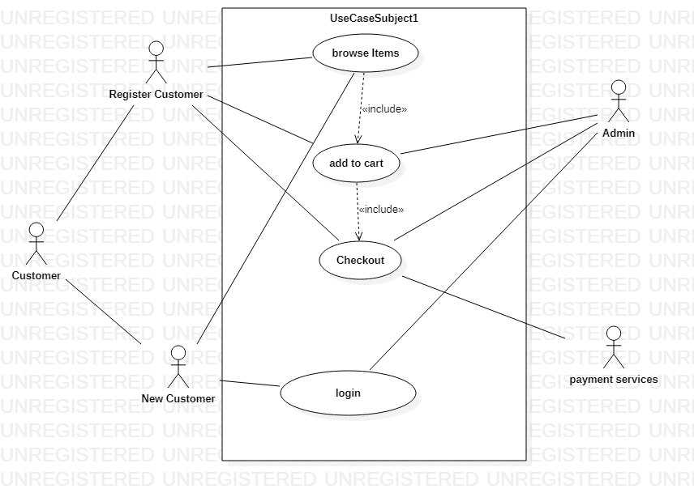
Use Case Diagram

Slide 7
Business Rules Catalog
Login/Registration
browse items
Add to cart
Checkout

Slide 8
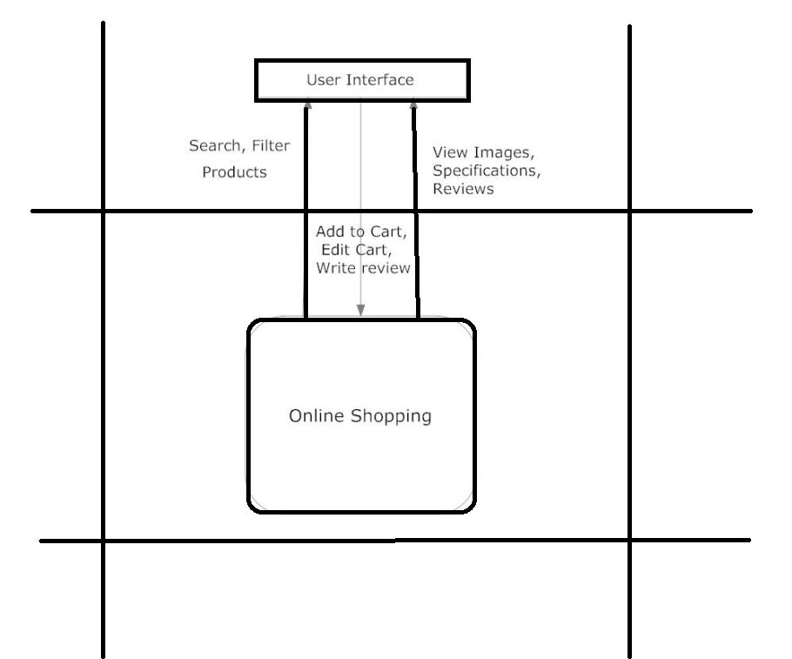
Architectural Design

Slide 9
Team Structure
Faizan Tahir
(Supervisor)
Approve documents
Approve final year project
Uroosa Ajaz
(BC160403977)
SRS
Document
Design
Document
Test Phase
Final
Deliverable

Slide 10
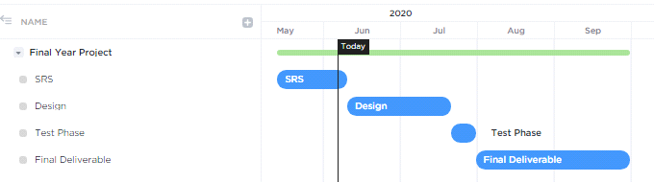
Project Schedule

Slide 11
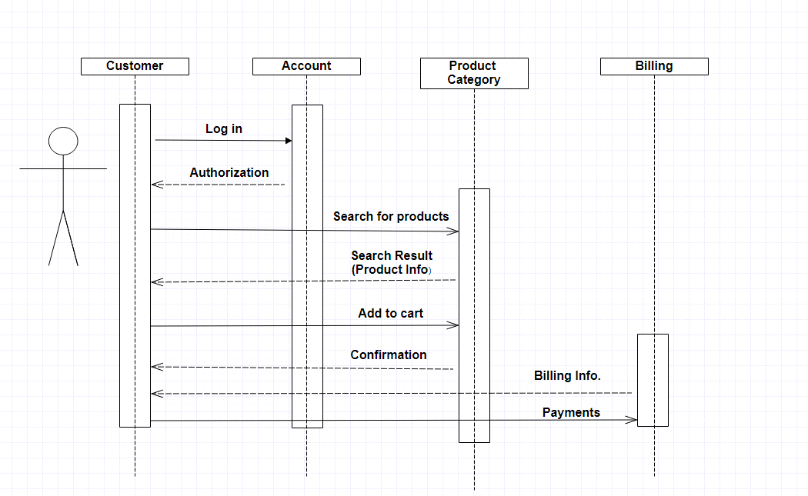
Sequence Diagrams

Slide 12
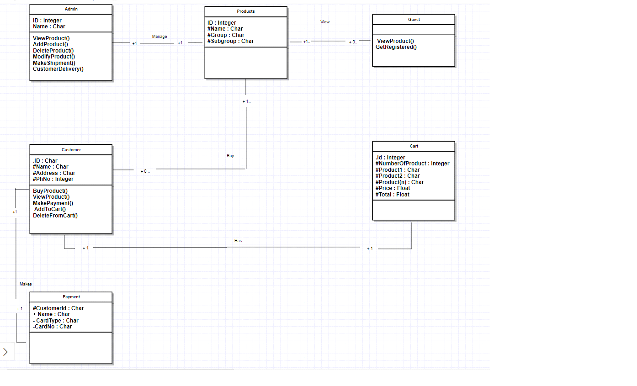
Logical Model/Class Diagram

Slide 13
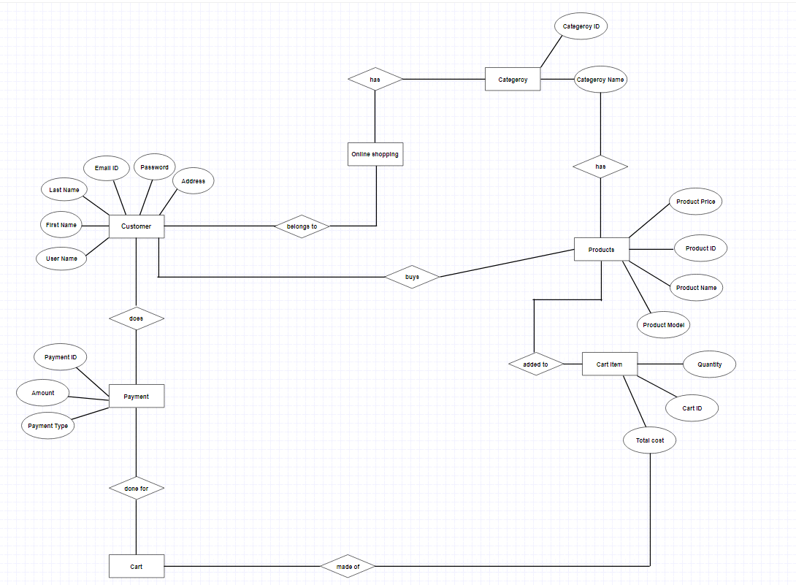
Entity-Relationship Diagram

Slide 14
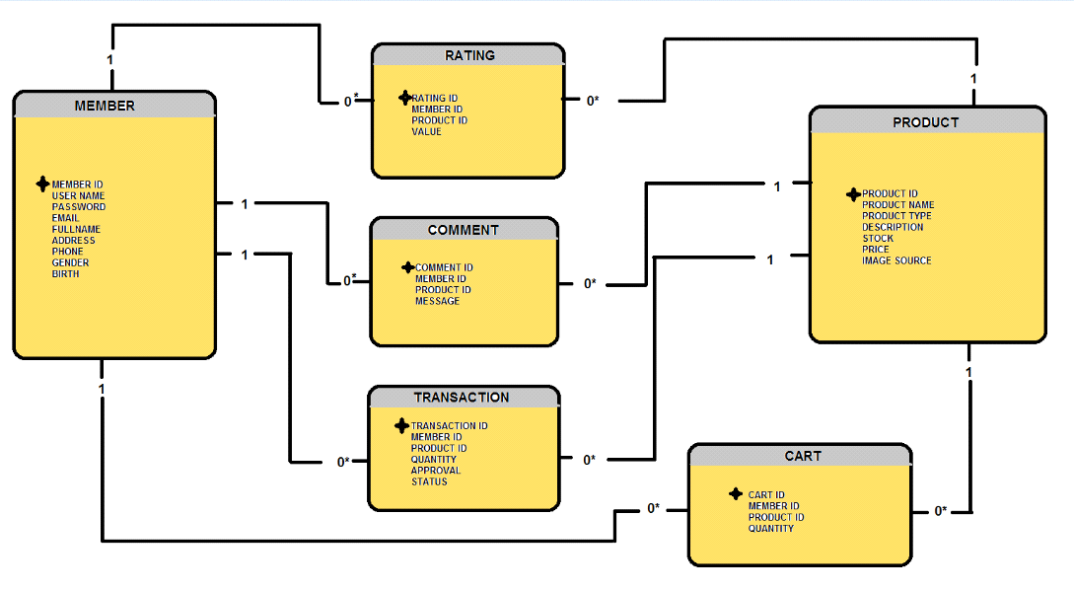
Database Diagram

Slide 15
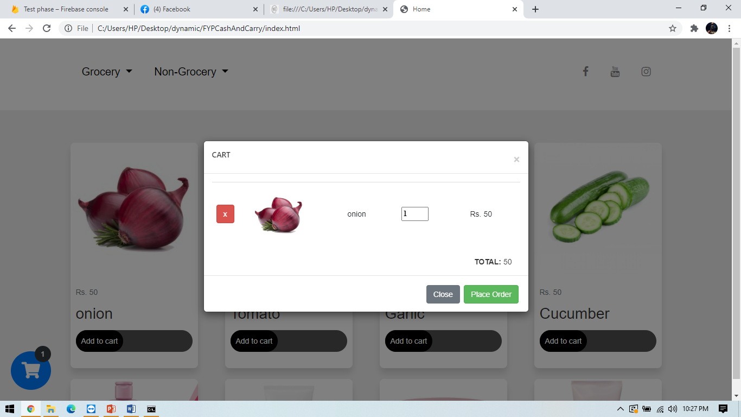
User Interfaces

Slide 16
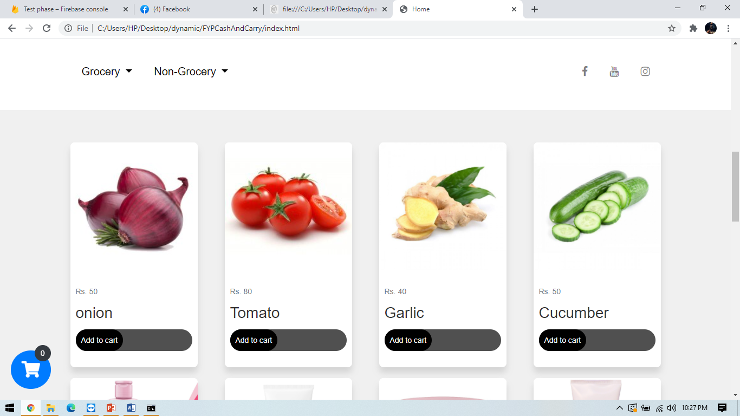

Slide 17
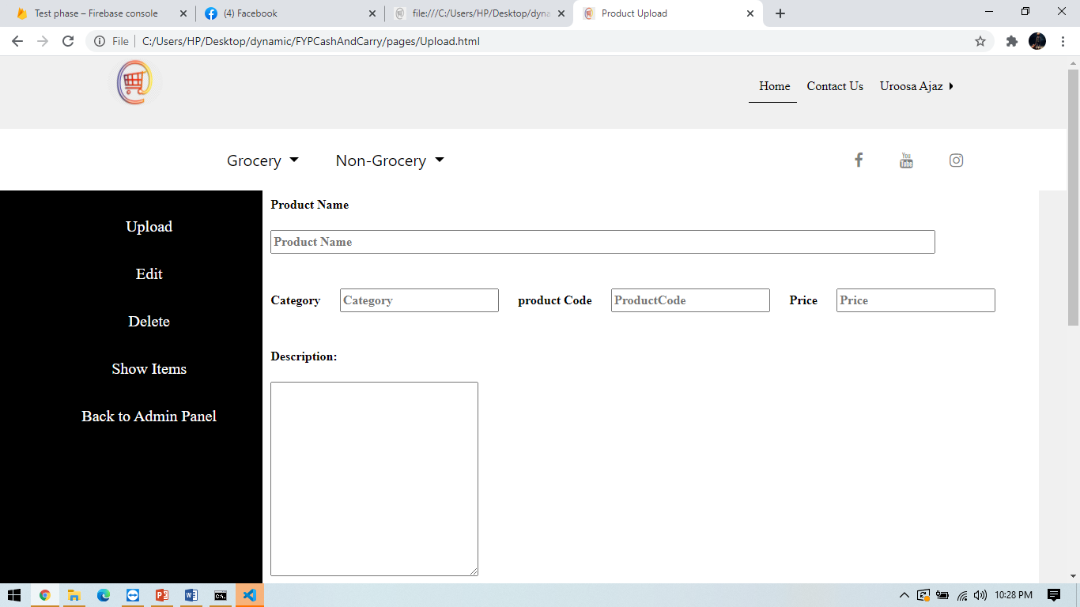

Slide 18
Tools
VSCode.
Firebase Database.

