Slide 1
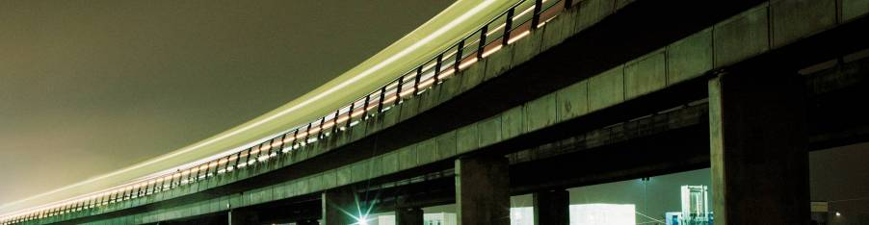
Official IBM Template Slides with alternate covers and chart library
Presenter’s Name - Presenter’s Title
DD Month Year

Slide 2
Table of contents
Alternative cover images
Slide library
Organizational charts
Box charts
Tables
Evaluation charts
Cause and effect charts
Decision trees
Methodology charts
Timeline charts
Project status and reference charts
Data charts
Relationship charts
Graphic components
Maps
Notes:
Master Draft 1
Master Draft 1
2

Slide 3



Figure A Jacobian of Q-function (white shadow) in Deep Q-Network follows the ball (red arrow) in Atari 2600 game, breakout. We use the Jacobian as a visual attention.

Slide 4
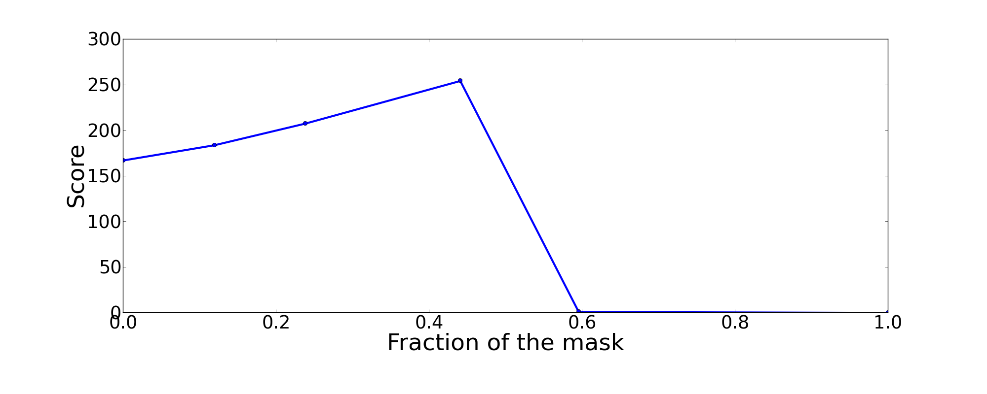
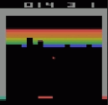
Figure The score increases if the screen is masked appropriately. The dashed line indicates the original score.

Slide 5
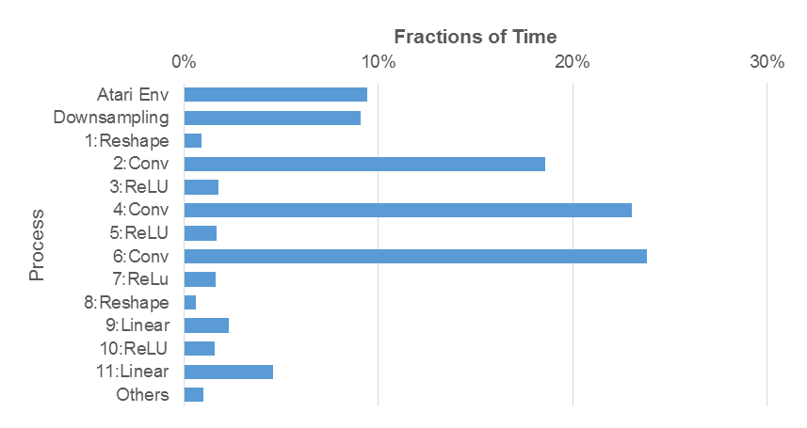

Slide 6
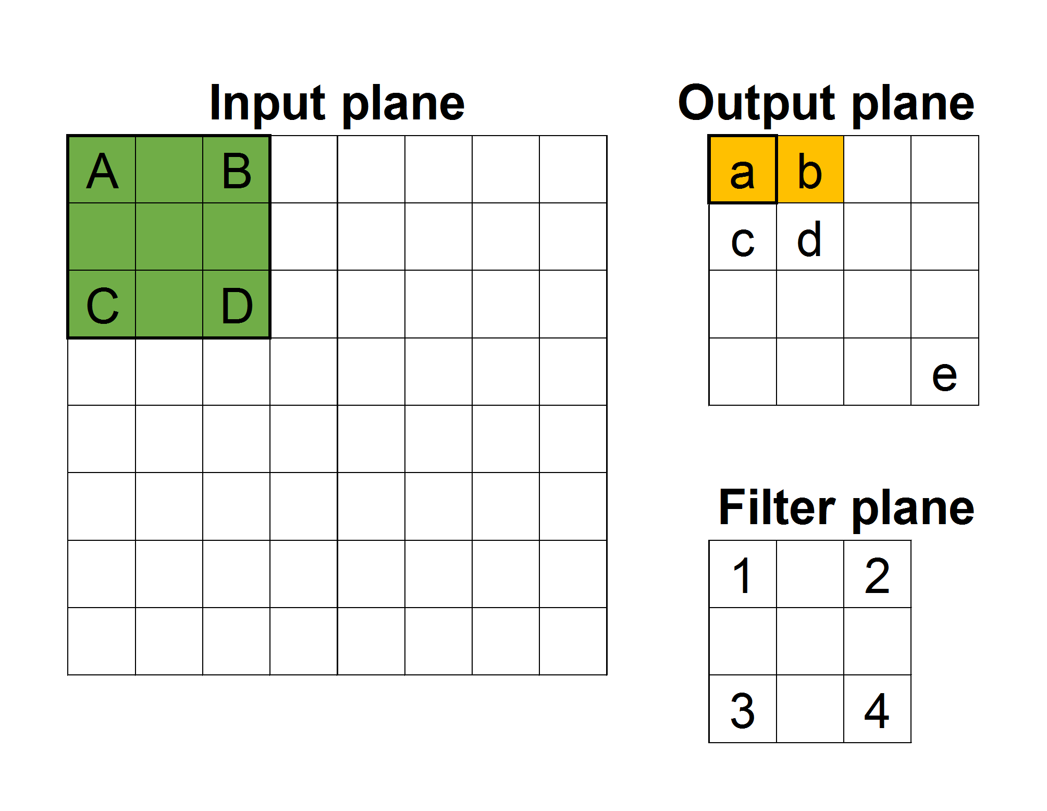
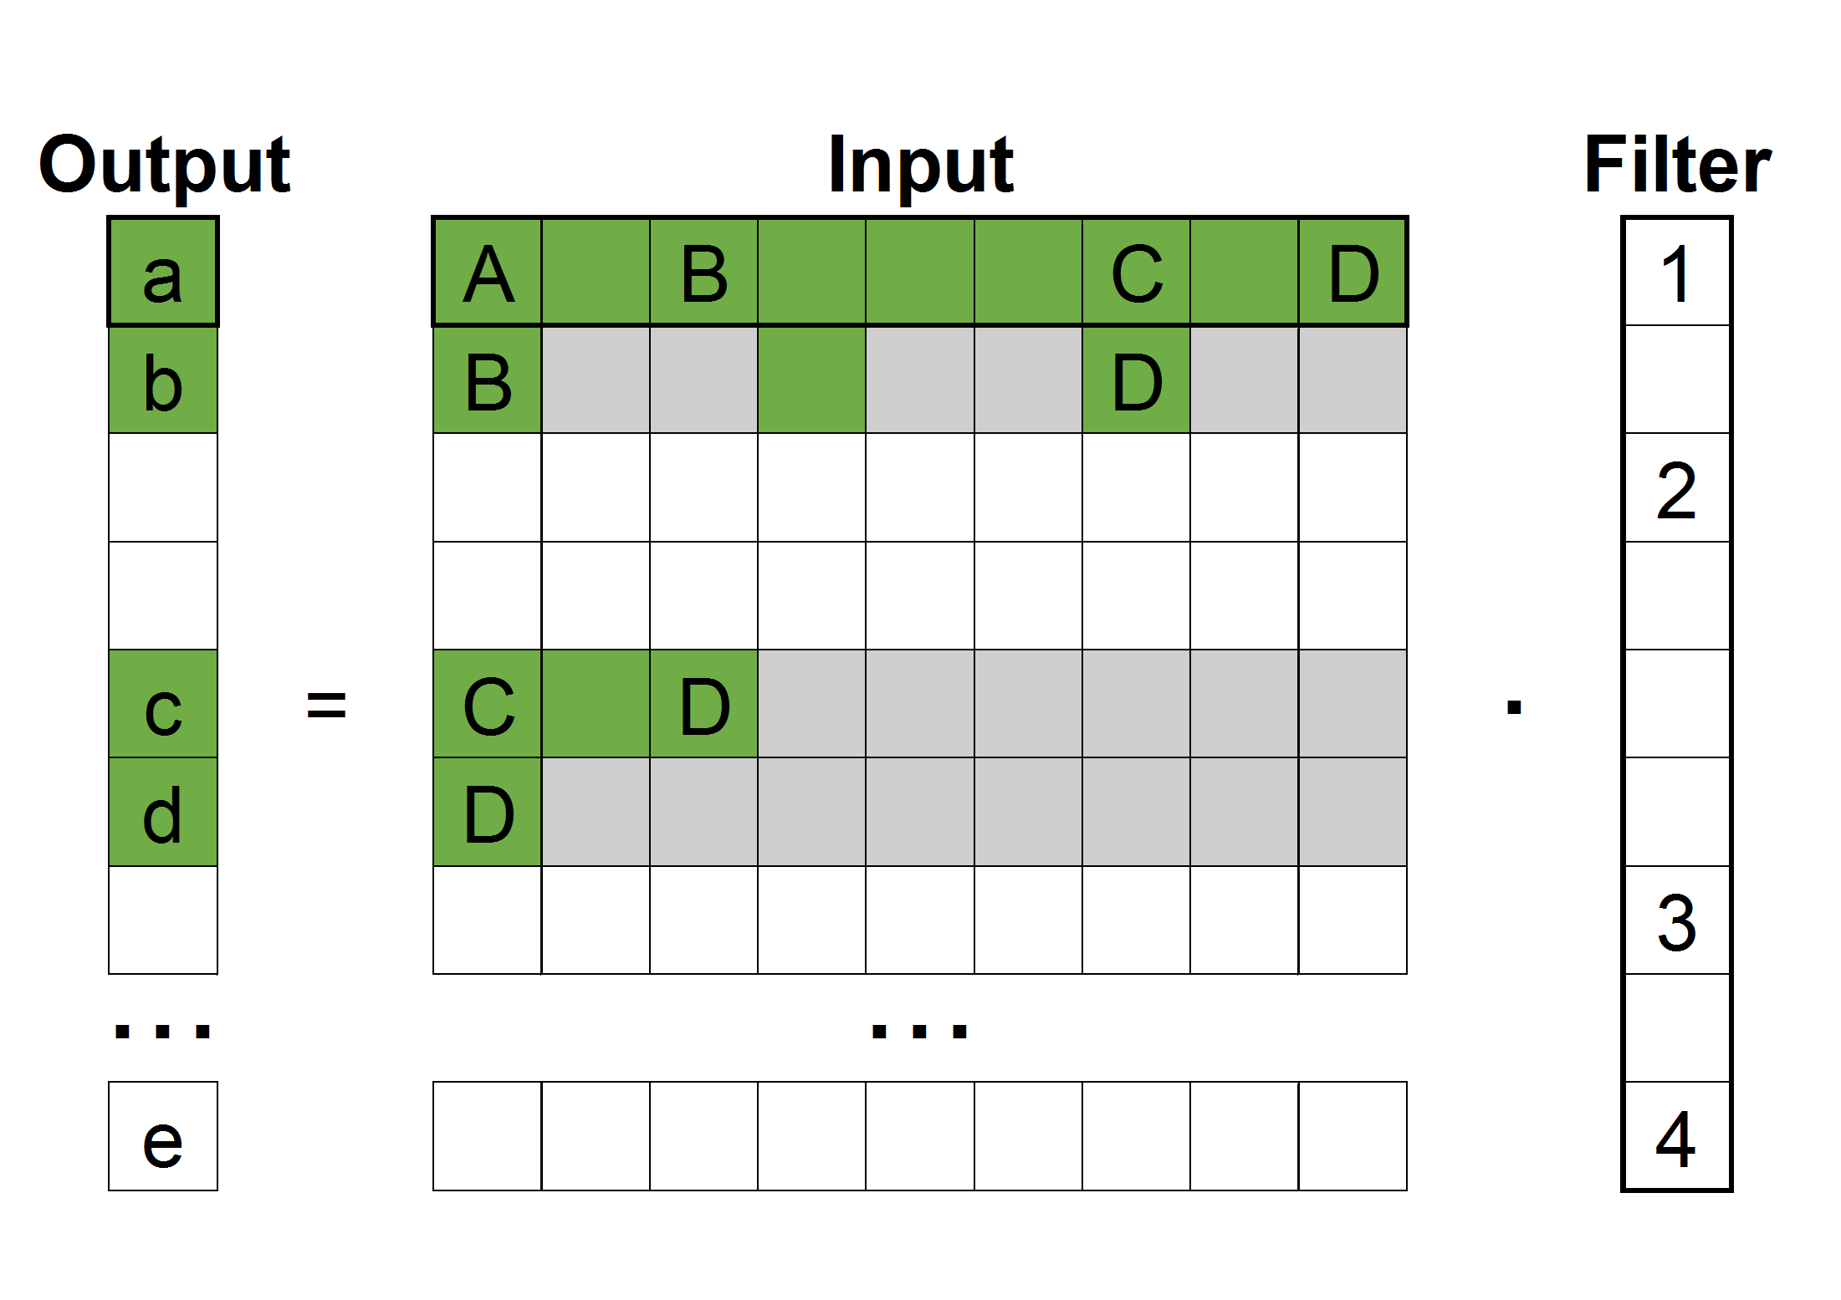
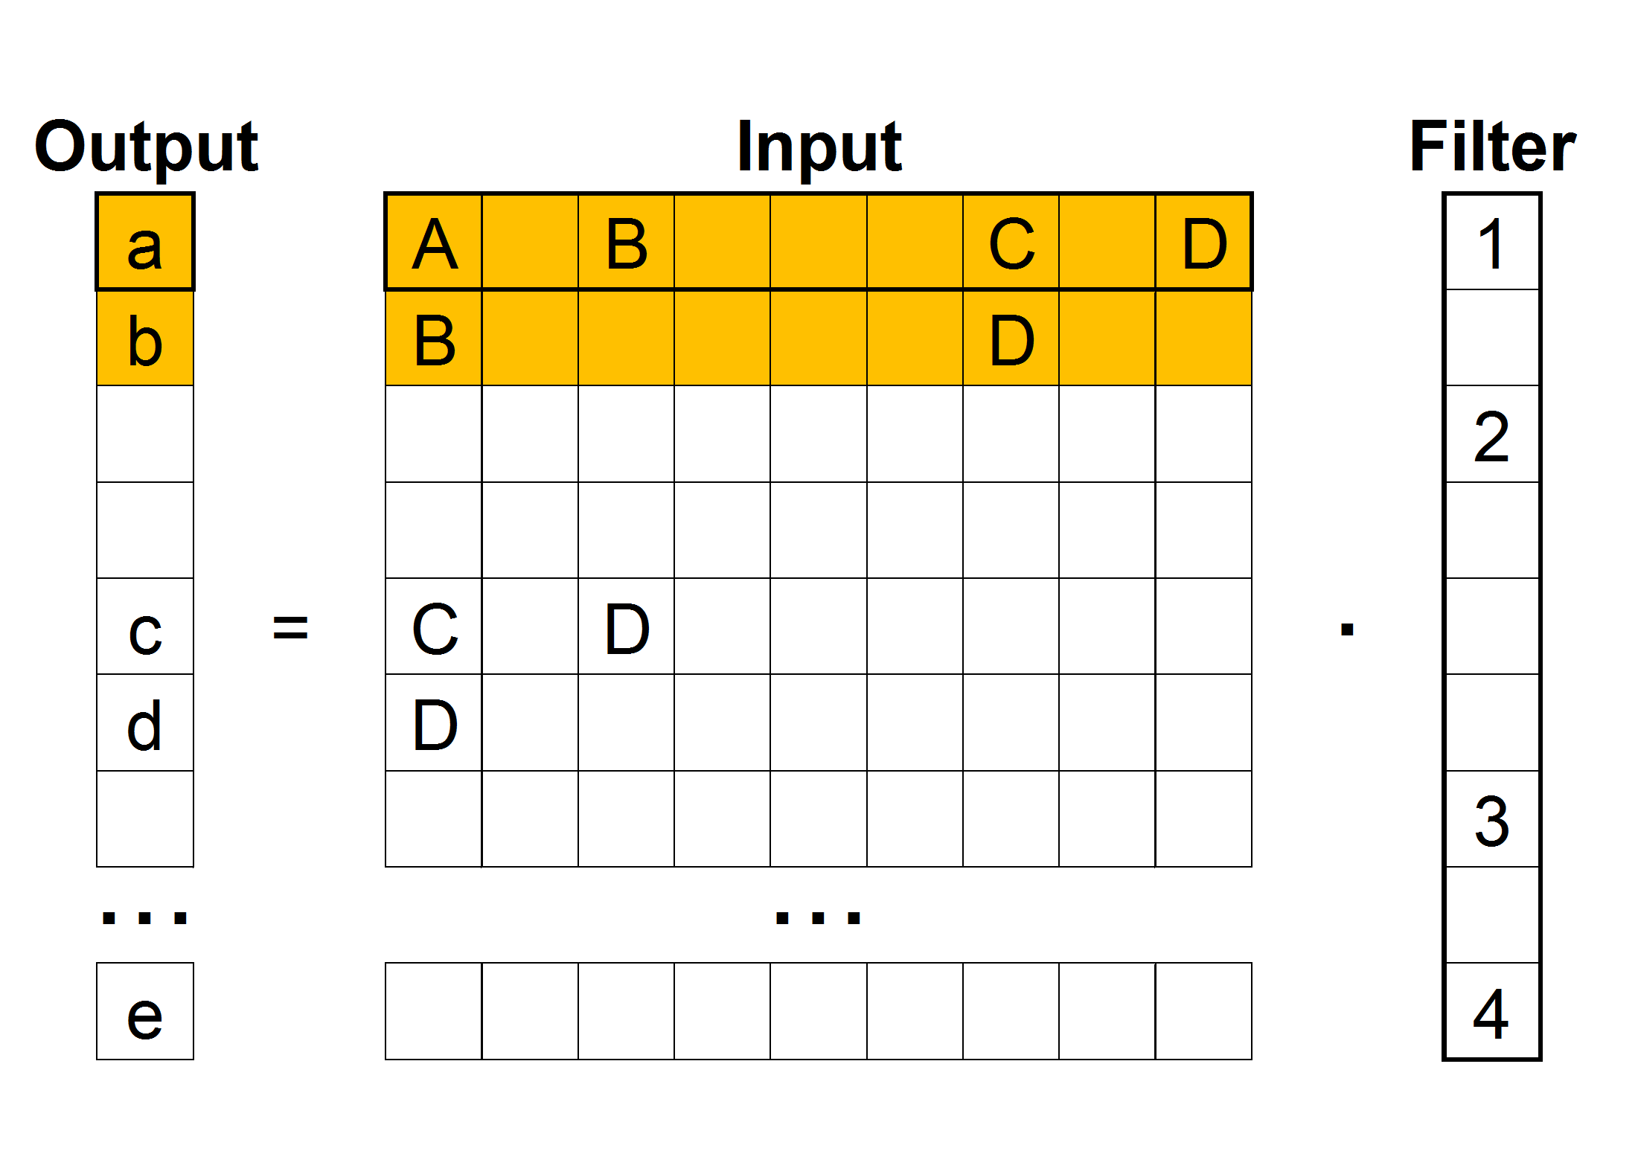
Figure: The output attention is more effective than an input attention.
Left: An example of CNN made of 8x8 input plane, 4x4 output plane, and 3x3 filter plane. Input attention and output attention are colored by green and yellow, respectively.
Middle: Input attention in a matrix representation of CNN. The characters in the cells are corresponding to the left figure. Although input attention is used, several elements are undesirably calculated (gray elements).
Right: Output attention does not yields the undesirably operations.

Slide 7





Previous
layer activation
$$g$$
Covariance
gate
1
ReLU
0
$$λc$$
$$Cov\left(h,L_{M}\right)$$
(a) a network architecture
$$ReLU(gh)$$
0
$$gh$$
(b) activation
Figure A combination of covariance gate and ReLU. A unit with low covariance are masked by a covariance gate and no longer activates.

Slide 10
Comparison with other methods
 | Collapses | Weight changes after learning? | Structure used | Other information
L0, L1, L2 (weight decay) | Weights | No | None | -
Dropout, Standout | Units | Yes | None | -
NIPS16, ICML16 | Input units | No | RNN | RNN-based attention mechanism has no success example in dynamic image recognition
AdaGrad, AdaDelta, RMSProp | None | No | None | -
FOBOS | Weights | No | None | -
Proposed | Units | No | None

Slide 11


Slide 12


Slide 13
Figure: Whether should we choose, input attention or output attention.
Left: Input, output, and filter plane. Input attention and output attention are colored by green and yellow, respectively.
Middle: Unfolded operation for matrix-matrix multiplication. Although such operation is GPU-familier, several elements are undesirably calculated if input-attention is used.
Right: Output attention does not yields the undesirably operations.

Slide 14
Figure: Whether should we choose, input attention or output attention.
Left: Input, output, and filter plane. Input attention and output attention are colored by green and yellow, respectively.
Middle: Unfolded operation for matrix-matrix multiplication. Although such operation is GPU-familier, several elements are undesirably calculated if input-attention is used.
Right: Output attention does not yields the undesirably operations.

Slide 15
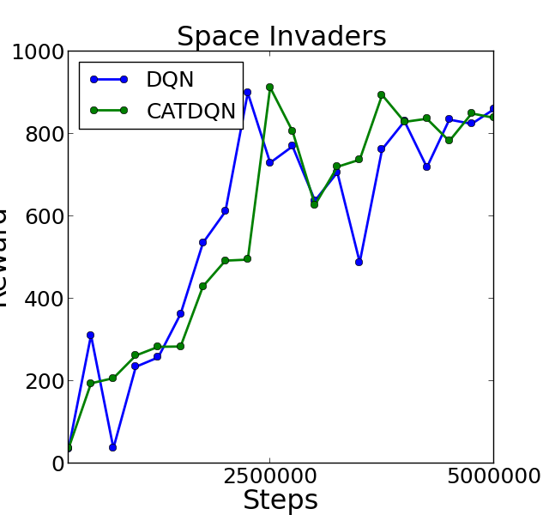
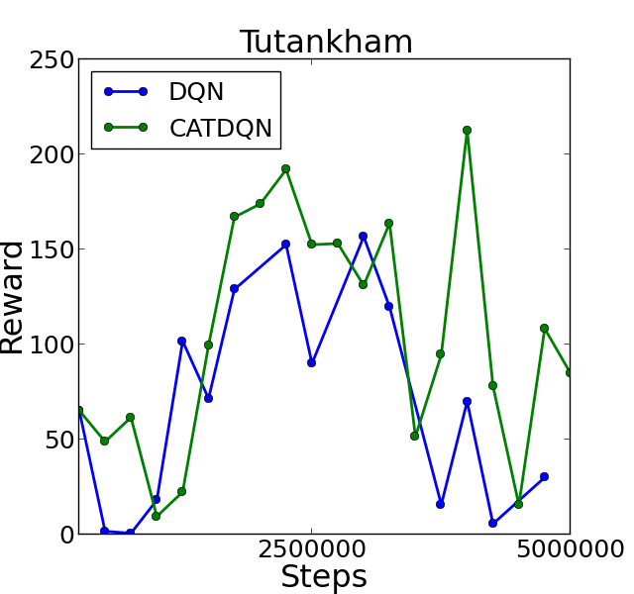
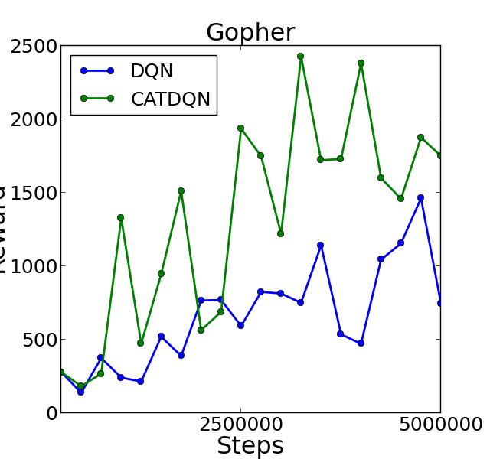
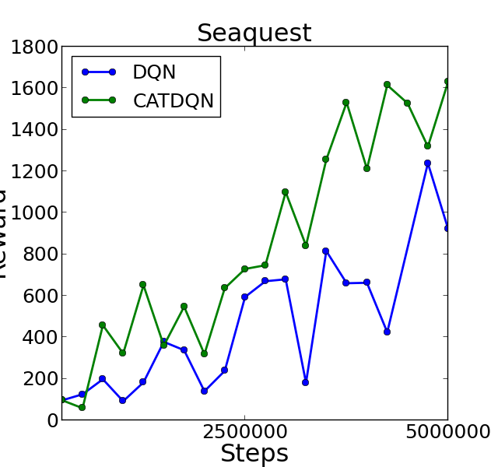
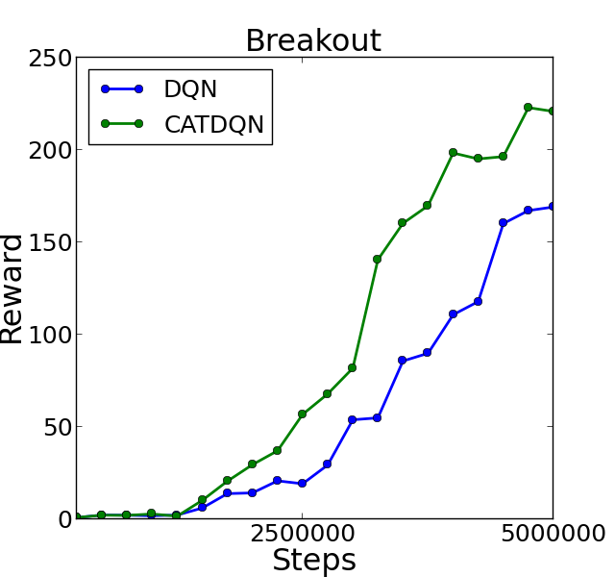

Slide 16
Figure: Input attention and output attention.
left: Input plane and output plane. Each attention is colored by green and yellow.
Middle: Calculated in matrix multiplication.
Right: Output attention can dense focus

Slide 17
Figure: Input attention and output attention.
left: Input plane and output plane. Each attention is colored by green and yellow.
Middle: Calculated in matrix multiplication.
Right: Output attention can dense focus

Slide 18
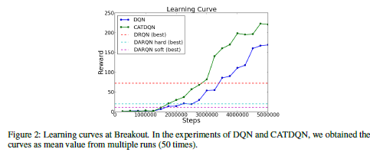

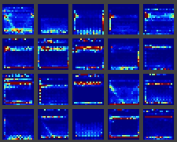

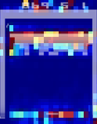
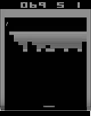
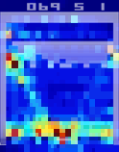



C)
A)
B)
A)
B)
C)

Slide 19
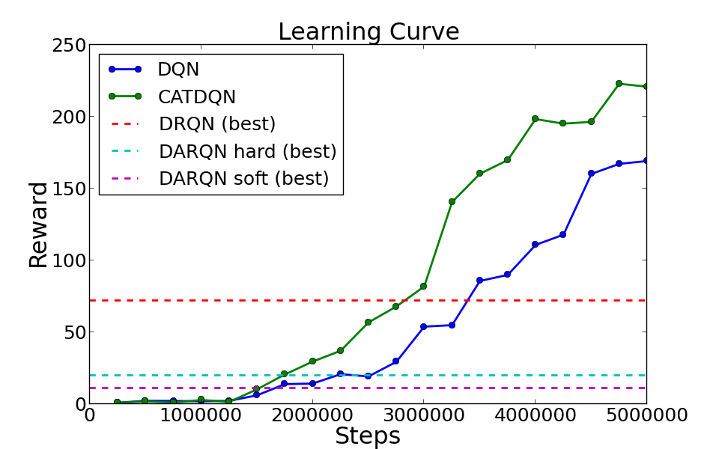
A)
B)
C)

Slide 20
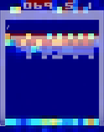
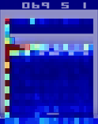
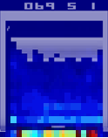
B)
C)
A)
ball
0.7
paddle
0
-0.2

Slide 21
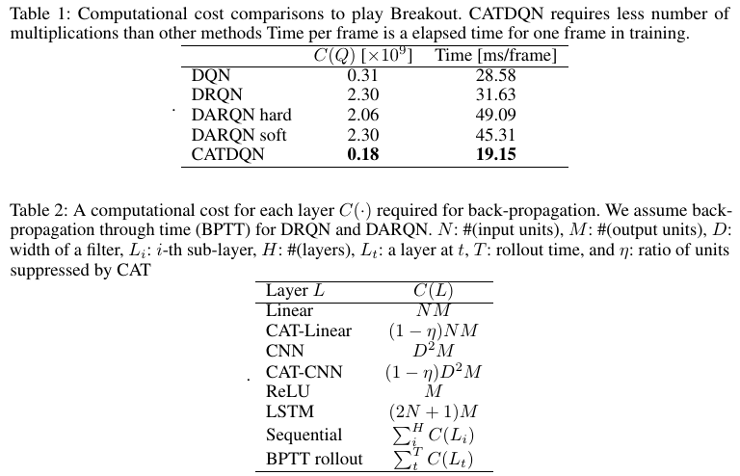

Slide 22
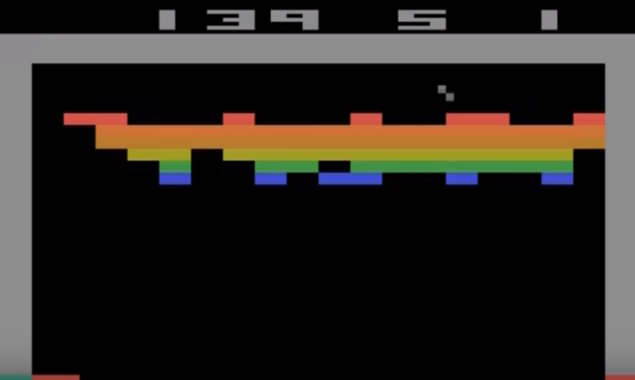

Slide 23
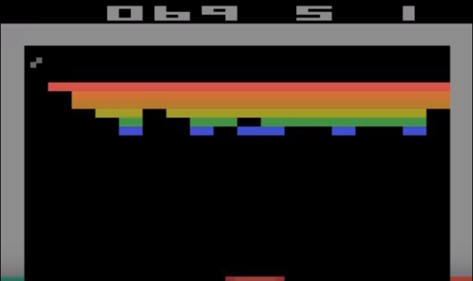

Slide 24
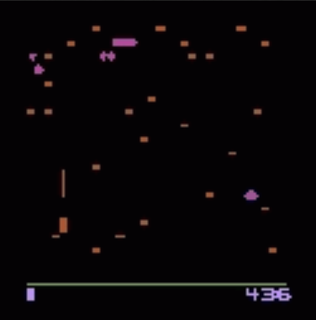

Slide 25
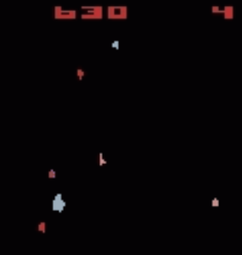

Slide 26
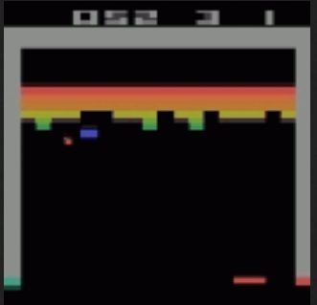

Slide 27
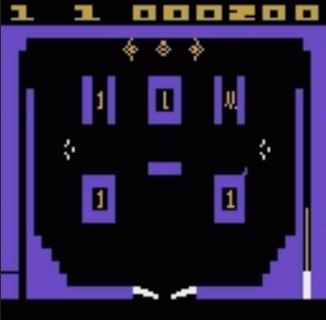

Slide 28
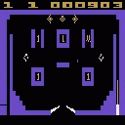

Slide 29

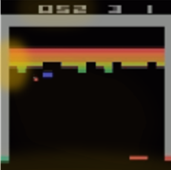
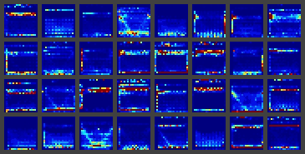
input
CNN
・・・
(a) DQN
(c) hidden saliency
(b) input saliency

Slide 30

input
CNN
$$Q$$
・・・
(a) DQN
(b) input saliency
(c) hidden saliency

Slide 31
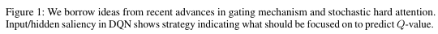

input
CNN
c1
c2
b
c1
c2
$$Q$$
・・・
b
(a) DQN
(b) input saliency
(c) hidden saliency

Slide 32


input
CNN
$$Q$$
・・・

Slide 33




Input: $s$
CNN
CAT Layer
State (screens)
CNN
CAT Layer
Output: $Q$
CNN
CAT Layer
FC
FC
$$Q$$
Static Attention

Slide 35
input
CNN
$$Q$$
・・・
(a) DQN
(b) input saliency
(c) hidden saliency

Slide 36

















allocated & buy
allocate & sell
bid
bid
input $x_{t}$
predicted input ${\tilde{x}}_{t}$
gated output $h_{t}$
output $h_{t}$
buy
sell
allocation $g_{t}$
expectation $$E(s_{t})$$
$$E(s_{t})$$
allocation $g_{t}^{′}$
1
allocate
allocated
$$s_{t}$$
1
Q-values $q_{t}$
0
duplicate
expected
input $\overline{x}$
bidding
prices $b_{t}^{′}$
$$A(s_{t})$$
$$\overline{A}(s_{t})$$
+
revenue $r_{t}$
configuration $u$
valuation $b_{t+1}$
normalize
-
bid_{t+1}
bid

Slide 37


















$$I[b_{i}≥\hat{a}]$$
$$b_{1}$$
$$\hat{a}$$
✓1
$$h$$
$$b_{2}$$
$$h$$
$$\hat{a}$$
$$h$$
✓1
$$b_{3}$$
$$\hat{a}$$
demand $d(a)$
$$a$$
✘0
1. bidding
2. asking
3. decision
revenue
$r=ad\left(a\right)$
demand, revenue
$$\hat{a}$$
$$−\hat{a}$$
$$h$$
$$h$$
$$\hat{a}$$
$$h$$
$$h$$
unit
$$0$$
$$−\hat{a}$$
message
$+\hat{a}d(\hat{a}$)
$$0$$
×
currency
optimal price $\hat{a}$
price $a$
4. payment
5. shipment

Slide 38








unit
message
currency
$$I[b_{i}≥\hat{a}]$$
$$b_{1}$$
$$\hat{a}$$
✓1
$$\hat{a}$$
$$−\hat{a}$$
$$h$$
$$h$$
$$b_{2}$$
$$h$$
$$\hat{a}$$
$$h$$
✓1
$$h$$
$$\hat{a}$$
$$−\hat{a}$$
$$h$$
$$h$$
$$b_{3}$$
$$\hat{a}$$
$$0$$
×
✘0
$+\hat{a}d(\hat{a}$)
$$0$$
1. bidding
2. asking
3. decision
4. payment
5. shipment

Slide 39
























$$b_{it}$$
$$g_{it}$$
$$b_{1it}$$
$${\hat{q}}_{it}$$
✓1
pruned ($g_{ijt}=0$)
allocated ($g_{ijt}=1$)
$$x_{it}$$
$$b_{2it}$$
$$x_{i}$$
$${\hat{q}}_{it}$$
✓1
$$b_{3it}$$
$${\hat{q}}_{it}$$
$$q$$
✘0
1. bidding
2. asking & allocation
revenue
$r_{it}=qd_{it}\left(q\right)$
demand, revenue
$${\hat{q}}_{it}$$
$$−{\hat{q}}_{it}$$
$$x_{it}$$
demand $d_{it}(q)$
$$x_{it}$$
$${\hat{q}}_{it}$$
$$−{\hat{q}}_{it}$$
$$x_{it}$$
$$x_{it}$$
$$0$$
×
optimal price ${\hat{q}}_{it}$
price $q$
$+{\hat{q}}_{it}d_{it}({\hat{q}}_{it}$)
$$0$$
$${\overline{x}}_{i}$$
3. payment
4. shipment

Slide 40
$$b_{it}$$
$$g_{it}$$
$$b_{1it}$$
$${\hat{q}}_{it}$$
✓1
pruned ($g_{ijt}=0$)
allocated ($g_{ijt}=1$)
$$x_{it}$$
$$b_{2it}$$
$$x_{i}$$
$${\hat{q}}_{it}$$
✓1
$$b_{3it}$$
$${\hat{q}}_{it}$$
$$q$$
✘0
1. bidding
2. asking & allocation
revenue
$r_{it}=qd_{it}\left(q\right)$
demand, revenue
$${\hat{q}}_{it}$$
$$−{\hat{q}}_{it}$$
$$x_{it}$$
demand $d_{it}(q)$
$$x_{it}$$
$${\hat{q}}_{it}$$
$$−{\hat{q}}_{it}$$
$$x_{it}$$
$$x_{it}$$
$$0$$
×
optimal price ${\hat{q}}_{it}$
price $q$
$+{\hat{q}}_{it}d_{it}({\hat{q}}_{it}$)
$$0$$
$${\overline{x}}_{i}$$
3. payment
4. shipment

Slide 42

$$b_{it}$$
$$g_{it}$$
$$b_{1it}$$
$${\hat{q}}_{it}$$
✓1
$$x_{it}$$
$$b_{2it}$$
$$x_{i}$$
$${\hat{q}}_{it}$$
✓1
$$b_{3it}$$
$${\hat{q}}_{it}$$
demand $d_{it}(q)$
$$q$$
✘0
1. bidding
2. asking & allocation
revenue
$r_{it}=qd_{it}\left(q\right)$
demand, revenue
$${\hat{q}}_{it}$$
$$−{\hat{q}}_{it}$$
$$x_{it}$$
$$x_{it}$$
$${\hat{q}}_{it}$$
$$−{\hat{q}}_{it}$$
$$x_{it}$$
$$x_{it}$$
$$0$$
×
optimal price ${\hat{q}}_{it}$
price $q$
$+\hat{a}d(\hat{a}$)
$$0$$
$${\overline{x}}_{i}$$
3. payment
4. shipment

Slide 43






$$I[b_{i}≥\hat{a}]$$
$$b_{1}$$
$$\hat{a}$$
✓1
$$h$$
$$b_{2}$$
$$h$$
$$\hat{a}$$
✓1
$$b_{3}$$
$$\hat{a}$$
demand $d(a)$
$$a$$
✘0
1. bidding
2. asking & allocation
revenue
$r=ad\left(a\right)$
demand, revenue
$$I[b_{i}≥\hat{a}]$$
$$I[b_{i}≥\hat{a}]$$
$$\hat{a}$$
✓1
$$h$$
✓1
$$h$$
$$\hat{a}$$
✓1
$$h$$
$$h$$
✓1
$$0$$
×
optimal price $\hat{a}$
price $a$
$r=\hat{a}d(\hat{a}$)
✘0
✘0
3. payment
4. shipment

Slide 44



$$I[b_{i}≥\hat{a}]$$
$$b_{1}$$
$$\hat{a}$$
$$b_{1}$$
✓1
$$h$$
$$b_{2}$$
$$h$$
$$b_{2}$$
✓1
$$b_{3}$$
$$b_{3}$$
demand $d(a)$
$$a$$
✘0
1. bidding
2. asking & allocation
revenue
$r=ad\left(a\right)$
demand, revenue
$$I[b_{i}≥\hat{a}]$$
$$I[b_{i}≥\hat{a}]$$
$$\hat{a}$$
✓1
$$h$$
✓1
$$h$$
$$\hat{a}$$
✓1
$$h$$
$$h$$
✓1
$$0$$
×
optimal price $\hat{a}$
price $a$
$r=\hat{a}d(\hat{a}$)
✘0
✘0
3. payment
4. shipment

Slide 45










$$b$$
$$I[b_{i}≥\hat{a}]$$
$$b_{1}$$
$\hat{a}$=10
18
✓1
$$h$$
$$h$$
10
✓1
5
demend $d(a)$
$$a$$
✘0
1. bid
2. allocation
demand, revenue
revenue
$r=ad\left(a\right)$
$$g$$
$$g$$
$\hat{a}$=10
10
✓1
$$h$$
✓1
$$h$$
10
✓1
$$h$$
$$h$$
✓1
×
✘0
×
✘0
optimal price $\hat{a}$
price $a$
3. buy
4. send

Slide 46













sensory agent
off $h$
allocated & buy
allocate & sell
bid
revenue
input $x$
predicted input $\tilde{x}$
output $h$
buy
sell
allocation $g$
expectation $$E(j)$$
$$E(j)$$
allocated
$$j$$
Q-values $Q$
duplicate
expected
input $\overline{x}$
predict the revenue
$$A(j)$$
$$\overline{A}(j)$$
+
configuration $u$
valuation $b$
normalize
-
bid

Slide 47






input $h$
output $h$
buy
sell
2×$k$
Q-values $Q$
+
predict
the revenue
2×$k$
valuation $o_{it}$
-
bid

