Slide 1

RUTGERS
Federal Reserve Communication,
Asset Prices, and Portfolio Reallocation
How monetary policy announcements transmit from words to prices to investor portfolios
Research Proposal
Submitted by: Eileen Zhang
Rutgers Business School | September 2026

Slide 2
The Research in One Page
Question | When the Fed releases an FOMC statement, how do its words and the two kinds of news it contains — news about policy and news about the economy — change asset prices and how investors reallocate money across mutual funds?
Why it matters | Households hold most of their market exposure through mutual funds and retirement accounts. If investors respond differently to the Fed’s economic news than to its policy news, monetary-policy transmission depends on what the Fed reveals, not only on what it does.
What is known | Only the unexpected part of an announcement moves prices (Kuttner 2001; Gürkaynak, Sack & Swanson 2005). Announcements carry both policy news and news about the economy (Nakamura & Steinsson 2018; Jarociński & Karadi 2020). Statement language moves bond yields (Lucca & Trebbi 2009; Hansen & McMahon 2016).
What this research adds | (1) Mutual-fund flows across seven asset classes after policy (MP) versus information (CBI) shocks. (2) Statement tone moves stock prices only in the forward-guidance regime. (3) A comparison of an LLM tone measure with standard finance dictionaries.
Main contribution: how investors reallocate portfolios after the two kinds of Fed news.
MP = monetary-policy shock; CBI = central-bank-information shock. All terms are defined on the Key Terms slide.

Slide 3
Key Findings at a Glance
Finding | Evidence | Sample
Fund flows (H4) | After an information (CBI) shock, government-bond funds receive inflows in the meeting month: +0.76% of assets (p = .037). After a policy (MP) shock they do not (−0.11, not significant). | 157 meeting months, 2006–2026
Risk ladder (H5) | Pooled over seven classes, flows tilt toward safer classes after CBI shocks (Risk × CBI = −0.066, p = .036). The tilt comes from government bonds: without them the slope is +0.024 (p = .34). | 1,099 class-months
Forward guidance (H3) | Tone moves same-day stock returns only in the forward-guidance period (Dec 2008 – Dec 2015): β = −1.01 per 100 words, p = .005, R² = 32.8%. Outside it: β = +0.14, p = .35. | 56 FG and 75 non-FG meetings
Tone outside FG (H1–H2) | Tone is not explained by Target or Path surprises (p = .36 and .92) and adds little to full-sample returns (p = .26). | 131–161 meetings
LLM vs. dictionary | LLM hawkishness separates rate hikes from cuts by 2.0 standard deviations (p < .001); the Loughran–McDonald dictionary by 0.4 (p = .16). | 161 statements
OLS estimates; sample size reported with every estimate. Sources: results_v2.json; flow_results_rerun_v8.json; models_v2_results.json; llm_statement_scores.jsonl.

Slide 4
Three Contributions
Contribution | What is new | Evidence
1. Main — Fed news and portfolio reallocation | How mutual-fund investors reallocate across seven asset classes after policy (MP) versus information (CBI) shocks. Prior work measures the two shocks’ effects on prices (Jarociński & Karadi 2020), not on portfolio flows. | H4–H5: government-bond inflows after CBI shocks; no comparable MP response
2. Tone and the policy regime | Statement tone moves stock prices when the policy rate is at its floor and guidance is the policy instrument, and not otherwise. | H3: Tone × FG = −1.16 (p = .003, N = 150)
3. Measuring tone | The Loughran–McDonald dictionary, built for 10-K filings, does not separate hikes from cuts in FOMC statements; an LLM reading the full text does. | 161 statements: hike–cut gap 2.0 SD (LLM) vs. 0.4 SD (LM)
Supporting tool: an interactive research site where every table and chart can be reproduced.
monetary-policy-lab.streamlit.app · code: github.com/dechang64/monetary-policy-lab

Slide 5
Rutgers
Agenda
Motivation & Contributions
Literature
Research Gap
Research Questions
Hypotheses
↓
Data
Variables
Empirical Models
Results & Plan to Finish

Slide 6
Motivation & Contribution
FOMC announcements contain more than a rate decision.
A single announcement may simultaneously reveal:
Policy action — what the Fed does today
Expected policy path — what markets learn about future policy
Economic information — what the Fed reveals about growth, inflation, employment, and risks
The challenge is that markets respond to both policy action and information revelation. The proposal specifically frames this as asking whether FOMC language contains incremental information that markets price beyond the mechanical policy-rate surprise.
Key motivation:
To understand market reactions to the Fed, we need to distinguish what the Fed does from what the Fed reveals.

Slide 7
Motivation & Contribution
The Interpretation Problem
The same rate surprise can have different market implications.
A surprise rate increase can reflect:
Policy Shock
Higher rates → tighter financial conditions → ↓ equity prices
Information Shock
Fed reveals stronger economic fundamentals → improved growth expectations → ↑ equity prices
This distinction is central to the proposal's comparison between text-based information/policy measures and the structural Jarociński–Karadi shocks.
Therefore:
Looking only at the rate surprise may miss an important part of the announcement.

Slide 8
Who Cares?
Everyone does—not only academics, policymakers, and investors.
Monetary policy affects interest rates, mortgages, car loans, retirement savings, and the broader economy.
Academics
Policy makers
Investor & households
Connects monetary-policy shock identification with textual analysis and asks whether text provides information beyond conventional policy surprises.
Helps distinguish the market effects of policy actions from the effects of the Fed's economic assessment and communication.
Helps explain why apparently similar Fed decisions can produce different - and sometimes opposite - market reactions across equities, Treasuries, credit, the dollar, volatility, and other assets.
Fed communication ultimately transmits through financial markets into borrowing costs, savings, investment, and household wealth.
The market reacts not only to what the Fed does, but also to what the Fed reveals.

Slide 9
Literature Review

Slide 10
Literature Review part 1:
Expected vs. Unexpected​→Target vs. Path​→Communication​→Policy vs. Information​→Asset Prices​
Author(s) | Year | Contribution
Kuttner | 2001 | Fed funds futures isolate the unexpected component of target-rate changes.
Gürkaynak, Sack & Swanson | 2005 | FOMC surprises contain distinct Target and Path factors; one policy surprise is insufficient.
Bernanke & Kuttner | 2005 | Equity prices respond strongly to unexpected monetary-policy changes, establishing an important asset-price transmission channel.
Gürkaynak, Sack & Swanson | 2005 | FOMC statements contain information about the future path of policy and can strongly affect longer-term asset prices.
Lucca & Trebbi | 2009 | Quantitative analysis of FOMC communication shows that statement language contains information relevant to Treasury yields.
Hansen & McMahon | 2016 | Textual analysis can identify different dimensions of central-bank communication and their effects on markets.
Nakamura & Steinsson | 2018 | High-frequency FOMC surprises can contain a central-bank information effect, not merely a policy shock.
Jarociński & Karadi | 2020 | Interest-rate and stock-price co-movement can separate conventional MP shocks from CBI shocks.
Hansen, McMahon & Tong | 2020 | Changes in FOMC communication affect how financial markets understand and respond to monetary policy.
Bauer & Swanson | 2023 | Some high-frequency surprises are predictable from pre-FOMC public information, motivating orthogonalized surprise measures.

Slide 11
Literature Review part 2:
From Monetary-Policy Shocks to Portfolio Reallocation FOMC Surprise​→MP vs. CBI​→Asset Prices​→Risk Perceptions​→Portfolio Reallocation
Author(s) | Year | Contribution
Bernanke & Kuttner | 2005 | Unexpected monetary-policy changes produce significant equity-market responses.
Bekaert, Hoerova & Lo Duca | 2013 | Monetary policy affects risk attitudes and uncertainty, providing a channel through which policy can alter portfolio demand.
Borio & Zhu | 2012 | Develop the risk-taking channel of monetary policy: monetary conditions can influence investors' willingness to bear risk.
Hanson & Stein | 2015 | Monetary-policy shocks affect longer-term real rates and financial conditions beyond the short end of the yield curve.
Nakamura & Steinsson | 2018 | FOMC announcements can reveal information about economic fundamentals in addition to changing policy expectations.
Jarociński & Karadi | 2020 | Separating MP and CBI shocks reveals fundamentally different asset-price responses to policy action and information revelation.
Bauer & Swanson | 2023 | Identification of monetary-policy shocks requires accounting for information available before FOMC announcements.
Jarociński & Karadi updated shocks | 2024 | Updated MP and CBI shock series facilitate analysis of policy and information shocks over a longer FOMC sample.

Slide 12
Literature Gaps
Gap 1: : Existing studies establish that policy surprises and central-bank communication affect asset prices, but less is known about whether FOMC statement tone provides incremental information beyond Target and Path shocks, particularly across different policy regimes.
Gap2 : Prior research focuses primarily on asset-price responses to monetary-policy announcements. We know much less about whether investors subsequently reallocate actual portfolios differently in response to policy-action (MP) versus information (CBI) shocks, particularly across asset classes ordered by risk.

Slide 13
Literature Gaps
Literature Analysis: What Is Missing?
Literature establishes | Remaining question | This research
Kuttner: unexpected policy matters | What dimension of the surprise matters? | —
GSS: Target ≠ Path | What does FOMC language add? | Part 1
Text literature: communication matters | Does language explain prices beyond Target/Path? | Part 1
Nakamura–Steinsson / JK: announcements reveal information | Do investors distinguish policy from information? | Part 2
JK: MP and CBI produce different price responses | Do those differences translate into actual portfolio reallocations? | Part 2
Risk-taking literature: monetary policy changes risk bearing | How does reallocation vary across safe → risky assets? | Part 2

Slide 14
Research Questions
What does FOMC statement tone reflect - unexpected current policy implementation or revisions to the expected future policy path?
RQ1
Does FOMC communication contain incremental information for asset prices beyond conventional high-frequency policy surprises?
RQ2
Do monetary-policy and central-bank-information shocks generate different mutual-fund flow responses?
RQ3
Do policy action and information revelation operate on different transmission timelines?
RQ4

Slide 15
Key Terms and Definitions
Term | Definition used in this research | Source
Tone | (positive − negative words)/total words, averaged with (hawkish − dovish words)/total words; reported per 100 words. Higher = more positive/hawkish. “Tone” is used throughout; “sentiment” is not used. | Loughran & McDonald 2011; central-bank word list
Expected / unexpected | Expected = what futures prices imply just before the announcement (ex ante). Unexpected = the change in those prices in a 30-minute window around the release (ex post minus ex ante). | Kuttner 2001
Shock (surprise) | The unexpected component of an announcement, measured from market prices only. | Gürkaynak, Sack & Swanson 2005
Target surprise | Unexpected change in the federal funds rate set at this meeting. (Not the Fed’s inflation target.) | GSS 2005; Acosta 2022
Path surprise | Unexpected change in expected rates over roughly the next year, holding the current setting fixed: news about future policy. (Not “path dependence.”) | GSS 2005; Acosta 2022
MP shock / CBI shock | Rate surprise with rates and stocks moving in opposite directions = policy (MP); in the same direction = information about the economy (CBI). | Jarociński & Karadi 2020
Forward-guidance (FG) regime | Dec 2008 – Dec 2015: policy rate at 0–¼% and statements state how long rates will stay low. | Swanson 2021
Fund flow | Net new money: TNA_t − TNA_{t−1}·(1 + R_t), summed by asset class, as % of lagged TNA. | CRSP Mutual Fund Database
Risk rank; windows | Ordinal 1–7: government bonds … small-cap equity. Same = meeting month; Post = month after; Diff = Post − Same. | Author’s classification

Slide 16
Why Two Kinds of News? Theory and Identification
Question | Answer | Basis
Why only the surprise? | Under rational expectations, anticipated policy is already in prices. Only the unexpected part of an announcement can move them. | Lucas 1972; Sargent & Wallace 1975; Kuttner 2001
What is the “information”? | The Fed has private information about the economy (staff forecasts, data). Its decision and statement reveal part of it, with noise; markets infer it — as prices reveal informed traders’ information in rational-expectations models. | Romer & Romer 2000; Grossman & Stiglitz 1980; Kyle 1985; Nakamura & Steinsson 2018
Are the two shocks correlated? | Yes in economics: both come from the same announcement. Identification classifies each meeting by which component dominates (sign of the stock response); it does not assume the two are independent. Target and Path surprises have correlation 0.11 in this sample. | Jarociński & Karadi 2020; GSS 2005
Is tone just the shock again? | No. Target and Path explain 0.4–0.7% of tone’s variation (H1). Tone orthogonalized to Target and Path gives the same flow results (tone p = .62; MP = CBI Wald p = .51). | H1; models_v2_results.json
Why a linear model? | Under no-arbitrage, expected returns are linear in exposures to unexpected factor news; here the factors are the announcement surprises and tone. | Ross 1976 (APT); Huberman 1982
Framing: the FOMC statement is a noisy signal of the Fed’s private information. This research measures what prices and portfolios learn from it.

Slide 17
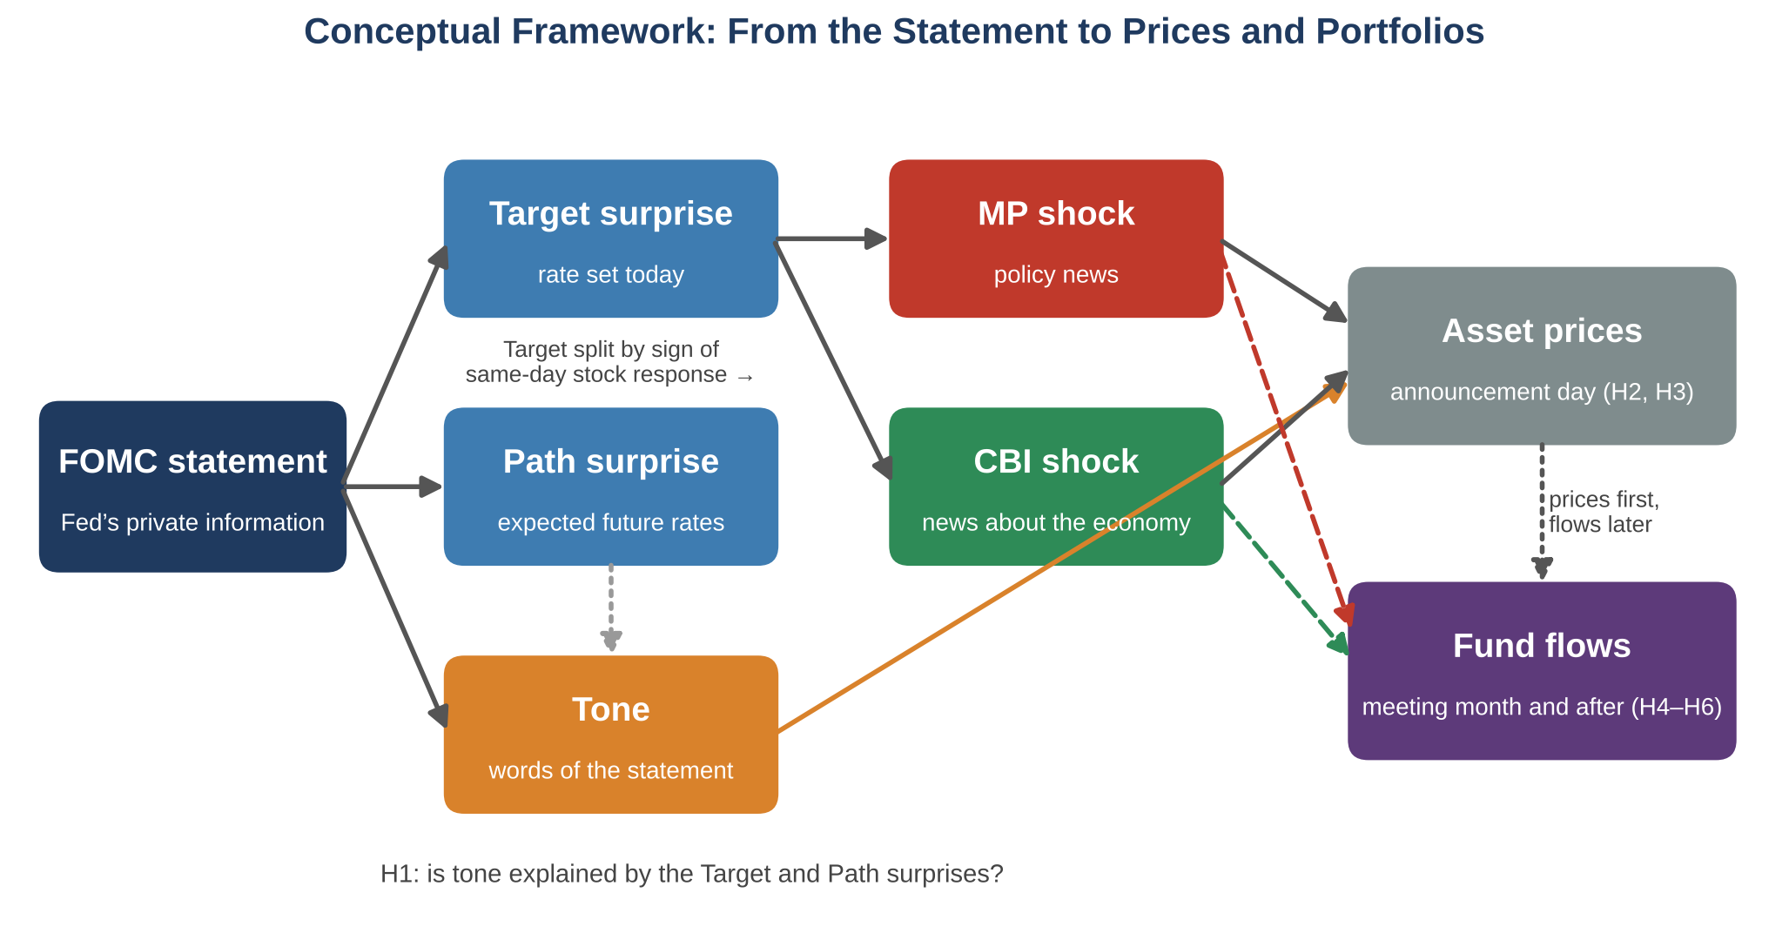
Framework by the author. Interactive results: monetary-policy-lab.streamlit.app

Slide 18
A Unified Theoretical Framework
Two channels · Three layers of information · One institutional friction
Three layers of information
Two transmission channels
One institutional friction
1 · Policy action → Target surprise
Discount-rate channel
MP shocks reprice assets immediately.
Prices adjust on the day
announcement day — information is in the price
↓
Flows adjust weeks later
decision cycles, risk controls, T+1 settlement
2 · Policy path → Path surprise
Information channel
CBI shocks update beliefs — prices respond with delay.
3 · Economic narrative → Tone
Price leads, flow lags
The narrative layer is not spanned by high-frequency surprises — it can carry incremental information.
Tests: H1 · H2 · H3
Same announcement, two shocks, opposite asset-pricing signatures (JK 2020).
Tests: H4 · H6 (Model 6A)
Rebalancing follows the shock, so flows identify which shock hit.
Tests: H5 · H6 (Model 6B)
Part 1 (H1–H3) What the words convey — Words Beyond the Rate → Part 2 (H4–H6) How investors respond — Information vs. Action

Slide 19
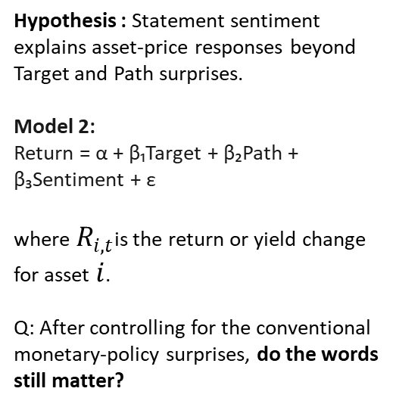
Hypotheses : Part 1 H1- H3
Words Beyond the Rate
H1: Statement language
H2: Incremental information
H3: State dependence
Hypothesis: FOMC statement tone is more closely associated with the Target surprise than with the Path surprise.
Model 1: Tone = α + β₁·Target + β₂·Path + ε (Wald: β₁ = β₂)
H1b (secondary): tone does not distinguish MP from CBI shocks (F-test β_MP = β_CBI).
Theory anchor: GSS (2005) target/path decomposition; Bauer–Swanson (2023) target dominance.
Hypothesis : Statement tone explains asset-price responses beyond Target and Path surprises.
Model 2:
Return = α + β₁Target + β₂Path + β₃Tone + ε
where $R_{i,t}$is the return or yield change for asset $i$.
Q: After controlling for the conventional monetary-policy surprises, do the words still matter?
Hypothesis: The incremental effect of statement tone varies across monetary-policy regimes, particularly during the forward-guidance/ZLB period.
Model 3:
Ri,t​= α + β₁ · Targetₜ + β₂ · Pathₜ + β₃ · Toneₜ +β4​(Tonet​×FGt​) + εₜ where FGt​=1, during the forward-guidance/ZLB period and 0 otherwise.
Q: Does the market respond differently to FOMC language when the policy rate is constrained and communication becomes relatively more important?
Theory anchor: Eggertsson & Woodford (2003); Swanson (2021) — communication substitutes for action at the ZLB.
Theory anchor: Romer & Romer (2000); Nakamura & Steinsson (2018).

Slide 20
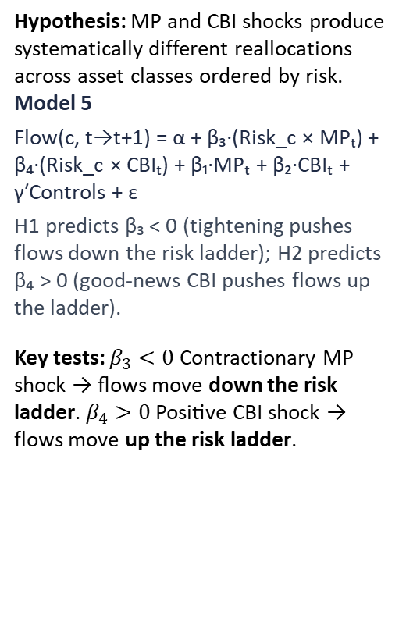
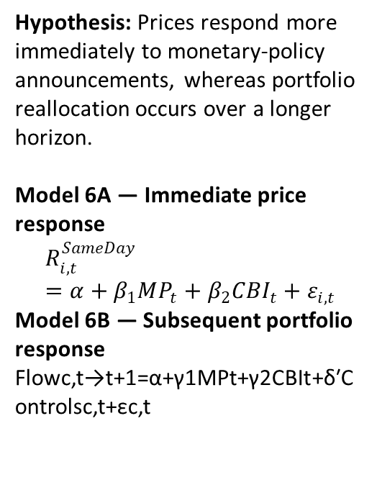
Hypotheses : Part 2 H4-H6
Information vs. Action
H4 : MP vs. CBI
H5 : Risk ladder
H6 : Transmission Timing
Hypothesis: Monetary-policy shocks and central-bank-information shocks generate different mutual-fund flow responses.
Model 4: Flow(c, t→t+1) = α + β₁·MPₜ + β₂·CBIₜ + γ′Controls(i,t) + ε
Wald test: β₁ = β₂ within each asset class; across seven classes (gov bonds … small-cap equity). Controls: log TNA, flow volatility, lagged return and expense ratio planned.
H4b (secondary): at the ZLB, MP effects are amplified for corporate-bond flows.
Q: do investors respond differently to a pure policy shock versus information revealed by the central bank?
Theory anchor: Jarociński & Karadi (2020) sign restriction; Koijen & Yogo (2019) fund demand; Froot et al. (2001).
Hypothesis: MP and CBI shocks produce systematically different reallocations across asset classes ordered by risk.
Model 5
Flow(c, t→t+1) = α + β₃·(Risk_c × MPₜ) + β₄·(Risk_c × CBIₜ) + β₁·MPₜ + β₂·CBIₜ + γ′Controls + ε
H1 predicts β₃ < 0 (tightening pushes flows down the risk ladder); H2 predicts β₄ > 0 (information-driven CBI pushes flows down the ladder — de-risking, as found in the Oct 2026 re-run).
Key tests: $β_{3}<0$ Contractionary MP shock → flows move down the risk ladder. $β_{4}>0$ Positive CBI shock → flows move up the risk ladder.
MP and CBI shocks move prices in opposite directions; prices adjust before portfolio reallocation — the CBI price effect fades before portfolio flows adjust.
Model 6A — Immediate price response
$$R_{i,t}^{SameDay}=α+β_{1}MP_{t}+β_{2}CBI_{t}+ε_{i,t}$$
Model 6B — Subsequent portfolio response
Flowc,t→t+1​=α+γ1​MPt​+γ2​CBIt​+δ′Controlsc,t​+εc,t​
Theory anchor: Adrian & Shin (2010); Borio & Zhu (2012).
Theory anchor: Jarociński & Karadi (2020) sign restrictions.

Slide 21
Data
FOMC Communication
High-Frequency shocks
Asset Prices
Portfolio Flows
161 FOMC meetings, 2006–2026
FOMC statement text
Loughran–McDonald (LM) tone
Central-bank hawkish/dovish tone
Combined tone: 50% LM + 50% CB
LLM communication measure — robustness
GSS Target & Path shocks
Target: current policy-rate surprise
Path: expected future policy-path surprise
JK-style MP / CBI decomposition
91 MP / 60 CBI meetings
Bauer–Swanson orthogonalization — robustness
CRSP value-weighted & equal-weighted returns
S&P 500
NASDAQ
Gold
10-year Treasury yield
13-week T-bill yield
Daily market data
CRSP U.S. Mutual Fund Database
7 asset classes, risk rank 1–7
Government bonds → small-cap equity
Monthly mutual-fund flows
Lagged-TNA-weighted aggregation
Same / Post / Diff FOMC windows

Slide 22
Variables
Part 1 : Tone and two shocks : Variables and construction
# | Variable | Role | Source / construction
1 | Target shock | X | Established GSS current-policy surprise
2 | Path shock | X | Established GSS future-policy-path surprise
3 | FOMC Statement Tone | Y or X | text measure
4 | CRSP VW return | Y | Market data
5 | CRSP EW return | Y | Market data
6 | S&P 500 return | Y | Market data
7 | NASDAQ return | Y | Market data
8 | 10-Year Treasury response | Y | Market data
9 | 13-Week Treasury response | Y | Market data
10 | Gold return | Y | Market data
11 | Forward-Guidance (FG) dummy | Moderator | define from policy regime
12 | Tone × FG | Interaction | construct

Slide 23
Variables
Part 2: Portfolio allocation: Variables and construction
# | Variable | Role | Source / construction
1 | MP shock | X | JK (2020) sign restriction: sign of Target surprise vs. same-day CRSP return
2 | CBI shock | X | JK (2020) sign restriction: sign of Target surprise vs. same-day CRSP return
3 | Mutual-fund flow | Y | Calculated from CRSP fund data
4 | Asset-class risk rank | X | 1–7 classification
5 | Risk × MP | Interaction | construct
6 | Risk × CBI | Interaction | construct
7 | Fund size / log TNA | Control | CRSP
8 | Flow volatility | Control | Constructed from prior flows
9 | Lagged return | Control (planned) | CRSP
10 | Expense ratio | Control (planned) | CRSP
11 | ZLB indicator | Moderator | Policy-regime indicator
12 | MP × ZLB | Interaction | construct

Slide 24
The Data and sources
Source | Raw data obtained | Variables used/constructed | Parts
Acosta (2022) | Extended GSS high-frequency surprises | Target, Path | 1
Federal Reserve | FOMC statement text | Statement corpus | 1 & robustness
Loughran–McDonald | Financial tone dictionary | LM tone | 1 / 2 robustness
Central-bank dictionary | Hawkish/dovish terms | CB tone | 1
GLM-4.6 | LLM tone robustness ONLY — never used to classify shocks | LLM hawkishness score | Robustness
CRSP/WRDS | Daily equity-market data | CRSP VW/EW and other equity returns | 1 & 2
FRED | Treasury, gold, VIX and macro series in current materials | Market outcomes / controls | 1 / robustness
Jarociński–Karadi (2020) method | Sign restriction applied to GSS Target + same-day CRSP return (Jarociński 2024 official index: planned robustness) | MP and CBI | 2
Bauer–Swanson framework/data | Raw/orthogonalized HFI and pre-FOMC predictors | Orthogonalized shock robustness | 1 & 2
CRSP Mutual Fund Database | TNA, returns, objective codes, expense ratios | Fund flows, asset-class flows, controls | 2
classification | CRSP fund categories | 7 asset classes + Risk Rank 1–7 | 2
event construction | FOMC dates + monthly flows | Same, Post, Diff | 2
regime construction | FOMC dates/policy periods | FG/ZLB dummy and interactions | 1 & 2

Slide 25
Variable Definitions: Shocks Are Market-Based
Measure | Source | Identification basis
Target & Path shocks (Part 1) | GSS (2005), extended by Acosta (2022) | Fed funds & eurodollar futures around FOMC windows — market prices
MP & CBI shocks (Part 1 §6.7 / Part 2) | Jarociński & Karadi (2020) sign restriction; Jarociński (2024) official index as planned robustness | Same sign of Target surprise and same-day CRSP VW return = information (CBI); opposite sign = policy (MP). 91 MP / 60 CBI meetings
Statement tone | LM (2011) + central-bank dictionary; GLM-4.6 LLM as robustness only | Text measurement of the outcome — never used to define or classify shocks
Shock identification relies exclusively on high-frequency market data.
Following Jarociński & Karadi (2020): same-direction rate/price moves = information shock; opposite-direction moves = policy shock. Classification uses market prices only, never the statement text.

Slide 26
Preliminary Results
Hypothesis | Results
H1 — Statement Language | On the corrected dataset (body-only statement text), neither Target (β = +0.078, p = .36) nor Path (β = +0.009, p = .92) is significantly associated with tone (2006–Jul 2022, N = 131; Wald p = .59). Full sample 2006–2026 (N = 161): Target p = .44, Path p = .86. H1 is not supported: tone is not a proxy for either surprise. The earlier p = .017 relied on the minutes-tied N = 117 sample.
H2 — Incremental Information | Over the full sample, tone adds little beyond Target and Path for same-day CRSP VW returns (β = −0.145, p = .26, ΔR² = +0.82 pp; 2006–Jul 2022: β = −0.066, p = .64). H2 is not supported unconditionally; the incremental effect appears only in the forward-guidance regime (H3).
H3 — State Dependence | Tone predicts same-day equity returns only under forward guidance (Dec 2008–Dec 2015): β = −1.01, p = .005, R² = 32.8% (N = 56); outside FG β = +0.14, p = .35. Tone × FG = −1.16, p = .003 (N = 150). Adding MP/CBI controls in FG: CRSP VW −1.21, S&P 500 −1.12 (both p < .001). Strong support.
H4 — MP vs. CBI | Meeting month: government bonds gain flows after CBI shocks (+0.759, p = .037) with no MP response (−0.110), but the Wald test is marginal (p = .098); real assets respond to MP (+0.296, p = .039). Month after: corporate bonds lose flows after CBI (−0.320, p = .026). 6 of 42 class-window tests are significant at 5% (≈2 expected by chance): partial, class-specific support.
H5 — Risk Ladder | Pooled Risk×CBI = −0.066 (p = .036); Risk×MP = +0.005 (p = .88). The slope comes from government bonds: excluding them, Risk×CBI = +0.024 (p = .34). MP shocks show ladder effects only at the zero bound (MP×ZLB = −1.505, p = .005). Partial support: a safe-asset effect, not a monotone ladder.
H6 — Timing | Prices respond on announcement day (CRSP VW: Target −0.20, Path −0.26, p = .04). Flows respond later and partly reverse: government-bond CBI inflow +0.76 in the meeting month, then Diff (post − same) = −0.99 (p = .014). Consistent with prices first, flows later; flow effects concentrate in government bonds.

Slide 27
Preliminary Results - Charts
Research Platform & Reproducibility
Interactive Analysis Platform:
Monetary Policy Research Lab
https://monetary-policy-lab.streamlit.app/
( all charts and research results)
Code & Reproducibility:
GitHub Repository — Monetary Policy Research Lab
GitHub - dechang64/monetary-policy-lab · GitHub

Slide 28
H1: Target and Path monetary-policy surprises are associated with FOMC statement tone — Regression Evidence
Dependent variable: statement tone (0.5·LM + 0.5·CB, per 100 net words) — corrected dataset, 2006 – Jul 2022
Variable | Coefficient | SE | p-value
Target shock (Acosta) | +0.078 | (0.085) | 0.358
Path shock (Acosta) | +0.009 | (0.088) | 0.923
N | 131
R² | 0.7%
Result: Neither shock is significantly associated with tone (Target β = +0.078, p = .36; Path β = +0.009, p = .92; Wald β_T = β_P p = .59). Full sample 2006–2026 (N = 161): Target p = .44, Path p = .86. H1 is not supported on the corrected dataset — tone is not a proxy for the rate surprise, which is why it can carry separate information (H2, H3).
Source: results_v2.json (website Research Results, updated-dataset tab); body-only statement text; OLS; N = 131 (2006–Jul 2022) and 161 (2006–2026).

Slide 29
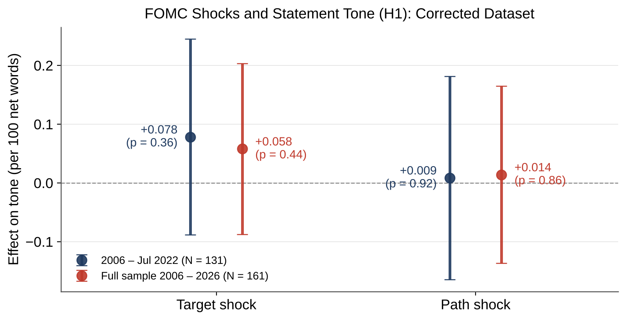
H1: Target and Path monetary-policy surprises are associated with FOMC statement tone — Coefficient Evidence
Result: All four 95% confidence intervals include zero, in both samples. Statement tone does not move with either the Target or the Path surprise — so tone is measuring something the high-frequency surprises do not capture.
Source: results_v2.json; corrected dataset; bars show 95% CI.

Slide 30
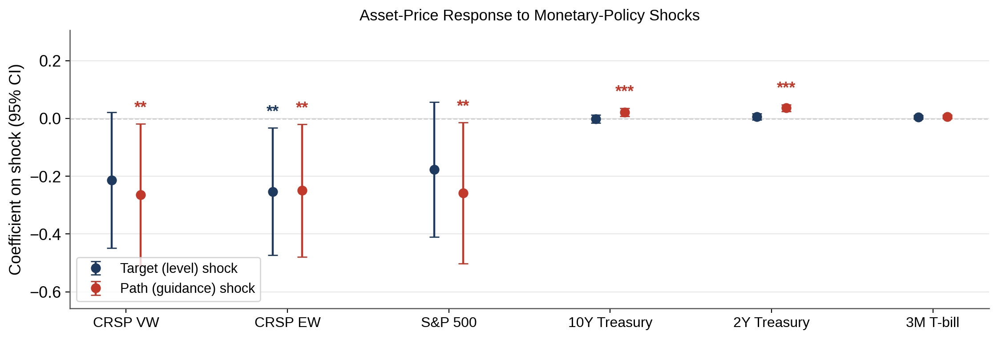
H1: Target and Path monetary-policy surprises are associated with FOMC statement tone — Both Shocks Move Prices on Announcement Day
Result: Equity indices respond negatively to both shocks (CRSP VW: Target -0.21, Path -0.26, p = 0.037); Treasury and bill responses are muted. Prices digest both components immediately — setting up the question of what the statement text adds on top (H2).
Source: fomc_dataset_2006_latest.csv; event-window returns on shocks, OLS with 95% CI; N = 161 meetings, 2006–2026.

Slide 31
H2: Incremental Information — Tone beyond Target and Path — Forward-Guidance Regime
FG sample (Dec 2008 – Dec 2015); dependent variable: asset return
Asset (FG sample) | β Tone | (SE) | β MP | β CBI | R²
CRSP VW | -1.205*** | (0.304) | -1.252*** | +1.933*** | 48.1%
S&P 500 | -1.119*** | (0.291) | -1.212*** | +1.956*** | 48.4%
10Y Treasury | +0.037 | (0.029) | +0.031 | +0.047 | 8.0%
2Y Treasury | +0.007 | (0.014) | +0.021* | +0.058* | 13.2%
Result: Over the full sample, tone adds little (CRSP VW β = −0.145, p = .26, ΔR² = +0.82 pp). Within the forward-guidance regime, tone carries significant incremental information for equities (CRSP VW −1.21, S&P 500 −1.12, both p < .001) beyond the MP and CBI components — R² rises to 48%. Treasuries show no tone effect.
Source: price_results_v1.json, spec C (tone + MP + CBI, FG sample); stars: * p<0.1, ** p<0.05, *** p<0.01.

Slide 32
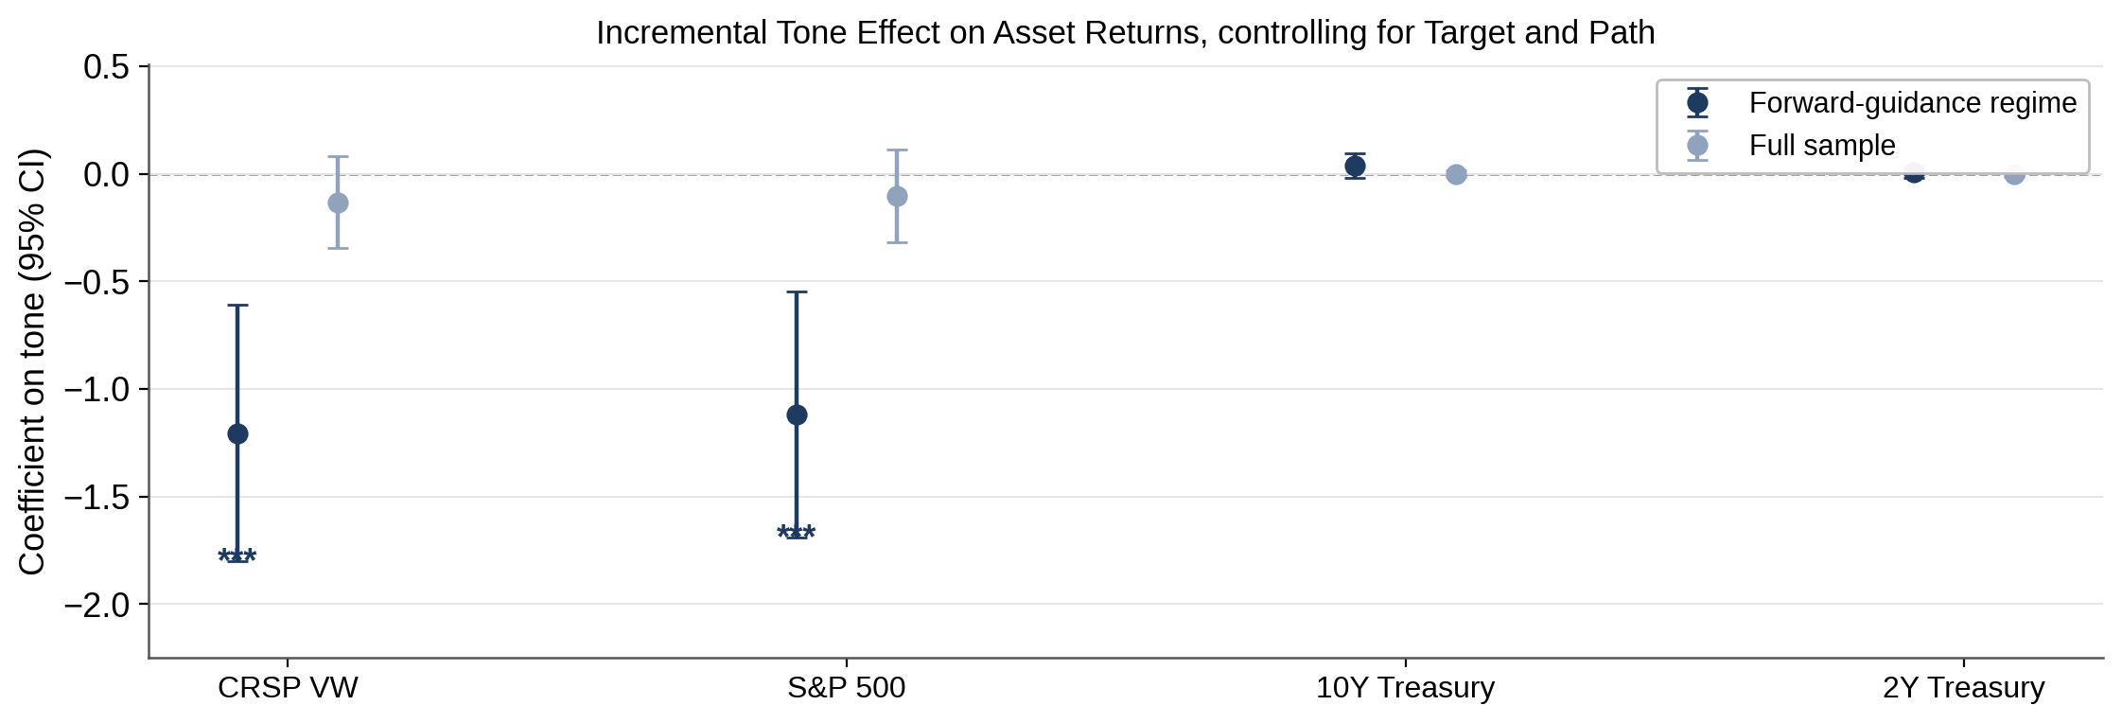
H2: Incremental Information — Tone Effects Concentrated in the FG Regime
Result: Full-sample tone coefficients (navy) are indistinguishable from zero; FG-regime coefficients (red) are significant for both equity indices. Words carry price information exactly when words were the policy instrument.
Source: price_results_v1.json, spec C by regime; 95% CI bars.

Slide 33
H3: State Dependence — Tone × FG Interaction (CRSP VW)
Dependent variable: CRSP VW return — interaction spec
Variable | Coefficient | SE | p-value
Tone (×100) | +0.037 | (0.151) | 0.808
FG regime dummy (2008–15) | +2.951*** | (0.982) | 0.003
Tone × FG | -1.156*** | (0.389) | 0.003
N | 150
R² | 6.9%
Result: The interaction confirms regime dependence: tone has no effect outside FG (+0.04, p = 0.81) but a large, significant effect inside it (−1.156, p = 0.003). Text matters exactly when the statement was the instrument.
Source: price_results_v1.json, spec D (interaction); OLS; 2006–2026, N = 150.

Slide 34
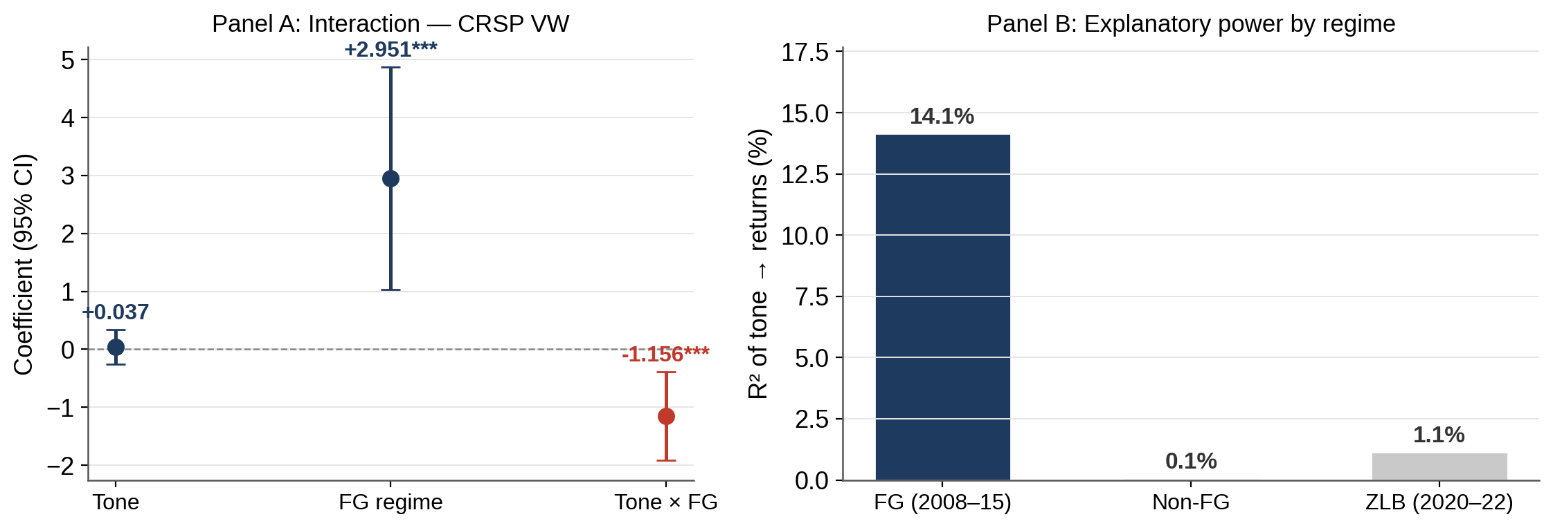
H3: State Dependence — Explanatory Power by Regime
Result: R² = 14.1% in the FG regime vs 0.1% outside it and 1.1% in the 2020–22 ZLB template era. State dependence is the rule, not the exception — and motivates the LLM-based measurement layer.
Source: price_results_v1.json spec B by regime; batch3_results.json (ZLB window).

Slide 35
What Forward Guidance Sounded Like
Date | Statement text (verbatim) | Type
Mar 28, 2006 | “The Committee judges that some further policy firming may be needed …” | Before FG: conditional, no horizon
Dec 16, 2008 | “… the Committee anticipates that weak economic conditions are likely to warrant exceptionally low levels of the federal funds rate for some time.” | FG: open-ended
Aug 9, 2011 | “… likely to warrant exceptionally low levels for the federal funds rate at least through mid-2013.” | FG: calendar date
Dec 12, 2012 | “… this exceptionally low range for the federal funds rate will be appropriate at least as long as the unemployment rate remains above 6-1/2 percent …” | FG: economic thresholds
Dec 19, 2018 | “The Committee judges that some further gradual increases in the target range for the federal funds rate will be consistent with sustained expansion …” | After FG: conditional
Tone also differs by regime: mean tone 2.35 per 100 words in FG vs. 3.01 outside; standard deviation 0.49 vs. 0.84.
Source: Federal Reserve FOMC statements (fomc_statements_clean.json). Tone varies less in the FG regime yet predicts returns only there (H3).

Slide 36
H4: MP vs. CBI — Differential Effects on Mutual-Fund Flows (meeting month)
Controls: log TNA, flow volatility; class-level flows
Asset class (meeting month) | β MP | β CBI | Wald p (MP=CBI)
Government bonds | -0.110 | +0.759** | 0.10
Corporate bonds | -0.039 | -0.195 | 0.44
Real assets | +0.296** | -0.023 | 0.11
Large-cap equity | -0.070* | +0.009 | 0.15
DM equity | +0.105 | -0.093 | 0.05
EM equity | +0.017 | -0.008 | 0.90
Small-cap equity | +0.011 | +0.023 | 0.84
Result: Government bonds gain flows after CBI shocks (+0.76 %TNA, p = .037) with no MP response, but MP = CBI is rejected only at 10% (Wald p = .098); real assets respond to MP instead (+0.30, p = .039). Only DM equity rejects MP = CBI at 5% (p = .048). 6 of 42 class-window tests are significant at 5% versus ≈2 expected by chance, so single-class results are suggestive.
Source: flow_rerun_output_v8/flow_results_rerun_v8.json, H4 same-window spec; class-level flows, N = 157 meeting months.

Slide 37
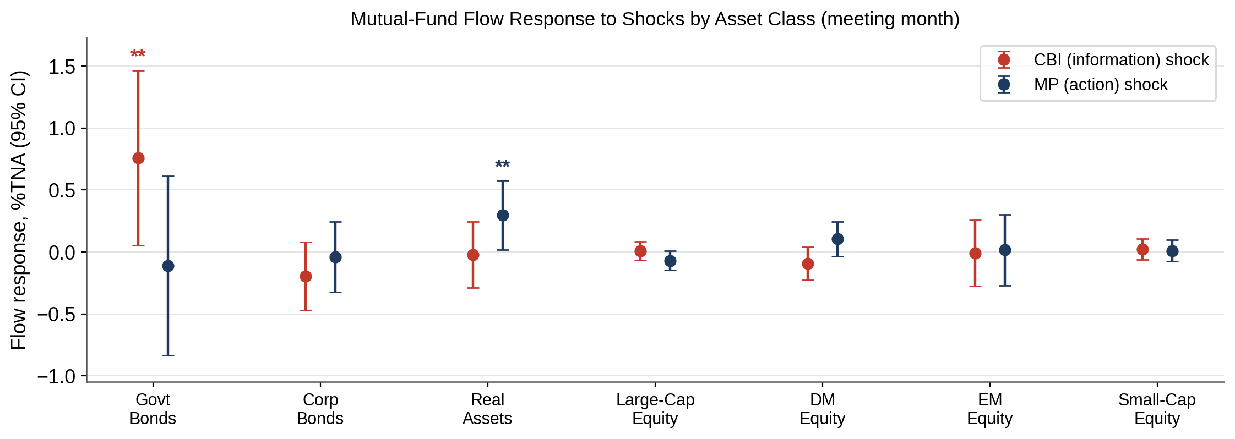
H4: MP vs. CBI — Flow Response by Asset Class
Result: The CBI effect concentrates in government bonds while the MP effect appears in real assets — the two shock components transmit to different portfolio margins, consistent with the information-vs-action decomposition.
Source: flow_rerun_output_v8; 95% CI bars; asset classes ordered by risk rank.

Slide 38
H5 — Risk Ladder — Interaction of Risk Rank with Shock Type
Dependent variable: class-level flow (%TNA), meeting month
Variable | Coefficient | SE | p-value
Risk × CBI | -0.066** | (0.032) | 0.036
Risk × MP | +0.005 | (0.032) | 0.877
Risk × CBI (positive CBI: good news) | -0.088** | (0.038) | 0.020
Risk × CBI (negative CBI: bad news) | -0.055* | (0.033) | 0.100
Risk × CBI, excluding government bonds | +0.024 | (0.025) | 0.341
MP × ZLB (2020–22) | -1.505*** | (0.532) | 0.005
Result: Pooled across seven classes, Risk×CBI = −0.066 (p = .036): CBI shocks are associated with flows toward safer classes. The slope comes from government bonds alone — excluding them, Risk×CBI = +0.024 (p = .34). Positive (good-news) CBI shocks drive the pooled effect. MP shocks show ladder effects only at the zero bound (MP×ZLB = −1.505, p = .005).
Source: flow_results_rerun_v8.json (H5_risk_ladder_same, zero_rate_check); models_v2_results.json (H5_sign_asymmetry); excl.-government row: same spec on 6 classes, N = 942.

Slide 39
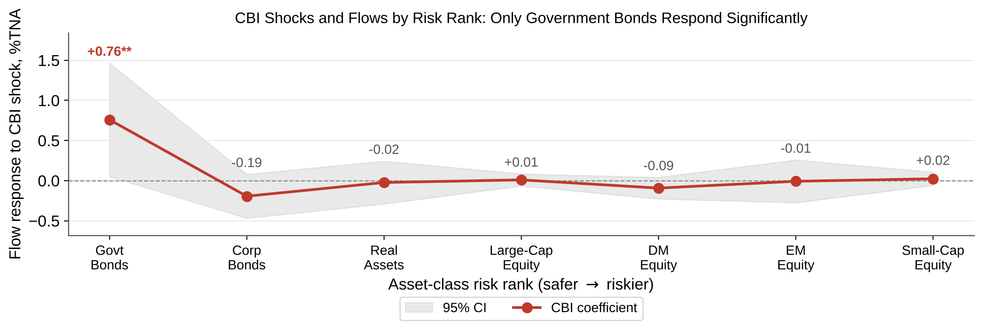
H5 — Risk Ladder — CBI Flow Response by Risk Rank
Result: The response is not monotone in risk rank. Government bonds are the only class with a significant CBI response (+0.76 %TNA, p = .037); corporate bonds −0.19 (n.s.); the five riskier classes stay within ±0.1 of zero. The negative Risk×CBI slope reflects a safe-asset inflow, not gradual de-risking along the ladder.
Source: flow_rerun_output_v8; CBI coefficients with 95% CI band; asset classes ordered from safest to riskiest.

Slide 40
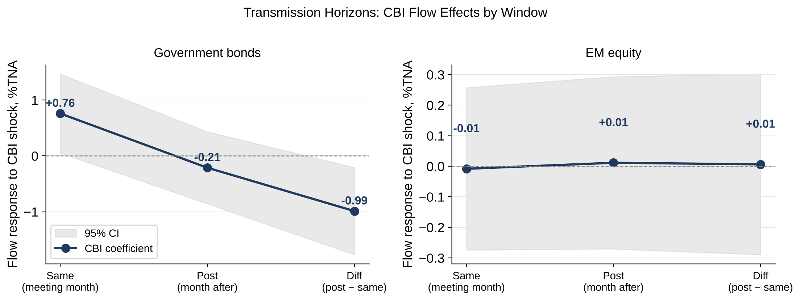
H6: MP and CBI shocks exhibit different transmission patterns across horizons — Prices First, Portfolios Later
Result: Government bonds: CBI inflow of +0.76 in the meeting month (p = .037), −0.21 the month after (p = .52), and the Diff window (post − same) is −0.99 (p = .014) — flows fall back after the initial inflow. EM equity shows no response in any window. Prices react on the day; safe-asset flows spike in the meeting month and then unwind.
Source: h4_all_windows.json (same / post / diff windows); 95% CI bands.

Slide 41
Who Trades When: Prices on the Day, Flows Later
Stage | Who acts | Evidence
Announcement day | Dealers, high-frequency and institutional traders reprice on public news. Public news can move prices with little net trading, because all traders see it at once. | Same-day CRSP VW: Target −0.20, Path −0.26 (p = .04), N = 150
Meeting month | Mutual-fund shareholders (retail and retirement-plan investors) reallocate: they trade at end-of-day NAV, decide less often, and flows are recorded monthly. | Government-bond funds after CBI: +0.76% of assets (p = .037)
Month after | Part of the inflow reverses as portfolios rebalance. | Diff (Post − Same): −0.99 (p = .014)
Bond markets | Most fixed income is held by insurers and pension funds that stay in investment-grade bonds; bond-fund flows capture the more mobile part of bond demand. | Flow effects concentrate in government- and corporate-bond funds
Prices react to public news immediately; fund flows record end investors’ slower portfolio decisions. Flows are not what moves the price on the day.
Planned test: split flows by retail vs. institutional share classes to identify who reallocates after prices move.

Slide 42
Measuring Tone: LLM vs. Dictionaries
Measure | Separates rate hikes from cuts? (21 hikes, 16 cuts) | Other evidence
Loughran–McDonald (LM) dictionary | Gap 0.39 SD, p = .16 — not significant | Built for 10-K filings; correlation with LLM score −0.24
Central-bank (CB) word list | Gap 0.67 SD, p = .024
Combined tone (½ LM + ½ CB) — used in H1–H3 | Gap 1.01 SD, p = .002 | Predicts FG-period stock returns: −0.81 per SD, p = .005 (N = 56)
LLM hawkishness (full text; 5-model cross-check) | Gap 2.00 SD, p < .001 | Moves with the Path surprise (p = .003, R² = 6.9%, N = 161); does not predict FG returns (p = .23)
The LLM reads the policy stance; the dictionary tone carries the return-relevant information under forward guidance. They measure different things.
Computed from llm_statement_scores.jsonl and fomc_dataset_2006_latest.csv (161 statements, 2006–2026). Hike/cut from each statement’s decision sentence; Welch t-test. The LLM measures tone only; it never classifies shocks.

Slide 43
Robustness Checks Completed
Check | Result | Conclusion
Tone orthogonalized to Target and Path, in flow regressions | Tone p = .62; MP = CBI Wald p = .51 (Same), .40 (Post); N = 1,099 | Tone does not drive flows
Tone by regime, in flow regressions | FG: p = .94 (N = 392); non-FG: p = .91 (N = 707) | No tone effect on flows in either regime
Sign of the CBI shock | Good news (CBI > 0): Risk × CBI = −0.088 (p = .020); bad news: −0.055 (p = .10) | Effect stronger after good-news CBI
Excluding government bonds | Risk × CBI = +0.024 (p = .34), N = 942 | Ladder effect is the government-bond effect
Asset-class fixed effects | Risk × CBI = −0.069 (p = .029) | Robust to class intercepts
Zero lower bound, 2020–22 | MP × ZLB = −1.505 (p = .005) | MP shocks matter at the floor
Statistical power: pooled vs. by regime | Tone on returns: pooled p = .26 (N = 150); FG only p = .005 (N = 56) | Pooling hides the regime effect
OLS; class-level flows in % of lagged assets. Sources: models_v2_results.json; flow_results_rerun_v8.json; results_v2.json; excluding-government row re-estimated with the same specification.

Slide 44
Appendix: Tables and Figures
Section | Slides
A. Current tables (Tables 1–9) | Slides 46–64
B. Current figures (F00–F07) | Slides 65–72
C. Archived tables (older website tabs, N = 117) — not cited | Slides 73–77
D. Archived figures (older website pages) — not cited | Slides 78–91
Current = corrected data, re-run October 2026. Archived = older website tabs, shown for reference only.
All tables and figures come from the monetary-policy-lab repository that produces the research website; workbook: Tables_All_Results.xlsx.

Slide 45
Table 1. H1 — Statement tone on Target and Path surprises
Dependent variable: tone per 100 words (½ LM + ½ CB). OLS. Corrected dataset (body-only statement text). Source: results/results_v2.json (website: Research Results → Updated dataset tab).
Sample | Variable | Coefficient | SE | p-value | Sig. | N | R²
2006 – Jul 2022 | target | 0.078 | 0.085 | 0.358 |  | 131 | 0.007
2006 – Jul 2022 | path | 0.009 | 0.088 | 0.923 |  | 131 | 0.007
2006 – Jul 2022 | const | 2.673 | 0.070 | 0.0000 | *** | 131 | 0.007
2006 – Jul 2022 | Wald test: Target = Path (p) |  |  | 0.587
Full sample 2006–2026 | target | 0.058 | 0.074 | 0.435 |  | 161 | 0.004
Full sample 2006–2026 | path | 0.014 | 0.077 | 0.855 |  | 161 | 0.004
Full sample 2006–2026 | const | 2.783 | 0.064 | 0.0000 | *** | 161 | 0.004
Full sample 2006–2026 | Wald test: Target = Path (p) |  |  | 0.696
Significance: * p < .10, ** p < .05, *** p < .01.

Slide 46
Table 2. H2 — Same-day CRSP value-weighted return on Target, Path and tone
Dependent variable: same-day CRSP VW return (%). OLS. Source: results/results_v2.json.
Sample | Variable | Coefficient | SE | p-value | Sig. | N | R²
2006 – Jul 2022 | target | -0.328 | 0.134 | 0.016 | ** | 131 | 0.075
2006 – Jul 2022 | path | -0.237 | 0.139 | 0.091 | * | 131 | 0.075
2006 – Jul 2022 | tone | -0.066 | 0.139 | 0.638 |  | 131 | 0.075
2006 – Jul 2022 | const | 0.592 | 0.388 | 0.130 |  | 131 | 0.075
2006 – Jul 2022 | ΔR² from adding tone (percentage points) | 0.162
Full sample 2006–2026 | target | -0.204 | 0.120 | 0.091 | * | 150 | 0.063
Full sample 2006–2026 | path | -0.261 | 0.125 | 0.038 | ** | 150 | 0.063
Full sample 2006–2026 | tone | -0.145 | 0.128 | 0.260 |  | 150 | 0.063
Full sample 2006–2026 | const | 0.729 | 0.372 | 0.052 | * | 150 | 0.063
Full sample 2006–2026 | ΔR² from adding tone (percentage points) | 0.820
Significance: * p < .10, ** p < .05, *** p < .01.

Slide 47
Table 3. H3 — Tone and returns by forward-guidance regime (1 of 2)
Dependent variable: same-day CRSP VW return. OLS. Source: results/results_v2.json. Note: in the interaction model the stand-alone tone coefficient appears to be on a different scale from tone × FG (×100); ask Dechang to confirm units. The subsample rows are unaffected.
Sample / model | Variable | Coefficient | SE | p-value | Sig. | N | R²
2006 – Jul 2022 — interaction model | target | -0.314 | 0.130 | 0.017 | ** | 131 | 0.147
2006 – Jul 2022 — interaction model | path | -0.236 | 0.135 | 0.083 | * | 131 | 0.147
2006 – Jul 2022 — interaction model | tone (see note) | 15.256 | 15.880 | 0.339 |  | 131 | 0.147
2006 – Jul 2022 — interaction model | FG dummy | 2.988 | 0.948 | 0.002 | *** | 131 | 0.147
2006 – Jul 2022 — interaction model | tone × FG | -1.215 | 0.375 | 0.002 | *** | 131 | 0.147
2006 – Jul 2022 — interaction model | const | -0.050 | 0.484 | 0.919 |  | 131 | 0.147
Full sample 2006–2026 — interaction model | target | -0.198 | 0.118 | 0.095 | * | 150 | 0.119
Full sample 2006–2026 — interaction model | path | -0.257 | 0.122 | 0.037 | ** | 150 | 0.119
Full sample 2006–2026 — interaction model | tone (see note) | 5.095 | 14.852 | 0.732 |  | 150 | 0.119
Full sample 2006–2026 — interaction model | FG dummy | 2.884 | 0.962 | 0.003 | *** | 150 | 0.119
Full sample 2006–2026 — interaction model | tone × FG | -1.133 | 0.381 | 0.003 | *** | 150 | 0.119
Full sample 2006–2026 — interaction model | const | 0.102 | 0.469 | 0.829 |  | 150 | 0.119
FG period only (Dec 2008–Dec 2015) | target | -0.582 | 0.293 | 0.053 | * | 56 | 0.328

Slide 48
Table 3. H3 — Tone and returns by forward-guidance regime (2 of 2)
Sample / model | Variable | Coefficient | SE | p-value | Sig. | N | R²
FG period only (Dec 2008–Dec 2015) | path | -0.526 | 0.250 | 0.041 | ** | 56 | 0.328
FG period only (Dec 2008–Dec 2015) | tone | -1.013 | 0.342 | 0.005 | *** | 56 | 0.328
FG period only (Dec 2008–Dec 2015) | const | 2.797 | 0.819 | 0.001 | *** | 56 | 0.328
Outside FG | target | -0.182 | 0.144 | 0.212 |  | 75 | 0.032
Outside FG | path | -0.026 | 0.162 | 0.872 |  | 75 | 0.032
Outside FG | tone | 0.145 | 0.155 | 0.353 |  | 75 | 0.032
Outside FG | const | -0.034 | 0.472 | 0.942 |  | 75 | 0.032
Significance: * p < .10, ** p < .05, *** p < .01.

Slide 49
Table 4. Price regressions, specifications A–D (tone, MP, CBI, FG) (1 of 6)
Spec A = headline; B = tone only by regime; C = tone + MP + CBI by regime; D = tone × FG interaction. Same-day changes. OLS. Source: direction2/flow_rerun_output_v8/price_results_v1.json (Oct 21, 2026).
Specification | Variable | Coefficient | SE | p-value | Sig. | N | R²
A_headline_ty10_FG | Intercept | -0.109 | 0.069 | 0.120 |  | 56 | 0.041
A_headline_ty10_FG | tone100 | 0.044 | 0.029 | 0.134 |  | 56 | 0.041
B_ty10_chg_all | Intercept | -0.008 | 0.022 | 0.711 |  | 161 | 0.0001
B_ty10_chg_all | tone100 | -0.0007 | 0.008 | 0.922 |  | 161 | 0.0001
B_ty10_chg_FG | Intercept | -0.109 | 0.069 | 0.120 |  | 56 | 0.041
B_ty10_chg_FG | tone100 | 0.044 | 0.029 | 0.134 |  | 56 | 0.041
B_ty10_chg_nonFG | Intercept | 0.007 | 0.021 | 0.715 |  | 105 | 0.010
B_ty10_chg_nonFG | tone100 | -0.007 | 0.007 | 0.317 |  | 105 | 0.010
B_ty2_chg_all | Intercept | -0.007 | 0.020 | 0.726 |  | 161 | 0.0002
B_ty2_chg_all | tone100 | -0.001 | 0.007 | 0.853 |  | 161 | 0.0002
B_ty2_chg_FG | Intercept | -0.044 | 0.035 | 0.211 |  | 56 | 0.018
B_ty2_chg_FG | tone100 | 0.015 | 0.015 | 0.326 |  | 56 | 0.018
B_ty2_chg_nonFG | Intercept | 0.002 | 0.028 | 0.942 |  | 105 | 0.002

Slide 50
Table 4. Price regressions, specifications A–D (tone, MP, CBI, FG) (2 of 6)
Specification | Variable | Coefficient | SE | p-value | Sig. | N | R²
B_ty2_chg_nonFG | tone100 | -0.004 | 0.009 | 0.641 |  | 105 | 0.002
B_crsp_vw_all | Intercept | 0.795 | 0.379 | 0.037 | ** | 150 | 0.011
B_crsp_vw_all | tone100 | -0.166 | 0.131 | 0.206 |  | 150 | 0.011
B_crsp_vw_FG | Intercept | 3.095 | 0.899 | 0.001 | *** | 56 | 0.141
B_crsp_vw_FG | tone100 | -1.119 | 0.375 | 0.004 | *** | 56 | 0.141
B_crsp_vw_nonFG | Intercept | 0.143 | 0.464 | 0.758 |  | 94 | 0.0007
B_crsp_vw_nonFG | tone100 | 0.037 | 0.147 | 0.803 |  | 94 | 0.0007
B_sp500_all | Intercept | 0.676 | 0.376 | 0.074 | * | 150 | 0.007
B_sp500_all | tone100 | -0.134 | 0.130 | 0.303 |  | 150 | 0.007
B_sp500_FG | Intercept | 2.858 | 0.869 | 0.002 | *** | 56 | 0.130
B_sp500_FG | tone100 | -1.027 | 0.362 | 0.006 | *** | 56 | 0.130
B_sp500_nonFG | Intercept | 0.006 | 0.470 | 0.989 |  | 94 | 0.002
B_sp500_nonFG | tone100 | 0.070 | 0.149 | 0.639 |  | 94 | 0.002

Slide 51
Table 4. Price regressions, specifications A–D (tone, MP, CBI, FG) (3 of 6)
Specification | Variable | Coefficient | SE | p-value | Sig. | N | R²
C_ty10_chg_FG | Intercept | -0.092 | 0.070 | 0.193 |  | 56 | 0.080
C_ty10_chg_FG | tone100 | 0.037 | 0.029 | 0.218 |  | 56 | 0.080
C_ty10_chg_FG | mp_shock | 0.031 | 0.024 | 0.208 |  | 56 | 0.080
C_ty10_chg_FG | cbi_shock | 0.047 | 0.062 | 0.452 |  | 56 | 0.080
C_ty10_chg_all | Intercept | -0.008 | 0.022 | 0.719 |  | 161 | 0.0002
C_ty10_chg_all | tone100 | -0.0008 | 0.008 | 0.917 |  | 161 | 0.0002
C_ty10_chg_all | mp_shock | 0.001 | 0.010 | 0.896 |  | 161 | 0.0002
C_ty10_chg_all | cbi_shock | -0.0002 | 0.010 | 0.984 |  | 161 | 0.0002
C_ty2_chg_FG | Intercept | -0.028 | 0.034 | 0.413 |  | 56 | 0.132
C_ty2_chg_FG | tone100 | 0.007 | 0.014 | 0.618 |  | 56 | 0.132
C_ty2_chg_FG | mp_shock | 0.021 | 0.012 | 0.076 | * | 56 | 0.132
C_ty2_chg_FG | cbi_shock | 0.058 | 0.031 | 0.065 | * | 56 | 0.132
C_ty2_chg_all | Intercept | -0.005 | 0.020 | 0.805 |  | 161 | 0.015

Slide 52
Table 4. Price regressions, specifications A–D (tone, MP, CBI, FG) (4 of 6)
Specification | Variable | Coefficient | SE | p-value | Sig. | N | R²
C_ty2_chg_all | tone100 | -0.002 | 0.007 | 0.777 |  | 161 | 0.015
C_ty2_chg_all | mp_shock | 0.010 | 0.009 | 0.284 |  | 161 | 0.015
C_ty2_chg_all | cbi_shock | 0.010 | 0.009 | 0.274 |  | 161 | 0.015
C_crsp_vw_FG | Intercept | 3.180 | 0.726 | 0.0001 | *** | 56 | 0.481
C_crsp_vw_FG | tone100 | -1.205 | 0.304 | 0.0002 | *** | 56 | 0.481
C_crsp_vw_FG | mp_shock | -1.252 | 0.250 | 0.000 | *** | 56 | 0.481
C_crsp_vw_FG | cbi_shock | 1.933 | 0.647 | 0.004 | *** | 56 | 0.481
C_crsp_vw_all | Intercept | 0.670 | 0.318 | 0.037 | ** | 150 | 0.315
C_crsp_vw_all | tone100 | -0.132 | 0.110 | 0.230 |  | 150 | 0.315
C_crsp_vw_all | mp_shock | -1.042 | 0.146 | 0.000 | *** | 150 | 0.315
C_crsp_vw_all | cbi_shock | 0.529 | 0.142 | 0.0003 | *** | 150 | 0.315
C_sp500_FG | Intercept | 2.957 | 0.694 | 0.0001 | *** | 56 | 0.484
C_sp500_FG | tone100 | -1.119 | 0.291 | 0.0003 | *** | 56 | 0.484

Slide 53
Table 4. Price regressions, specifications A–D (tone, MP, CBI, FG) (5 of 6)
Specification | Variable | Coefficient | SE | p-value | Sig. | N | R²
C_sp500_FG | mp_shock | -1.212 | 0.239 | 0.000 | *** | 56 | 0.484
C_sp500_FG | cbi_shock | 1.956 | 0.619 | 0.003 | *** | 56 | 0.484
C_sp500_all | Intercept | 0.559 | 0.317 | 0.080 | * | 150 | 0.306
C_sp500_all | tone100 | -0.103 | 0.109 | 0.349 |  | 150 | 0.306
C_sp500_all | mp_shock | -1.001 | 0.146 | 0.000 | *** | 150 | 0.306
C_sp500_all | cbi_shock | 0.558 | 0.142 | 0.0001 | *** | 150 | 0.306
D_ty10_chg_interact | Intercept | 0.007 | 0.028 | 0.785 |  | 161 | 0.031
D_ty10_chg_interact | tone100 | -0.007 | 0.009 | 0.456 |  | 161 | 0.031
D_ty10_chg_interact | fg_2008_2015 | -0.116 | 0.058 | 0.046 | ** | 161 | 0.031
D_ty10_chg_interact | tone_x_fg | 0.050 | 0.023 | 0.029 | ** | 161 | 0.031
D_ty2_chg_interact | Intercept | 0.002 | 0.025 | 0.936 |  | 161 | 0.005
D_ty2_chg_interact | tone100 | -0.004 | 0.008 | 0.605 |  | 161 | 0.005
D_ty2_chg_interact | fg_2008_2015 | -0.046 | 0.053 | 0.383 |  | 161 | 0.005

Slide 54
Table 4. Price regressions, specifications A–D (tone, MP, CBI, FG) (6 of 6)
Specification | Variable | Coefficient | SE | p-value | Sig. | N | R²
D_ty2_chg_interact | tone_x_fg | 0.019 | 0.021 | 0.376 |  | 161 | 0.005
D_crsp_vw_interact | Intercept | 0.143 | 0.478 | 0.765 |  | 150 | 0.069
D_crsp_vw_interact | tone100 | 0.037 | 0.151 | 0.808 |  | 150 | 0.069
D_crsp_vw_interact | fg_2008_2015 | 2.951 | 0.982 | 0.003 | *** | 150 | 0.069
D_crsp_vw_interact | tone_x_fg | -1.156 | 0.389 | 0.003 | *** | 150 | 0.069
D_sp500_interact | Intercept | 0.006 | 0.475 | 0.989 |  | 150 | 0.062
D_sp500_interact | tone100 | 0.070 | 0.150 | 0.642 |  | 150 | 0.062
D_sp500_interact | fg_2008_2015 | 2.851 | 0.976 | 0.004 | *** | 150 | 0.062
D_sp500_interact | tone_x_fg | -1.097 | 0.386 | 0.005 | *** | 150 | 0.062
Significance: * p < .10, ** p < .05, *** p < .01.

Slide 55
Table 5. H4 — Mutual-fund flows on MP and CBI shocks, by asset class and window
Dependent variable: class-level flow, % of lagged TNA. Controls: log TNA, 12-month flow volatility. OLS. Source: direction2/flow_rerun_output_v8/h4_all_windows.json. — Same window
Window | Asset class | β MP | SE | p | Sig. | β CBI | SE | p | Sig. | Wald MP = CBI (p) | N | R²
Same (meeting month) | 1 Government bonds | -0.110 | 0.368 | 0.765 |  | 0.759 | 0.360 | 0.037 | ** | 0.098 | 157 | 0.034
Same (meeting month) | 2 Corporate bonds | -0.039 | 0.144 | 0.787 |  | -0.195 | 0.140 | 0.166 |  | 0.445 | 157 | 0.060
Same (meeting month) | 3 Real assets | 0.296 | 0.143 | 0.039 | ** | -0.023 | 0.136 | 0.863 |  | 0.110 | 157 | 0.083
Same (meeting month) | 4 Large-cap equity | -0.070 | 0.039 | 0.076 | * | 0.009 | 0.038 | 0.809 |  | 0.154 | 157 | 0.045
Same (meeting month) | 5 Developed-market equity | 0.105 | 0.071 | 0.138 |  | -0.093 | 0.068 | 0.175 |  | 0.048 | 157 | 0.092
Same (meeting month) | 6 Emerging-market equity | 0.017 | 0.146 | 0.908 |  | -0.008 | 0.136 | 0.951 |  | 0.899 | 157 | 0.073
Same (meeting month) | 7 Small-cap equity | 0.011 | 0.043 | 0.802 |  | 0.023 | 0.042 | 0.587 |  | 0.843 | 157 | 0.039

Slide 56
Table 5. H4 — Mutual-fund flows on MP and CBI shocks, by asset class and window
Dependent variable: class-level flow, % of lagged TNA. Controls: log TNA, 12-month flow volatility. OLS. Source: direction2/flow_rerun_output_v8/h4_all_windows.json. — Post window
Window | Asset class | β MP | SE | p | Sig. | β CBI | SE | p | Sig. | Wald MP = CBI (p) | N | R²
Post (month after) | 1 Government bonds | 0.006 | 0.337 | 0.985 |  | -0.212 | 0.329 | 0.520 |  | 0.648 | 158 | 0.011
Post (month after) | 2 Corporate bonds | -0.080 | 0.147 | 0.589 |  | -0.320 | 0.143 | 0.026 | ** | 0.248 | 158 | 0.088
Post (month after) | 3 Real assets | -0.006 | 0.131 | 0.962 |  | -0.194 | 0.125 | 0.124 |  | 0.310 | 158 | 0.131
Post (month after) | 4 Large-cap equity | -0.050 | 0.037 | 0.177 |  | -0.084 | 0.036 | 0.022 | ** | 0.518 | 158 | 0.050
Post (month after) | 5 Developed-market equity | 0.026 | 0.065 | 0.694 |  | -0.105 | 0.064 | 0.103 |  | 0.162 | 158 | 0.082
Post (month after) | 6 Emerging-market equity | -0.138 | 0.152 | 0.365 |  | 0.011 | 0.144 | 0.937 |  | 0.479 | 158 | 0.091
Post (month after) | 7 Small-cap equity | 0.029 | 0.042 | 0.492 |  | -0.060 | 0.041 | 0.144 |  | 0.135 | 158 | 0.067

Slide 57
Table 5. H4 — Mutual-fund flows on MP and CBI shocks, by asset class and window
Dependent variable: class-level flow, % of lagged TNA. Controls: log TNA, 12-month flow volatility. OLS. Source: direction2/flow_rerun_output_v8/h4_all_windows.json. — Diff window
Window | Asset class | β MP | SE | p | Sig. | β CBI | SE | p | Sig. | Wald MP = CBI (p) | N | R²
Diff (Post − Same) | 1 Government bonds | 0.126 | 0.408 | 0.757 |  | -0.988 | 0.398 | 0.014 | ** | 0.055 | 158 | 0.040
Diff (Post − Same) | 2 Corporate bonds | -0.027 | 0.170 | 0.872 |  | -0.130 | 0.165 | 0.432 |  | 0.670 | 158 | 0.013
Diff (Post − Same) | 3 Real assets | -0.277 | 0.150 | 0.068 | * | -0.171 | 0.144 | 0.235 |  | 0.616 | 158 | 0.053
Diff (Post − Same) | 4 Large-cap equity | 0.024 | 0.048 | 0.620 |  | -0.100 | 0.048 | 0.037 | ** | 0.073 | 158 | 0.036
Diff (Post − Same) | 5 Developed-market equity | -0.067 | 0.066 | 0.311 |  | -0.026 | 0.064 | 0.681 |  | 0.665 | 158 | 0.021
Diff (Post − Same) | 6 Emerging-market equity | -0.105 | 0.160 | 0.512 |  | 0.006 | 0.151 | 0.967 |  | 0.617 | 158 | 0.023
Diff (Post − Same) | 7 Small-cap equity | 0.019 | 0.048 | 0.701 |  | -0.087 | 0.047 | 0.066 | * | 0.122 | 158 | 0.027

Slide 58
Table 6. H5 — Risk-rank interactions (risk 1 = government bonds … 7 = small-cap) (1 of 3)
Pooled class-month panel; dependent variable: flow % of lagged TNA. OLS. Sources: flow_results_rerun_v8.json; models_v2_results.json. Last two rows re-estimated Nov 12, 2026 with the repo code and v8 data (not yet on the website).
Model | Variable | Coefficient | SE | p-value | Sig. | N | R²
Pooled panel, Same window (7 classes) | const | 1.185 | 0.535 | 0.027 | ** | 1099 | 0.043
Pooled panel, Same window (7 classes) | mp_shock | -0.012 | 0.144 | 0.932 |  | 1099 | 0.043
Pooled panel, Same window (7 classes) | cbi_shock | 0.332 | 0.141 | 0.019 | ** | 1099 | 0.043
Pooled panel, Same window (7 classes) | risk_x_mp | 0.005 | 0.032 | 0.877 |  | 1099 | 0.043
Pooled panel, Same window (7 classes) | risk_x_cbi | -0.066 | 0.032 | 0.036 | ** | 1099 | 0.043
Pooled panel, Same window (7 classes) | log_tna | -0.090 | 0.038 | 0.017 | ** | 1099 | 0.043
Pooled panel, Same window (7 classes) | flow_vol_12m | 24.742 | 4.575 | 0.0000 | *** | 1099 | 0.043
With ZLB 2020–22 interactions | const | 1.204 | 0.534 | 0.024 | ** | 1099 | 0.050
With ZLB 2020–22 interactions | mp_shock | 0.009 | 0.144 | 0.948 |  | 1099 | 0.050
With ZLB 2020–22 interactions | cbi_shock | 0.332 | 0.141 | 0.018 | ** | 1099 | 0.050
With ZLB 2020–22 interactions | risk_x_mp | 0.005 | 0.032 | 0.874 |  | 1099 | 0.050
With ZLB 2020–22 interactions | risk_x_cbi | -0.066 | 0.031 | 0.036 | ** | 1099 | 0.050
With ZLB 2020–22 interactions | log_tna | -0.092 | 0.037 | 0.015 | ** | 1099 | 0.050

Slide 59
Table 6. H5 — Risk-rank interactions (risk 1 = government bonds … 7 = small-cap) (2 of 3)
Model | Variable | Coefficient | SE | p-value | Sig. | N | R²
With ZLB 2020–22 interactions | flow_vol_12m | 24.504 | 4.564 | 0.0000 | *** | 1099 | 0.050
With ZLB 2020–22 interactions | mp_x_zlb | -1.505 | 0.532 | 0.005 | *** | 1099 | 0.050
With ZLB 2020–22 interactions | cbi_x_zlb | 0.802 | 2.858 | 0.779 |  | 1099 | 0.050
Sign asymmetry (positive vs negative shocks) | const | 1.222 | 0.537 | 0.023 | ** | 1099 | 0.044
Sign asymmetry (positive vs negative shocks) | risk_x_mp_pos | 0.001 | 0.045 | 0.979 |  | 1099 | 0.044
Sign asymmetry (positive vs negative shocks) | risk_x_mp_neg | 0.006 | 0.033 | 0.853 |  | 1099 | 0.044
Sign asymmetry (positive vs negative shocks) | risk_x_cbi_pos | -0.088 | 0.038 | 0.020 | ** | 1099 | 0.044
Sign asymmetry (positive vs negative shocks) | risk_x_cbi_neg | -0.055 | 0.033 | 0.100 | * | 1099 | 0.044
Sign asymmetry (positive vs negative shocks) | mp_shock | -0.012 | 0.144 | 0.932 |  | 1099 | 0.044
Sign asymmetry (positive vs negative shocks) | cbi_shock | 0.333 | 0.141 | 0.019 | ** | 1099 | 0.044
Sign asymmetry (positive vs negative shocks) | log_tna | -0.092 | 0.038 | 0.015 | ** | 1099 | 0.044
Sign asymmetry (positive vs negative shocks) | flow_vol_12m | 24.338 | 4.615 | 0.0000 | *** | 1099 | 0.044
Excluding government bonds (6 classes) | risk_x_cbi | 0.024 | 0.025 | 0.341 |  | 942

Slide 60
Table 6. H5 — Risk-rank interactions (risk 1 = government bonds … 7 = small-cap) (3 of 3)
Model | Variable | Coefficient | SE | p-value | Sig. | N | R²
With asset-class fixed effects | risk_x_cbi | -0.069 |  | 0.029 | ** | 1099
Significance: * p < .10, ** p < .05, *** p < .01.

Slide 61
Table 7. Tone in the fund-flow regressions (raw, orthogonalized, by regime) (1 of 4)
Pooled class-month panel. OLS. Source: direction2/flow_rerun_output_v8/models_v2_results.json (Oct 20, 2026).
Model | Variable | Coefficient | SE | p-value | Sig. | N | R²
Tone (raw) — same | const | 1.121 | 0.548 | 0.041 | ** | 1099 | 0.039
Tone (raw) — same | mp_shock | 0.006 | 0.065 | 0.922 |  | 1099 | 0.039
Tone (raw) — same | cbi_shock | 0.067 | 0.063 | 0.293 |  | 1099 | 0.039
Tone (raw) — same | tone100 | 0.023 | 0.049 | 0.636 |  | 1099 | 0.039
Tone (raw) — same | log_tna | -0.090 | 0.038 | 0.016 | ** | 1099 | 0.039
Tone (raw) — same | flow_vol_12m | 25.153 | 4.581 | 0.0000 | *** | 1099 | 0.039
Tone (raw) — same | Wald MP = CBI (p) |  |  | 0.506 |  | 1099 | 0.039
Tone (raw) — post | const | 2.002 | 0.509 | 0.0001 | *** | 1106 | 0.043
Tone (raw) — post | mp_shock | -0.059 | 0.060 | 0.327 |  | 1106 | 0.043
Tone (raw) — post | cbi_shock | -0.130 | 0.059 | 0.027 | ** | 1106 | 0.043
Tone (raw) — post | tone100 | 0.022 | 0.046 | 0.623 |  | 1106 | 0.043
Tone (raw) — post | log_tna | -0.148 | 0.035 | 0.0000 | *** | 1106 | 0.043
Tone (raw) — post | flow_vol_12m | 17.972 | 4.288 | 0.0000 | *** | 1106 | 0.043

Slide 62
Table 7. Tone in the fund-flow regressions (raw, orthogonalized, by regime) (2 of 4)
Model | Variable | Coefficient | SE | p-value | Sig. | N | R²
Tone (raw) — post | Wald MP = CBI (p) |  |  | 0.400 |  | 1106 | 0.043
Tone orthogonalized to Target & Path — same | const | 1.185 | 0.536 | 0.027 | ** | 1099 | 0.039
Tone orthogonalized to Target & Path — same | mp_shock | 0.008 | 0.065 | 0.905 |  | 1099 | 0.039
Tone orthogonalized to Target & Path — same | cbi_shock | 0.068 | 0.063 | 0.283 |  | 1099 | 0.039
Tone orthogonalized to Target & Path — same | tone_orth | 0.024 | 0.049 | 0.625 |  | 1099 | 0.039
Tone orthogonalized to Target & Path — same | log_tna | -0.090 | 0.038 | 0.016 | ** | 1099 | 0.039
Tone orthogonalized to Target & Path — same | flow_vol_12m | 25.157 | 4.581 | 0.0000 | *** | 1099 | 0.039
Tone orthogonalized to Target & Path — same | Wald MP = CBI (p) |  |  | 0.507 |  | 1099 | 0.039
Tone orthogonalized to Target & Path — post | const | 2.064 | 0.498 | 0.0000 | *** | 1106 | 0.043
Tone orthogonalized to Target & Path — post | mp_shock | -0.058 | 0.060 | 0.337 |  | 1106 | 0.043
Tone orthogonalized to Target & Path — post | cbi_shock | -0.129 | 0.059 | 0.029 | ** | 1106 | 0.043
Tone orthogonalized to Target & Path — post | tone_orth | 0.023 | 0.046 | 0.612 |  | 1106 | 0.043
Tone orthogonalized to Target & Path — post | log_tna | -0.148 | 0.035 | 0.0000 | *** | 1106 | 0.043

Slide 63
Table 7. Tone in the fund-flow regressions (raw, orthogonalized, by regime) (3 of 4)
Model | Variable | Coefficient | SE | p-value | Sig. | N | R²
Tone orthogonalized to Target & Path — post | flow_vol_12m | 17.976 | 4.288 | 0.0000 | *** | 1106 | 0.043
Tone orthogonalized to Target & Path — post | Wald MP = CBI (p) |  |  | 0.399 |  | 1106 | 0.043
Tone by regime — FG period | const | 5.223 | 1.084 | 0.0000 | *** | 392 | 0.065
Tone by regime — FG period | mp_shock | 0.137 | 0.111 | 0.220 |  | 392 | 0.065
Tone by regime — FG period | cbi_shock | 0.297 | 0.286 | 0.300 |  | 392 | 0.065
Tone by regime — FG period | tone100 | 0.011 | 0.135 | 0.936 |  | 392 | 0.065
Tone by regime — FG period | log_tna | -0.365 | 0.074 | 0.0000 | *** | 392 | 0.065
Tone by regime — FG period | flow_vol_12m | -12.436 | 7.459 | 0.096 | * | 392 | 0.065
Tone by regime — Outside FG | const | -0.069 | 0.670 | 0.919 |  | 707 | 0.088
Tone by regime — Outside FG | mp_shock | -0.065 | 0.077 | 0.401 |  | 707 | 0.088
Tone by regime — Outside FG | cbi_shock | 0.054 | 0.064 | 0.397 |  | 707 | 0.088
Tone by regime — Outside FG | tone100 | 0.006 | 0.057 | 0.913 |  | 707 | 0.088
Tone by regime — Outside FG | log_tna | -0.012 | 0.044 | 0.778 |  | 707 | 0.088

Slide 64
Table 7. Tone in the fund-flow regressions (raw, orthogonalized, by regime) (4 of 4)
Model | Variable | Coefficient | SE | p-value | Sig. | N | R²
Tone by regime — Outside FG | flow_vol_12m | 44.873 | 5.663 | 0.0000 | *** | 707 | 0.088
Significance: * p < .10, ** p < .05, *** p < .01.

Slide 65
Table 8. Do the tone measures separate rate hikes from cuts?
Mean score by decision (21 hikes, 16 cuts, 124 holds); gap in standard deviations; Welch t-test hike vs cut. Computed Nov 12, 2026 from llm_statement_scores.jsonl and fomc_dataset_2006_latest.csv; decision taken from each statement’s decision sentence. Not yet on the website.
Measure | Mean (hikes) | Mean (cuts) | Mean (holds) | Hike–cut gap (SD) | p-value | Sig. | N hikes | N cuts
Loughran–McDonald dictionary | 3.587 | 3.031 | 4.584 | 0.394 | 0.160 |  | 21 | 16
Central-bank word list | 2.689 | 1.621 | 0.975 | 0.672 | 0.024 | ** | 21 | 16
Combined tone (½ LM + ½ CB) | 3.138 | 2.326 | 2.780 | 1.012 | 0.002 | *** | 21 | 16
LLM hawkishness score (−100 to +100) | 51.667 | -43.125 | -15.927 | 1.997 | 0.0000 | *** | 21 | 16
Other results
LLM score on Target, Path (N = 161): Path β = 13.39, p = .003; Target p = .23; R² = 6.9%
FG-period CRSP VW return on standardized measure (N = 56): combined tone −0.81 (p = .005); LLM −0.27 (p = .23)
Correlation of LLM score with: combined tone 0.35; LM −0.24; CB 0.56
Significance: * p < .10, ** p < .05, *** p < .01.

Slide 66
Table 9. Mutual-fund flow data by asset class
CRSP Mutual Fund Database, monthly, point-in-time classification, gap ≤ 3 months, flows capped at 50%. Source: direction2/flow_rerun_output_v8/flows_by_class_month_v8.csv.
Asset class | First month | Last month | Months | Avg. funds per month | Max funds | Mean flow (% TNA) | SD flow (% TNA)
1 Government bonds | 2006-02 | 2026-06 | 245 | 988 | 1169 | 0.606 | 2.838
2 Corporate bonds | 2006-02 | 2026-06 | 245 | 1010 | 1355 | 0.163 | 1.099
3 Real assets | 2006-02 | 2026-06 | 245 | 921 | 1188 | 0.107 | 1.028
4 Large-cap equity | 2006-02 | 2026-06 | 245 | 3693 | 4301 | -0.233 | 0.292
5 Developed-market equity | 2006-02 | 2026-06 | 245 | 3305 | 3979 | 0.139 | 0.534
6 Emerging-market equity | 2006-02 | 2026-06 | 245 | 978 | 1335 | 0.384 | 1.134
7 Small-cap equity | 2006-02 | 2026-06 | 245 | 6435 | 8021 | -0.067 | 0.308
Significance: * p < .10, ** p < .05, *** p < .01.

Slide 67
Figure F00 conceptual framework
Source: research repository (paper/ppt_charts and corrected re-run, Nov 2026).

Slide 68
Figure F01 H1 tone on shocks
Source: research repository (paper/ppt_charts and corrected re-run, Nov 2026).

Slide 69
Figure F02 asset prices on shocks
Source: research repository (paper/ppt_charts and corrected re-run, Nov 2026).

Slide 70
Figure F03 H2 tone effect by regime
Source: research repository (paper/ppt_charts and corrected re-run, Nov 2026).

Slide 71
Figure F04 H3 tone x FG and R2 by regime
Source: research repository (paper/ppt_charts and corrected re-run, Nov 2026).

Slide 72
Figure F05 H4 flows MP vs CBI by class
Source: research repository (paper/ppt_charts and corrected re-run, Nov 2026).

Slide 73
Figure F06 H5 CBI flows by risk rank
Source: research repository (paper/ppt_charts and corrected re-run, Nov 2026).

Slide 74
Figure F07 H6 CBI flows by window
Source: research repository (paper/ppt_charts and corrected re-run, Nov 2026).

