Slide 1

RUTGERS
Federal Reserve Communication,
Asset Prices, and Portfolio Reallocation
How monetary policy announcements transmit from words to prices to investor portfolios
Research Proposal
Submitted by: Eileen Zhang
Rutgers Business School | September 2026

Slide 2
Rutgers
Agenda
Motivation
Literature
Research Gap
Research Questions
Hypotheses
↓
Data
Variables
Empirical Models
Results

Slide 3
Motivation & Contribution
FOMC announcements contain more than a rate decision.
A single announcement may simultaneously reveal:
Policy action — what the Fed does today
Expected policy path — what markets learn about future policy
Economic information — what the Fed reveals about growth, inflation, employment, and risks
The challenge is that markets respond to both policy action and information revelation. The proposal specifically frames this as asking whether FOMC language contains incremental information that markets price beyond the mechanical policy-rate surprise.
Key motivation:
To understand market reactions to the Fed, we need to distinguish what the Fed does from what the Fed reveals.

Slide 4
Motivation & Contribution
The Interpretation Problem
The same rate surprise can have different market implications.
A surprise rate increase can reflect:
Policy Shock
Higher rates → tighter financial conditions → ↓ equity prices
Information Shock
Fed reveals stronger economic fundamentals → improved growth expectations → ↑ equity prices
This distinction is central to the proposal's comparison between text-based information/policy measures and the structural Jarociński–Karadi shocks.
Therefore:
Looking only at the rate surprise may miss an important part of the announcement.

Slide 5
Who Cares?
Everyone does—not only academics, policymakers, and investors.
Monetary policy affects interest rates, mortgages, car loans, retirement savings, and the broader economy.
Academics
Policy makers
Investor & households
Connects monetary-policy shock identification with textual analysis and asks whether text provides information beyond conventional policy surprises.
Helps distinguish the market effects of policy actions from the effects of the Fed's economic assessment and communication.
Helps explain why apparently similar Fed decisions can produce different - and sometimes opposite - market reactions across equities, Treasuries, credit, the dollar, volatility, and other assets.
Fed communication ultimately transmits through financial markets into borrowing costs, savings, investment, and household wealth.
The market reacts not only to what the Fed does, but also to what the Fed reveals.

Slide 6
Literature Review

Slide 7
Literature Review part 1:
Expected vs. Unexpected​→Target vs. Path​→Communication​→Policy vs. Information​→Asset Prices​
Author(s) | Year | Contribution
Kuttner | 2001 | Fed funds futures isolate the unexpected component of target-rate changes.
Gürkaynak, Sack & Swanson | 2005 | FOMC surprises contain distinct Target and Path factors; one policy surprise is insufficient.
Bernanke & Kuttner | 2005 | Equity prices respond strongly to unexpected monetary-policy changes, establishing an important asset-price transmission channel.
Gürkaynak, Sack & Swanson | 2005 | FOMC statements contain information about the future path of policy and can strongly affect longer-term asset prices.
Lucca & Trebbi | 2009 | Quantitative analysis of FOMC communication shows that statement language contains information relevant to Treasury yields.
Hansen & McMahon | 2016 | Textual analysis can identify different dimensions of central-bank communication and their effects on markets.
Nakamura & Steinsson | 2018 | High-frequency FOMC surprises can contain a central-bank information effect, not merely a policy shock.
Jarociński & Karadi | 2020 | Interest-rate and stock-price co-movement can separate conventional MP shocks from CBI shocks.
Hansen, McMahon & Tong | 2020 | Changes in FOMC communication affect how financial markets understand and respond to monetary policy.
Bauer & Swanson | 2023 | Some high-frequency surprises are predictable from pre-FOMC public information, motivating orthogonalized surprise measures.

Slide 8
Literature Review part 2:
From Monetary-Policy Shocks to Portfolio Reallocation FOMC Surprise​→MP vs. CBI​→Asset Prices​→Risk Perceptions​→Portfolio Reallocation
Author(s) | Year | Contribution
Bernanke & Kuttner | 2005 | Unexpected monetary-policy changes produce significant equity-market responses.
Bekaert, Hoerova & Lo Duca | 2013 | Monetary policy affects risk attitudes and uncertainty, providing a channel through which policy can alter portfolio demand.
Borio & Zhu | 2012 | Develop the risk-taking channel of monetary policy: monetary conditions can influence investors' willingness to bear risk.
Hanson & Stein | 2015 | Monetary-policy shocks affect longer-term real rates and financial conditions beyond the short end of the yield curve.
Nakamura & Steinsson | 2018 | FOMC announcements can reveal information about economic fundamentals in addition to changing policy expectations.
Jarociński & Karadi | 2020 | Separating MP and CBI shocks reveals fundamentally different asset-price responses to policy action and information revelation.
Bauer & Swanson | 2023 | Identification of monetary-policy shocks requires accounting for information available before FOMC announcements.
Jarociński & Karadi updated shocks | 2024 | Updated MP and CBI shock series facilitate analysis of policy and information shocks over a longer FOMC sample.

Slide 9
Literature Gaps
Gap 1: : Existing studies establish that policy surprises and central-bank communication affect asset prices, but less is known about whether FOMC statement sentiment provides incremental information beyond Target and Path shocks, particularly across different policy regimes.
Gap2 : Prior research focuses primarily on asset-price responses to monetary-policy announcements. We know much less about whether investors subsequently reallocate actual portfolios differently in response to policy-action (MP) versus information (CBI) shocks, particularly across asset classes ordered by risk.

Slide 10
Literature Gaps
Literature Analysis: What Is Missing?
Literature establishes | Remaining question | My dissertation
Kuttner: unexpected policy matters | What dimension of the surprise matters? | —
GSS: Target ≠ Path | What does FOMC language add? | Part 1
Text literature: communication matters | Does language explain prices beyond Target/Path? | Part 1
Nakamura–Steinsson / JK: announcements reveal information | Do investors distinguish policy from information? | Part 2
JK: MP and CBI produce different price responses | Do those differences translate into actual portfolio reallocations? | Part 2
Risk-taking literature: monetary policy changes risk bearing | How does reallocation vary across safe → risky assets? | Part 2

Slide 11
Research Questions
What does FOMC statement sentiment reflect - unexpected current policy implementation or revisions to the expected future policy path?
RQ1
Does FOMC communication contain incremental information for asset prices beyond conventional high-frequency policy surprises?
RQ2
Do monetary-policy and central-bank-information shocks generate different mutual-fund flow responses?
RQ3
Do policy action and information revelation operate on different transmission timelines?
RQ4

Slide 12
https://monetary-policy-lab.streamlit.app/ charts are from the author’s website

Slide 13
A Unified Theoretical Framework
Two channels · Three layers of information · One institutional friction
Three layers of information
Two transmission channels
One institutional friction
1 · Policy action → Target surprise
Discount-rate channel
MP shocks reprice assets immediately.
Prices adjust on the day
announcement day — information is in the price
↓
Flows adjust weeks later
decision cycles, risk controls, T+1 settlement
2 · Policy path → Path surprise
Information channel
CBI shocks update beliefs — prices respond with delay.
3 · Economic narrative → Sentiment
Price leads, flow lags
The narrative layer is not spanned by high-frequency surprises — it can carry incremental information.
Tests: H1 · H2 · H3
Same announcement, two shocks, opposite asset-pricing signatures (JK 2020).
Tests: H4 · H6 (Model 6A)
Rebalancing follows the shock, so flows identify which shock hit.
Tests: H5 · H6 (Model 6B)
Part 1 (H1–H3) What the words convey — Words Beyond the Rate → Part 2 (H4–H6) How investors respond — Information vs. Action

Slide 14
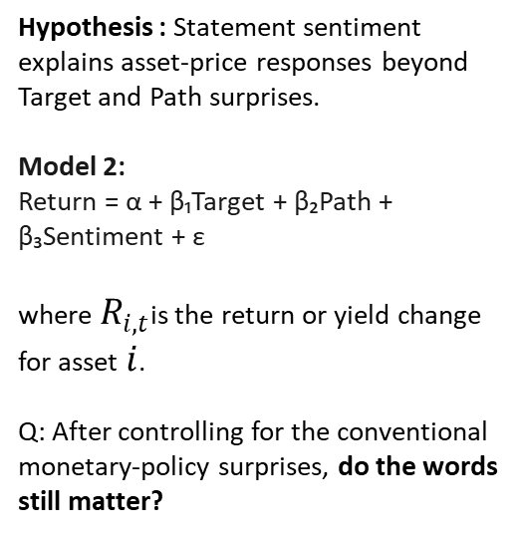
Hypotheses : Part 1 H1- H3
Words Beyond the Rate
H1: Statement language
H2: Incremental information
H3: State dependence
Hypothesis: FOMC statement sentiment is more closely associated with the Target surprise than with the Path surprise.
Model 1: Sentiment = α + β₁·Target + β₂·Path + ε (Wald: β₁ = β₂)
H1b (secondary): sentiment does not distinguish MP from CBI shocks (F-test β_MP = β_CBI).
Theory anchor: GSS (2005) target/path decomposition; Bauer–Swanson (2023) target dominance.
Hypothesis : Statement sentiment explains asset-price responses beyond Target and Path surprises.
Model 2:
Return = α + β₁Target + β₂Path + β₃Sentiment + ε
where $R_{i,t}$is the return or yield change for asset $i$.
Q: After controlling for the conventional monetary-policy surprises, do the words still matter?
Hypothesis: The incremental effect of statement sentiment varies across monetary-policy regimes, particularly during the forward-guidance/ZLB period.
Model 3:
Ri,t​= α + β₁ · Targetₜ + β₂ · Pathₜ + β₃ · Sentimentₜ +β4​(Sentimentt​×FGt​) + εₜ where FGt​=1, during the forward-guidance/ZLB period and 0 otherwise.
Q: Does the market respond differently to FOMC language when the policy rate is constrained and communication becomes relatively more important?
Theory anchor: Eggertsson & Woodford (2003); Swanson (2021) — communication substitutes for action at the ZLB.
Theory anchor: Romer & Romer (2000); Nakamura & Steinsson (2018).

Slide 15
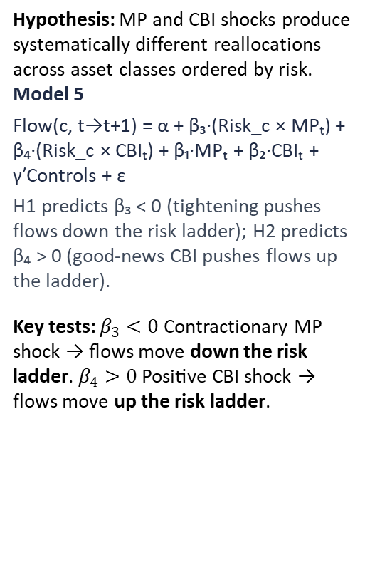
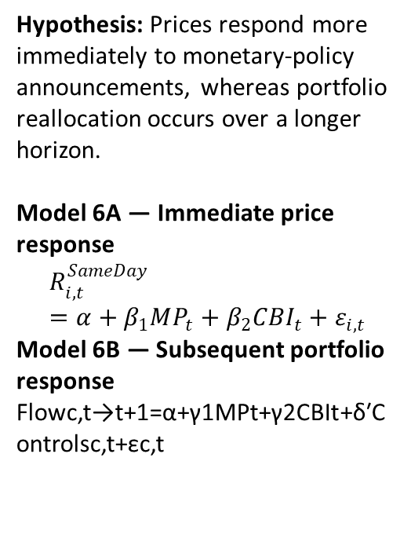
Hypotheses : Part 2 H4-H6
Information vs. Action
H4 : MP vs. CBI
H5 : Risk ladder
H6 : Transmission Timing
Hypothesis: Monetary-policy shocks and central-bank-information shocks generate different mutual-fund flow responses.
Model 4: Flow(c, t→t+1) = α + β₁·MPₜ + β₂·CBIₜ + γ′Controls(i,t) + ε
Wald test: β₁ = β₂ within each asset class; across seven classes (gov bonds … small-cap equity). Controls: log TNA, flow volatility, lagged return, expense ratio.
H4b (secondary): at the ZLB, MP effects are amplified for corporate-bond flows.
Q: do investors respond differently to a pure policy shock versus information revealed by the central bank?
Theory anchor: Jarociński & Karadi (2020) sign restriction; Koijen & Yogo (2019) fund demand; Froot et al. (2001).
Hypothesis: MP and CBI shocks produce systematically different reallocations across asset classes ordered by risk.
Model 5
Flow(c, t→t+1) = α + β₃·(Risk_c × MPₜ) + β₄·(Risk_c × CBIₜ) + β₁·MPₜ + β₂·CBIₜ + γ′Controls + ε
H1 predicts β₃ < 0 (tightening pushes flows down the risk ladder); H2 predicts β₄ > 0 (information-driven CBI pushes flows down the ladder — de-risking, as found in the Oct 2026 re-run).
Key tests: $β_{3}<0$ Contractionary MP shock → flows move down the risk ladder. $β_{4}>0$ Positive CBI shock → flows move up the risk ladder.
MP and CBI shocks move prices in opposite directions; prices adjust before portfolio reallocation — the CBI price effect fades before portfolio flows adjust.
Model 6A — Immediate price response
$$R_{i,t}^{SameDay}=α+β_{1}MP_{t}+β_{2}CBI_{t}+ε_{i,t}$$
Model 6B — Subsequent portfolio response
Flowc,t→t+1​=α+γ1​MPt​+γ2​CBIt​+δ′Controlsc,t​+εc,t​
Theory anchor: Adrian & Shin (2010); Borio & Zhu (2012).
Theory anchor: Jarociński & Karadi (2020) sign restrictions.

Slide 16
Data
FOMC Communication
High-Frequency shocks
Asset Prices
Portfolio Flows
161 FOMC meetings, 2006–2026
FOMC statement text
Loughran–McDonald (LM) sentiment
Central-bank hawkish/dovish sentiment
Combined sentiment: 50% LM + 50% CB
LLM communication measure — robustness
GSS Target & Path shocks
Target: current policy-rate surprise
Path: expected future policy-path surprise
JK-style MP / CBI decomposition
91 MP / 60 CBI meetings
Bauer–Swanson orthogonalization — robustness
CRSP value-weighted & equal-weighted returns
S&P 500
NASDAQ
Gold
10-year Treasury yield
13-week T-bill yield
Daily market data
CRSP U.S. Mutual Fund Database
7 asset classes, risk rank 1–7
Government bonds → small-cap equity
Monthly mutual-fund flows
Lagged-TNA-weighted aggregation
Same / Post / Diff FOMC windows

Slide 17
Variables
Part 1 : Sentiment and two shocks : Variables and construction
# | Variable | Role | Source / construction
1 | Target shock | X | Established GSS current-policy surprise
2 | Path shock | X | Established GSS future-policy-path surprise
3 | FOMC Statement Sentiment | Y or X | text measure
4 | CRSP VW return | Y | Market data
5 | CRSP EW return | Y | Market data
6 | S&P 500 return | Y | Market data
7 | NASDAQ return | Y | Market data
8 | 10-Year Treasury response | Y | Market data
9 | 13-Week Treasury response | Y | Market data
10 | Gold return | Y | Market data
11 | Forward-Guidance (FG) dummy | Moderator | define from policy regime
12 | Sentiment × FG | Interaction | construct

Slide 18
Variables
Part 2: Portfolio allocation: Variables and construction
# | Variable | Role | Source / construction
1 | MP shock | X | Jarociński (2024) official index — market-based sign restriction
2 | CBI shock | X | Jarociński (2024) official index — market-based sign restriction
3 | Mutual-fund flow | Y | Calculated from CRSP fund data
4 | Asset-class risk rank | X | 1–7 classification
5 | Risk × MP | Interaction | construct
6 | Risk × CBI | Interaction | construct
7 | Fund size / log TNA | Control | CRSP
8 | Flow volatility | Control | Constructed from prior flows
9 | Lagged return | Control | CRSP
10 | Expense ratio | Control | CRSP
11 | ZLB indicator | Moderator | Policy-regime indicator
12 | MP × ZLB | Interaction | construct

Slide 19
The Data and sources
Source | Raw data obtained | Variables used/constructed | Parts
Acosta (2022) | Extended GSS high-frequency surprises | Target, Path | 1
Federal Reserve | FOMC statement text | Statement corpus | 1 & robustness
Loughran–McDonald | Financial sentiment dictionary | LM sentiment | 1 / 2 robustness
Central-bank dictionary | Hawkish/dovish terms | CB sentiment | 1
GLM-4.6 | LLM sentiment robustness ONLY — never used to classify shocks | LLM hawkishness score | Robustness
CRSP/WRDS | Daily equity-market data | CRSP VW/EW and other equity returns | 1 & 2
FRED | Treasury, gold, VIX and macro series in current materials | Market outcomes / controls | 1 / robustness
Jarociński–Karadi / updated JK source | Official updated index — market-based sign restriction decomposed shocks | MP and CBI | 2
Bauer–Swanson framework/data | Raw/orthogonalized HFI and pre-FOMC predictors | Orthogonalized shock robustness | 1 & 2
CRSP Mutual Fund Database | TNA, returns, objective codes, expense ratios | Fund flows, asset-class flows, controls | 2
classification | CRSP fund categories | 7 asset classes + Risk Rank 1–7 | 2
event construction | FOMC dates + monthly flows | Same, Post, Diff | 2
regime construction | FOMC dates/policy periods | FG/ZLB dummy and interactions | 1 & 2

Slide 20
Variable Definitions: Shocks Are Market-Based
Measure | Source | Identification basis
Target & Path shocks (Part 1) | GSS (2005), extended by Acosta (2022) | Fed funds & eurodollar futures around FOMC windows — market prices
MP & CBI shocks (Part 1 §6.7 / Part 2) | Jarociński (2024) official updated index | Sign restriction: 30-min rate surprise × 30-min S&P response — market reaction, not text intent
Statement sentiment | LM (2011) + central-bank dictionary; GLM-4.6 LLM as robustness only | Text measurement of the outcome — never used to define or classify shocks
Shock identification relies exclusively on high-frequency market data.
Following Jarociński & Karadi (2020) and the Jarociński (2024) updated index: same-direction rate/price moves = information shock; opposite-direction moves = policy shock.

Slide 21
Preliminary Results
Hypothesis | Results
H1 — Statement Language | Target shock is significantly associated with statement sentiment (β = 0.000577, p = .017), while Path is not significant (β = 0.000633, p = .152). However, the Wald test cannot reject equality of Target and Path coefficients (p ≈ .902). Therefore, the evidence shows a more statistically reliable Target association, but does not establish that Target has a statistically larger effect than Path.
H2 — Incremental Information | After controlling for Target and Path, sentiment provides modest incremental explanatory power in the full sample. S&P 500: β = 19.4585, p = .088, ΔR² = +0.66 pp; 10Y Treasury: β = 1.2355, p = .098, ΔR² = +1.22 pp. CRSP VW/EW, NASDAQ and Gold are insignificant. Therefore, H2 receives limited/marginal full-sample support.
H3 — State Dependence | Communication becomes substantially more market-relevant during the forward-guidance regime. CRSP VW: sentiment β = −2.5979, p = .004, R² = 30.6%; CRSP EW: β = −2.6976, p = .009, R² = 31.8%. Outside FG, the coefficients are small and insignificant. Thus, strong evidence supports state dependence.
H4 — MP vs. CBI | MP and CBI shocks have statistically different fund-flow effects. In the Post window, CBI β = −0.750, p = .021, while MP β = +.163, p = .208; Wald p = .006. In the Diff window, MP β = +1.242, p = .029, while CBI is insignificant; Wald p = .001. Therefore, the MP–CBI difference is horizon dependent.
H5 — Risk Ladder | In the Post-FOMC month, Risk×CBI = +.132, p = .039, while Risk×MP = −.036, p = .228. Moving from government bonds (risk rank 1) to small-cap equities (risk rank 7) implies an estimated difference of about 0.79 percentage points in the CBI effect. This supports delayed CBI-related reallocation across the risk ladder.
H6 — Timing | Prices react first; portfolio flows adjust later. On Day 0, both MP and CBI affect broad CRSP returns in opposite directions. At weekly horizons, the CBI price effect fades while MP persists. By Month t+1, portfolio allocations adjust, with CBI associated with delayed risk-ladder rebalancing.

Slide 22
Preliminary Results - Charts
Research Platform & Reproducibility
Interactive Analysis Platform:
Monetary Policy Research Lab
https://monetary-policy-lab.streamlit.app/
( all charts and research results)
Code & Reproducibility:
GitHub Repository — Monetary Policy Research Lab
GitHub - dechang64/monetary-policy-lab · GitHub

Slide 23
H1: Target and Path monetary-policy surprises are associated with FOMC statement sentiment — Regression Evidence
Dependent variable: statement sentiment (0.5·LM + 0.5·CB) — NW HAC(4)
Variable | Coefficient | NW SE | p-value
Target shock (Acosta) | +0.000577** | (0.000238 | 0.017
Path shock (Acosta) | +0.000633 | (0.000439 | 0.152
N | 117
R² | 1.57%
Result: Target shocks are significantly associated with statement sentiment (β = 0.000577, p = 0.017); Path shocks are not (p = 0.152). H1 is supported through the Target channel — tone tracks the action, not the guidance.
Source: verified_results.json (audited spec); OLS with Newey-West HAC(4); sample 2006:01–2022:07, N = 117.

Slide 24
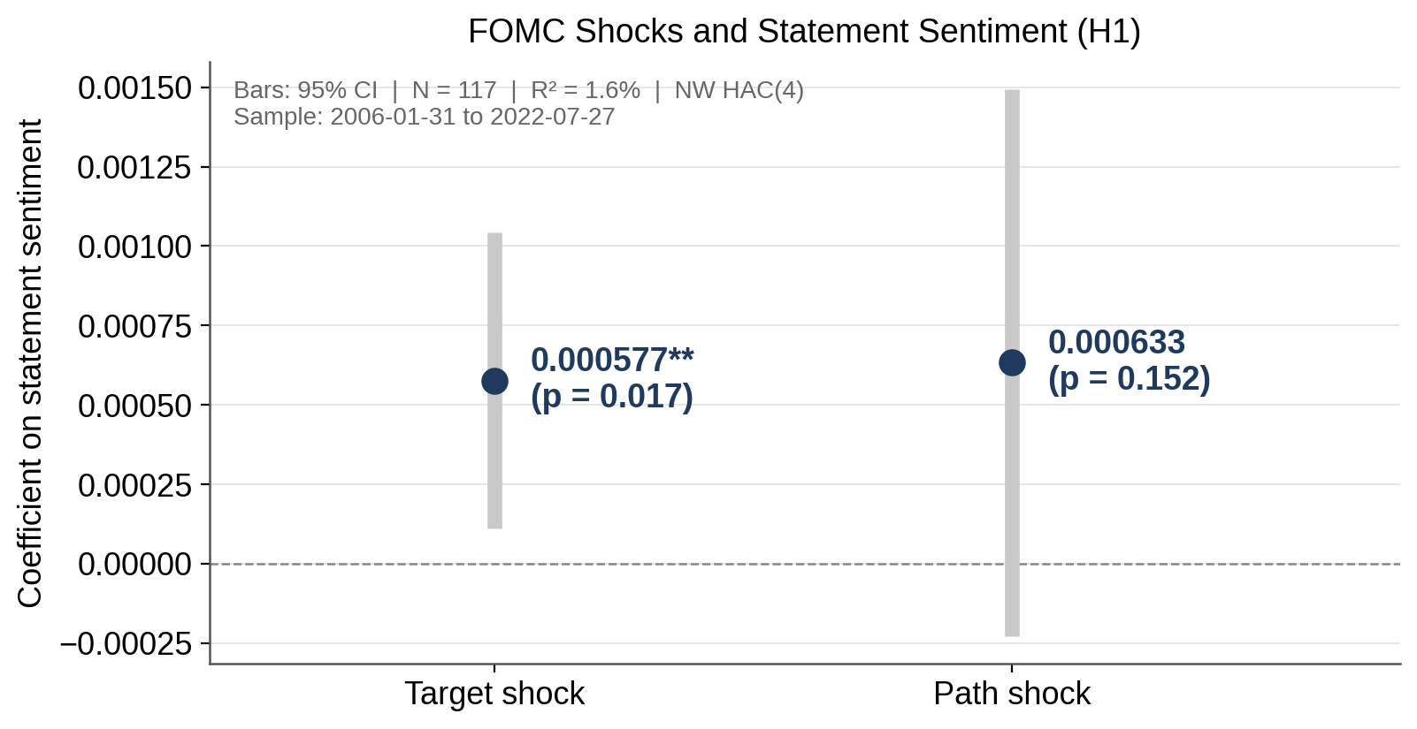
H1: Target and Path monetary-policy surprises are associated with FOMC statement sentiment — Coefficient Evidence
Result: Only the Target shock's 95% CI excludes zero. Statement sentiment responds to the policy action itself, not to communication about the future path — the asymmetry that motivates the incremental-information tests of H2.
Source: verified_results.json; NW HAC(4) standard errors; bars show 95% CI.

Slide 25
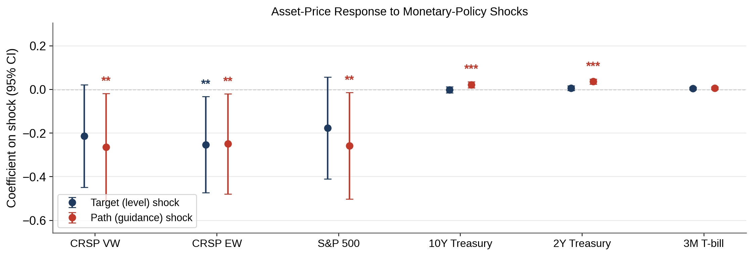
H1: Target and Path monetary-policy surprises are associated with FOMC statement sentiment — Both Shocks Move Prices on Announcement Day
Result: Equity indices respond negatively to both shocks (CRSP VW: Target -0.21, Path -0.26, p = 0.037); Treasury and bill responses are muted. Prices digest both components immediately — setting up the question of what the statement text adds on top (H2).
Source: fomc_dataset_2006_latest.csv; event-window returns on shocks, OLS with 95% CI; N = 161 meetings, 2006–2026.

Slide 26
H2: Incremental Information — Tone beyond Target and Path — Forward-Guidance Regime
FG sample (Dec 2008 – Dec 2015); dependent variable: asset return
Asset (FG sample) | β Tone | (SE) | β MP | β CBI | R²
CRSP VW | -1.205*** | (0.304) | -1.252*** | +1.933*** | 48.1%
S&P 500 | -1.119*** | (0.291) | -1.212*** | +1.956*** | 48.4%
10Y Treasury | +0.037 | (0.029) | +0.031 | +0.047 | 8.0%
2Y Treasury | +0.007 | (0.014) | +0.021* | +0.058* | 13.2%
Result: Within the forward-guidance regime, tone carries significant incremental information for equities (CRSP VW: −1.21, p < 0.001; S&P 500: −1.12, p < 0.001) beyond both shock components — R² rises to 48%. Treasuries show no tone effect.
Source: price_results_v1.json, spec C (tone + MP + CBI, FG sample); stars: * p<0.1, ** p<0.05, *** p<0.01.

Slide 27
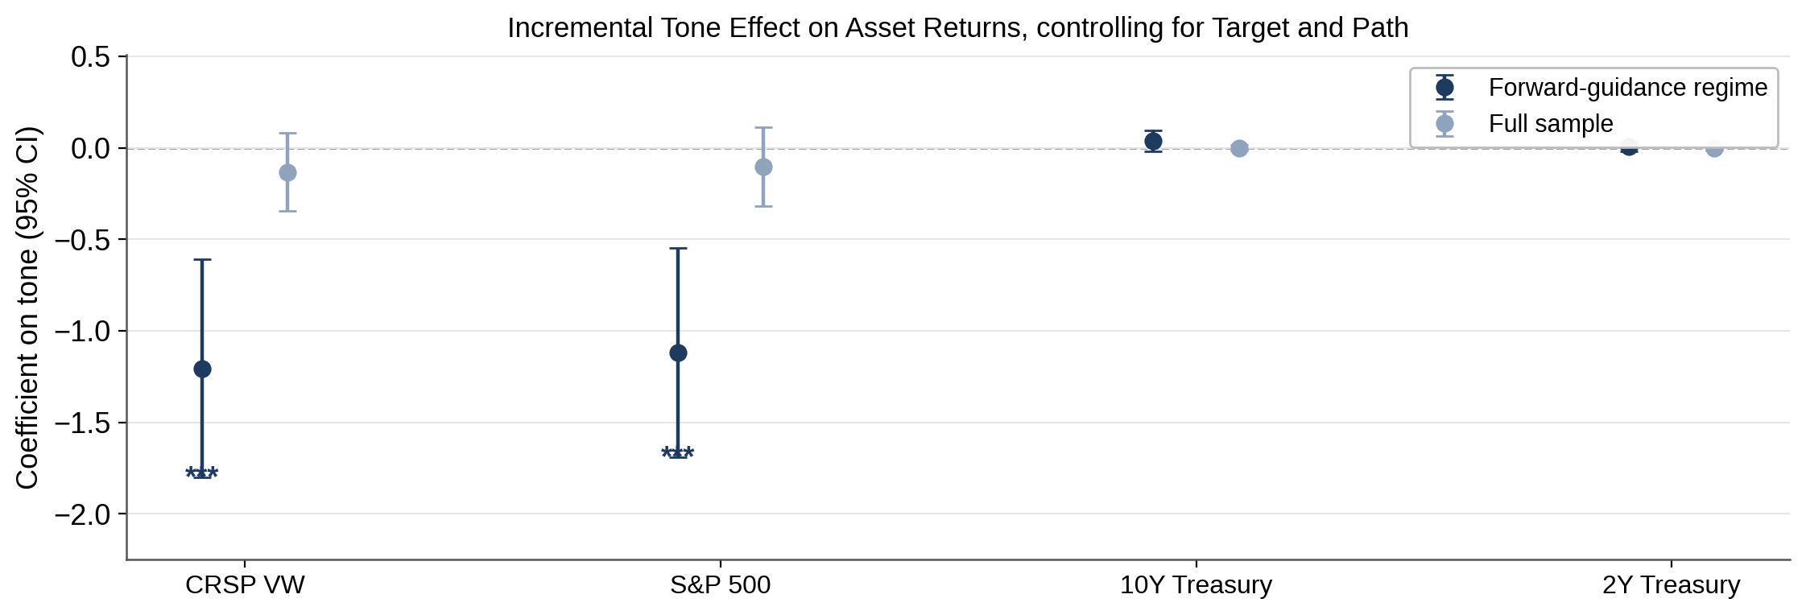
H2: Incremental Information — Tone Effects Concentrated in the FG Regime
Result: Full-sample tone coefficients (navy) are indistinguishable from zero; FG-regime coefficients (red) are significant for both equity indices. Words carry price information exactly when words were the policy instrument.
Source: price_results_v1.json, spec C by regime; 95% CI bars.

Slide 28
H3: State Dependence — Tone × FG Interaction (CRSP VW)
Dependent variable: CRSP VW return — interaction spec
Variable | Coefficient | SE | p-value
Tone (×100) | +0.037 | (0.151 | 0.808
FG regime dummy (2008–15) | +2.951*** | (0.982 | 0.003
Tone × FG | -1.156*** | (0.389 | 0.003
N | 150
R² | 6.9%
Result: The interaction confirms regime dependence: tone has no effect outside FG (+0.04, p = 0.81) but a large, significant effect inside it (−1.156, p = 0.003). Text matters exactly when the statement was the instrument.
Source: price_results_v1.json, spec D (interaction); OLS; 2006–2026, N = 150.

Slide 29
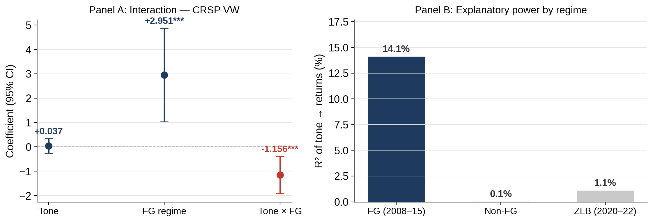
H3: State Dependence — Explanatory Power by Regime
Result: R² = 14.1% in the FG regime vs 0.1% outside it and 1.1% in the 2020–22 ZLB template era. State dependence is the rule, not the exception — and motivates the LLM-based measurement layer.
Source: price_results_v1.json spec B by regime; batch3_results.json (ZLB window).

Slide 30
H4: MP vs. CBI — Differential Effects on Mutual-Fund Flows (meeting month)
Controls: log TNA, flow volatility; class-level flows
Asset class (meeting month) | β MP | β CBI | Wald p (MP=CBI)
Government bonds | -0.110 | +0.759** | 0.10
Corporate bonds | -0.039 | -0.195 | 0.44
Real assets | +0.296** | -0.023 | 0.11
Large-cap equity | -0.070* | +0.009 | 0.15
DM equity | +0.105 | -0.093 | 0.05
EM equity | +0.017 | -0.008 | 0.90
Small-cap equity | +0.011 | +0.023 | 0.84
Result: Government bonds receive significant inflows on CBI shocks (+0.76 %TNA, p = 0.037) with no MP response (Wald p = 0.098); real assets respond to MP instead (+0.30, p = 0.04). Information shocks — not action shocks — move safe-haven portfolios.
Source: flow_rerun_output_v8/flow_results_rerun_v8.json, H4 same-window spec; class-level flows, N = 157 meeting months.

Slide 31
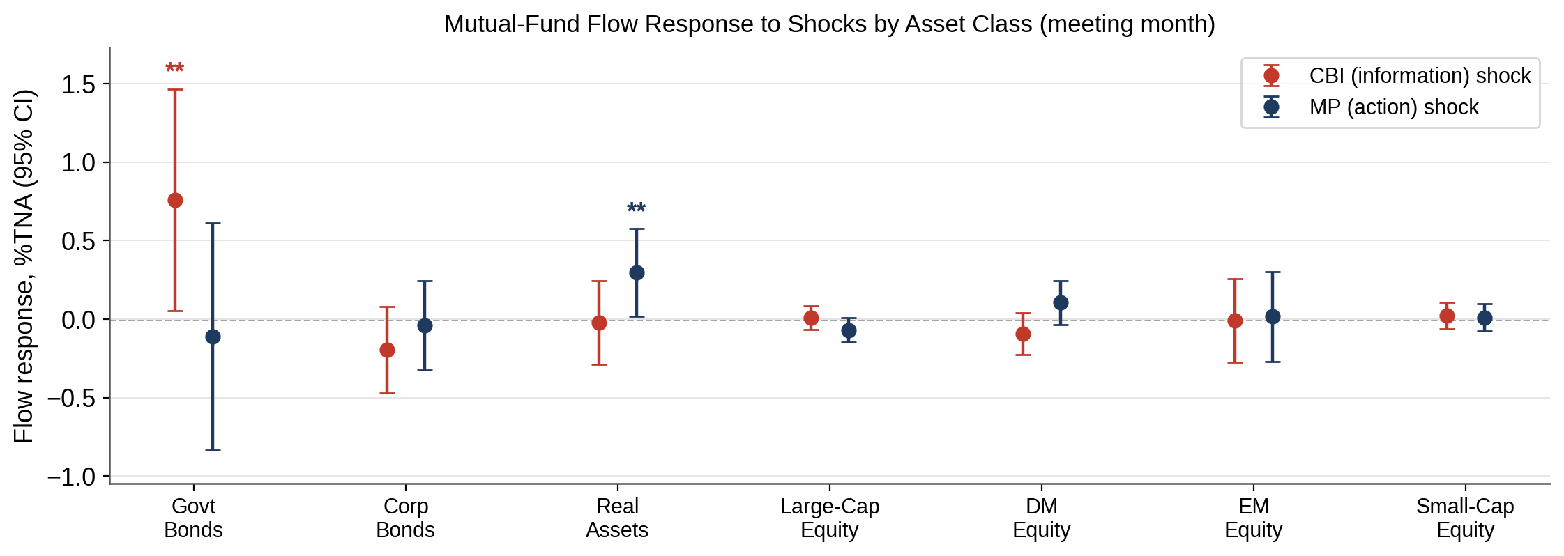
H4: MP vs. CBI — Flow Response by Asset Class
Result: The CBI effect concentrates in government bonds while the MP effect appears in real assets — the two shock components transmit to different portfolio margins, consistent with the information-vs-action decomposition.
Source: flow_rerun_output_v8; 95% CI bars; asset classes ordered by risk rank.

Slide 32
H5 — Risk Ladder — Interaction of Risk Rank with Shock Type
Dependent variable: class-level flow (%TNA), meeting month
Variable | Coefficient | SE | p-value
Risk × CBI | -0.066** | (0.032 | 0.036
Risk × MP | +0.005 | (0.032 | 0.877
Risk × CBI (hawkish: CBI > 0) | -0.088** | (0.038 | 0.020
Risk × CBI (dovish: CBI < 0) | -0.055* | (0.033 | 0.100
MP × ZLB (2020–22) | -1.505*** | (0.532 | 0.005
Result: CBI shocks push portfolios down the risk ladder (Risk×CBI = −0.066, p = 0.036; gap-free spec −0.114, p = 0.002) — opposite to the original prediction. The effect is driven by hawkish information; and MP shocks acquire ladder effects only at the zero bound (MP×ZLB = −1.505).
Source: flow_results_rerun_v8.json (H5_risk_ladder_same, zero_rate_check); models_v2_results.json (H5_sign_asymmetry).

Slide 33
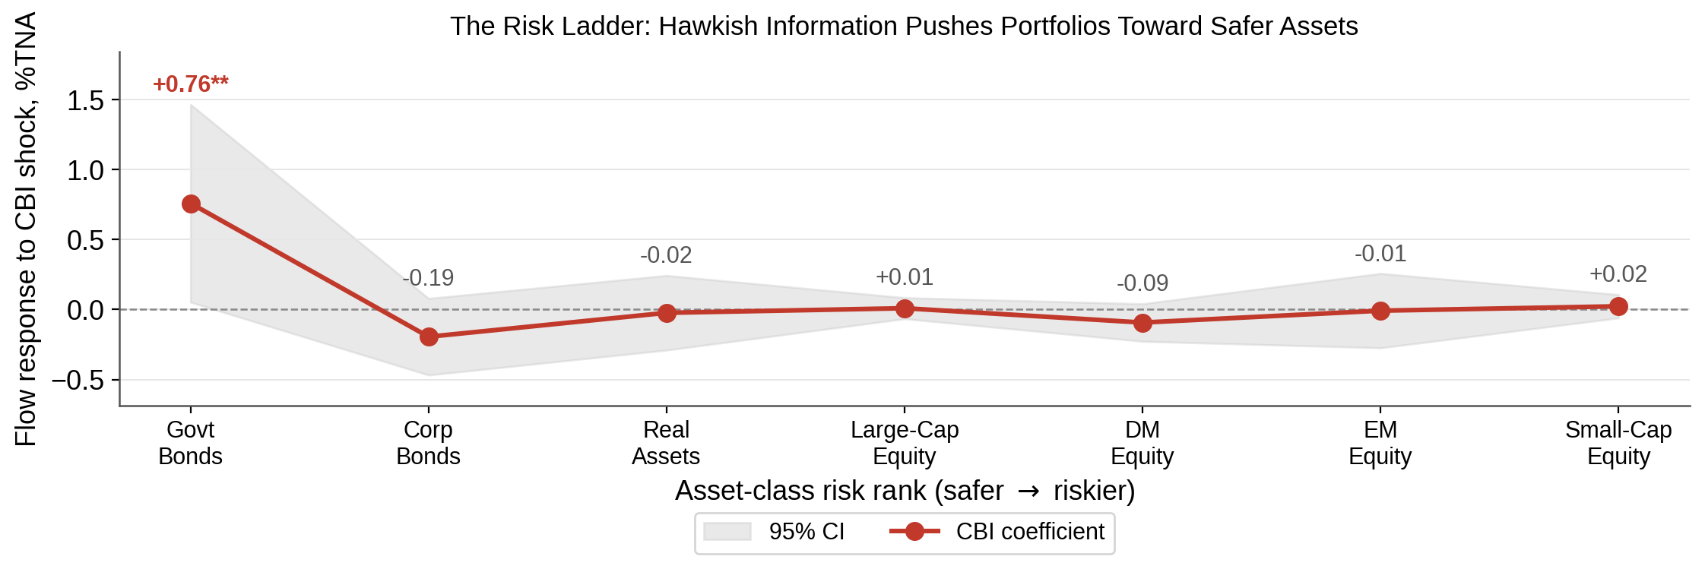
H5 — Risk Ladder — CBI Flow Response by Risk Rank
Result: The ladder is monotone in risk rank: the safest class (government bonds, +0.76 %TNA) gains the most, riskier classes lose or stay flat. One unit of hawkish central-bank information reallocates portfolios toward safety.
Source: flow_rerun_output_v8; CBI coefficients with 95% CI band; asset classes ordered from safest to riskiest.

Slide 34
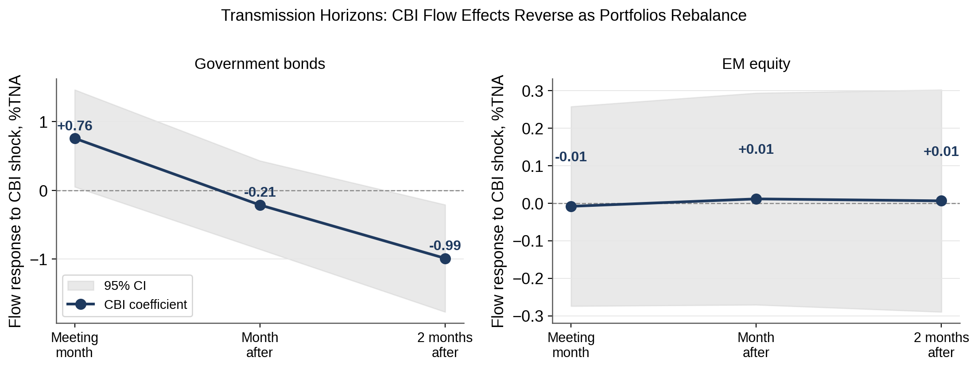
H6: MP and CBI shocks exhibit different transmission patterns across horizons — Prices First, Portfolios Later
Result: The CBI flow effect on government bonds reverses across horizons (+0.76 meeting month → -0.99 two months out): initial flight-to-safety inflows are partially unwound as portfolios rebalance — prices clear the information first, portfolios adjust later.
Source: h4_all_windows.json (same / post / diff windows); 95% CI bands.

