Slide 1

Wolfpack
By Godfrey Ndu

Slide 2

What is Wolfpak
A data collecting program designed to improve on the inefficiencies of the Voodoo Scripts.
Utilizes Python 3
Innovation in form of parallel programming
Tailored Specifically to meet the data needs of the Intelsat Neteng Team

Slide 3
Voodoo Vs Wolfpak
Wolfpack
Voodoo
One SSH and Telnet Session per server
Utilizes latest version of Python3
Utilizes Paramiko library for server interaction
Multiprocessing for servers
Data model: Hash data Structure
Extensive use of if statements for independent command processing
99% efficiency in remote processing
Designed in a manner that allows for quick and easy debugging for errors
Understandable log file: error accounting
Integration with Influxdb
Integration of Realtime dashboards
High processing speed (90% faster than voodoo, over 1.6k remotes in less that 4mins)
On demand data availability for maintenance
Adapted to PP_TPA inconsistencies
Easy to run
Designed with as much file/script independence as possible
Easy to carry out upgrades
Multiple telnet sessions per server: one telnet per remote
Some files written in Python 2 and outdated
Pexpect Library for server interaction
No parallel programing (linear/sequential server processing)
Linear data structure
Few if statements and built-in error traps
70% efficiency in remote processing
Incomprehensible logfile
No database integration; utilized csv files for data storage
No Realtime dashboard; utilized Pandas & matplotlib to create data snapshots
Very slow processing speed(800 remotes in 35-40mins)
No on demand data
Not adapted to PP_TPA inconsistencies
Complicated to run
Very bogus script with multiple files and dependencies
hard to upgrade

Slide 4
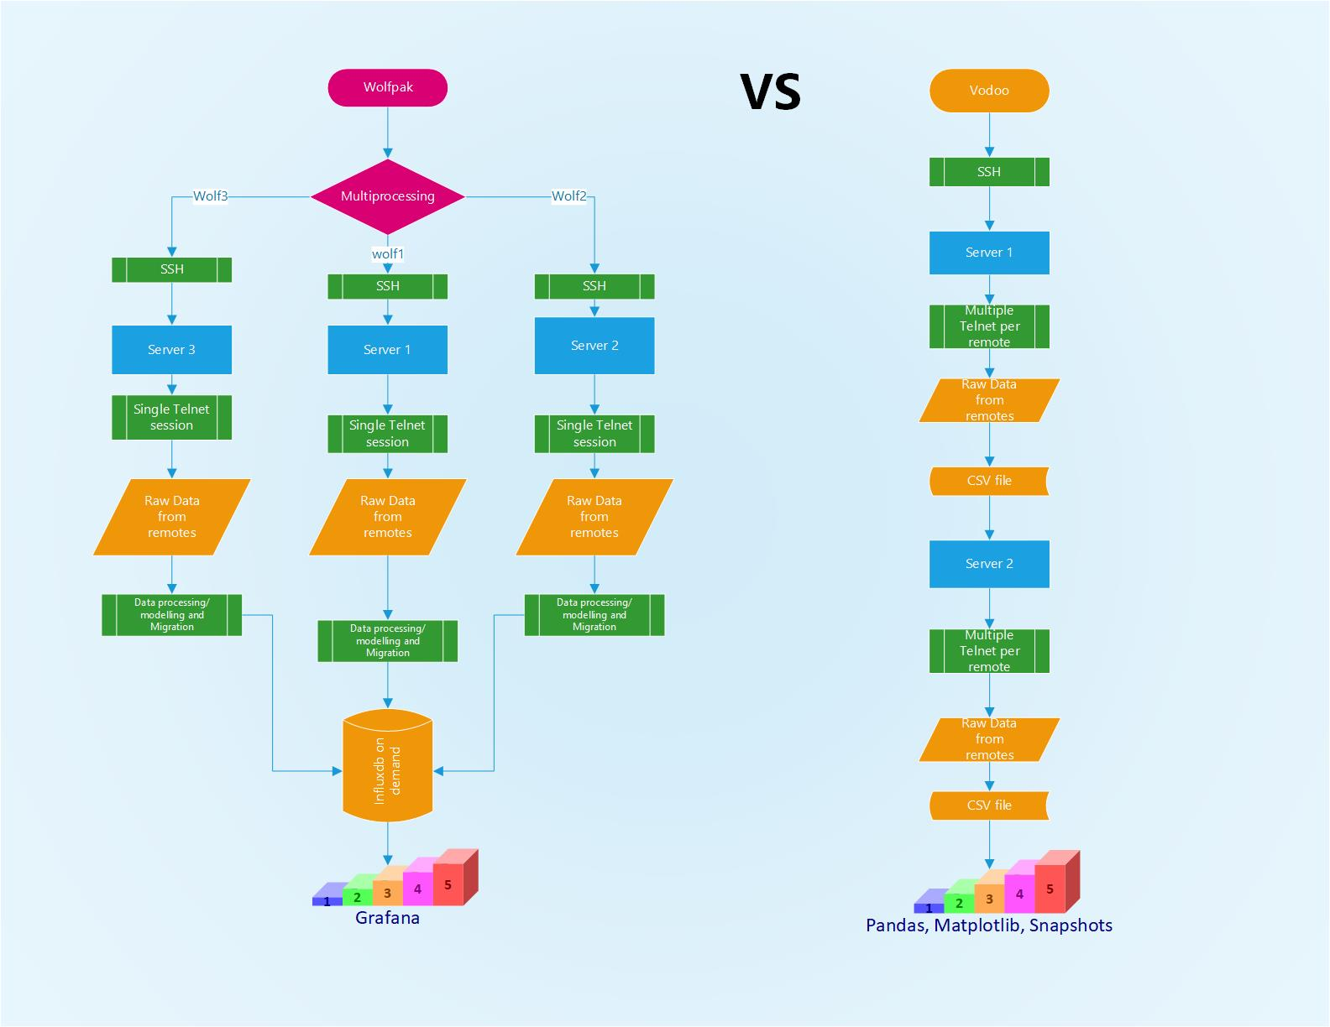

Slide 5
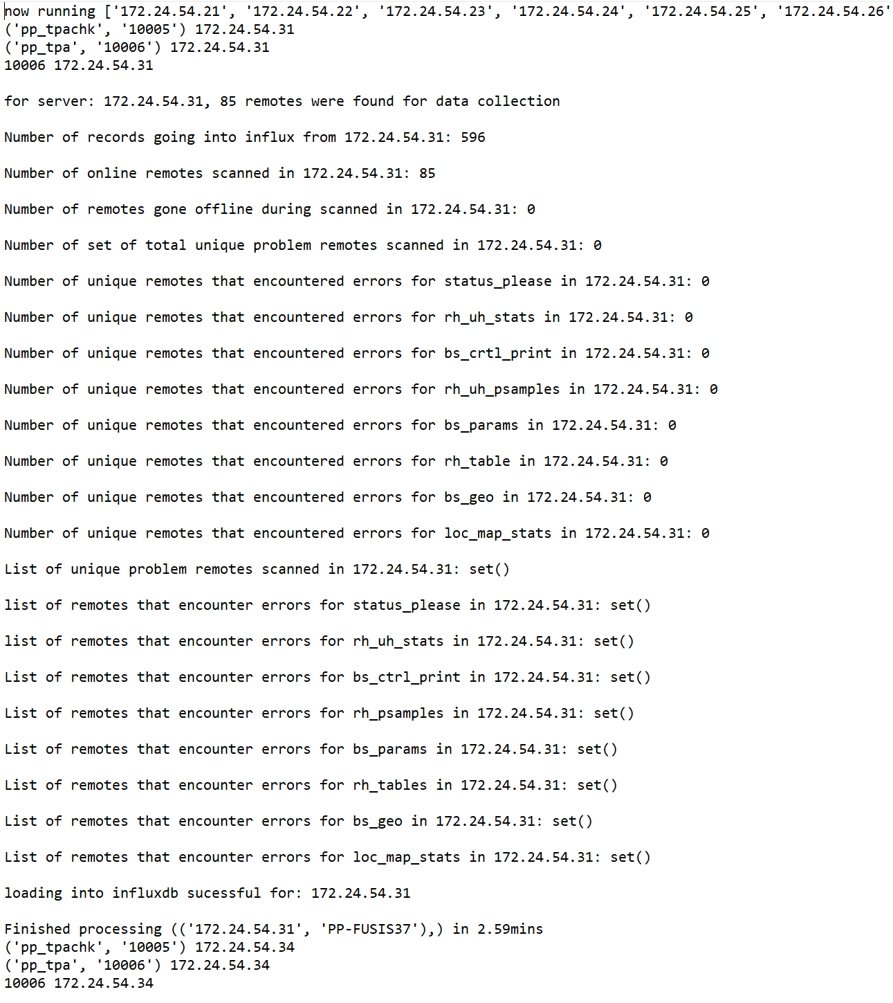
Log file

Slide 6
Questions & Input & improvement

