Slide 1
MCMC Parameter Estimation of Empirical and Physics-Based Forecasting Models
Wajahat Ali, Rui Kou, Texa A&M University

Slide 2
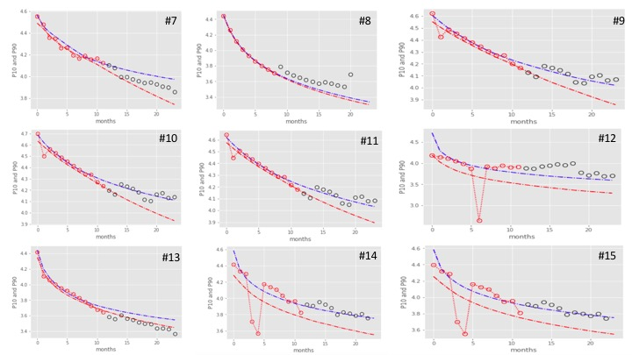
Overview
Slide 2
Background
Objective
Model Formulation
Results
Concluding Remarks

Slide 3
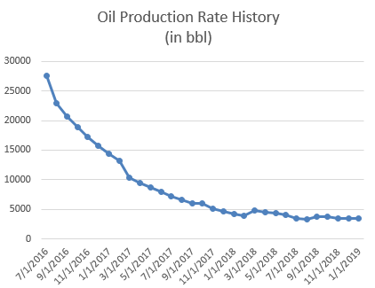
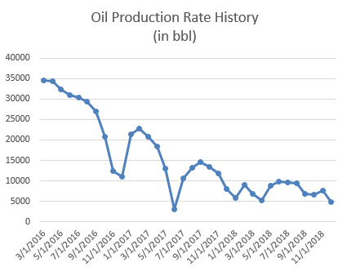
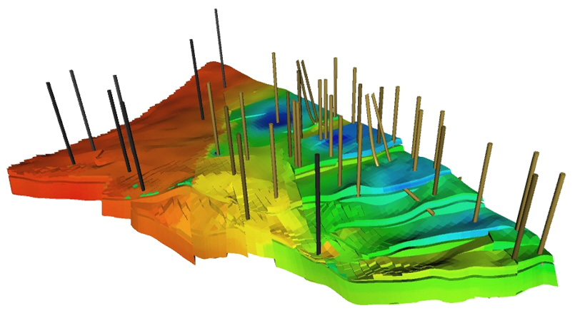
Oil and Gas Production Forecasting
Source:https://www.dcsc.tudelft.nl/research/by_project_name/projects-alphabetical-lvzmteidna-1144831603-9895.html
Uncertainty in production forecasting and reserve evaluation
Deterministic method: least square fit, no uncertainty information
Probabilistic method: posterior distribution of parameter, P10-P90, focus of our study

Slide 4
Objectives
To develop a probabilistic production analysis method using Bayesian model and MCMC sampling method
To apply the probabilistic method to 3 different decline curve models: Arps (empirical), Transient Hyperbolic Model (THM) and Jacobi θ Function Model (physics-based)
To investigate the performance of the three models using real production data from Midland, Texas (2016-2018)
To improve the performance of the method and extend the model

Slide 5
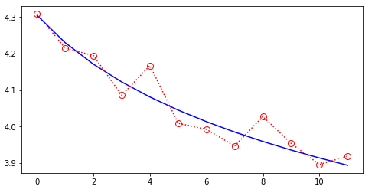
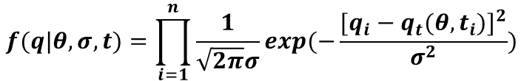





Model Formulation: Arps Model
Model
$$q_{t}=q_{i}{(1+bD_{i}t) }^{−\frac{1}{b}}$$
Arps Model, Empirical
$$D=−\frac{1}{q}\frac{dq}{dt}$$
Decline rate, first derivative
$$q$$
$$b= \frac{d}{dt}[\frac{1}{D}]$$
b-factor (constant), second derivative
Likelihood
$$f(q|θ,σ,t)=\prod_{i=1}^{n}{\frac{1}{\sqrt{2π}σ}exp(−\frac{{[q_{i}−q_{t}(θ,t_{i})]}^{2}}{σ^{2}})}$$
$$t$$

Slide 6
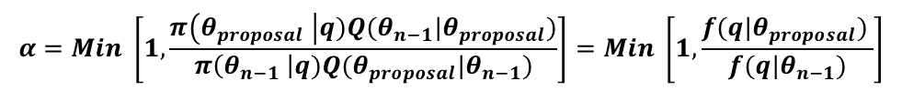







Model Formulation: Arps Model
Model
$$q_{t}=q_{i}{(1+bD_{i}t) }^{−\frac{1}{b}}$$
Arps Model, Emperical
Parameters
Proposal Distribution
$$q_{i}$$
Uniform Prior [0.1, 1,000,000]
$$q_{i,propose}\sim N (q_{i,n−1}, 1)$$
$$D_{i}$$
Uniform Prior [0.1, 50]
$$D_{i,propose}\sim N (D_{i,n−1}, 0.1)$$
$$b$$
Uniform Prior [0, 2]
$$b_{propose}\sim N (b_{n−1}, 0.1)$$
Acceptance Ratio
$$α=Min \left[1, \frac{π\left(θ_{proposal} \right|q)Q(θ_{n−1}|θ_{proposal})}{π\left(θ_{n−1} \right|q)Q(θ_{proposal}|θ_{n−1})}\right]=Min \left[1, \frac{f(q|θ_{proposal}) }{f(q|θ_{n−1})}\right]$$

Slide 7
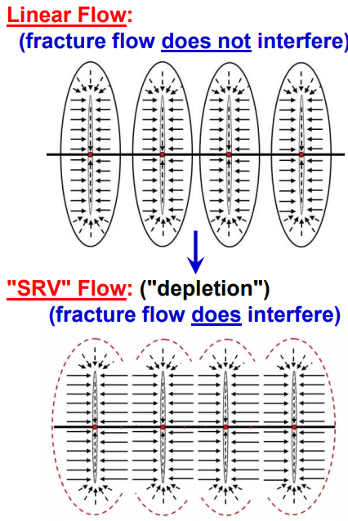
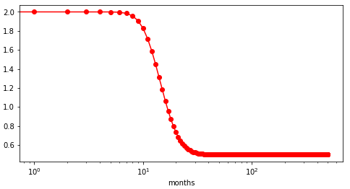






Model Formulation: Transient Hyperbolic Model (THM)
Model (Fulford and Blasingame, 2015)
$$q_{t}=q_{i}{(1+bD_{i}t) }^{−\frac{1}{b(t)}}$$
$b_{t}=$ $b_{i}−\left(b_{i}−b_{f}\right)exp(−exp\left(−c(t−t_{elf})\right)+e^{γ})$
$$c=\frac{e^{γ}}{1.175t_{elf}}$$
Parameters
$$q_{i},D_{i},b_{i},b_{f},t_{elf}$$
$$b_{i}$$
$$t_{elf}$$
$$b_{f}$$
Source:http://www.pe.tamu.edu/blasingame/data/z_Presentations/20150412_(Blasingame)_Pres_SPE_ATW_Prs_Mgt_Dallas_Flowback_(wCor)_(pdf).pdf

Slide 8
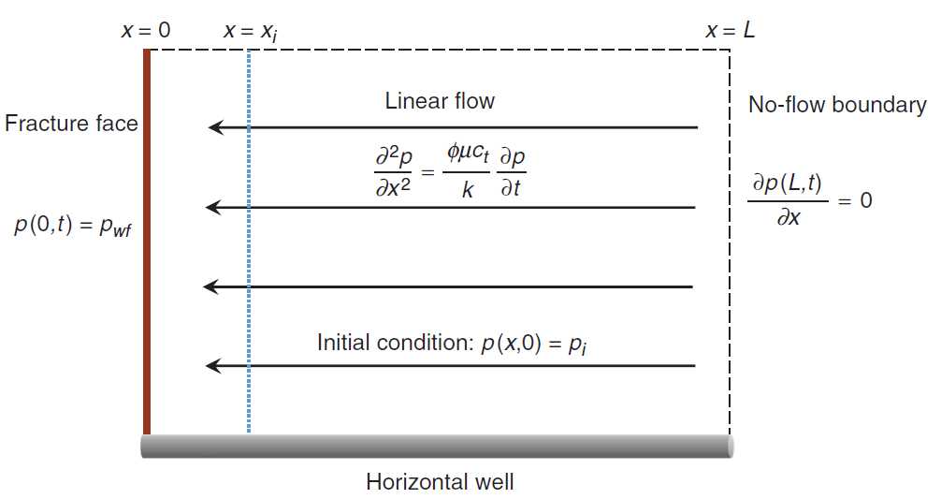



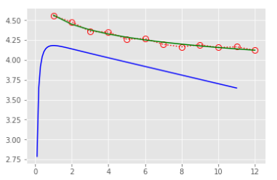






Model Formulation: Jacobi θ Function Model
Model (Holanda, Gildin, Valko, 2018)
$$q(t)=q_{i}θ_{2}(χ, e^{−ηt})$$
2nd Jacobi θ Function
Parameters
$$q_{i}$$
Uniform Prior [0.1, 1,000,000]
$$χ$$
$$χ>0$$
$$η$$
$$η>0$$
Source: Holanda, Gildin, Valko, 2018

Slide 9
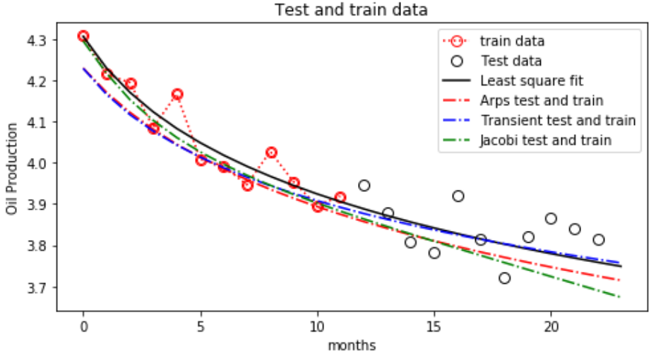
Plot of 3 Models Using Posterior Mean

Slide 10
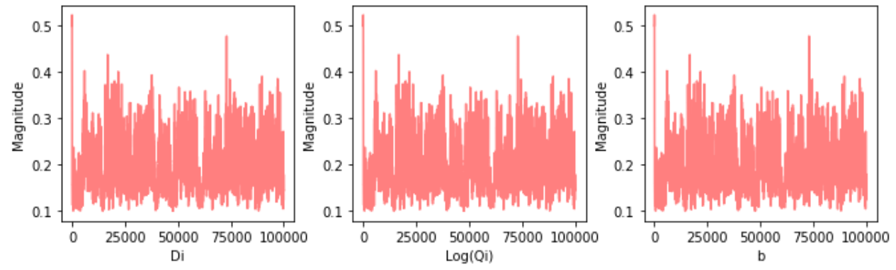
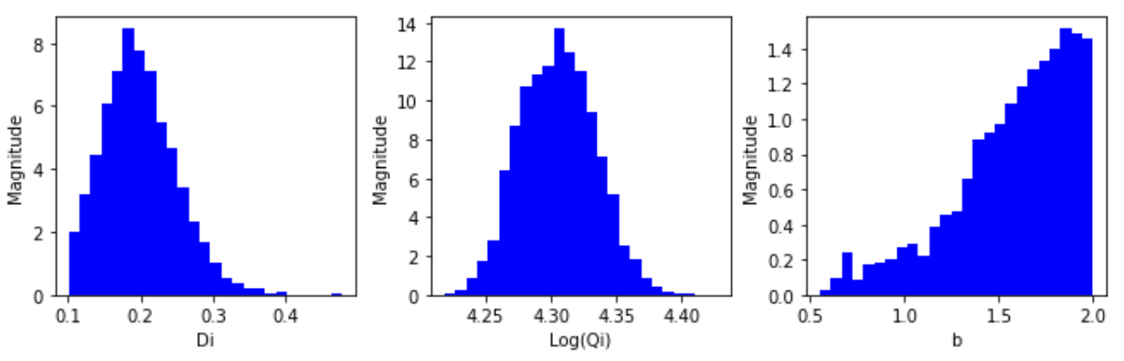
Arps Model Mixing and Parameter Posterior Distribution

Slide 11
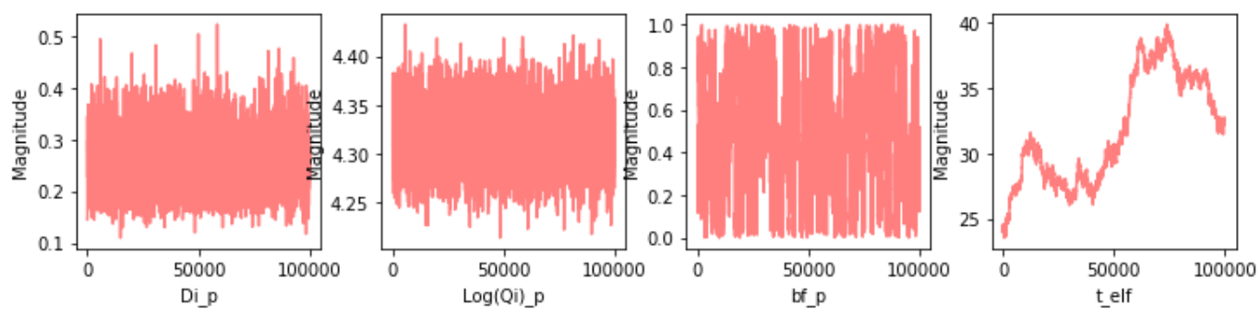
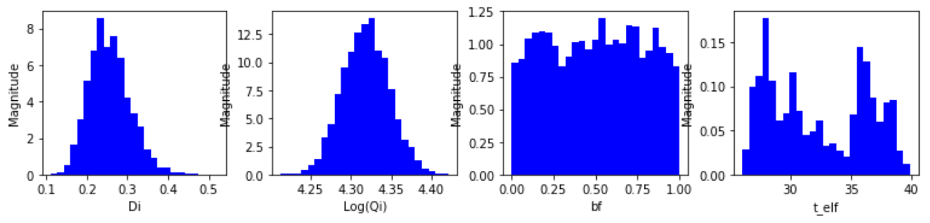
THM Model Mixing and Parameter Posterior Distribution

Slide 12
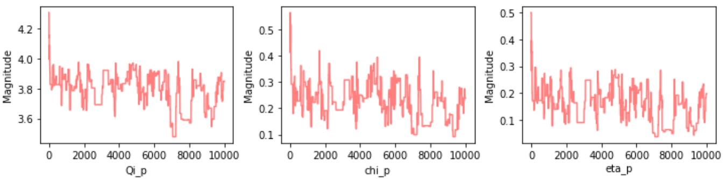
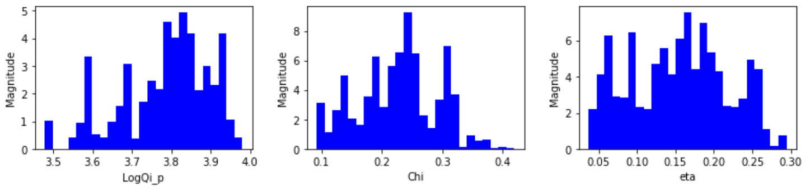
Jacobi Model Mixing and Parameter Posterior Distribution

Slide 13
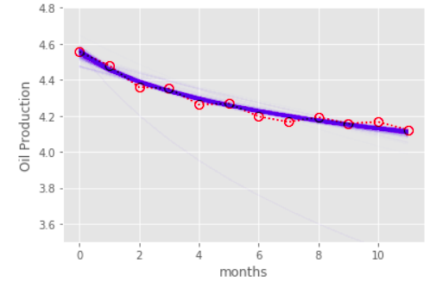
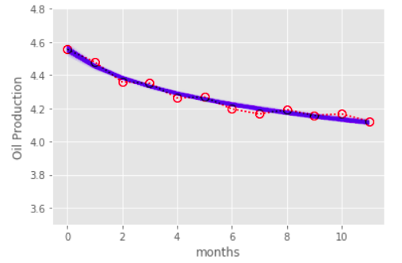
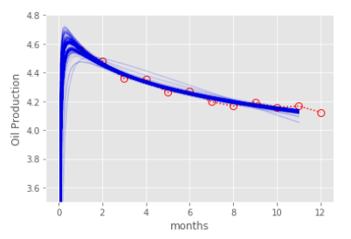
Plot of Last 1000 Samples for Each Model
Arps Model
THM
Jacobi θ

Slide 14
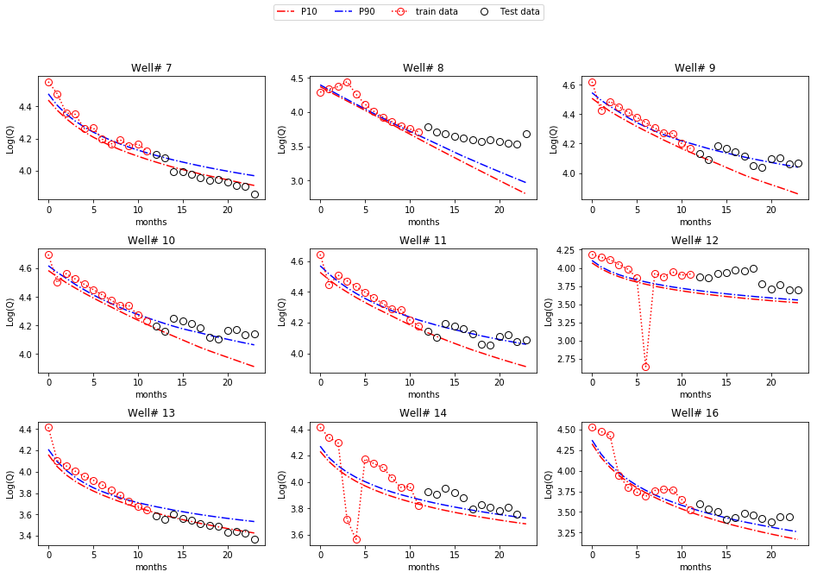
2nd Year Prediction: Arps

Slide 15
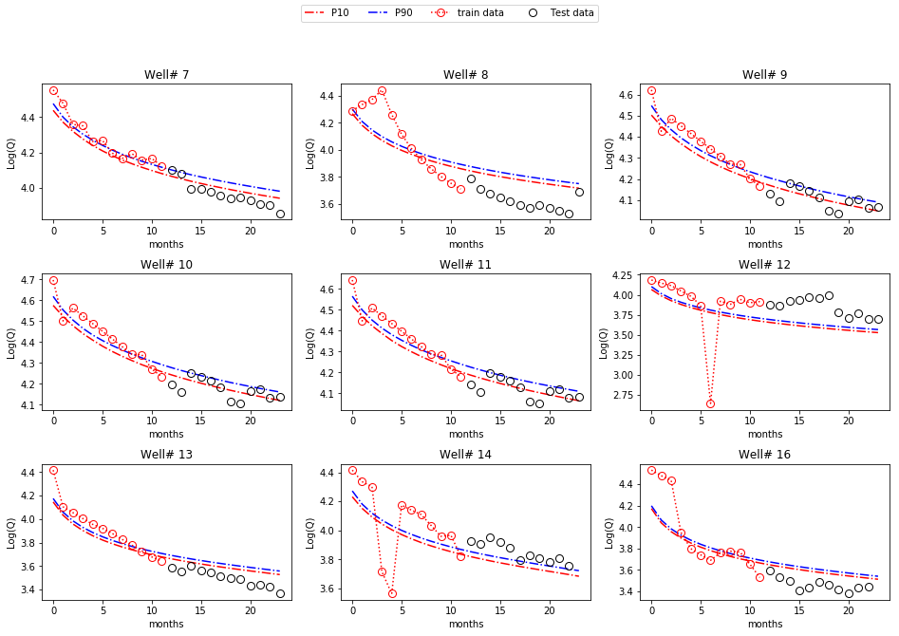
2nd Year Prediction: THM

Slide 16
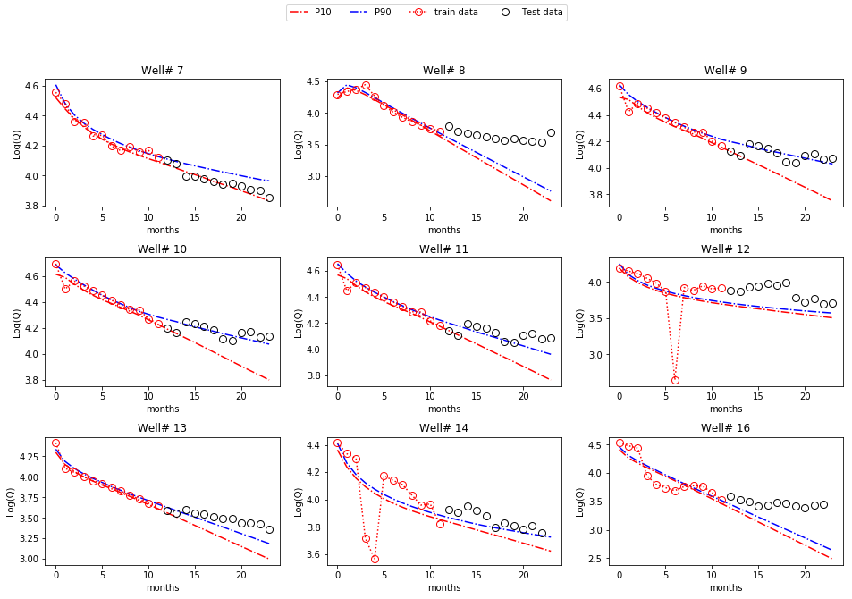
2nd Year Prediction: Jacobi θ function

Slide 17
RMS Error
Model | RMS Train (%), 1st year | RMS Test (%), 2nd year
Least Square fit | 3.366 | 5.066
ARPs | 4.366 | 6.645
Hyperbolic transient (THM) | 4.454 | 5.116
Jacobi θ Function | 3.115 | 7.362

Slide 18
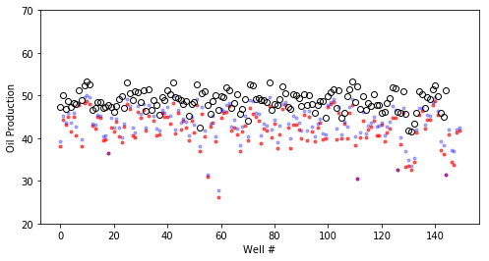
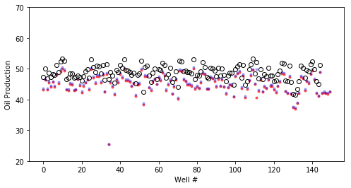
2nd Year Accumulative Production: True, P10, P90
Arps Model, 8.1% under estimation
THM Model, 3.6 % under estimation

Slide 19
Concluding Remarks
Implemented three probablistic production forcasting models in Python
Compared prediction accuracy using RMS Error, still more need to be done to evlutae the models (accumulated True vs P10, P90)
Anomalies / outliers are production data which does not represent reservoir capacity, due to unknown reasons (well reconstruction, change in formation condition)
Production prediction is influenced by anomalier by great amount.
How to detect and remove anomalies and what value should be used to replace anomalies.
Next: hierarchical models, parallel the code using multi-processors

Slide 20
Thank You
Question

