Slide 1

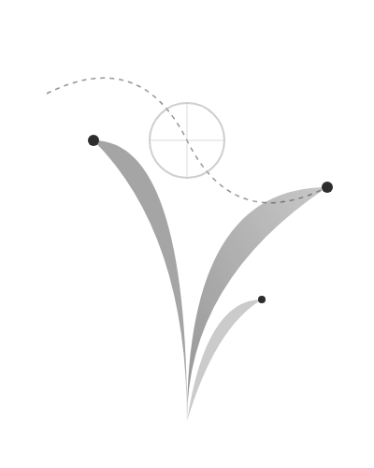
ANNUAL PODCAST NOMINATIONS
之道耐听
探寻声音的Grow纹理
Gray
Rule
温度
Grayscale
Rules
Temperature
2024 | LISTENING AWARDS

