Slide 1
An Introduction to Python Programming

Slide 2
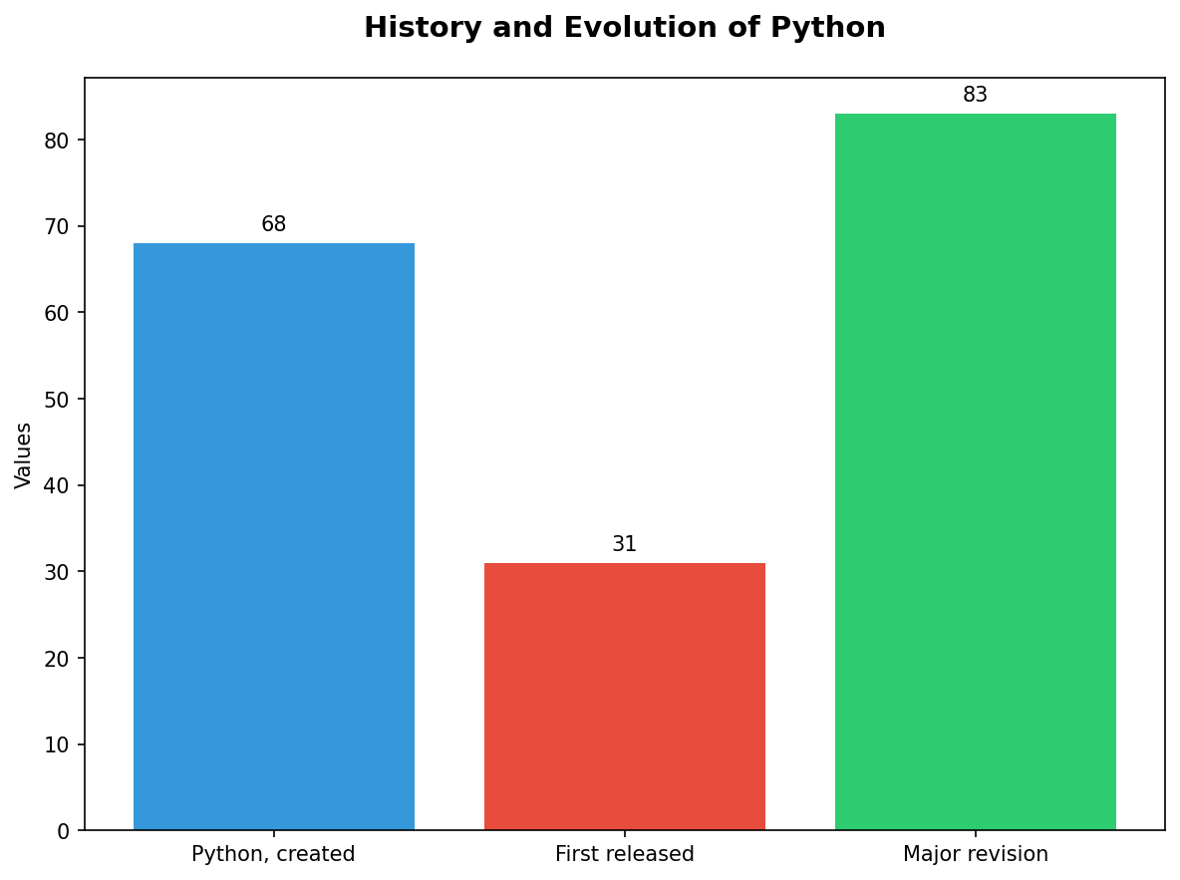
History and Evolution of Python
• Python, created by Guido van Rossum in the late 1980s.
• First released as Python 1.0 on January 20, 1994.
• Major revision with version 2.0 introduced significant changes like Unicode support (2003).

Slide 3
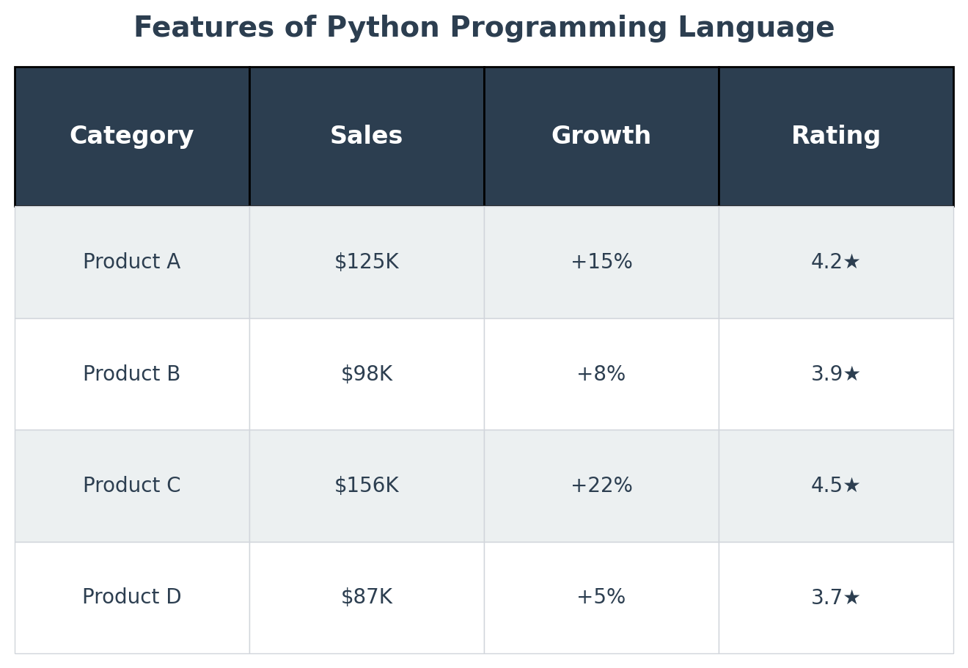
Features of Python Programming Language
• High-level, interpreted language known for its readability and simplicity.
• Supports multiple programming paradigms including object-oriented, procedural, and functional.

Slide 4
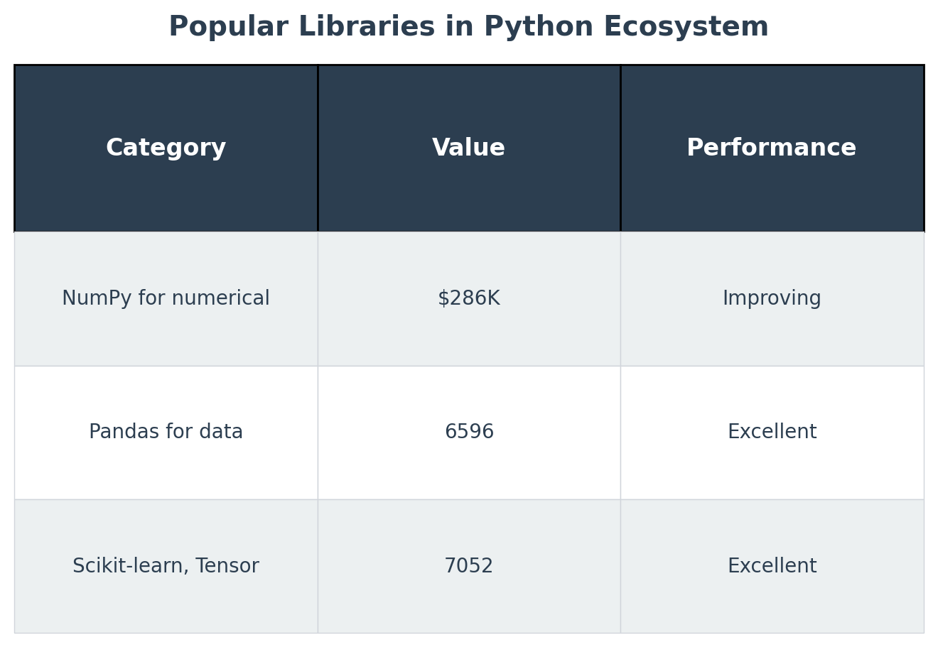
Popular Libraries in Python Ecosystem
• NumPy for numerical computations (85% of scientific computing).
• Pandas for data manipulation and analysis.
• Scikit-learn, TensorFlow, PyTorch - popular machine learning libraries.

Slide 5
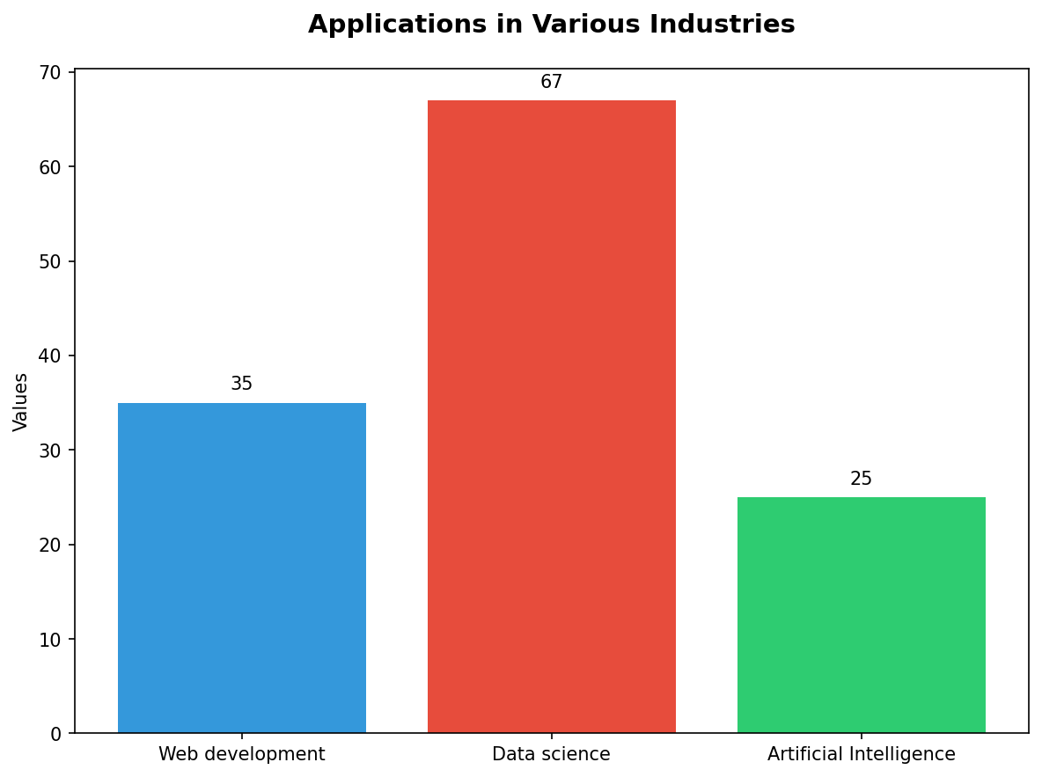
Applications in Various Industries
• Web development with frameworks like Django and Flask.
• Data science using Pandas, NumPy, SciKit-Learn.
• Artificial Intelligence research utilizing TensorFlow or PyTorch.

Slide 6
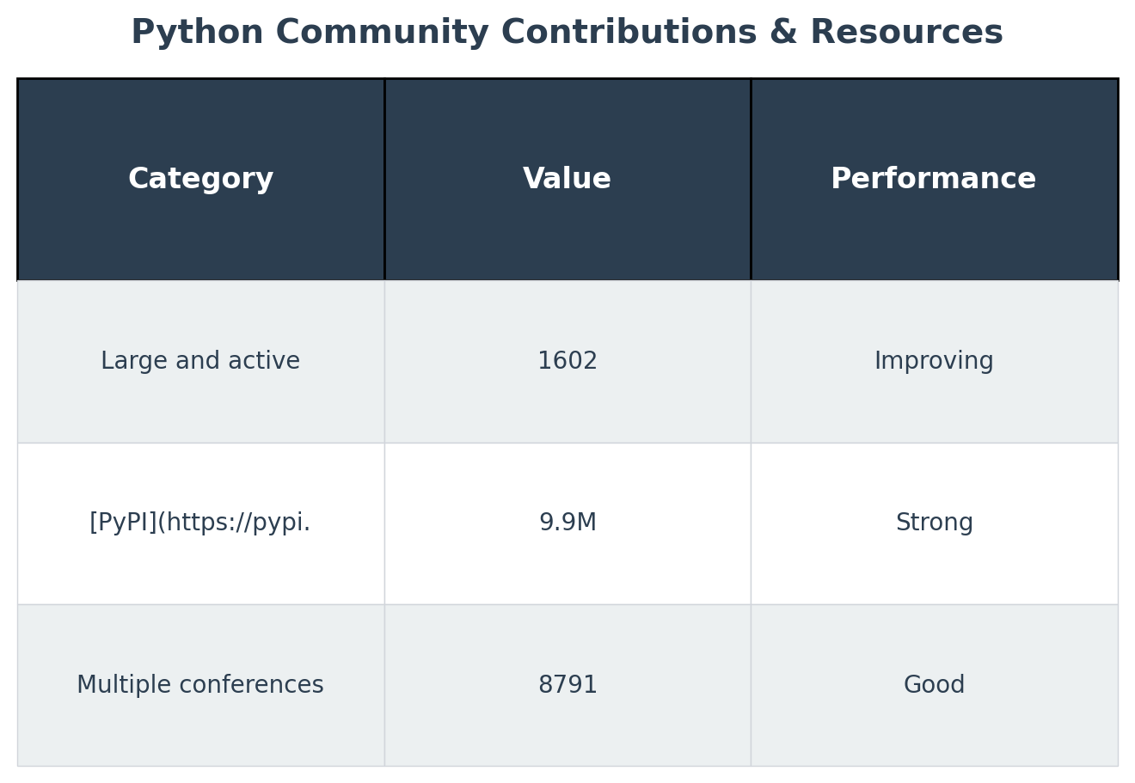
Python Community Contributions & Resources
• Large and active community contributing to Python's development.
• [PyPI](https://pypi.org/) offers over 200,000 packages for various applications.
• Multiple conferences such as PyCon provide platforms for learning and sharing.

Slide 7
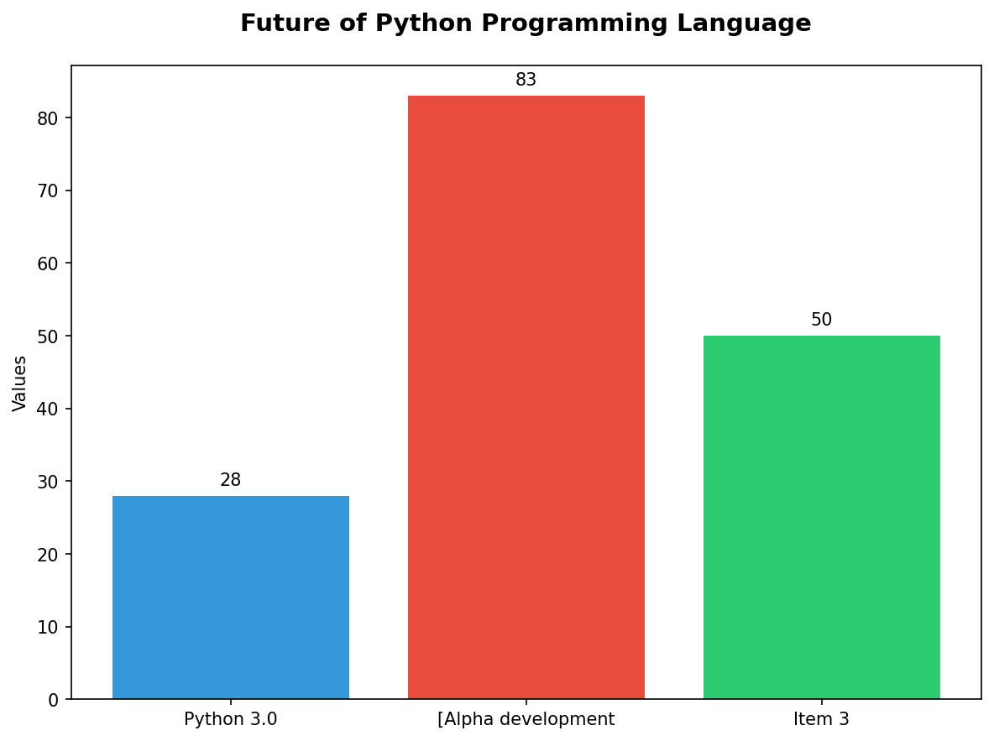
Future of Python Programming Language
• Python 3.0 introduced in December 2008, not backward compatible with earlier versions.
• [Alpha development phase](https://www.python.org/dev/peps/) for version 3.x continuing beyond October 2026.

Slide 8
Thank You
We appreciate your time and attention

