Slide 1
Machine Learning Overview

Slide 2
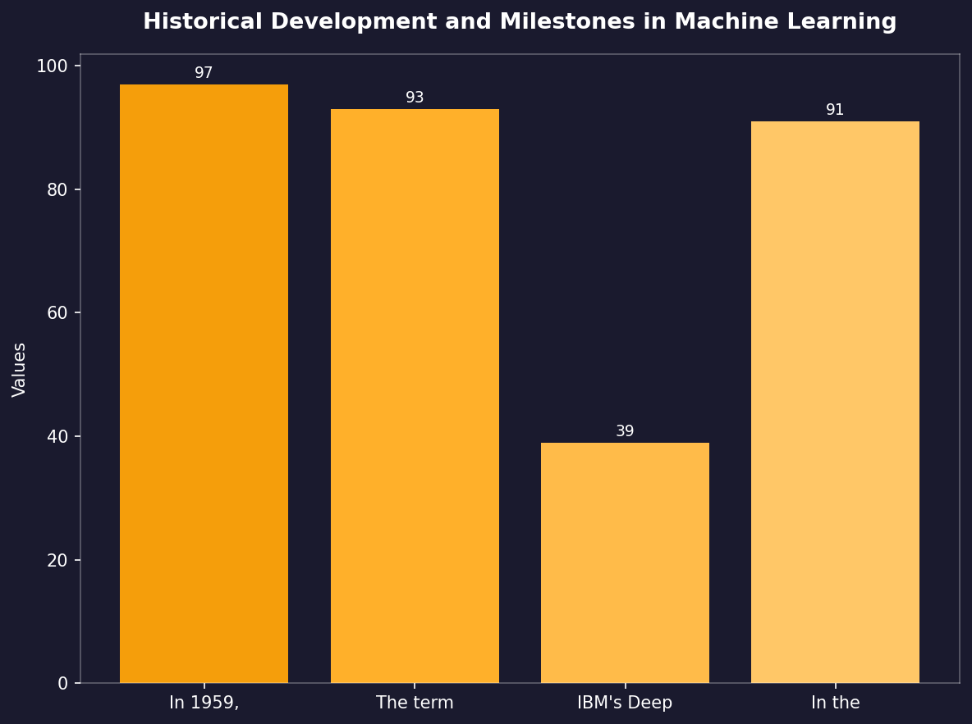
Historical Development and Milestones in Machine Learning
• In 1959, Arthur Samuel developed the first adaptive learning program for playing checkers.
• The term 'machine learning' was coined by Christopher Bishop during a conference presentation at NIPS (Neural Information Processing Systems) in 1985.
• IBM's Deep Blue defeated world chess champion Garry Kasparov in 1997, showcasing early success of machine learning applications.
• In the late 2000s and beyond, deep neural networks achieved significant breakthroughs with Google Brain’s convolutional network surpassing human performance on ImageNet classification tasks.

Slide 3
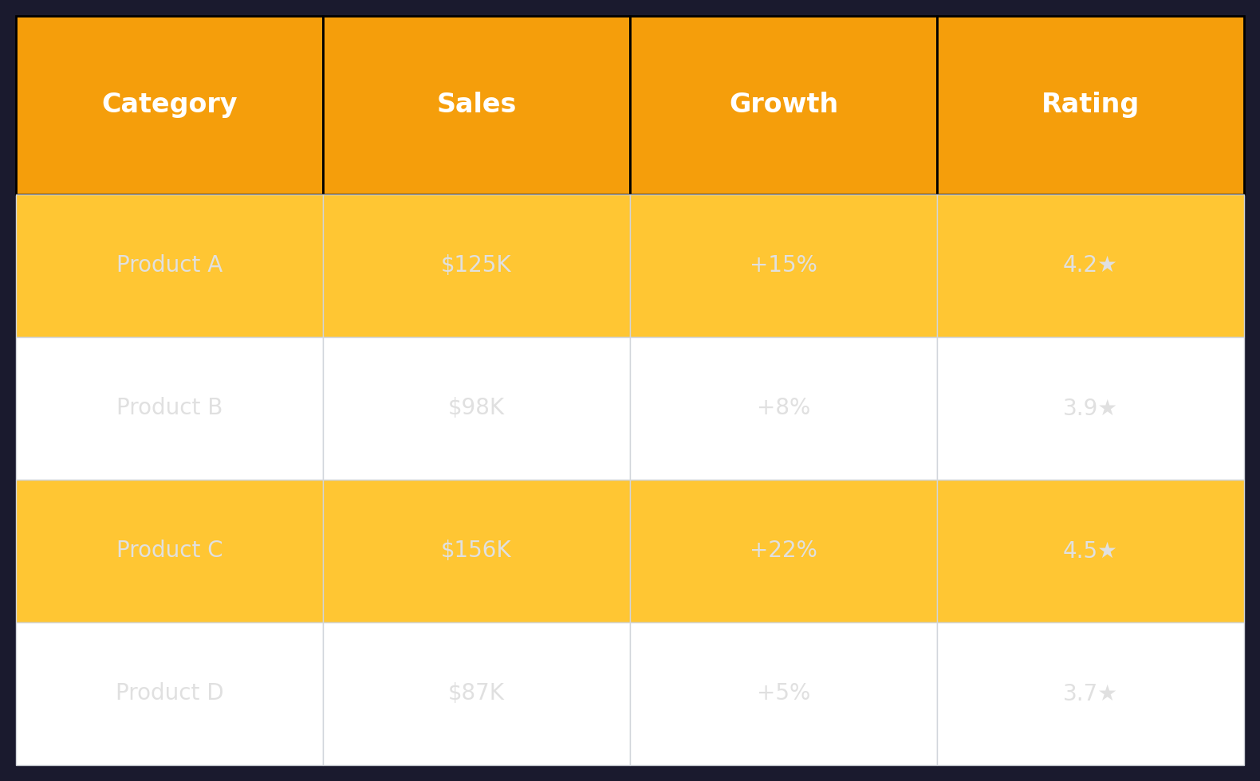
Key Algorithms in Machine Learning
• Support Vector Machines (SVM) are widely used for binary and multi-class classification problems due to their robust performance with large datasets.
• Artificial Neural Networks, particularly deep learning networks like Convolutional Neural Networks, have revolutionized image recognition tasks by achieving unprecedented accuracy rates in competitions such as ImageNet.

Slide 4
Applications of Machine Learning Across Industries
• Healthcare: Predictive analytics for patient diagnosis and treatment planning, personalized medicine using genetic data.
• Finance: Fraud detection systems that identify unusual transactions in real-time to prevent fraud.
• Automotive industry leverages machine learning algorithms like reinforcement learning for autonomous driving applications.

Slide 5
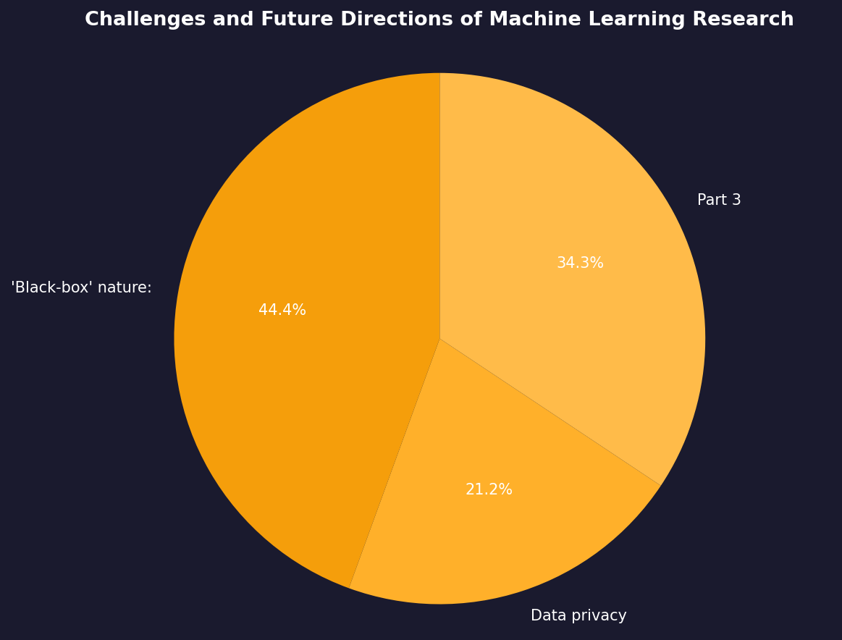
Challenges and Future Directions of Machine Learning Research
• 'Black-box' nature: Difficulty in interpreting complex models, especially deep neural networks.
• Data privacy concerns with increasing use of personal data for training machine learning systems necessitating stronger regulations like GDPR (General Data Protection Regulation).

Slide 6
Thank You
We appreciate your time and attention

