Slide 1
Overview of Machine Learning (ML)

Slide 2
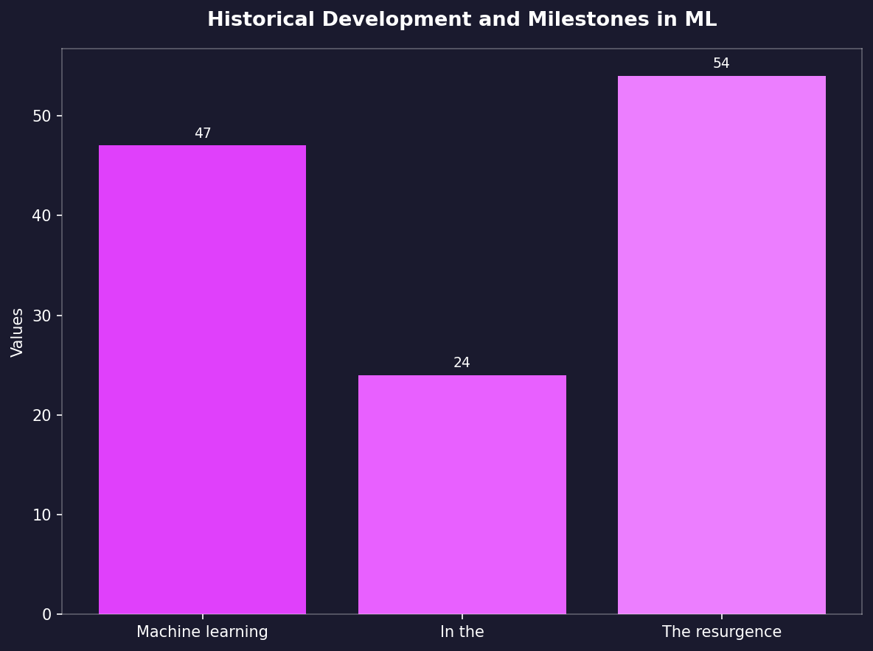
Historical Development and Milestones in ML
• Machine learning traces its roots to the 1950s with early work on chess-playing programs.
• In the mid-1980s, notable achievements included expert systems demonstrating practical applications of machine learning.
• The resurgence began around 1995 when IBM introduced Deep Blue defeating world champion Garry Kasparov in a game of chess.

Slide 3
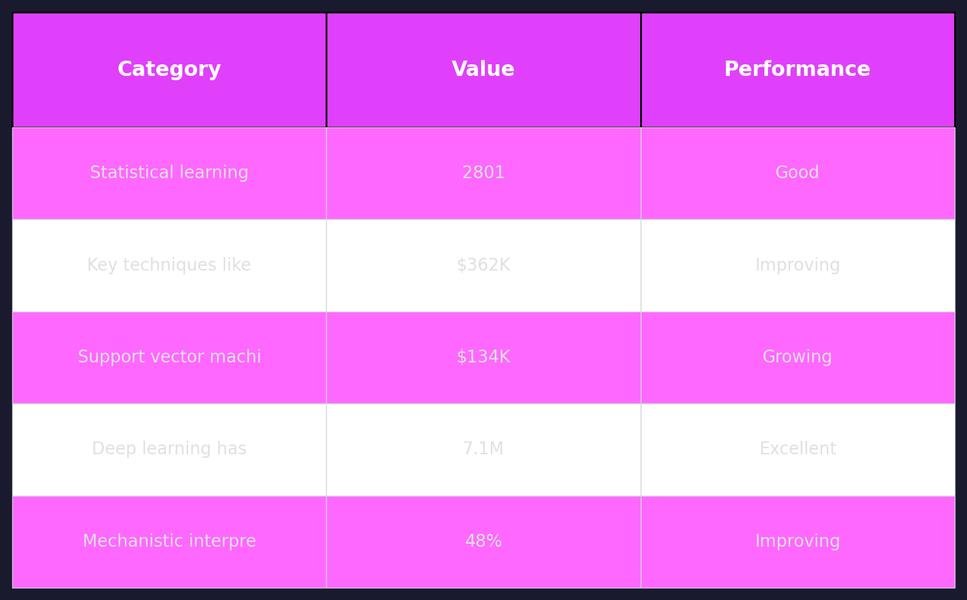
Core Concepts and Techniques in ML
• Statistical learning methods, such as regression analysis, are foundational for understanding machine-learning algorithms.
• Key techniques like decision trees have been essential tools since the 1960s to model complex relationships.
• Support vector machines (SVM) emerged prominently around 1995 and remain one of today's most effective classification models.
• Deep learning has dominated recent advancements, with convolutional neural networks achieving breakthroughs in image recognition tasks.
• Mechanistic interpretability focuses on understanding how machine-learning systems make decisions based on underlying physical principles.

Slide 4
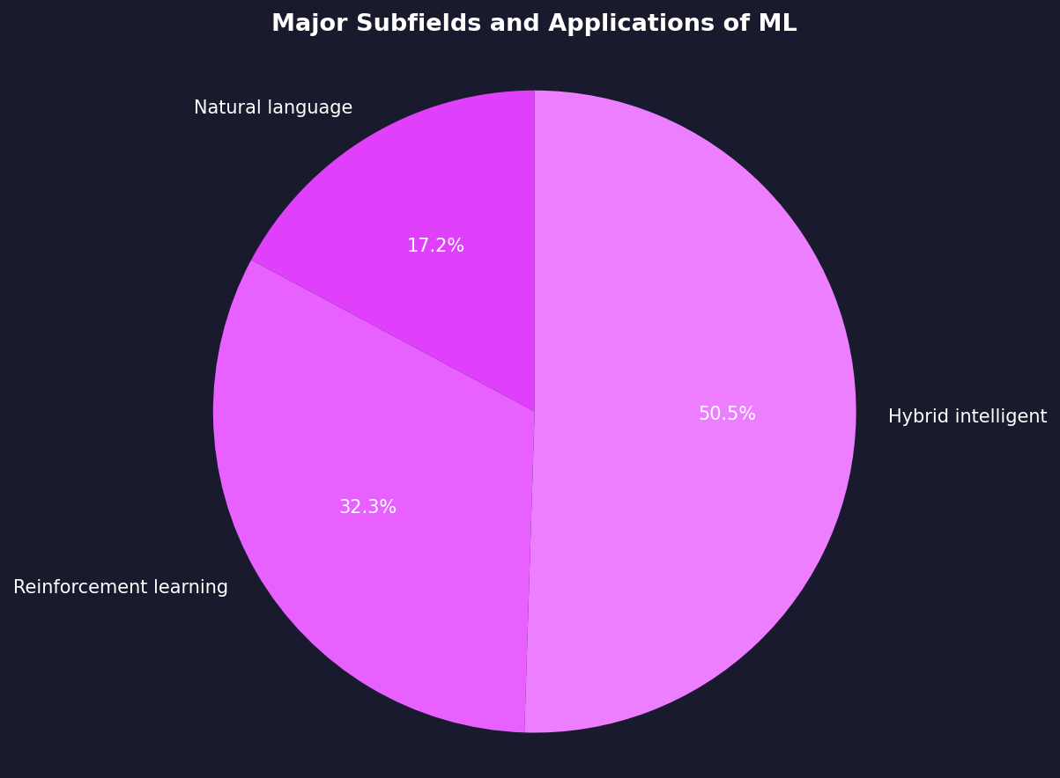
Major Subfields and Applications of ML
• Natural language processing (NLP) has revolutionized machine translation, voice recognition systems like Siri.
• Reinforcement learning powers advanced robotics applications for autonomous vehicles navigating complex environments.
• Hybrid intelligent systems integrate rule-based methods with AI to enhance decision-making processes in sectors such as healthcare and finance.

Slide 5
Challenges and Ethical Considerations
• The ethical implications of deploying biased algorithms highlight the necessity for fairness-aware machine learning practices.
• Privacy concerns arise from extensive data collection required by deep-learning models, prompting stringent regulations like GDPR.
• Ensuring transparency in AI decision-making processes is crucial to maintain public trust and accountability.

Slide 6
Thank You
We appreciate your time and attention

