Slide 1
An Overview of Machine Learning

Slide 2
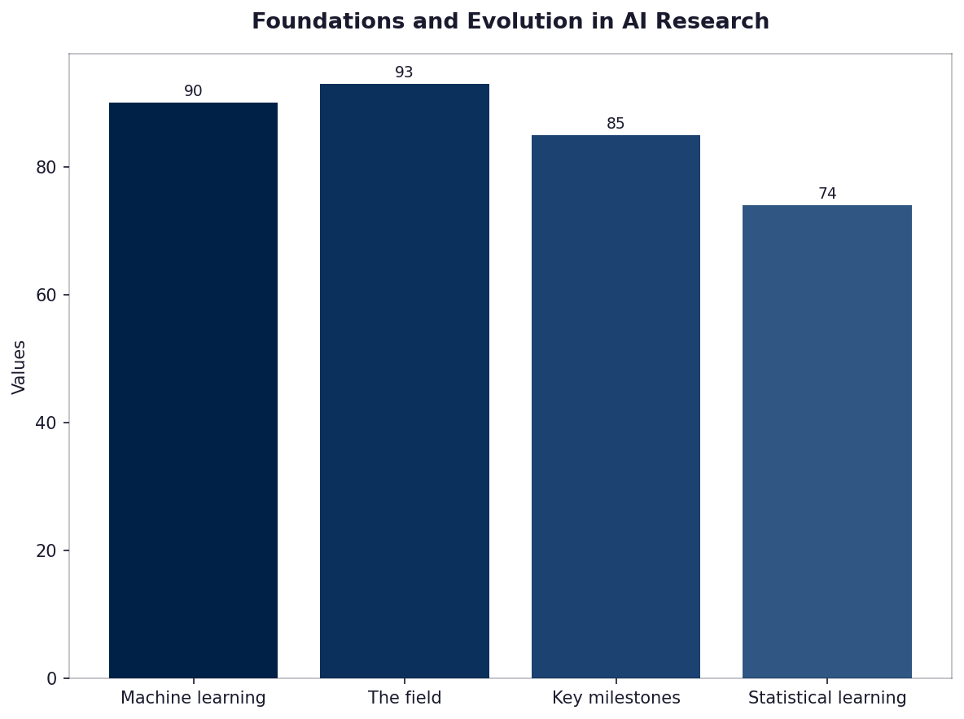
Foundations and Evolution in AI Research
• Machine learning traces its origins back to Alan Turing's 1950 paper proposing a computing machine.
• The field has evolved significantly since the introduction of artificial neural networks by Frank Rosenblatt in 1958.
• Key milestones include Yann LeCun, Yoshua Bengio and Geoffrey Hinton’s contributions during 'Deep Learning Revolution'.
• Statistical learning methods have been refined over decades to handle large datasets effectively.

Slide 3
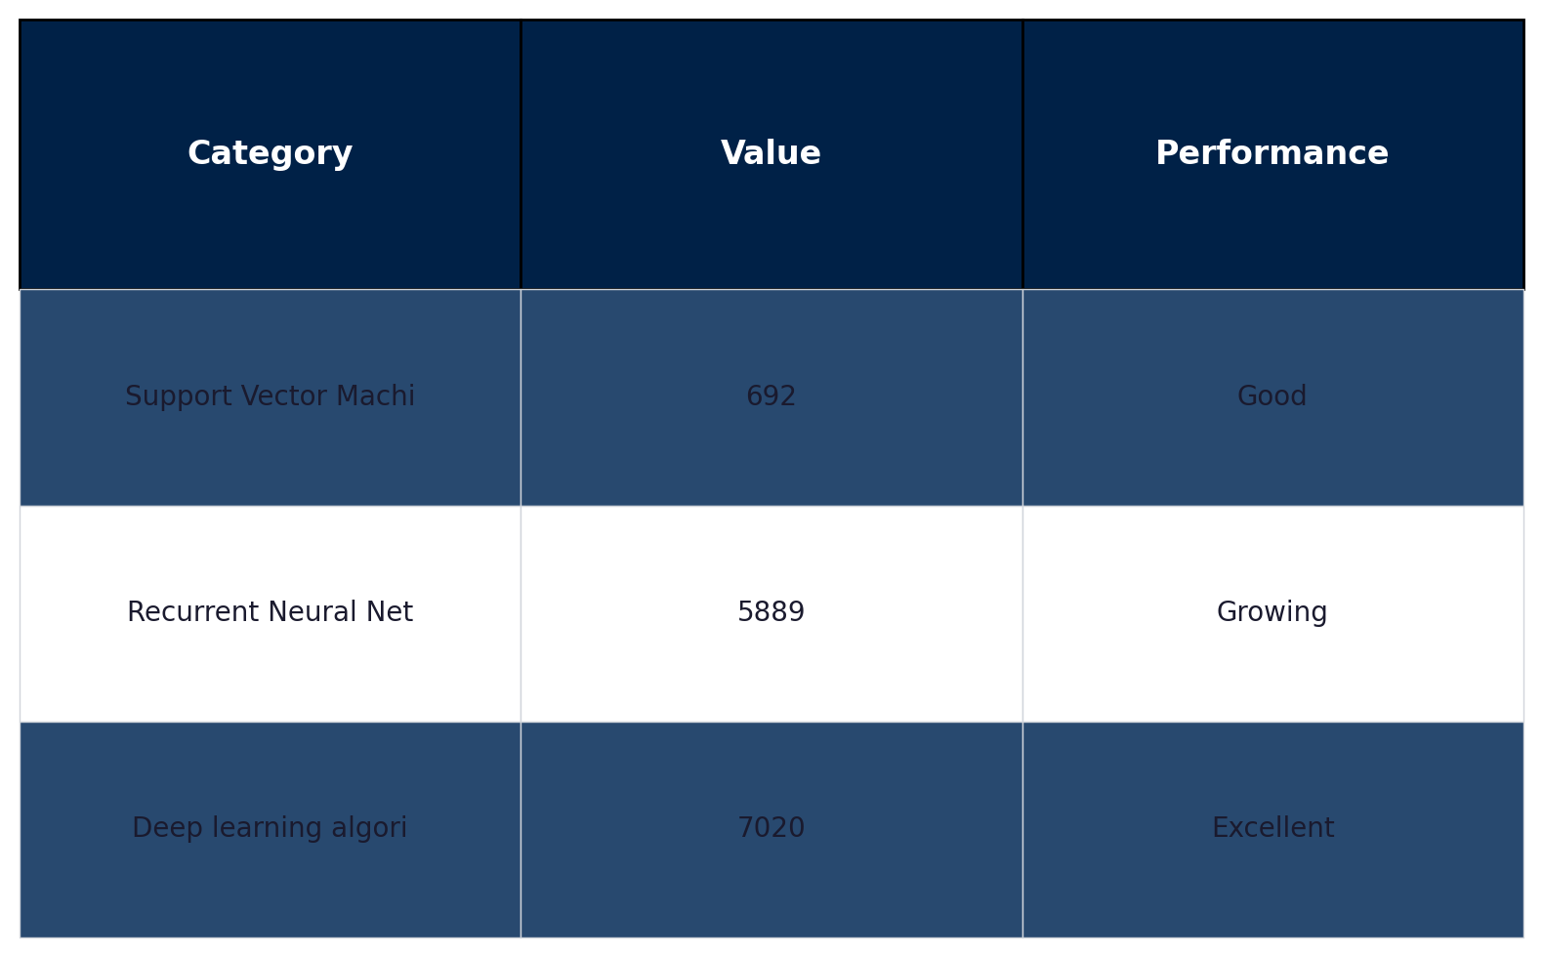
Key Algorithms in Machine Learning Development
• Support Vector Machines (SVM) were developed by Vapnik and Cortes as a method to find the optimal hyperplane for classification.
• Recurrent Neural Networks, crucially advanced research on sequence prediction tasks like language modeling.
• Deep learning algorithms such as Convolutional Neural Networks revolutionized image recognition accuracy.

Slide 4

Applications and Impact of Machine Learning Today
• Machine learning powers recommendation systems like Netflix, enhancing user experience with personalized content.
• Natural language processing algorithms drive applications such as Google Assistant to understand human speech effectively.

Slide 5
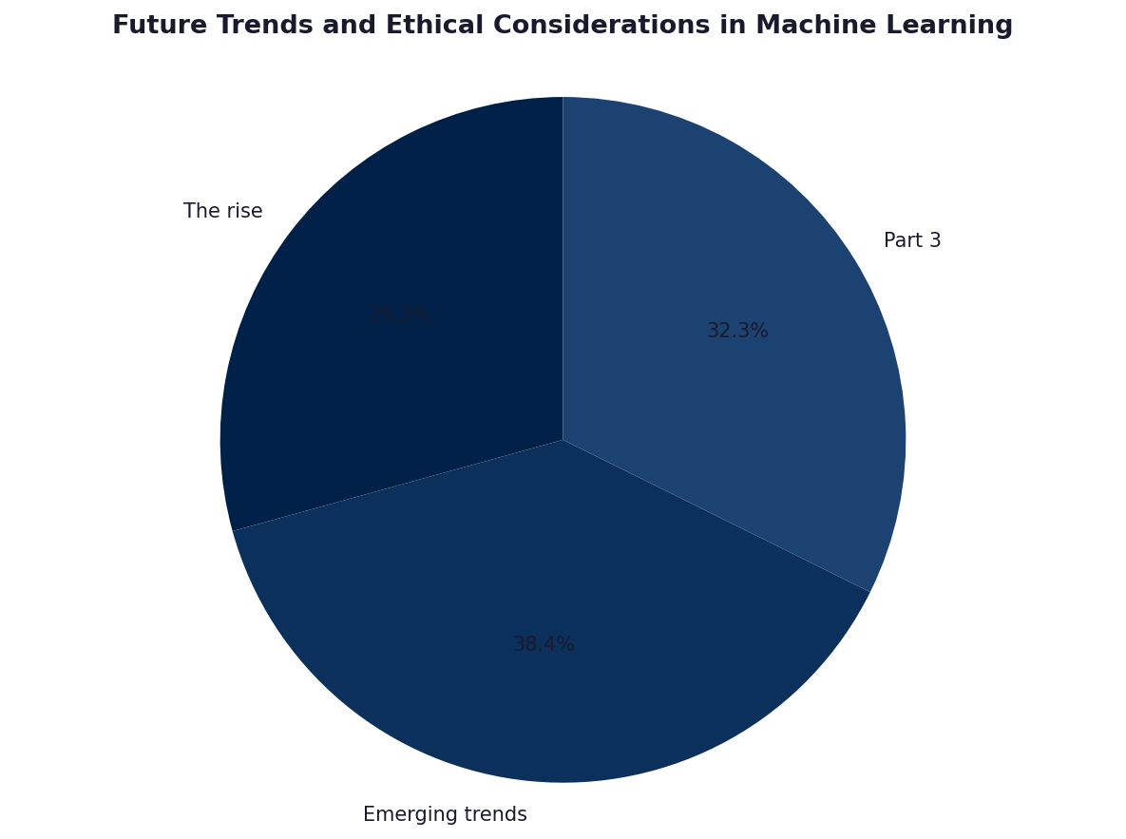
Future Trends and Ethical Considerations in Machine Learning
• The rise of ethical AI addresses issues like bias, transparency; the development focuses on fairness algorithms.
• Emerging trends include quantum machine learning for solving complex problems with unprecedented speed.

Slide 6
Thank You
We appreciate your time and attention

