Slide 1
Introduction to Mona Lisa by Leonardo da Vinci
Leonardo began painting 'Mona Lisa' around the year 1503.

Slide 2

Subject and Patronage of Mona Lisa
• 'Mona Lisa' depicts an Italian noblewoman believed to be Lisa Gherardini.
• Leonardo never explicitly mentioned the subject's name in his notes.

Slide 3
Composition and Style of Mona Lisa
• The subtle modelling techniques contribute to its lifelike quality.
• Atmospheric perspective adds depth, enhancing the realistic portrayal.

Slide 4
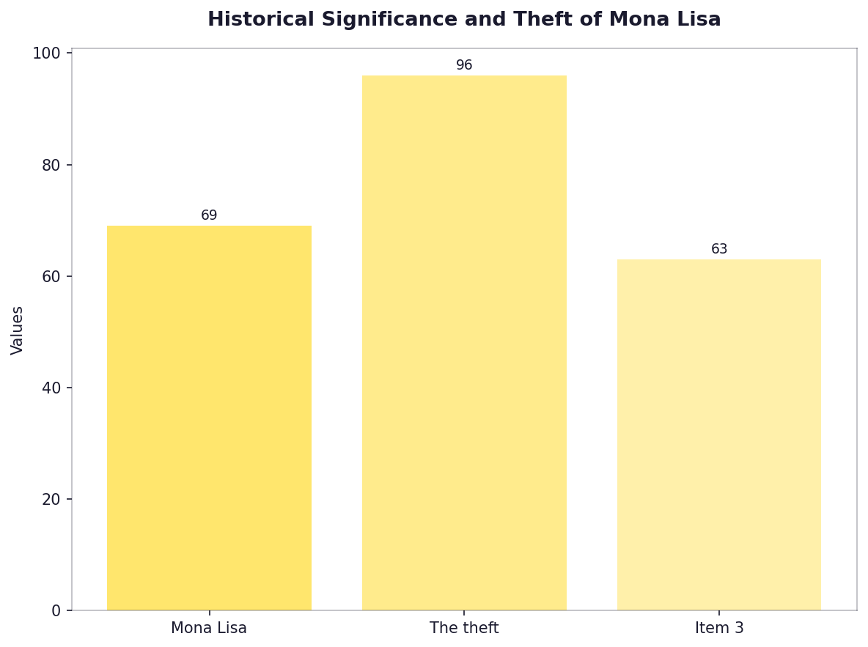
Historical Significance and Theft of Mona Lisa
• Mona Lisa was stolen in 1911 by Vincenzo Peruggia.
• The theft increased the painting's global fame.

Slide 5
Restoration and Preservation Efforts
• Mona Lisa underwent restoration in 1963-65.
• It is now housed at the Louvre Museum, France.

Slide 6
Economic Impact and Valuation of Mona Lisa
• In 1962, it was insured for $100 million.
• $1 billion as adjusted value in 2023.

Slide 7

Public and Cultural Influence of Mona Lisa
• The painting has inspired countless artworks, films, songs.
• Its image appears on various currencies worldwide.

Slide 8
Scientific Analysis and Technology in Art Study of Mona Lisa
• Infrared reflectography reveals underdrawings by Leonardo.
• X-ray fluorescence shows changes during the painting's history.

Slide 9
Sociopolitical Context of Mona Lisa Creation and Theft
• 'Mona Lisa' was painted in a politically tumultuous Florence.
• The theft reflects early 20th-century nationalist sentiments.

Slide 10
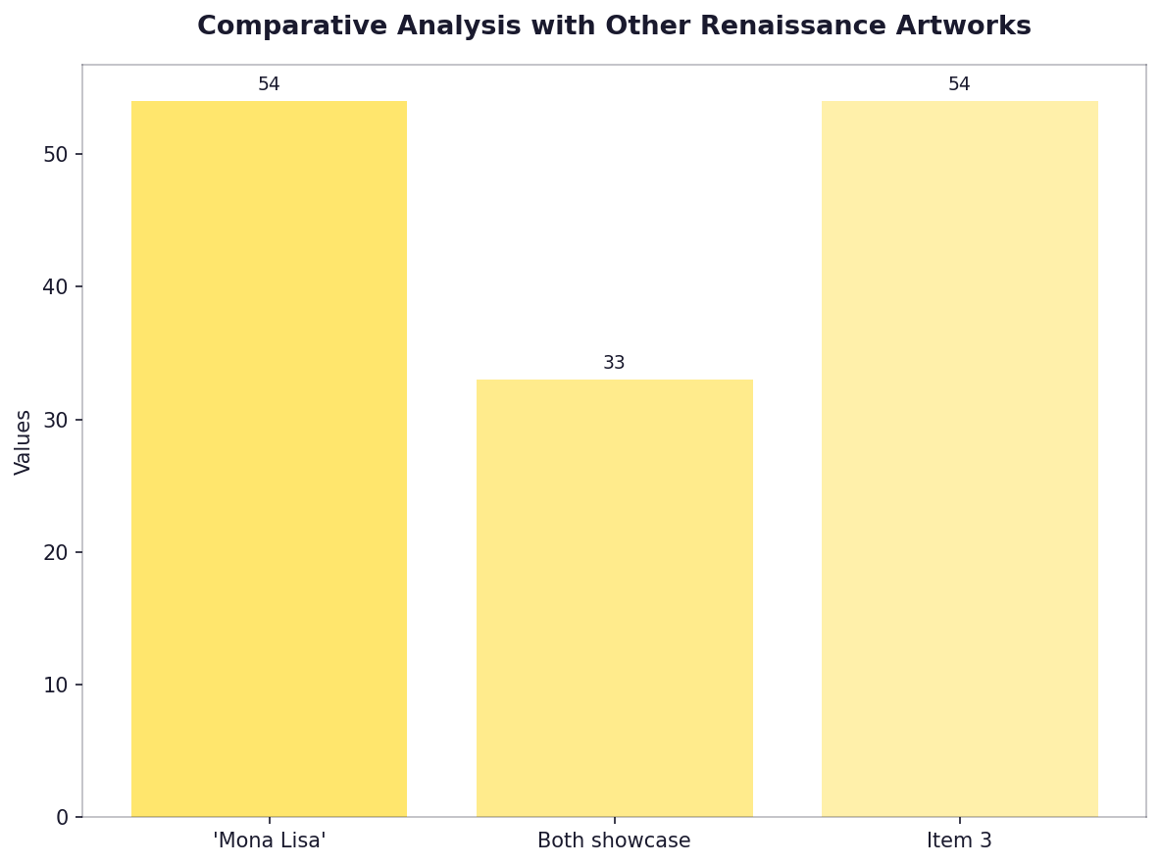
Comparative Analysis with Other Renaissance Artworks
• 'Mona Lisa' compares favorably to 'Virgin of the Rocks'.
• Both showcase mastery in sfumato and depth.

Slide 11
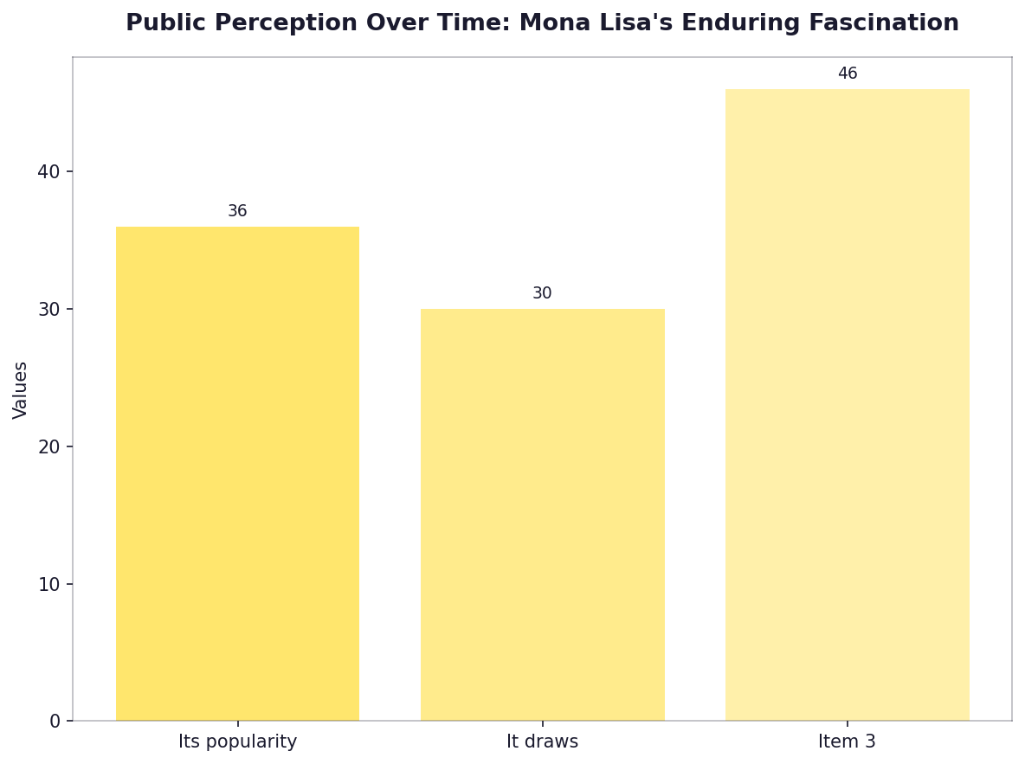
Public Perception Over Time: Mona Lisa's Enduring Fascination
• Its popularity soared after its theft.
• It draws millions of visitors annually to the Louvre.

Slide 12
Challenges in Preservation and Security Measures
• The painting faces threats from environmental factors at its museum location.
• Advanced security systems protect it against theft or damage.

Slide 13
Influence on Modern Art and Pop Culture
• 'Mona Lisa' inspired Salvador Dalí in 'The Persistence of Memory'.
• Its portrayal affects modern media representations.

Slide 14
Educational Impact and Art Studies Related to Mona Lisa
• Universities worldwide host courses on Leonardo's techniques.
• Art students analyze its composition for learning purposes.

Slide 15
The Role of Museums in Curating Mona Lisa and Related Artworks
• 'Mona Lisa' draws significant attention to museum exhibitions.
• Museums enhance educational programs related to Renaissance art.

Slide 16
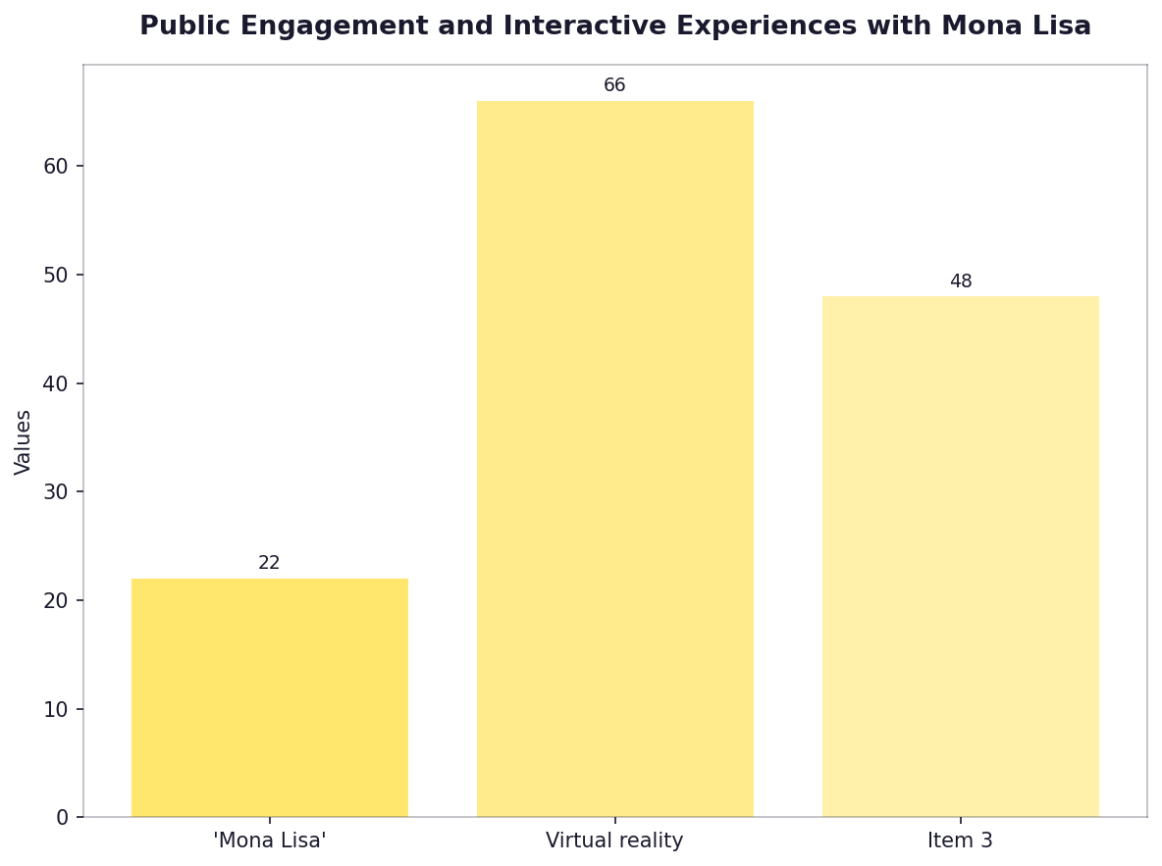
Public Engagement and Interactive Experiences with Mona Lisa
• 'Mona Lisa' has interactive displays in the Louvre.
• Virtual reality tours allow global access to its details.

Slide 17
Artistic Techniques and Innovations by Leonardo da Vinci for Mona Lisa
• 'Mona Lisa' features Leonardo's sfumato technique.
• His use of chiaroscuro creates realistic shading.

Slide 18
Comparison with Other Famous Paintings by Renaissance Artists
• 'Mona Lisa' competes in fame and technique against 'The School of Athens'.
• Both works highlight the era's artistic achievements.

Slide 19
Influence on Contemporary Artists Inspired by Mona Lisa
• 'Mona Lisa' influenced Andy Warhol and Roy Lichtenstein.
• Modern artists continue to reinterpret its themes.

Slide 20
The Role of Technology in Art Preservation Today as Applied to Mona Lisa
• 'Mona Lisa' benefits from advanced imaging technology.
• Digital archiving preserves its details for future study.

Slide 21
Educational Programs Featuring 'Mona Lisa'
'Mona Lisa' is used in educational curricula worldwide.

